Slide 1
Welcome
Welcome!
The FMT system utilizes Roles to determine ownership and levels of responsibility within the FMT system.
The Well Licensee/Unit Operator is automatically defaulted to the role of PE Administrator, Payor for non-corporate owned Titles and Lessee when a new production entity is added to the system.
These roles may be transferred to another party upon their concurrence at any time throughout the life for the effective range of the Production Entity (PE) and associated titles.
An email notification will be sent to the assigned or transferred role holder at the time of creation or transfer, instructing the Transferee to log in and perform concurrence through the Work In Progress screen.
To the ETS – Transfer Roles
Online Training Course

Slide 2
Revisions
Date | Revisions Type | Page Number
August 31, 2012 | Conversion | All

Slide 3

Introduction
In this module, you as the role holder, will learn how to transfer to another party the role of:
  Lessee
  Payor
  Production Entity Administrator

Slide 4
Default Administrator Rules
The Unit Operator or the Well Licensee will be defaulted to the role of PE Administrator for all new Production Entities.
An email notification is sent by the system to the FMT PE Coordinator. If there is no assigned Coordinator then the emails will be sent to the Administrator.
TIP: All roles must be assigned. A role cannot be left blank.
TIP: You will not be allowed to remove yourself from the role of lessee if there are no other lessees listed in that role.
TIP: If you transfer your role to another transferee, and that transferee does not accept the role, you will remain responsible for that role.
TIP: Assigned PE Administrator must have an ETS Account.

Slide 5
Default Payor Rules
For newly associated titles:, if a new FMT PE is linked to a Title where another FMT PE exists, the Payor will be carried forward from that FMT PE. For already active Freehold Titles, the Payor assigned remains assigned.
For corporate owned titles, that corporate entity's BA ID is assigned as Payor.
For Titles with more than one Corporate client as owner, the company with the greater percentage of ownership will be the defaulted Payor.
If there is more than one Corporate Owner and all have equal percentage of ownership, the FMT system will chose the payor.
If there are two Owners on a title, one corporate and one non-corporate then the corporate owner will be the Payor.
The PE Administrator will be the default Payor for all non-corporate-owned titles that do not already have a Payor assigned.
An Assigned Payor must have an ETS Account. An e-mail notification will be sent by the system to the assigned title Payor.

Slide 6
Default lessee Rules
The PE Administrator will be set as the default lessee for the following situations:
Newly associated title to an existing PE
Newly associated PE to an existing title with more than one (different) existing PE Administrator
An existing lessee for another PE associated to the Title, will be assigned as lessee to the new PE as well, if the PE Administrator from the existing PE(s) matches the PE Administrator for the newly associated PE.
Note: An assigned lessee must have an ETS Account. An email notification will be sent by the system to the newly designated lessee(s).

Slide 7
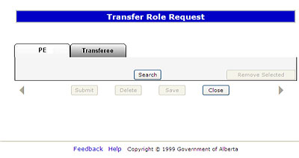
Transfer a Role
The Transfer Role function is used to initiate a transfer of the PE Administrator, Lessee and Payor roles from one party to another.
To initiate the role transfer, click on the Role Transfer tree node, and click Search to find the FMT PE. (see Query FMT section for details).
The query results are displayed on the ‘Search Results’ screen.
An email notification will be sent at night to the newly assigned role holder. Emails are not sent when the assigned role is the same for an existing association to that PE or Title. Emails for more than one role assigned to the same BA will be combined in one email.
An Effective Date selection is required for all transfers.
TIP: A user will not be allowed to transfer the role of another client.
TIP: Use the Group by PE in order to perform the PE Admin and lessee transfers.
Use the Group by title when performing the payor transfers.

Slide 8
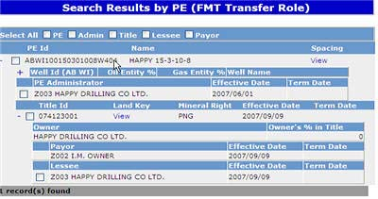
Search Results by PE
More Information (Pages 9 to 12)
The ‘Search Results’ screen is used to select the roles being transferred for specific titles or PE’s. You should not select any returned records that you do not want to transfer.
You may transfer roles by using the ALL selection at the top of the results page, or, you can individually select one or more individual roles for transfer.
The SAVE button will save your selections and begin your transfer process. The SUBMIT button sends the transfer request to the transferee.
You may also use the COPY TRANSFER option for transferring the same data to more than one Transferee i.e. with different effective date ranges.
TIP: The PE Admin will only be transferable if results are grouped by PE on search results screen.
TIP: You may use the “ALL’ select option, and then deselect individual roles you want to exclude from the transfer.

Slide 9
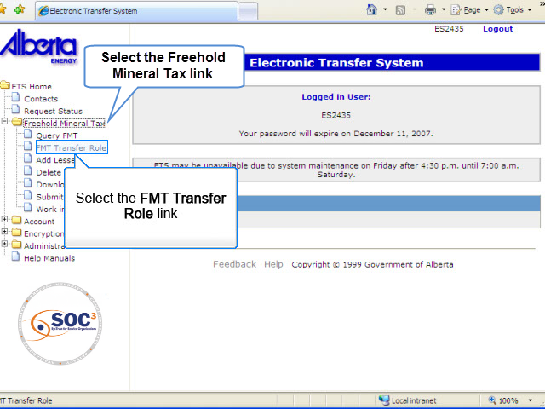
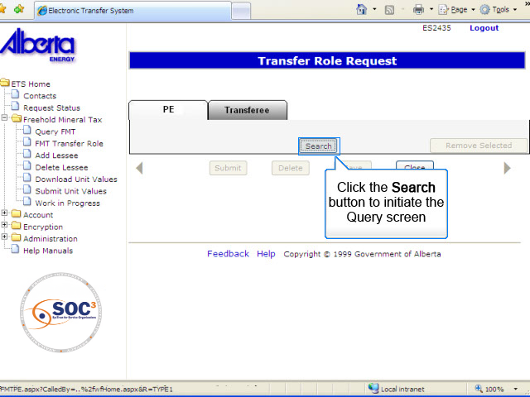
SR by PE1
Back to Search Results by PE

Slide 10
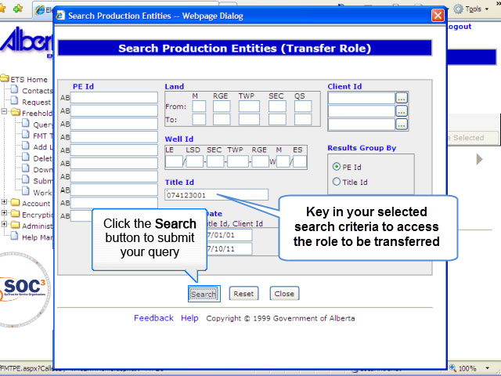
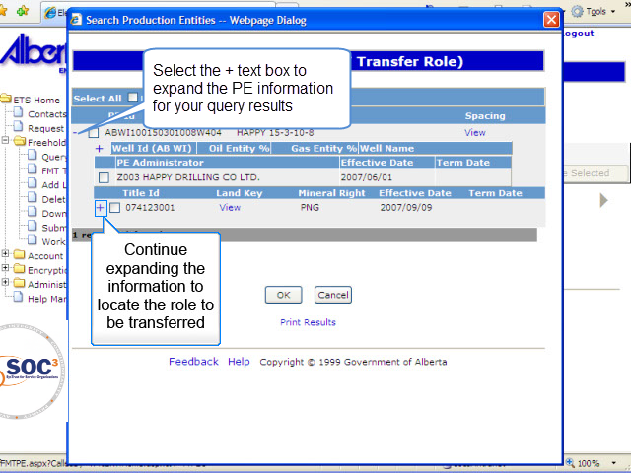
SR by PE2
Back to Search Results by PE

Slide 11
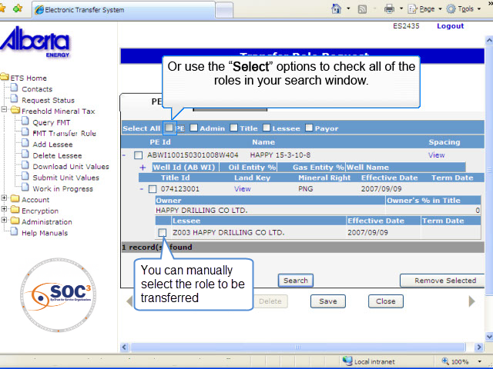
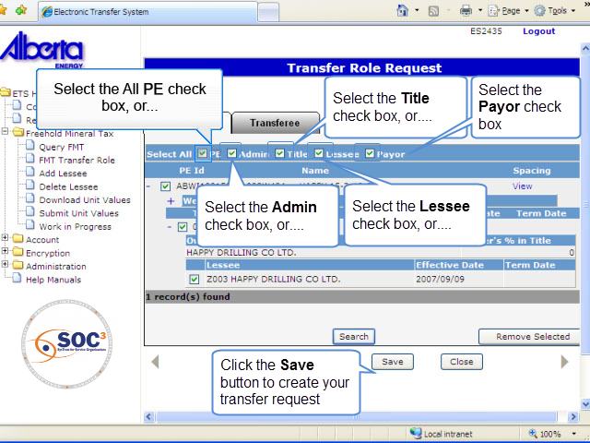
SR by PE3
Back to Search Results by PE

Slide 12
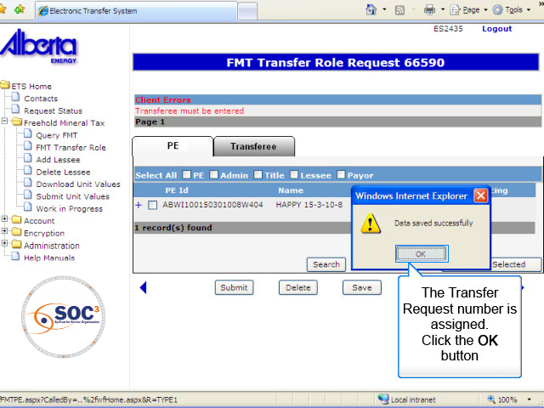
SR by PE4
Back to Search Results by PE

Slide 13
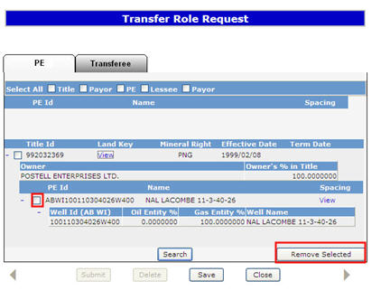
Add Transferee
More Information (Pages 14 to 21)
Once your selection has been saved, the selected PEs will be displayed on the 'Transfer Role Request' screen.
You must add the Transferee and effective date in the Transferee Tab. All other fields are optional.
A PE can be deleted by clicking on the check box and selecting the Remove Selection button.
Saving the Transfer Request assigns a Request number to the transfer and creates a link to the document.

Slide 14
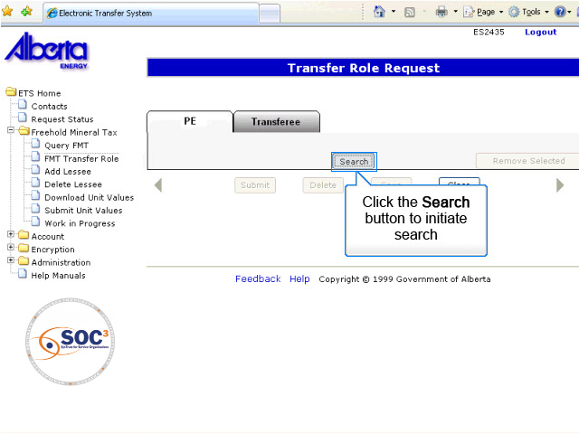
AT1
Back to Add Transferee

Slide 15
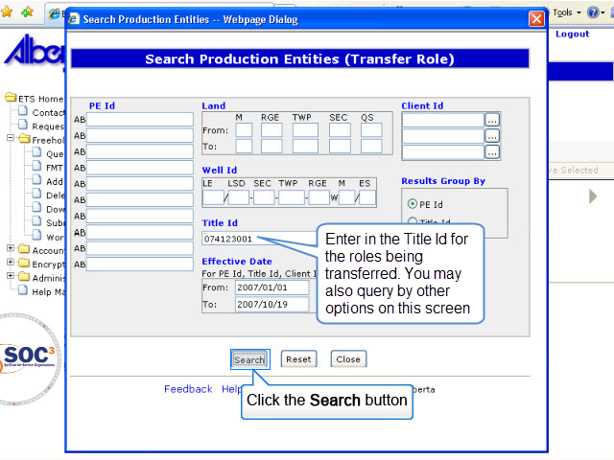
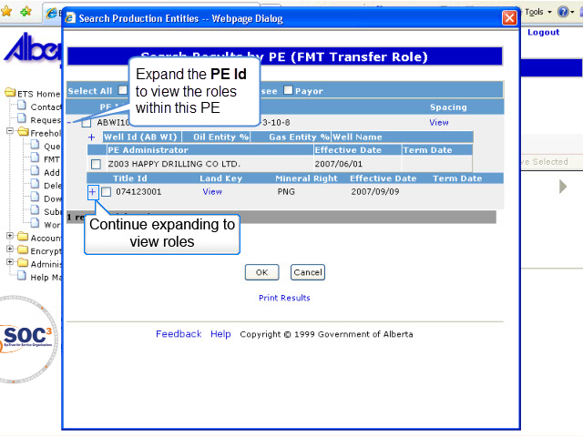
AT2
Back to Add Transferee

Slide 16
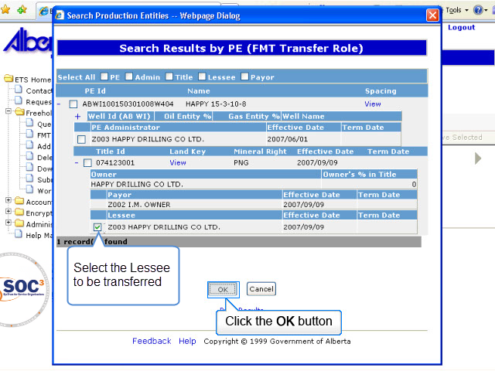
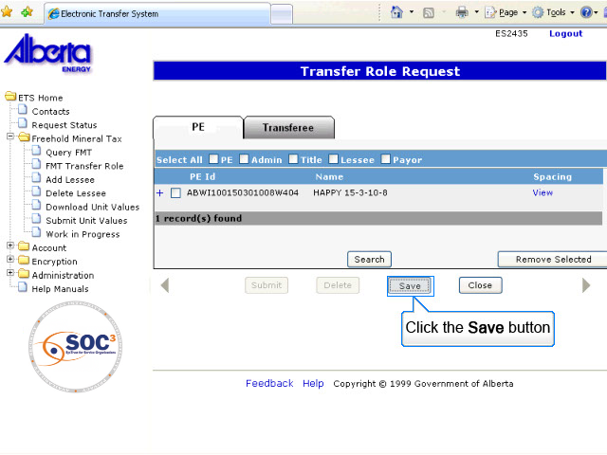
AT3
Back to Add Transferee

Slide 17
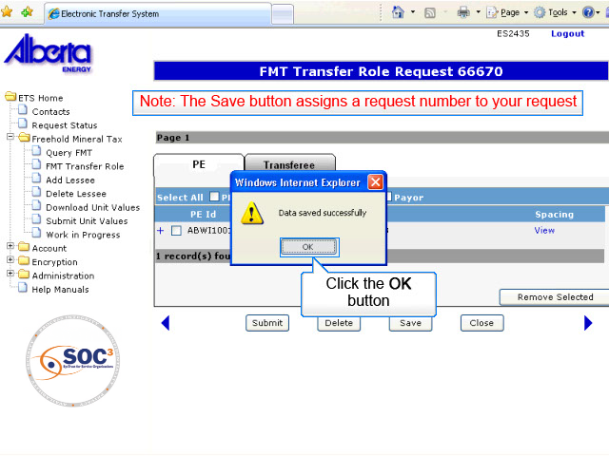
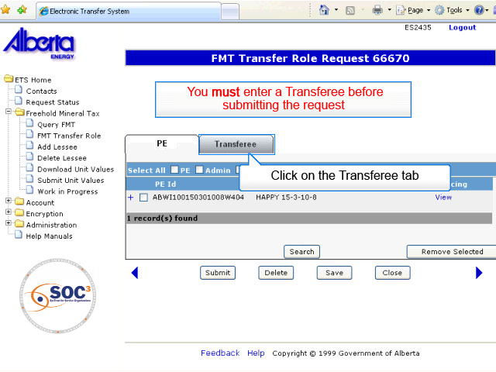
AT4
Back to Add Transferee

Slide 18
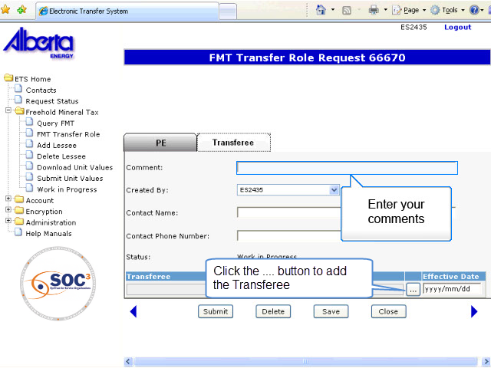
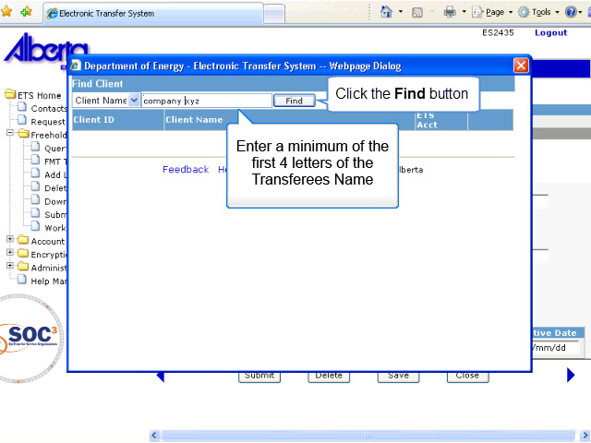
AT5
Back to Add Transferee

Slide 19
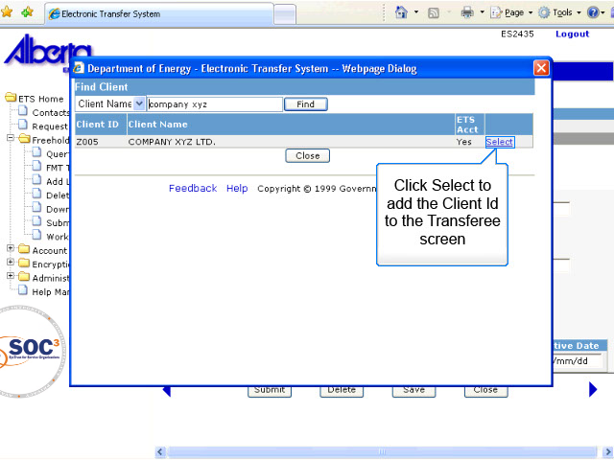
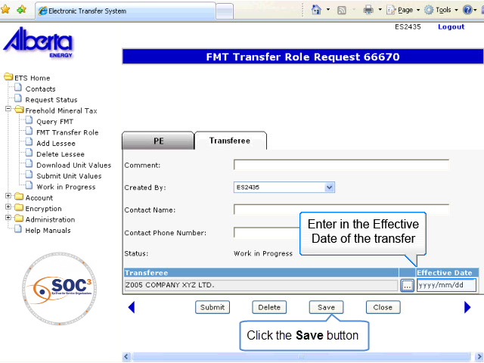
AT6
Back to Add Transferee

Slide 20
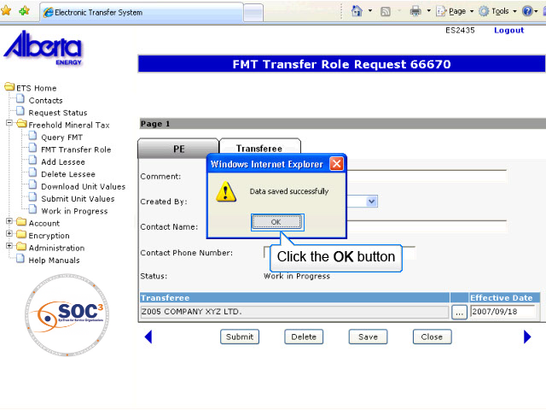
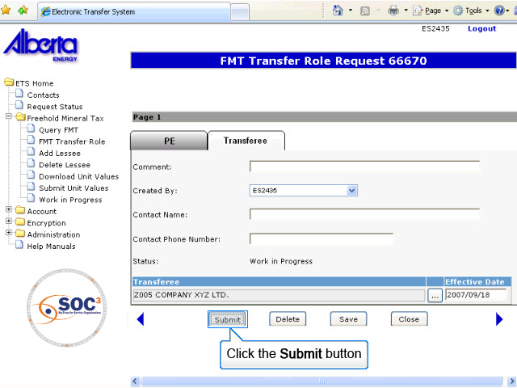
AT7
Back to Add Transferee

Slide 21
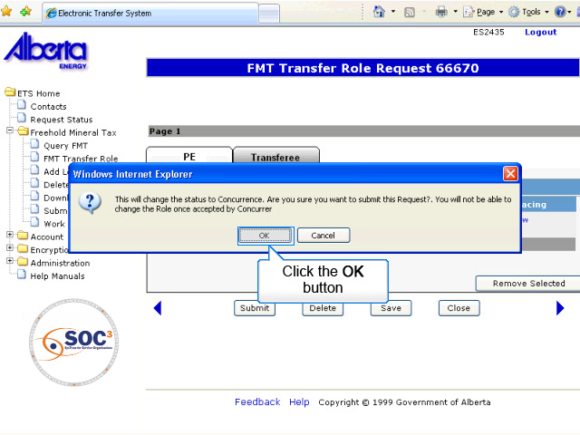
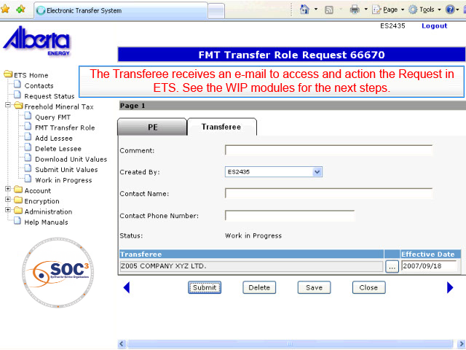
AT8
Back to Add Transferee

Slide 22
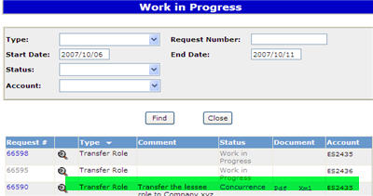
Transfer Role Concurrence
The status changes to ‘Concurrence’ when all required fields are entered and screens have been validated. Information on the Transfer Role document cannot change once the request status is changed to concurrence.
At concurrence, the Transferee receives an email notification. Concurrence is required from the transferee in order to complete the transfer of any role to another party.
You must always sign on to ETS to locate and concur to the request number supplied in the notifying e-mail. For training on the Concurrence process, refer to the WORK IN PROGRESS module.
A Completed status indicates that the role transfer has been successfully accepted. A Rejected status or any other status indicates that the role transfer has not been completed, and the role remains with the transferor.
TIP: Saving your file in a text format using Notepad will create the proper file format.

Slide 23

Conclusion
Congratulations!
You have completed the ETS – Transfer Roles Online Training Course
Please proceed to the subsequent courses detailing other functionality of the Freehold Mineral Tax application.
If you have any comments or questions on this training course, please forward them to the following email address:
Mintax.Energy@gov.ab.ca

