Slide 1
Welcome
Welcome!
The Unit Value is used in the calculation of tax. The Download Unit Values Report contains PE's with production where the company is a lessee in the tax year. The user can review the PE's to determine if the Unit Values needs to be submitted. Industry may submit a Unit Value for a Production Entity. If no Unit Value is submitted, a Crown calculated Default Unit Value will be used.
To the ETS – Download Unit Value
Online Training Course

Slide 2
Revisions
Date | Revisions Type | Page Number
August 31, 2012 | Conversion | All

Slide 3
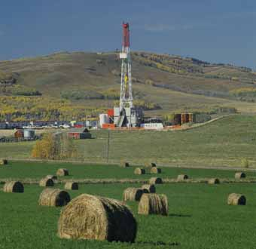
Introduction
In this module, you will learn how to obtain reports to:
Determine which PE's are available to submit Unit Values for current or past years

Slide 4
Business Rules
Unit values will only download for Lessee role holders.
A logged in user must be in a Lessee role and cannot specify any other Client Id which is not associated with the user's/company ETS Account.
The Unit Value Guidelines, including the Default Values and the filing deadline, are published annually and can be accessed through the web at http://www.energy.gov.ab.ca/Tenure/871.asp

Slide 5
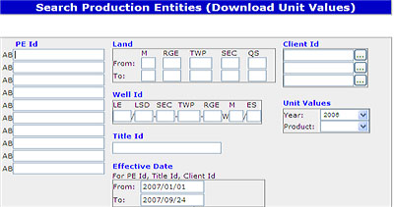
Search
To begin the ‘Download Unit Values’ process, initiate a search:
Search by a PE if you are only interested in the unit value for that one PE.
Search by the Land keys if your focus is on a specific area or region.
Search by a Title Id to retrieve only those PEs connected to that particular title where you are connected as a lessee.
Search by one of your active client id's to retrieve all producing PEs where you, as that BA Id, are connected as lessee.
Tip: Your search results will display possible unit value entry to the PE-Title combination where you are linked as a lessee. You will not see any other PEs for that title where you are not linked.
Tip: You must specify the tax year.

Slide 6
Search (Continued)
Search by product to receive only those PEs where the product was produced for that tax year.
Search by Tax year only for retrieving all producing PEs for your ETS account for that tax year. This is the broadest search and will return all PEs where you currently have active lessee roles. Tip: This option is very useful if PEs or Titles are not known or if there are many PEs.

Slide 7
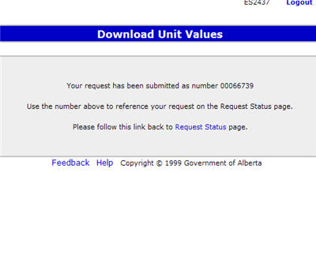
Search Results
More Information (Pages 8 to 11)
The search results will not be displayed on screen. You will be given a hyper-link to the Request Status folder. You may also retrieve the results at anytime through the Request Status option in the tree view. The results are displayed in a down-loadable “CSV” format. The CSV file format for downloading unit values is:
“PE ID”, ”PE Name”, “Year”, “Product Type”, “Unit Value”, “Production”. The production is reported in Cubic Meters (M³) for OIL and CON and 1000 Cubic Meters(10³M³) for GAS and SOL. Tip: The production shown for the PE is cumulative production for the year from that PE for the calendar year.

Slide 8
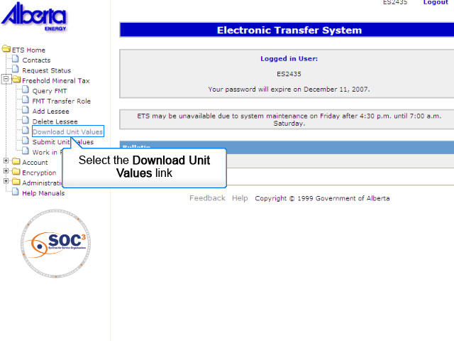
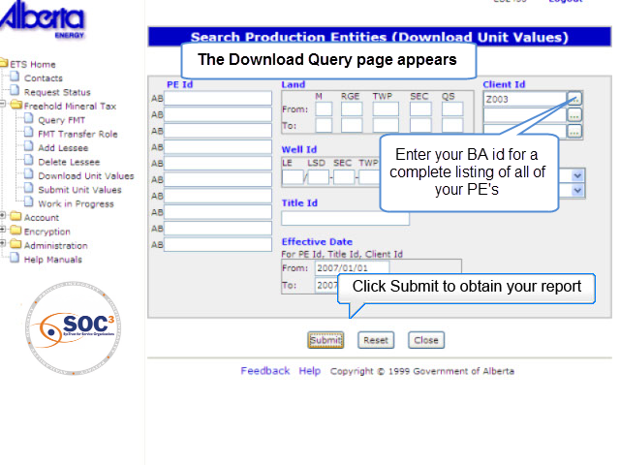
SR1
Back to Search Results

Slide 9
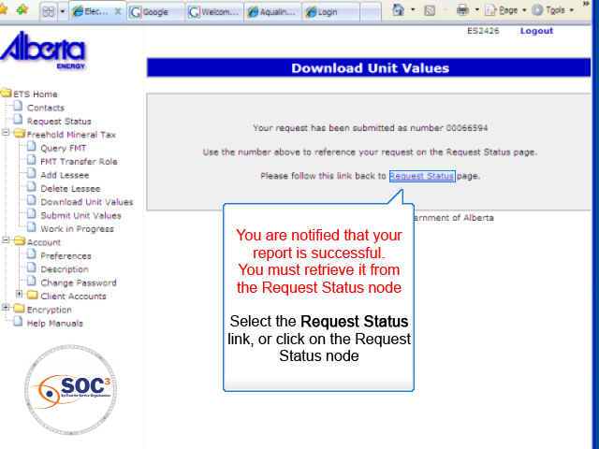
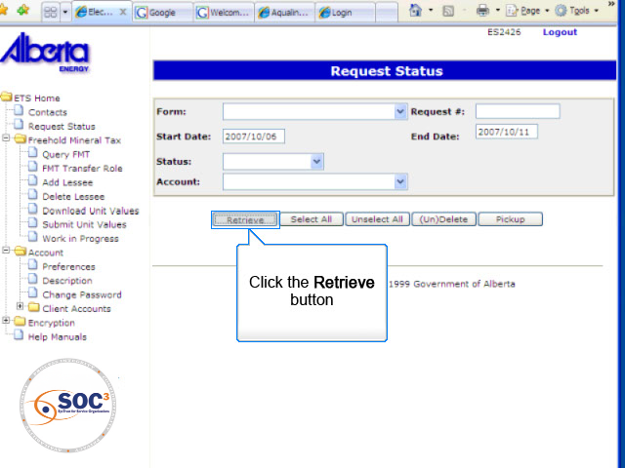
SR2
Back to Search Results

Slide 10
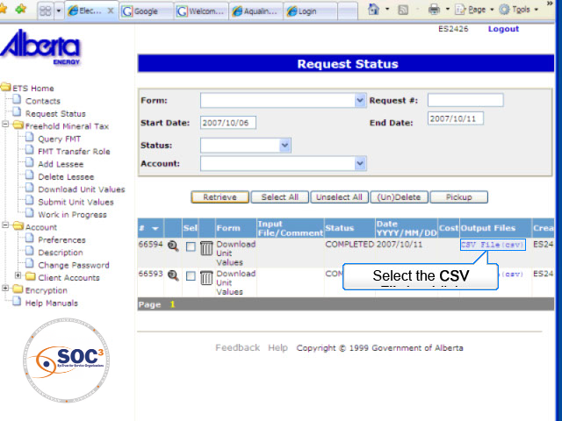
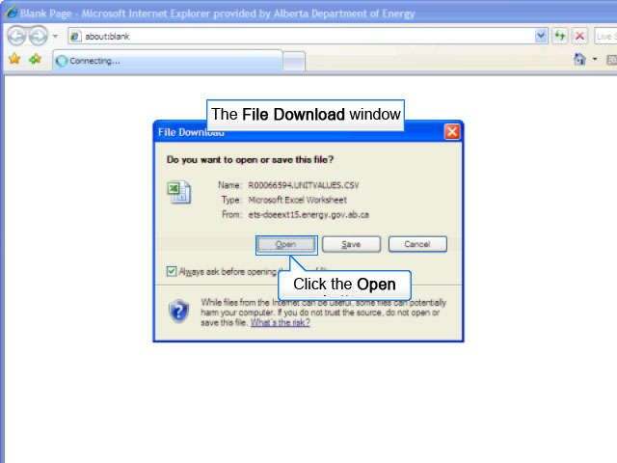
SR3
Back to Search Results

Slide 11
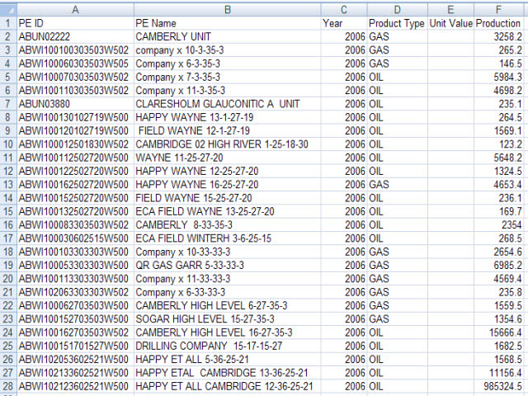
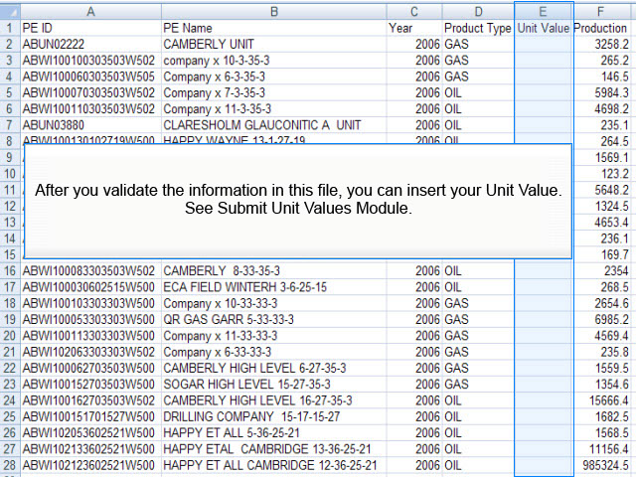
SR4
Back to Search Results

Slide 12

Conclusion
Congratulations!
You have completed the ETS – Download Unit Values Online Training Course
Please proceed to the subsequent courses detailing other functionality of the Freehold Mineral Tax application. If you have any comments or questions on this training course, please forward them to the following email address: Mintax.Energy@gov.ab.ca

