Slide 1
Welcome
Welcome!
A Lessee may be deleted from a PE Title if they no longer wish to show an interest in that title.
A lessee may be deleted by either:
The PE Administrator or
by the existing lessee
To the ETS – Delete Lessee
Online Training Course

Slide 2
Revisions
Date | Revisions Type | Page Number
August 31, 2012 | Conversion | All

Slide 3
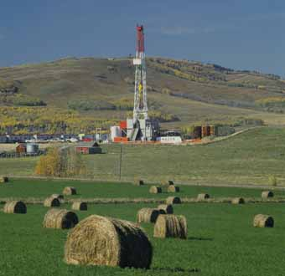
Introduction
In this module, you will learn how a Lessee linked to a PE/Title can be deleted from that role.
Lessees can delete themselves very easily, as soon as they know they are divesting from a well or wells.
"Pending" deletions may be set up by the Lessee up to 60 days in advance.
All the pending Delete transactions will be validated on the date set for deletion.

Slide 4
Business Rules
The following rules apply when deleting a lessee:
A Lessee cannot be deleted if no other lessee is connected to the Title/PE for the effective period.
An error message will be displayed.
A lessee will not be allowed to be removed if a Lessee transfer is pending on a Title/PE.
An error message will indicate the title that has the transfer pending.
A Terminated lessee cannot be deleted.
  Note: you would only see a terminated lessee if you searched within an earlier effective date timeframe.
If a Lessee being selected for deletion is also the PE Administrator, then a warning message will be displayed.
  You will still be allowed to proceed with the deletion of the Lessee, providing that none of the previous rules are contravened.

Slide 5
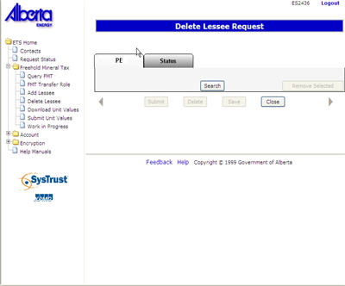

Search
To begin the ‘Delete Lessee’ process, do a search for the Production Entity (PE) or Title from which the Lessee needs to be deleted.
A PE Administrator can delete multiple lessees linked to a PE/Title in one request.
Lessee(s) may also delete their own role. Concurrence is not required for this process.
One Lessee must remain. The last Lessee will not be allowed to delete themselves. They will have to transfer their Lessee Role to another company.

Slide 6
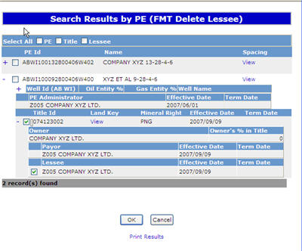
Search Results
To delete a lessee from individual titles, select those titles or lessees only.
You may also delete a lessee from all titles and PE’s displayed on the search results screen by selecting the “All PE” or “All Titles” option located at the top of the grid.
The OK button functions as a clearance button, causing any unselected titles and PEs to be removed from the display screen.

Slide 7
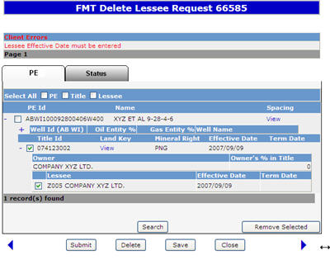
Add Effective Date
More Information (Pages 8 to 13)
Saving the request allocates a Request Number and triggers a prompt to enter the effective date for the deletion of the lessee.
The SUBMIT button triggers the removal of the lessee from all selected titles and changes the request status to ‘Completed’.
An e-mail notification is sent to the deleted lessee if the deletion is created by the PE Administrator for concurrence.
To cancel the request to delete a lessee, use the DELETE button. This will change the request status to CLIENT CANCELLED.

Slide 8
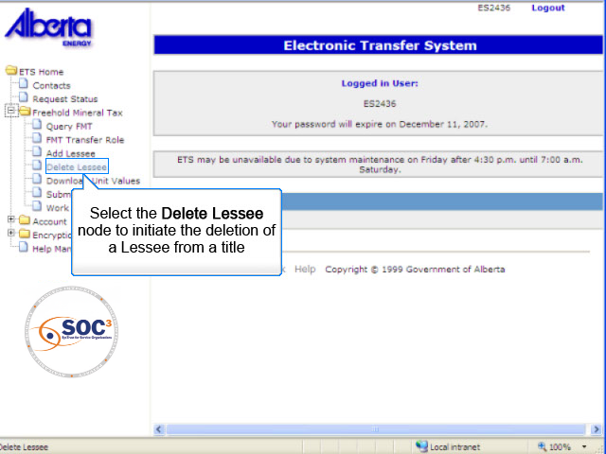
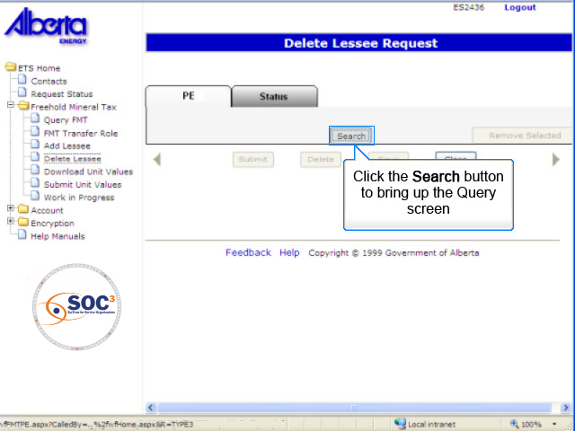
AED1
Back to Add Effective Date

Slide 9
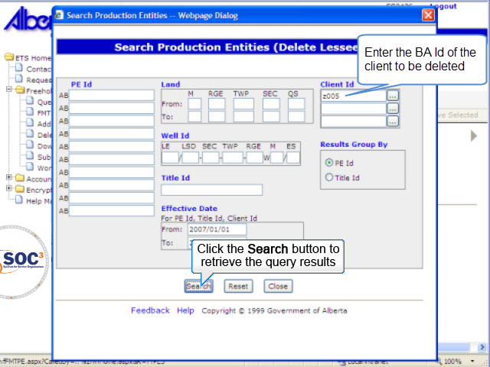
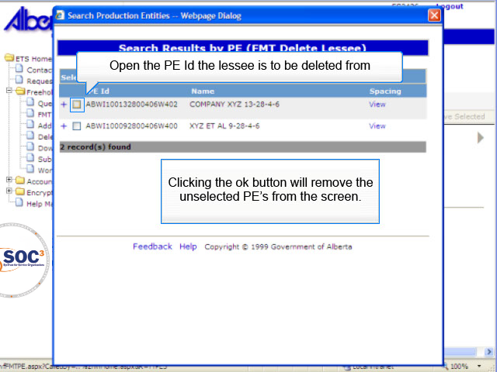
AED2
Back to Add Effective Date

Slide 10
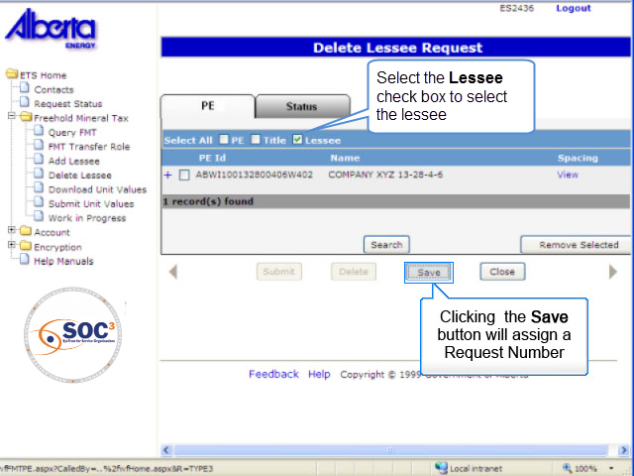
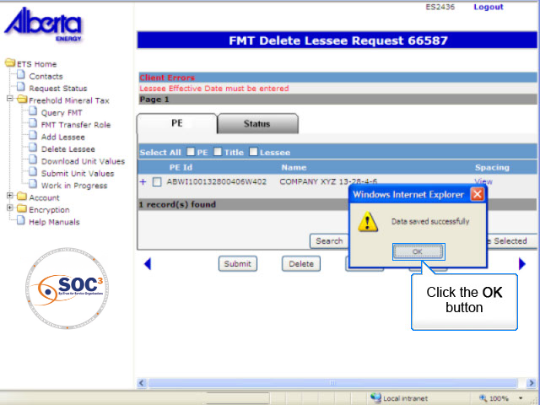
AED3
Back to Add Effective Date

Slide 11
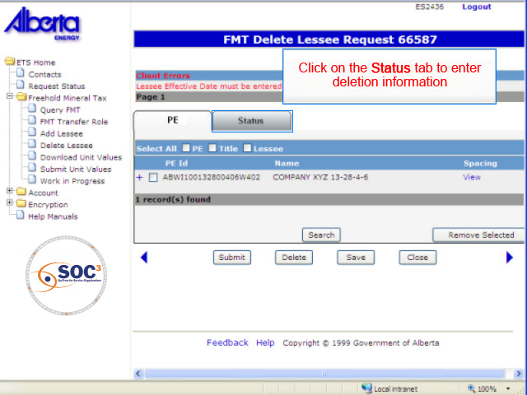
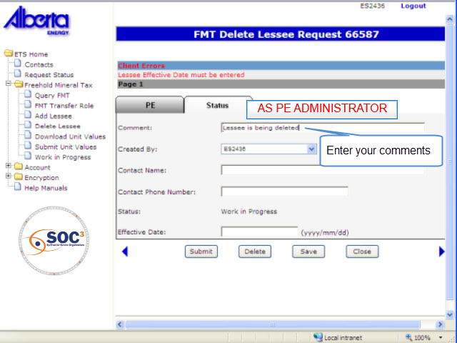
AED4
Back to Add Effective Date

Slide 12
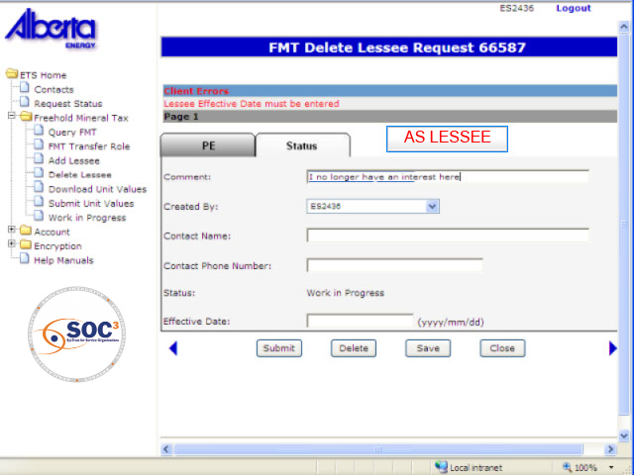
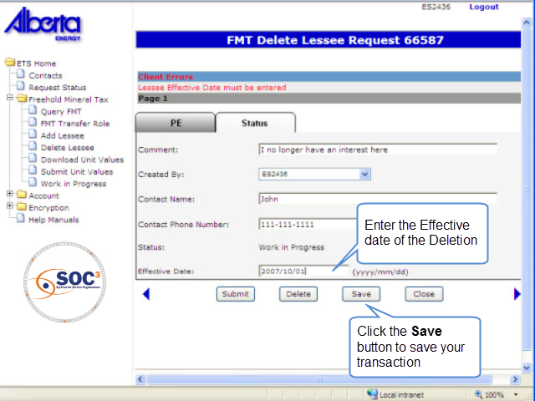
AED5
Back to Add Effective Date

Slide 13
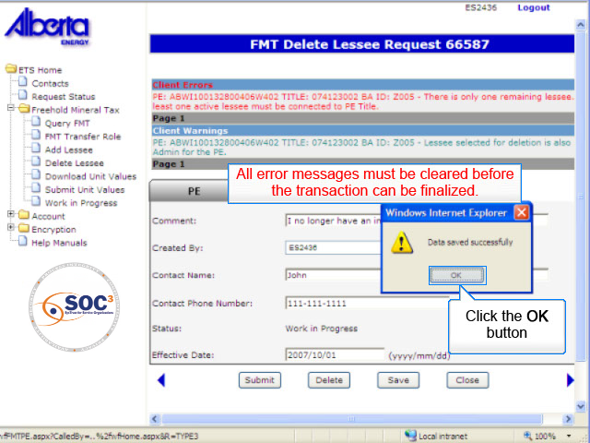
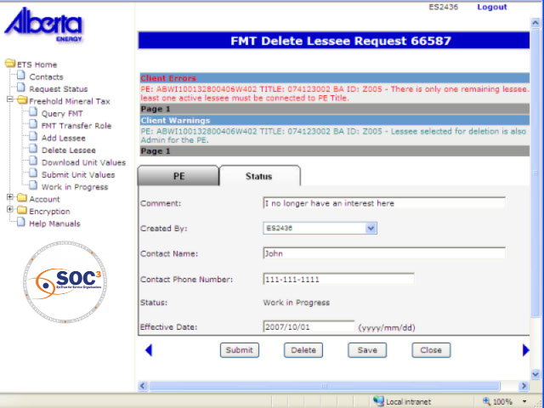
AED6
Back to Add Effective Date

Slide 14

Conclusion
Congratulations!
You have completed the ETS – Delete Lessee Online Training Course
Please proceed to the subsequent courses detailing other functionality of the Freehold Mineral Tax application.
If you have any comments or questions on this training course, please forward them to the following email address:
Mintax.Energy@gov.ab.ca

