Slide 1
Unit Agreement Exhibit A
Government of Alberta
Welcome!
to the
ETS – Unit Agreement Exhibit A
Unit Tract Revision
Online Training Course
The purpose of this course is to provide guidance and information to ETS clients who require a
Unit Tract Revision.
Page 1 of 40

Slide 2
Unit Agreement Exhibit A
Government of Alberta
Revision Page
Revisions Table
Date | Revisions Type | Page Number
March 7, 2016 | Initial Creation | All
November 3, 2020 | Update headers and contents | All
July 6, 2023 | Update contents | 15, 25
Page 2 of 40

Slide 3
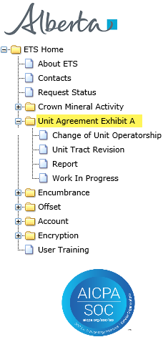
Unit Agreement Exhibit A
Government of Alberta
INTRODUCTION
In this module, you will learn how to:
Submit a Unit Tract Revision utilizing the following tabs:
Administrative
Unit Tract
Royalty Owners
Prerequisite Learning Module
Before proceeding, we recommend that you view the Unit Agreement Exhibit A Roles and Reports modules located in the Online Learning portal.
Page 3 of 40

Slide 4
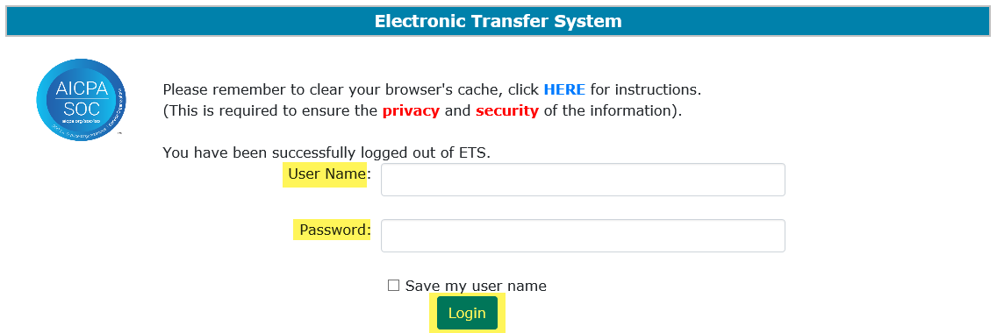
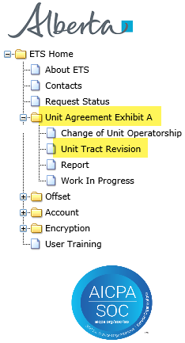
Unit Agreement Exhibit A
Government of Alberta
UNIT AGREEMENT EXHIBIT A – LOGIN – UNIT TRACT REVISION
2. Expand Unit Agreement Exhibit A
1. Login to ETS with your User Name and Password
3. Select Unit Tract Revision
Page 4 of 40

Slide 5
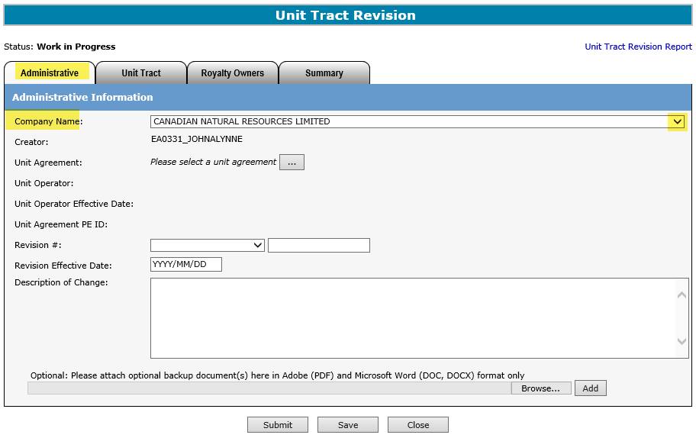

Unit Agreement Exhibit A
Government of Alberta
UNIT TRACT REVISION – ADMINISTRATIVE TAB - COMPANY NAME
Select Company Name from the dropdown
The Company Name dropdown includes all company that the ETS Account is assigned to.
Page 5 of 40

Slide 6
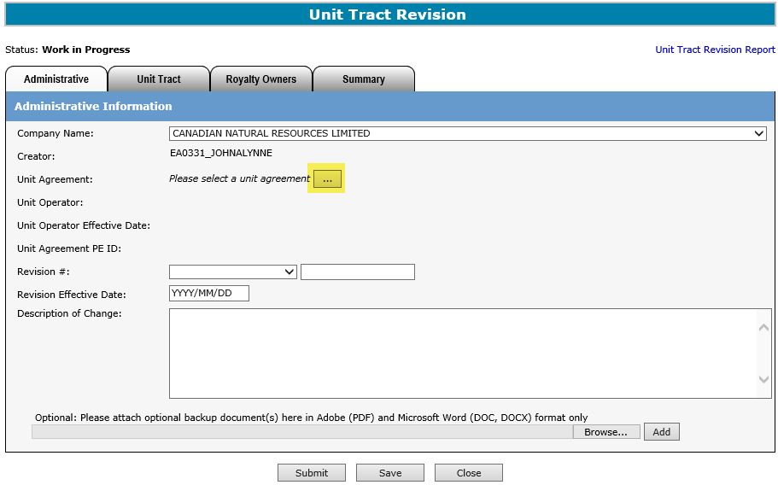
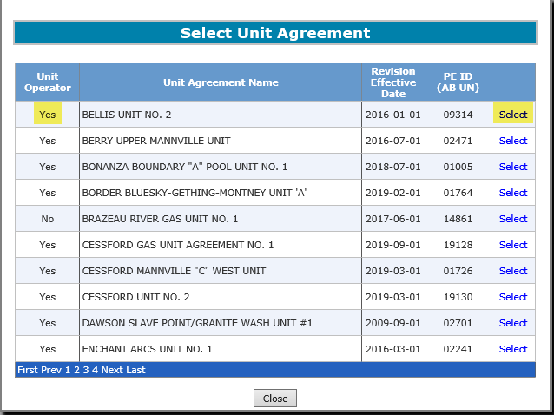
Unit Agreement Exhibit A
Government of Alberta
UNIT TRACT REVISION – ADMINISTRATIVE TAB - UNIT AGREEMENT
2. Click Select
1. Click to to search Unit Agreement
The Unit Operator, Unit Agreement Name, Revision Effective Date and PE ID columns can be sorted in Ascending or Descending order by clicking on the column title.
Only a Unit Operator can submit a Unit Tract Revision. Non-Unit Operator can only view the revision.
Page 6 of 40

Slide 7
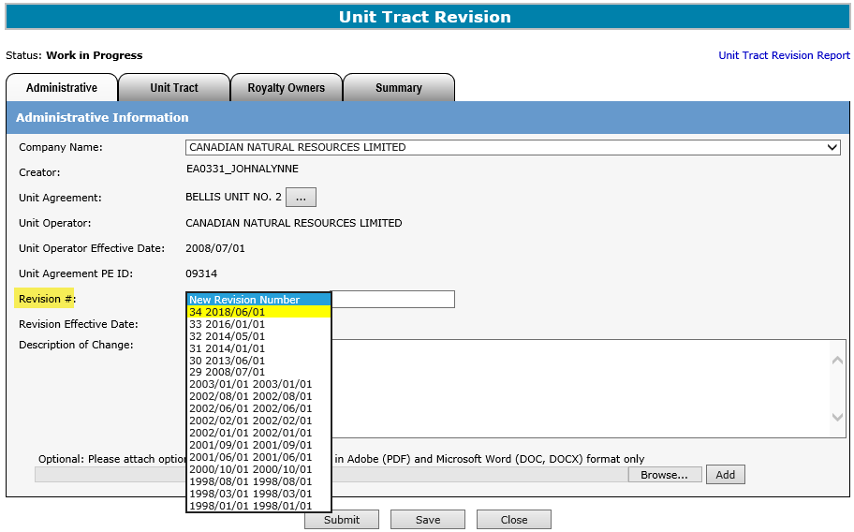
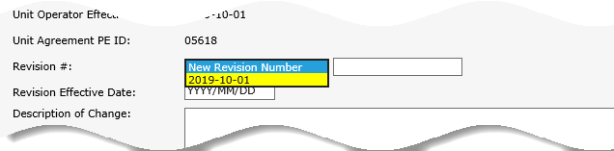
Unit Agreement Exhibit A
Government of Alberta
UNIT TRACT REVISION – ADMINISTRATIVE TAB – REVISION #
The dropdown list under Revision # field consists of revision numbers and their effective dates.
The highlighted revisions in are within the open years and can be revised.
This is the initial Exhibit A. No revision submitted.
If the New Revision Number dropdown list is only showing one revision without a Revision number, this means that this is the initial Exhibit A and no revision(s) were submitted yet. The creator would have to be enter a New Revision Number that will be sequentially followed throughout the lifetime of this unit agreement, for example, 1, 2, 3, etc.
Page 7 of 40

Slide 8
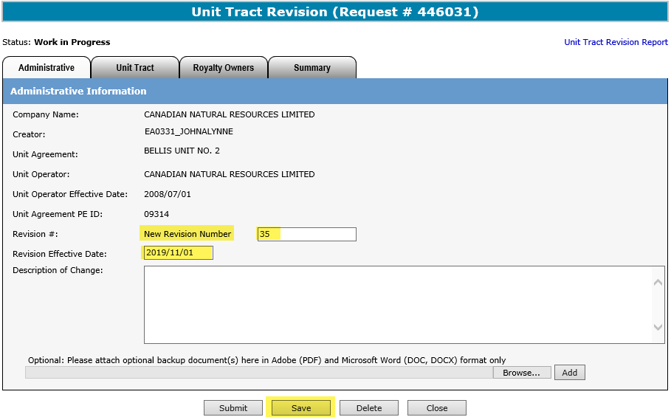
Unit Agreement Exhibit A
Government of Alberta
UNIT TRACT REVISION – ADMINISTRATIVE TAB – REVISION # AND EFFECTIVE DATE
1. From the Revision # dropdown, select New Revision Number
2. Enter the new revision number here. Ensure you use the next sequential number following the last revision.
To prevent your request from being rejected, it is important to not use previously used revision number.
3. Enter the Revision Effective Date. The Effective Date must be the first day of the month, greater than the current revision Effective Date and in open years.
4. Click Save
While working in the Unit Tract Revision screen, saving periodically is required to avoid the session from timing out. If there is no screen activity, the screen timeouts in 15 minutes.
Once the Save button is click, ETS generate the Request #, which is displayed in the header, e.g Request # 446031.
Page 8 of 40

Slide 9
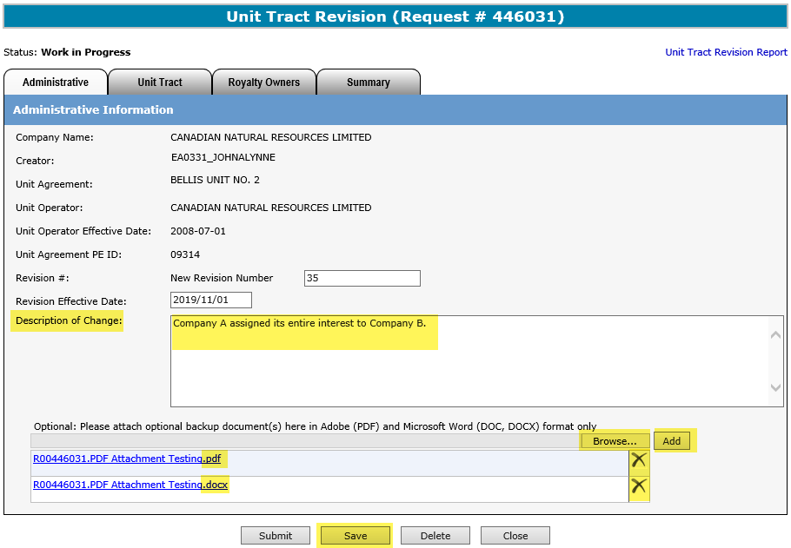
Unit Agreement Exhibit A
Government of Alberta
UNIT TRACT REVISION – ADMINISTRATIVE TAB – DESCRIPTION OF CHANGE, ATTACHMENTS
1. Add the description here. An error kicks in if a return paragraph and/or special characters is added. The valid characters are: comma(,), percent (%), ampersand (&), underscore (_), period (.)
2. (optional) Add attachment. Click Browse to browse your own folder for the document
PDF and Microsoft Word format
3. Click Add, once the document is chosen.
4. Click Save
Click the to remove an attachment.
More than one document can be attached. Follow steps 2 to 4.
Page 9 of 40

Slide 10
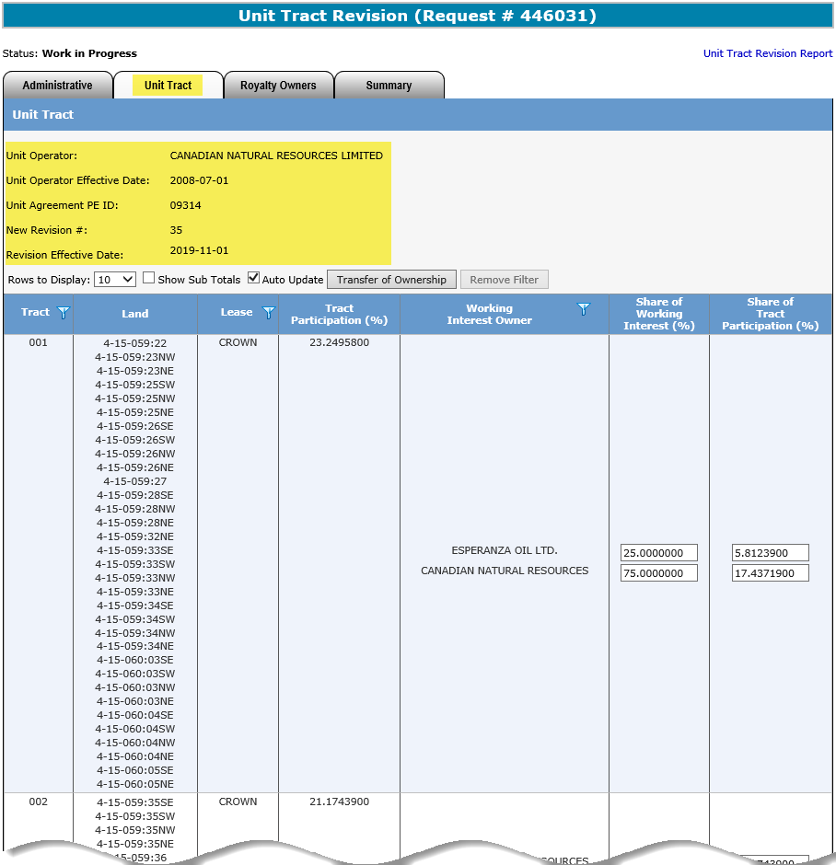
Unit Agreement Exhibit A
Government of Alberta
UNIT TRACT REVISION – UNIT TRACT TAB – COPY OF CURRENT REVISION
This header is constant to Administrative, Unit Tract and Royalty Owners tab for reference.
This revision is a copy of the current revision where the new revision data is updated.
Page 10 of 40

Slide 11
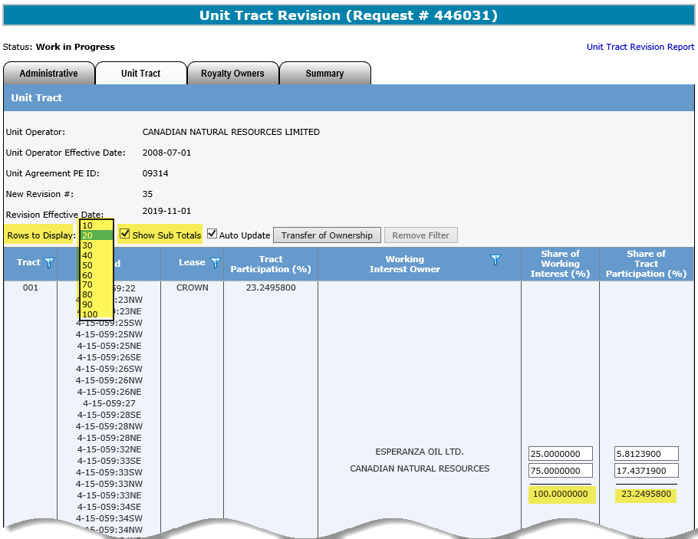
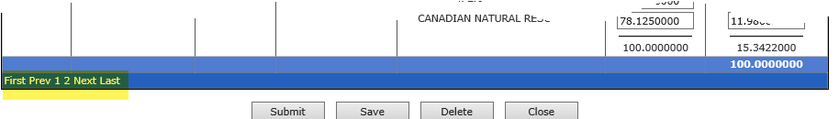
Unit Agreement Exhibit A
Government of Alberta
UNIT TRACT REVISION – UNIT TRACT TAB – ROWS TO DISPLAY, SHOW SUB TOTALS
Rows to Display
Click the dropdown to display more than 10 rows, if desired.
Show Sub Totals
If the box is checked, the sub totals for each tract is displayed.
If the unit agreement has more than 10 tracts, this page navigation appears at the bottom depending on the Rows to Display chosen.
Page 11 of 40

Slide 12
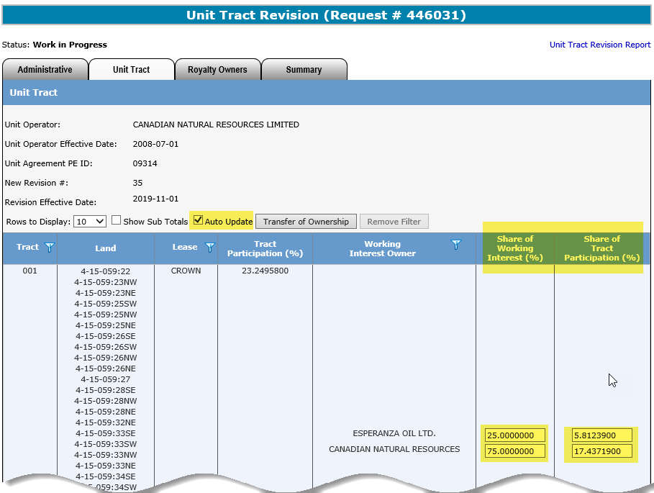
Unit Agreement Exhibit A
Government of Alberta
UNIT TRACT REVISION – UNIT TRACT TAB – AUTO UPDATE
Auto Update
This box is checked by default. For example, if Share of Working Interest (%) is changed, the Share of Tract Participation (%) is auto updated and vice versa.
Page 12 of 40

Slide 13
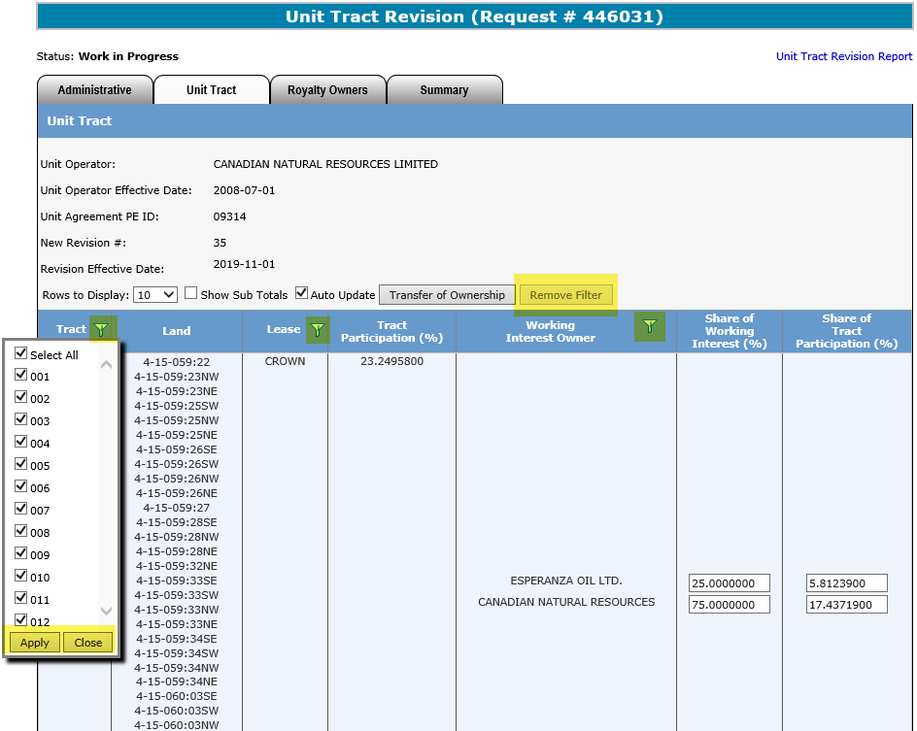
Unit Agreement Exhibit A
Government of Alberta
UNIT TRACT REVISION – UNIT TRACT TAB - FILTERS
Remove Filter
If filter has been activated, this button is enabled to remove the filter.
Filter is available to columns that have this symbol Click the filter to bring up the filter.
1. Select Apply to apply the selected filter.
2. Select Close to close the filter box.
Filters are useful when there are many rows of information on a screen that you must scroll through.
It allows you to narrow down the amount of information displayed.
Page 13 of 40

Slide 14
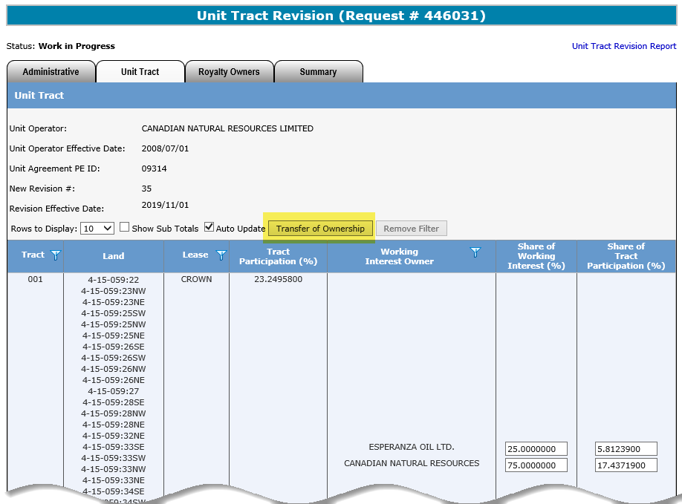
Unit Agreement Exhibit A
Government of Alberta
UNIT TRACT REVISION – UNIT TRACT TAB – TRANSFER OF OWNERSHIP
Transfer of Ownership
Click this button to process the assignment of interest.
If there is only a specific tract that require updating, other option is to update here without using the Transfer of Ownership button.
Page 14 of 40

Slide 15
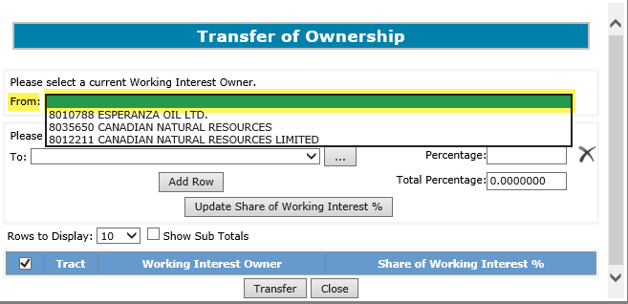
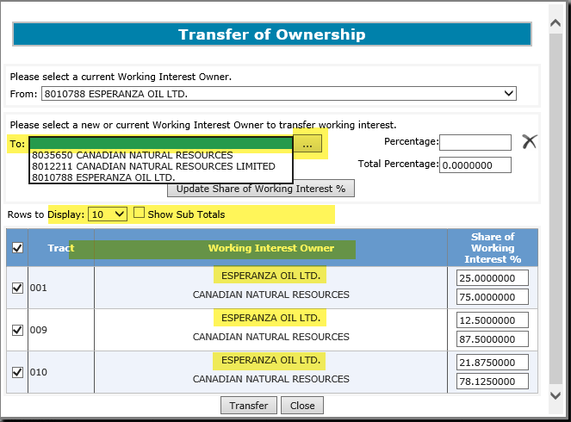
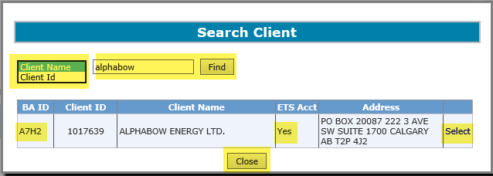
Unit Agreement Exhibit A
Government of Alberta
UNIT TRACT REVISION – UNIT TRACT TAB – TRANSFER OF OWNERSHIP – INPUT FROM AND TO
3. Click To dropdown to bring up all current Working Interest Owners (WIOs). Select which WIO you want to transfer % from.
1. Click From dropdown to bring up all current Working Interest Owners (WIOs). Select which WIO you want to transfer % from.
4. If the To WIO is not one of the current WIO, click the search button to add new WIO.
5. Search Client either by Client Name or Client ID. Enter the first word of the name and click Find.
2. This grid only displays WIO based on the selected WIO from the From dropdown
6. At the search result grid, click Select (or Close, if this is not the correct search)
The Client ID is the Department of Energy and Minerals (DOE) Client ID.
The Business Associate (BA) ID is Alberta Energy and Minerals’ (the department) internal ID use for business dealings.
Page 15 of 40

Slide 16
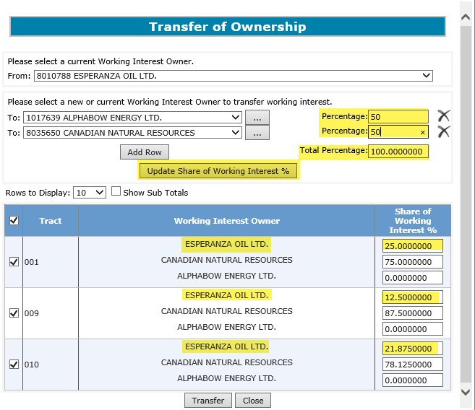
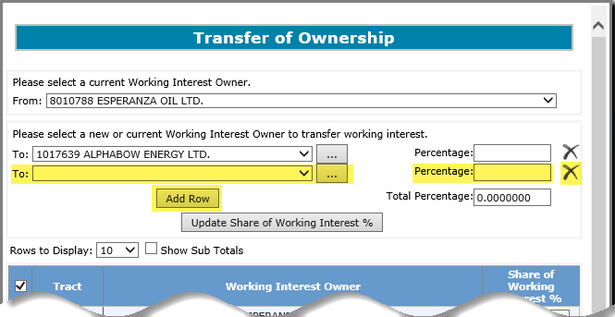
Unit Agreement Exhibit A
Government of Alberta
UNIT TRACT REVISION – UNIT TRACT TAB – ADD ROW, PERCENTAGE, UPDATE SHARE OF WORKING INTEREST %
3. Input the transfer % for each WIO
2. New row is added.
running total
4. Click Update Share of Working Interest (WI) % to update the transfer.
Click the to remove a row.
1. If the transfer % is being split with multiple WIO, click Add Row. Notice that it also add the corresponding Percentage field.
In this example, notice that Esperanza still have interest %. However, this will be updated once the WI % is updated.
It is important to click Update Share of Working Interest % button once the percentage is entered to update the transfer. If this step is missed, the transfer will not reflect the correct transfer.
Page 16 of 40

Slide 17
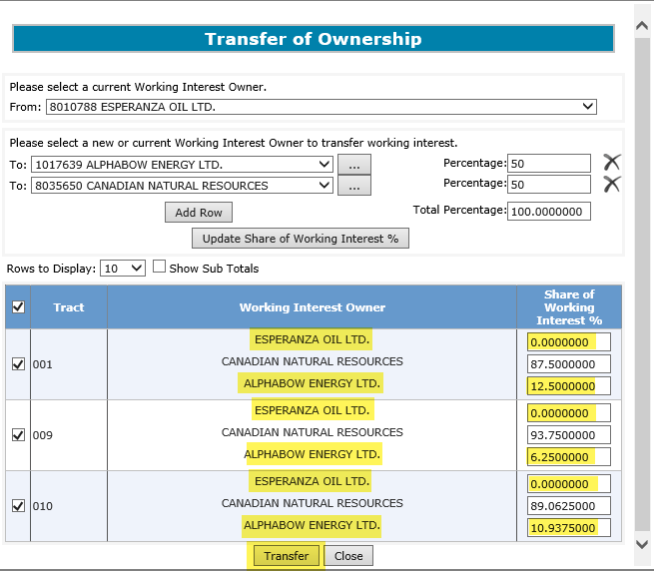
Unit Agreement Exhibit A
Government of Alberta
UNIT TRACT REVISION – UNIT TRACT TAB – TRANSFER
The Share of WI % is now updated. In this example, notice how Esperanza now has 0% and Alphabow is added with %.
1. Scroll down and click Transfer to apply this update and to return to the main grid.
It is important to click Transfer (scroll down to this button). The main grid will not reflect the revision if it’s not transferred.
Page 17 of 40

Slide 18
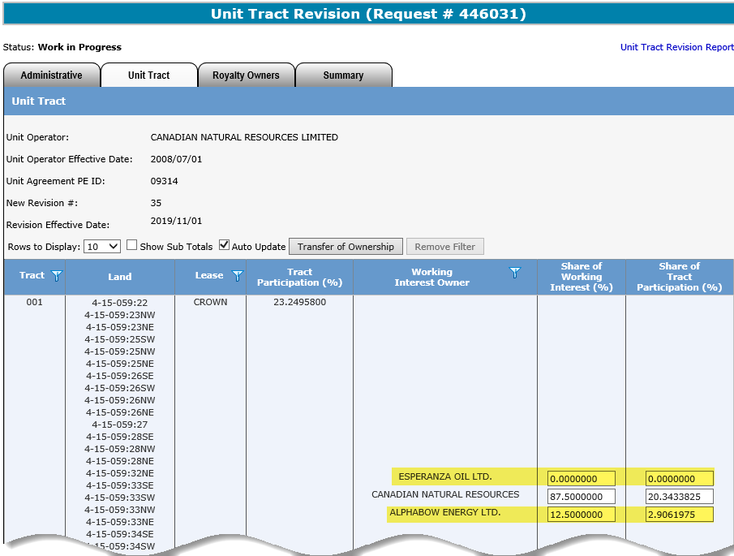
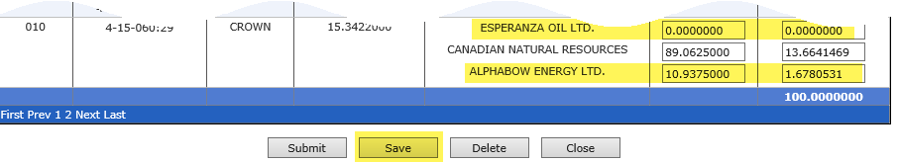
Unit Agreement Exhibit A
Government of Alberta
UNIT TRACT REVISION – UNIT TRACT TAB – SAVE THE TRANSFER
Back to the main grid, the % must reflect what was transferred.
1. Click Save
It is important to click Save (scroll down to this button) in order to complete and reflect the revision.
Page 18 of 40

Slide 19
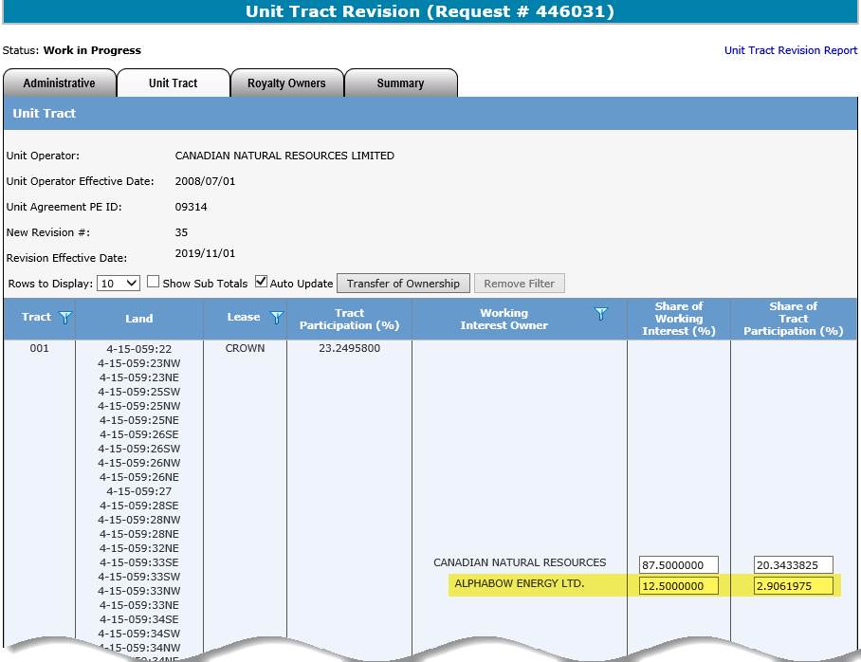
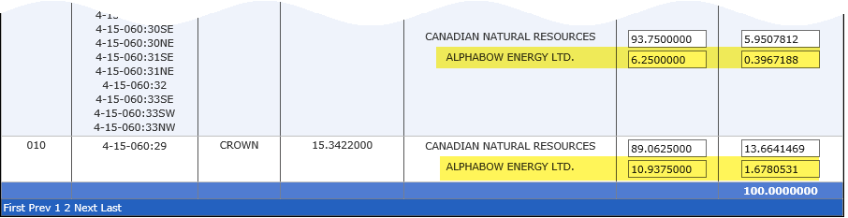
Unit Agreement Exhibit A
Government of Alberta
UNIT TRACT REVISION – UNIT TRACT TAB – REVISION COMPLETED
The revision is now complete.
Page 19 of 40

Slide 20
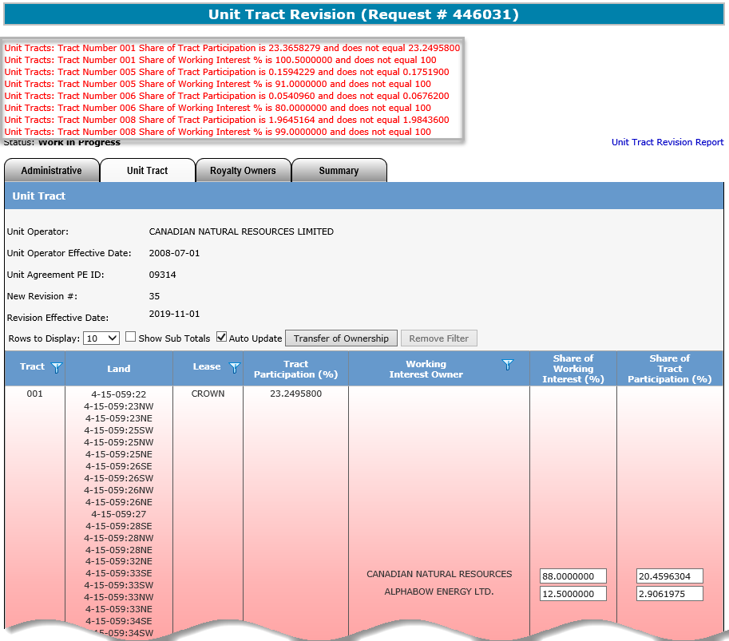
Unit Agreement Exhibit A
Government of Alberta
UNIT TRACT REVISION – UNIT TRACT TAB – VALIDATION ERROR – TRACT % IN ERROR
Tract(s) that have incorrect percentage(s) are automatically highlighted in cascading red. Once the percentage(s) is corrected, the highlight is removed.
Once the revision is saved, ETS validates behind the scene if any rules were not met.
If rules are not met, the validation is listed at the top in red. These must be actioned before submission.
Page 20 of 40

Slide 21
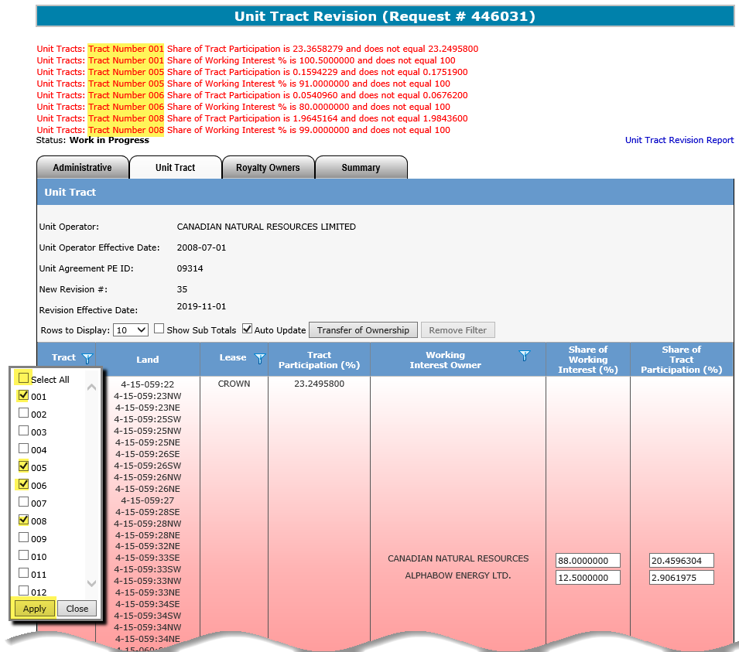
Unit Agreement Exhibit A
Government of Alberta
UNIT TRACT REVISION – UNIT TRACT TAB – FILTER TRACTS IN ERROR
1. Deselect Select All box.
2. Based on the validation errors above, check mark the tracts listed.
3. Click Apply to only display the selected tracts.
For efficient navigation of the tracts in error, utilize the Tract column filter.
The filter allows you to only display the tracts in error.
Page 21 of 40

Slide 22
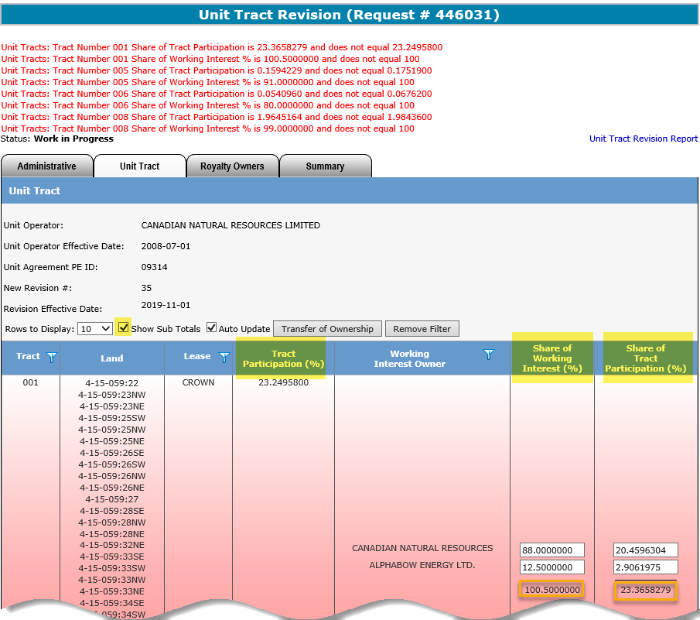
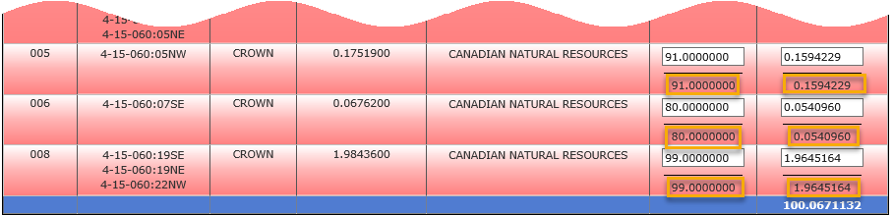
Unit Agreement Exhibit A
Government of Alberta
UNIT TRACT REVISION – UNIT TRACT TAB – SHOW SUB TOTALS
Share of Working Interest (%)
Must equal to 100.0000000 for each tract.
Show Sub Totals Check this box to assist you in correcting the % in error.
Tract Participation (%) and sub total of Share of Tract Participation (%) must equal for each tract.
Page 22 of 40

Slide 23
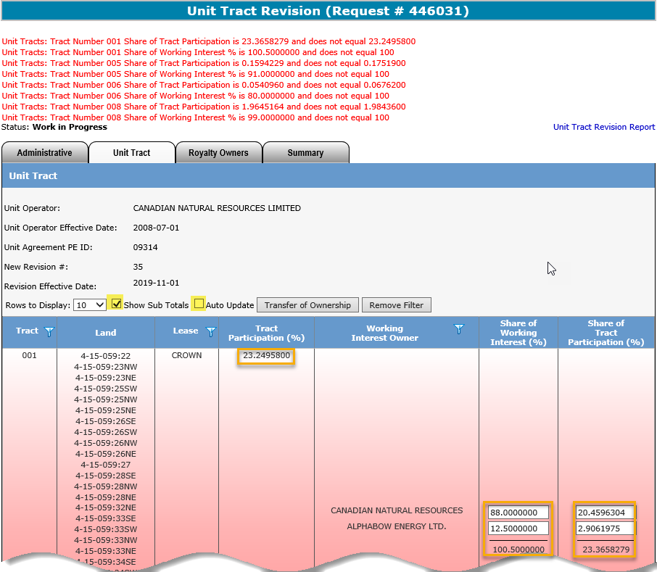
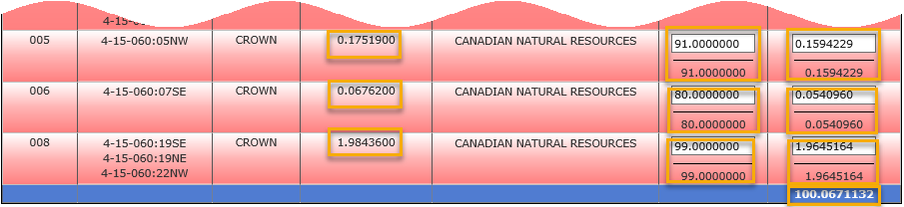
Unit Agreement Exhibit A
Government of Alberta
UNIT TRACT REVISION – UNIT TRACT TAB – CORRECT TRACT IN ERRORS
1. Turn on the Show Sub Totals
2. Auto Update box must be unchecked if there is an issue with the decimal; otherwise, keep it checked.
4. Then, the Share of Tract Participation should equal to Tract Participation
3. In this example for Tract 001, update the Share of Working Interest (%) to exactly 100.0000000
Page 23 of 40

Slide 24
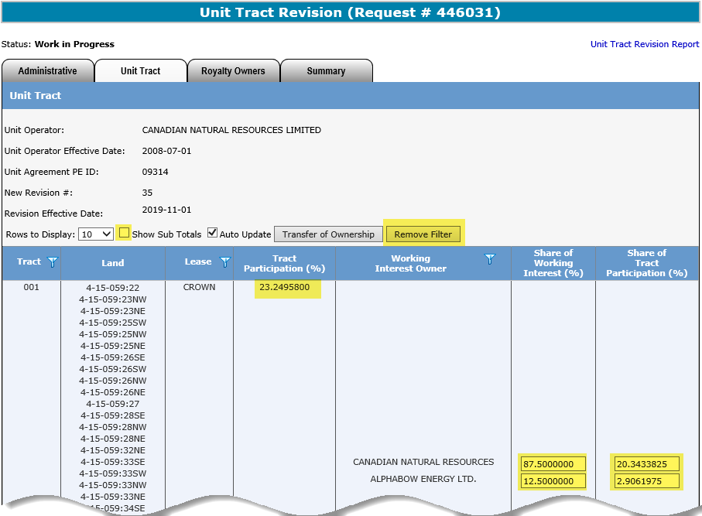
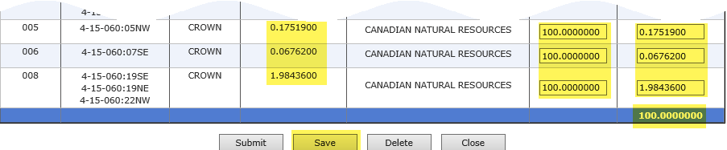
Unit Agreement Exhibit A
Government of Alberta
UNIT TRACT REVISION – UNIT TRACT TAB – SAVE CORRECTIONS
2. Check the Auto Update box if it was unchecked.
1. Once all tracts in error are corrected, uncheck Show Sub Totals box
3. Click Remove Filter to show all tracts
A running total is at the bottom of the Share of Tract Participation (%) column for reference.
4. Click Save to apply all corrections.
The unit tract revision entry is now complete. If there is no other validation errors and no requirement to update a Royalty Owner, skip the Royalty Owner tab and proceed to Summary tab to confirm the Working Interest Owner Summary (page 36).
Page 24 of 40

Slide 25
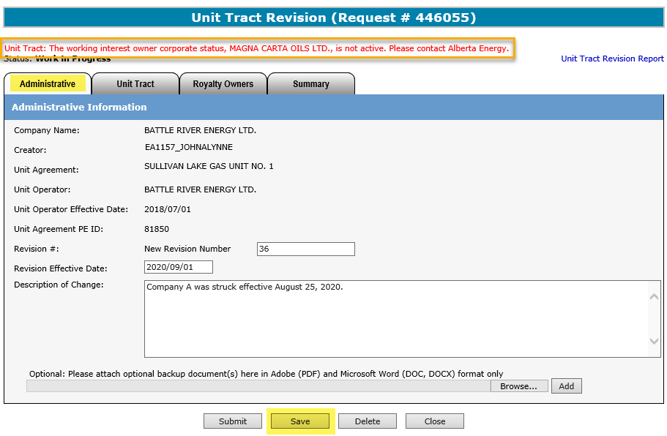
Unit Agreement Exhibit A
Government of Alberta
UNIT TRACT REVISION – UNIT TRACT TAB – VALIDATION ERROR – INACTIVE WORKING INTEREST OWNER (WIO)
A unit tract revision is required when a WIO becomes inactive from the current revision. The deparment sends notification letter to Unit Operator advising to submit a revision. It is important that revision is submitted so that royalties are correctly assessed.
Once the request is saved after inputting Administrative data, validation error below appears:
“The working interest owner corporate status, ##Company Name##, is not active. Please contact Alberta Energy and Minerals.”
Proceed to the next step, i.e., enter the revision under Unit Tract tab. Once the revision is saved, this validation error disappears.
Page 25 of 40

Slide 26
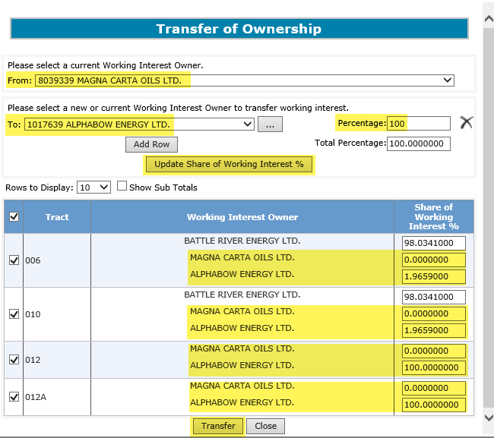
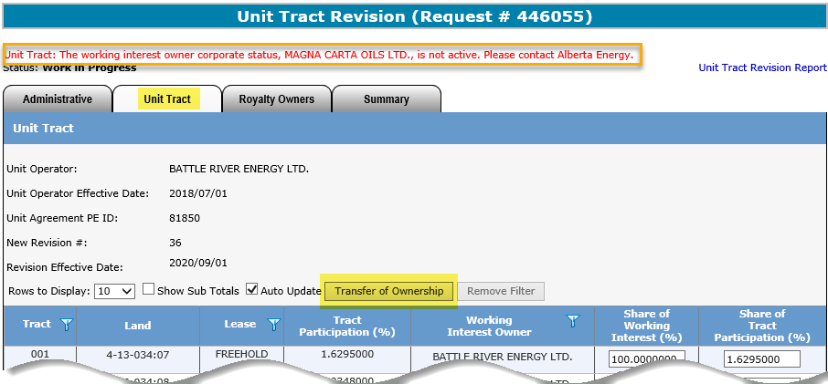
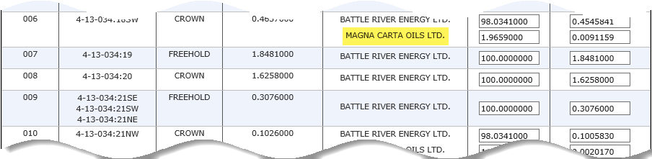
Unit Agreement Exhibit A
Government of Alberta
UNIT TRACT REVISION – UNIT TRACT TAB – REPLACE INACTIVE WIO TO ACTIVE WIO
2. Select the inactive client.
1. Click Transfer of Ownership
3. For the rest of the steps, refer to pages 15 to 18
The validation error remains at the top of the screen until the inactive WIO is replaced.
Page 26 of 40

Slide 27
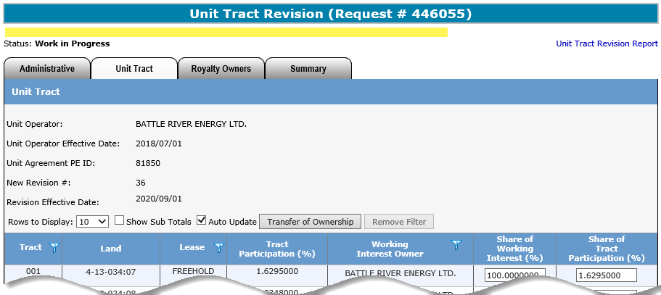
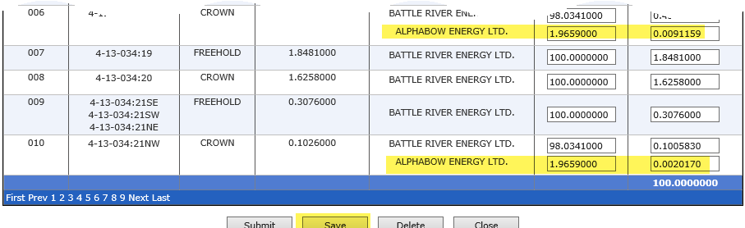
Unit Agreement Exhibit A
Government of Alberta
UNIT TRACT REVISION – UNIT TRACT TAB – INACTIVE WIO REPLACED AND SAVED
Once the transfer is saved, the validation error disappears. The inactive WIO is now replaced with the active WIO.
Proceed to submission.
Page 27 of 40

Slide 28
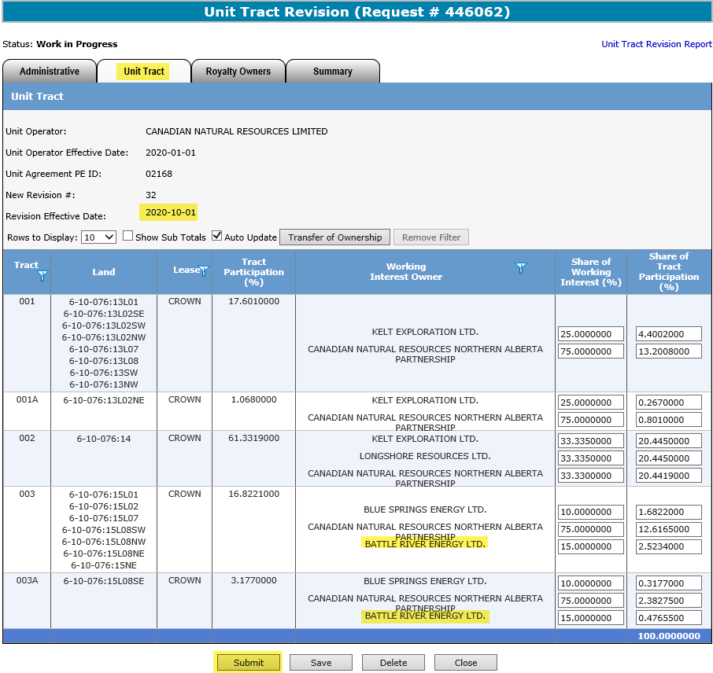
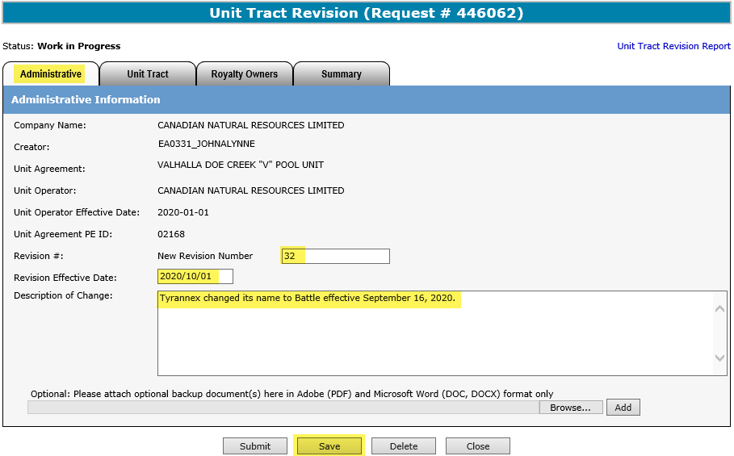
Unit Agreement Exhibit A
Government of Alberta
UNIT TRACT REVISION – UNIT TRACT TAB – NAME CHANGE ON EXISTING WIO
A unit tract revision is required when an existing WIO has undergone a Name Change.
The department sends notification letter to Unit Operator advising to submit a revision. It is important that revision is submitted so that royalties are correctly assessed.
4. Go to Unit Tract tab to confirm the change.
1. Enter Revision Effective Date. See note below.
3. Once the Revision Effective Date is entered and the request is Saved, the name of the affected WIO is automatically reflected under the Unit Tract tab.
2. Click Save
5. Click Submit
The effective date of the revision is the 1st day of the month following the name change.
For example, name change was effective September 16, 2020. The effective of the revision would be October 1, 2020.
Page 28 of 40

Slide 29
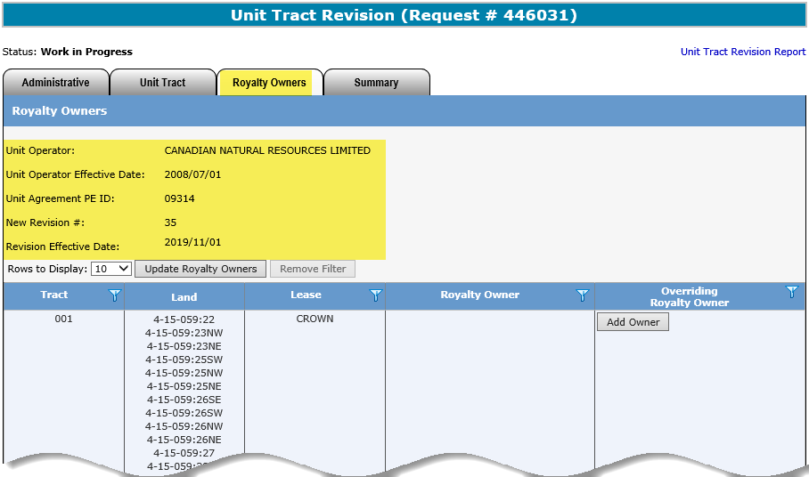
Unit Agreement Exhibit A
Government of Alberta
UNIT TRACT REVISION – ROYALTY OWNERS TAB – COPY OF CURRENT REVISION
This header is constant to Administrative, Unit Tract and Royalty Owners tab for reference.
This revision is a copy of the current revision where the new revision data is updated.
Unit Operator can submit New Revision with only Royalty Owners updates. If this is the case, only the Administrative and Royalty Owners tabs are required for submission.
Page 29 of 40

Slide 30
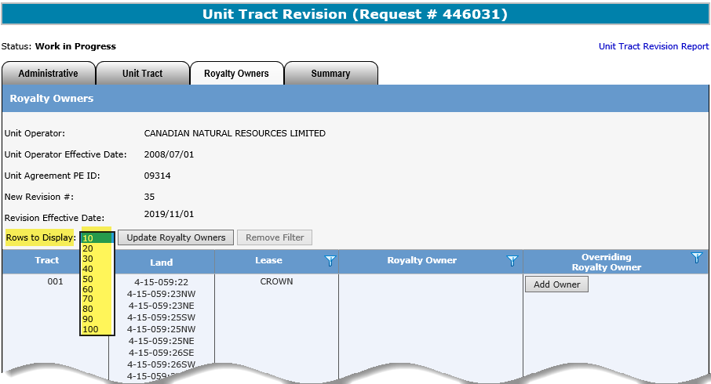
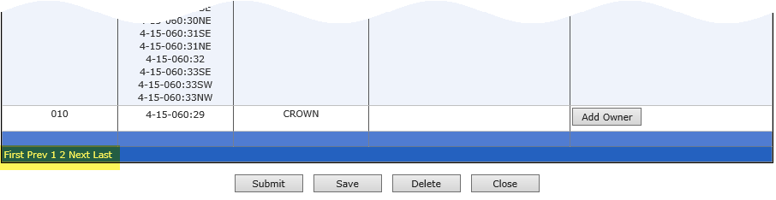
Unit Agreement Exhibit A
Government of Alberta
UNIT TRACT REVISION – ROYALTY OWNERS TAB – ROWS TO DISPLAY
Rows to Display
Click the dropdown to display more than 10 rows, if desired.
If the unit agreement has more than 10 tracts, this page navigation appears at the bottom depending on the Rows to Display chosen.
Page 30 of 40

Slide 31
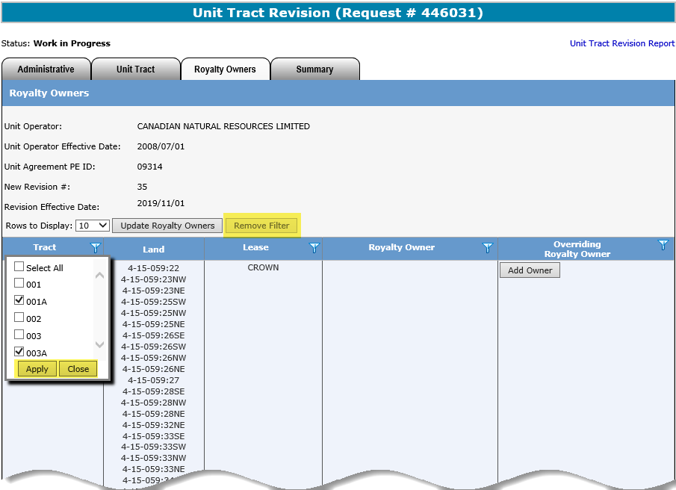
Unit Agreement Exhibit A
Government of Alberta
UNIT TRACT REVISION – ROYALTY OWNERS TAB – FILTERS
Remove Filter
If filter has been activated, this button is enabled to remove the filter.
Filter is available to columns that have this symbol Click the filter to bring up the filter.
1. Select Apply to apply the selected filter.
2. Select Close to close the filter box.
Filters are useful when there are many rows of information on a screen that you must scroll through.
It allows you to narrow down the amount of information displayed.
Page 31 of 40

Slide 32
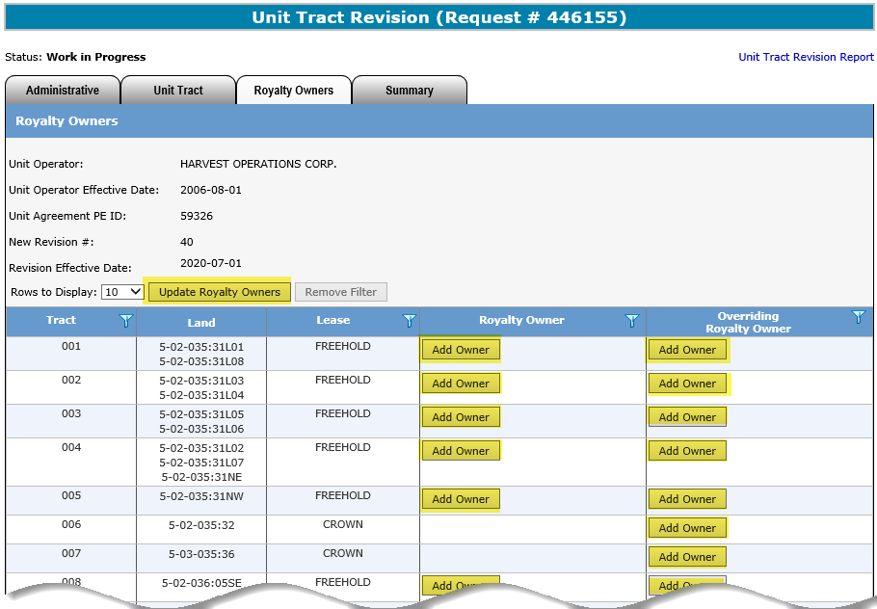
Unit Agreement Exhibit A
Government of Alberta
UNIT TRACT REVISION – ROYALTY OWNERS TAB – UPDATE ROYALTY OWNERS BUTTONS
The Add Owner button is only available under Royalty Owner column when it is a Freehold tract.
1. Click Update Royalty Owners button. A new dialog box opens…
2. Click Add Owner button on each tract, where this button is available
Royalty Owners and/or Overriding Royalty Owners can be updated or added.
There are two ways to update or add Royalty Owners:
1. Update Royalty Owners button
2. Add Owner button designated on each tract
Page 32 of 40

Slide 33
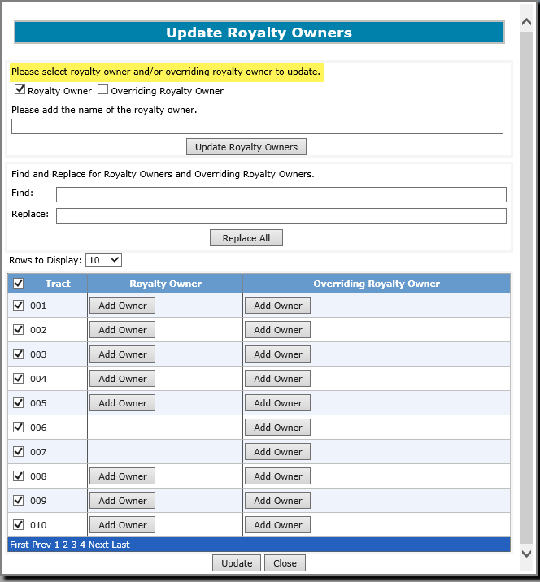
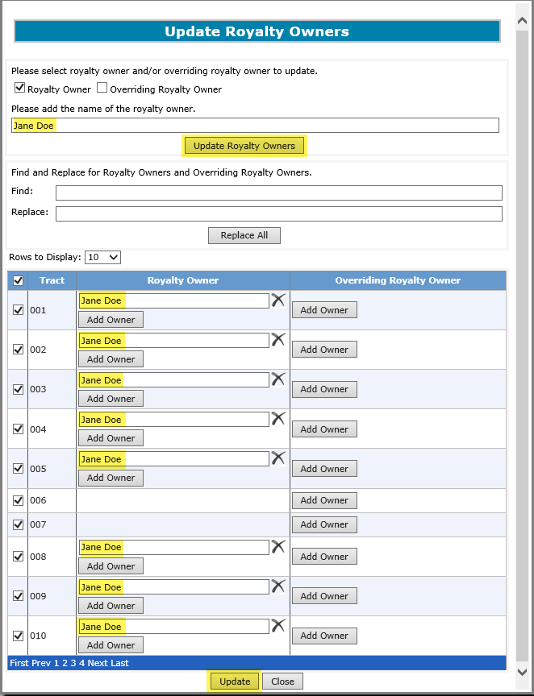
Unit Agreement Exhibit A
Government of Alberta
UNIT TRACT REVISION – ROYALTY OWNERS TAB – UPDATE ROYALTY OWNERS
1. Check mark Royalty Owner box to update Royalty Owners
2. Enter the correct and complete name of the Royalty Owner.
3. Click Update Royalty Owners to update the owners in the selected tracts below.
4. All selected tracts are now updated.
5. Click Update to update the main grid.
The tracts are check marked by default. You can unselect all and reselect specific tract that require update.
The same steps apply to update Overriding Royalty Owner.
Page 33 of 40

Slide 34
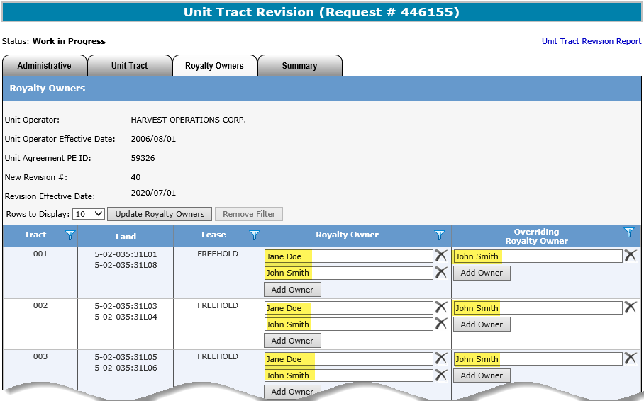

Unit Agreement Exhibit A
Government of Alberta
UNIT TRACT REVISION – ROYALTY OWNERS TAB – SAVE
Once back on the main grid, click Save.
You can also update either/both Royalty Owner/Overriding Royalty Owner here by clicking Add Owner button to a specific tract. Click Save once update is done.
Page 34 of 40

Slide 35


Unit Agreement Exhibit A
Government of Alberta
UNIT TRACT REVISION – ROYALTY OWNERS TAB – UPDATE ROYALTY OWNERS – FIND/REPLACE
1. Enter the require information
2. Click Replace All.
3. Click Update
If only specific tract needs to be replaced, uncheck the tract that no update require before clicking Replace All.
Once update is done on all 3 tabs, i.e. Administrative, Unit Tract, Royalty Owners, proceed to Summary tab for a quick review on Working Interest Owner Summary before submission.
Page 35 of 40

Slide 36

Unit Agreement Exhibit A
Government of Alberta
UNIT TRACT REVISION – SUMMARY TAB – REVIEW WIO AND REPORT
Click to view the report.
Summary tab provides summary of all WIO Unit Participation %, Crown Share % and Crown Interest %.
Unit Tract Revision Report is an overview of screen data, which helps in verifying data entered. This report can be generated at any time during the request’s lifecycle.
Page 36 of 40

Slide 37





Unit Agreement Exhibit A
Government of Alberta
UNIT TRACT REVISION – SUBMIT REQUEST
1. Click Submit
2. Click OK
3. Click OK
4. Status changed from Work in Progress to Submitted.
5. Status changed from Submitted to Completed.
Once the request is submitted, Withdraw option is enabled. You can choose to withdraw the request at this point.
However, once the status is changed from Submitted to Completed, the withdraw option is disabled.
Page 37 of 40

Slide 38



Unit Agreement Exhibit A
Government of Alberta
UNIT TRACT REVISION – UNIT TRACT REVISION – EMAIL NOTIFICATION & WORK IN PROGRESS
An email notification is sent to the creator indicating that the request is now Completed.
Once this email notification is received,
the next step is to generate the Exhibit A report.
Refer to Reports available in our online learning portal.
The Unit Operator is responsible in preparing and distributing the same copy of the revised Exhibit A created in ETS to all unit parties including Alberta Energy Regulator.
The Status of a Request can be searched and viewed in the Work in Progress screen.
Requests that have been created will remain available in the Work in Progress for 90 days after which they are archived and then deleted.
Page 38 of 40

Slide 39
Unit Agreement Exhibit A
Government of Alberta
UNIT TRACT REVISION – CORRECTION
If correction is required to a previously submitted revision,
please refer to Unit Tract Correction available in our Online Learning portal.
Types of correction that Unit Operator can correct electronically on revision that is either current and/or within the open year:
*Revision #
*Revision Effective Date
Working Interest Owners
Share of Working Interest %
Share of Tract Participation %
Royalty Owners
*can only correct on current revision
Page 39 of 40

Slide 40

Unit Agreement Exhibit A
Government of Alberta
CONCLUSION
Congratulations!
You have completed the
Unit Agreement Exhibit A
Unit Tract Revision
Online Training Course
If you have any comments or questions on this training course,
please forward them to the following email address:
EnergyUnitsHelpdesk@gov.ab.ca
Page 40 of 40

