Slide 1
Unit Agreement Exhibit A
Government of Alberta
Welcome!
to the
ETS – Unit Agreement Exhibit A
Unit Tract Correction
Online Training Course
The purpose of this course is to provide guidance and information to ETS clients who need to correct a previously submitted unit tract revision.
Page 1 of 14

Slide 2
Unit Agreement Exhibit A
Government of Alberta
Revision Page
Revisions Table
Date | Revisions Type | Page Number
March 7, 2016 | Initial Creation | All
November 6, 2020 | Update headers and contents | All
July 10, 2023 | Update content | 5, 8
Page 2 of 14

Slide 3
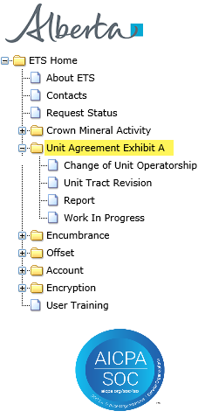
Unit Agreement Exhibit A
Government of Alberta
INTRODUCTION
In this module, you will learn how to:
Correct a previously submitted Unit Tract Revision
Note: As per the Petroleum Joint Venture Association model,
Exhibit A Revision is when a modification to an Exhibit A is required.
Exhibit A Correction is when there is an error of a clerical nature occurred.
Prerequisite Learning Module
Before proceeding, we recommend that you view the Unit Agreement Exhibit A Roles, Unit Tract Revision and Reports modules located in the Online Learning portal.
Page 3 of 14

Slide 4
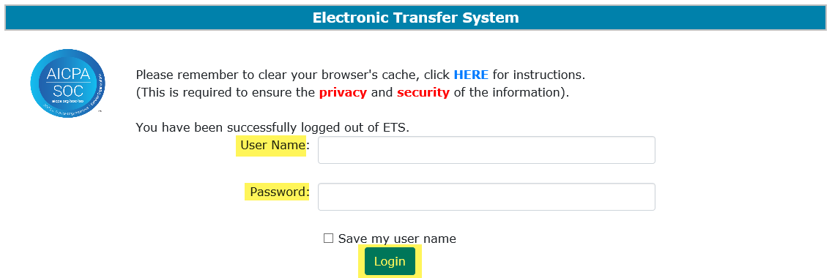
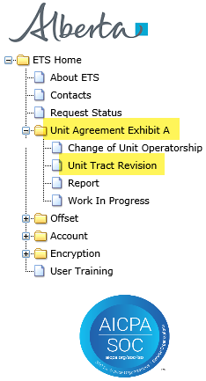
Unit Agreement Exhibit A
Government of Alberta
UNIT AGREEMENT EXHIBIT A – LOGIN – UNIT TRACT REVISION
2. Expand Unit Agreement Exhibit A
1. Login to ETS with your User Name and Password
3. Select Unit Tract Revision
Page 4 of 14

Slide 5
Unit Agreement Exhibit A
Government of Alberta
UNIT TRACT REVISION – CORRECTION
Types of correction that Unit Operator can correct electronically on revision that is either current and/or within the open year:
*Revision Effective Date
Working Interest Owners
Share of Working Interest %
Share of Tract Participation %
Royalty Owners
*can only correct on current revision
Page 5 of 14

Slide 6
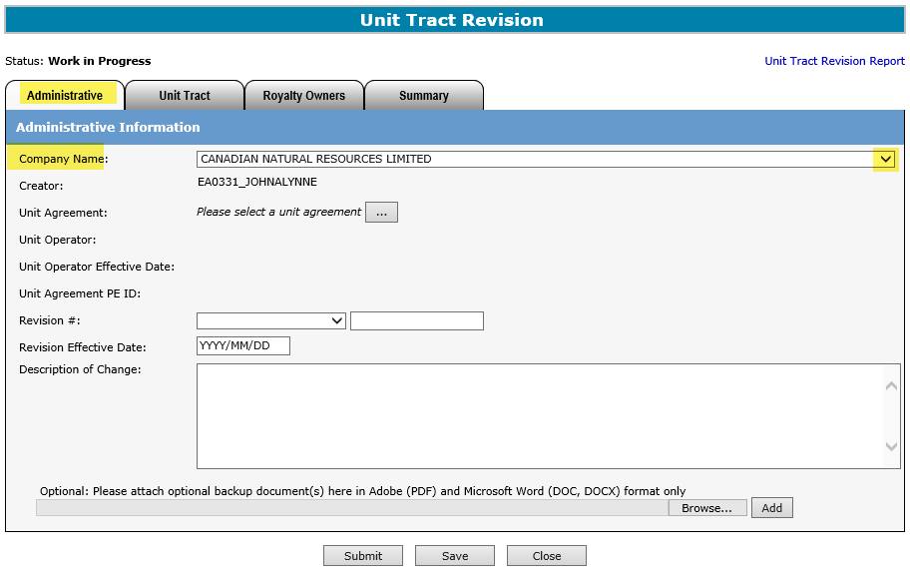

Unit Agreement Exhibit A
Government of Alberta
UNIT TRACT CORRECTION – ADMINISTRATIVE TAB - REVISION EFFECTIVE DATE
Select Company Name from the dropdown
A new Unit Tract Revision request must be created in order to process Correction.
The Administrative tab is required in order to proceed to any of the correction type.
Page 6 of 14

Slide 7
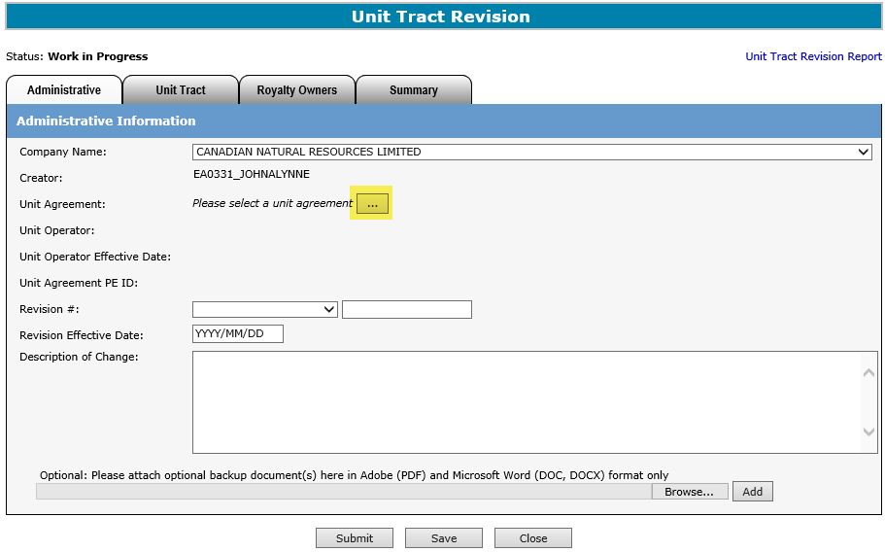
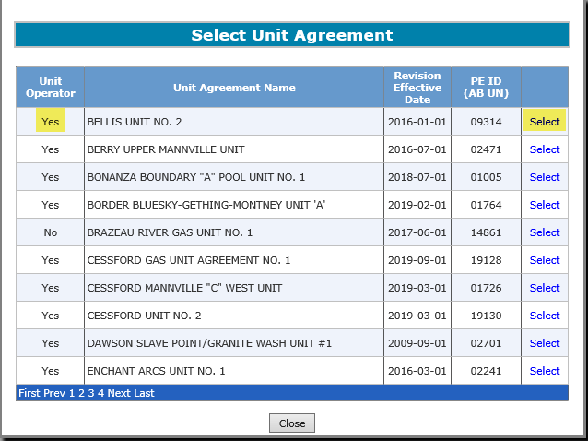
Unit Agreement Exhibit A
Government of Alberta
UNIT TRACT CORRECTION – ADMINISTRATIVE TAB – REVISION EFFECTIVE DATE
2. Click Select
1. Click to to search Unit Agreement
The Unit Operator, Unit Agreement Name, Revision Effective Date and PE ID columns can be sorted in Ascending or Descending order by clicking on the column title.
Page 7 of 14

Slide 8
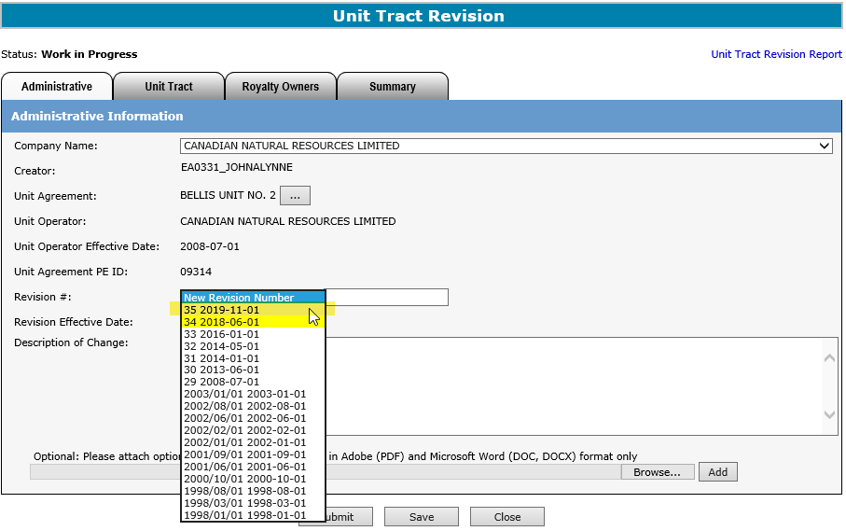
Unit Agreement Exhibit A
Government of Alberta
UNIT TRACT CORRECTION – ADMINISTRATIVE TAB – REVISION EFFECTIVE DATE
From the Revision # dropdown, select the current revision.
The Revision Effective Date can only be corrected on the current revision.
Correction of Revision Effective Date to an older (and within the open year) revision is submitted manually.
Please email EnergyUnitsHelpdesk@gov.ab.ca for manual submission.
Page 8 of 14

Slide 9
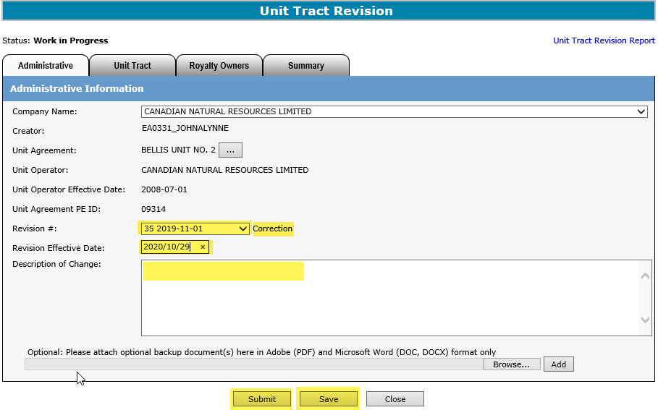
Unit Agreement Exhibit A
Government of Alberta
UNIT TRACT CORRECTION – ADMINISTRATIVE TAB – REVISION EFFECTIVE DATE
Once the current revision is selected, the indicator, “Correction” appears
1. Enter the correct Revision Effective Date
2. Enter Description of the correction
4. Click Submit
3. Click Save
If the correction is only for Revision Effective Date, the request can be submitted at this point.
If the correction is for Working Interest Owner, Royalty Owner, Share of Working Interest % and/or Share of Tract Participation %, then proceed to the appropriate tab after clicking Save.
Page 9 of 14

Slide 10
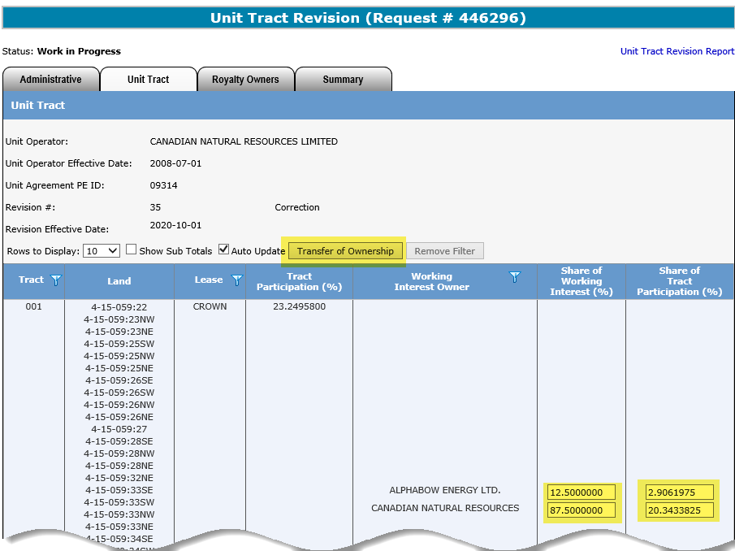
Unit Agreement Exhibit A
Government of Alberta
UNIT TRACT CORRECTION – UNIT TRACT TAB – WORKING INTEREST OWNER (WIO) & SHARE OF INTEREST %
Use Transfer of Ownership if correcting both WIO and %.
(You can…) Modify the Share of Interest % on this grid for any specific tract
To correct a WIO, you must use Transfer of Ownership.
To correct Share of Interest %, you can either use the Transfer of Ownership or update any specific tract on the main grid.
Refer to Unit Tract Revision module for steps from the Online Learning portal.
Page 10 of 14

Slide 11
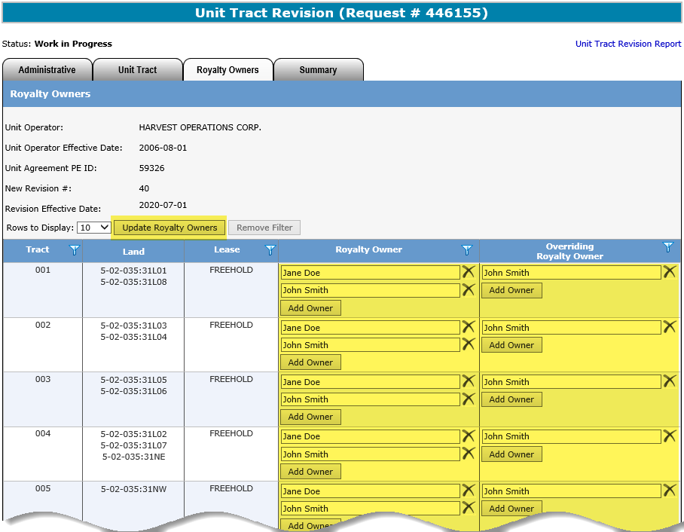
Unit Agreement Exhibit A
Government of Alberta
UNIT TRACT CORRECTION – ROYALTY TAB – ROYALTY OWNERS
To correct a Royalty Owner, you can either use the Update Royalty Owners or update any specific tract on the main grid.
Refer to Unit Tract Revision module for steps from the Online Learning portal.
Page 11 of 14

Slide 12
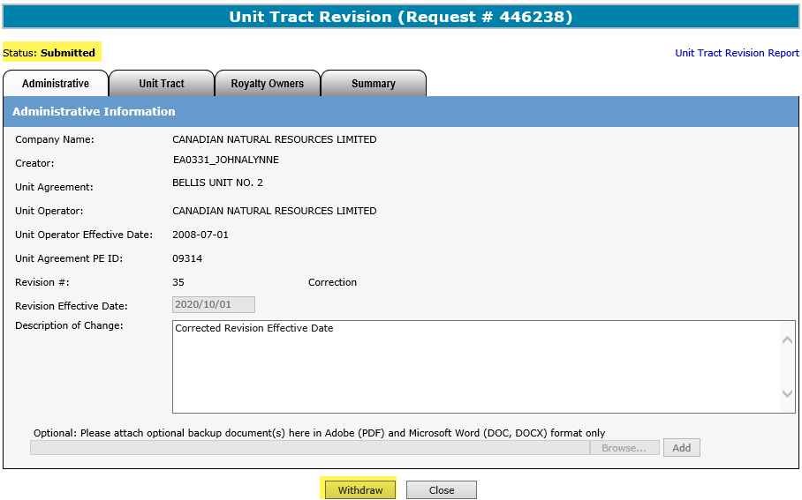
Unit Agreement Exhibit A
Government of Alberta
UNIT TRACT CORRECTION – SUBMITTED
Once the correction is submitted, Withdraw option is enabled. You can choose to withdraw the request at this point.
However, once the status is changed from Submitted to Completed, the withdraw option is no longer available.
Page 12 of 14

Slide 13
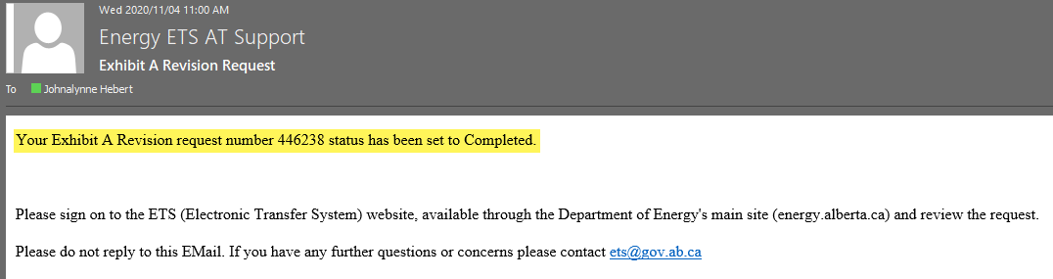

Unit Agreement Exhibit A
Government of Alberta
UNIT TRACT CORRECTION – EMAIL NOTIFICATION
An email notification is sent to the creator indicating that the request is now Completed.
Once this email notification is received, the next step is to generate the Exhibit A report.
Refer to Reports module available in our Online Learning portal.
The Unit Operator is responsible in preparing and distributing the same copy of the revised Exhibit A created in ETS to all unit parties including Alberta Energy Regulator.
Page 13 of 14

Slide 14

Unit Agreement Exhibit A
Government of Alberta
CONCLUSION
Congratulations!
You have completed the
Unit Agreement Exhibit A
Unit Tract Correction
Online Training Course
If you have any comments or questions on this training course,
please forward them to the following email address:
EnergyUnitsHelpdesk@gov.ab.ca
Page 14 of 14

