Slide 1
Unit Agreement Exhibit A
Government of Alberta
Welcome!
to the
ETS – Unit Agreement Exhibit A
Reports
Online Training Course
The purpose of this course is to provide guidance and information to ETS clients who need to generate the Unit Agreement Exhibit “A” Reports.
Page 1 of 14

Slide 2
Unit Agreement Exhibit A
Government of Alberta
Revision Page
Revisions Table
Date | Revisions Type | Page Number
March 7, 2016 | Initial Creation | All
November 9, 2020 | Update headers and contents | All
Page 2 of 14

Slide 3
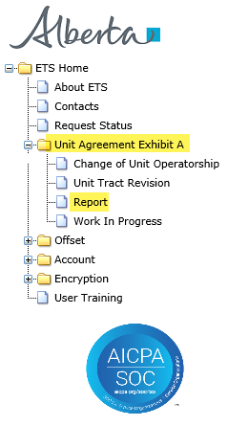
Unit Agreement Exhibit A
Government of Alberta
INTRODUCTION
In this module, you will learn how to:
submit and view Exhibit “A” Reports (Part I and Part II)
Note:
User must have both a Submitter and Viewer Role for this Form Type.
Prerequisite Learning Module
Before proceeding, we recommend that you view the Unit Agreement Exhibit A Roles module located in the Online Learning portal.
Page 3 of 14

Slide 4
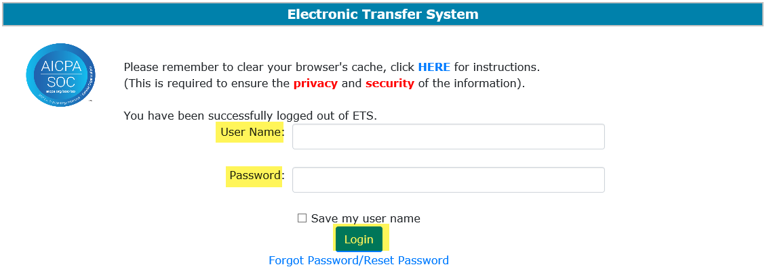
Unit Agreement Exhibit A
Government of Alberta
UNIT AGREEMENT EXHIBIT A – LOGIN – UNIT TRACT REVISION
2. Expand Unit Agreement Exhibit A
1. Login to ETS with your User Name and Password
3. Select Report
Page 4 of 14

Slide 5
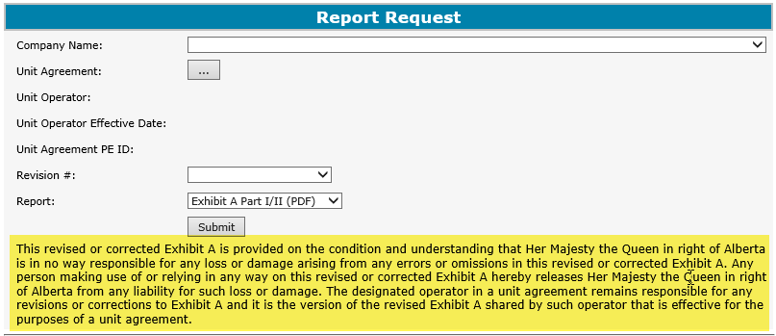

Unit Agreement Exhibit A
Government of Alberta
REPORT – DISCLAIMER
The Unit Operator is responsible for the dissemination of a revised Exhibit A to all unit parties including Alberta Energy Regulator.
Page 5 of 14

Slide 6
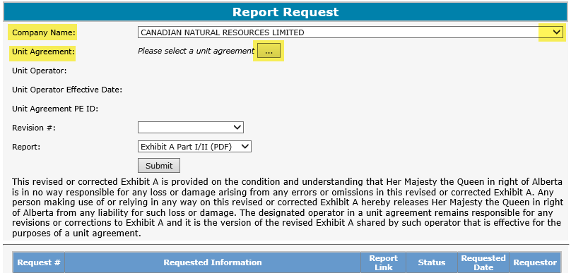
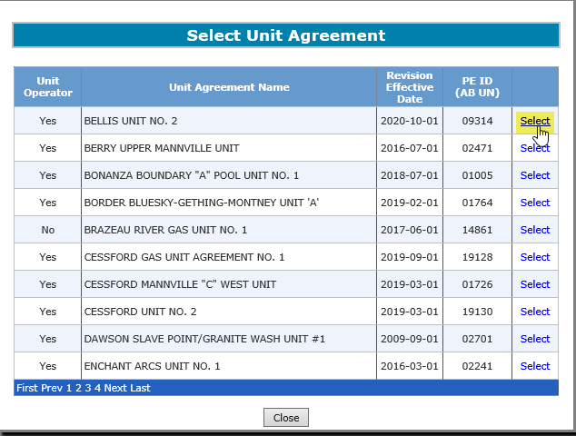
Unit Agreement Exhibit A
Government of Alberta
REPORT – COMPANY NAME AND UNIT AGREEMENT
1. Click dropdown to add Company Name
2. Click dropdown to add Unit Agreement
3. Click Select
The Company Name dropdown displays all companies associated to the ETS account login.
Unit Operator or Working Interest Owner of the selected Unit Agreement can submit and view the report request provided that they have an ETS Account.
Page 6 of 14

Slide 7
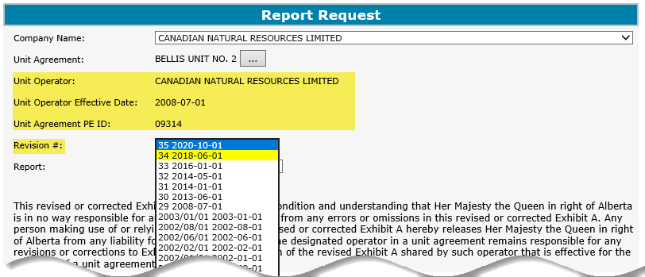
Unit Agreement Exhibit A
Government of Alberta
REPORT – REQUEST – REVISION #
Once a unit agreement is selected, these fields are automatically filled in.
1. Choose a Revision # number to generate.
Any Revision # highlighted in yellow is an indication that this revision is in the open years.
Page 7 of 14

Slide 8
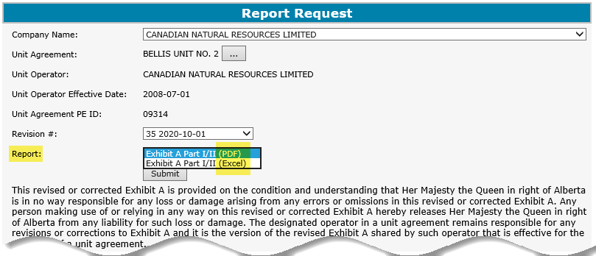
Unit Agreement Exhibit A
Government of Alberta
REPORT – FORMAT
1. Select the report format, either PDF or Excel
PDF report format (recommended) is best for disseminating to all parties involved.
Excel report format is best for working copy.
Page 8 of 14

Slide 9
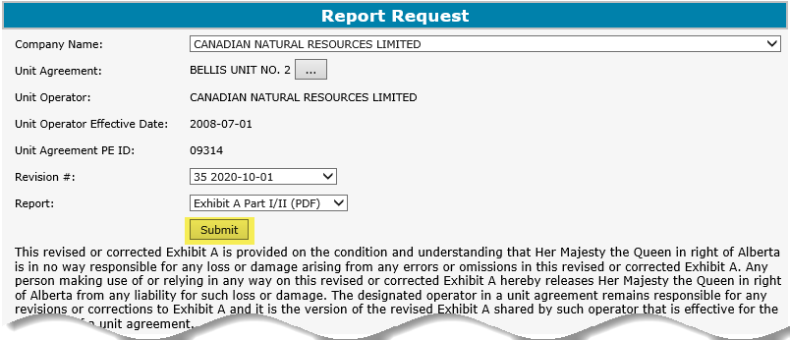
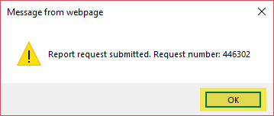
Unit Agreement Exhibit A
Government of Alberta
REPORT – SUBMIT
1. Click Submit
2. Click OK
Page 9 of 14

Slide 10
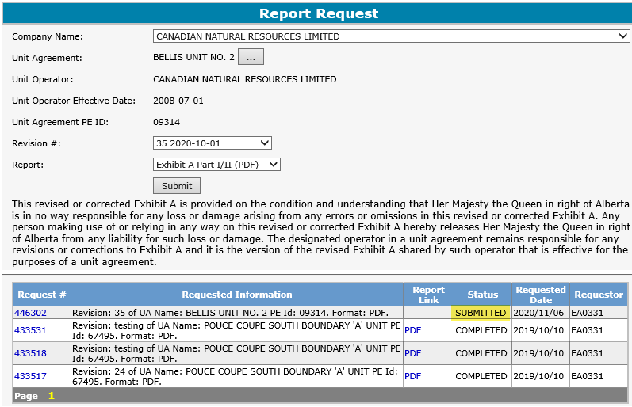
Unit Agreement Exhibit A
Government of Alberta
REPORT – WORK IN PROGRESS
Status changed to Submitted.
The Report Request has its own Work In Progress grid. This include history of all previous requests.
To refresh the grid, click back out of the Report node on the menu tree onto any other node and then click back to the Report node.
Page 10 of 14

Slide 11
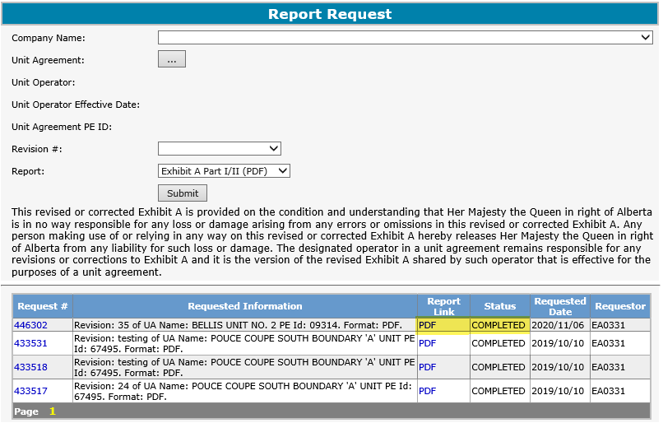
Unit Agreement Exhibit A
Government of Alberta
REPORT – COMPLETED
Once the request is completed, a link is available under Report Link, depending on the report format chosen.
Click the PDF report link to open the report.
Unit Operator is responsible in preparing and distributing the same copy of the revised Exhibit A Part I and II generated from ETS to all unit parties including Alberta Energy Regulator.
Page 11 of 14

Slide 12
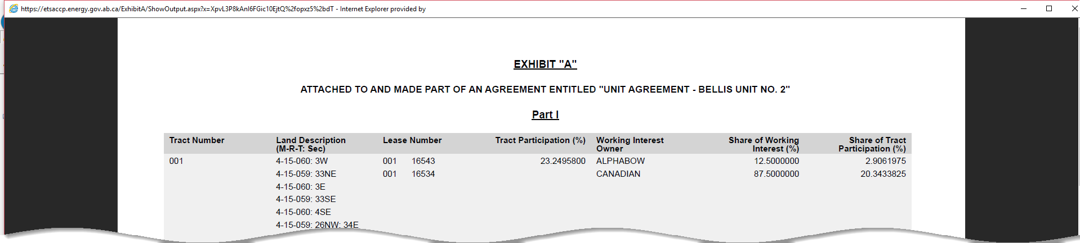
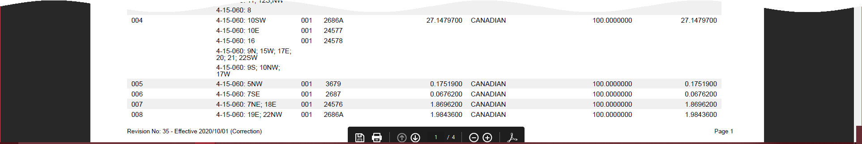
Unit Agreement Exhibit A
Government of Alberta
REPORT – REPORT IN PDF FORMAT SAMPLE
The PDF report is open in your default web browser. Click the Adobe icon below to open this report in Adobe.
Page 12 of 14

Slide 13
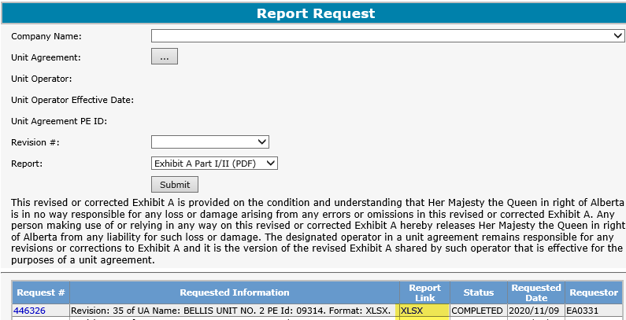
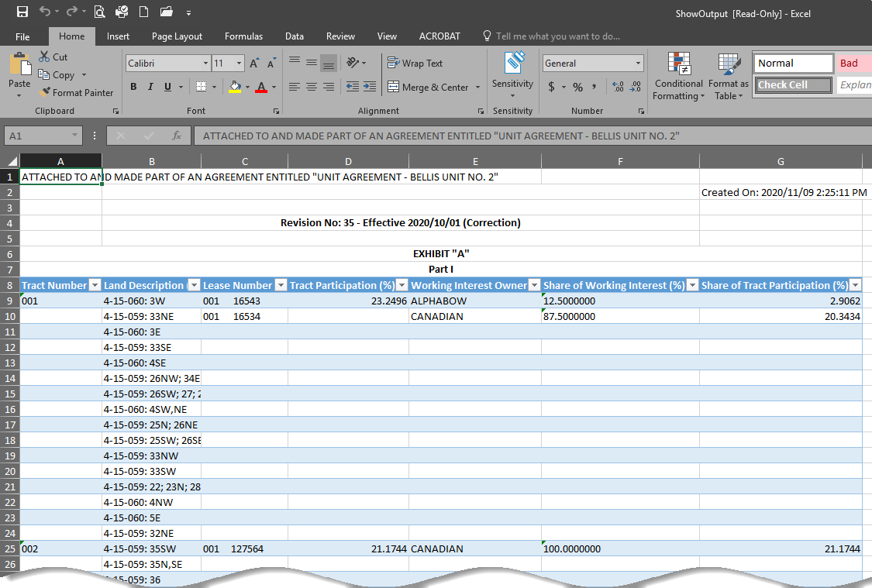
Unit Agreement Exhibit A
Government of Alberta
REPORT – REPORT IN EXCEL FORMAT SAMPLE
Note that in Excel format, the page setup will require adjustment if this is going to be printed.
Page 13 of 14

Slide 14

Unit Agreement Exhibit A
Government of Alberta
CONCLUSION
Congratulations!
You have completed the
Unit Agreement Exhibit A
Report
Online Training Course
If you have any comments or questions on this training course,
please forward them to the following email address:
EnergyUnitsHelpdesk@gov.ab.ca
Page 14 of 14

