Slide 1
Welcome
Welcome!
The Transfers program is an online service that will enable clients to submit electronically, the transfer of registered interest in Crown petroleum and natural gas, oil sands, coal, metallic and industrial minerals, using a web interface. Transfer of Ownership During the life of petroleum and natural gas agreements, registered ownership in Crown agreements can change due to acquisition and divestiture activities that occur in industry. When ownership changes occur, the new registered interest is recorded in the records of Alberta Energy. This ensures the most current ownership is in place for proper collection of Crown royalties, and provides up-to-date information to industry that allows them to know who to approach if they want to proceed with development in any particular area of the Province.
To the ETS – Transfer Overview
Online Training Course

Slide 2
Revisions
Date | Revisions Type | Page Number
August 31, 2012 | Conversion | All
April 2020 | Cosmetic Updates | All
April 2020 | Website Update | Slide 4

Slide 3

Introduction
In this module, you will learn about:
Transfers - ETS Account
Transfers Roles
Transfers Lifecycle
We recommend that you view the common training module before proceeding to the other Transfers training modules:
ETS Account Setup and Preferences (For Site Administrators)

Slide 4
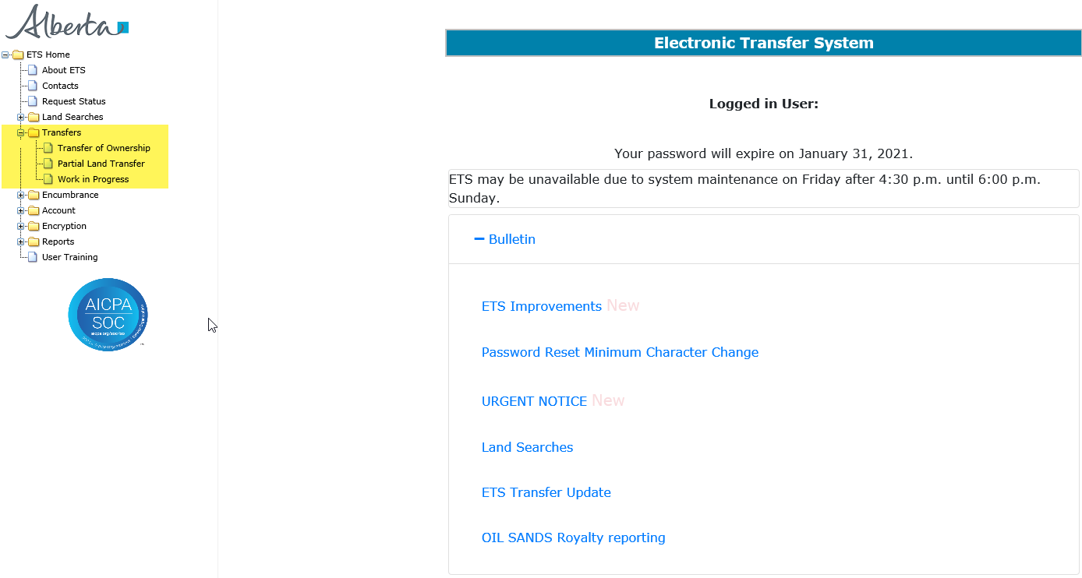
ETS Account
Transfers is one of many online services, which the Electronic Transfer System (ETS) handles. ETS is accessed through the following website.
https://www.alberta.ca/alberta-energy-online-services.aspx In order for a company to participate in the electronic transfer process, a company must have an ETS Account. The Site Administrator for a company is responsible for creating Client Accounts and administrating the level of access to ETS based on the role an individual has within the company.

Slide 5
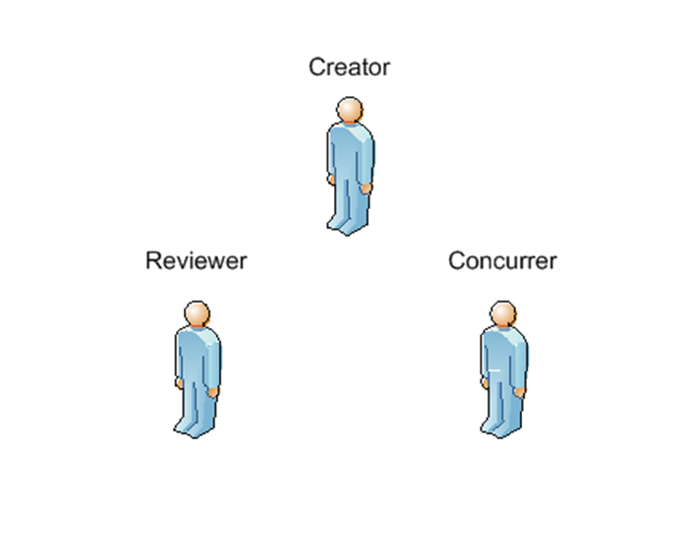
Roles
In order for a Client Account (Individual Account) to access the Transfers functionality on the ETS web site, the Site Administrator must first assign a role to the Client Account. These are the roles for Transfers: Creator - The client can create and cancel a Transfer request in ETS. Reviewer - The client can review and change the transfer status to Concurrence for the company. Concurrer - The client concur or reject a Transfer request to which it is a party.
For more information please review the following training module:
ETS Account Setup and Preferences (For Site Administrators)

Slide 6
Transfers Lifecycle
The electronic Transfers Lifecycle encompasses all transactions, documents, and data exchanges associated with the Crown registration of the transfer of the owner's interest in the mineral rights to another party. Electronic notification will be generated by ETS for the approval, rejection, or cancellation of a transfer request.

Slide 7
Resources
ETS Support and Online Learning provides access to relevant guides, course and other information
If you have questions, please contact Transfers.Energy@gov.ab.ca or the Transfer Helpdesk at (780)644-2300

Slide 8

Conclusion
Congratulations!
You have completed the ETS – Transfers Overview
Online Training Course
Please proceed to Search Agreements training module detailing other functionality of Transfers. If you have any comments or questions on this training module, please forward them to the following email address: Transfers.Energy@gov.ab.ca

