Slide 1
Welcome
Welcome!
The Search Agreements functionality in Transfers enables you to find existing agreements pertaining to registered interests.
Using the search results, you can select the agreements and request for a transfer of ownership to another party.
To the ETS – Search Agreements
Online Training Course

Slide 2
Revisions
Date | Revisions Type | Page Number
August 31, 2012 | Conversion | All
April 2020 | Updates | All
November 2022 | Update | Includes Geothermal Agreements

Slide 3

Introduction
In this module, you will learn how to:
Search by Agreement Type and Number
Search by Agreement Type and Number using your own Input File
Search by Client ID (10-digit)
Find Client ID (by name or 7-digit client ID)
Display Agreements Found

Slide 4
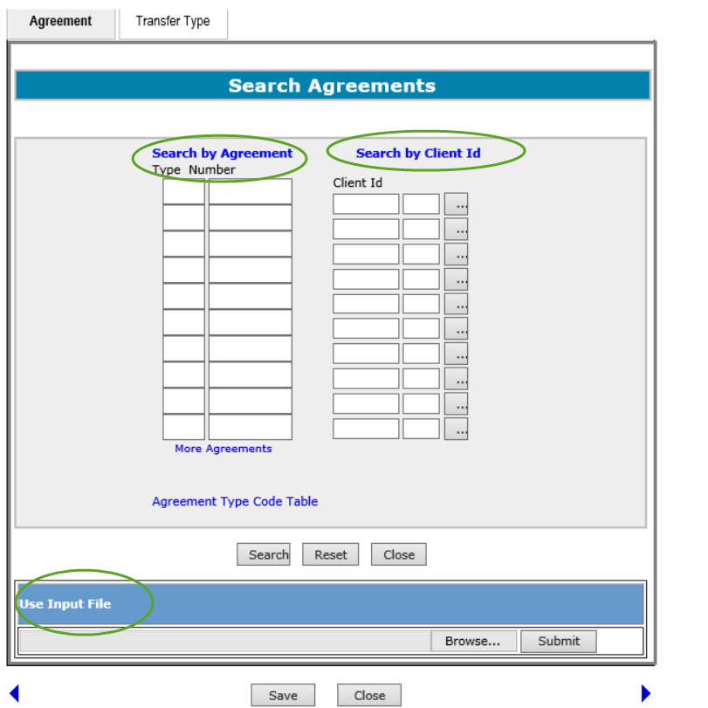
Search Agreements Options
You can search agreements using the following options:
Agreement Type and Number
Client ID
You may search by one or all of the above options. Selection of multiple options will refine your search criteria.
In addition, you can also import your own file that contains the list of agreements you want to search on.
Agreement numbers include PNG, Oil Sands, Coal and Mineral Development as well as Geothermal agreements.

Slide 5
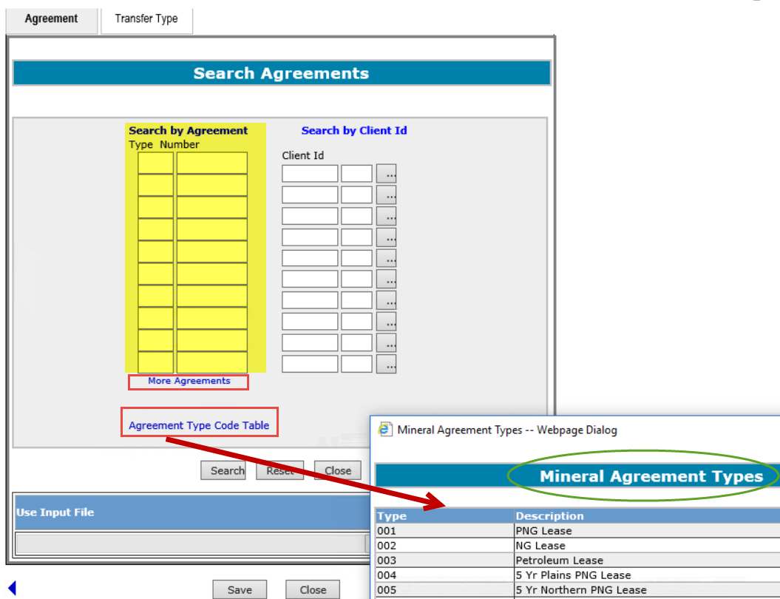
Search Agreements by Agreement Type and Number
More Information (Pages 6 to 11)
Use this option when you know the Agreement Type and Number. You may enter only the agreement number and leave the 3 digit agreement type blank. If there is more than one agreement type with that number, the search results will display all the activity types matching that number. To obtain an exact match, you need to enter both the agreement type and the agreement number.
Clicking on the More Agreements link will display 10 more rows of agreement type and number boxes. You may enter up to 100 agreements in the Search by Agreement option.
The Agreement Type Code Table link shows a complete listing of all agreement type codes.
Click on More Information to view how to search by agreement type and number.

Slide 6
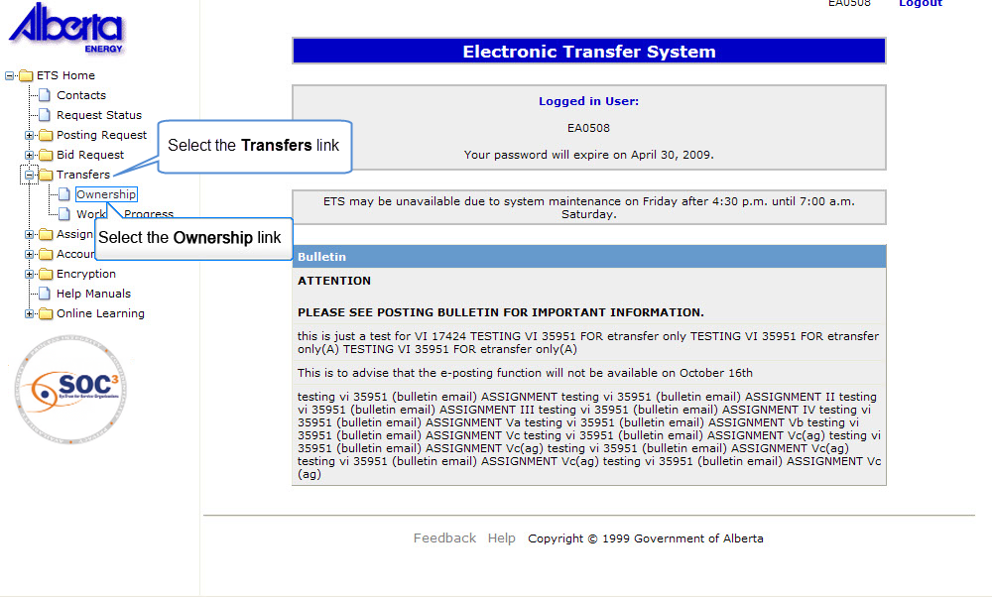

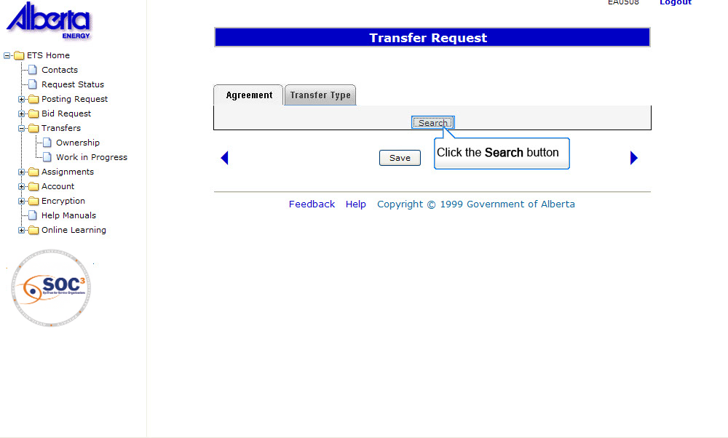
SA by ATN
Back to Search Agreements by Agreement Type and Number

Slide 7
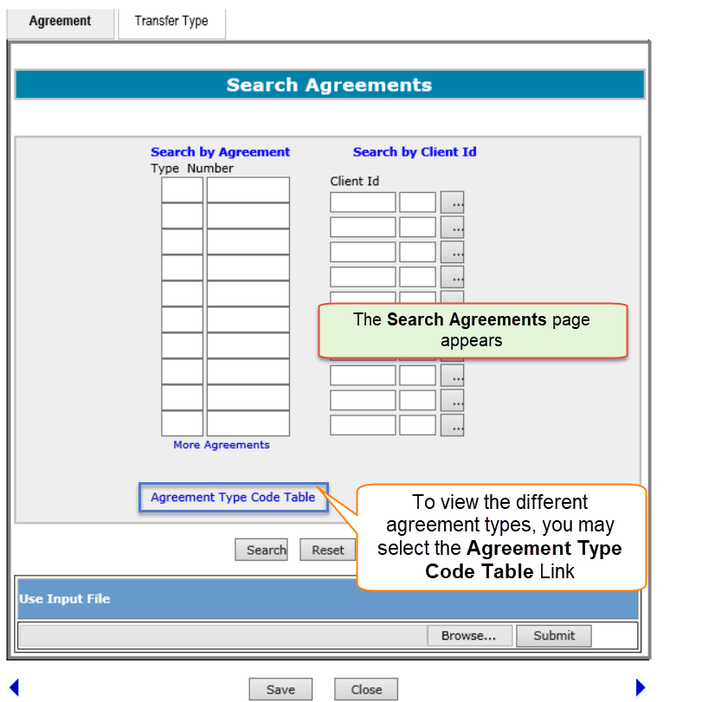
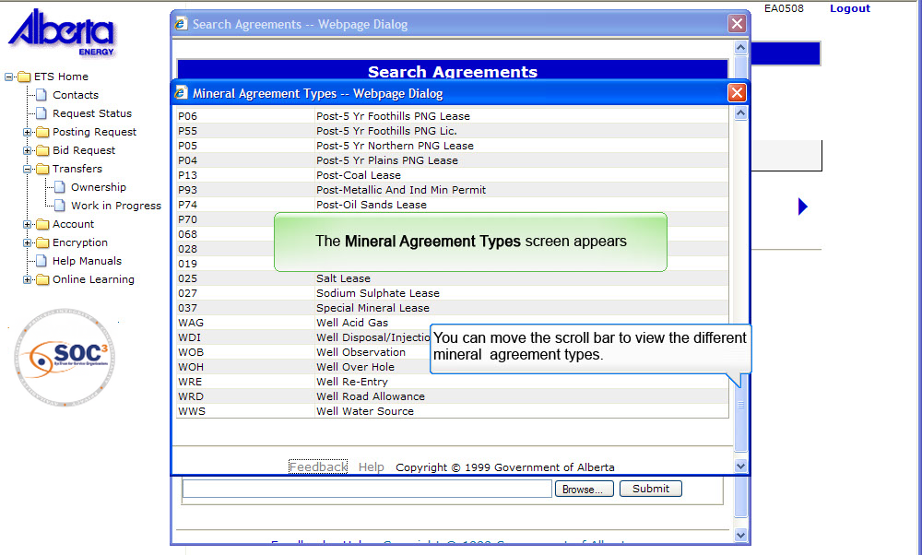
SA by ATN
Back to Search Agreements by Agreement Type and Number

Slide 8
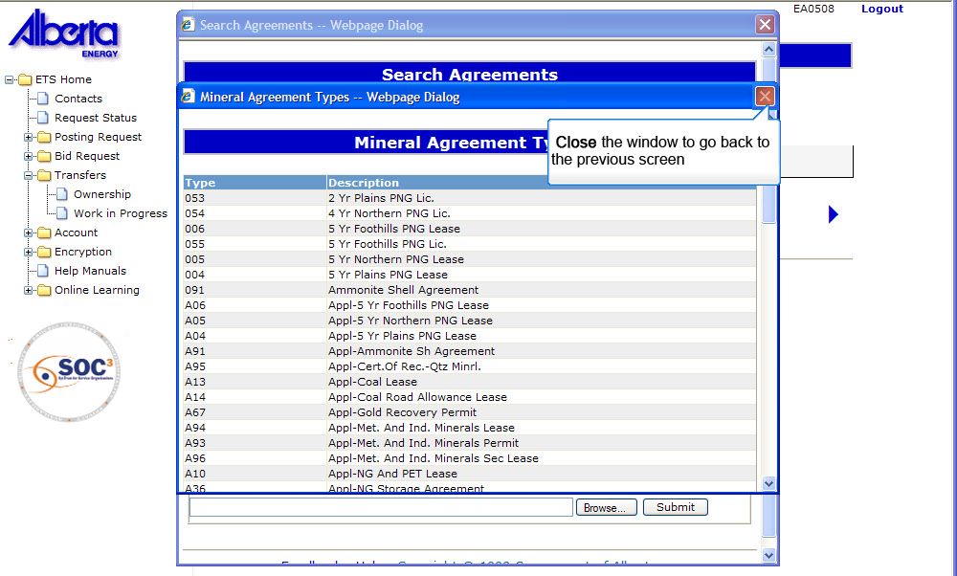
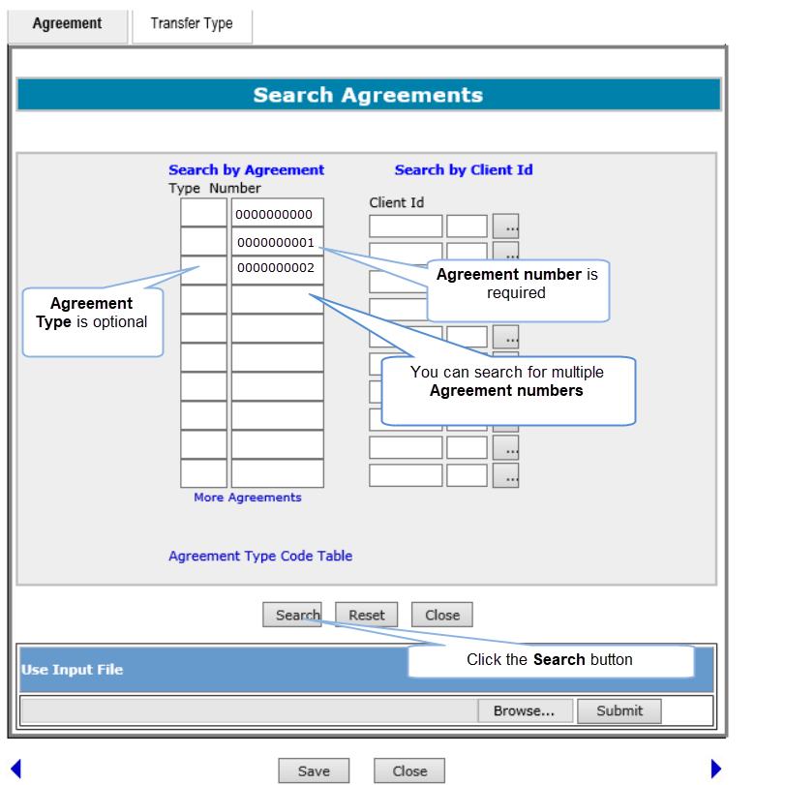
SA by ATN
Back to Search Agreements by Agreement Type and Number

Slide 9
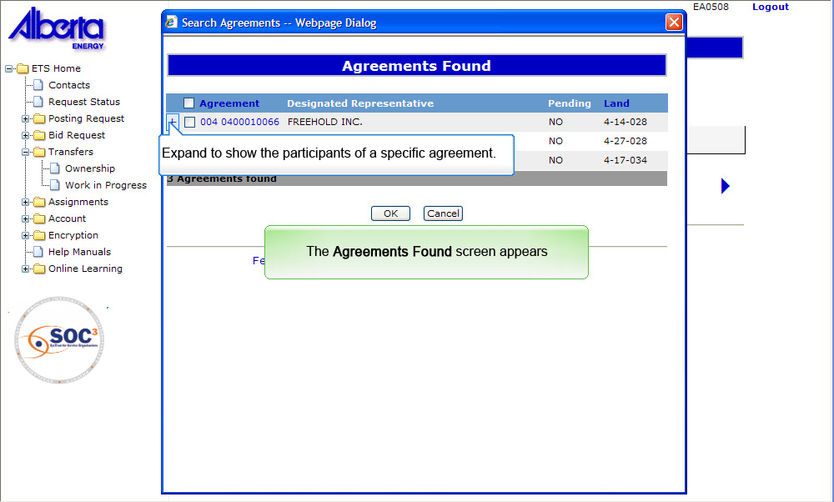
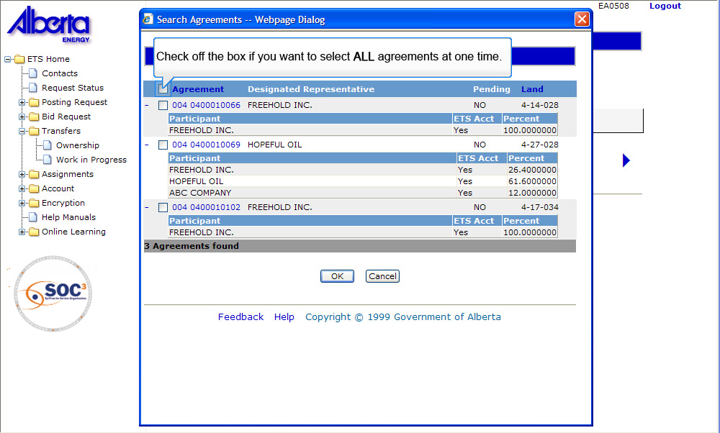
SA by ATN
Back to Search Agreements by Agreement Type and Number

Slide 10
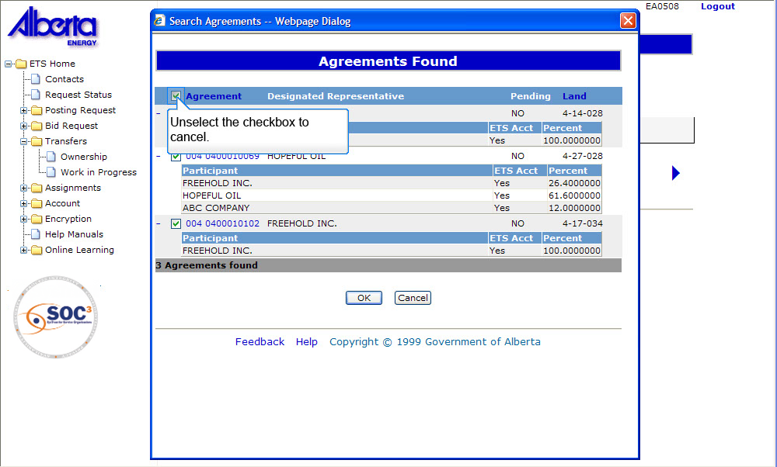
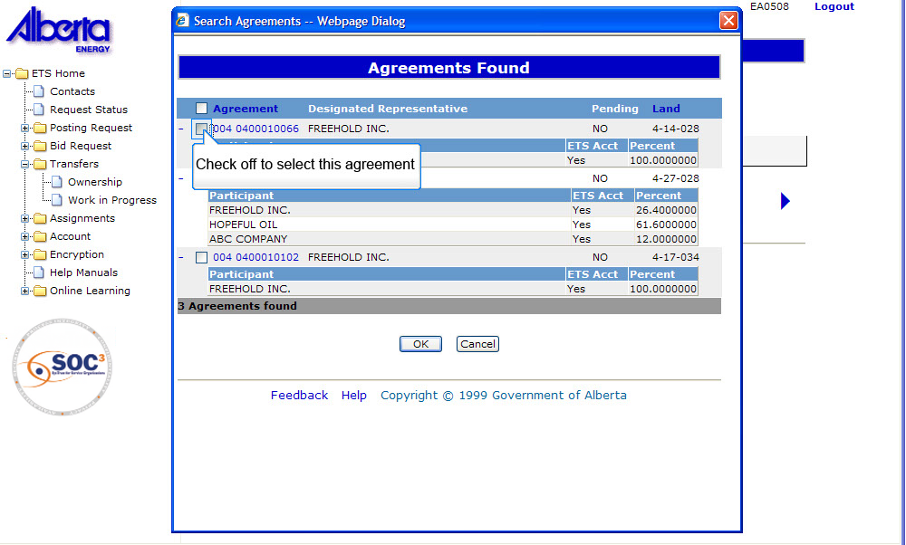
SA by ATN
Back to Search Agreements by Agreement Type and Number

Slide 11
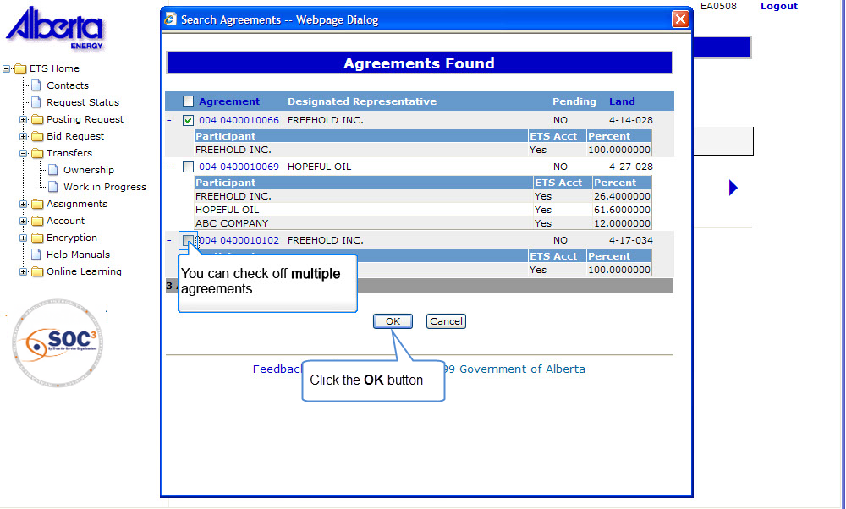
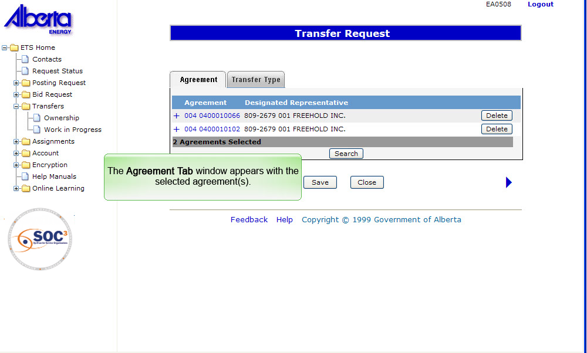
SA by ATN
Back to Search Agreements by Agreement Type and Number

Slide 12
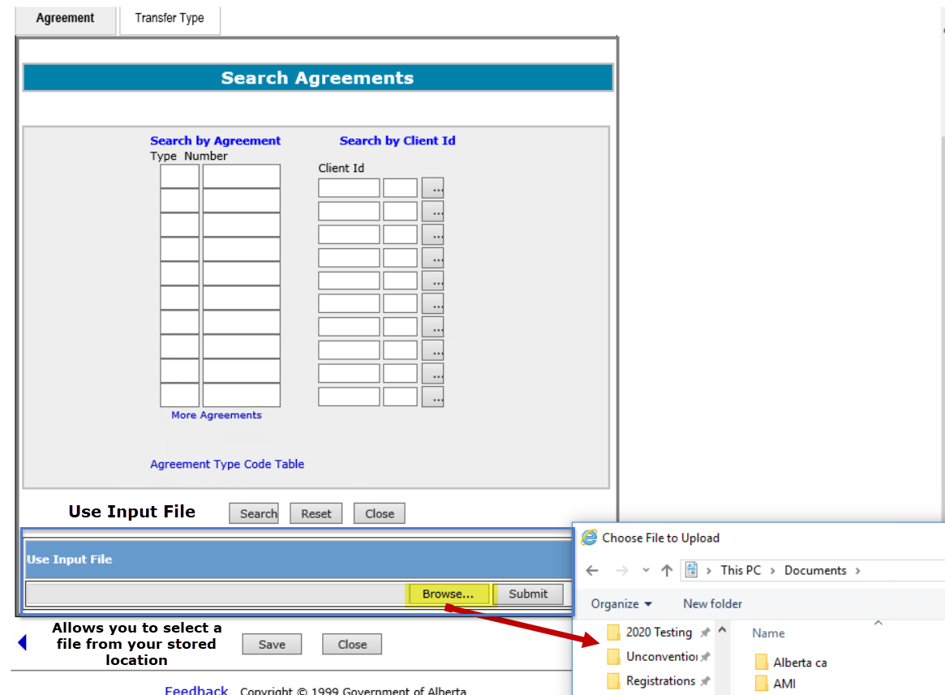
Search Agreements using Input File
More Information (Pages 13 to 16)
To help you save data entry time, you can import your own file that contains your list of agreements to be transferred. The list MUST follow a pre-defined format as follows:
The first line is called the header line and it must be TYPE,NUMBER.
The successive lines after the header line must follow the format: 3 digit agreement type, a comma, and agreement number.
Example:
    TYPE,NUMBER
    004,0495070093
    071,7196020386
    001,123456
The input file should be a text file (.TXT) and can contain either lowercase or uppercase letters.
Click on More Information to view how to search agreements using an input file.
TIP: Saving your file in a text format using Notepad will create the proper file format.

Slide 13
SAIF
Back to Search Agreements using Input File

Slide 14
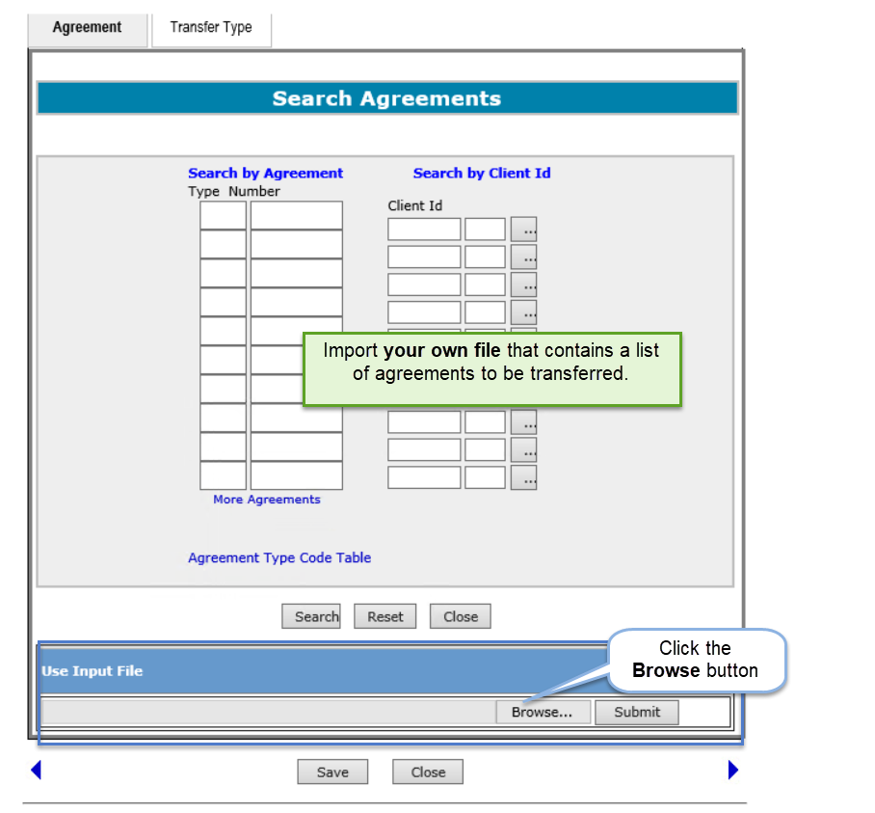
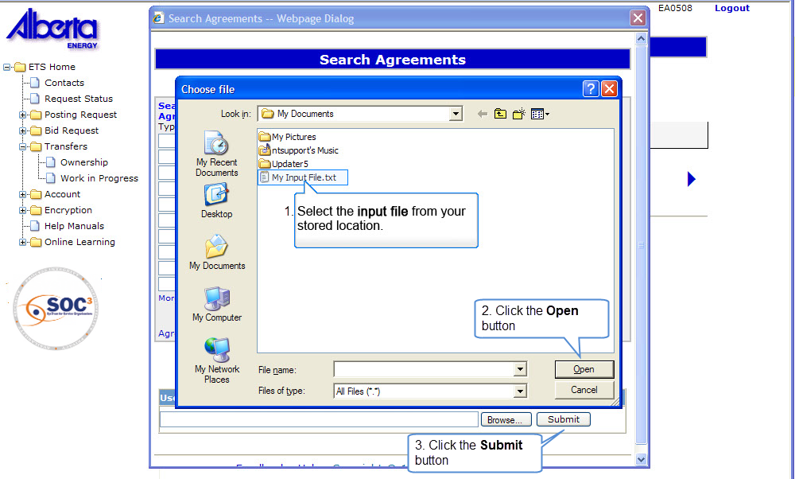
SAIF
Back to Search Agreements using Input File

Slide 15
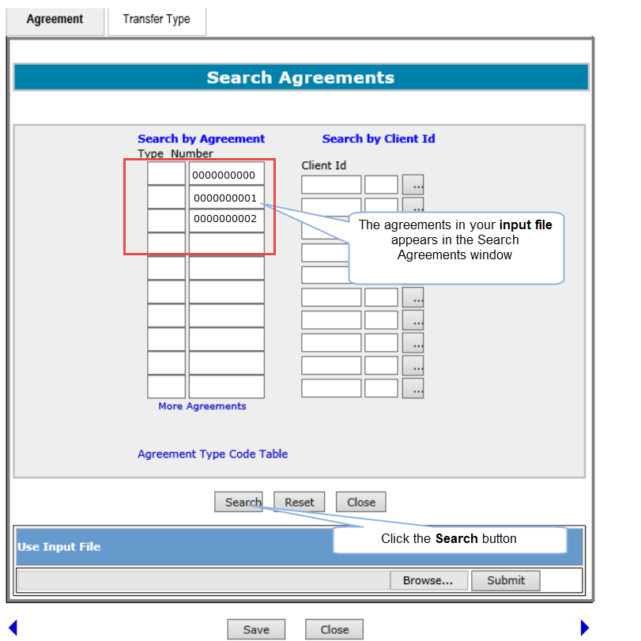
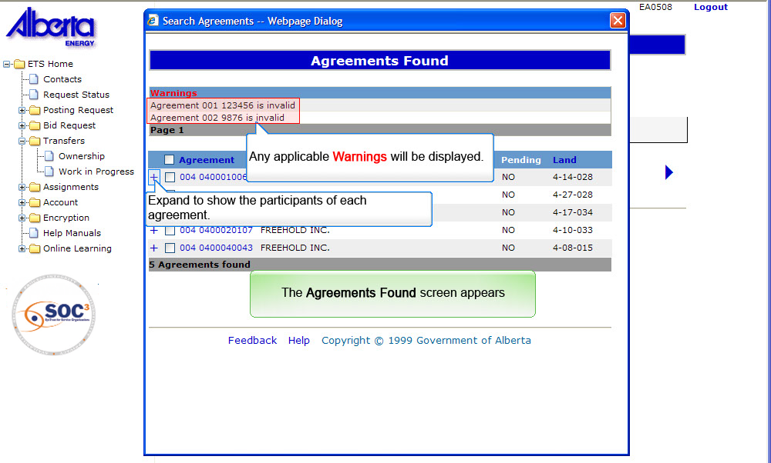
SAIF
Back to Search Agreements using Input File

Slide 16
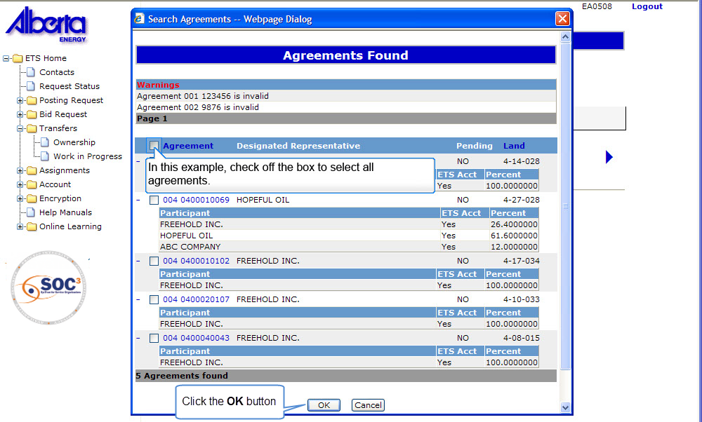
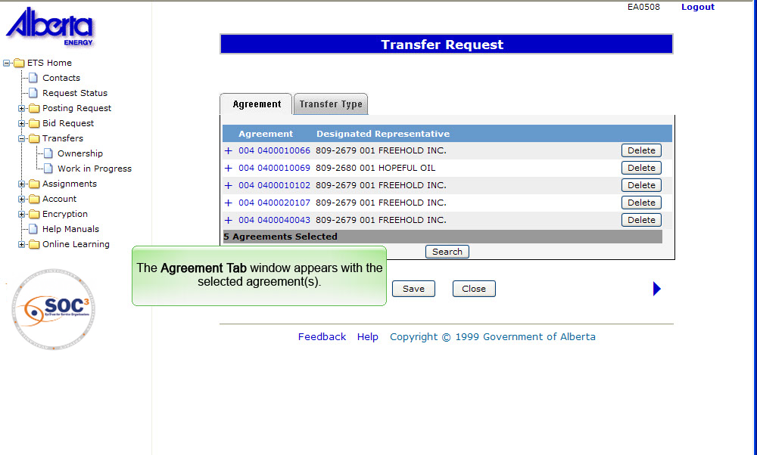
SAIF
Back to Search Agreements using Input File

Slide 17
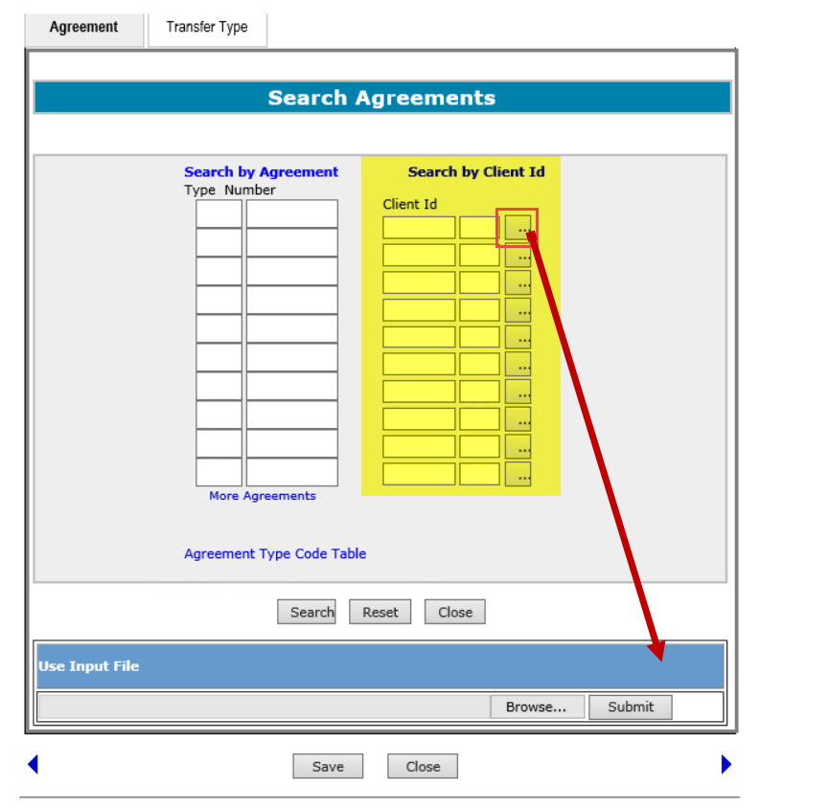
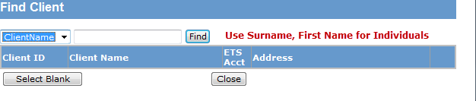
Search Agreements by Client ID
More Information (Pages 18 to 20)
Use this option when you know the 10-digit Client ID. The Client ID consists of the 7 digit Client ID and the 3 digit address code.
i.e. 8029377-001
8029377 is the 7 digit client Id for Company A
001 is the 3 digit address code for Company A
Find Client: Use this option if you do not know the Client ID. This takes you to the Find Client screen, which provides you with a field to enter the client’s name.
Click on More Information to view how to search by client ID.

Slide 18
SACID
Back to Search Agreements by Client ID

Slide 19
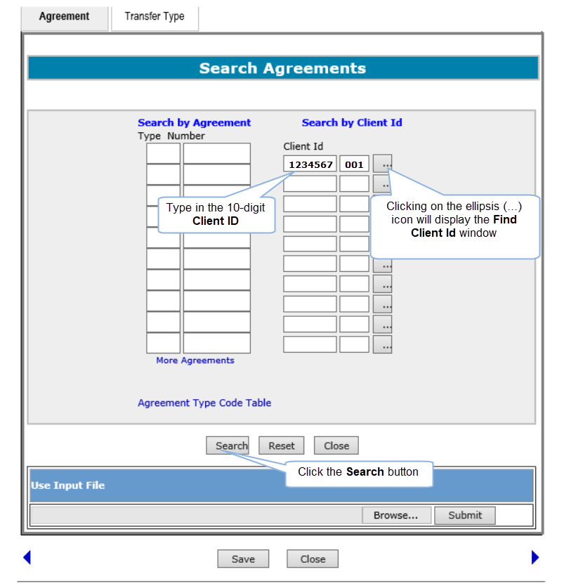
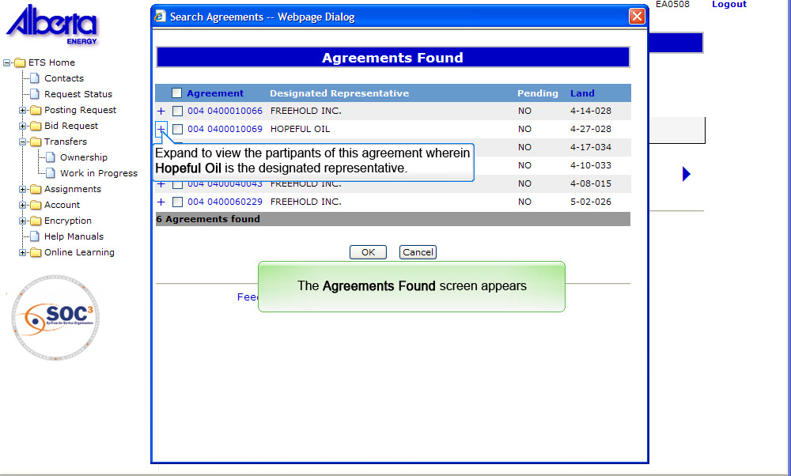
SACID
Back to Search Agreements by Client ID

Slide 20
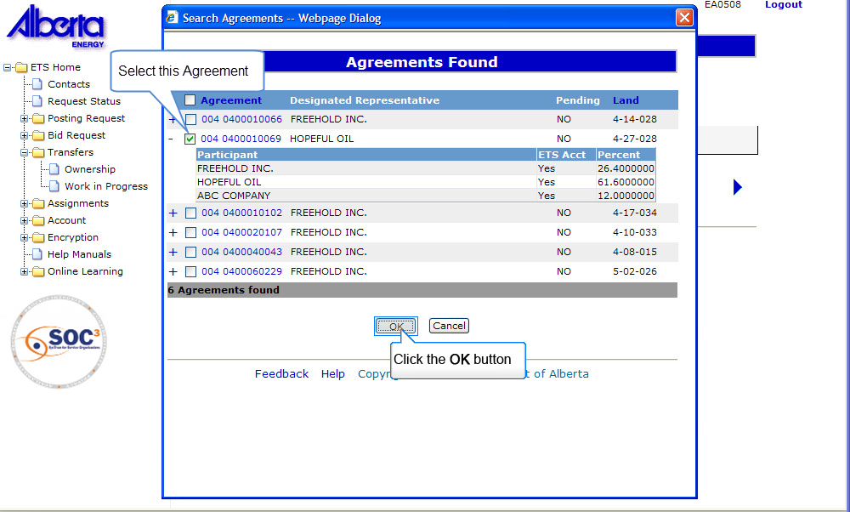
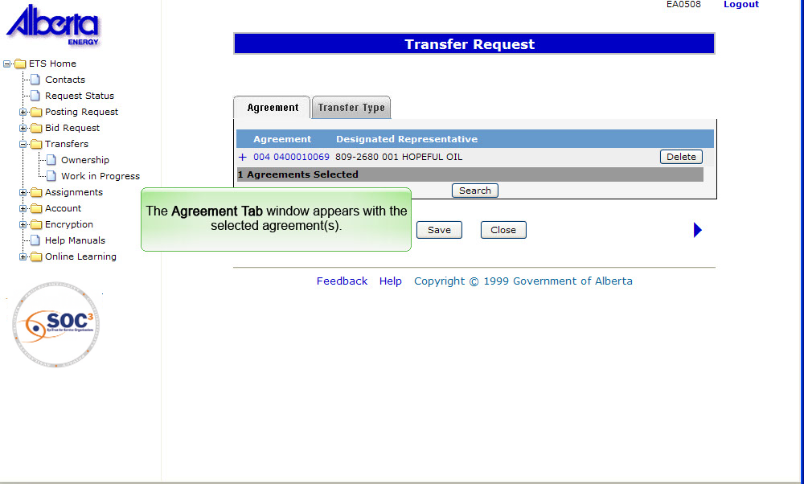
SACID
Back to Search Agreements by Client ID

Slide 21
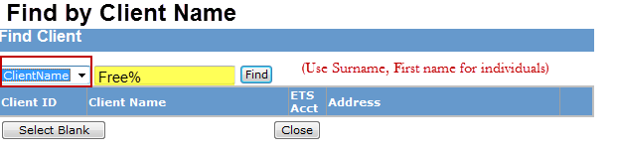
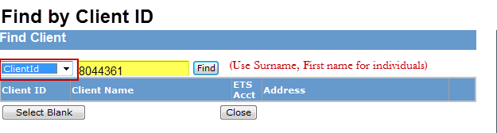
Search Agreements by Client ID using Find Client Screen
More Information (Pages 22 to 26)
The Find Client screen allows a search by name or by the first 7 digits of the client ID, if you do not know the client’s address code.
Find by Client Name. This option allows you to find the client ID by specifying a client name. You can enter the first 4 characters of the client’s name to begin the search.
Find by Client ID. This option allows you to find the full client ID (10-digit) using the first 7 digits of the client ID in the search.
Click on More Information to view how to find client.
Tip: Click the dropdown arrow to select between Client Name and Client ID.

Slide 22
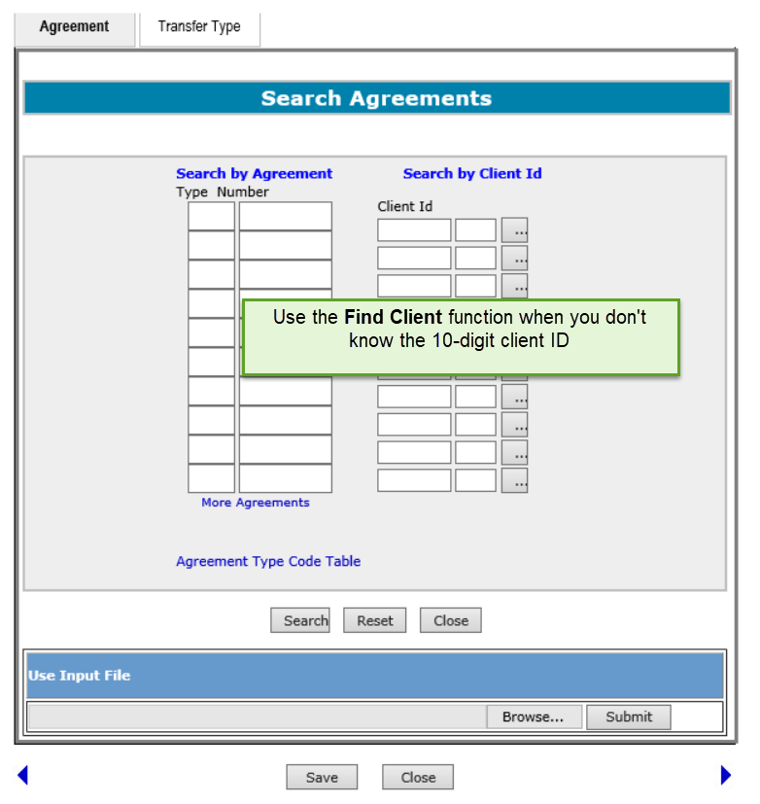
SACIDFCS
Back to Search Agreements by Client ID using Find Client Screen

Slide 23
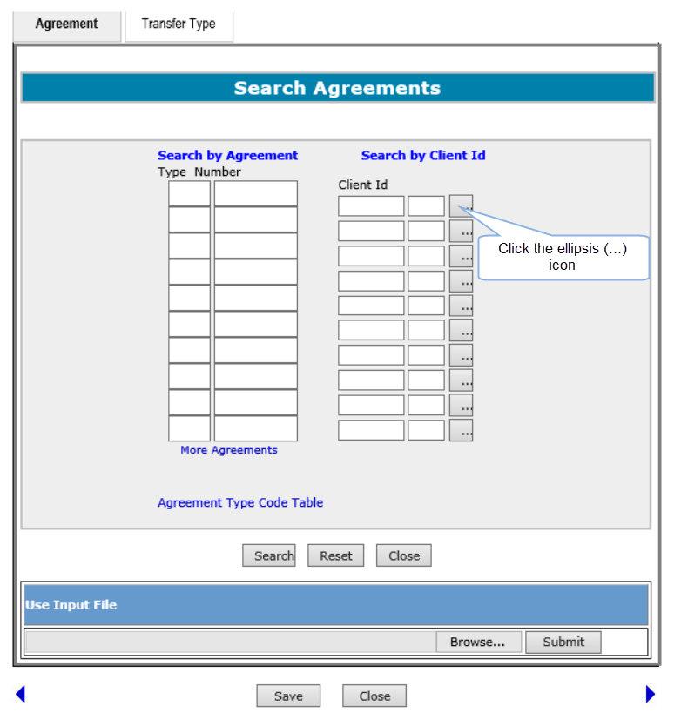
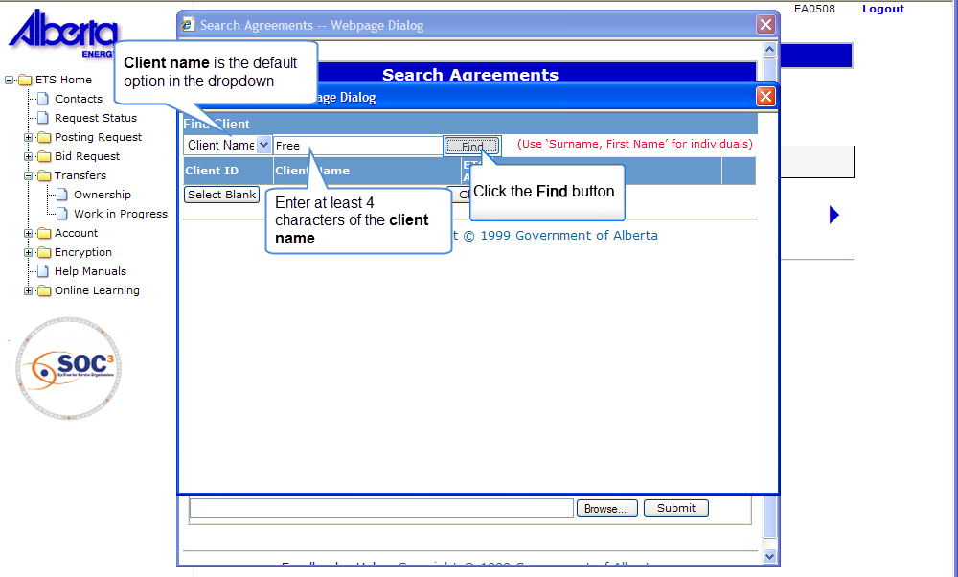
To Find Client ID using a Client’s Name
Back to Search Agreements by Client ID using Find Client Screen

Slide 24
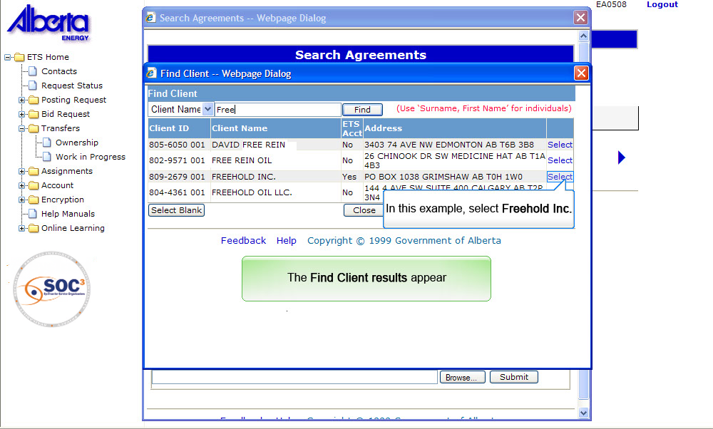
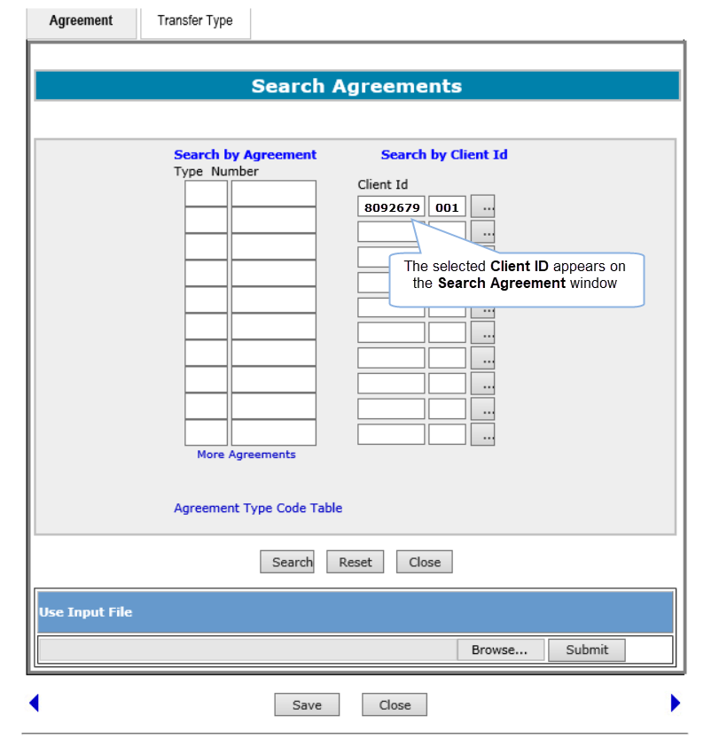
SACIDFCS
Back to Search Agreements by Client ID using Find Client Screen

Slide 25
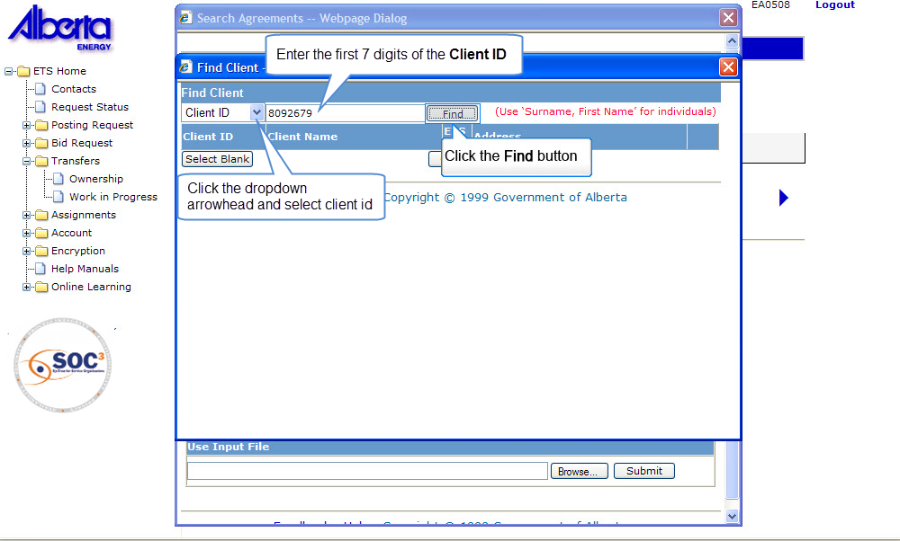
To Find Client ID using the first 7 digits of a Client ID
Back to Search Agreements by Client ID using Find Client Screen

Slide 26
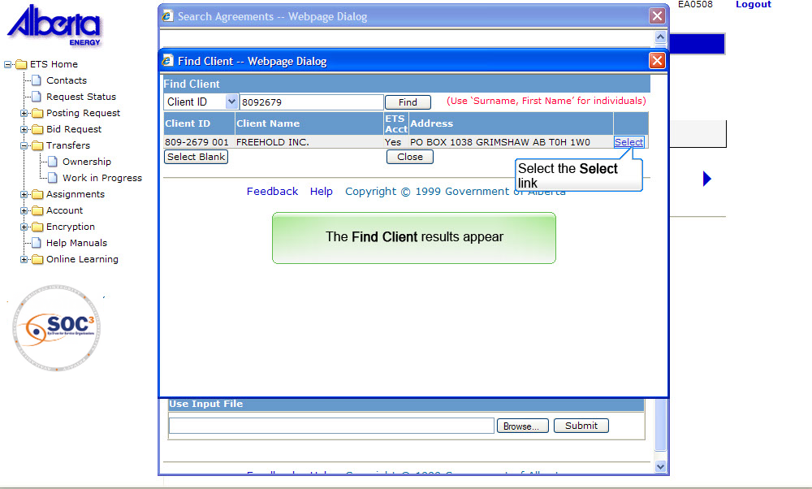
SACIDFCS
Back to Search Agreements by Client ID using Find Client Screen

Slide 27

Search Agreements by Client ID using Find Client Screen (Continued)
The Find Client Results screen will only display ACTIVE clients.
You need to select the client from the Find Client Results screen to populate the Search by Client ID field in the Search Agreements window. In case a client has multiple client IDs, it is important that you select ALL of the client IDs to ensure an accurate search is obtained.
Client ID - The Client ID column displays a list of client IDs that match your selection criteria.
Client Name - The Client Name column displays the corresponding client’s name on our Alberta Mineral Information System
ETS Acct - The ETS Acct column indicates if the client has an ETS account. If the client you select does NOT have an ETS account, inform the specific client to apply for an ETS Account.
Address - The Address column displays the Official Service Address according to the Records of Alberta Energy for each client.
Select - Use the Select link to select the client involved.

Slide 28
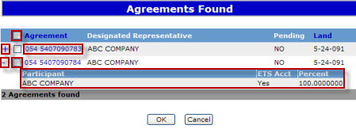
Search Results
The Agreements Found screen will display all the agreements found in ascending Agreement Type and Agreement Number order.
The Pending column indicates if there is a transfer pending for the agreement displayed. A Transferor(s) undivided interest is locked once the transfer is in Pending status. If there is more than one participant in an agreement, transfers can be prepared involving the remaining participants.
If individual transfers are prepared for each participant in an agreement, each participant’s interest will be locked in Pending status.
.
Select All - Putting a check mark in the box at the top of the screen will select ALL agreements.
Agreement Number - To display the Agreement information, click on the agreement number.
Show Details - Clicking on the ‘+’ will show the participant details.
Hide Details - Clicking on the ‘-’ will hide the participant details.
Participant - The participant details include the participant name, whether or not that participant holds an ETS account, and percentage of interest held.

Slide 29
Resources
ETS Support and Online Learning provides access to relevant guides, course and other information
If you have questions, please contact Transfers.Energy@gov.ab.ca or the Transfer Helpdesk at (780)644-2300

Slide 30

Conclusion
Congratulations!
You have completed the ETS – Search Agreements
Online Training Course
Please proceed to Initiate a Transfer module detailing other functionality of Transfers.
If you have any comments or questions on this training module, please forward them to the following email address:
Transfers.Energy@gov.ab.ca

