Slide 1

Welcome
Alberta Energy sends the agreement documents on ETS. The following week on the Friday. An email is sent to the Designated Representative indicated on the bid request or the Direct Purchase application.
The Designated Representative is the company or person who is designated as the representative of the agreement, and will receive all correspondence and notices issued by the department for that agreement. Note: The email sent only advises that the agreement has been made available; it will not specify the agreement number.
To the ETS – Retrieve Agreement Documents
Online Training Course

Slide 2
Revisions
Date | Revisions Type | Page Number
August 31, 2012 | Initial Creation | All
April 2020 | Updates to Headings and Links | All
December 2020 | Update the ETS login page | Various

Slide 3

Introduction
In this module, you will learn how to:
Assign Viewer Role for Agreement Documents Form Type
Retrieve Agreement Documents using Request Status Screen

Slide 4
Assign Role
The Designated Representative MUST have an ETS Account to retrieve the (company) Agreement Document(s) using the Request Status functionality. An individual within the company can access the Request Status functionality in ETS if he/she has a Client Account created and assigned a Viewer Role by the company's Site Administrator.
Please review:
ETS Account Setup and Preferences (For Site Administrators)

Slide 5
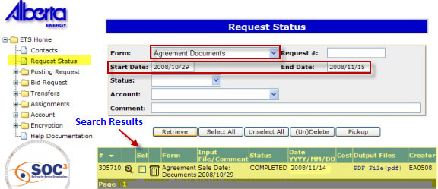

Request Status Screen
More Information (Pages 6 to 8)
Agreement Documents are available by accessing the Request Status page on ETS. Note: If you wish to keep the agreement you must print or save the file to your own in-house system. If you don't print or save the document within the time allocated by your site administrator, it will not display and cannot be retrieved.
Form - Select Agreement Documents as the Form type.
Dates - Based on the Start Date and End Date entered, all the agreement documents sent within that time frame will be displayed. If the Start Date is removed, all available agreement documents will be displayed on the screen.

Slide 6
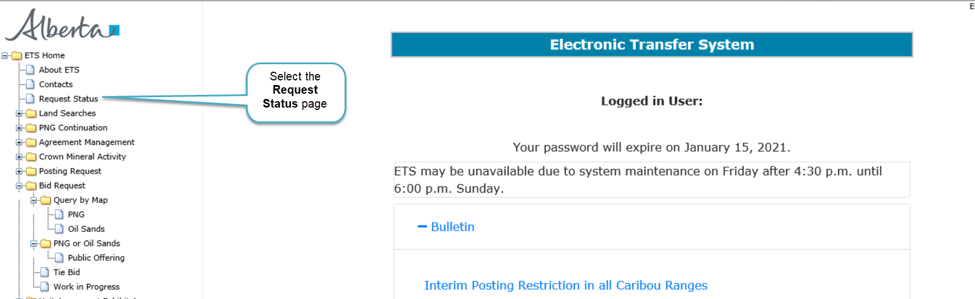
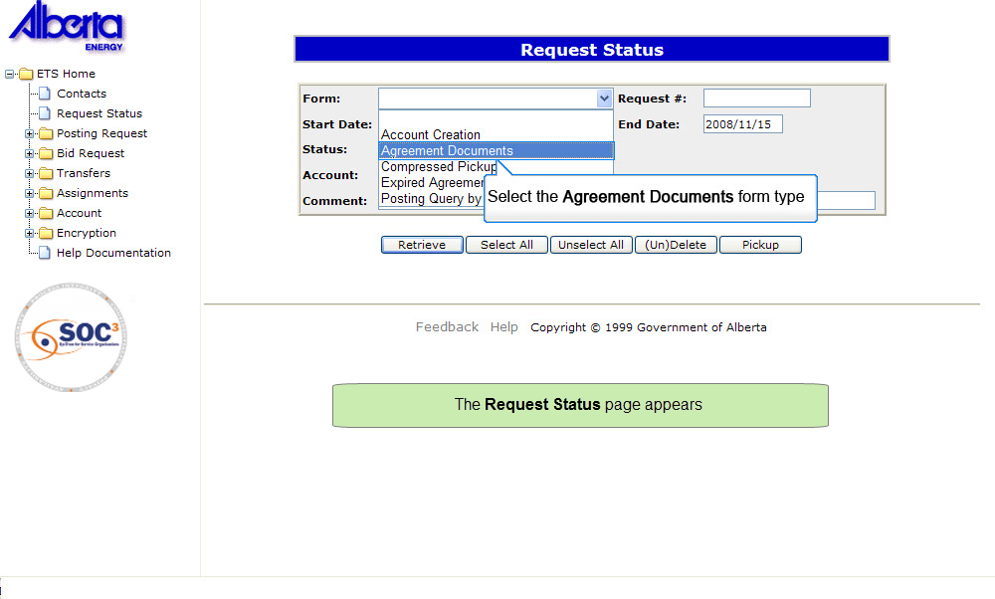

Back to Request Status Screen

Slide 7
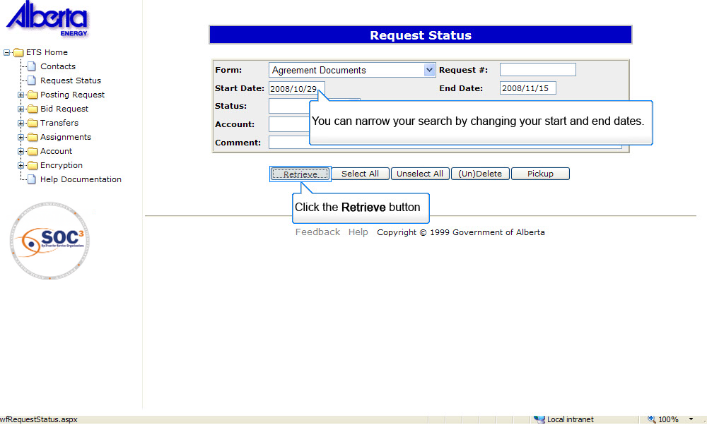
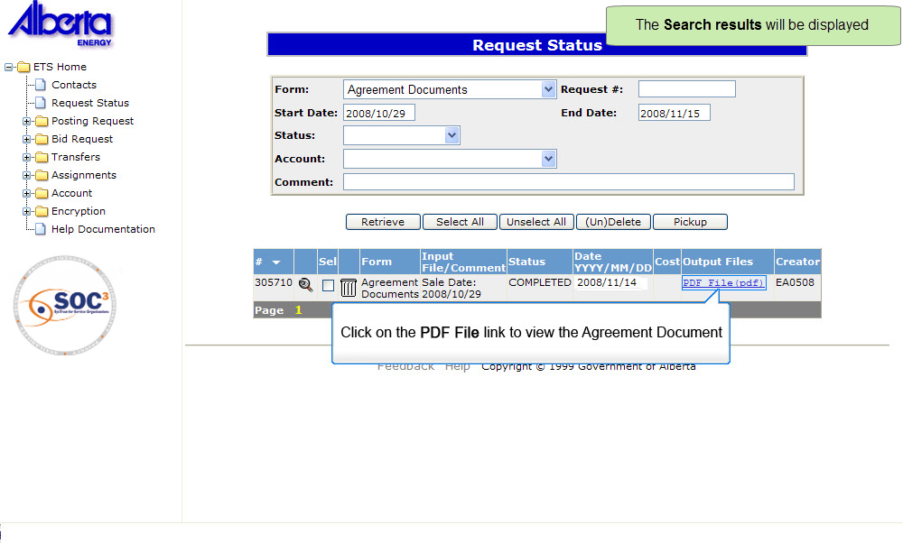
Back to Request Status Screen

Slide 8
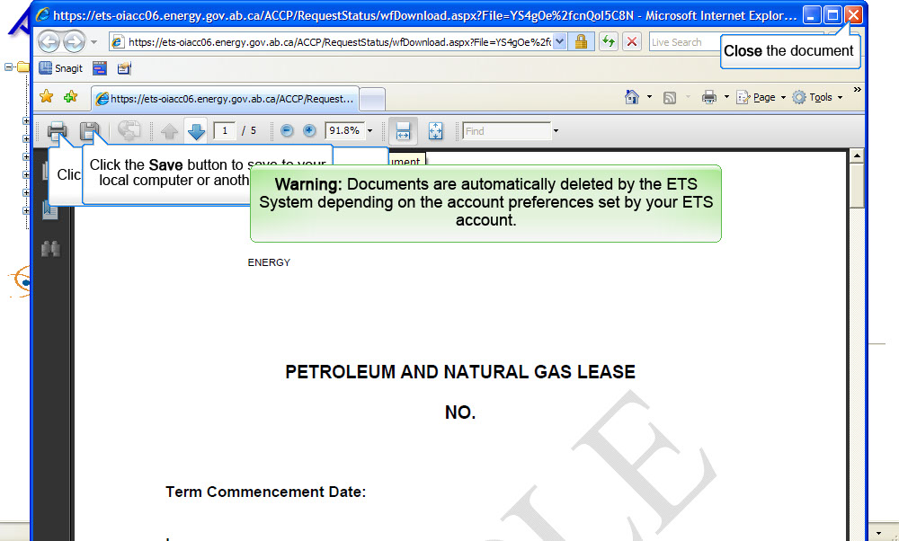
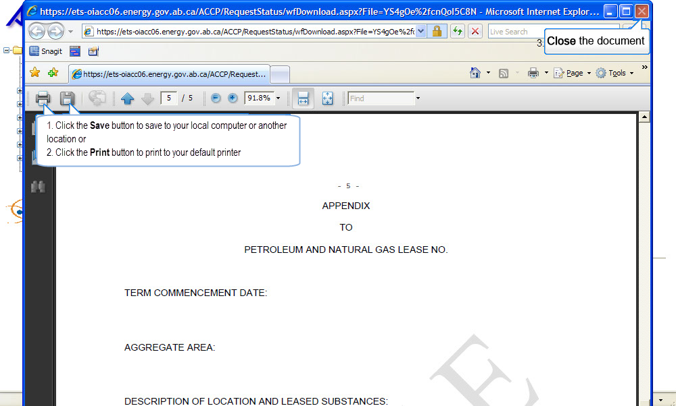
Back to Request Status Screen

Slide 9
Resources
ETS Support and Online Learning provides access to relevant guides, course and other information
If you have questions, please contact
For PNG: Bidding.Energy@gov.ab.ca or the Sales Helpdesk at (780)644-2300 or
for Oil Sands: OSTenure@gov.ab.ca

Slide 10

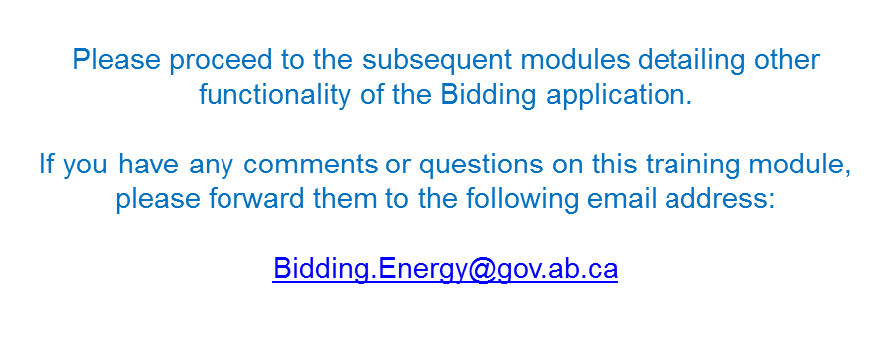
Conclusion
Congratulations!
You have completed the ETS – Retrieve Agreement Documents
Online Training Course

