Slide 1
Welcome
Welcome!
The Query functionality in Posting allows users to search for Crown mineral rights that are available before a posting request is submitted.
To the ETS – Query
Online Training Course

Slide 2
Revisions
Date | Revisions Type | Page Number
August 31, 2012 | Conversion | All
May 10, 2013 | Updated Query by Map | 4 - 25
June 2016 | Updated Query by Map | 4-13
April 2020 | Update Headers and links | All
December 2020 | Update ETS login page | Various

Slide 3

Introduction
In this module, you will learn how to:
Do a Query by Map
Do a Query by Land
Do an Expired Agreement Notification Request
Retrieve Queries
Note: As this course demonstrates the use of the GeoView tool, the data in some instances may not portray the actual Crown or Freehold ownership and is not specific to a particular mineral type map.

Slide 4
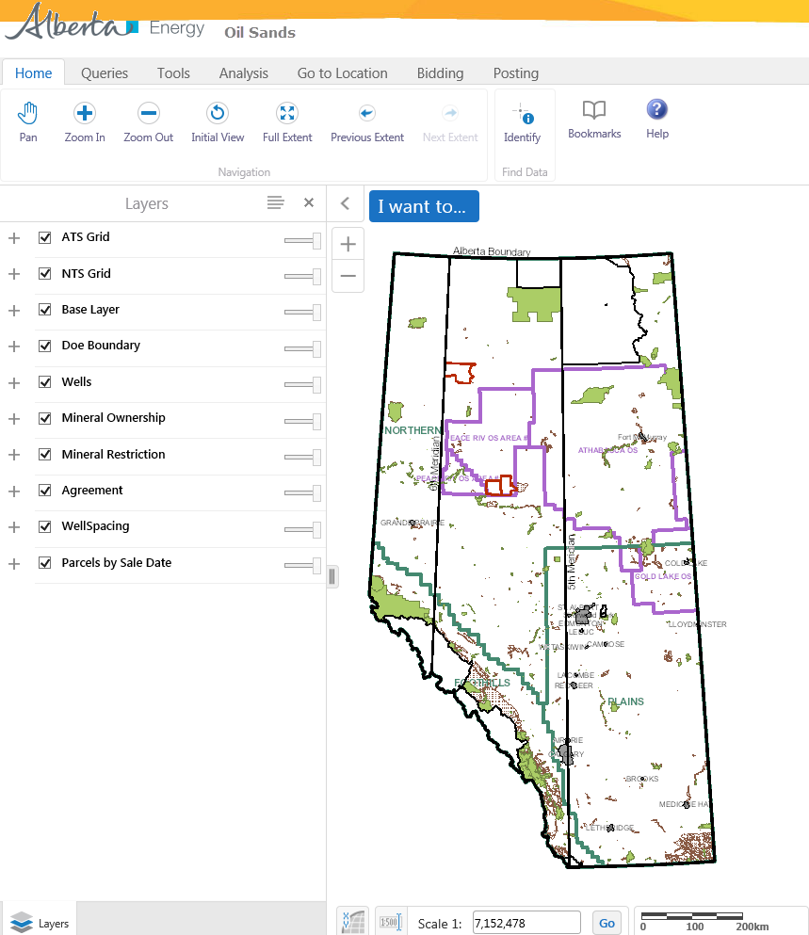
Query by Map
This option allows you to search for available Crown mineral rights graphically by entering an area of interest and viewing a map. You can then load the rights into the Public Offering posting request form. You can also view where the Crown owns the minerals and where the minerals are non-Crown (Freehold). Tip: Direct purchase requests cannot be processed through the Query by Map function. If you want to use the Query by Map for information purposes, you can still view the graphic output however, you must enter the information for a Direct purchase request manually.
More Information (Pages 5 to 19)

Slide 5
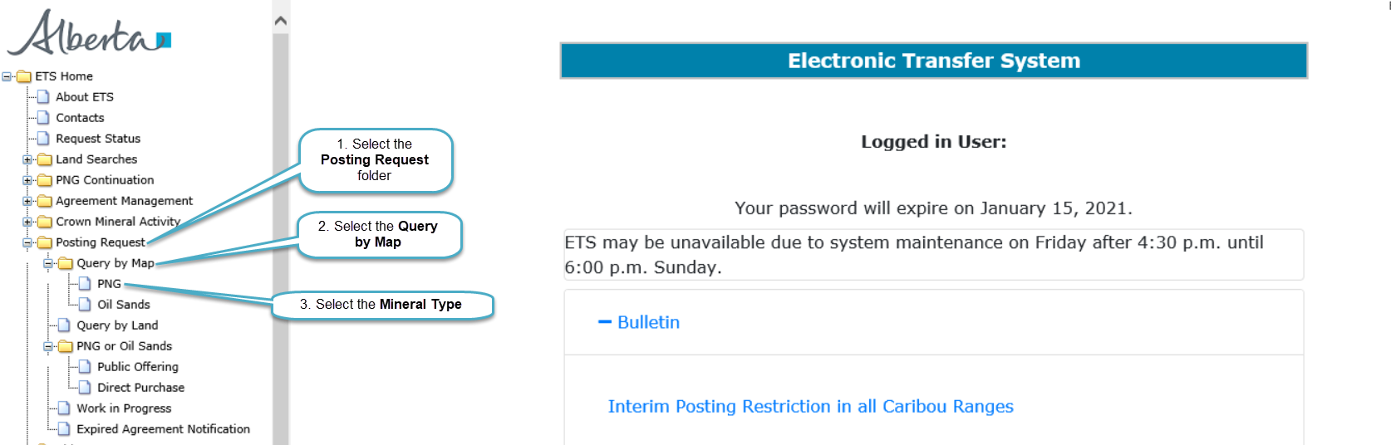
Map of Alberta is displayed
Back to Query by Map

Slide 6
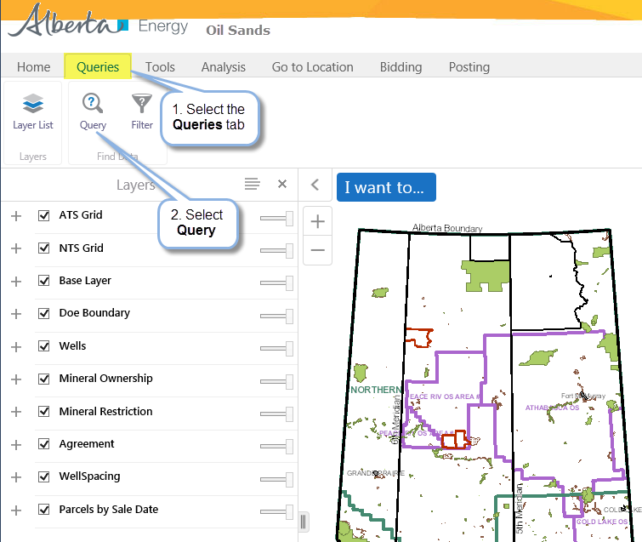
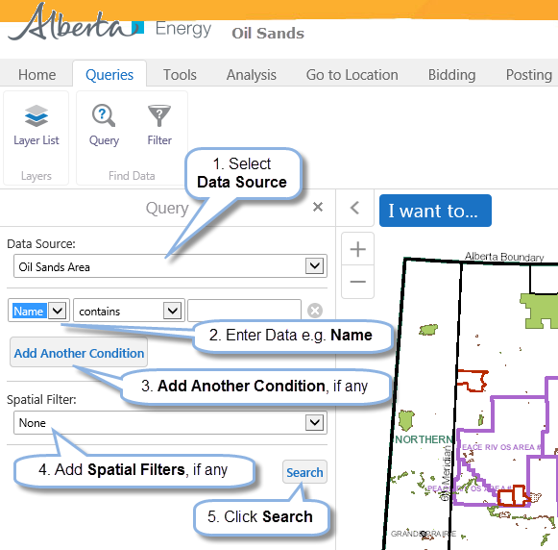
Query Builder displayed
Back to Query by Map

Slide 7
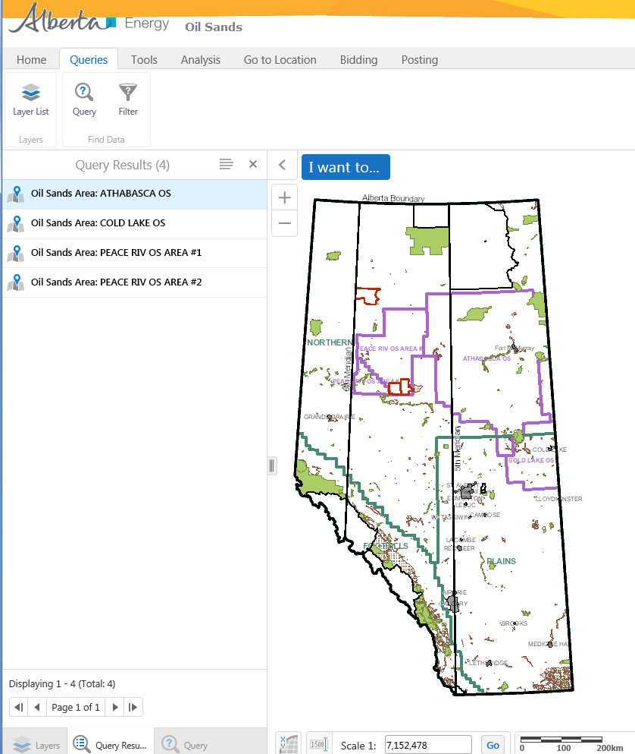
Query Results are displayed
Back to Query by Map

Slide 8
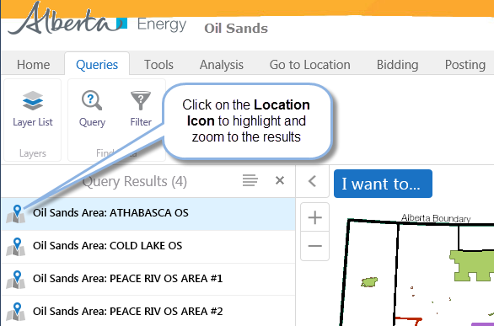
Back to Query by Map

Slide 9
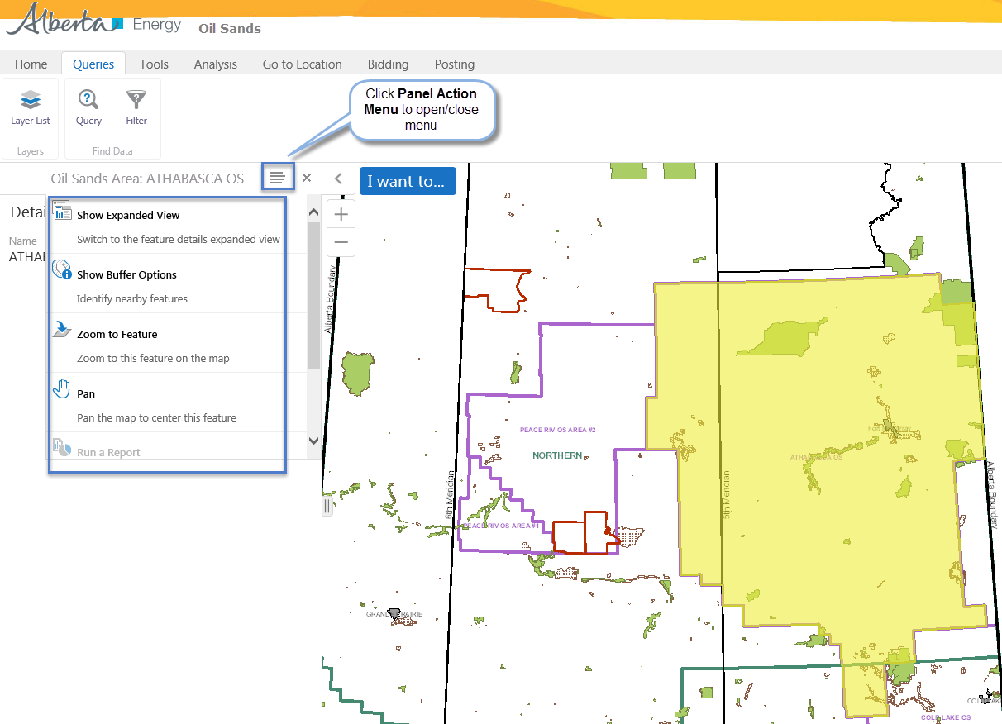
Results are displayed (highlighted in yellow)
Back to Query by Map

Slide 10
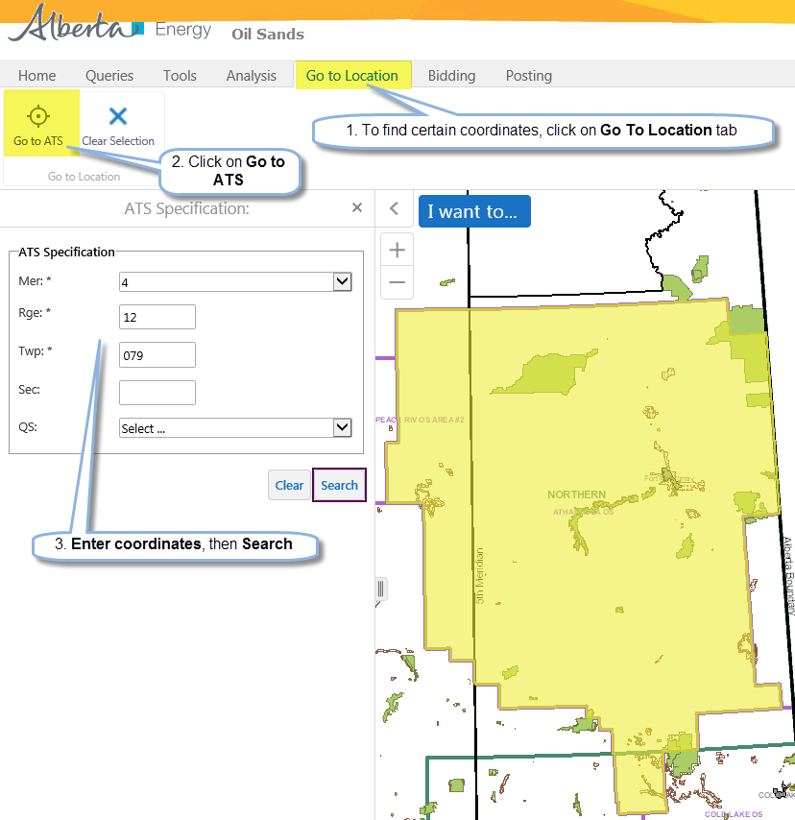
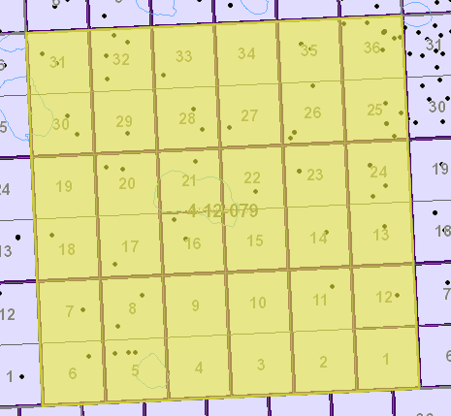
Back to Query by Map
Results are displayed

Slide 11
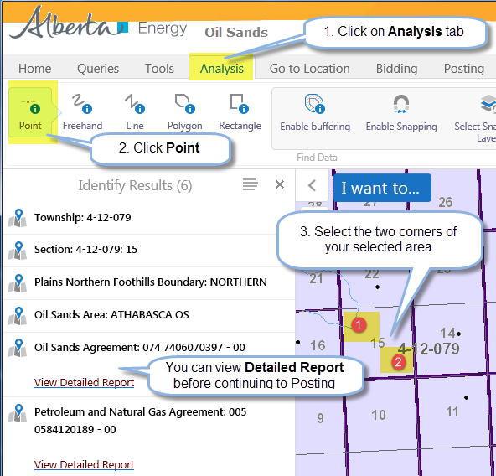
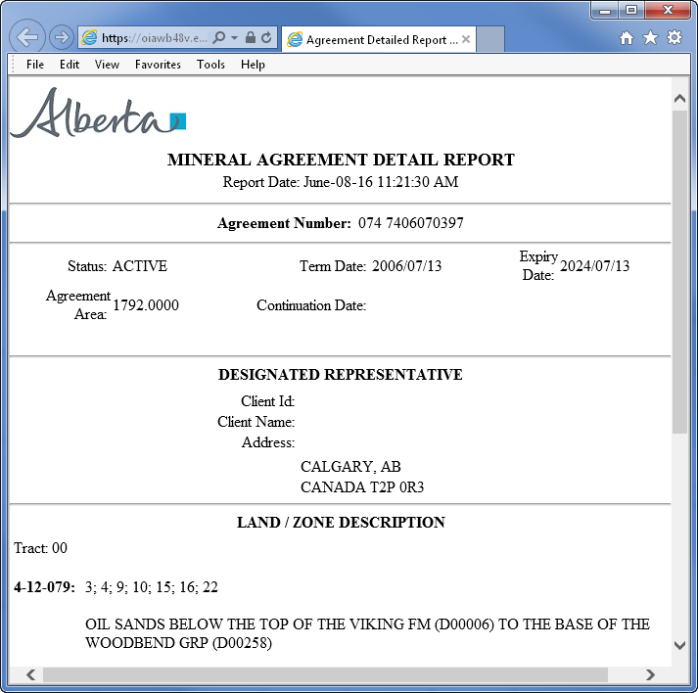
Back to Query by Map
Detailed Report is displayed

Slide 12
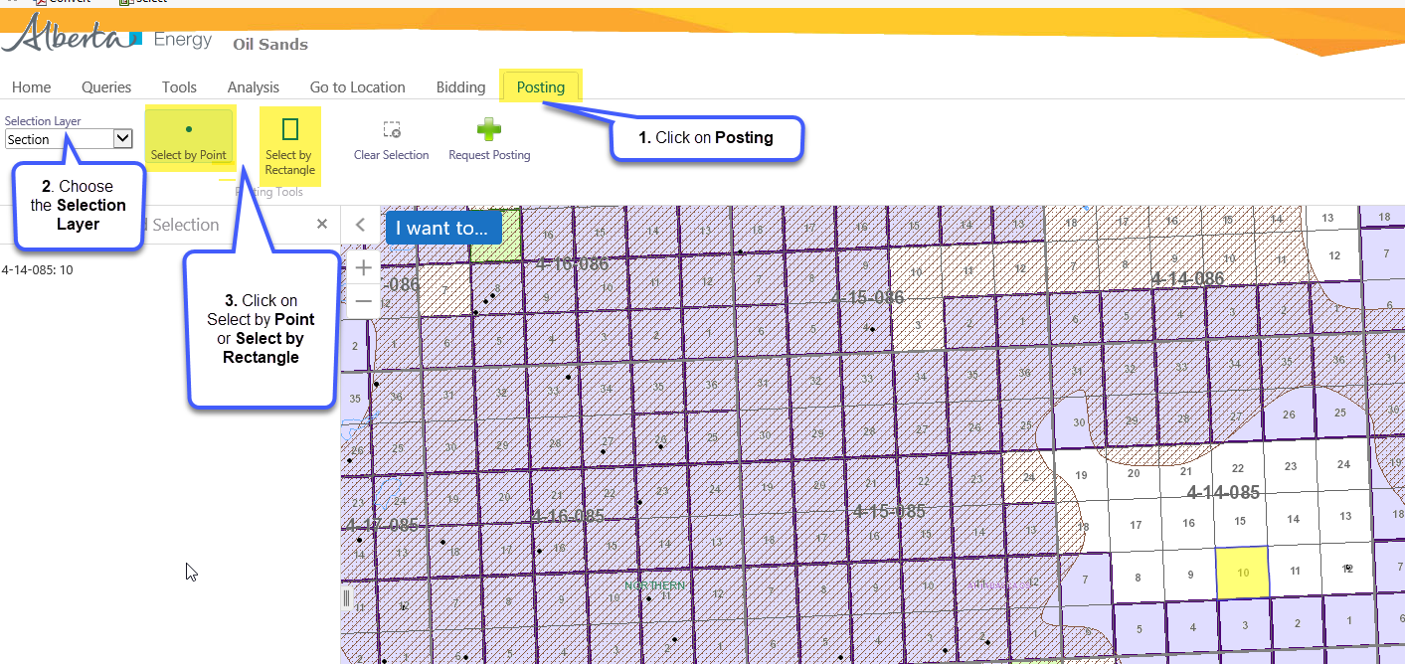

Slide 13
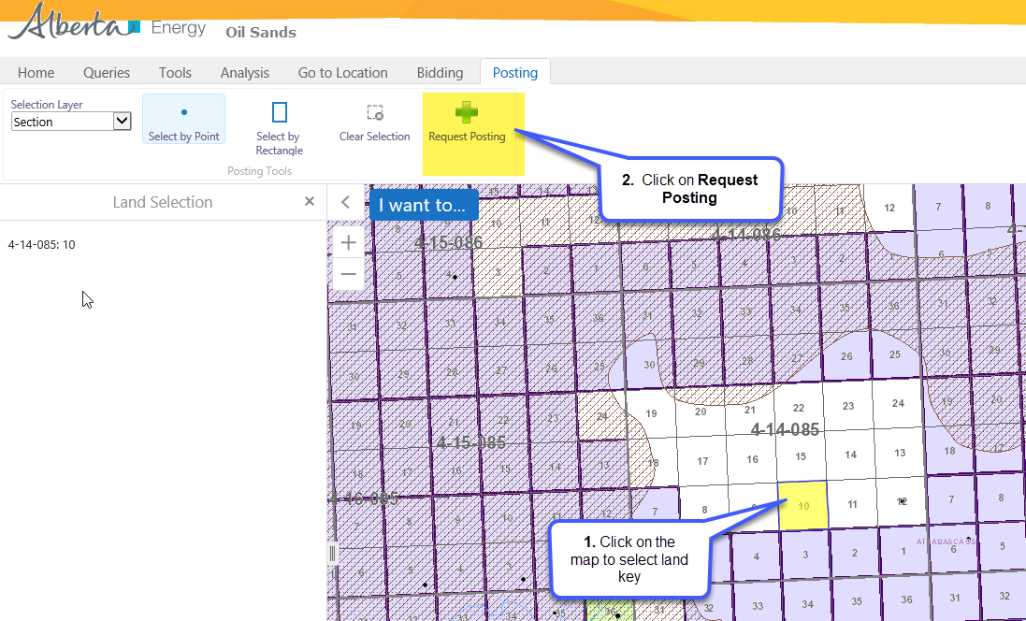
Back to Query by Map

Slide 14
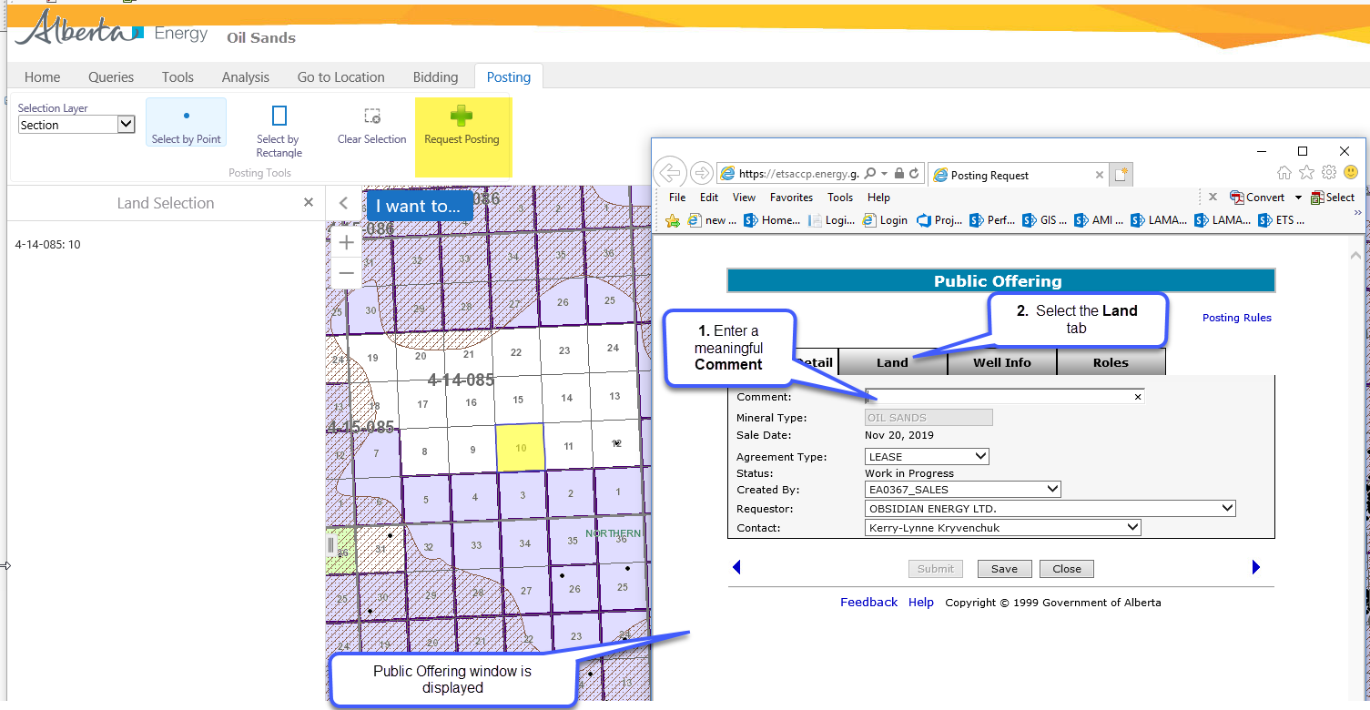
Back to Query by Map

Slide 15
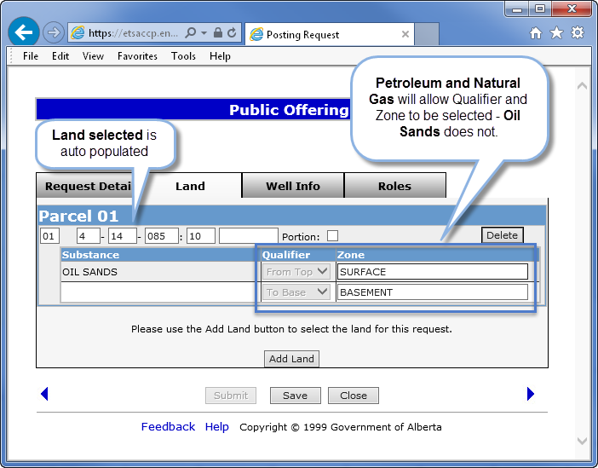
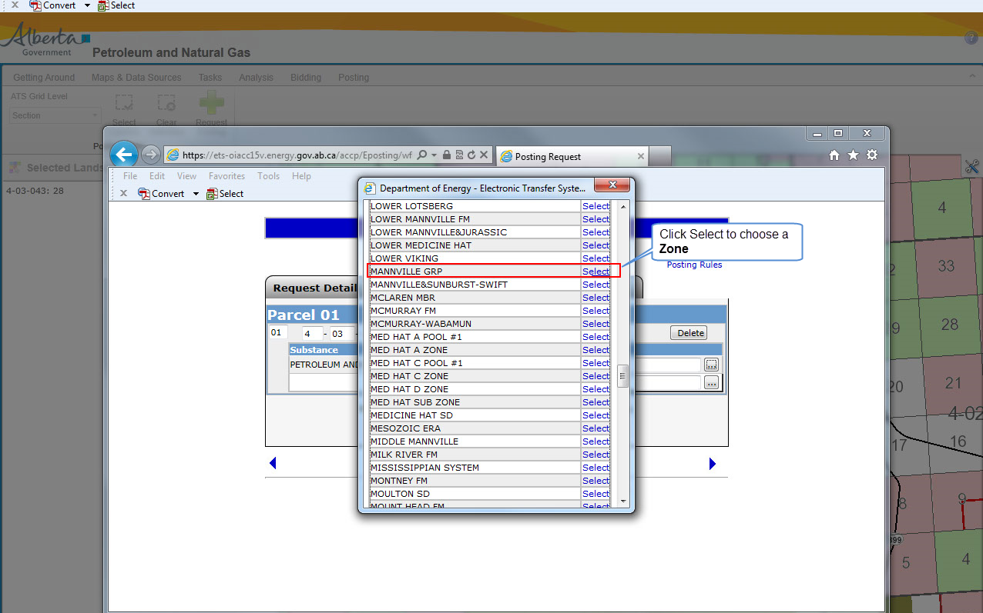
Back to Query by Map

Slide 16
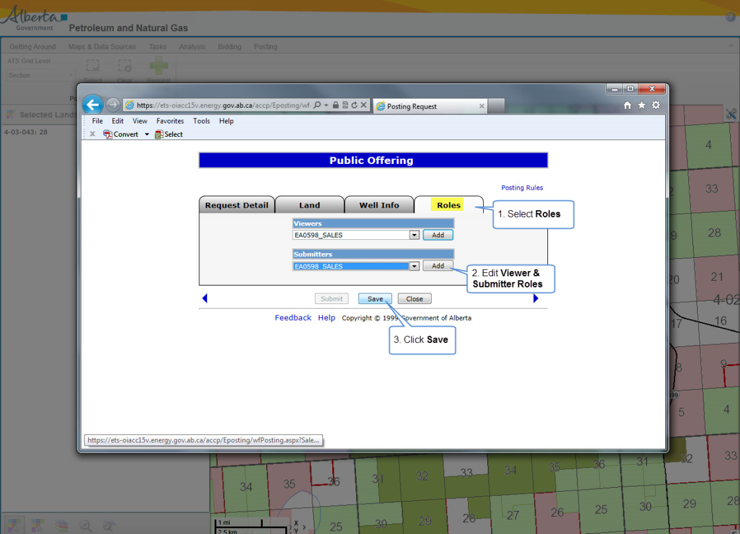
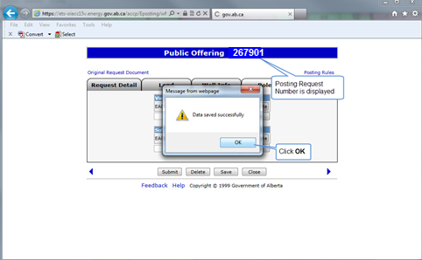
Back to Query by Map

Slide 17
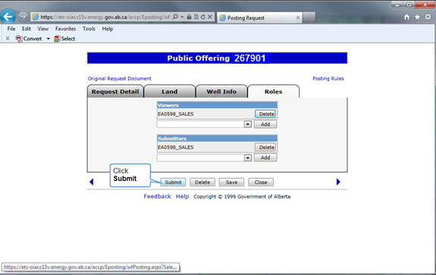
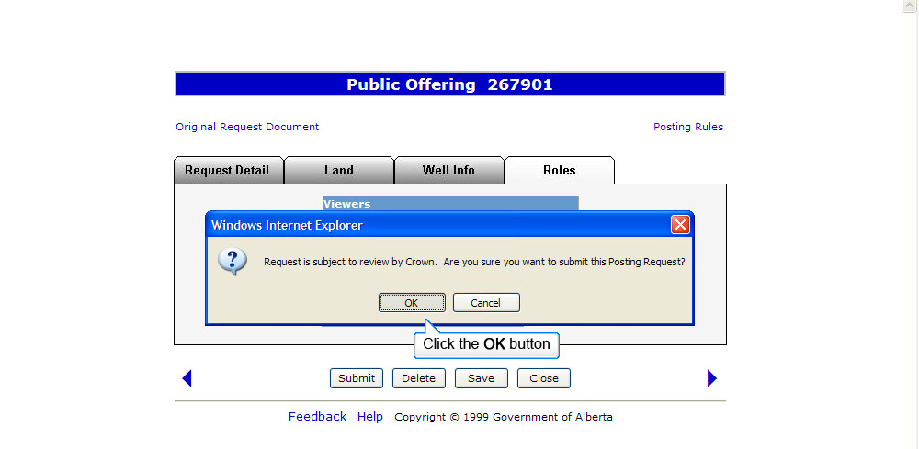
Back to Query by Map

Slide 18
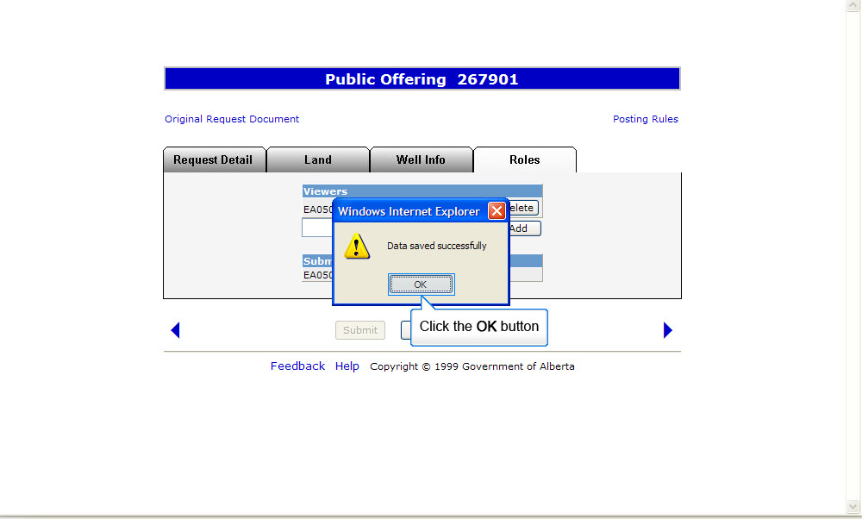
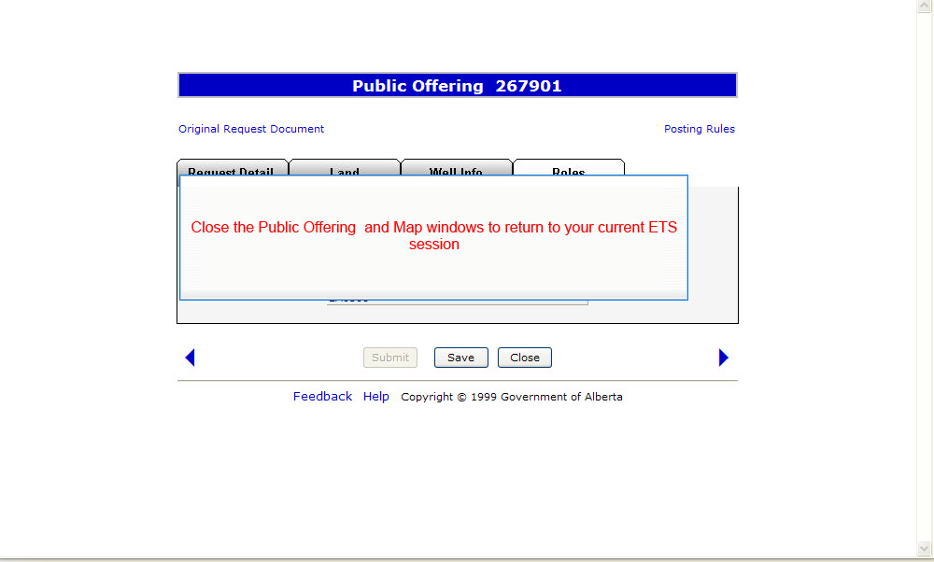
Back to Query by Map

Slide 19
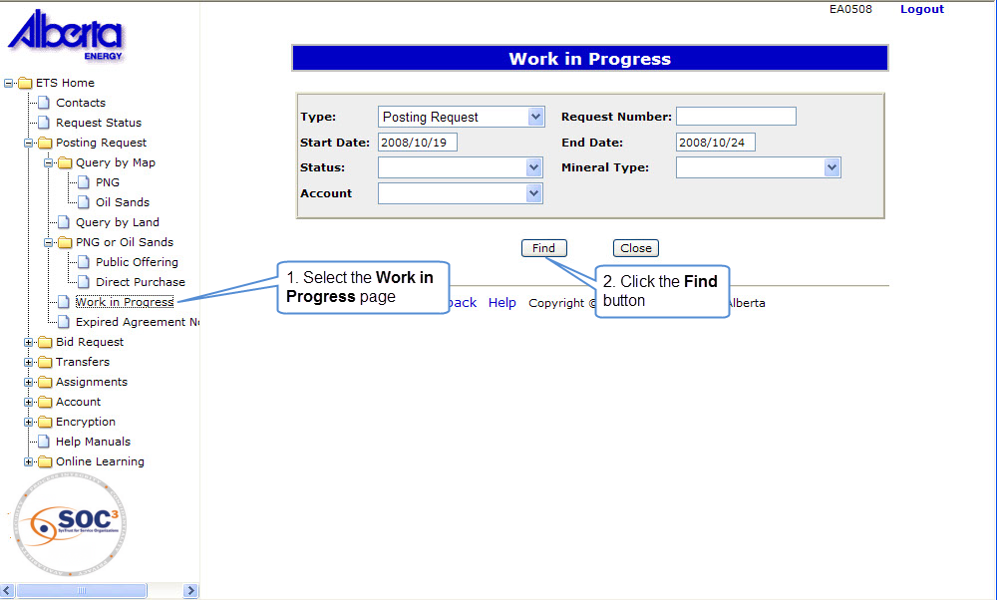
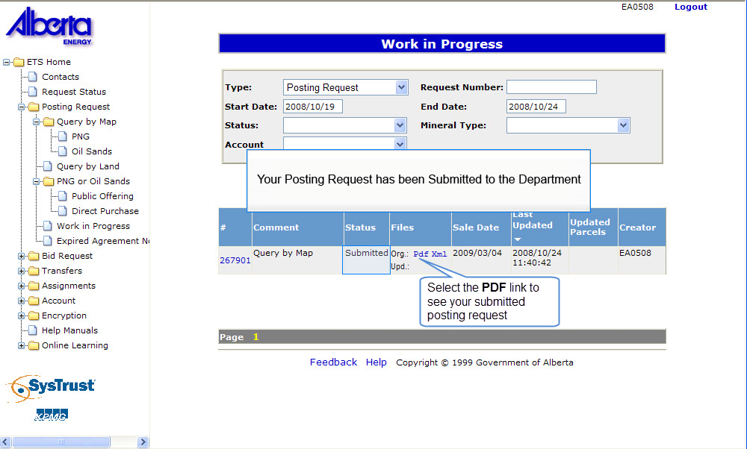

Back to Query by Map

Slide 20
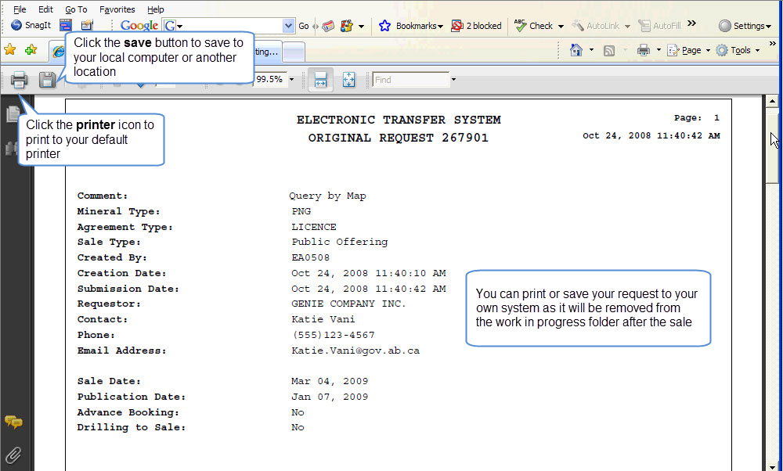
Back to Query by Map

Slide 21
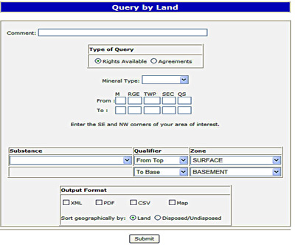
Query by Land
This option allows you to search for available Crown mineral rights or active agreements for the land you enter.
Selecting Rights Available will provide a report of all the Rights Available for the entered Land and Zone range.
Selecting Agreements will provide a report of all the current Agreements in the entered Land and Zone range. The report can be sorted geographically by land or by disposed/undisposed.
If the ‘Expiring in’ field is specified in an agreement type query, the query will return any agreements expiring in the specified time period.
More Information (Pages 21 to 45)

Slide 22
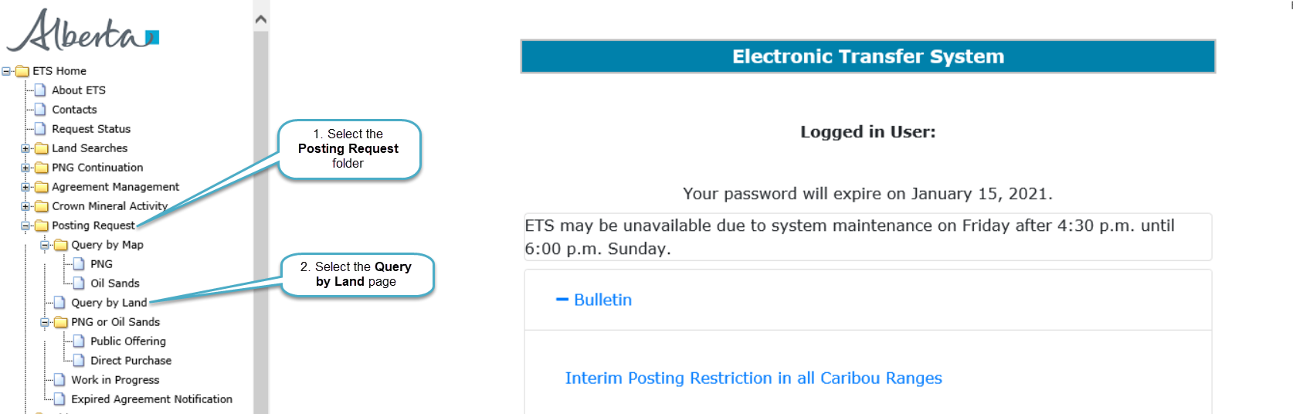
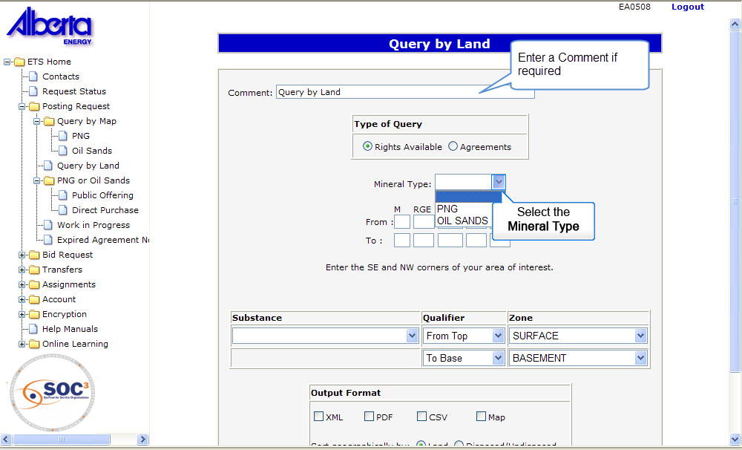
Back to Query by Land

Slide 23
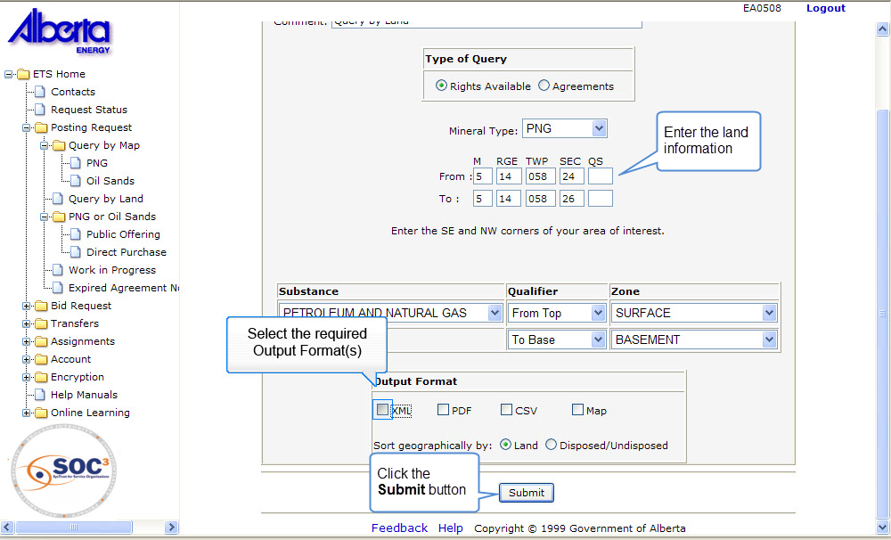
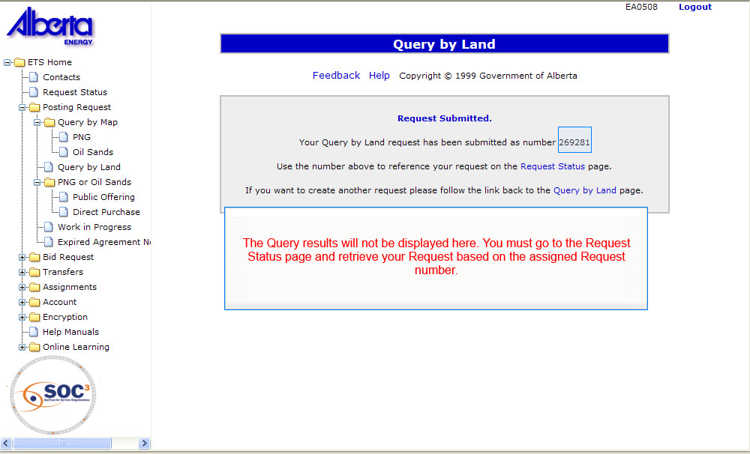
Back to Query by Land

Slide 24
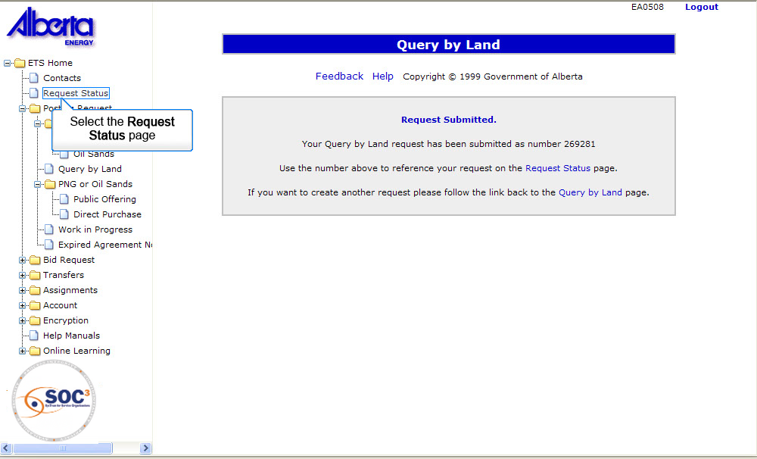
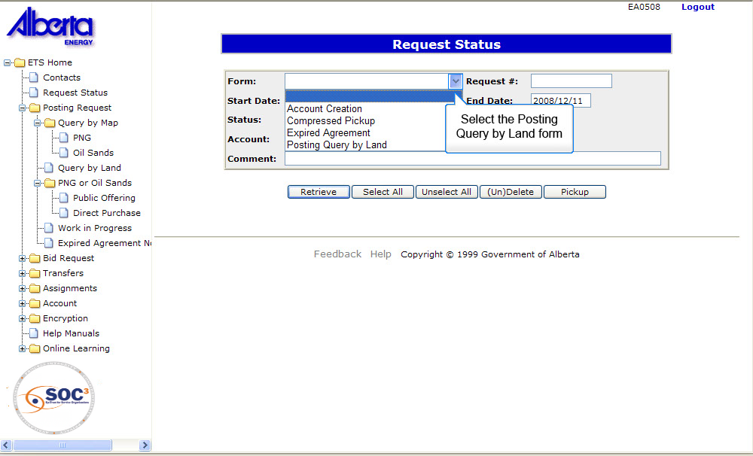
Back to Query by Land

Slide 25
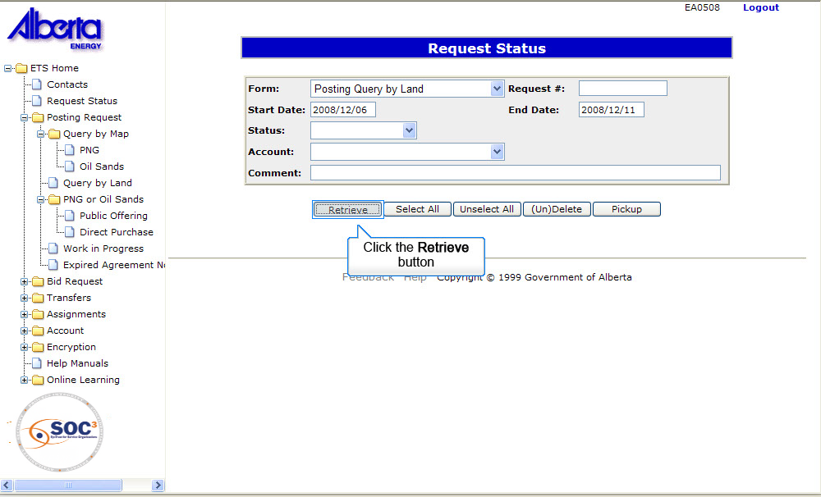
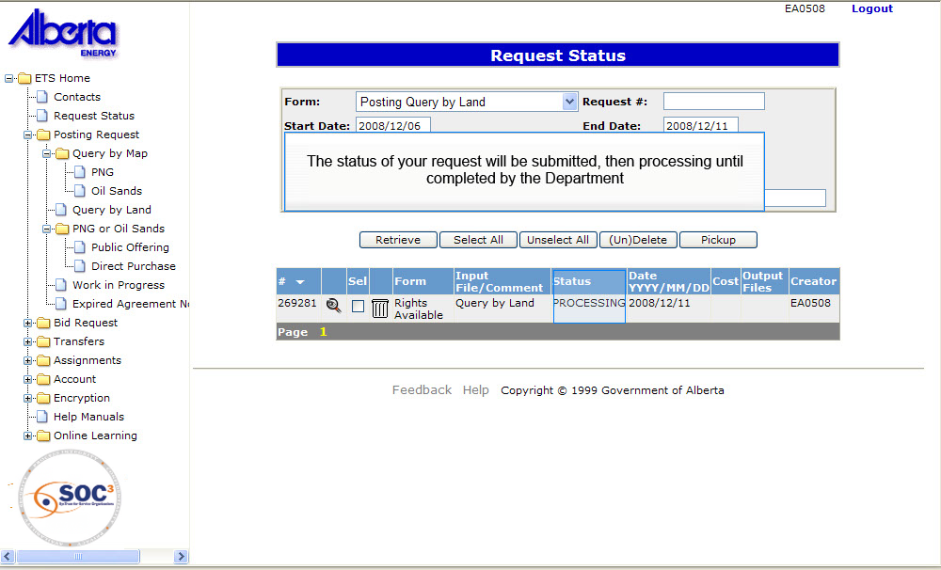
Back to Query by Land

Slide 26
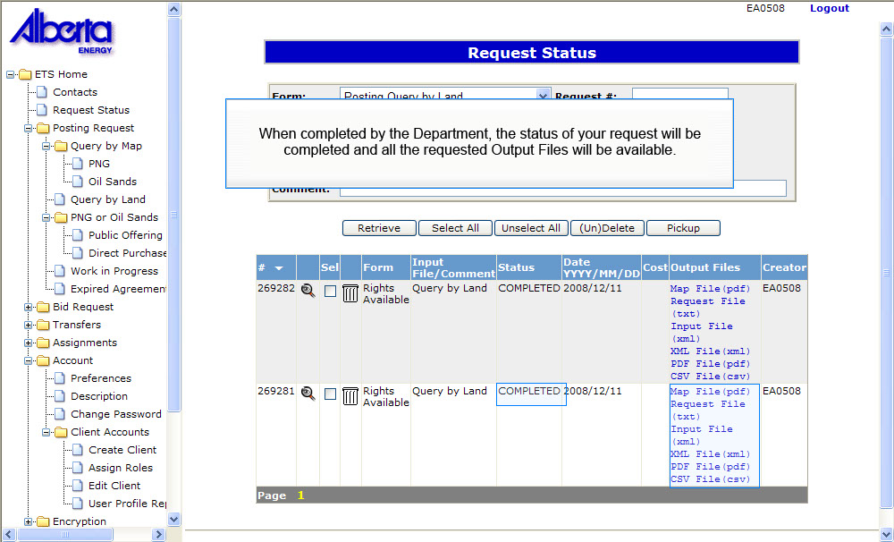
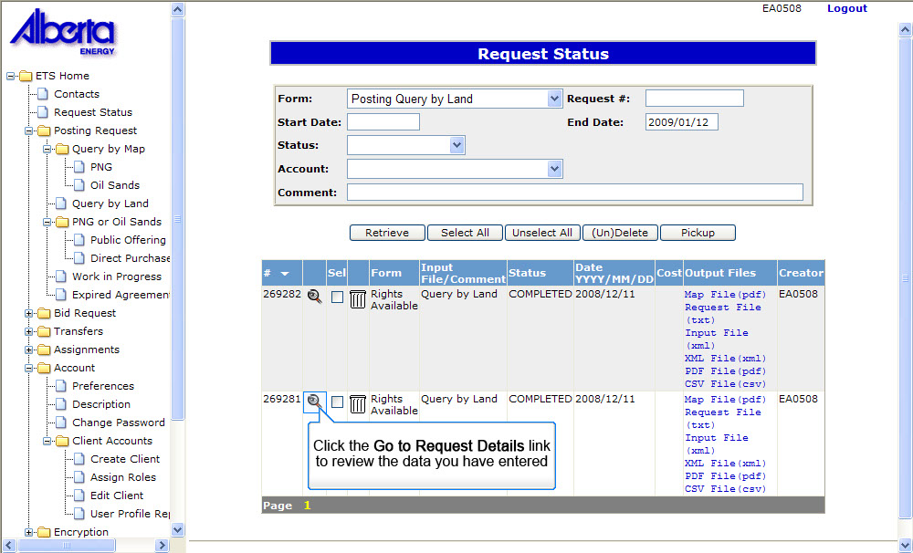
Back to Query by Land

Slide 27
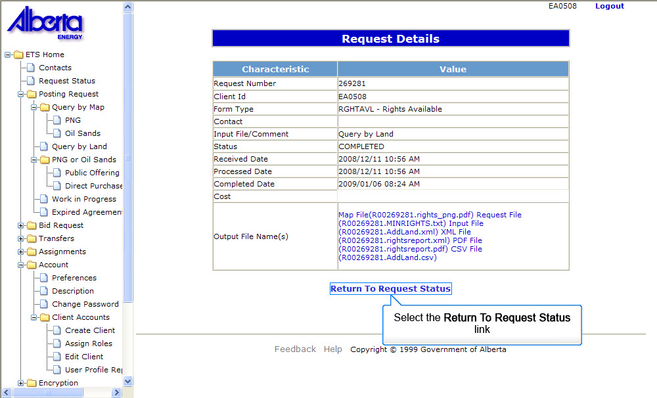
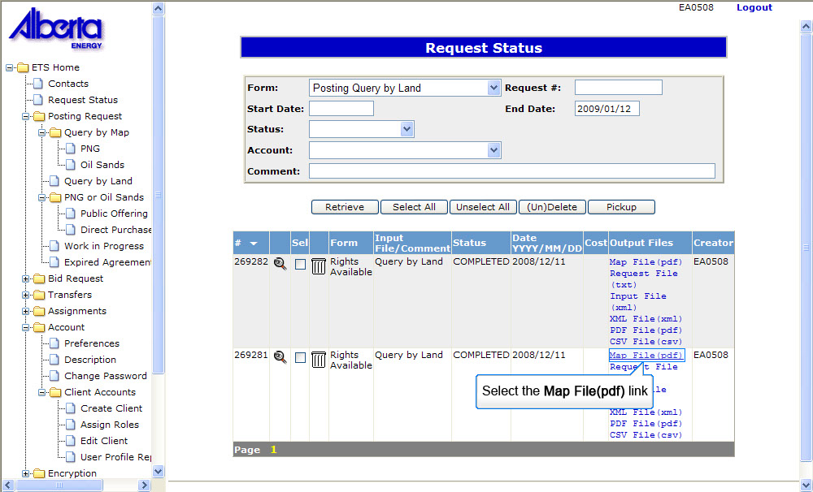
Back to Query by Land

Slide 28
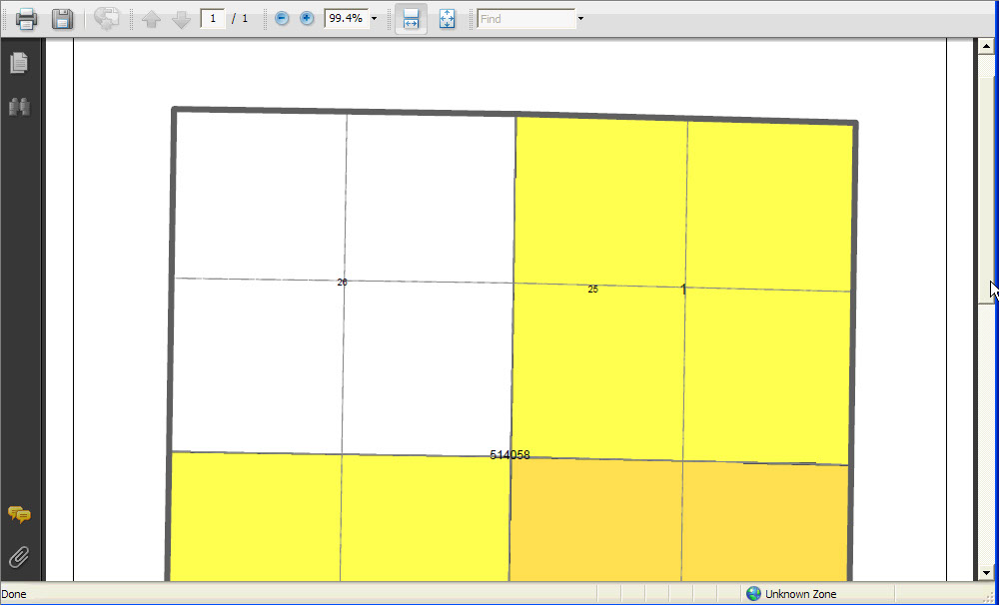
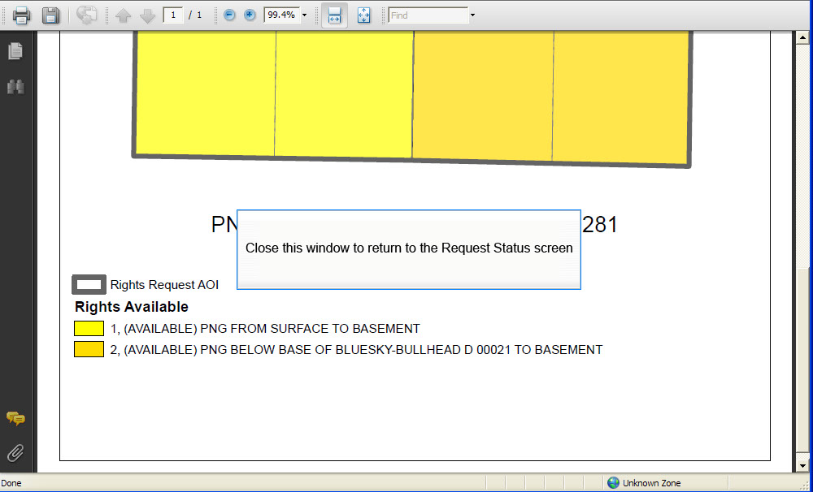
Back to Query by Land

Slide 29
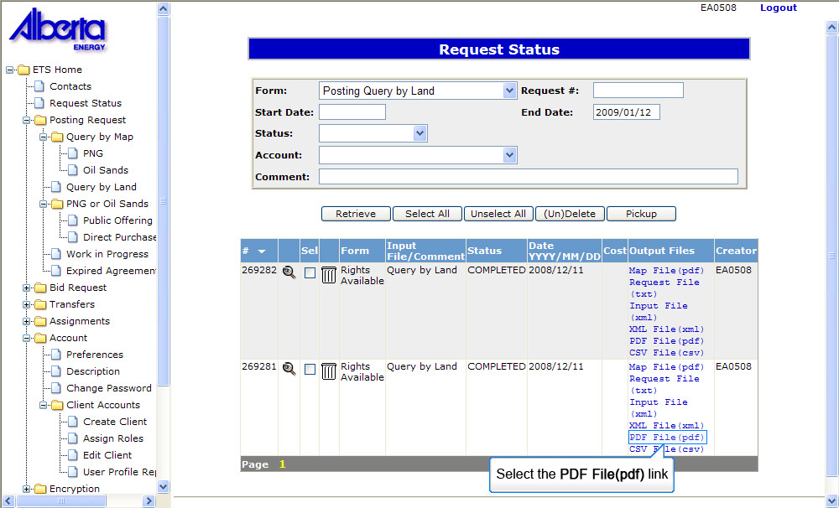
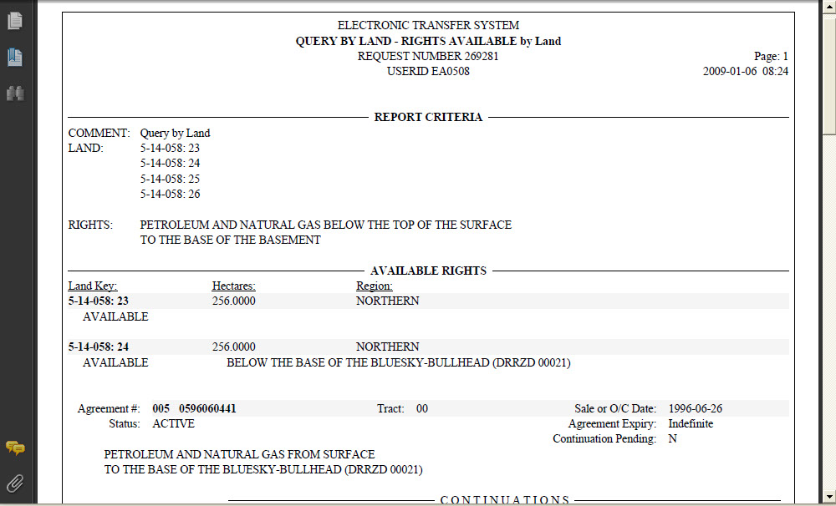
Back to Query by Land

Slide 30
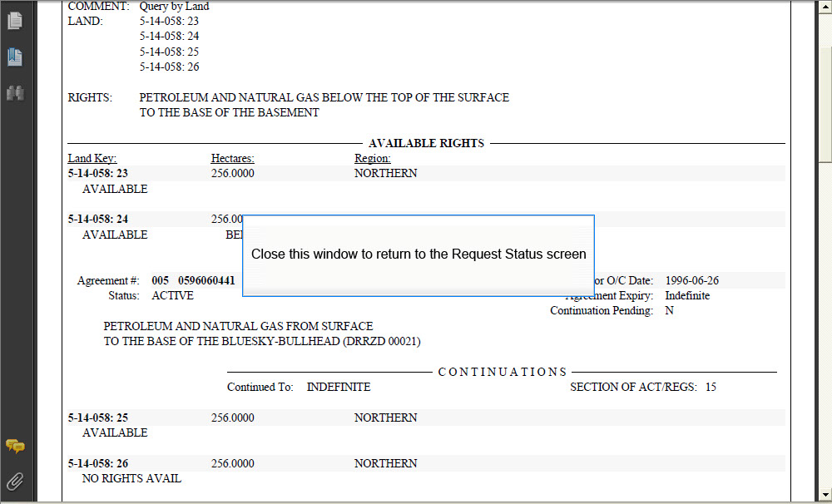
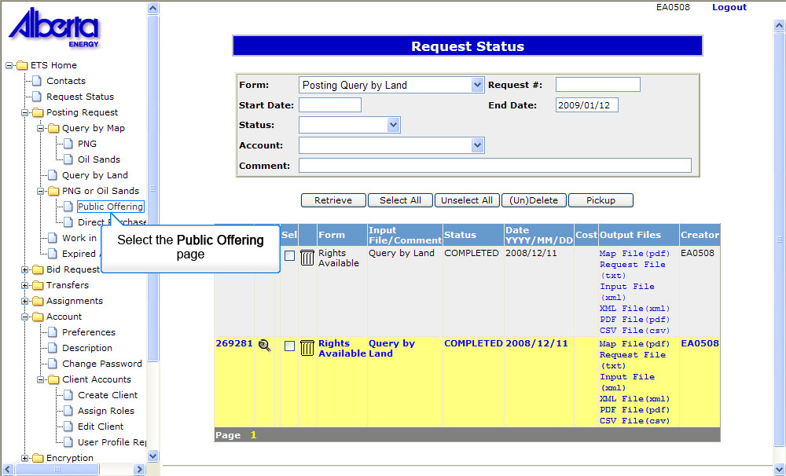
Back to Query by Land

Slide 31
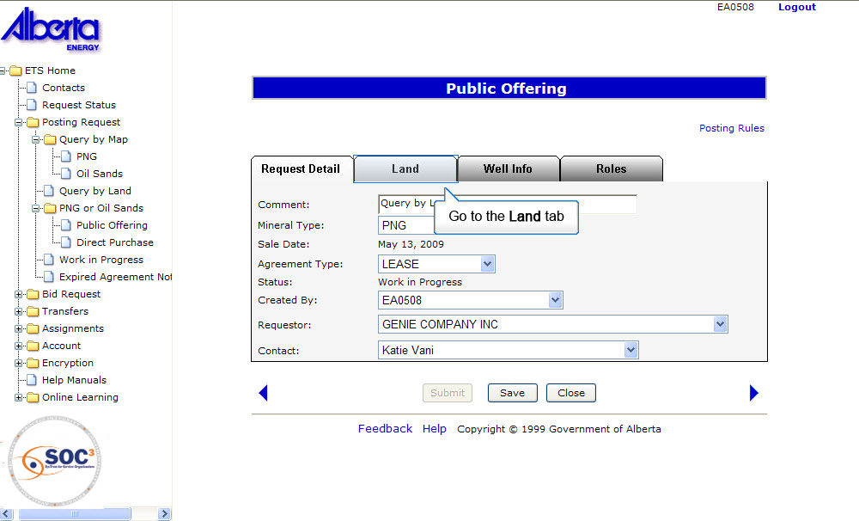
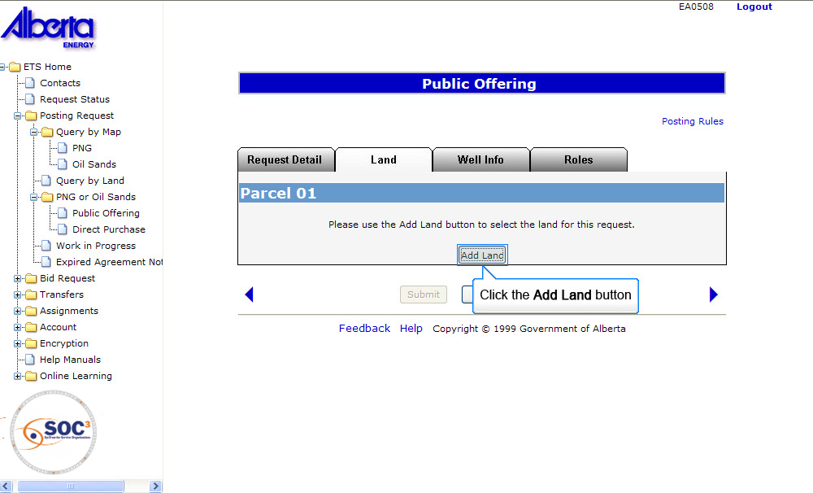
Back to Query by Land

Slide 32
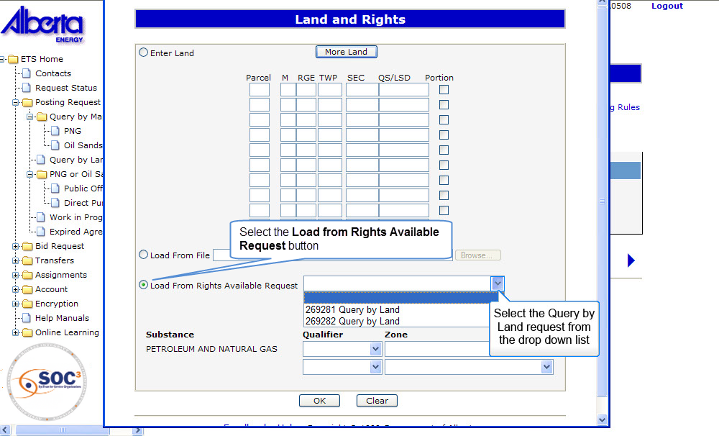
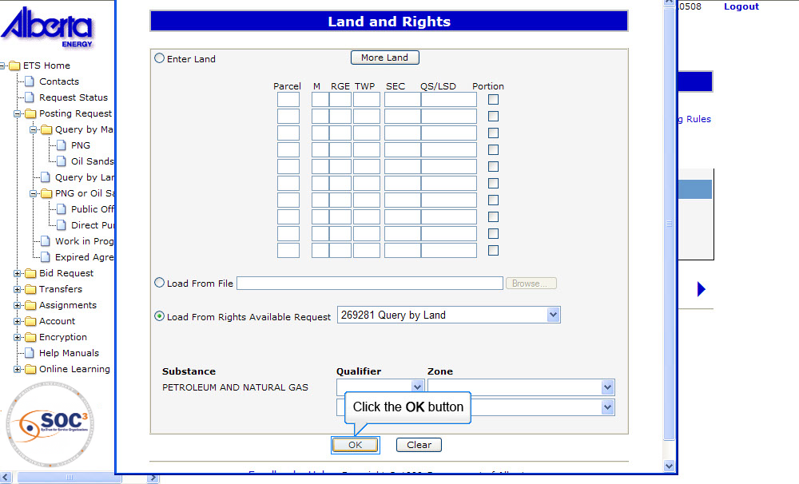
Back to Query by Land

Slide 33
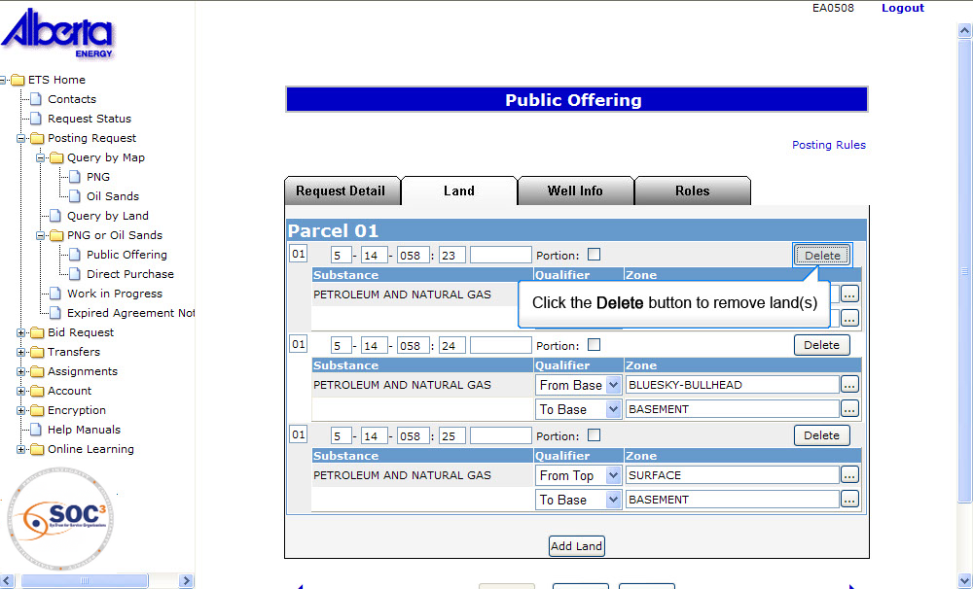
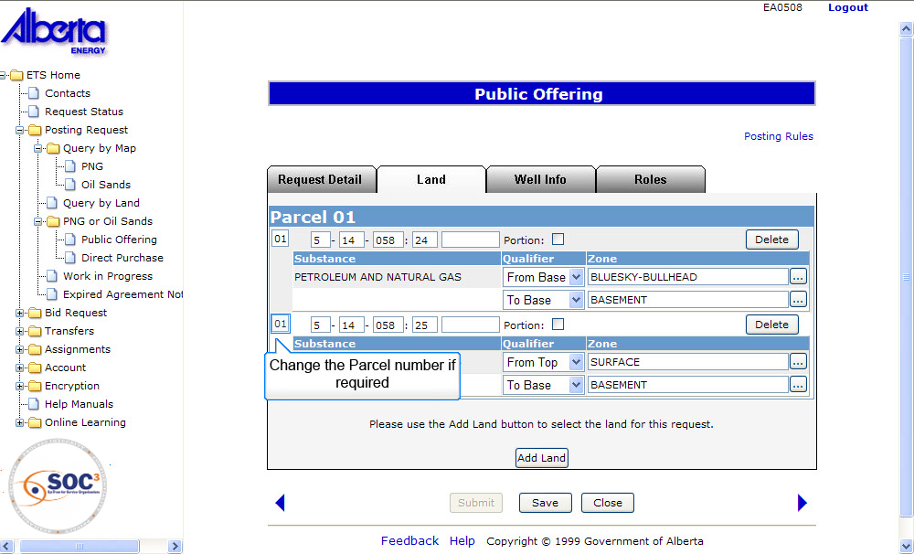
Back to Query by Land

Slide 34


Back to Query by Land

Slide 35


Back to Query by Land

Slide 36


Back to Query by Land

Slide 37


Back to Query by Land

Slide 38


Back to Query by Land

Slide 39


Back to Query by Land

Slide 40


Back to Query by Land

Slide 41


Back to Query by Land

Slide 42


Back to Query by Land

Slide 43


Back to Query by Land

Slide 44


Back to Query by Land

Slide 45


Back to Query by Land

Slide 46


Back to Query by Land

Slide 47

Expired Agreement
If you request land and receive a status of Expired Agreement - Not Posted, this means that the agreement is being reviewed by the Alberta Energy to determine if it should be cancelled or if it qualifies for continuation. Only when the continuation has been finalized or the agreement has been cancelled will the rights be available for posting.

Slide 48

Expired Agreement (Continued)
You can request Alberta Energy to advise you when a continuation decision has been made on an expired agreement. Once you have completed the request, select the Request Status page. The status in the request will be set to processing until it is complete at which time you will be sent an email advising you that a decision has been made.
TIP: Older agreements may require you to enter an Agreement Type Number. In those cases, a drop down box will be displayed to allow you to select the Type number.
More Information (Pages 48 to 50)

Slide 49


Back to Expired Agreement

Slide 50


Back to Expired Agreement

Slide 51

Back to Expired Agreement

Slide 52

Retrieving Queries
After you have done a Query by Land or an Expired Agreement Notification Request, you can access the results by opening the Request Status page on the main menu. Tip: If searching for more than one request, use the Start and End dates to retrieve all requests created within those dates or remove the Start Date to see all available information on the screen. The status of a Request will not automatically update on the screen. Click Retrieve to refresh the screen.

Slide 53
Resources
ETS Support and Online Learning provides access to relevant guides, course and other information
If you have questions, please contact
For PNG: Postings.Energy@gov.ab.ca or the Sales Helpdesk at (780)644-2300 or
for Oil Sands: OSTenure@gov.ab.ca

Slide 54

Conclusion
Congratulations!
You have completed the ETS – Query
Online Training Course
Please proceed to the subsequent modules detailing other functionality of the Posting application. If you have any comments or questions on this training module, please forward them to the following email address: Postings.Energy@gov.ab.ca

