Slide 1
Welcome
Welcome!
The Work In Progress functionality of Postings enables you to retrieve a posting request, view the posting status, delete a posting request and create a new request by copying an existing one.
To the ETS – Postings Work in Progress
Online Training Course

Slide 2
Revisions
Date | Revisions Type | Page Number
August 31, 2012 | Conversion | All
April 2020 | Headers and links | All
December 2020 | Update ETS login page | Various

Slide 3

Introduction
In this module, you will learn how to:
Retrieve Posting Requests for Public Offerings
Retrieve Direct Purchase Requests

Slide 4
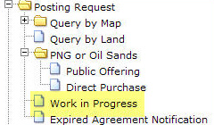
Screen
The Work in Progress screen is accessed from the ETS main menu. This screen allows you to monitor the status and the updates made by the Department to your requests. When submitted, the status of the request changes from Work in Progress to Submitted. When the Department has started the processing of your request, the status changes to Processing until the request is Completed, Client Withdrawn or Department Withdrawn. All requests will be removed from the Work in Progress screen 90 days after the last update date. If you wish to keep the data you must save the files to your own system.

Slide 5
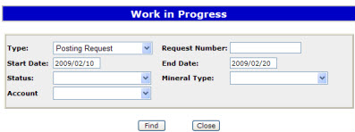
Retrieving and Reviewing Requests
More Information (Pages 6 & 7)
On the Work in Progress screen you can search for your requests by:
Request Type
Request Number
Start Date and End Date
Status
Mineral Type
Account
Tip: The Start and End dates default depending on the range of days chosen in your Account Preferences. To see all available requests remove the Start Date.

Slide 6
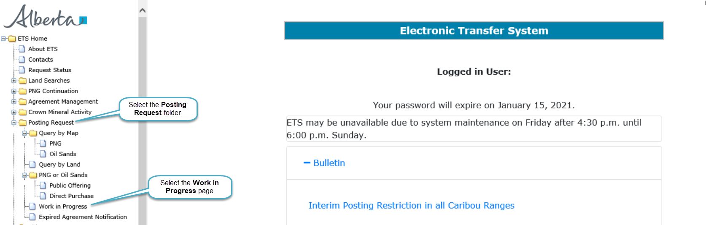
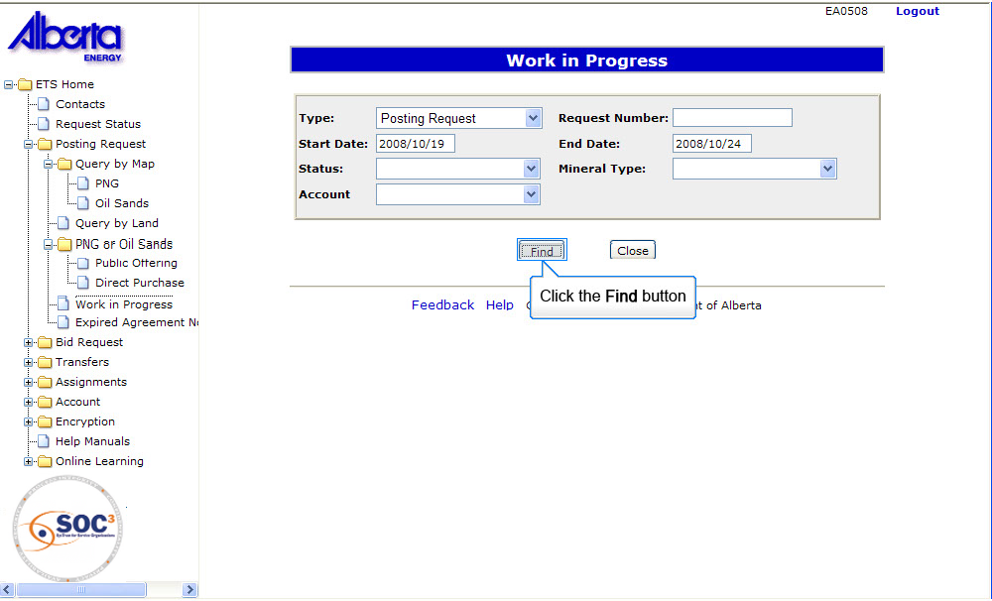

Back to Retrieving and Reviewing Requests

Slide 7
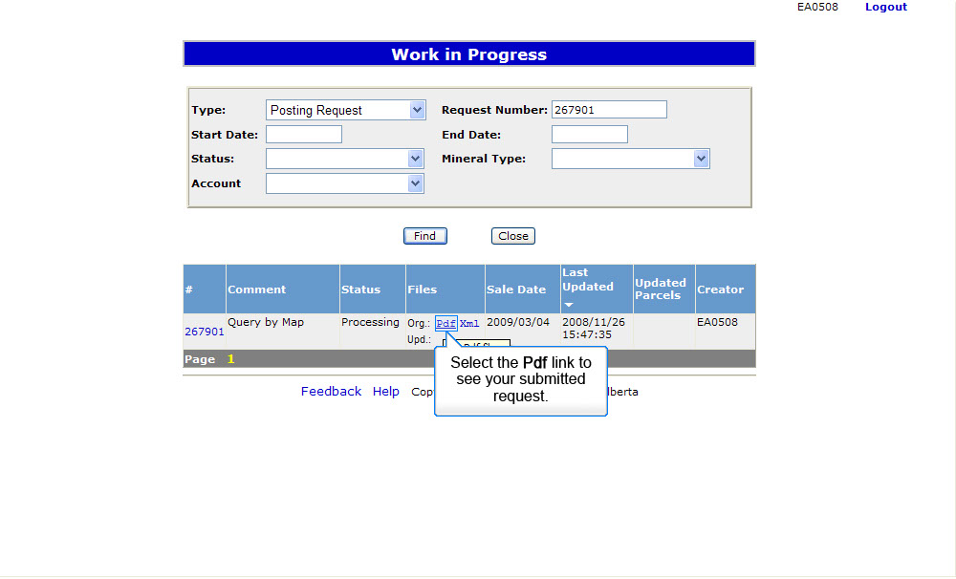
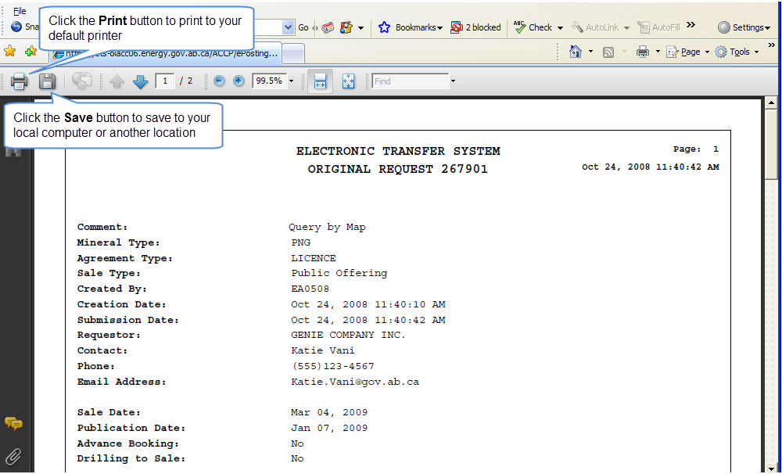
You can print or save your request to your own system as it will be removed from the work in progress folder 90 days after the last update date
Back to Retrieving and Reviewing Requests

Slide 8
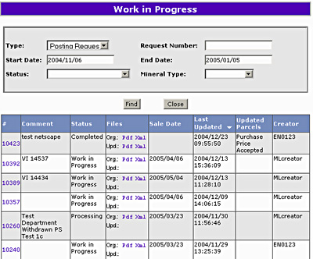
Results
The information on the screen can be re-sorted by clicking on the column headers. If the cursor changes to a hand when you move over a column heading you can re-sort the column. For each request, there will be two PDF documents available in the files column. The Org file is a record of the land and rights requested. The Upd file provides updated information about the land and rights requested.
You must monitor the updated file to determine what has changed from your original request.

Slide 9
Resources
ETS Support and Online Learning provides access to relevant guides, course and other information
If you have questions, please contact
For PNG: Postings.Energy@gov.ab.ca or the Sales Helpdesk at (780)644-2300 or
for Oil Sands: OSTenure@gov.ab.ca

Slide 10

Conclusion
Congratulations!
You have completed the ETS – Postings Work in Progress
Online Training Course
Please proceed to the subsequent modules detailing other functionality of the Posting application. If you have any comments or questions on this training module, please forward them to the following email address: Postings.Energy@gov.ab.ca

