Slide 1
Postings
Government of Alberta
Welcome!
Posting Request, a part of the Electronic Transfer System (ETS), allows you to apply for Petroleum and Natural Gas (PNG) and Oil Sands (OS) rights through an electronic posting request form. You will be able to query mineral rights availability and submit posting requests for a Public Offering using this system. Leasing of mineral rights by direct purchase will also be accommodated.
To the
ETS-Postings Overview
Online Training Course

Slide 2
Postings
Government of Alberta
Revision Page
Revisions Table
Date | Revisions Type | Page Number
August 31, 2012 | Initial Creation | All
April 2020 | Updates Headings and Links | All
December 2020 | Updated ETS login page | Various

Slide 3

Postings
Government of Alberta
INTRODUCTION
In this module, you will learn:
Account Preferences
Posting Request Preferences
Posting Roles
We recommend that you view the common training module,
“ETS Account Setup and Preferences (For Site Administrators)”
before proceeding to the other Posting training modules:

Slide 4
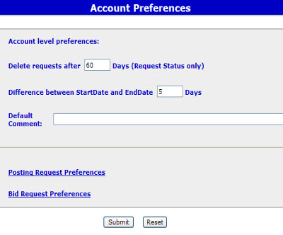
Postings
Government of Alberta
Account Preferences
All requests for expired agreements, query by land, posting, bidding requests and agreement documents will be automatically deleted by the ETS system depending on the Account Preferences set by your ETS account. Difference between Start Date and End Date X Days allows you to set the range of days (maximum 90 days) you can see results displayed on the Request Status screen and the Work in Progress screen. Default Comment allows you to enter text that will be displayed in the comment box in the Query by Land and the Posting Request screen. This comment will assist you in identifying the request. Tip: If you remove the Start Date from the Request Status or Work in Progress screen you will see all the available information on the screen.

Slide 5
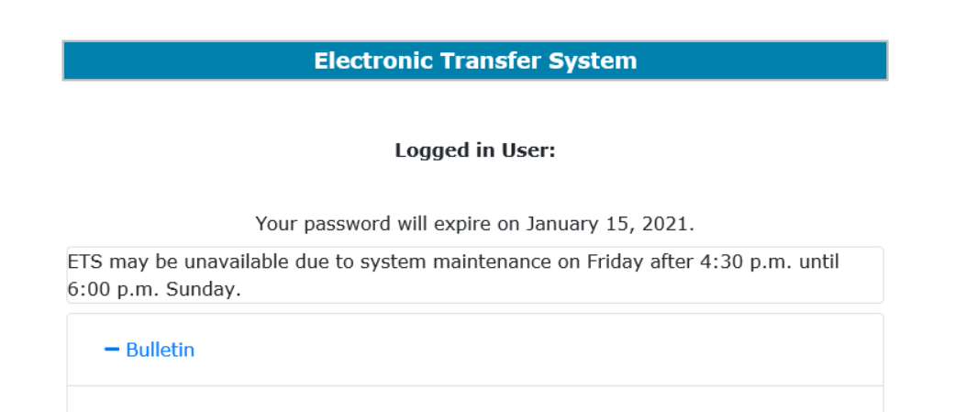
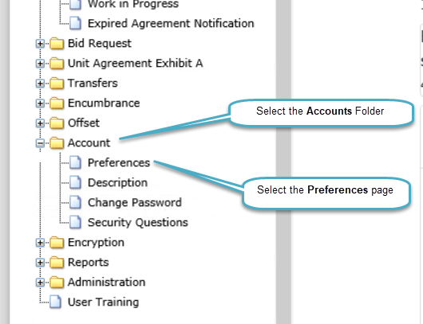
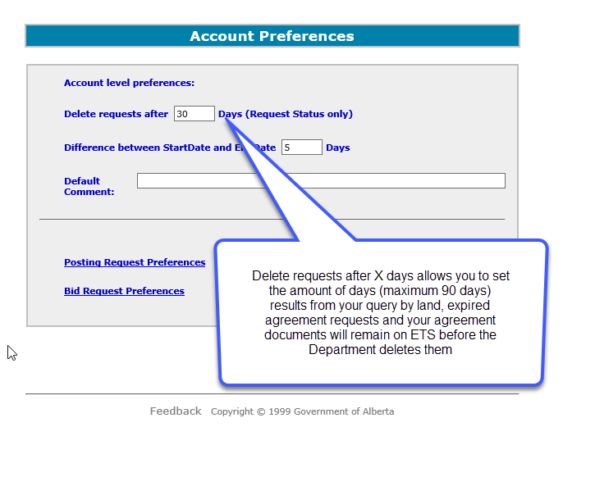
Postings
Government of Alberta

Slide 6
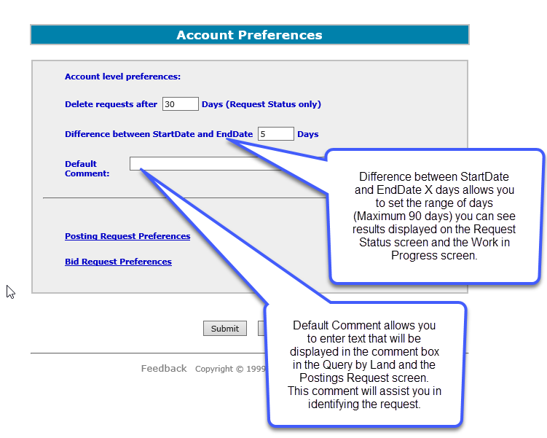
Postings
Government of Alberta

Slide 7
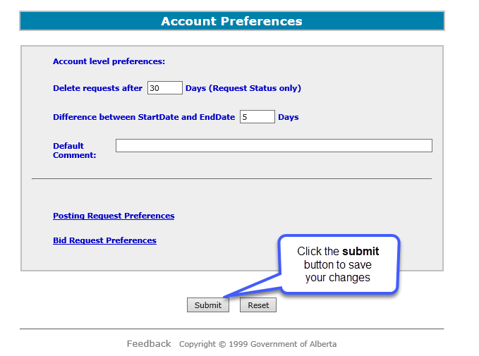
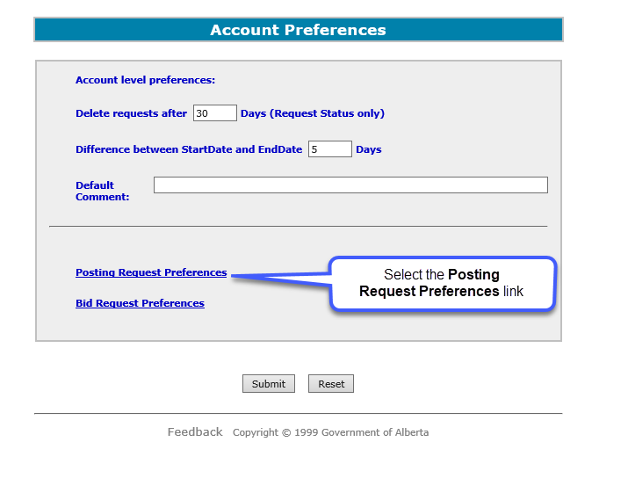
Postings
Government of Alberta

Slide 8
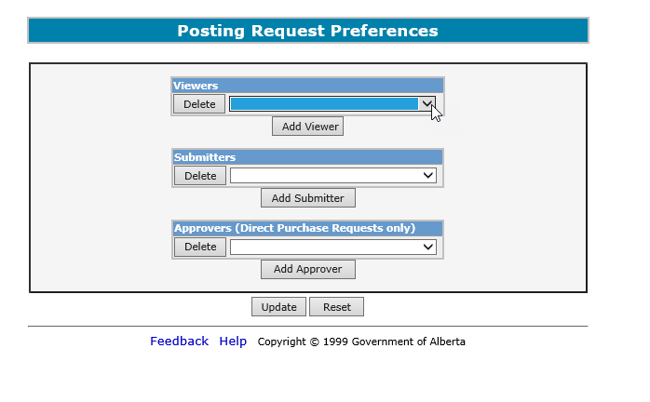
Postings
Government of Alberta
Posting Request Preferences
Under Viewers, you can select users to view your posting requests. You can add as many viewers as you want by using the Add Viewer button and selecting their account name from the drop down list. Under Submitters, you can select users to submit your posting requests. If you have a creator/submitter role, adding yourself in this screen by selecting your account name from the drop down list will allow you to submit each posting request you create. If you do not do this, you will need to select a submitter every time you create a posting request. Under Approvers, you can select users to accept or decline the purchase price for a Direct Purchase request. You can add as many approvers as you want by using the Add Approver button and selecting their account name from the drop down list.

Slide 9
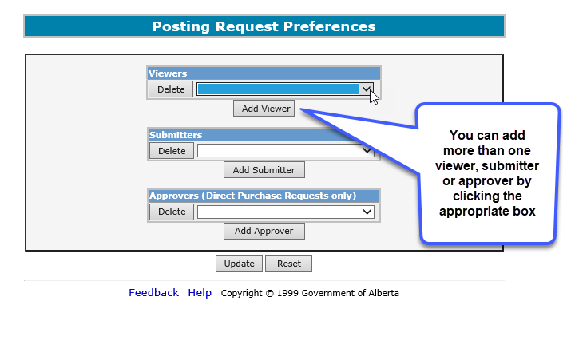
Postings
Government of Alberta

Slide 10
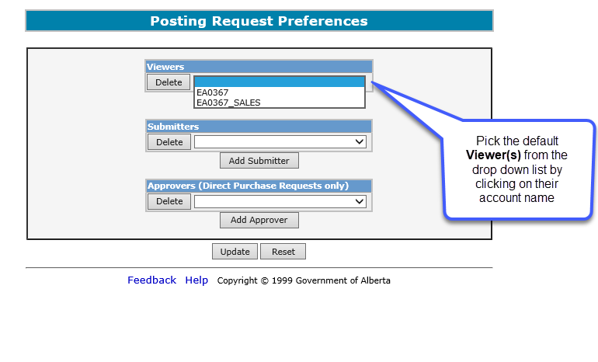
Postings
Government of Alberta

Slide 11
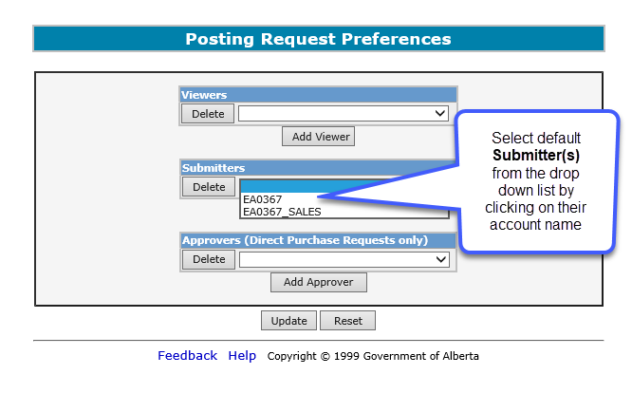
Postings
Government of Alberta

Slide 12
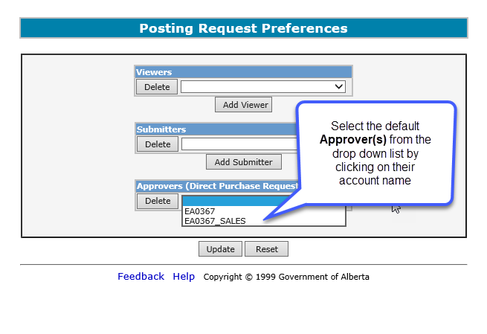
Postings
Government of Alberta

Slide 13
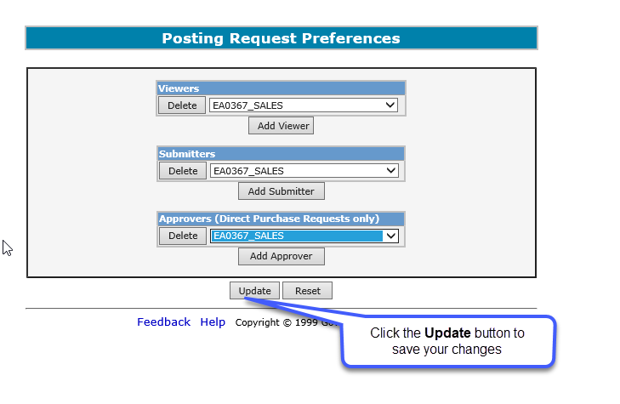
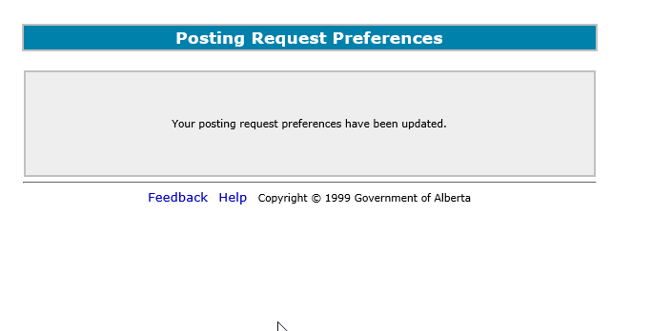
Postings
Government of Alberta

Slide 14
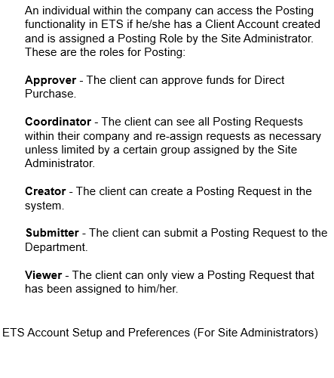
Postings
Government of Alberta
Roles

Slide 15

Postings
Government of Alberta
Resources
ETS Support and Online Learning provides access to relevant guides, course and other information
If you have questions, please contact
For PNG: Postings.Energy@gov.ab.ca or the Sales Helpdesk at (780)644-2300 or
for Oil Sands: OSTenure@gov.ab.ca

Slide 16

Postings
Government of Alberta
Congratulations!
You have completed the Postings Overview
Online Training Course
If you have any comments or questions on this training course,
please forward them to the following email address:
Postings.Energy@gov.ab.ca

