Slide 1
Welcome
Welcome!
The Metis Direct Purchase functionality is to allow users to submit a request to acquire Crown Petroleum and Natural Gas (PNG) and Oil Sands (OS) rights without going through the public offering process.
Note: The user must be a wholly owned Metis Settlement Corporation.
This module will describe the procedure for a Metis Direct Purchase and how to upload the Metis Waiver Form.
To the ETS – Metis Direct Purchase
Online Training Course

Slide 2
Revision
Date | Revisions Type | Page Number
July 16, 2013 | Initial Creation | All
April 2020 | Update to Headings and Links | All
December 2020 | Update the ETS login page | Various

Slide 3

Introduction
In this module, you will learn how to:
Complete Request Tab
Complete Land Tab
Complete Land Tab – Add Land
Identify Metis Land
Complete Client Tab
Complete Roles Tab
Upload Metis Supporting Documentation
How to Submit

Slide 4
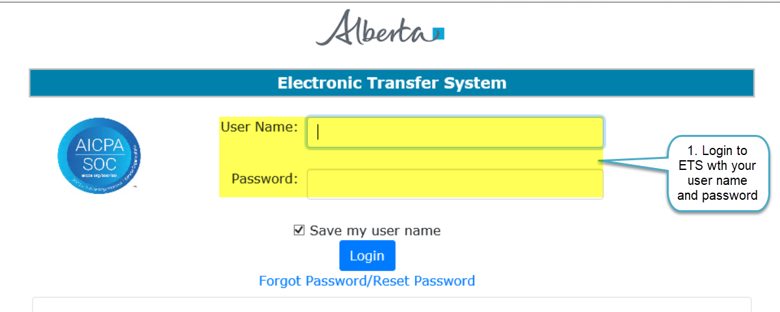
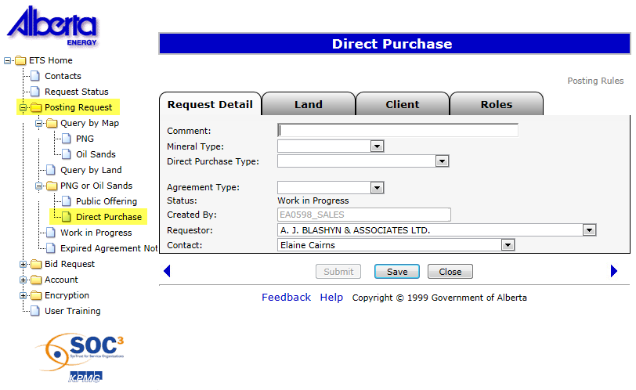

Login to ETS
2. Expand Posting Request
3. Select Direct Purchase

Slide 5
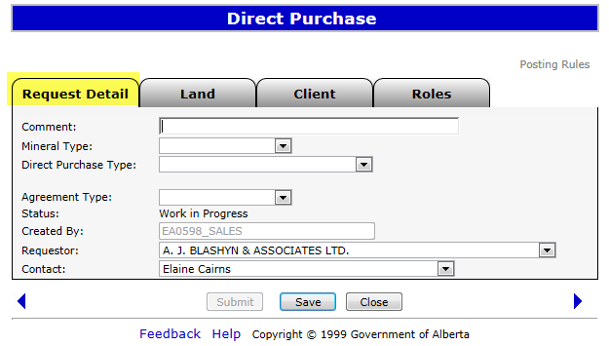
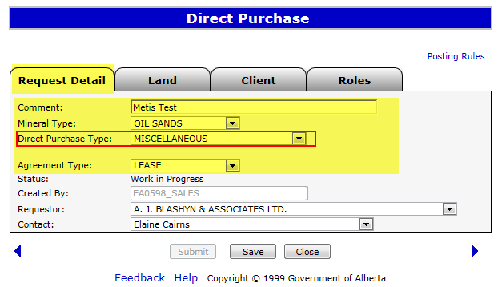
Complete Request Tab
Enter Request Detail Information
Enter Comments, Select Mineral Type, Direct Purchase Type & Agreement Type
You can only select Miscellaneous for Metis lands

Slide 6
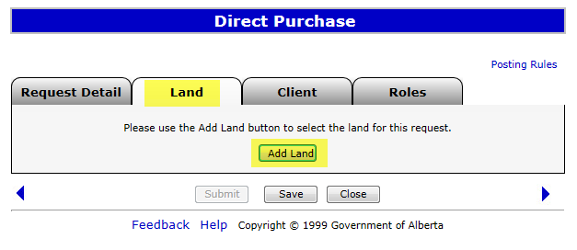
Complete Land Tab
1. Click on Land Tab
2. Click on Add Land

Slide 7
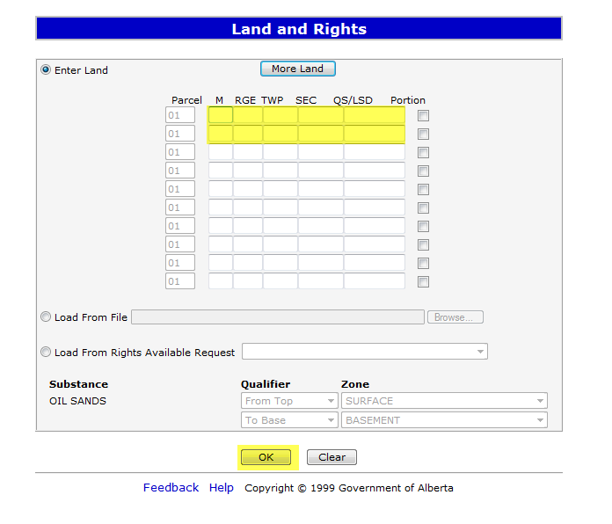
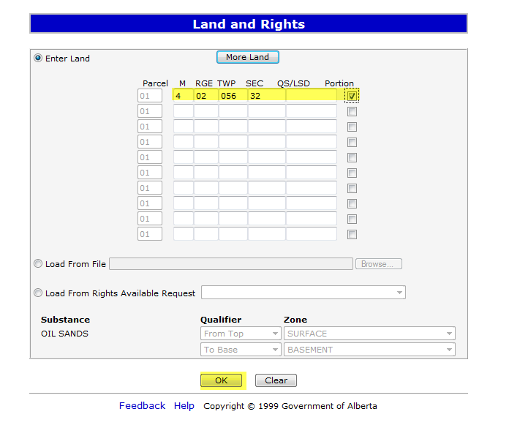
Complete Land Tab – Add Land
1. Enter Land Keys
2. Click OK

Slide 8
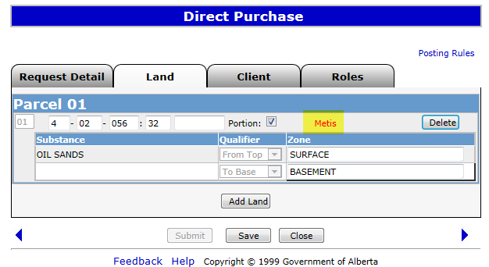
Identify Metis Land
Metis is displayed, when Metis land is entered

Slide 9
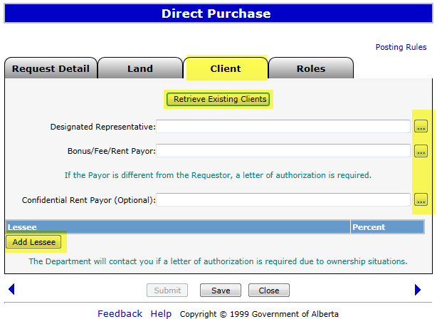
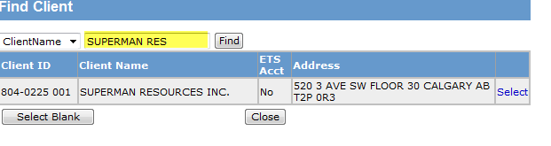
Complete Client Tab
1. Select “Retrieve Existing Clients”
2. Or click to find Designated Representative, Bonus/Fee/Rent Payor and Confidential Rent Payor
3. Click Add Lessee
3. Click on Select

Slide 10
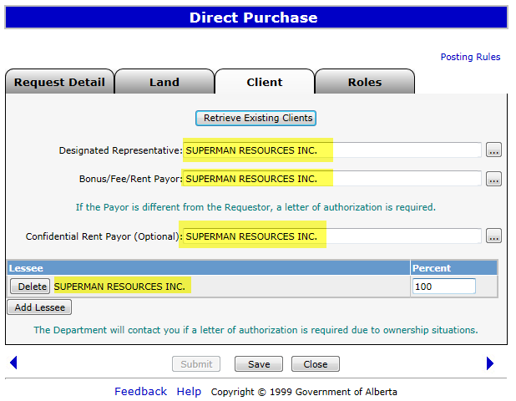
Complete Client Tab

Slide 11
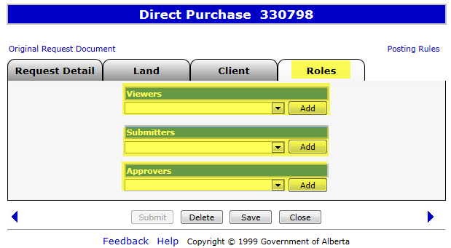
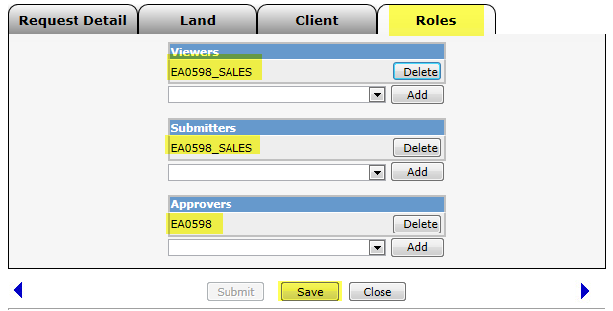
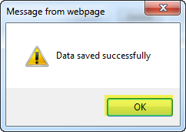
Complete Roles Tab
1. Click dropdown arrows to select the roles
2. Click Add
Roles Added
2. Click OK to Save
1. Click Save

Slide 12
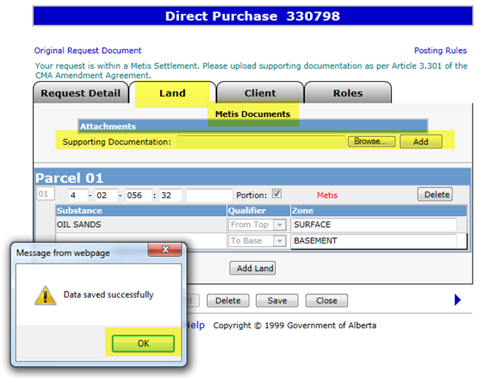
Upload Metis Supporting Documentation
Direct Purchase Request Number is generated after clicking save
Metis Supporting Documents are required to complete Direct Purchase
Go back to the land tab and the attachments area will be available for uploading
Click on Browse and once the file is located in your system, click on Add
1. Click on Browse
2. Click on Add
3. Click OK to Save

Slide 13
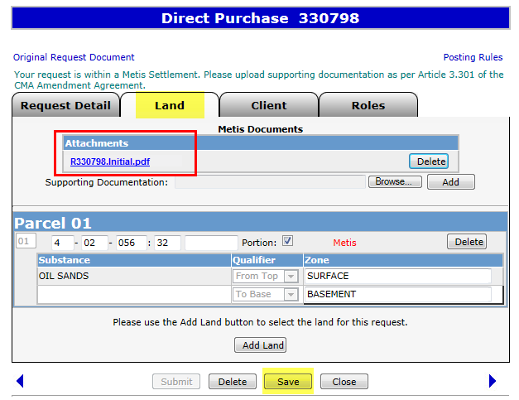
Upload Metis Supporting Documentation
The PDF Document is Displayed
Click Save

Slide 14
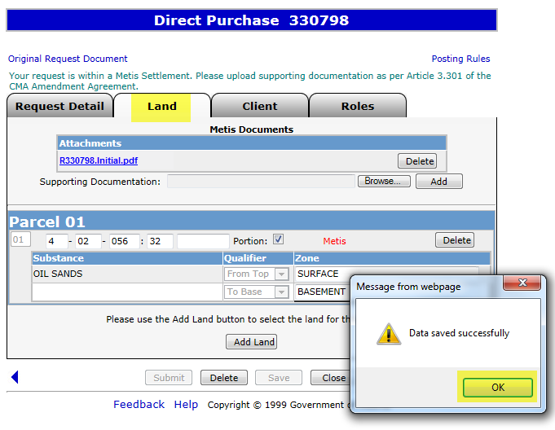
Upload Metis Supporting Documentation
Click OK to Save

Slide 15
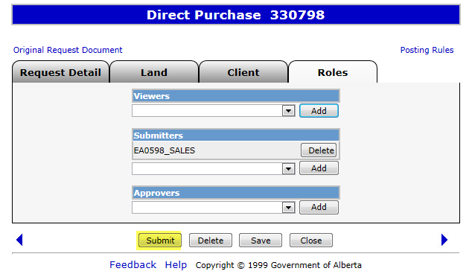
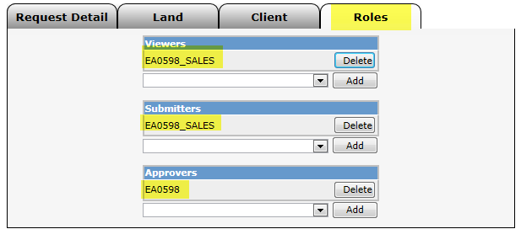
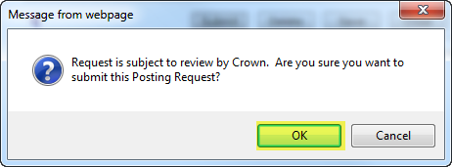
Submit
Click Submit
Click OK

Slide 16
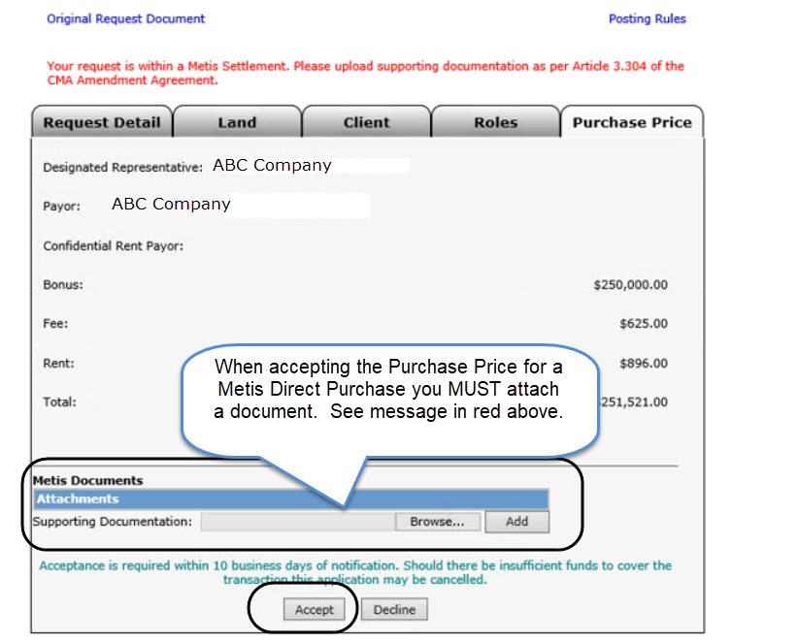
Accepting Direct Purchase Offer
When our review of your request is completed we will send back the Purchase Price, you can accept or decline that offer. If you accept, please ensure you attach a document according to Article 3.304 of the CMA Amendment Agreement

Slide 17
Resources
ETS Support and Online Learning provides access to relevant guides, course and other information
If you have questions, please contact
For PNG: Postings.Energy@gov.ab.ca or the Sales Helpdesk at (780)644-2300 or
for Oil Sands: OSTenure@gov.ab.ca

Slide 18

Conclusion
Congratulations!
You have completed the ETS – Metis Direct Purchase
Online Training Course
Please proceed to the subsequent modules detailing other functionality of the Posting application. For additional information on Postings, see the module, Direct Purchase.
If you have any comments or questions on this training module, please forward them to the following email address:
Postings.Energy@gov.ab.ca

