Slide 1

Welcome
This module will describe the procedure for a Metis Bid Request and how to upload the Metis supporting documentation.
To the ETS – Metis Bid Request
Online Training Course

Slide 2
Revisions
Date | Revisions Type | Page Number
July 17, 2013 | Initial Creation | All
April 2020 | Updates to Headings and Links | All
December 2020 | Update the ETS login page | Various

Slide 3

Introduction
In this module, you will learn how to:
Create a Bid Request
Add Parcels into your Bid Request
Calculate Bid amounts by Bonus or by Price per Hectare
Submit Metis Supporting Documentation
Submit a Bid Request
Assign Roles

Slide 4
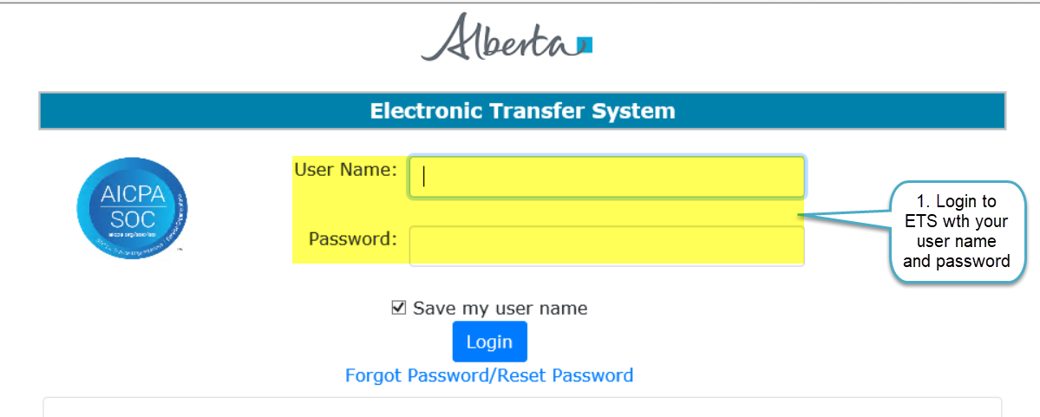
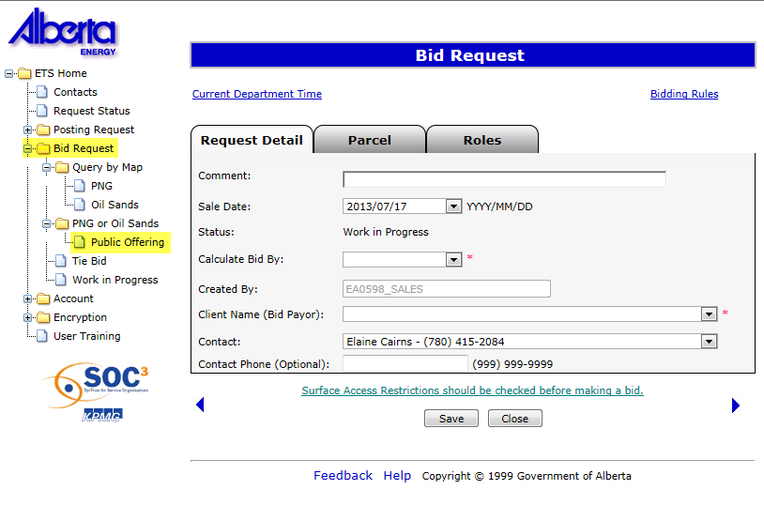

Login to ETS
2. Expand Bid Request
3. Select Public Offering

Slide 5
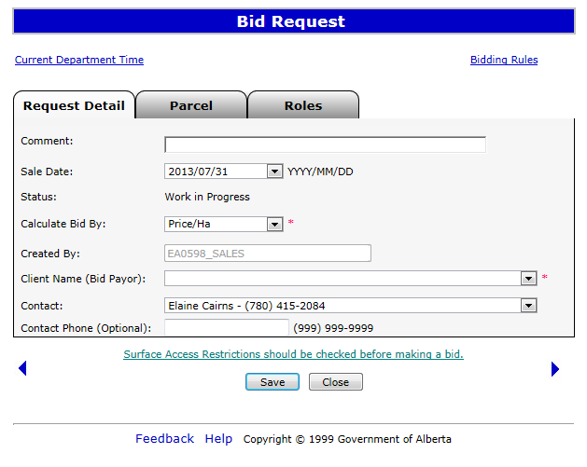

Bid Request Screen - Tabs
Request Detail - this screen contains the information required for you to begin preparing your bid
Parcel – this screen displays the available parcels that you can bid on for a selected sale date. This screen can be populated using the Query by Map function, or Load from File function
Roles – this screen allows you to identify who the viewers and submitters are for the Bids.
Use the Current Department Time link to validate the time. Bids will be closed according to this clock on Sale Days.
Use the Bidding Rules link to review current bidding rules.
The next available sale date is displayed. Use the drop-down arrow to change the Sale Date. You must create separate Bid Requests for each sale.

Slide 6
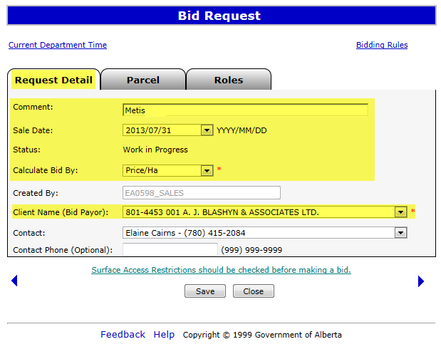
Request Detail Tab
The Request Detail screen allows you to add or change information on the bid request.
Comment: Enter Comments
Sale Date - The Default Sale Date is the next available sale. There are commonly 3 or 4 sale dates to select from in the drop down menu. Both PNG and OS Sales are held on the same sale dates. Ensure that you have selected the correct sale date prior to preparing your bids.
Status - The initial status of the request is Work In Progress.
Calculate Bid by - You can choose to calculate your bid by BONUS or PRICE PER HECTARE. This field is mandatory.
Created By - is defaulted to the user who is logged in. Only the individual with a Coordinator role can use the drop-down arrow to select a different CREATOR.
The Client Name or Bid Payor - is the company that will be debited for the total amount of all of the successful bids. You MUST be set up with an Electronic Funds Transfer account by the Sales area. If you do not want to be debited for all of your successful bids, you must submit separate Bid Request identifying the new Payor for those parcels you are not paying for. This field is mandatory.
Contact - Use the drop-down arrow to select the Contact person or keep the default. This is the person Alberta Energy contacts with any emails or phone calls. To pick another person as the contact, you must add this person to the bid request as a Viewer first.
1. Enter Comments, Select Sale Date, and choose Calculate Bid by method
2. Select Client Name (Bid Payor)
You cannot save a request until you choose at least one parcel

Slide 7
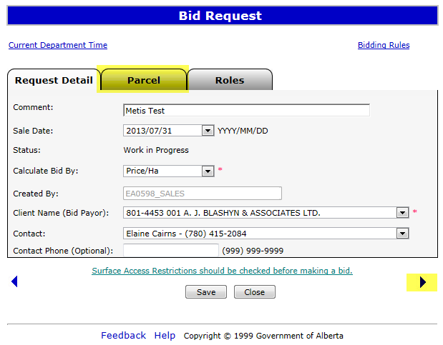
Parcel Tab
Click on the Parcel Tab
Or Click on right arrow to go to Parcels Screen
Clicking on the right arrow will take you to the next tab or, you can click on the PARCEL tab at top

Slide 8
Bid by Bonus or Price Per Hectare
The Bidding system will assist you in calculating your bid amount. You can choose to calculate your bid by BONUS or PRICE PER HECTARE. If you choose to Calculate by Bonus, the system will enter your specified Bonus value against each Parcel selected, and will calculate the Price per Hectare for each of the Parcels selected, dividing the Bonus by the Parcel hectares. If you choose to Calculate by Price per Hectare, the system will automatically calculate the Bonus amount for all of the Parcels selected, using the value you insert times the Parcel hectares. Refer to Submit Request page of this training module to view the More Information - Bid by Bonus. Refer to Query by Map training module to view the More Information - Bid by Price Per Hectare.

Slide 9
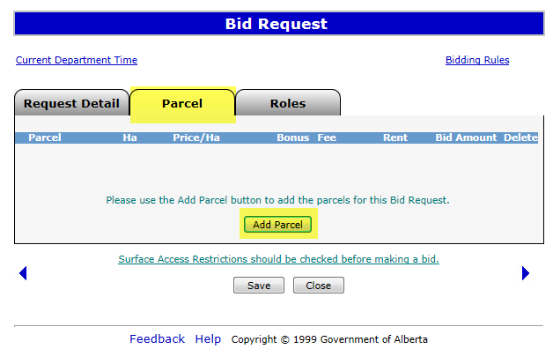
Parcel Tab – add Parcel
The Parcel screen allows you to add/delete parcels and to enter corresponding client information. There are 2 methods of manually adding Parcels to your Bid Request. Method 1 - Select Parcel Method 2 - Load from File
Clicking on the Add Parcel button will display the Add Parcel Screen.
View Add Parcel Screen

Slide 10
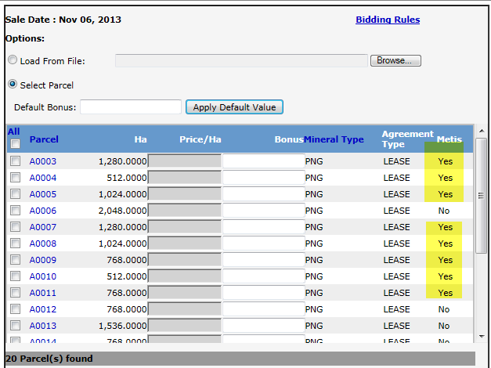
Add Parcel
Using the Select Parcel method will load all of the parcels available for the Sale you selected. The parcels will be displayed in numerical sequence and will include parcels beginning with “A” (PNG Leases), followed by “B” (PNG Licences), “L” (OS Leases) and the “P” (OS Permits).
A ‘Yes’ is displayed wherever Metis Parcel is found
Default Bonus - Based on the calculation type selected on the Request Detail screen, this button will be Default Bonus or Default Price/Ha.
Apply Default Value - After you enter your Bonus or Price/Ha value, clicking the Apply Default Value button will populate all the parcels selected with the specified Bonus amount or Price/Ha you entered. You can amend the Bonus amount or Price/Ha for individual parcels.
Check All - Clicking on this box will select ALL the parcels in the sale.
Parcel - Parcel number as it appears in the Public Offering Notice. Clicking on the Parcel column header will sort it in ascending/descending order.
HA. - Number of hectares in the parcel
Price/Ha - You must enter the money value you are bidding per hectare ($ x ha = Bonus) for each parcel you selected.
Continued………

Slide 11
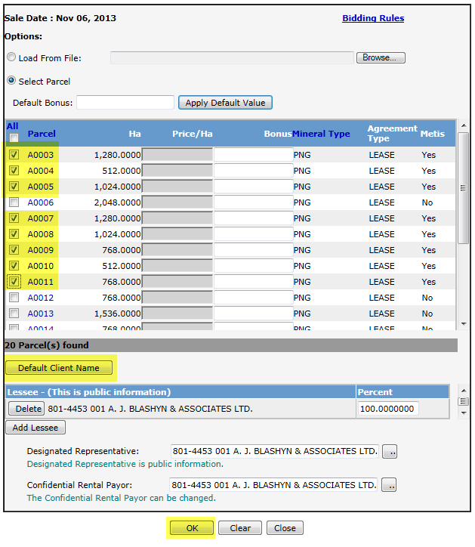
Select Parcels to Bid
1. Click the checkbox(s) to select the parcels to bid
2. Select “Default Client Name”
3. Click OK

Slide 12
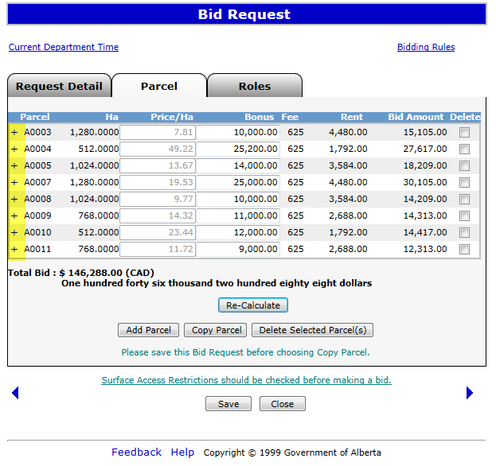
Parcel Details
Expand by clicking on ‘+’ signs to show details of the parcel(s)

Slide 13
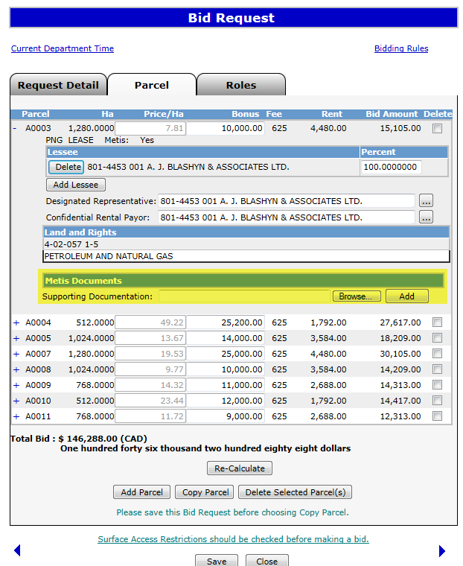
Metis Supporting Documentation
Metis Supporting Documents are required to complete Bid Request
Click on Browse and once the file is located in your system, click on Add
1. Click on Browse
2. Click on Add

Slide 14
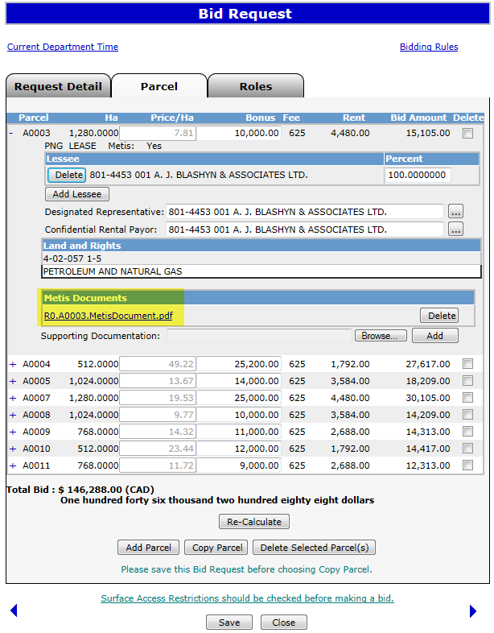
Metis Supporting Documentation
The PDF Document is Displayed

Slide 15
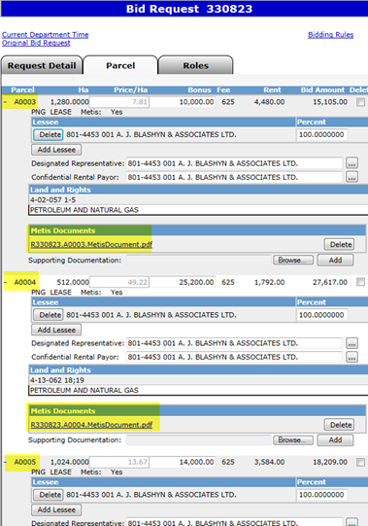
Attach Metis Supporting Documents
Follow the same steps explained in page 12 to expand the parcels
All the required parcels are expanded with a ‘-’ sign and the Metis documentation can be attached using Browse and Add buttons

Slide 16
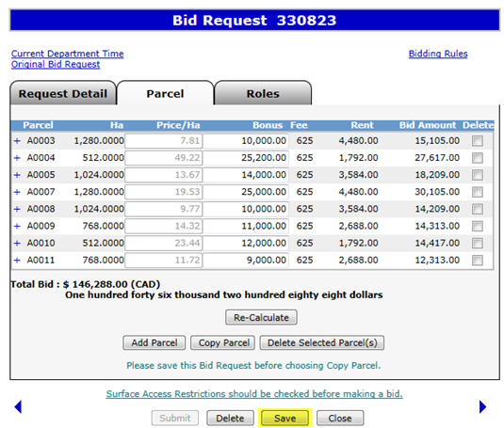
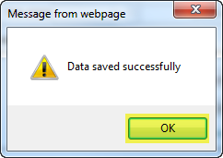
Saving Parcels for Bid
1. Click Save
2. Click OK to Save

Slide 17
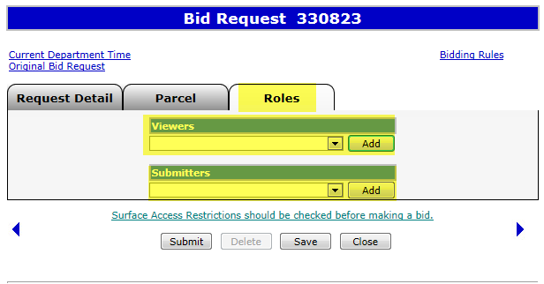
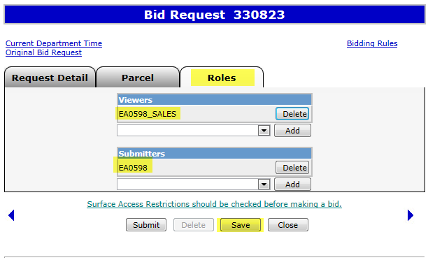
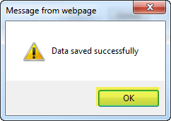
Add Roles
2. Click Add
1. Click dropdown arrows to select the roles
Roles Added
2. Click OK to Save
1. Click Save

Slide 18
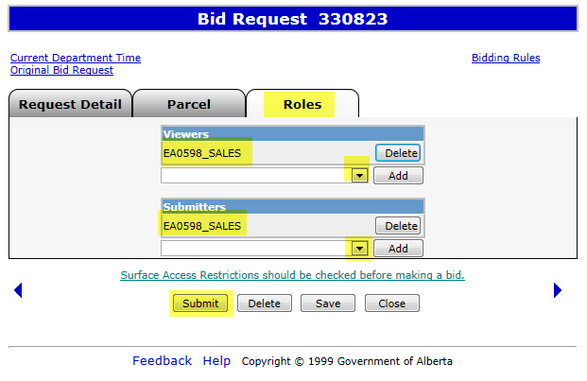
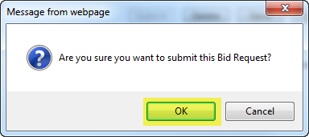
Add Roles
1. Click Submit
2. Click OK to Confirm

Slide 19
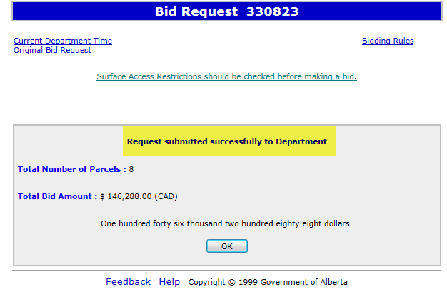
Bid Request Submitted
Request submitted successfully message appears

Slide 20
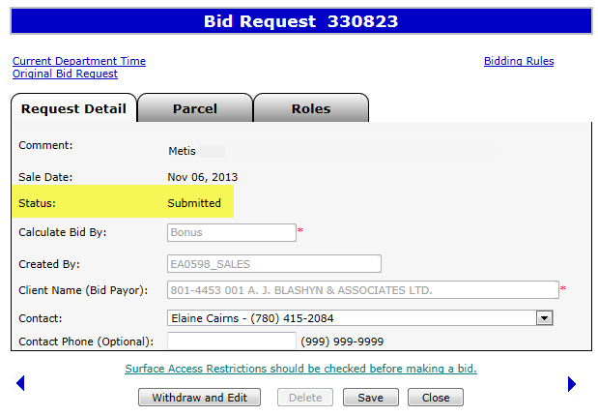
Status - Submitted
Once your bid is successfully submitted the Status changes to Submitted

Slide 21
Resources
ETS Support and Online Learning provides access to relevant guides, course and other information
If you have questions, please contact
For PNG: Bidding.energy@gov.ab.ca or the Sales Helpdesk at (780)644-2300 or
for Oil Sands: OSTenure@gov.ab.ca

Slide 22

Conclusion
Congratulations!
You have completed the ETS – Metis Bid Request
Online Training Course
Please proceed to the subsequent modules detailing other functionality of the Bidding application. For additional information on Bidding, see the module, Initiate Bid Request. If you have any comments or questions on this training module, please forward them to the following email address: Bidding.Energy@gov.ab.ca

