Slide 1

Welcome
Your total bid includes the bonus, rent at $3.50/ha or $50.00 whichever is greater, and an agreement fee of $625.00.
A bonus offer of less than $35.00 per hectare for a lease or a licence will not be considered.
Electronic Funds Transfer (EFT) is the only method of payment for bids.
In order for you to create bid requests, you MUST have a Creator role. Once a bid request is created, it can be submitted by someone who has been assigned the role of Submitter.
To the ETS – Initiate Bid Request
Online Training Course

Slide 2
Revisions
Date | Revisions Type | Page Number
August 31, 2012 | Conversion | All
May 10, 2013 | Updated Query by Map | 4
April 2020 | Update | All
July 15, 2021 | Update | 1

Slide 3

Introduction
In this module, you will learn how to:
Create a Bid Request
Import Parcels into your Bid Request using Query by Map
Calculate Bid amounts by Bonus or by Price per Hectare
Submit a Bid Request

Slide 4
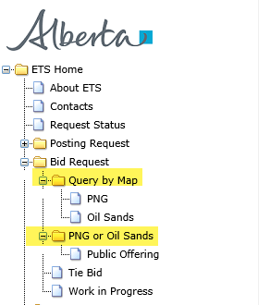
Methods of Creating a Bid Request
A Bid Request can be created using 2 methods.
Query by Map
Allows you to select P&NG and OS parcels geographically using a Map and then load them into the Bid Request screen. The P&NG and OS parcels are on separate maps. Once the Bid Request screen has been populated with the graphically selected Parcel information, you will complete the Bid Request in the same manner as Method 2. To learn more about Query by Map please refer to the module Query by Map on Bidding Home page of online learning.
Public Offering
Allows you to create a Bid Request by selecting a Sale Date and displaying all of the available parcels or, by loading your parcels from an .xml or a .csv file.
The Public Offering option allows users to create a bid request for the PNG and OS rights for a specific sale date. Users must fill in the information on the Bid Request screen and then submit the request to Alberta Energy

Slide 5
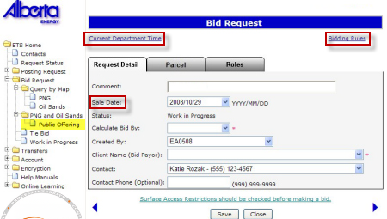
Bid Request Screen
Request Detail - this screen contains the information required for you to begin preparing your bid
Parcel – this screen displays the available parcels that you can bid on for a selected sale date. This screen can be populated using the Query by Map function, or Load from File function
Roles – this screen allows you to identify who the viewers and submitters are for the Bids.
Tip: Use the Current Department Time link to validate the time. Bids will be closed according to this clock on Sale Days.
Tip: Use the Bidding Rules link to review current bidding rules.
Tip: The next available sale date is displayed. Use the drop-down arrow to change the Sale Date. You must create separate Bid Requests for each sale.

Slide 6
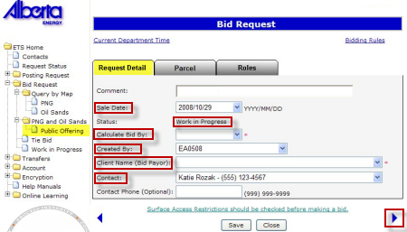
Request Detail Tab
The Request Detail screen allows you to add or change information on the bid request.
Sale Date - The Default Sale Date is the next available sale. There are commonly 3 or 4 sale dates to select from in the drop down menu. Both PNG and OS Sales are held on the same sale dates. Ensure that you have selected the correct sale date prior to preparing your bids.
Status - The initial status of the request is Work In Progress.
Calculate Bid by - You can choose to calculate your bid by BONUS or PRICE PER HECTARE. This field is mandatory.
Created By - is defaulted to the user who is logged in. Only the individual with a Coordinator role can use the drop-down arrow to select a different CREATOR.
The Client Name or Bid Payor - is the company that will be debited for the total amount of all of the successful bids. You MUST be set up with an Electronic Funds Transfer account by the Sales area. If you do not want to be debited for all of your successful bids, you must submit another Bid Request identifying the new Payor for those parcels you are not paying for. This field is mandatory.
Right Arrow - Clicking on the right arrow will take you to the next tab or, you can click on the PARCEL tab at top
Contact - Use the drop-down arrow to select the Contact person or keep the default. This is the person the DOE contacts with any emails or phone calls. To pick another person as the contact, you must add this person to the bid request as a Viewer first.
Tip: You cannot save a request before choosing Parcels.

Slide 7
Bid by Bonus or Price Per Hectare
The Bidding system will assist you in calculating your bid amount. You can choose to calculate your bid by BONUS or PRICE PER HECTARE.
If you choose to Calculate by Bonus, the system will enter your specified Bonus value against each Parcel selected, and will calculate the Price per Hectare for each of the Parcels selected, dividing the Bonus by the Parcel hectares.
If you choose to Calculate by Price per Hectare, the system will automatically calculate the Bonus amount for all of the Parcels selected, using the value you insert times the Parcel hectares.
Refer to Submit Request page of this training module to view the More Information - Bid by Bonus.
Refer to Query by Map training module to view the More Information - Bid by Price Per Hectare.

Slide 8
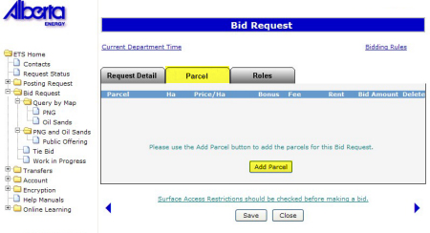
Parcel Tab
The Parcel screen allows you to add/delete parcels and to enter corresponding client information. There are 2 methods of manually adding Parcels to your Bid Request.
Method 1 - Select Parcel
Method 2 - Load from File
Clicking on the Add Parcel button will display the Add Parcel Screen.
View Add Parcel Screen

Slide 9
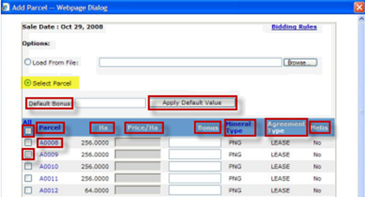
Add Parcel using Select Parcel Method
Using the Select Parcel method will load all of the parcels available for the Sale you selected. The parcels will be displayed in numerical sequence and will include parcels beginning with “A” (PNG Leases), followed by “B” (PNG Licences), “L” (OS Leases) and the “P” (OS Permits).
Using the Query by Map option allows you to select parcels geographically using a Map. The parcels selected can be loaded into the Bid Request Parcel screen.
Default Bonus - Based on the calculation type selected on the Request Detail screen, this button will be Default Bonus or Default Price/Ha.
Apply Default Value - After you enter your Bonus or Price/Ha value, clicking the Apply Default Value button will populate all the parcels selected with the specified Bonus amount or Price/Ha you entered. You can amend the Bonus amount or Price/Ha for individual parcels.
Check All - Clicking on this box will select ALL the parcels in the sale.
Parcel - Parcel number as it appears in the Public Offering Notice. Clicking on the Parcel column header will sort it in ascending/descending order.
No. - Number of hectares in the parcel
Price/Ha - You must enter the money value you are bidding per hectare ($ x ha = Bonus) for each parcel you selected.
Continued………

Slide 10
Add Parcel using Select Parcel Method (Continued)
Bonus - You must enter the total money value (Bonus) you are bidding for each parcel you selected.
Mineral Type - Mineral type of the parcel (PNG or OS). You can change the order of parcels to OS Mineral Type first by clicking on the Mineral Type column header.
Agreement type - Agreement type of the parcel (Lease, Licence or Permit).
Metis - The Yes/No flag indicates if the parcel is a Metis parcel.
Parcel Number - Clicking on a parcel number will show the land and rights associated with the parcel.
Select Parcel - Clicking on the box beside the Parcel number will select that parcel.

Slide 11
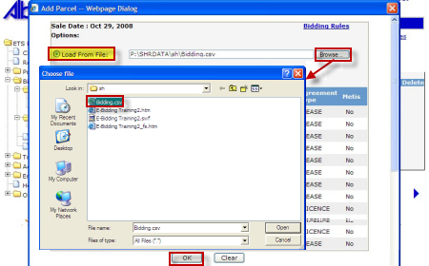
Add Parcel using Load from File Method
Use the Load from File method to load your parcels, monetary values and client information from an XML or CSV file that was created using your in-house system.
Load from File - Select the Load from File button.
Browse - Click Browse to find the file containing the XML or CSV file you have created.
Select - Select the file
OK - Clicking on the OK button will populate the Parcel screen with the information from the XML or CSV file.

Slide 12
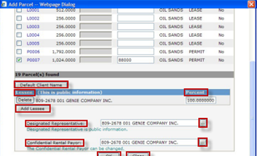
Add Parcel – Client Information
In the Add Parcel screen, you must add the client information (Lessee(s), Designated Representative, and Confidential Rental Payor) for the parcels you are bidding on. Once you have filled in the information, click OK.
Default Client Name - Clicking on the Default Client Name button will default your client name as the Lessee, Designated Representative and Confidential Rental Payor for the parcel(s).
Lessee - The Lessee is the client who has an interest in the lease, licence or permit.
Percent - Each Lessee's interest must be shown as a percentage and the total of all the percentages must be 100 percent.
Add Lessee - Use the Add Lessee button to select the lessee, or add additional lessees from the FIND CLIENT screen.
Designated Representative is the client designated as the representative of the lease, licence or permit. This client will receive all correspondence from Alberta Energy relating to the agreement.
Find - If your company is not the representative of the lease, licence, or permit, use the ellipsis button to select a different Designated Representative from the FIND CLIENT screen.
The Confidential Rental Payor defaults to the client creating the bid request (bid payor).
Find - If your company is not responsible for future rent payments, use the ellipsis button to select a different rent payor from the FIND CLIENT screen.
OK - Clicking on the OK button will validate the information, and enter it on the Parcel Tab.
Clear button resets all the values in the screen.

Slide 13
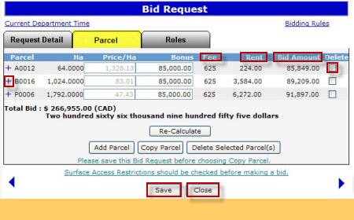
Change Parcel Information Prior to Submitting
Once the Parcel tab is populated , the Bonus or Price/Ha of a parcel and the client information can be modified by clicking on the following buttons:
Re-Calculate button re-calculates the Bonus, Price/Ha, and Bid Amount based on the changes made.
Add Parcel button allows you to add more parcels to your bid request.
Copy Parcel button allows you to copy the Bonus or Price/Ha and/or client information from one parcel to other parcels on the same bid request.
Delete Selected Parcel(s) button allows you to delete parcels from your bid request.
Fee - Mineral Agreement Issuance Fee
Rent - Annual Rent
Bid amount includes the Bonus Amount, the Agreement Fee and the Rent for the first year of the agreement.
Delete - Click the Delete checkbox to select the Parcel you want to delete. Clicking on the Delete Selected Parcel(s) button will delete the selected parcel(s).
Information - Clicking on the "+” sign will show the land and rights and client information associated with the parcel.
Save - Clicking on the Save button will save the changes.
Close - Clicking on the Close button will close the screen and all the changes will be lost.

Slide 14
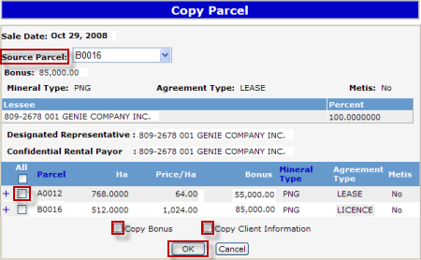
Change Parcel Information Prior to Submitting (Continued)
Tip: Always save your bid request before performing the Copy Parcel operation to make sure you are copying the right information.
Source Parcel - Source Parcel can be chosen from the list of parcels selected for the bid request.
Select - Select the box beside the parcel number that you want to copy to.
Copy Bonus - Select the Copy Bonus box to copy the bonus. If bid is created by Price/Ha, this box will be called Copy Price/Ha.
Copy Client Information - Select the Copy Client Information box to copy the client information.
OK - Click OK to perform the copy operation. Clicking CANCEL will cancel the copy operation.

Slide 15
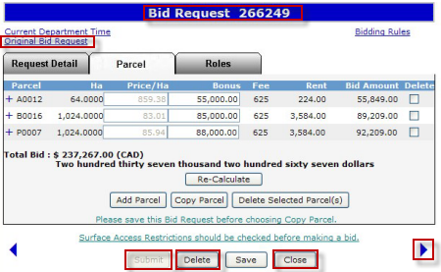
Save Request
When you save the bid request, any error or warning messages will be displayed at the top of the screen. If there are no errors, the system will assign a Bid Request Number and provide a link to the Original Bid Request.
Tip: Saving a bid request does not submit it to Alberta Energy.
A Bid Request Number is assigned when the request is saved.
Original Bid Request - Clicking on the Original Bid Request link will open your bid document.
Right Arrow - To move to the Roles tab, you can click on the right arrow or click on the Roles tab at the top of the screen.
Submit - If the Submit button is greyed out, you must add a Submitter in the Roles screen to submit the bid.
Delete - Clicking on the Delete button will display a confirmation message. Upon acceptance, the status of the request will be changed to Client Cancelled. Client Cancelled bid requests cannot be edited.
Close - Clicking on the Close button will close the screen and all the changes will be lost.

Slide 16
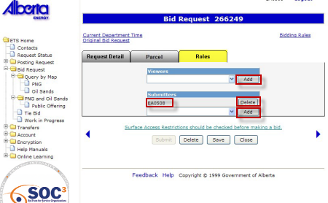

Roles Tab
The Roles screen is used to define who can view and submit your request. If you have already added a viewer and/or submitter by accessing the Account folder, Preferences page, Bid Request Preferences, the Viewer and Submitter box will be filled in. You can add or delete Viewers and Submitters for each bid request.
Tip: If the submitter and the creator of the bid request are different users, it is the responsibility of the creator to advise the submitter that the request is now available for submission to the Department.
Add - Adding a Viewer to the bid request is optional. Use the drop-down arrow to find and select users who can view requests.
Submitters - This submitter was set up in the ETS Account - Bid Request Preference and can submit the bid.
Delete - Use the Delete button to remove a Viewer or Submitter from your bid request.
Add Submitter - If the Submit button is greyed out, you must add a Submitter to submit your bid request. Use the drop-down arrow to find and select users who can submit requests.

Slide 17
Submit Request – Bid by Bonus
More Information (Pages 18 to 45)
If you do not have a submitter role, the user selected as the Submitter for this request must log onto the system and submit the request.
Clicking on the SUBMIT button will display a confirmation message. Upon acceptance, the system validates the request and if no errors are encountered, the request will be submitted to Alberta Energy. The status of your request will change to "Submitted" and the SUBMIT button changes to WITHDRAW AND EDIT.
Tip: Once submitted only the Contact Name, Contact Phone, or Created By fields can be changed and saved without withdrawing the request.

Slide 18
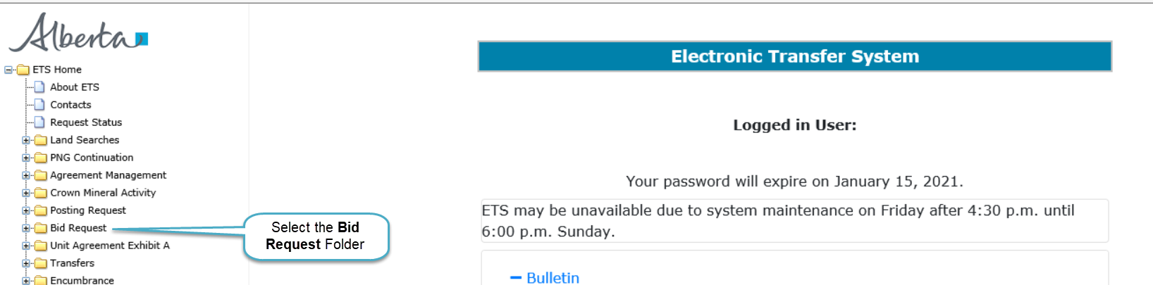
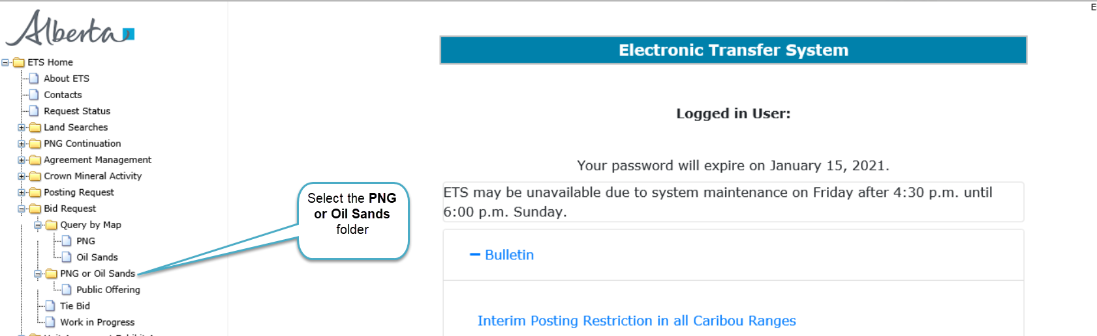
Selecting Bid request folder expands tree node to show PNG or Oil Sands folder
Back to Submit Request – Bid by Bonus

Slide 19
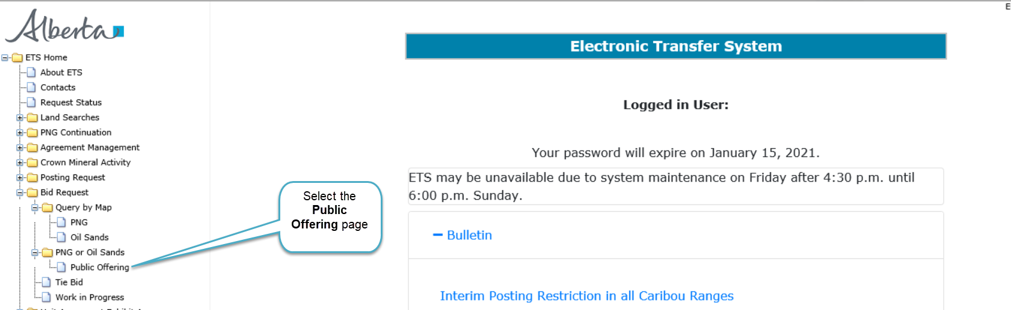
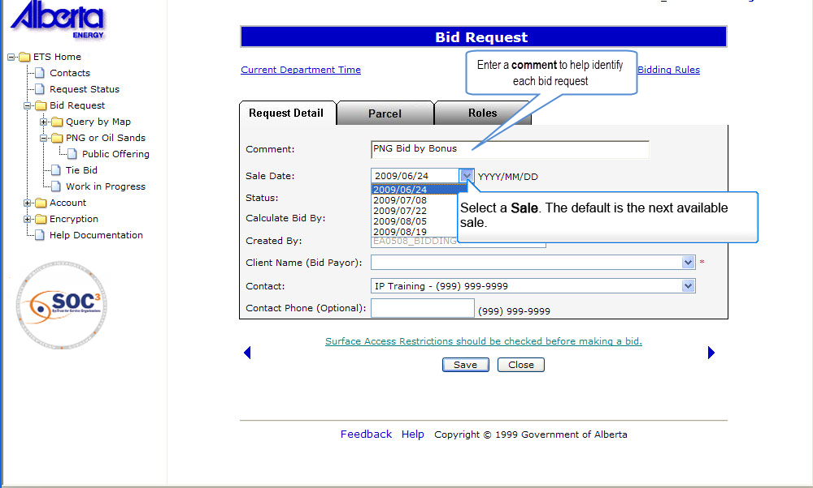
Selecting Public Offering link brings up the Bid Request page
Back to Submit Request – Bid by Bonus

Slide 20
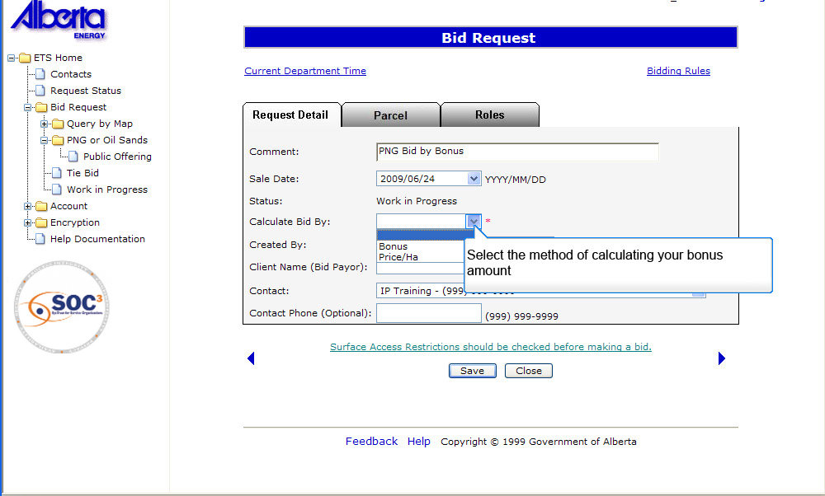
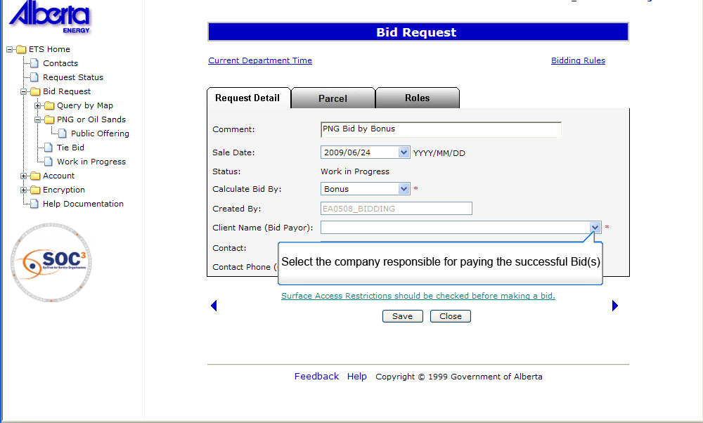
Select method of calculating bonus from dropdown list and select company responsible
Back to Submit Request – Bid by Bonus

Slide 21
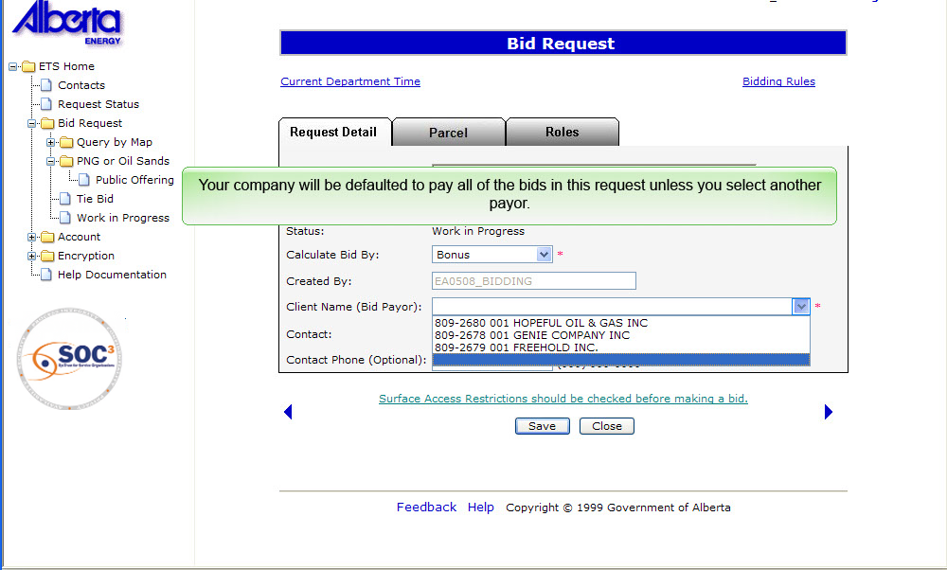
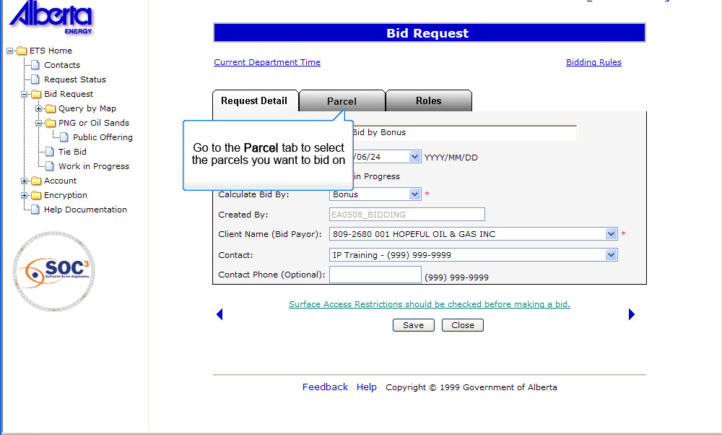
To select parcels click on parcel tab
Back to Submit Request – Bid by Bonus

Slide 22
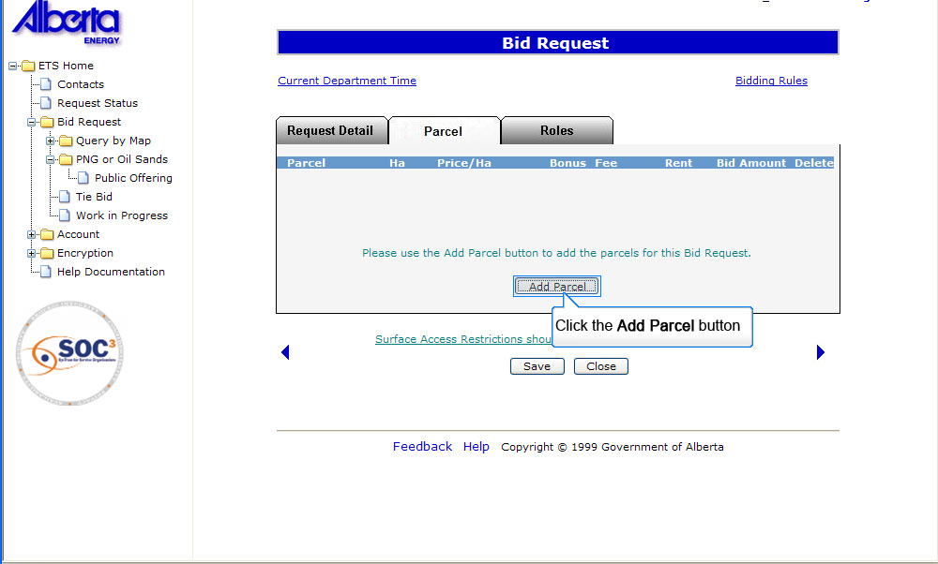
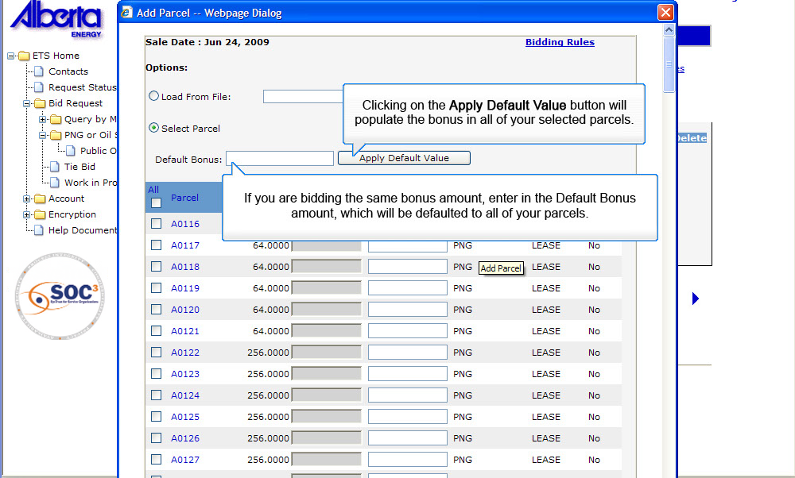
Enter the default bonus amount if you are bidding the same bonus amount
Back to Submit Request – Bid by Bonus

Slide 23
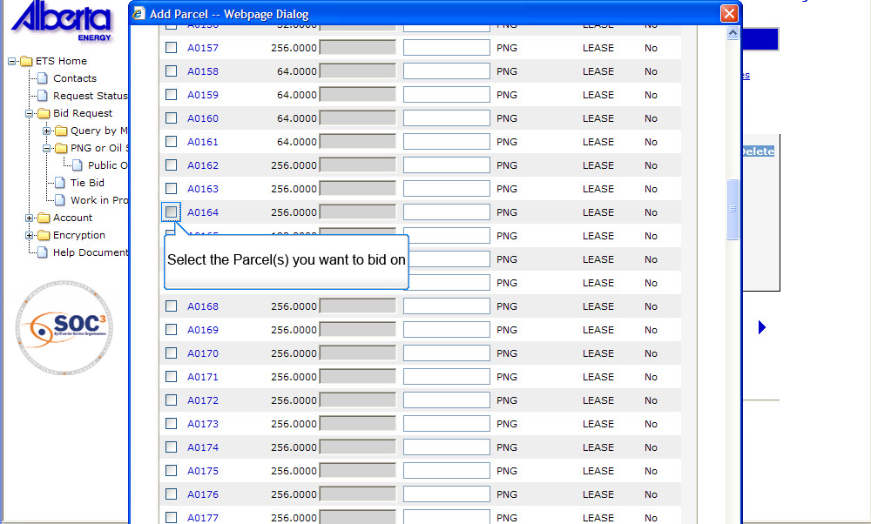
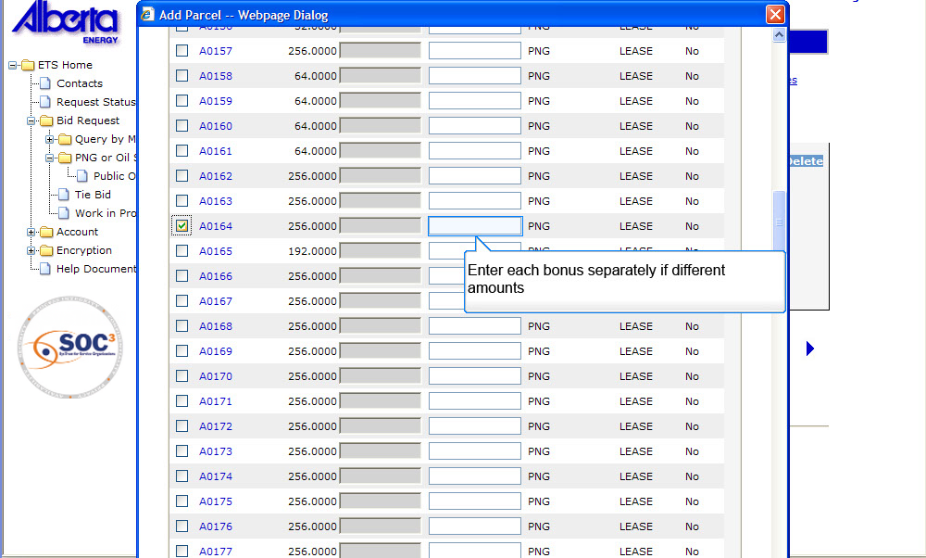
Enter each bonus separately if different amounts
Back to Submit Request – Bid by Bonus

Slide 24
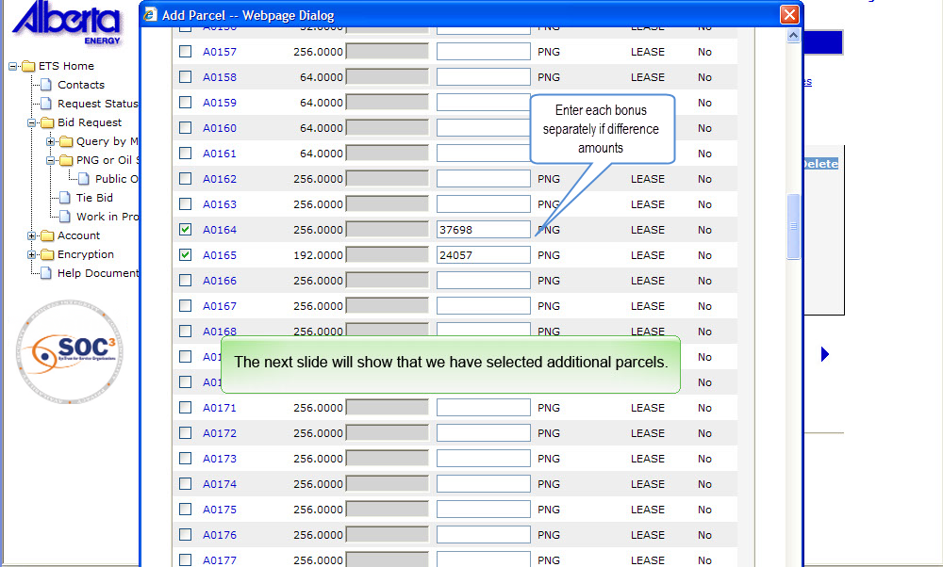
Selection of additional parcels is shown on next slide
Back to Submit Request – Bid by Bonus

Slide 25
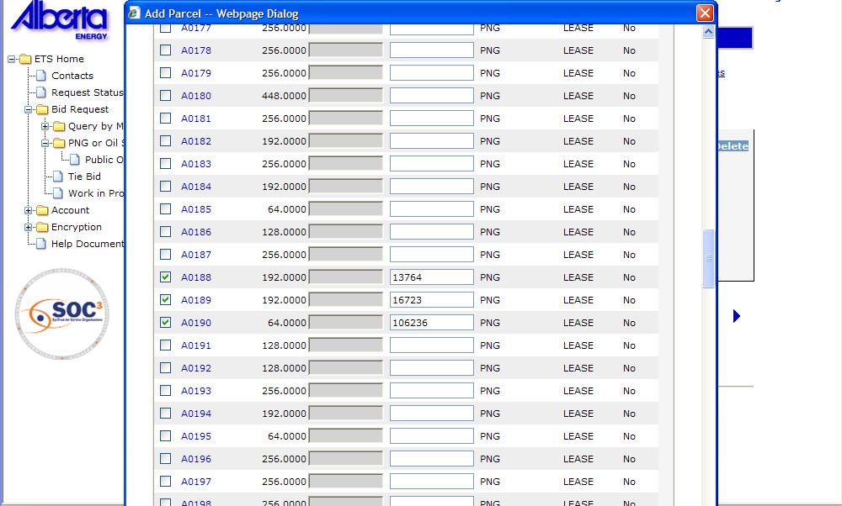
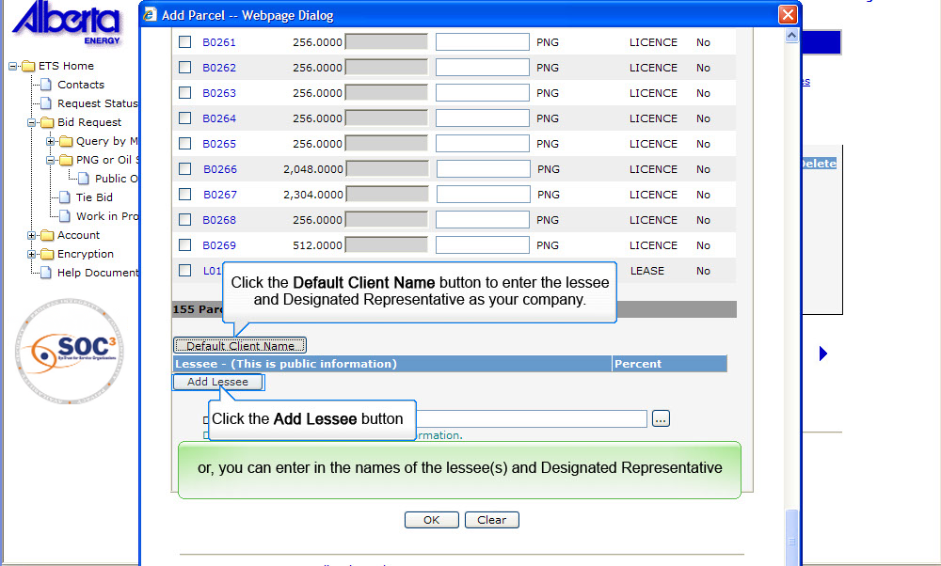
Click Default client name or add lessee, you can also enter the names of both
Back to Submit Request – Bid by Bonus

Slide 26
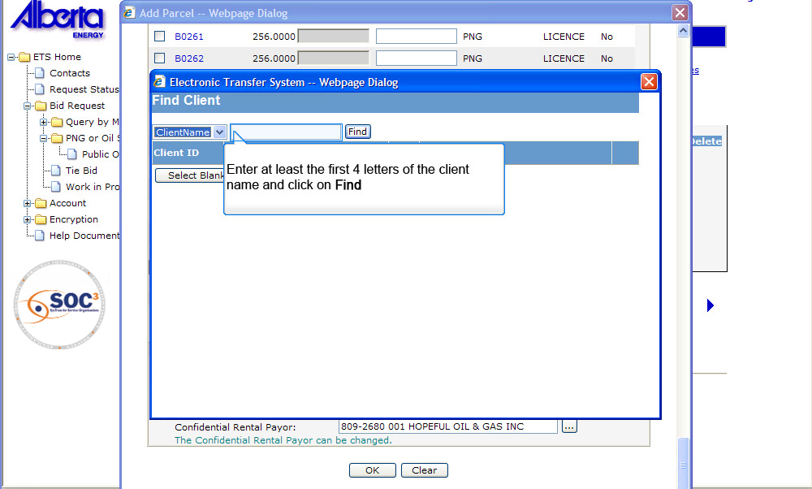
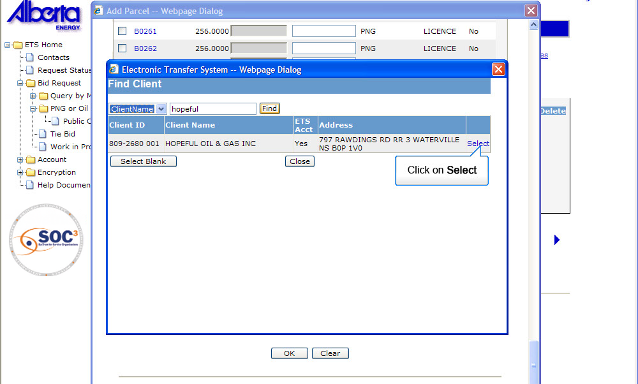
Clicking find after entering first 4 letters of client name will bring up the full client name
Back to Submit Request – Bid by Bonus

Slide 27
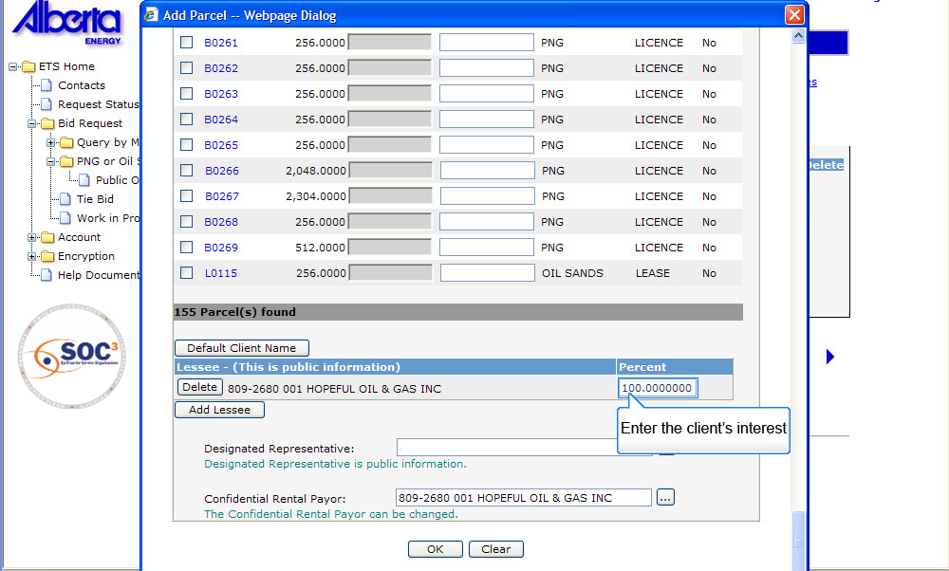
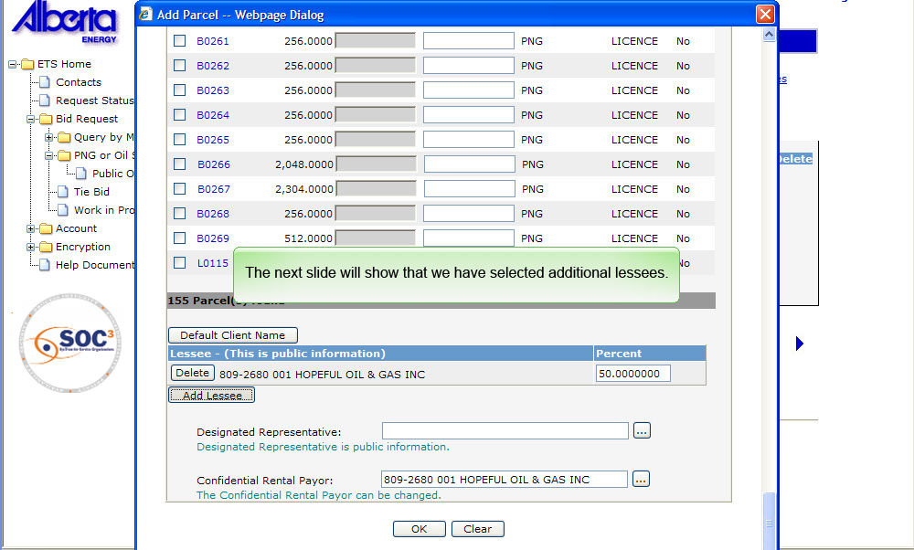
Back to Submit Request – Bid by Bonus

Slide 28
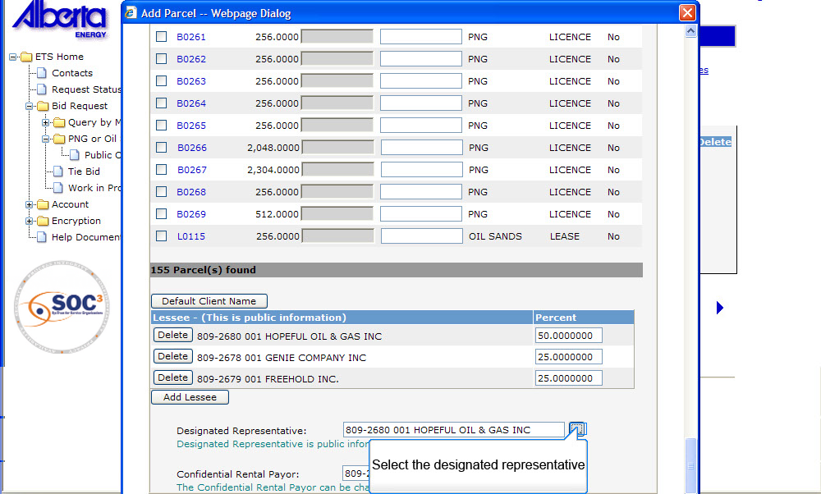
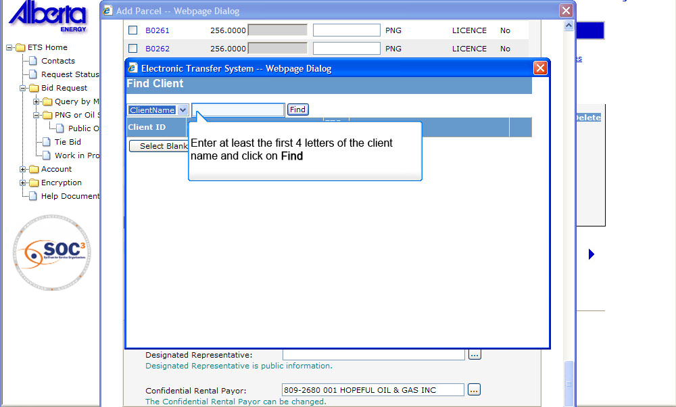
Clicking find after entering first 4 letters of client name will bring up the full client name
Back to Submit Request – Bid by Bonus

Slide 29
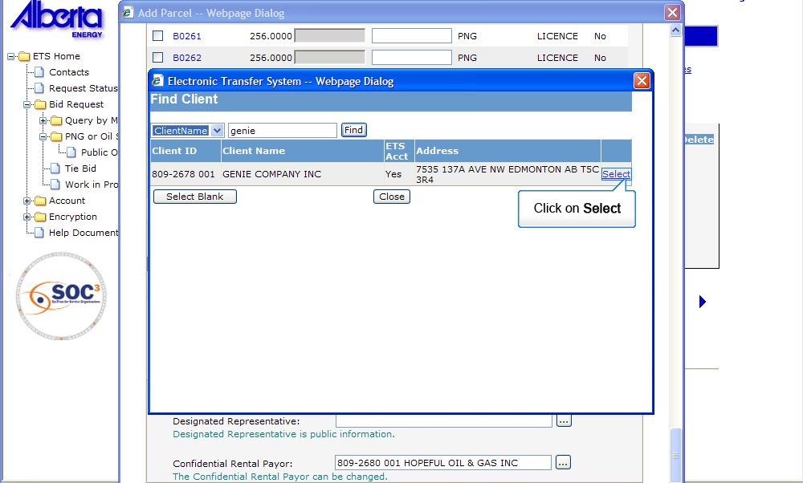
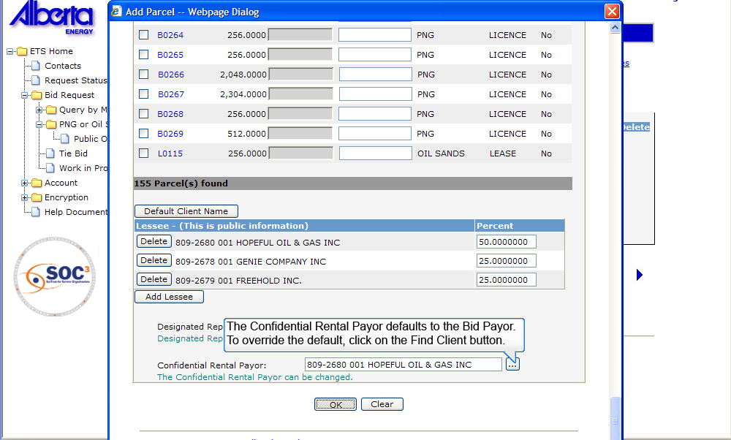
To override the default, click on the Find Client button
Back to Submit Request – Bid by Bonus

Slide 30
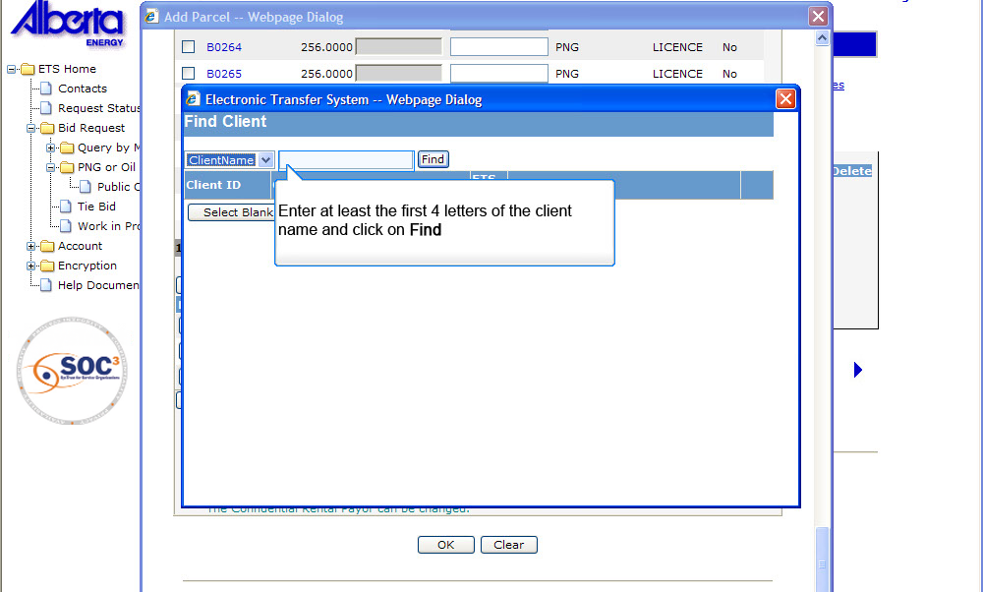
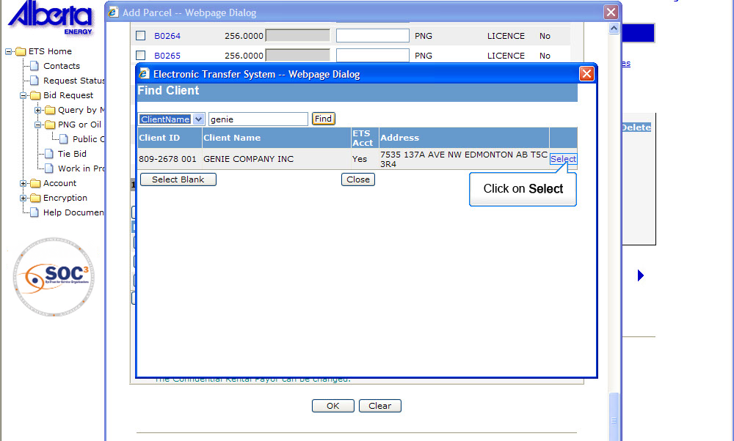
Clicking find after entering first 4 letters of client name will bring up the full client name
Back to Submit Request – Bid by Bonus

Slide 31
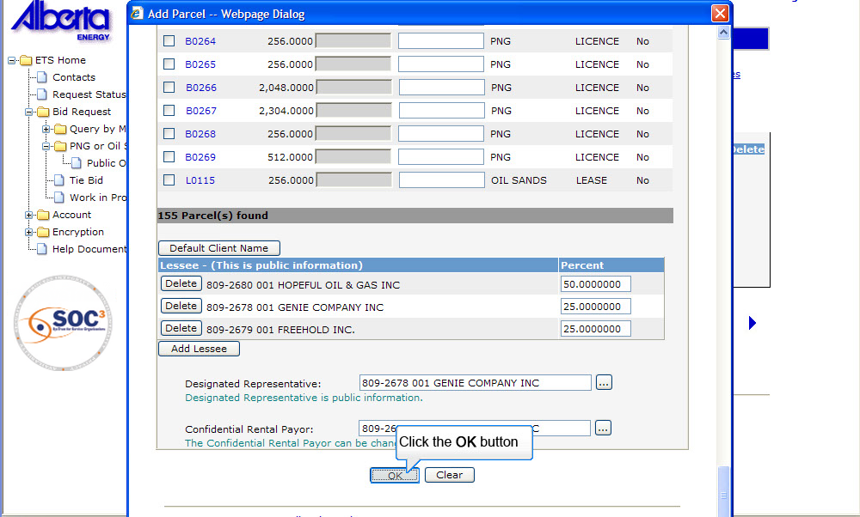
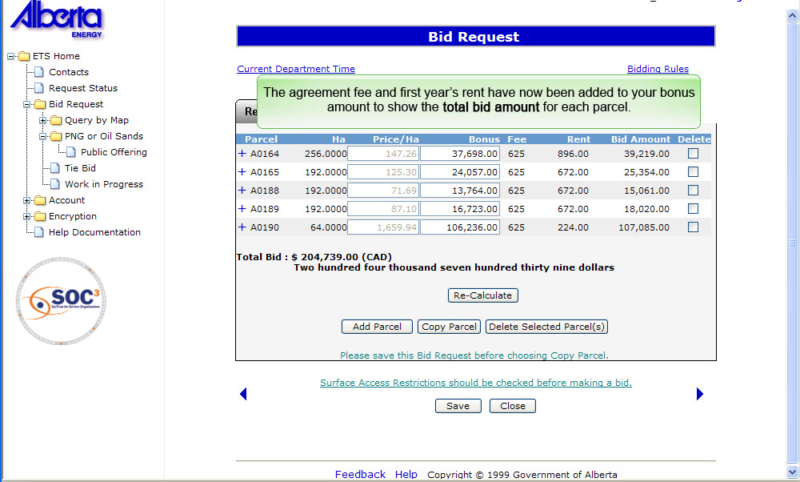
The agreement fee and first year’s rent is added
Back to Submit Request – Bid by Bonus

Slide 32
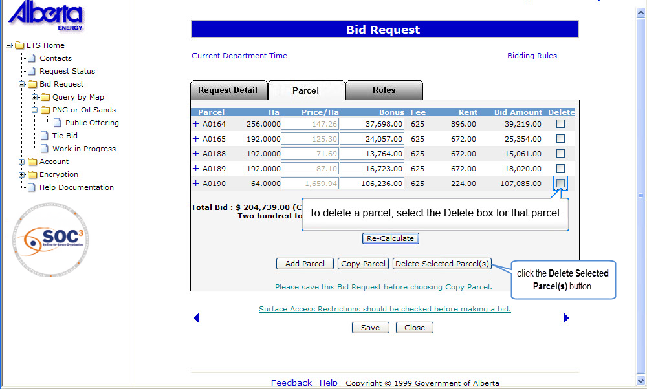
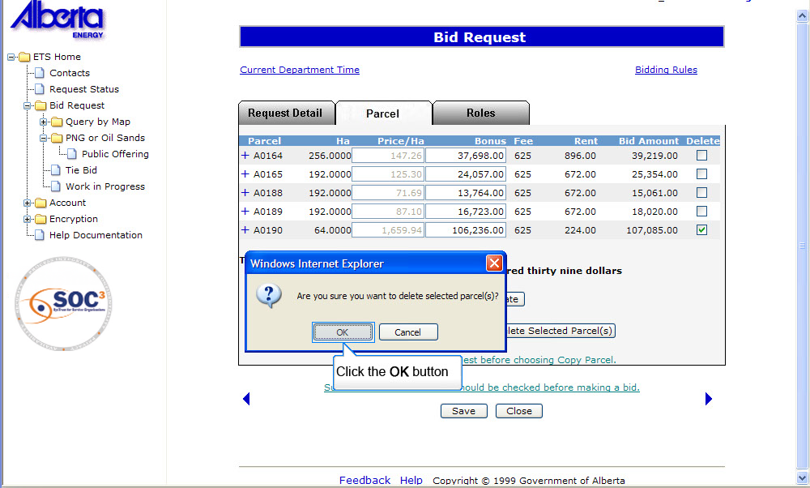
To Change Parcel Information prior to Submitting
Clicking OK will complete the deletion process
Back to Submit Request – Bid by Bonus

Slide 33
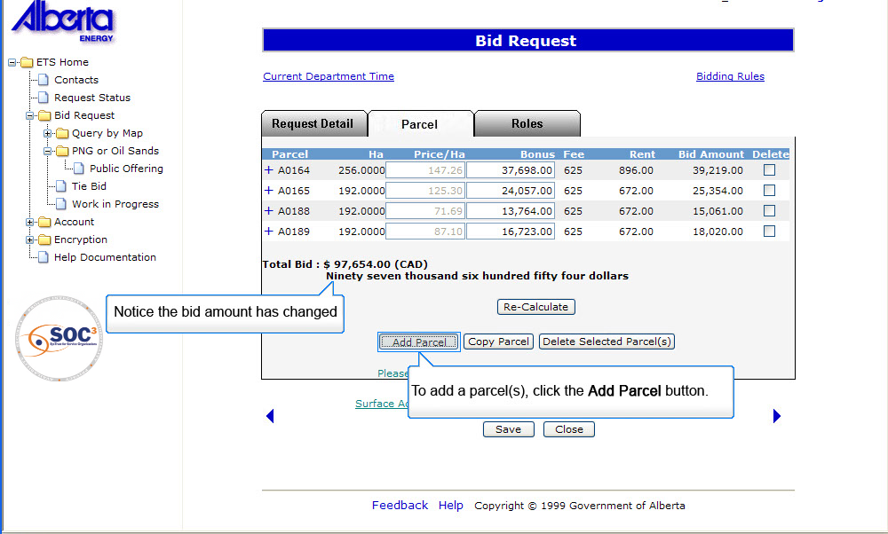
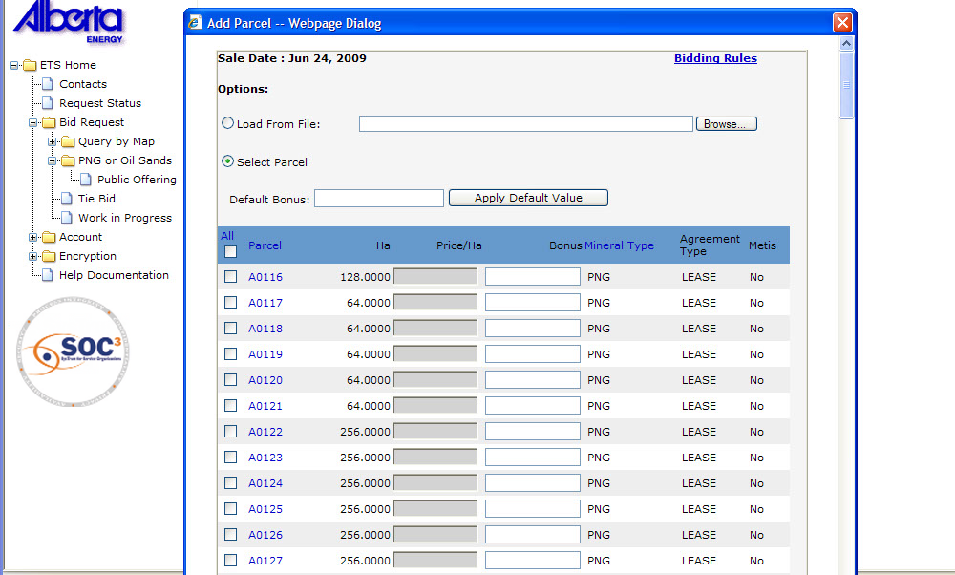
Bid amount will change
Back to Submit Request – Bid by Bonus

Slide 34
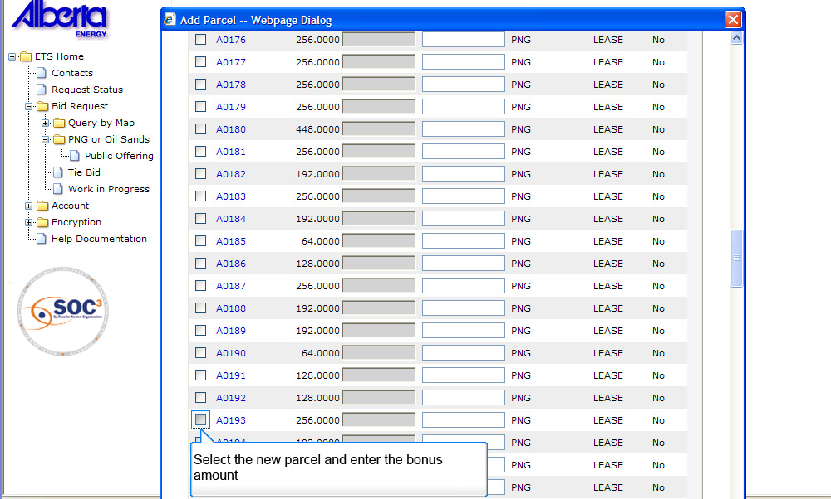
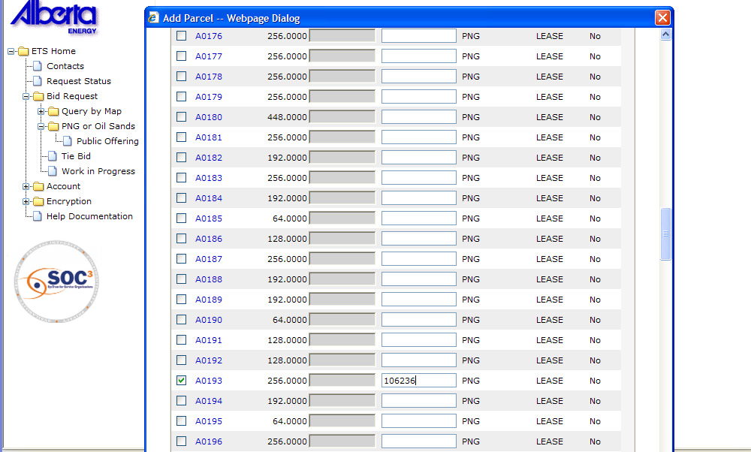
You can select new parcel now
Back to Submit Request – Bid by Bonus

Slide 35
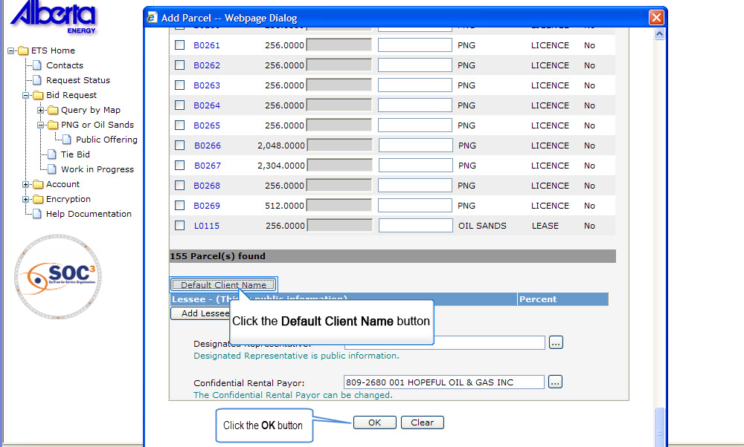
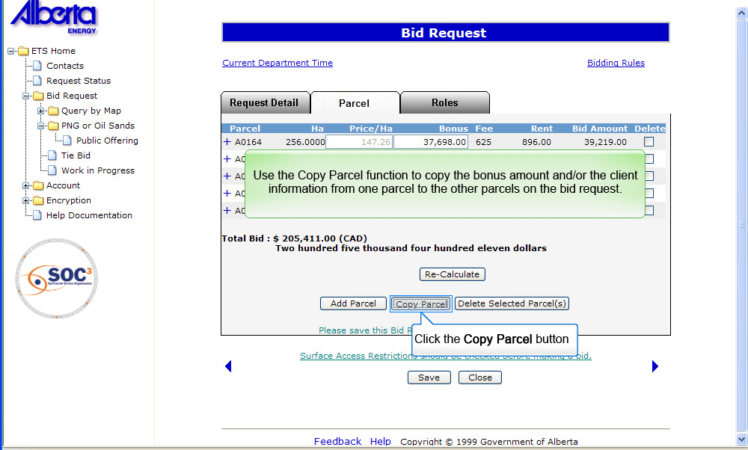
Copy parcel function copies the bonus amount and client information from one parcel to the other on the bid request
Back to Submit Request – Bid by Bonus

Slide 36
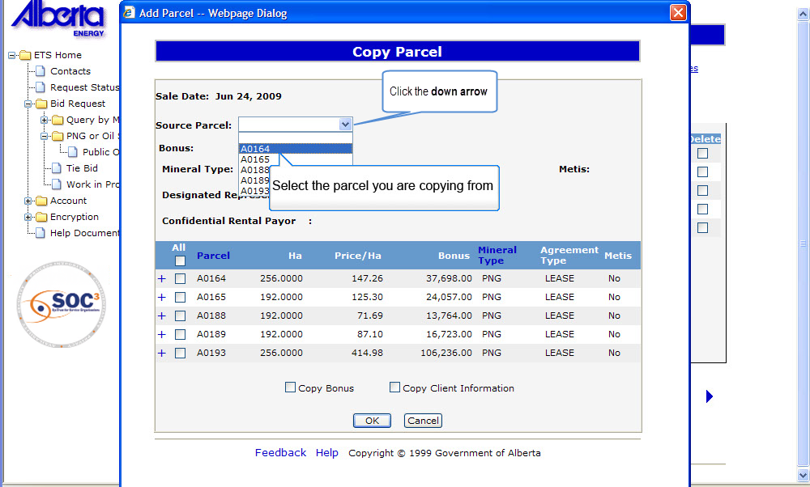
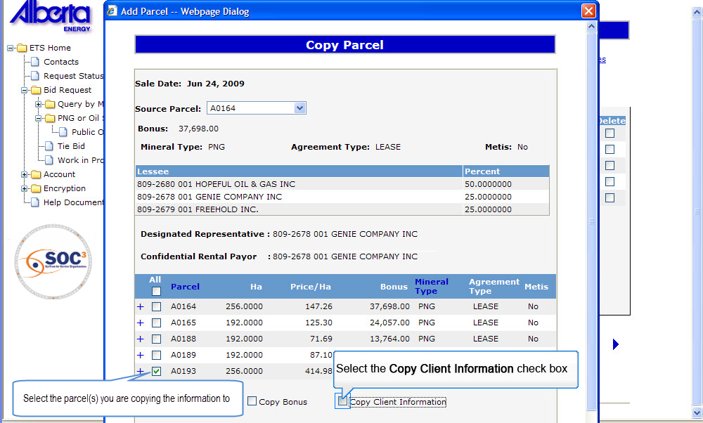
Select the parcel you are copying from and next select the parcel you are copying to
Back to Submit Request – Bid by Bonus

Slide 37
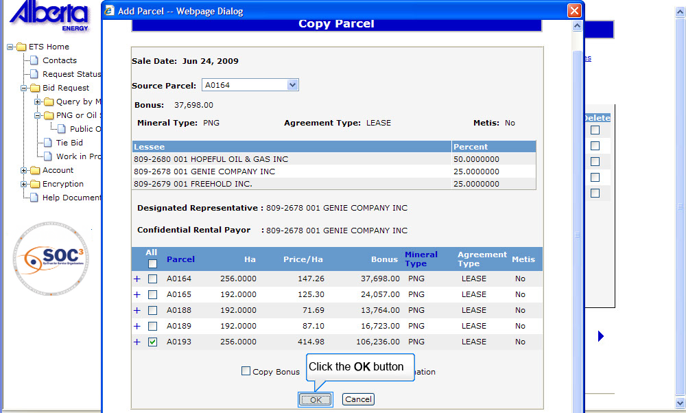
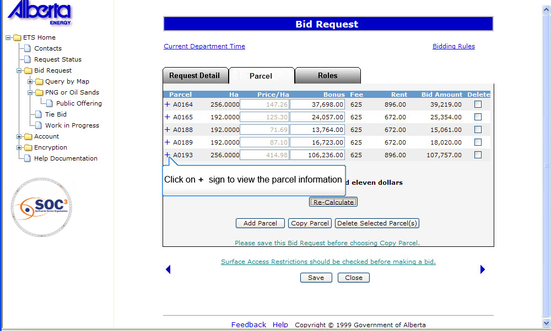
Clicking ‘+’ sign will show the parcel information
Back to Submit Request – Bid by Bonus

Slide 38


Clicking ‘-’ sign closes the screen. You can make changes to the bid amount if required
Back to Submit Request – Bid by Bonus

Slide 39

Back to Submit Request – Bid by Bonus

Slide 40


To Save Bid Request
Click OK after clicking save button
Back to Submit Request – Bid by Bonus

Slide 41


To view the request click on Original Bid Request
Back to Submit Request – Bid by Bonus

Slide 42


To Submit Bid Request
If preference page was used to add viewer and/or submitter the information will automatically be populated
Back to Submit Request – Bid by Bonus

Slide 43


Click submit and ok button to complete the bid submission
Back to Submit Request – Bid by Bonus

Slide 44


Selecting the original bid request link will open up the original bid request details
Back to Submit Request – Bid by Bonus

Slide 45

Back to Submit Request – Bid by Bonus

Slide 46
Resources
ETS Support and Online Learning provides access to relevant guides, course and other information
If you have questions, please contact
for PNG: Bidding.Energy@gov.ab.ca or the Sales Helpdesk at (780)644-2300 or
for Oil Sands: OSTenure@gov.ab.ca

Slide 47

Conclusion
Congratulations!
You have completed the ETS – Initiate Bid Request
Online Training Course
Please proceed to the subsequent modules detailing other functionality of the Bidding application.
If you have any comments or questions on this training module, please forward them to the following email address:
Bidding.Energy@gov.ab.ca

