Slide 1
Welcome
Welcome!
The Direct Purchase functionality in Posting allows users to submit a request to acquire Crown Petroleum and Natural Gas (PNG) and Oil Sands (OS) rights without going through the public offering process.
To the ETS – Direct Purchase Request
Online Training Course

Slide 2
Revision
Date | Revisions Type | Page Number
August 31, 2012 | Conversion | All
April 2020 | Updated | All
December 2020 | Updated ETS login page | Various

Slide 3

Introduction
In this module, you will learn how to:
Add/Change Direct Purchase Request Detail
Add Parcel of Land using any of the following options
Enter Land
Load from File
Load from Rights Available
Retrieve/Change Client(s)
Designated Representative
Bonus/Fee/Rent Payor
Lessee
Add Roles
Viewer
Submitter
Approver
Accept/Decline Purchase Price
Retrieve Agreement Documents

Slide 4
Initiate Requests
More Information (Pages 5 to 28)
There are four types of Direct Purchase requests for PNG and five types for Oil Sands:
The Portion type is where there is both Crown and non-crown mineral rights ownership in the spacing unit. If you control the freehold minerals by title or an active lease, you can lease the Crown portion. There are some restrictions which are explained in the Posting Rules. A statutory declaration is required by Alberta Energy as confirmation that you control the freehold minerals.
The Complementing Rights type is where the lessee of an oil sands agreement can lease the associated natural gas rights that match the oil sands zones.
The Single Substance type is where you have either the petroleum or the natural gas in an active agreement and you can ask Alberta Energy to lease you the other substance. Your existing agreement will be amended by adding the other substance.
There is also a Miscellaneous type but that is only used if Alberta Energy instructs you to use this type
The Road Allowance type is only used for Oil Sands agreements. Lessees may request the direct purchase of Crown oil sands rights underlying statutory road allowances established by the Crown that fall within the Surface Mineable Area, if the road allowances are not included in their existing agreement.

Slide 5
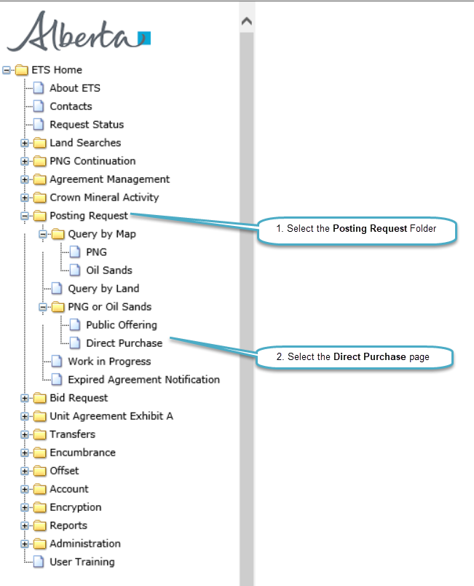
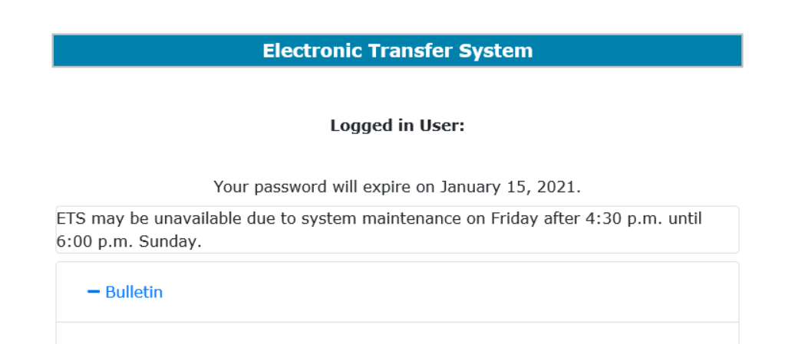
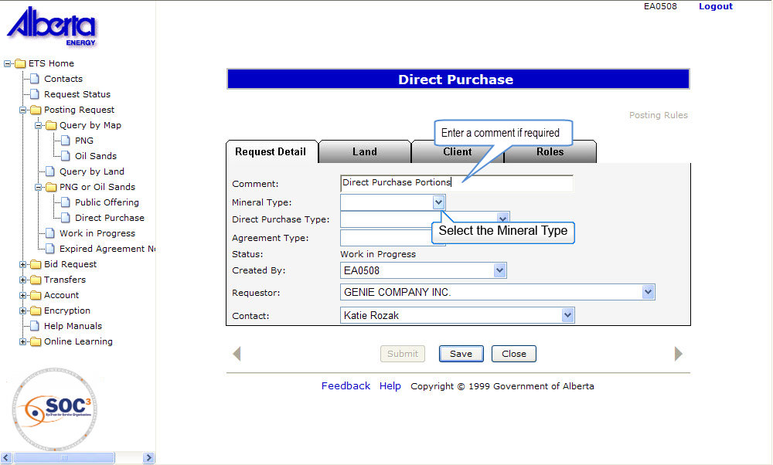

Back to Initiate Requests

Slide 6
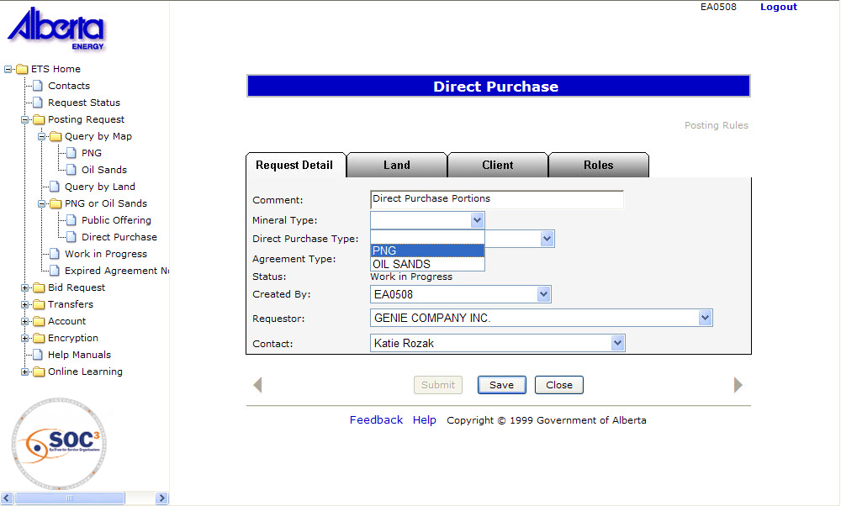
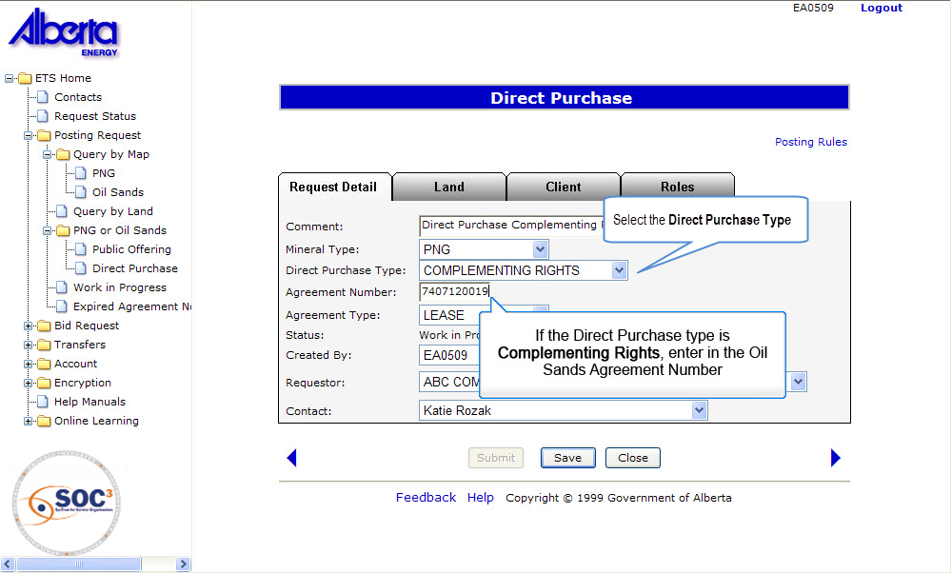
Back to Initiate Requests

Slide 7
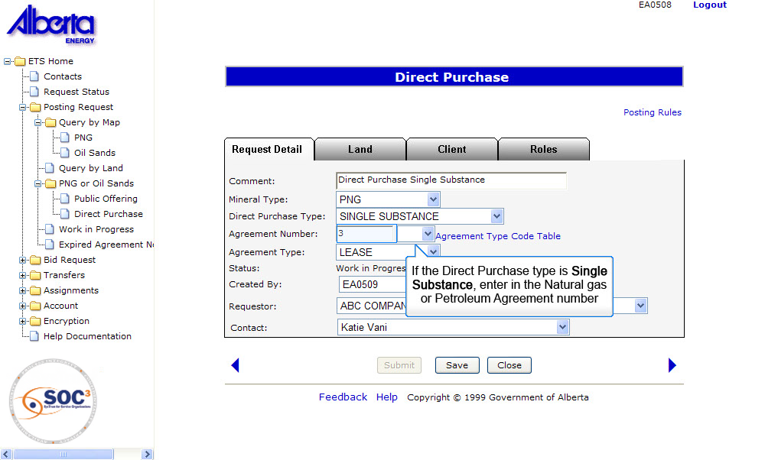
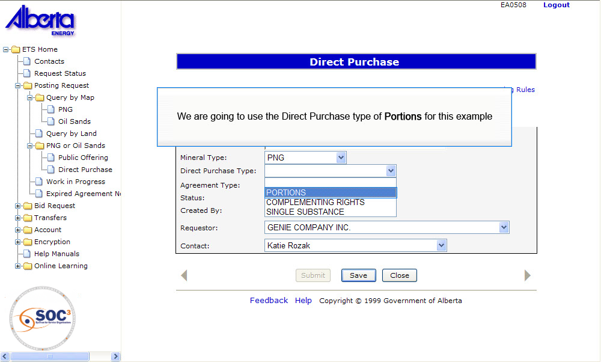
Back to Initiate Requests

Slide 8
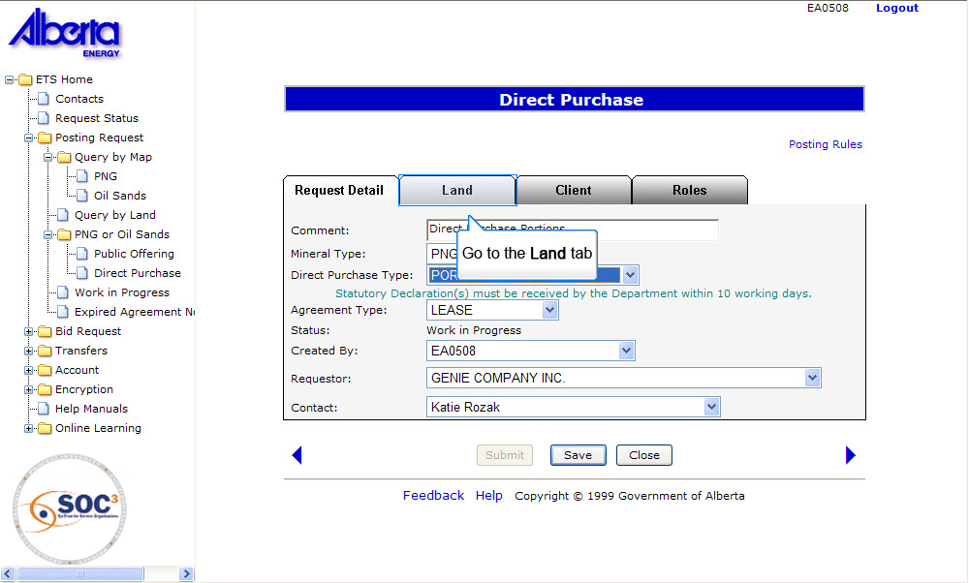
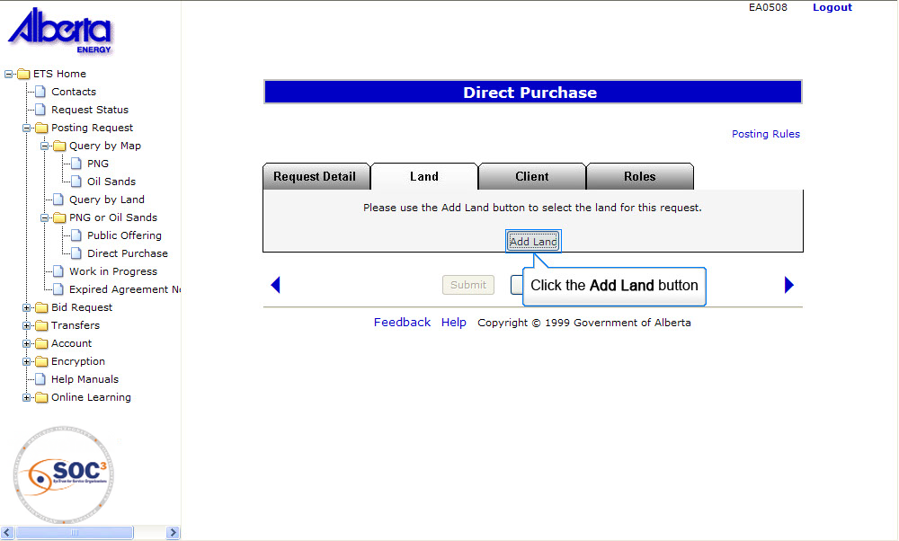
Back to Initiate Requests

Slide 9
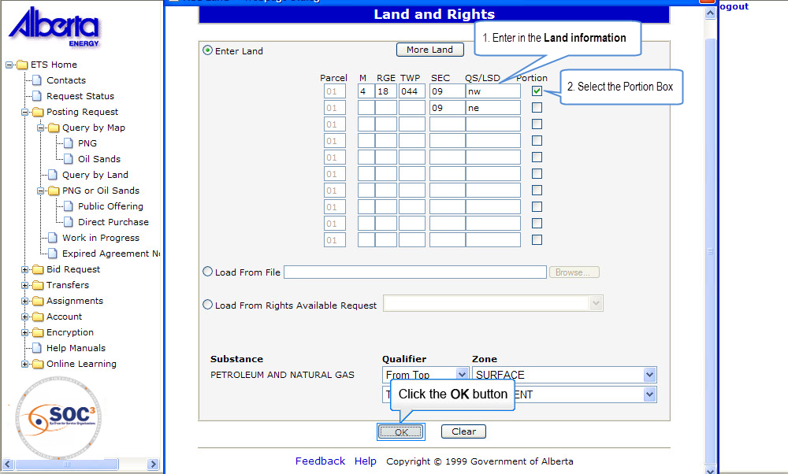
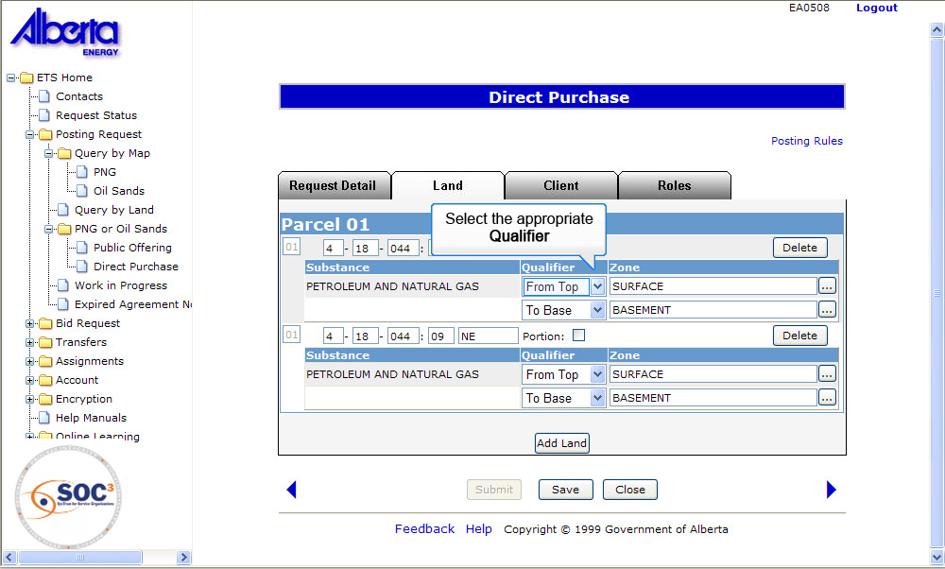
Back to Initiate Requests

Slide 10
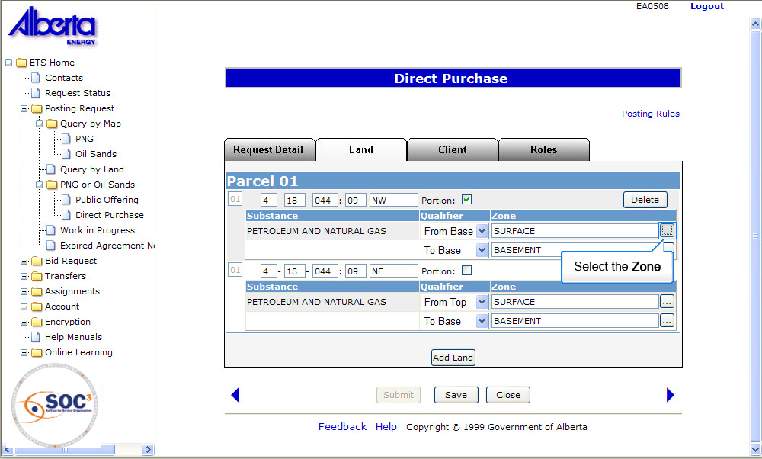
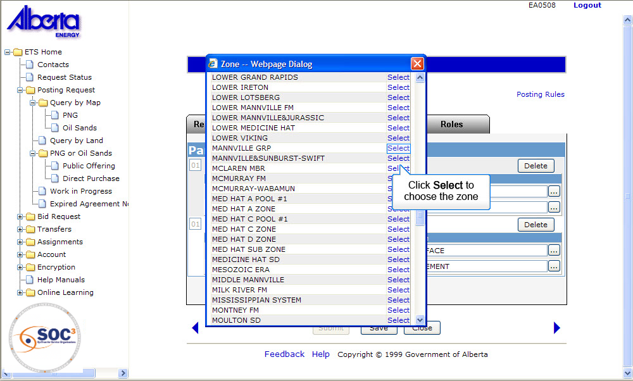
Back to Initiate Requests

Slide 11
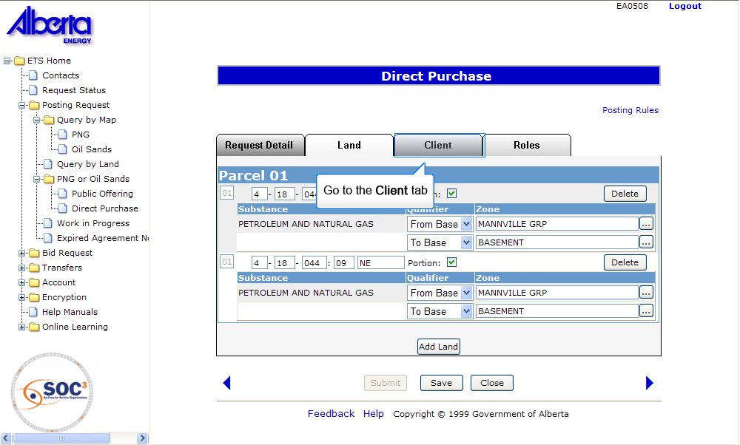
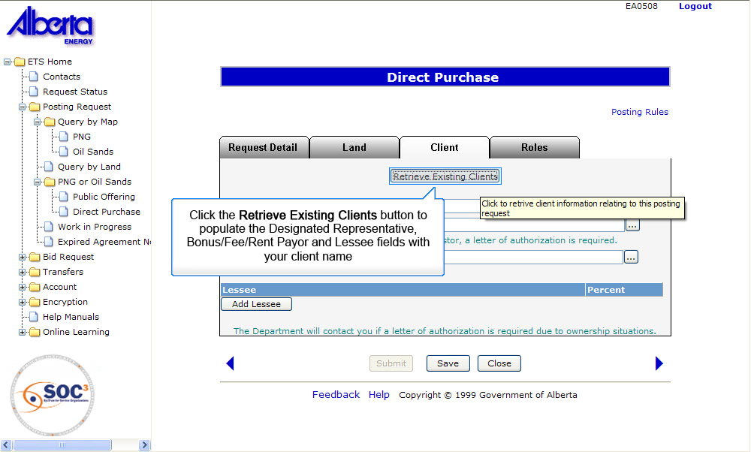
Back to Initiate Requests

Slide 12
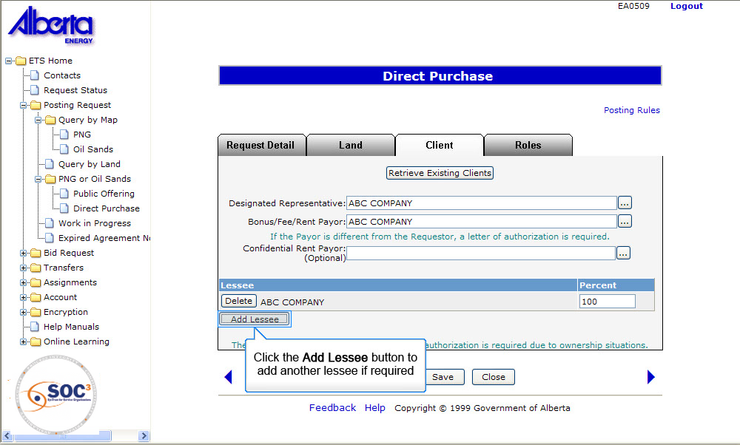
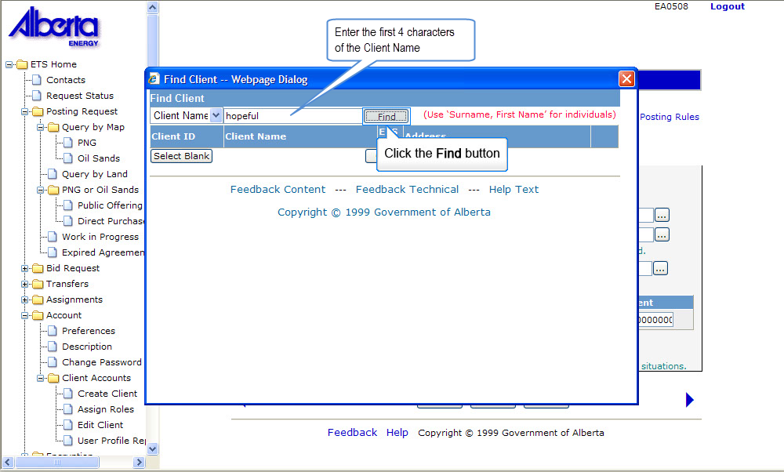
Back to Initiate Requests

Slide 13
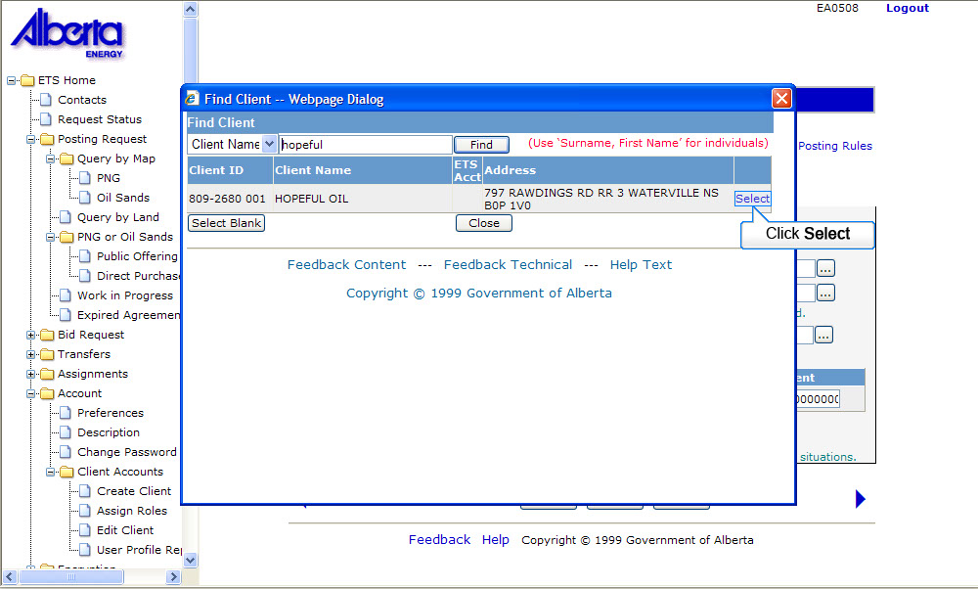
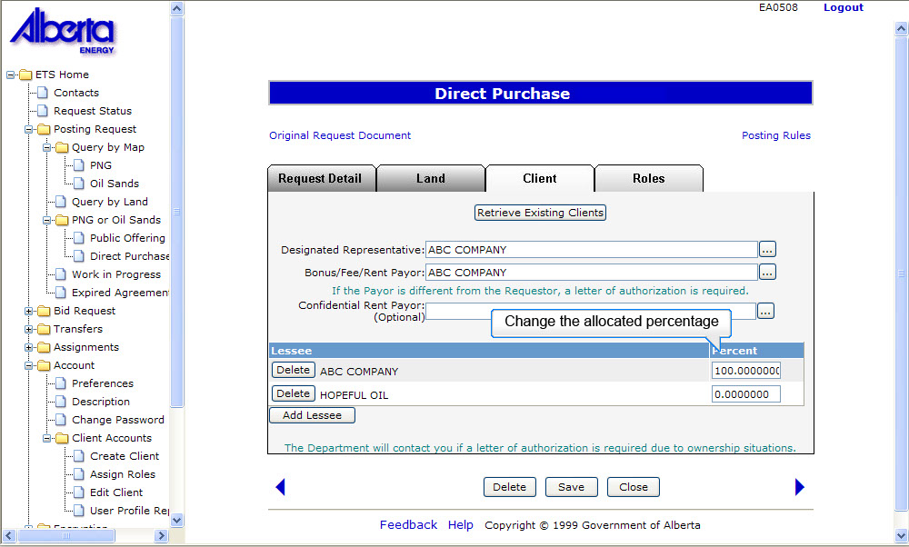
Back to Initiate Requests

Slide 14
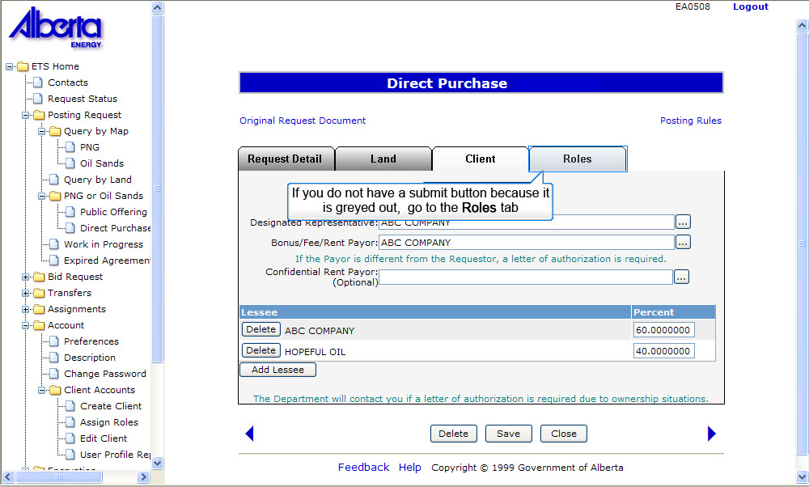
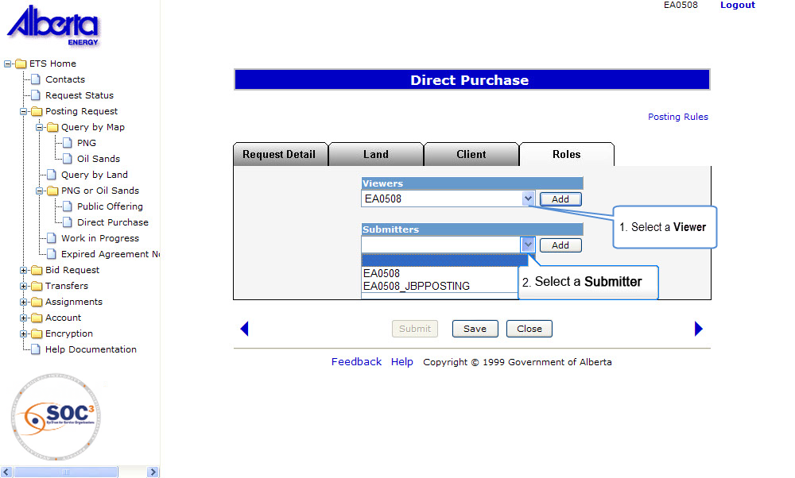
Back to Initiate Requests

Slide 15
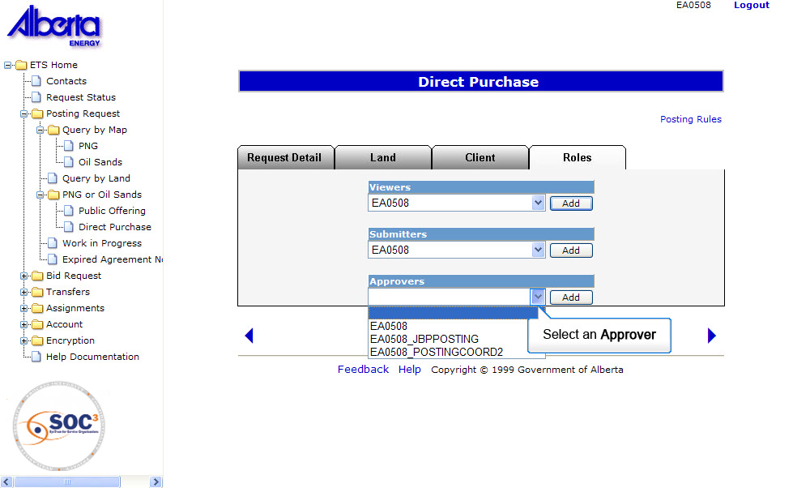
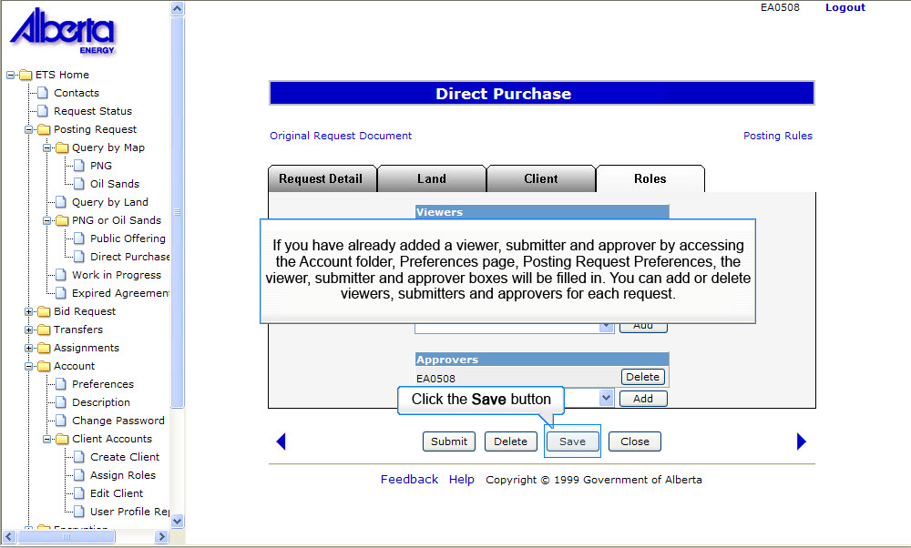
Back to Initiate Requests

Slide 16
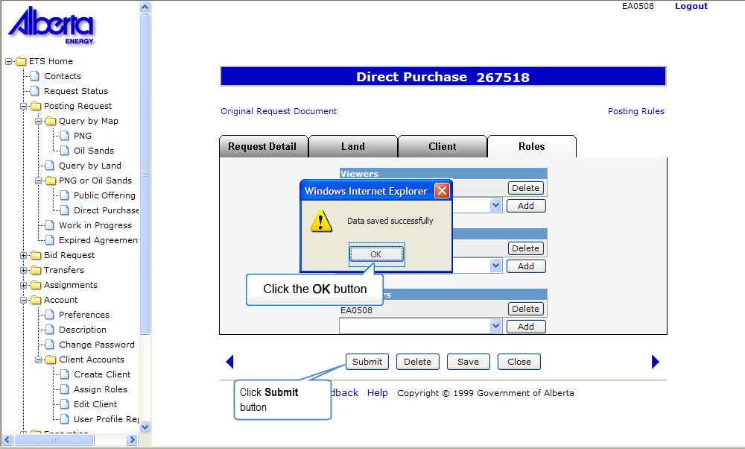
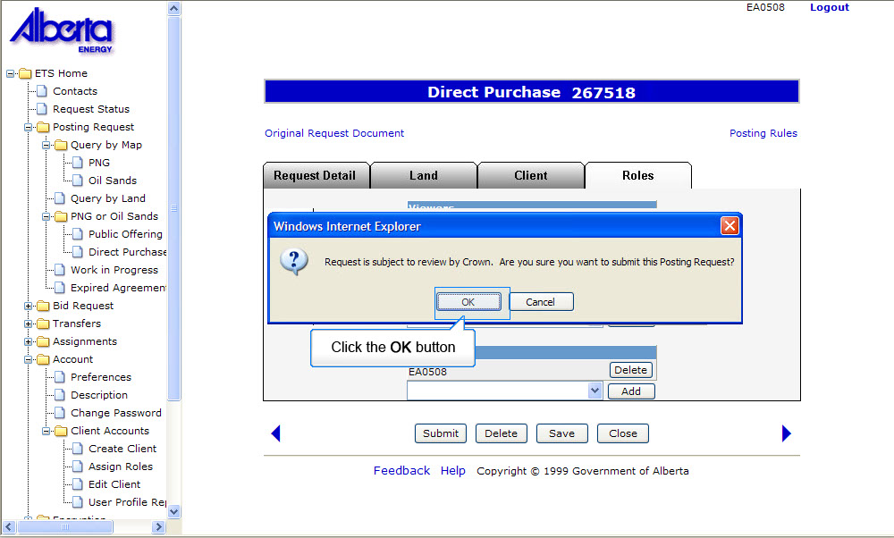
Back to Initiate Requests

Slide 17
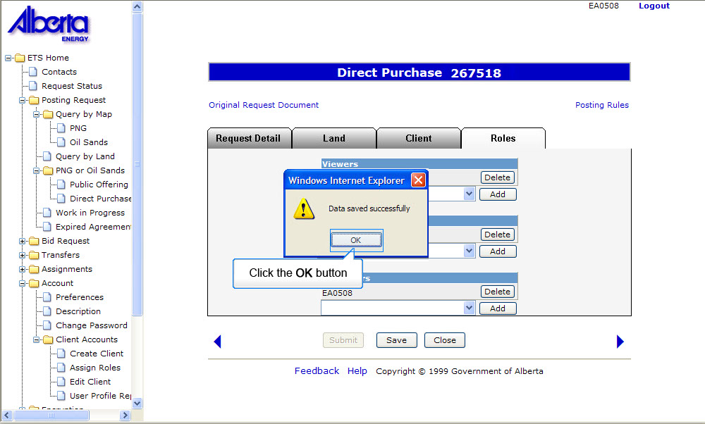
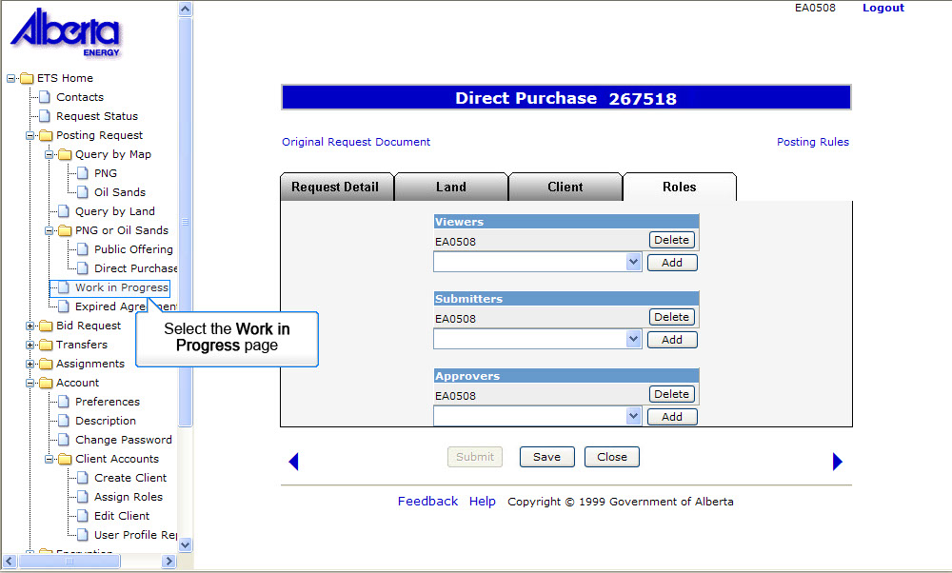
Back to Initiate Requests

Slide 18
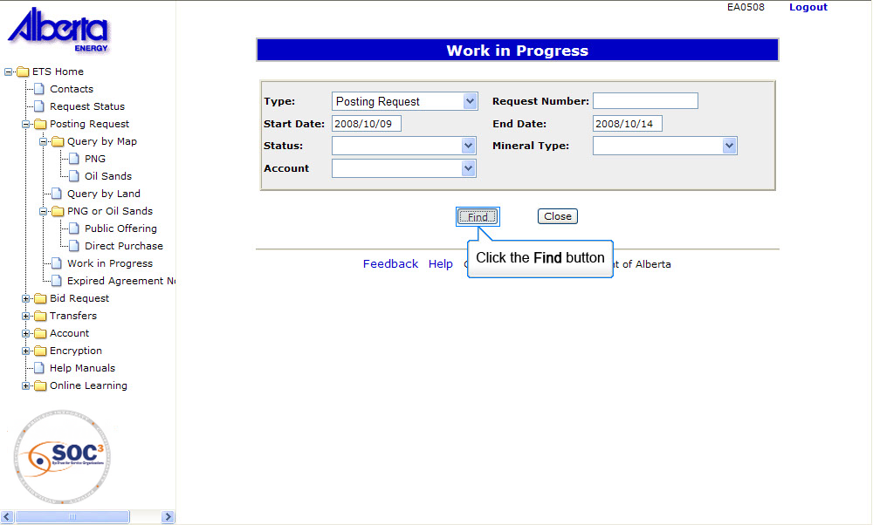
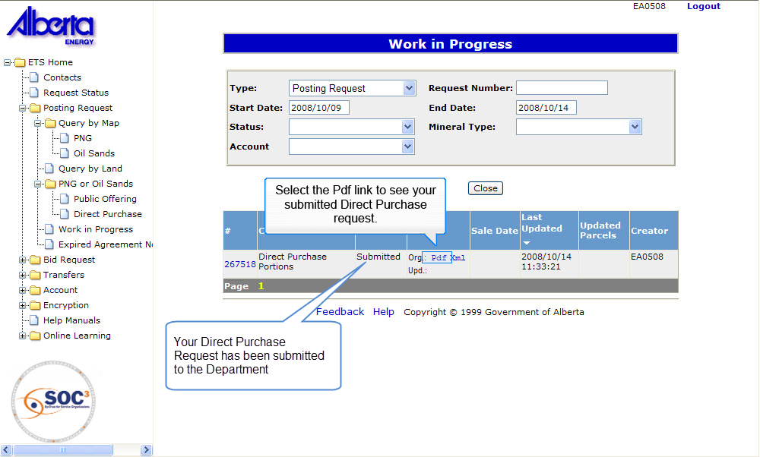
Back to Initiate Requests

Slide 19
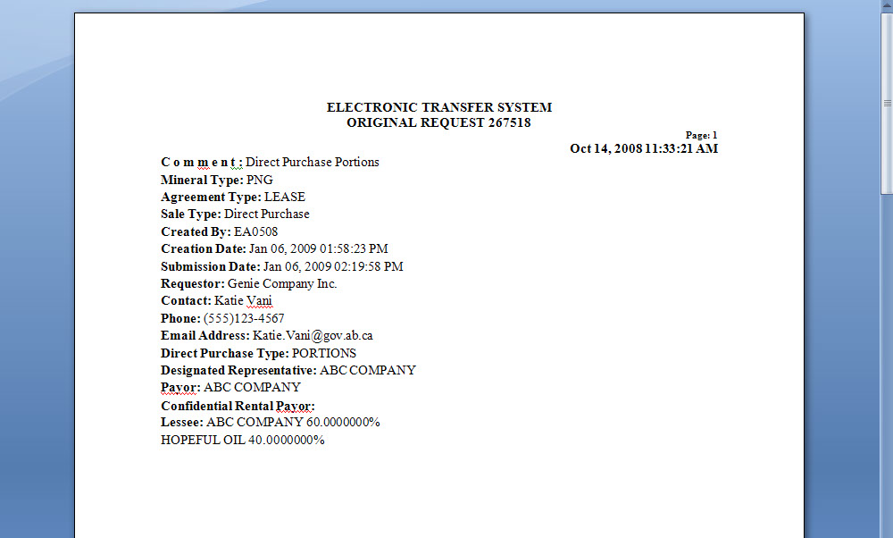
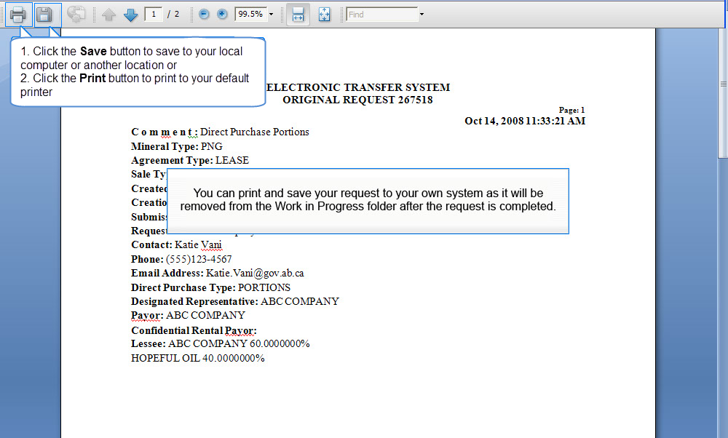
Back to Initiate Requests

Slide 20

When Alberta Energy has received your request the status will change from Submitted to Processing. When Alberta Energy has finalized the review of your request, you will be notified that you must accept or decline the purchase price. There will be a Purchase Price tab added to your request. Please note if you decline this purchase price, you cannot request this land again by Direct Purchase. It will only be available through the Public Offering.
Back to Initiate Requests

Slide 21
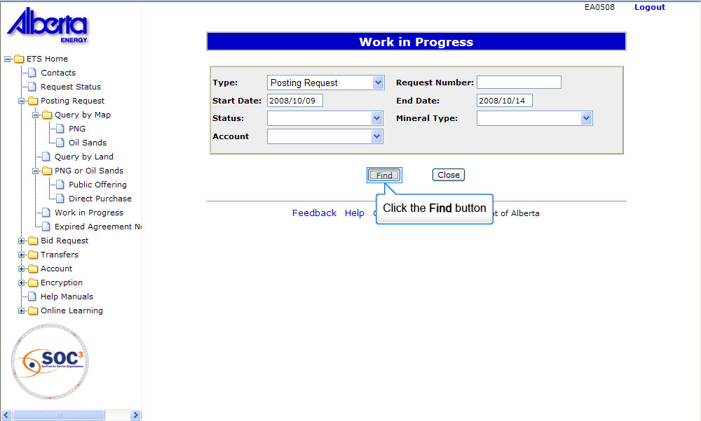
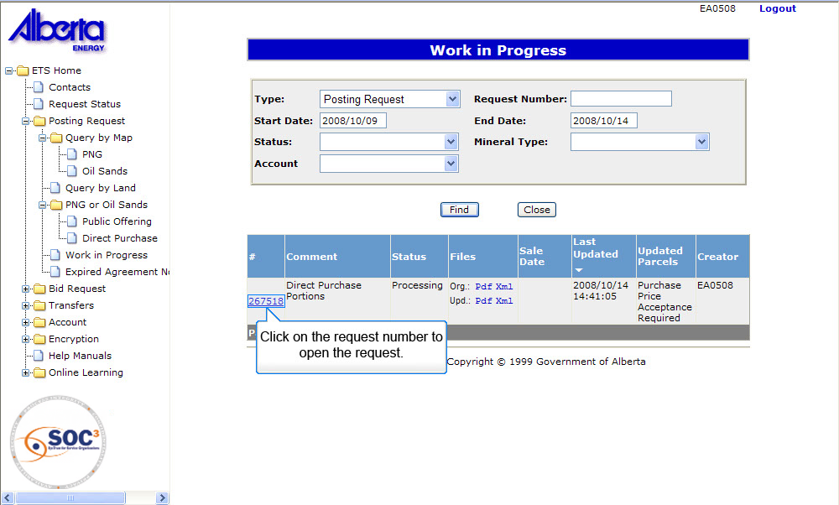
Back to Initiate Requests

Slide 22
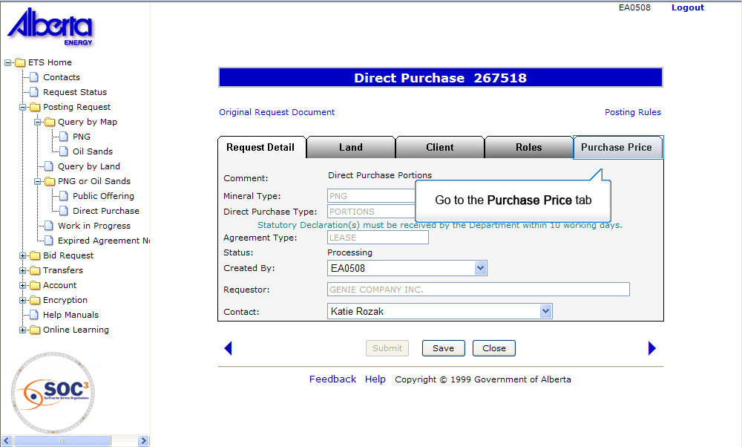
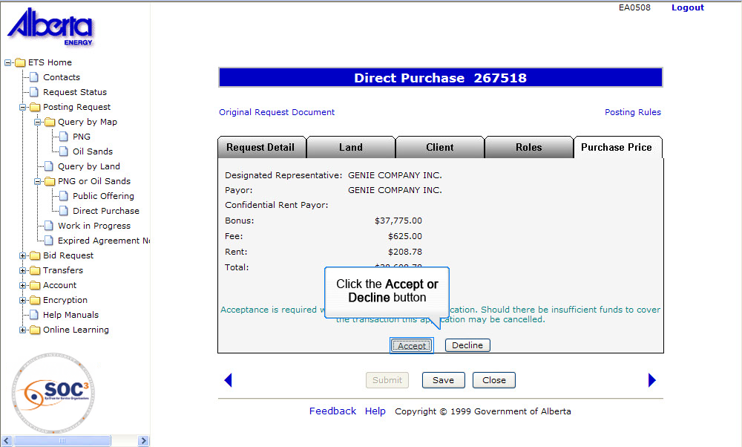
Back to Initiate Requests

Slide 23
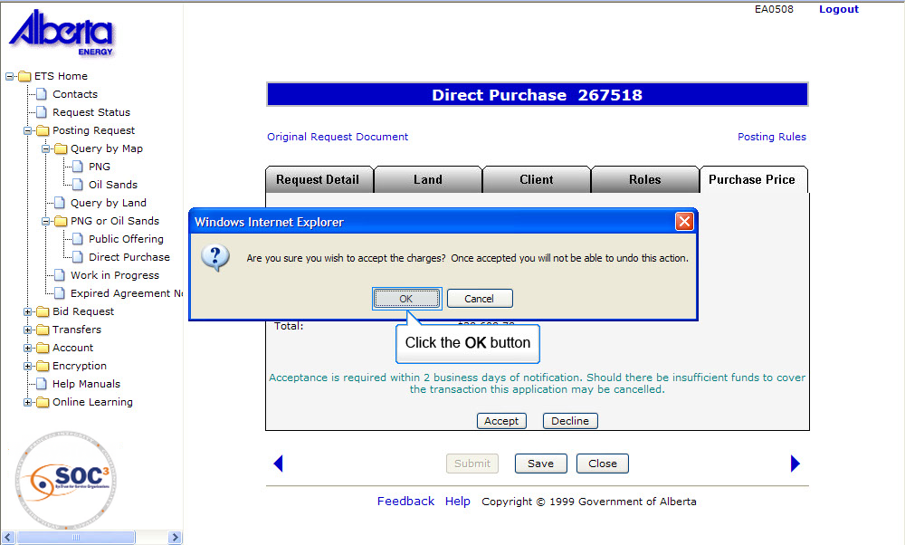
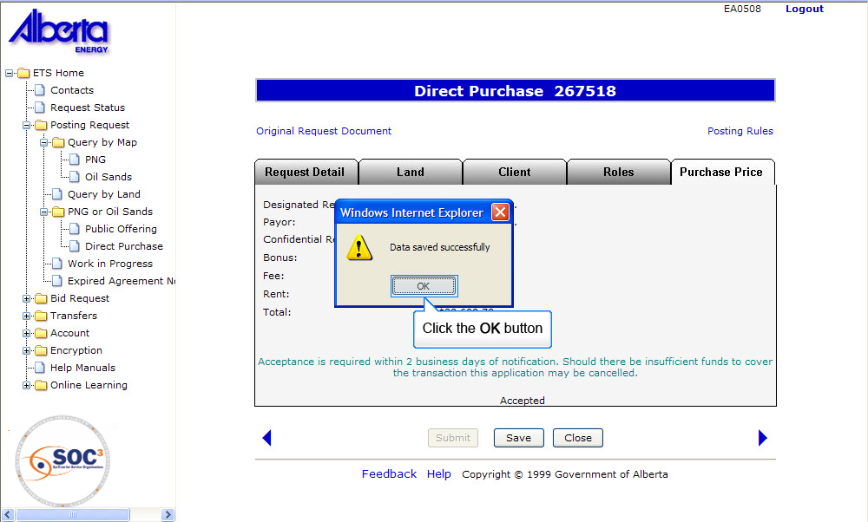
Back to Initiate Requests

Slide 24
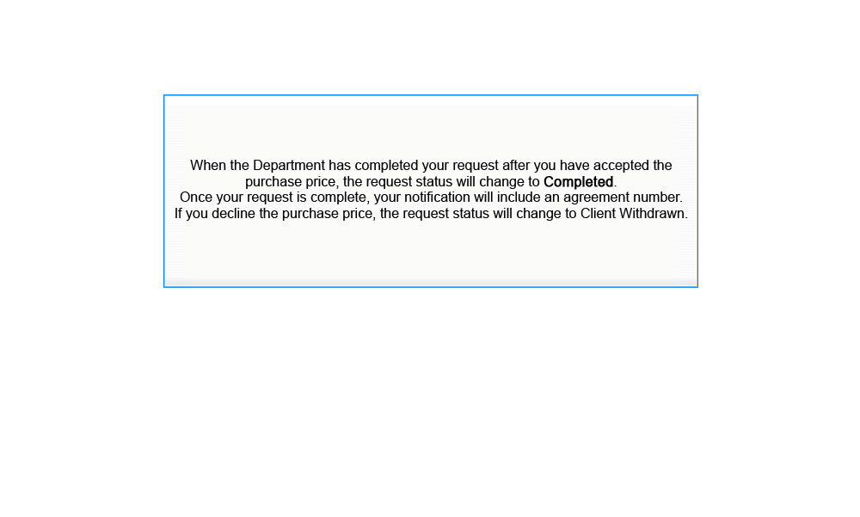
Back to Initiate Requests

Slide 25
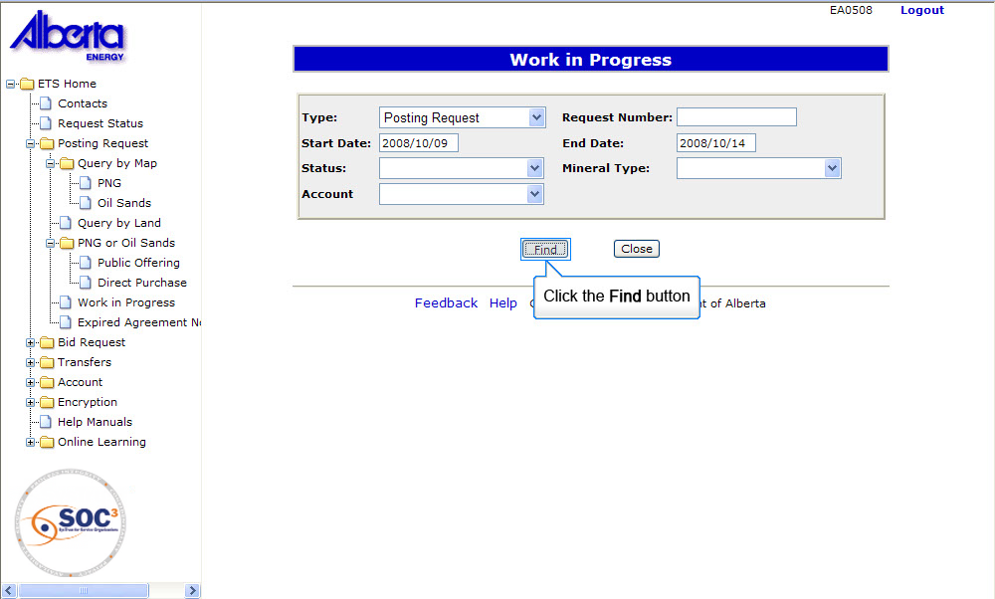
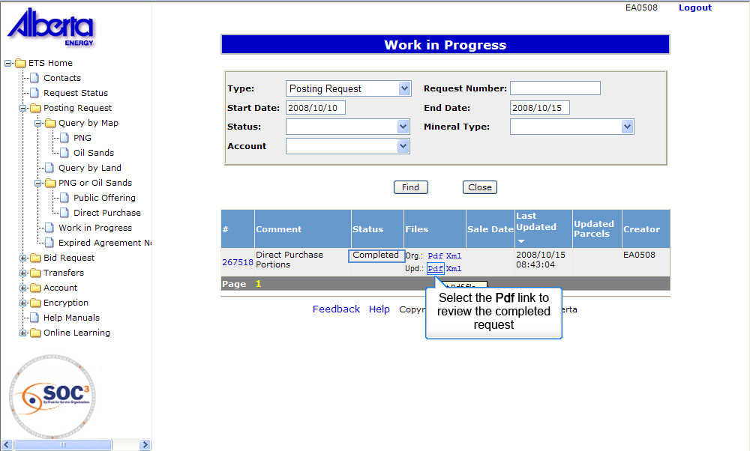
Back to Initiate Requests

Slide 26
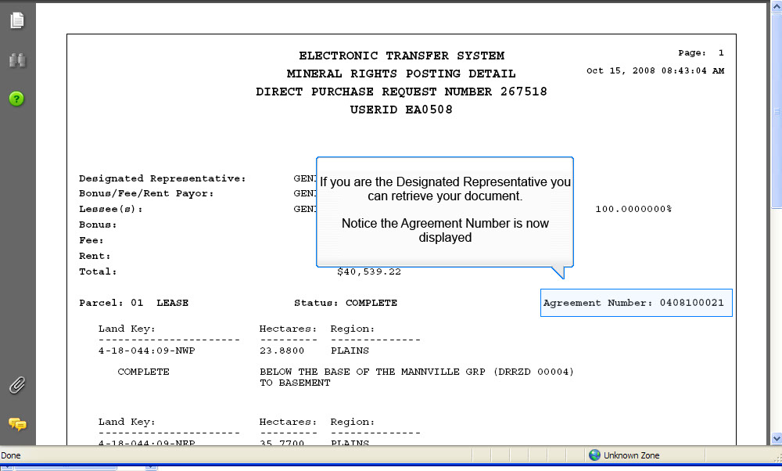
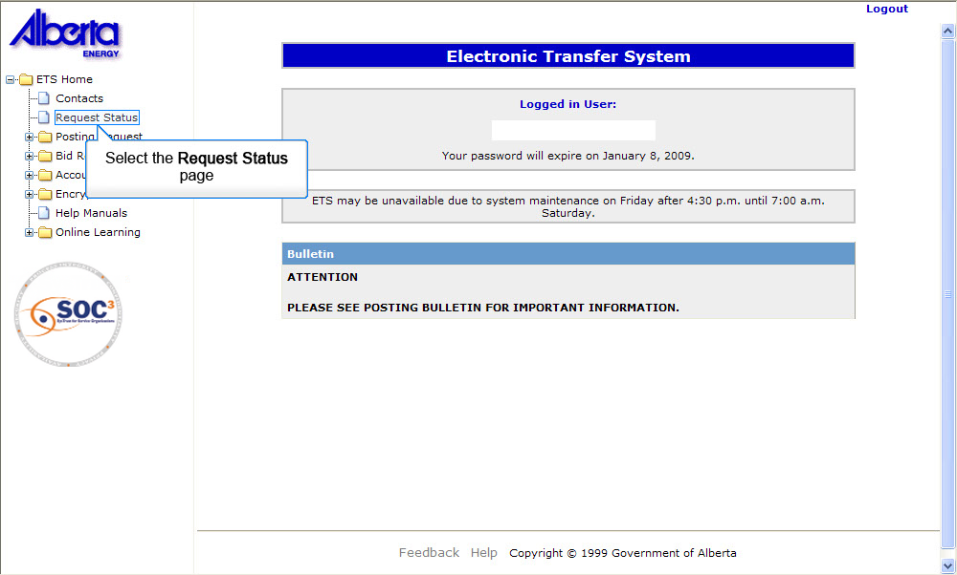
Back to Initiate Requests

Slide 27
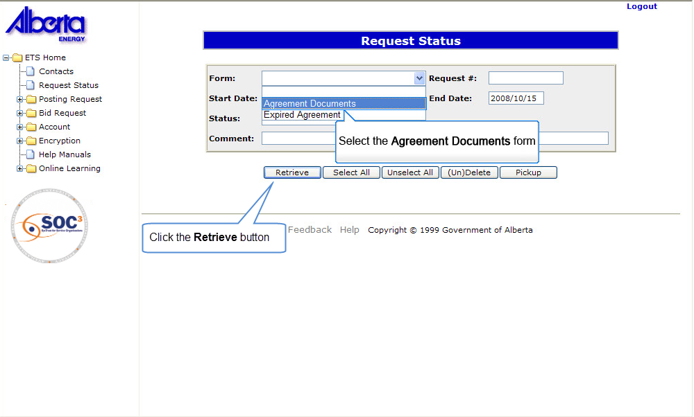
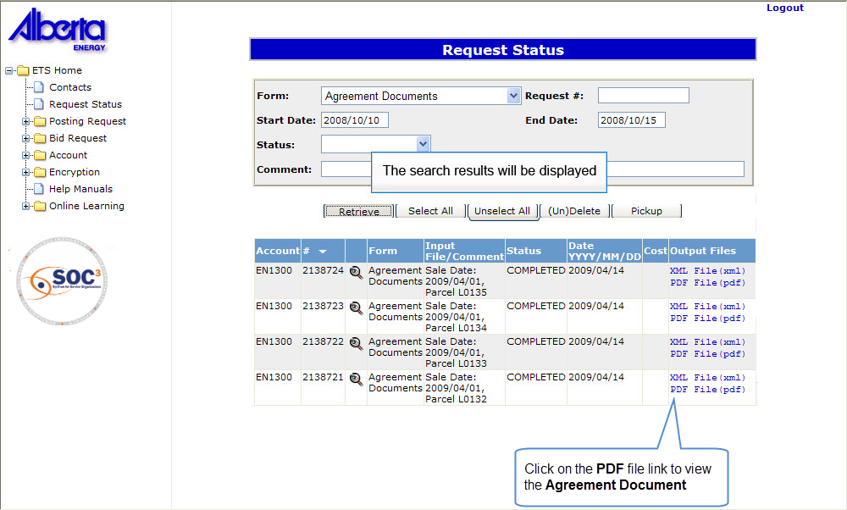
Back to Initiate Requests

Slide 28
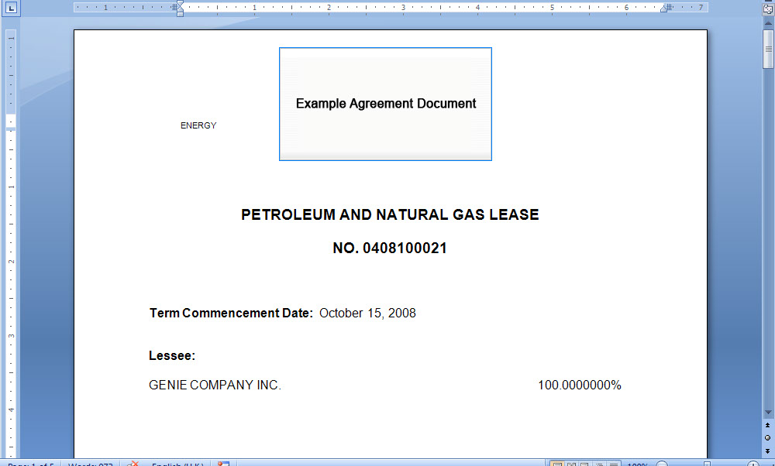
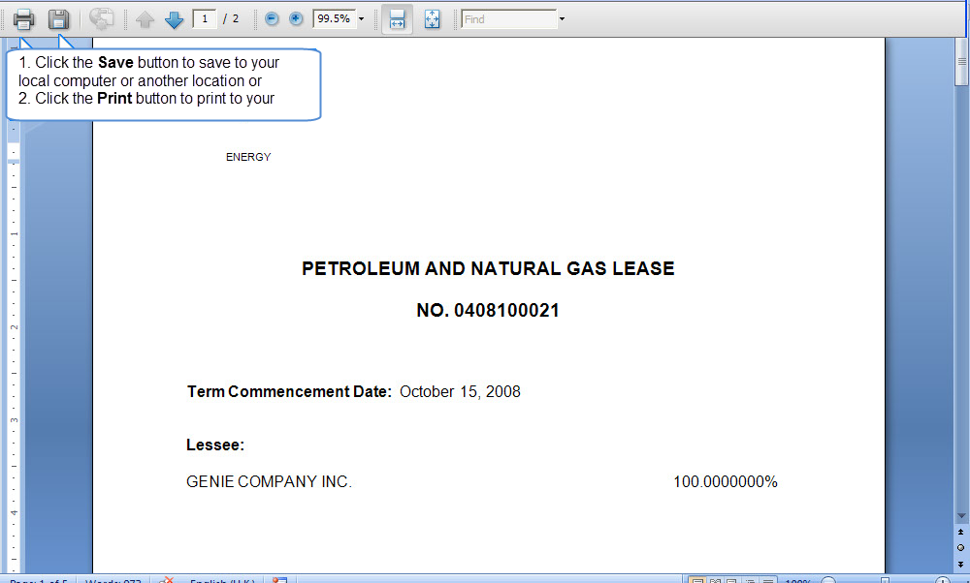
Back to Initiate Requests

Slide 29
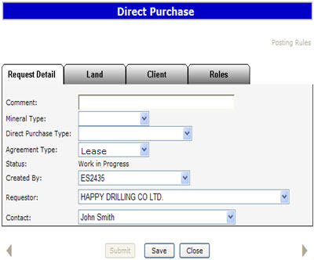
Request Detail Tab
The Request Detail tab allows you to enter or change information about your request. Enter a comment to identify the request (optional field). If you entered a comment in your Account Preferences it will be shown here. Select the Mineral Type (PNG or OS). Select the Direct Purchase Type. Enter an Agreement Number if you are doing a Complementing Rights or Single Substance type of Direct Purchase.

Slide 30
Request Detail Tab - Continued
For PNG, the Agreement Type will default to Lease with the option of changing to a Licence. For OS, the Agreement Type will default to Lease with the option of changing to a Permit. The status of the request will be displayed as work in progress until the request is submitted to Alberta Energy The Created By and Contact fields will be defaulted to your user name and the Requestor field will indicate your company name. The contact will receive notification by email regarding updates to the request. Tip: Only the Coordinator can use the drop down arrow to select a different Creator.

Slide 31
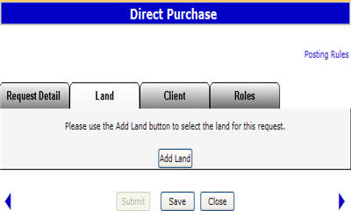
Land Tab
The Land tab allows you to add, change or delete the land, and change rights (PNG only). For a Single Substance type Direct Purchase the land and rights will be populated from the agreement entered. Changes cannot be made.

Slide 32
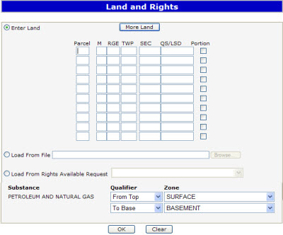
Enter Land and Rights
Method 1 – Enter Land and Rights You can enter land and rights manually on the Land and Rights screen. Enter the land description. Select the Portion check box if the land you are requesting has Crown and non-Crown mineral rights ownership. Tip:
If the Meridian, Range and Township are identical for the next section of land, you do not need to enter this information again
Only one parcel can be added for a direct purchase. The substance will be defaulted to Petroleum and Natural Gas for a PNG Request. This allows Alberta Energy to process the request for both substances.

Slide 33
Enter Land and Rights Continued
For PNG the Zones are defaulted to Surface to Basement with the option to change. Tip: If the zones are different for each section of land, leave as Surface to Basement. This can be changed in the Land screen. If you are requesting all available rights leave the default as Surface to Basement. For OS the zones are defaulted to Surface to Basement, no changes allowed. When processed by Alberta Energy, any available rights within the respective OS area may be granted.

Slide 34
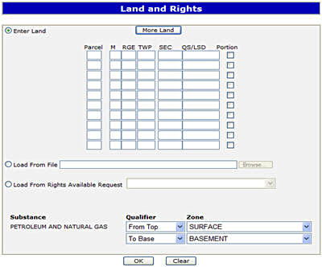
Enter Land and Rights – Load from File
Method 2 – Load from File You can load the Land and Rights from an XML or CSV file created using the Query by Land option. You can also produce the XML or CSV file using an in-house system.

Slide 35
Enter Land and Rights – Load from Rights Available Request
Method 3 - Load from Rights Available Request You can load the requested land by selecting the Request that you have made in the past 60 days that have rights available.

Slide 36

Land Tab - Zones
Use the drop down arrow to select the Qualifier, either From Top, To Base, From Base and To Top. To change the zones, click on the ellipsis (...) button to open the Zone table. You can sort the zones by Name or Depth. Click on the Select button to the right of the zone you want.

Slide 37

Land Tab – Zone Table
For a Portion type direct purchase, the Crown rights must match the freehold rights indicated in the statutory declaration. For Complementing Rights type direct purchase, the rights must match the rights in your oil sands agreement. For a Single Substance type direct purchase, the rights will be populated from the agreement number that was entered. No changes allowed.

Slide 38

Client Tab
Click on the Retrieve Existing Clients button. The Designated Representative, Bonus/Fee/Rent Payor and Lessee fields are defaulted to your client name. You can use the ellipsis (...) button to change the fields or add additional Lessees.
Tips:
For a Portion type Direct Purchase, the Lessee(s) must correspond to the client that has control of the freehold minerals.
For a Complementing Rights type Direct Purchase, the Designated Representative, and Lessee fields will be populated to match the holders of the oil sands agreement you entered. No changes allowed.
For a Single Substance type Direct Purchase, the Designated Representative and Lessee fields will be populated to match the holders of the petroleum or natural gas agreement you entered. No changes allowed.
If the Bonus/Fee/Rent Payor is different from the Requestor, a letter of authorization is required.
Any changes to a request must be made before the request is submitted. Any future changes to a request can still be done by contacting the Sales group.
Saving a request does not submit it to Alberta Energy.
If the request has no errors, a Request number will be indicated at the top of the screen and a link to the Original Request Document will be visible. This document details the information entered for the request.

Slide 39

Roles Tab
The Roles tab is used to define who can view, submit and approve your request. If you have already added a viewer, submitter, or approver by accessing the Accounts folder, Preferences page, Posting Request Preferences, the Viewer and Submitter and Approver boxes will be filled in. You can add or delete Viewers, Submitters and Approvers for each request. Tip: If the submitter and the creator of the request are different users, it is the responsibility of the creator to advise the submitter that the request is now available for submission to Alberta Energy

Slide 40

Purchase Price Tab
When Alberta Energy has finished processing your request, you will be notified that acceptance of the purchase price is required. The user that has the assigned Approver role can click on the Purchase Price tab and then select the Accept or Decline button. Selecting the Accept button informs Alberta Energy to proceed with your request and remove the funds from your bank account. Selecting the Decline button informs Alberta Energy to Client Withdraw your request.
Please note that if you do not accept the offer you will not be able to request the lands again through a Direct Purchase and can only request them for the Public Offering. Tip: If the requestor accepting the purchase price and the payor are different, it is the requestor's responsibility to inform the payor that the money is being removed from his account.

Slide 41
Retrieve Agreement Document
When Alberta Energy has completed your request, the Designated Representative can retrieve the agreement document by opening the Request Status folder on the main menu. All agreements will be removed from the Request Status folder based on your Site Administrator's Account Preferences Setting - Delete requests after X days. If you wish to keep the agreement you must save the file to your own system.

Slide 42
Resources
ETS Support and Online Learning provides access to relevant guides, course and other information
If you have questions, please contact
for PNG: Postings.Energy@gov.ab.ca or the Sales Helpdesk at (780)644-2300 or
for Oil Sands: OSTenure@gov.ab.ca

Slide 43

Conclusion
Congratulations!
You have completed the ETS – Direct Purchase Request
Online Training Course
Please proceed to the subsequent modules detailing other functionality of the Posting application. If you have any comments or questions on this training module, please forward them to the following email address: Postings.Energy@gov.ab.ca

