Slide 1

Welcome
Accessing the Work in Progress folder allows you to review, edit or withdraw and track bid request(s).
To the ETS – Change Bid Request
Online Training Course

Slide 2
Revisions
Date | Revisions Type | Page Number
August 31, 2012 | Conversion | All
April 2020 | Updated | All
December 2020 | Update the ETS login page | Various

Slide 3

Introduction
In this module, you will learn how to:
Retrieve Bid Request
Delete Bid Request
Withdraw and Edit Bid Request
Change and Re-Submit Bid for a Tie Bid
View Bid Reports

Slide 4
Bid Request Status
Work In Progress status is assigned when you save a new request.
Submitted status is assigned when you submit the request.
Client Cancelled status is assigned when you cancel the request by using the Delete function and the Sale is NOT closed.
Completed status is assigned when the Sale is CLOSED.

Slide 5
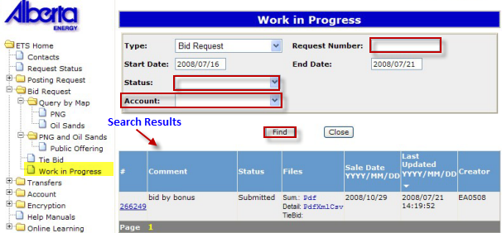
Retrieve Bid Request
More Information (Pages 6 to 9)
Request Number - You can enter a Bid Request number or leave blank and all bid requests created within the start date and end date will be listed.
Status - You can limit your search by selecting a specific Status (i.e., Work In Progress, Submitted, Completed, Client Cancelled)
Account - This option shows ONLY to accounts with Coordinator role. The drop-down arrow is used to select an ACCOUNT in order to limit search results to requests that have the selected account as a viewer, submitter, creator, or contact. Leave blank to select all accounts.
Find - The Find button will execute the search based on the specified parameters. The search results are listed in descending order from the most recent updated Bid Request.

Slide 6
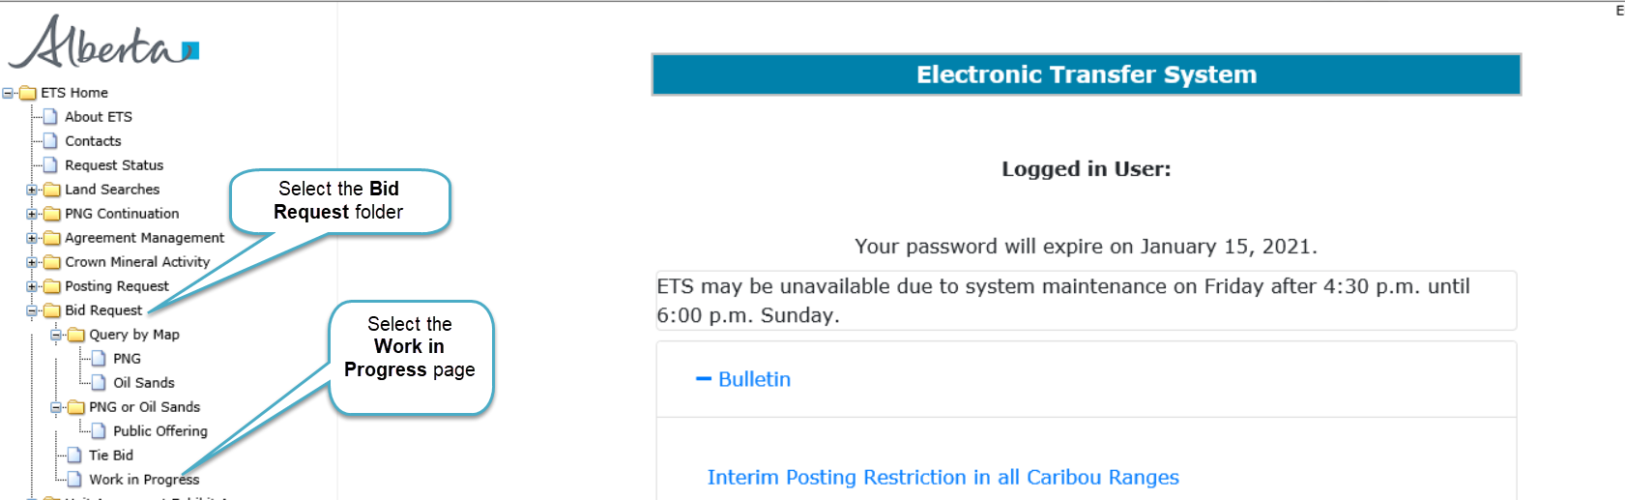
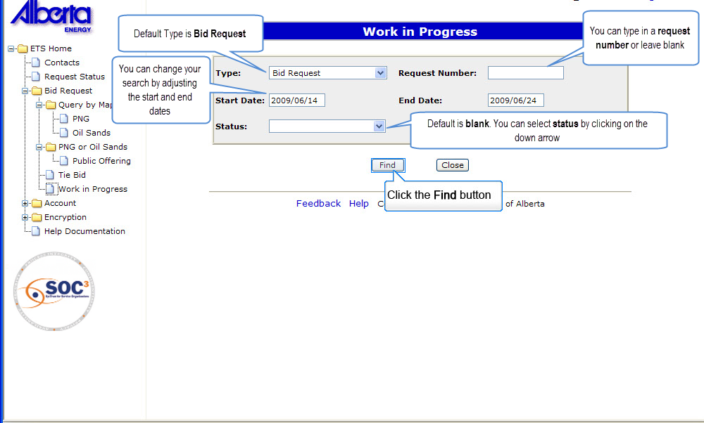

Selecting Work in Progress provides several user options to chose from to narrow down the search
Back to Retrieve Bid Request

Slide 7
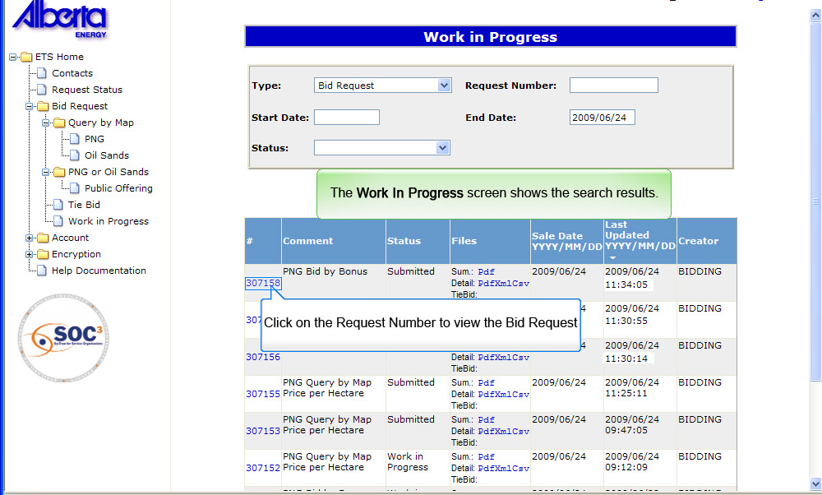
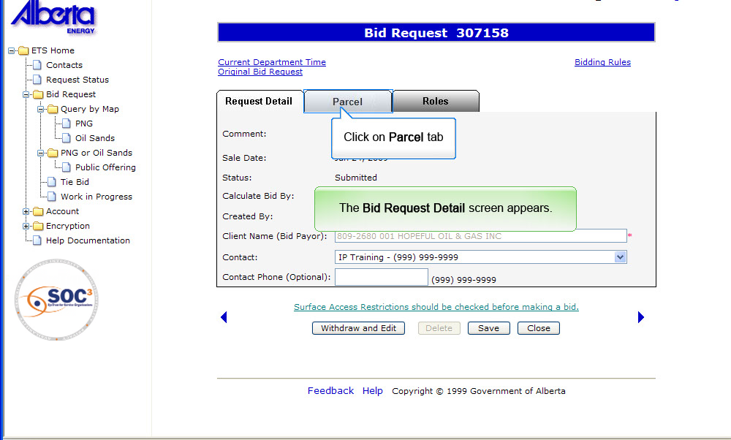
Back to Retrieve Bid Request

Slide 8
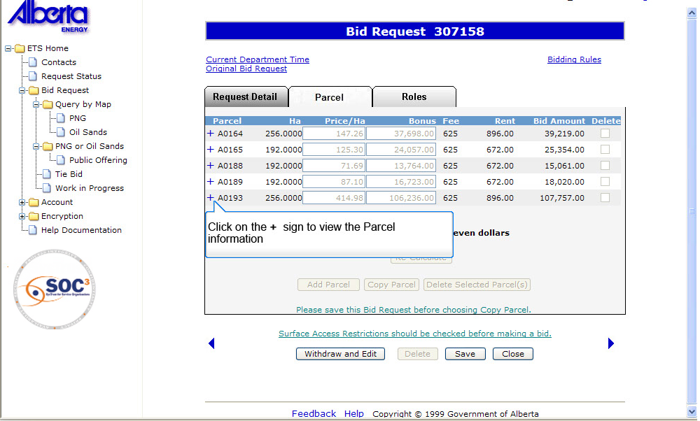
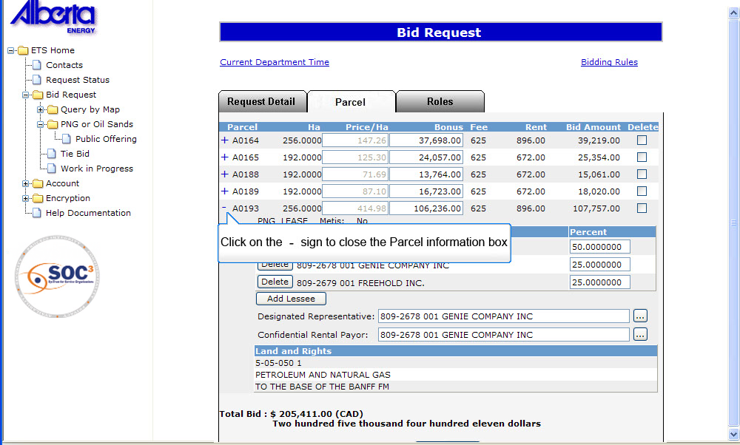
Clicking on ‘+’ sign brings up more information in parcel information box
Back to Retrieve Bid Request

Slide 9
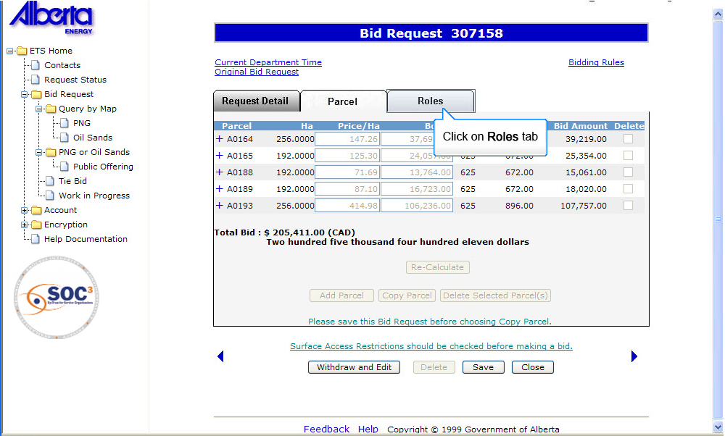
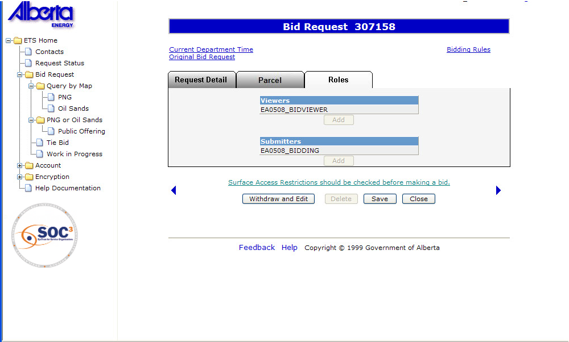
Clicking on roles tab brings up roles information
Back to Retrieve Bid Request

Slide 10
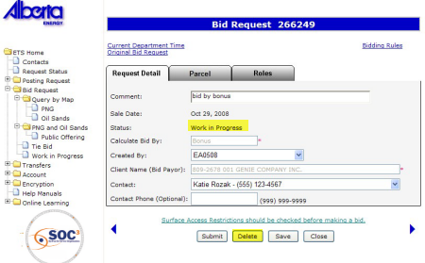
Delete Request
Only the creator of the bid request is allowed to delete the bid if the sale is not closed. If the creator of the bid request is not available, the Coordinator can change the created by and the new creator can delete the bid. Clicking on the Delete button will display a confirmation message. Upon acceptance, the system sets the status of the request to Client Cancelled. Once this is done, no editing or reinstatement is allowed on a cancelled bid request. Tip: The DELETE button is only enabled while the request is in Work in Progress status. If the request has been submitted, you need to withdraw the request before you can delete it.

Slide 11
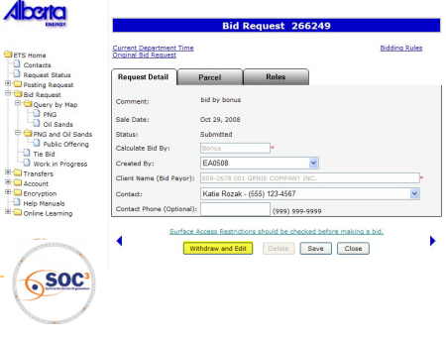
Withdraw & Edit Request
More Information (Pages 12 to 19)
After a bid is submitted to Alberta Energy, the Submit button changes to the Withdraw and Edit button. Changes can be made to a Submitted bid request by selecting the Withdraw and Edit button as long as the Sale is not closed. The status of the bid changes back to Work In Progress and the bid must be re-submitted to Alberta Energy prior to the close of the Sale. Once submitted only the Created By, Contact and Contact Phone fields can be changed and saved without withdrawing the bid request. Click on More Information to view how to withdraw and edit a bid request.

Slide 12
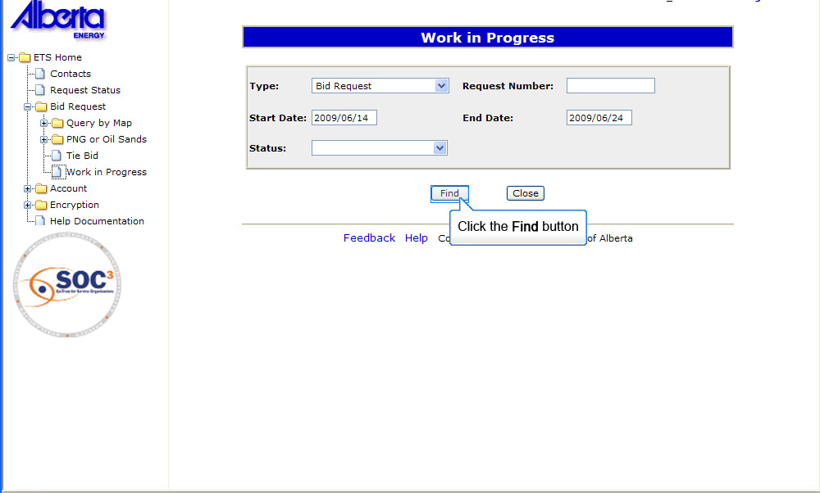
Back to Withdraw and Edit Request

Slide 13
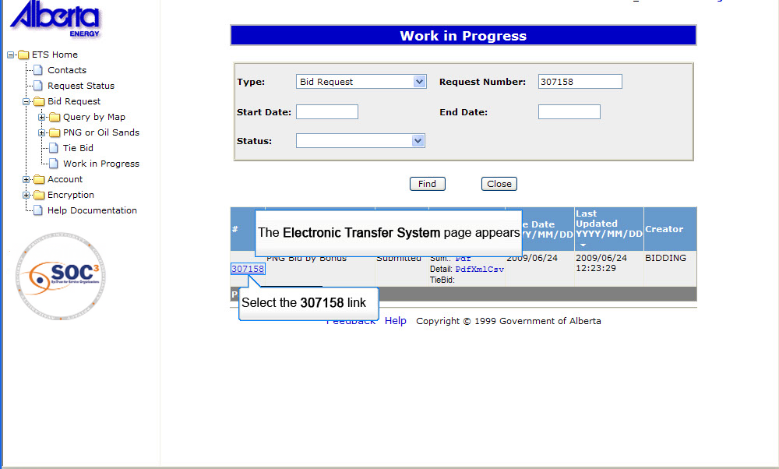
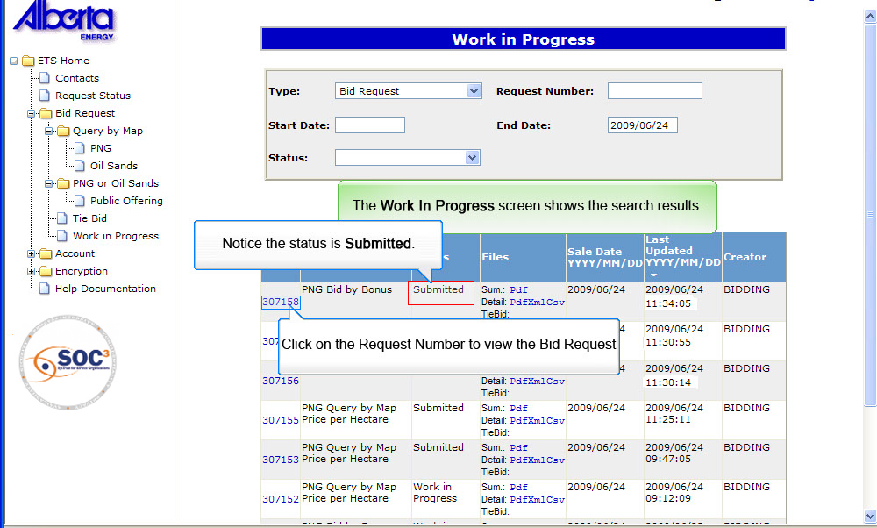
You can type in a request number to retrieve specific request or simply click find to retrieve all requests
Back to Withdraw and Edit Request

Slide 14
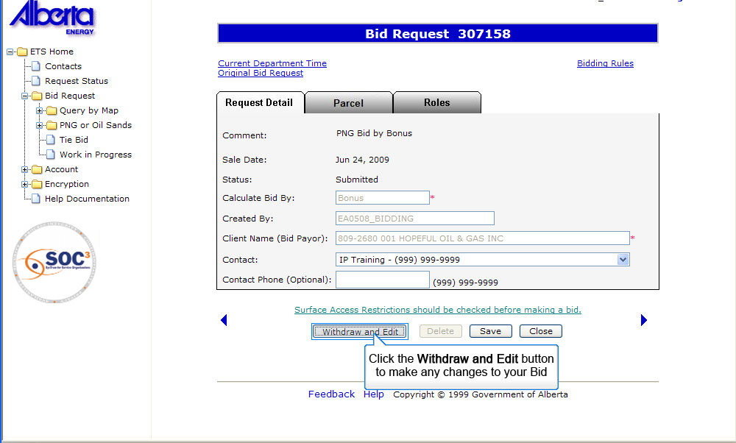
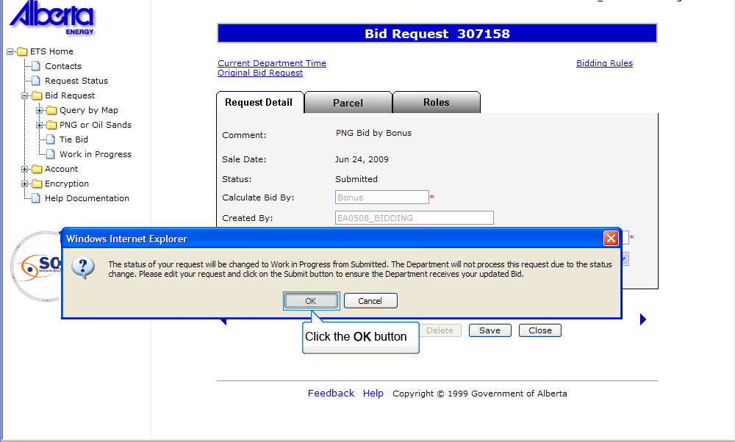
Clicking on Withdraw and edit button will change the status of the request to work in progress after requesting user confirmation
Back to Withdraw and Edit Request

Slide 15
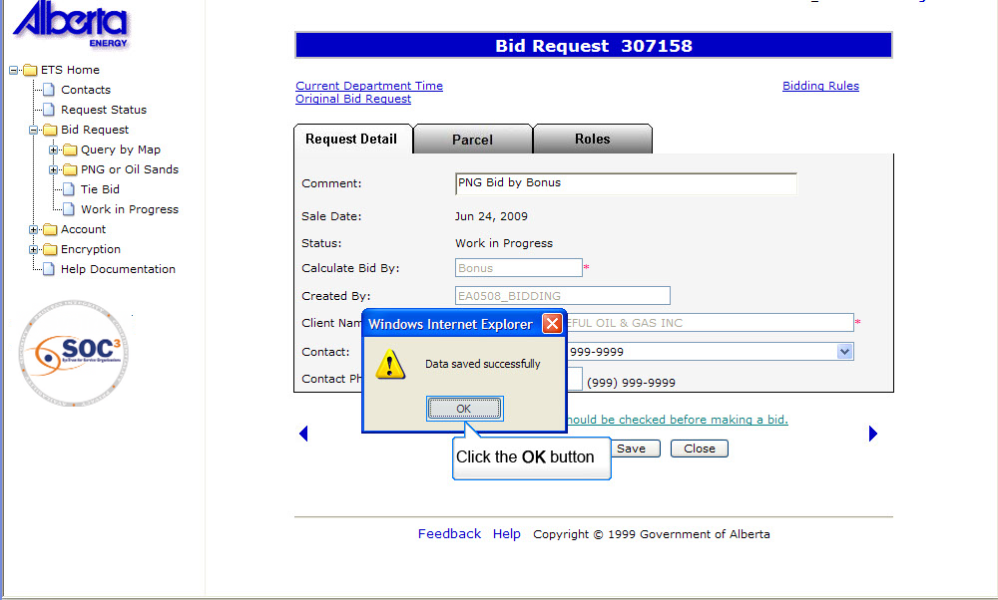
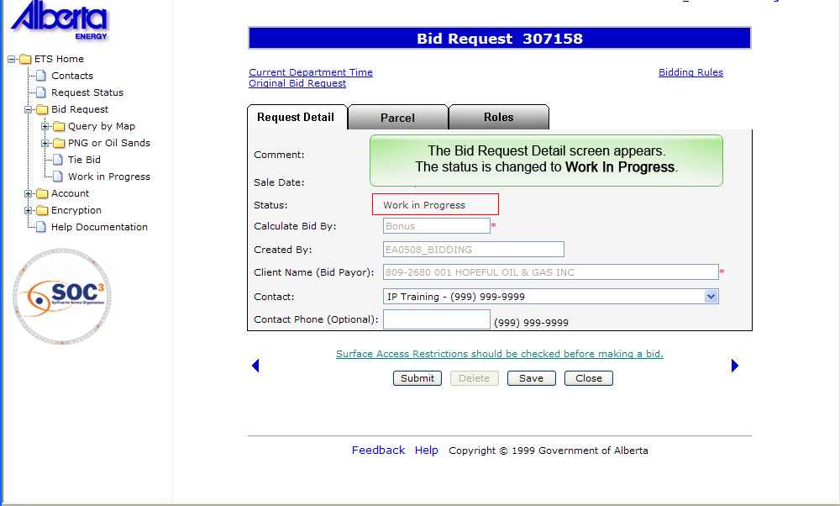
Clicking on OK button will change the status of the request to work in progress on Request Detail Tab
Back to Withdraw and Edit Request

Slide 16
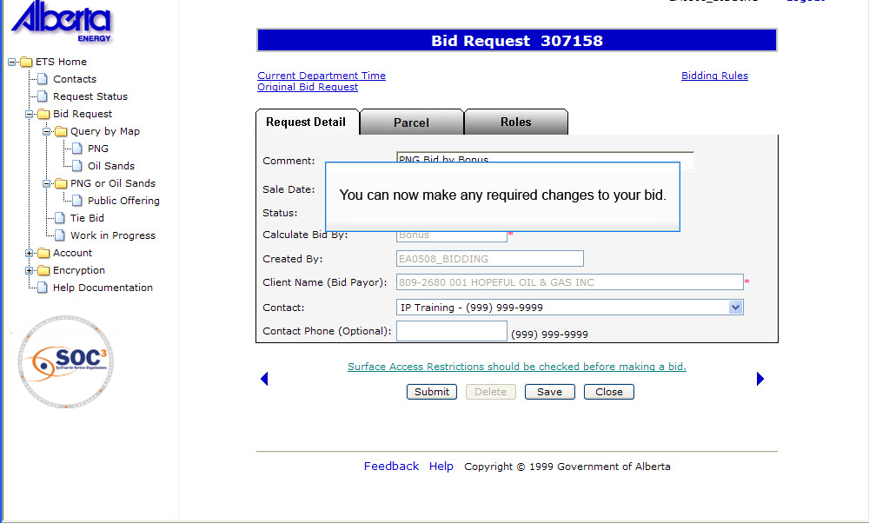
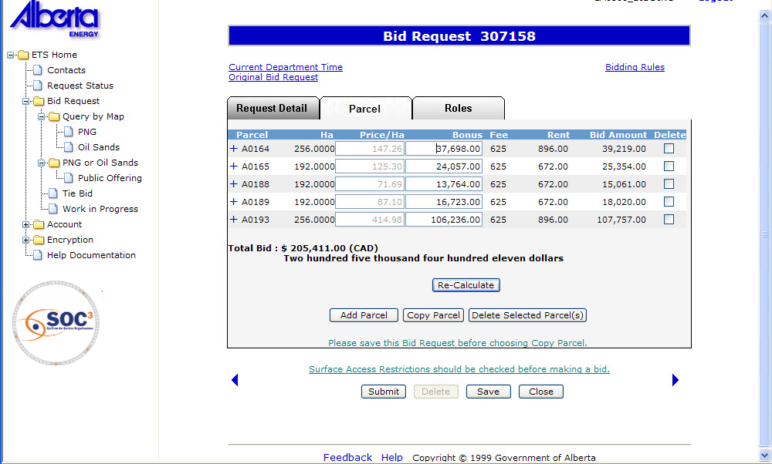
All the required changes to the bid can be made now
Back to Withdraw and Edit Request

Slide 17
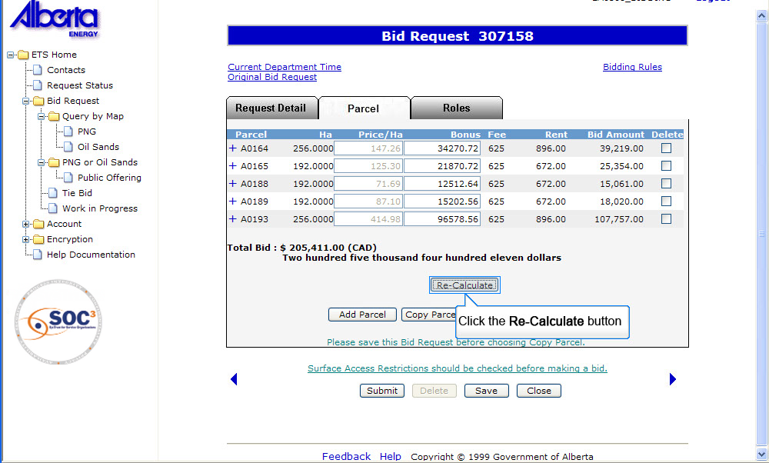
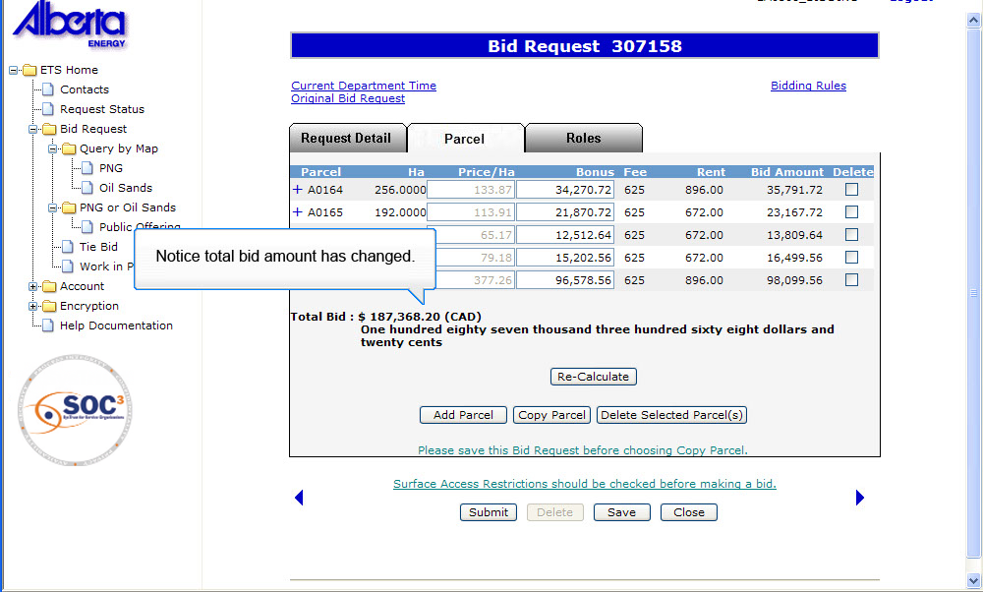
Once All the required changes are made click re-calculate button, the changes will take effect
Back to Withdraw and Edit Request

Slide 18
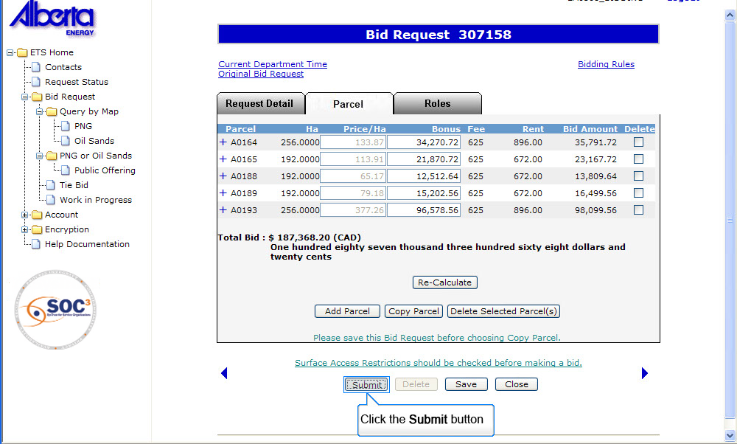
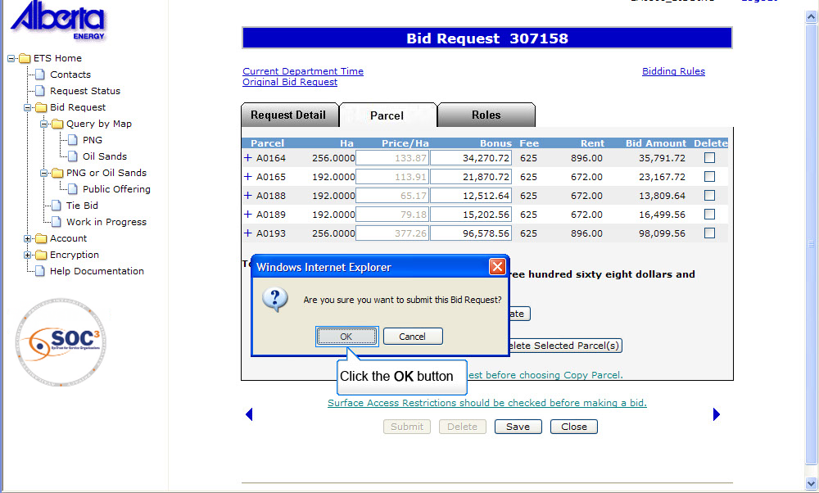
Back to Withdraw and Edit Request

Slide 19
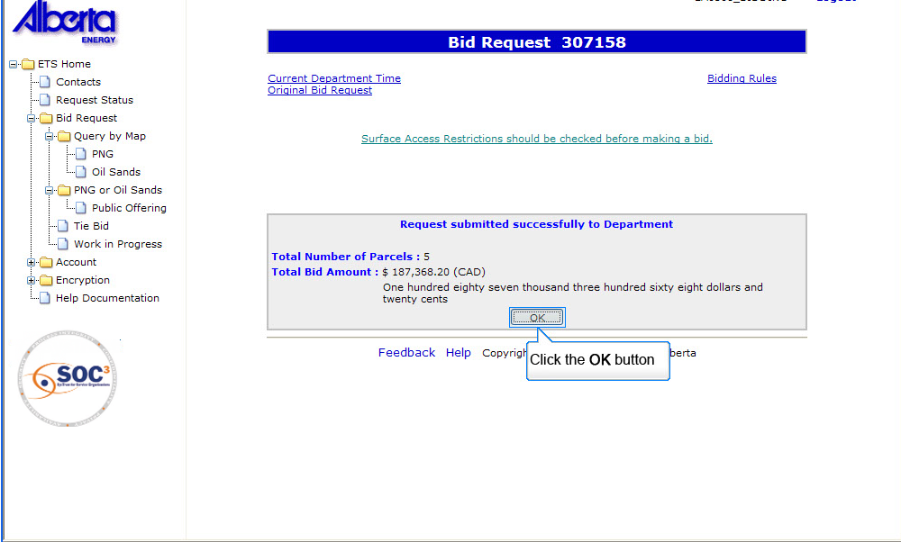
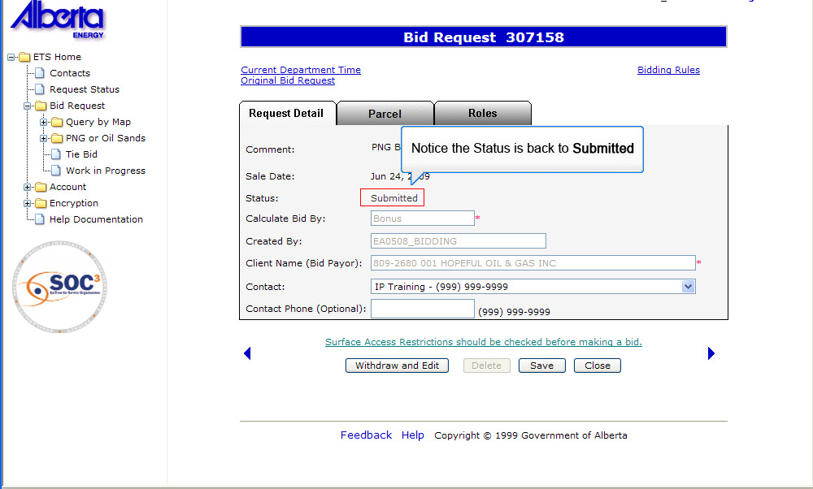
Clicking OK button after submitting the request to Alberta Energy will show the status changed to submitted from work in progress
Back to Withdraw and Edit Request

Slide 20
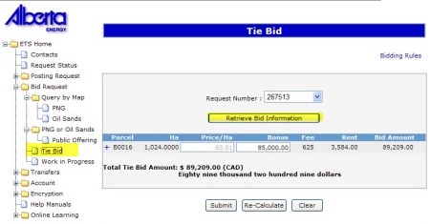
Tie Bid
More Information (Pages 21 to 25)
If two or more companies submit the same bid value on a parcel and that value is the highest submitted bid, Alberta Energy will ask the companies to submit a new bid for the parcel. There will be a time limit given for the re-submission of the bid. Click on More Information to view how to change and re-submit a tie bid.

Slide 21
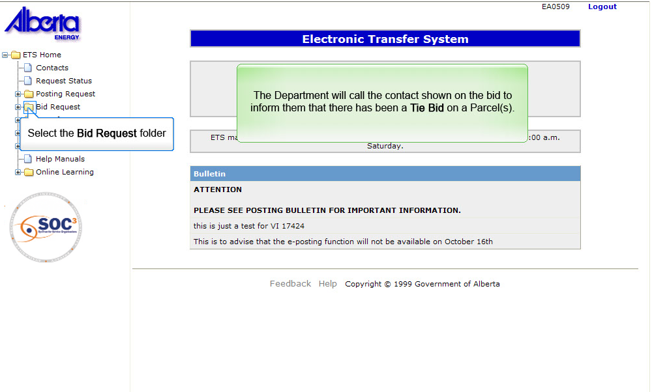
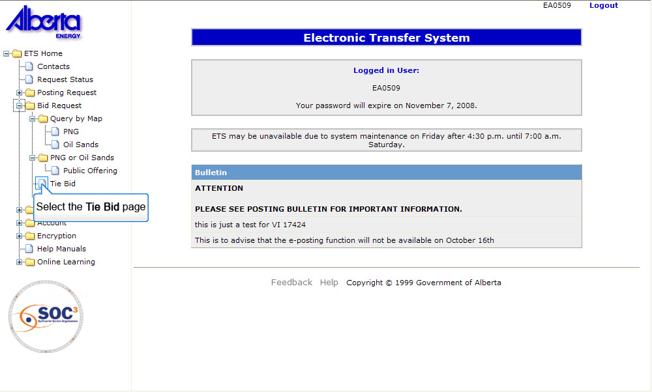
Selecting Bid folder expands the node to show tie bid
Back to Tie Bid

Slide 22
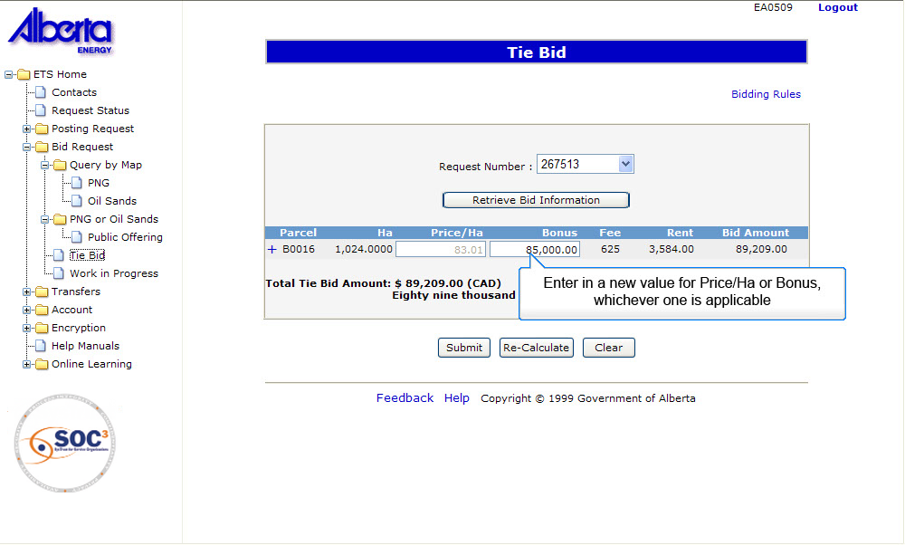
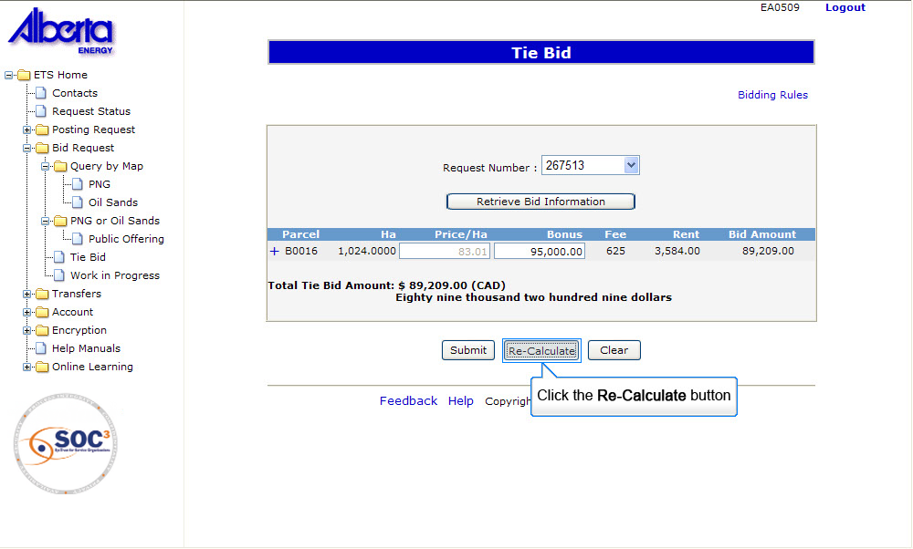
Enter an applicable value and click Re-Calculate
Back to Tie Bid

Slide 23
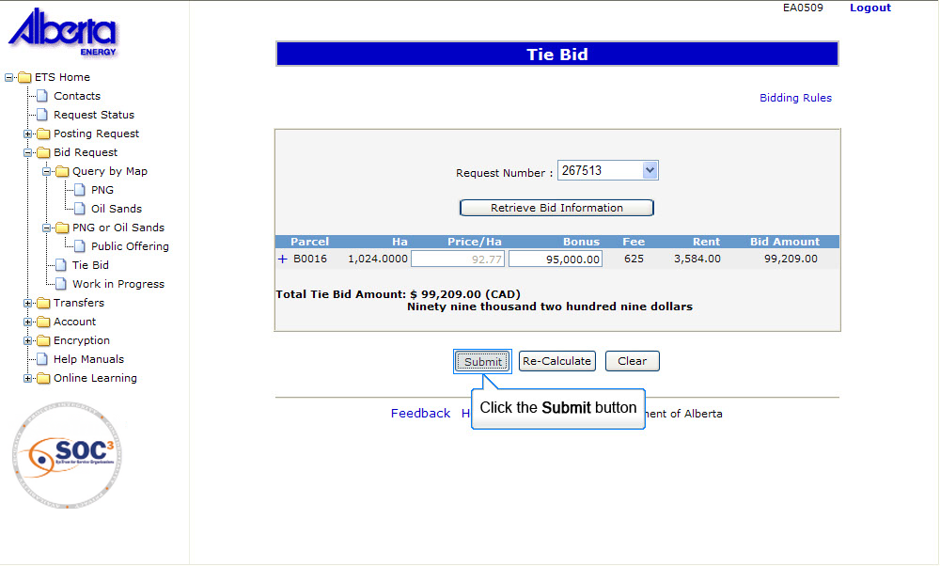
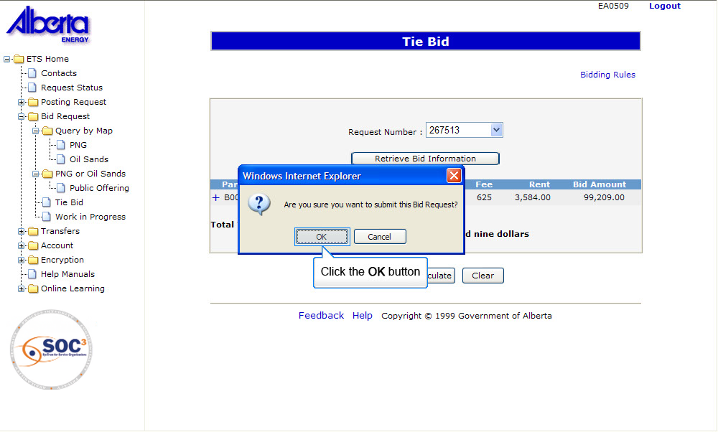
Back to Tie Bid

Slide 24
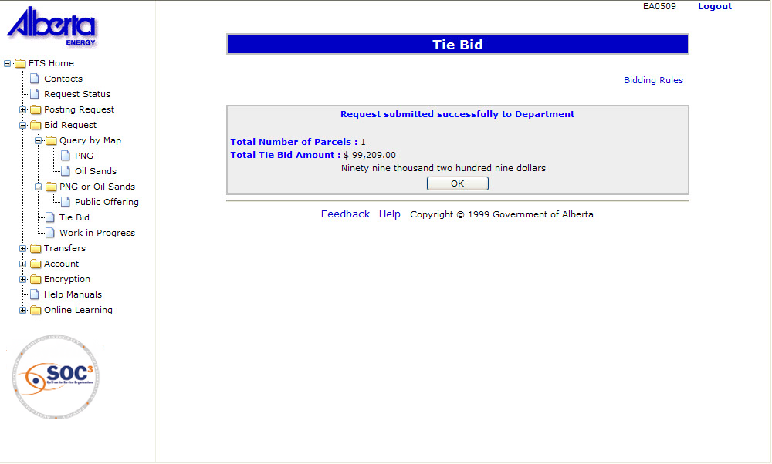
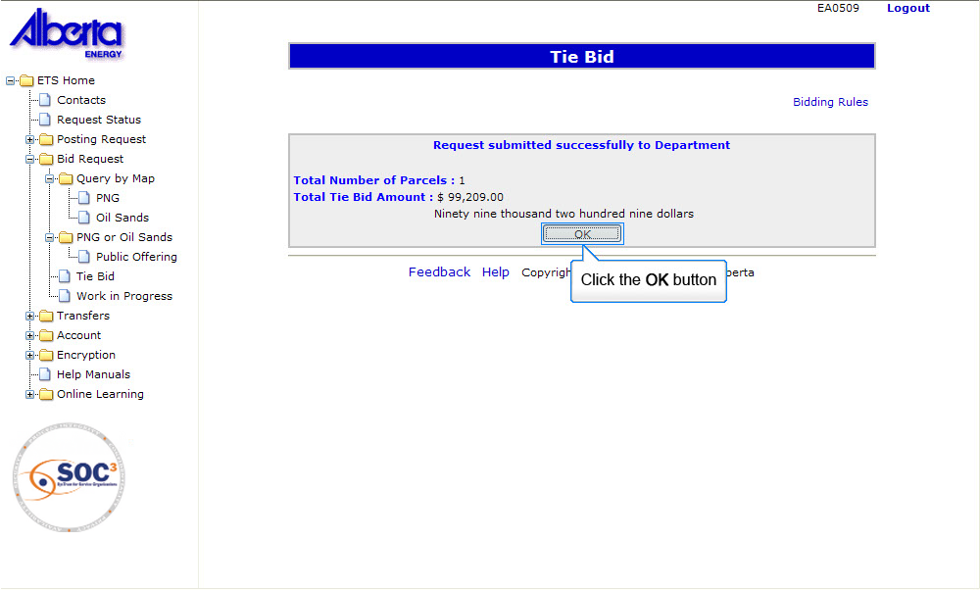
Once the submission is done, Click OK and Request will be sent to Alberta Energy
Back to Tie Bid

Slide 25
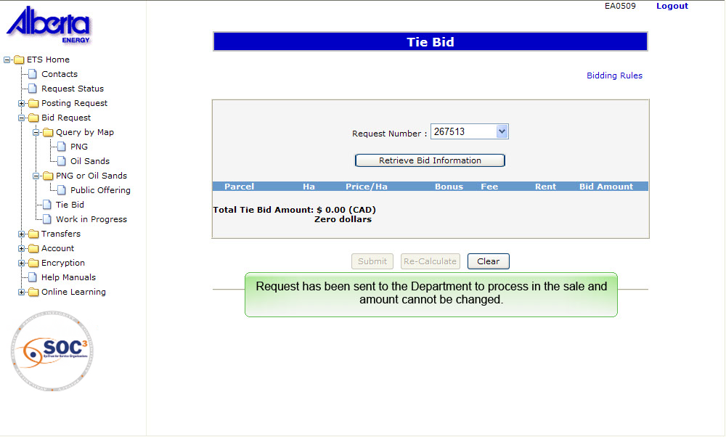
Back to Tie Bid

Slide 26
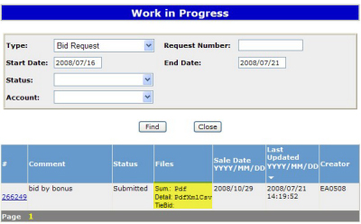
View Bid Reports
You can view, save, and/or print your bid request from the Work In Progress page under Bid Request folder. In the Files column, the bid request is available in summary and detail PDF, XML and CSV file formats.

Slide 27
Resources
ETS Support and Online Learning provides access to relevant guides, course and other information
If you have questions, please contact
for PNG: Bidding.Energy@gov.ab.ca or the Sales Helpdesk at (780)644-2300 or
for Oil Sands: OSTenure@gov.ab.ca

Slide 28

Conclusion
Congratulations!
You have completed the ETS – Change Bid Request
Online Training Course
Please proceed to the subsequent modules detailing other functionality of the Bidding application. If you have any comments or questions on this training module, please forward them to the following email address: Bidding.Energy@gov.ab.ca

