Slide 1
Welcome!
To the ETS – Agreement Management
Rental/Surrender Reinstatement
Online Training Course
Agreement Management – Rental / Surrender Reinstatement: This is the process to complete and submit an Online Rental Reinstatement request via ETS. This node is utilized for an agreement cancelled by either Rental Default or Surrender. The process begins with the creation of a new request through to submission. The request progresses through various stages (statuses) until completion.

Slide 2
Revisions Table
Date | Revisions Type | Page Number
March 10, 2017 | Initial Creation | All
June 2020 | Update Banner and add Resource Page | All
October 2020 | Updated | Various
January 2022 | Adding Surrenders | Various
November 2022 | Updated | Added reference to Geothermal Agreements

Slide 3
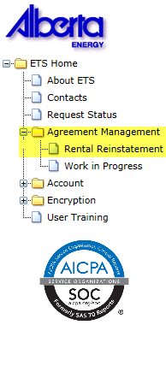

Rental Reinstatement - Introduction
In this module, you will learn how to:
Create and submit an Online Rental / Surrender Reinstatement request
Cancel or withdraw an Online Rental / Surrender Reinstatement request
Review response document(s)
Course Pre-requisites:
Training System Overview
ETS Account Setup and Preferences (For Site Administrators)
You must have the Creator role to create or withdraw a request and the Submitter role to submit a request.

Slide 4
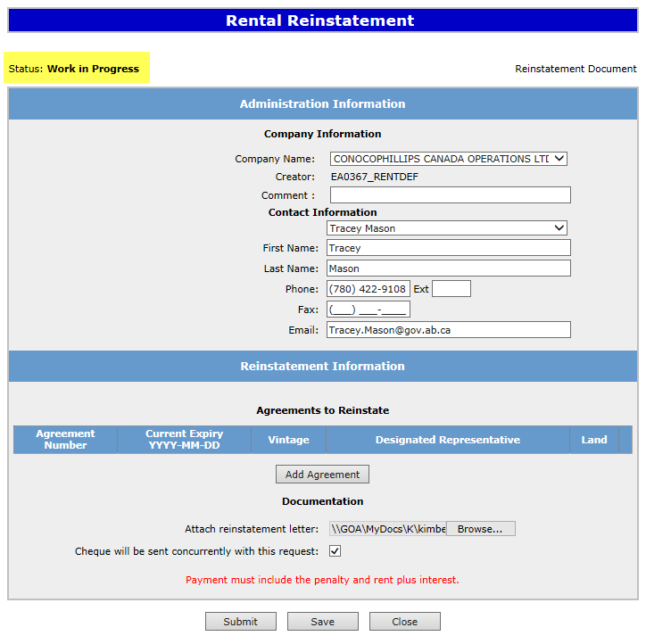

Create - Rental Reinstatement
Select the Rental Reinstatement node located under Agreement Management. Complete the Company Information, check off Cheque sent concurrently, select Add Agreement.
1. Complete Company Information
ABC Company
3. Select Add Agreement
2. Check off Cheque Sent Concurrently
Ensure you check off, that payment has been sent concurrently with this request. You will not be able to submit the request unless you recognize payment being sent. We can not complete the process until the request document and funds have been received.

Slide 5
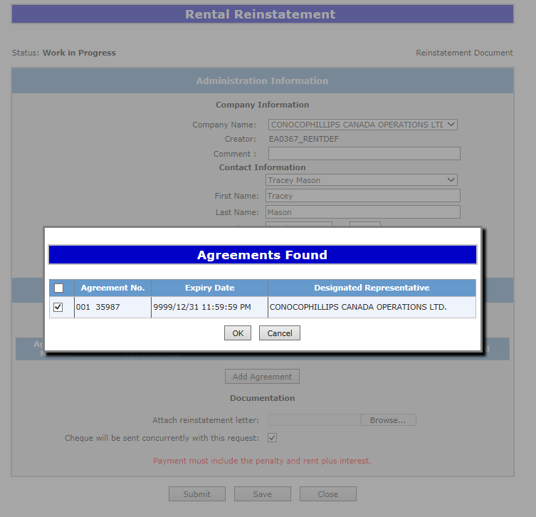
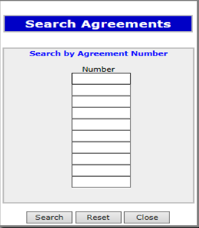
Insert in the PNG or Geothermal Agreement Number in the Search Agreements screen, select Search. The Agreements Found screen will populate with the requested agreement number. Select the Agreement Number Check Box, then select Ok.
1. Insert PNG Agreement Number
3. Select Check Box
ABC Company
2. Select Search
001 0000100001
ABC Company
4. Select Ok

Slide 6
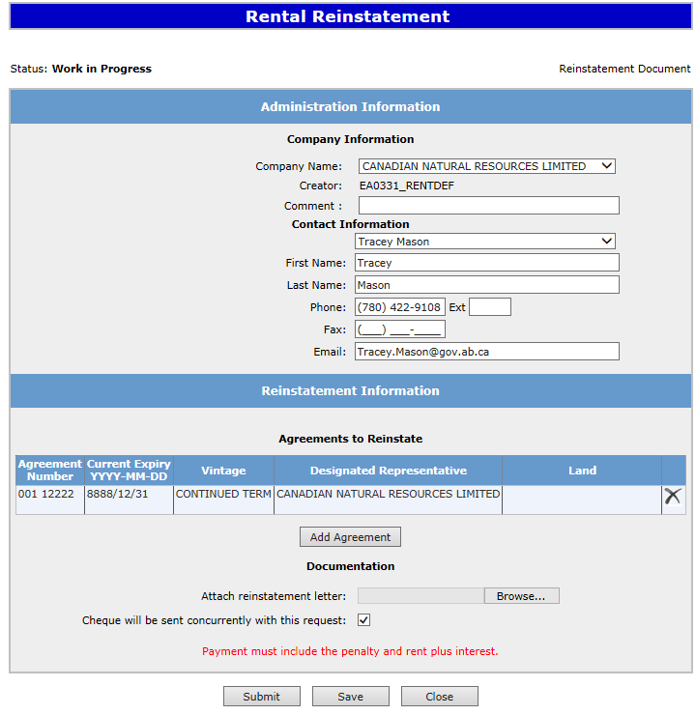

After selecting Ok you will be taken back to the Rental Reinstatement Administration Information screen. The screen status will be updated to Work in Progress. Attach your reinstatement request letter which outlines your rational for requesting the reinstatement. Select Browse and upload your document
ABC Company
1. Select Browse
001 0000100001
ABC Company

Slide 7
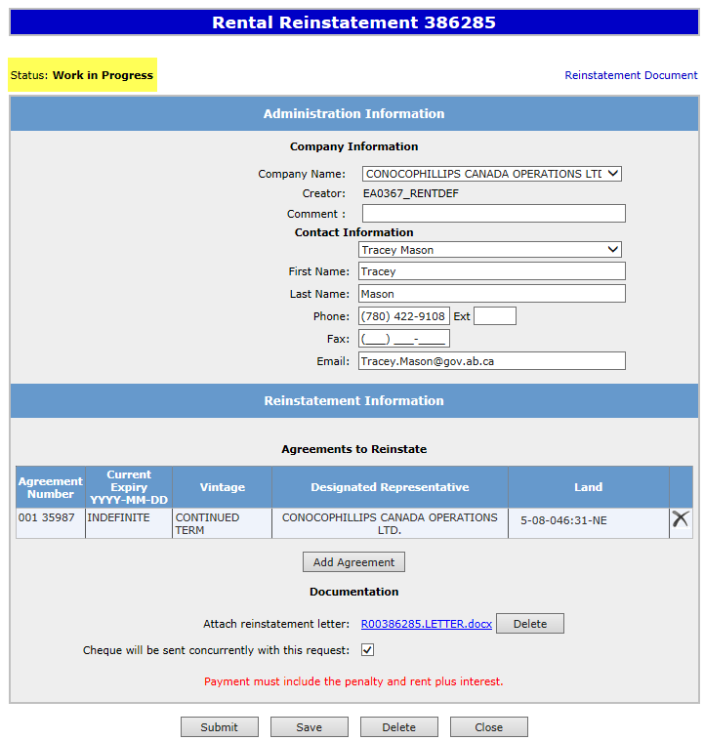
Select Save and then Submit.
ABC Company
M1234
2. Select Submit
1. Select Save
001 0000100001
ABC Company
1-01-001:1

Slide 8
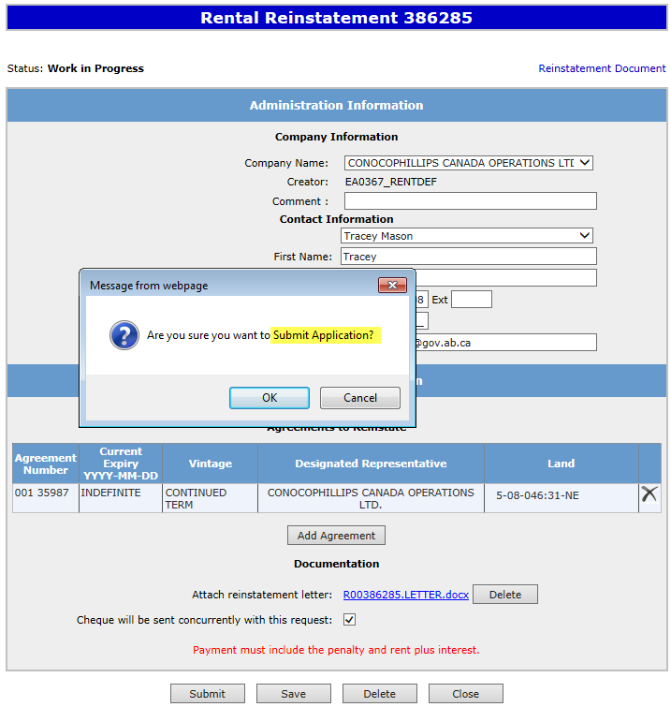
A Message Box will populate asking if you are sure you want to Submit your Rental /Surrender Reinstatement Application, select Ok.
ABC Company
1. Select Ok
001 0000100001
ABC Company
1-01-001:1

Slide 9
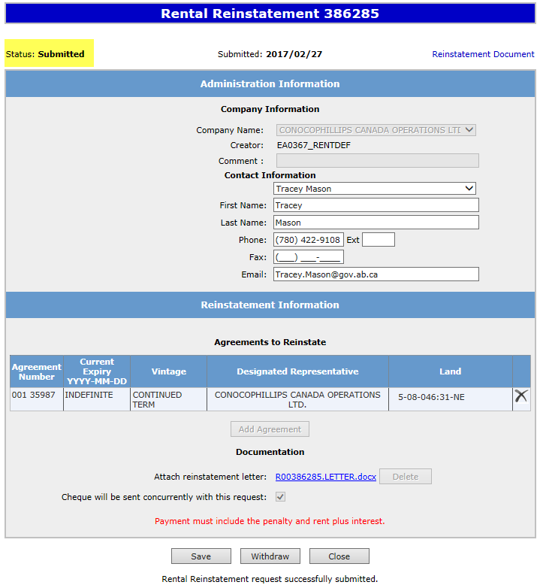

After submitting your request the Status will change to Submitted. At the bottom of the screen you have a Save, Close and a Withdraw Button is now available.
Please note: By selecting the Reinstatement Document a PDF electronic version of your form will populate.
ABC Company
001 0000100001
ABC Company
1-01-001:1

Slide 10
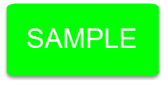
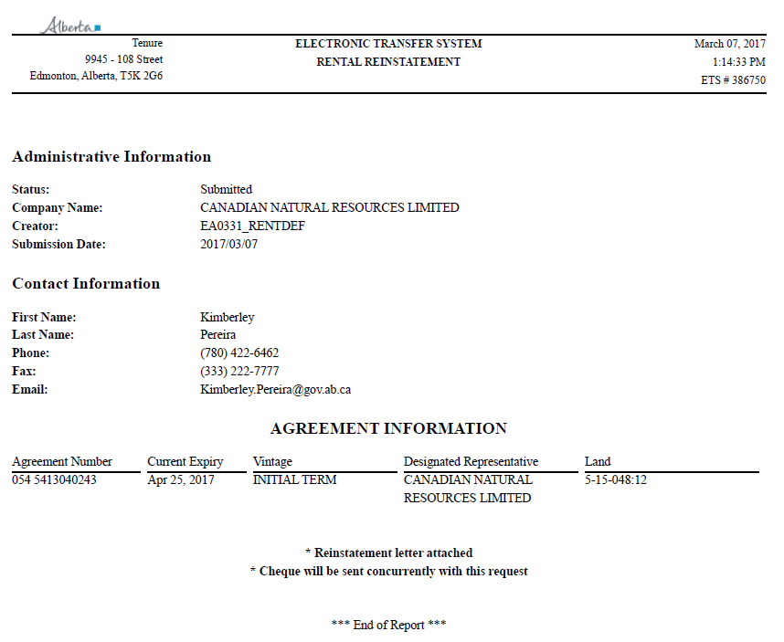
Reinstatement Document
ABC Company
001 0000100001
December 22 2016
ABC Company
1-01-001:01

Slide 11
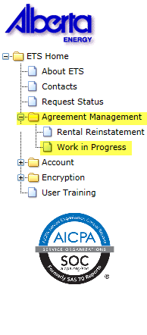
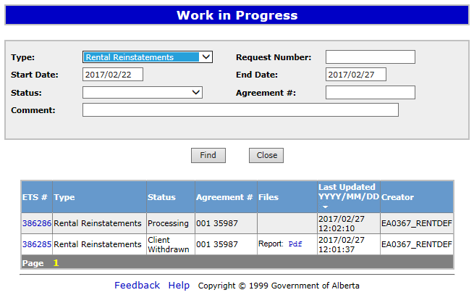
Work in Progress
To check the status of your agreement, select the Work in Progress screen under the Agreement Management node. In the Type drop down box select Rental Reinstatements and then select Find. All submitted Reinstatements will populate with their current status. By changing the parameters on the Work in Progress screen varying results will populate, example: you may also enter the Request Number.
1. Select Find
001 0000100002
Submitted
001 0000100001

Slide 12
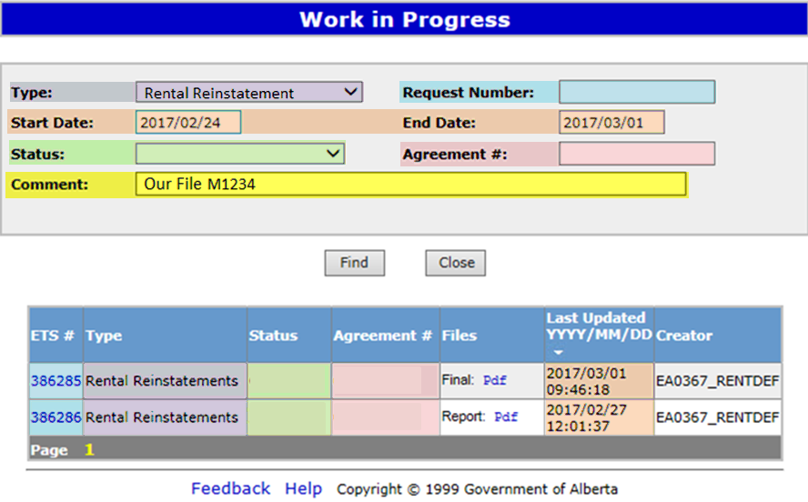
Request Status – Search Parameters and Result
Parameter Field | Result Column
Type | Form Type
Request Number | ETS #
Start/End Date | Last Updated
Status | Status
Agreement # | Agreement #
Comment | (not shown as a result column)
You can utilize the search parameter fields to filter search results.
The table on the right shows the correlation between the parameter fields and each corresponding result column.
Below is a color-highlighted illustration of the Work in Progress search screen to further demonstrate the relationship between the data.
Client Submitted
001 0000100001
Processing
001 0000100002

Slide 13
Request Status – Search Result
To load a request, click on the ETS Request number link.
To open a document click on the report Pdf link.
Search Results
001 0000100002
Submitted
001 0000100001
Navigate with this page number, if there are multiple pages of search results.

Slide 14
Reinstatement Completed
Upon completion of the Rental / Surrender Reinstatement request, a notification email will be sent to the site Administrator/Contact.
EXTERNAL SENDER. Do not open links or attachments that are unexpected. Do not give out User IDs or Passwords. Your Rental Reinstatement Request Number XXXXXX for account ENXXXXX has been Completed. This request can be found under Agreement Management-Work in Progress. To review your request sign on to the Electronic Transfer System (ETS) website, available through Alberta.ca. Do not reply to this EMail. If you have questions or concerns please contact Energy.Rentals@gov.ab.ca.

Slide 15
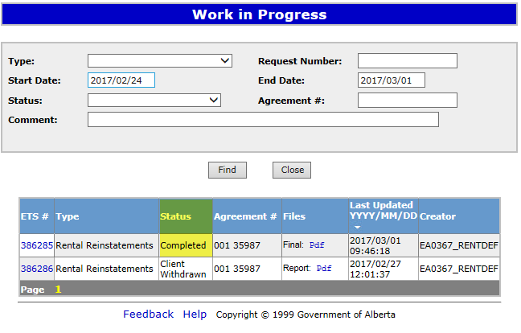
Select Work in Progress under the Agreement Management node. The Work In Progress screen will populate and select Find, all of your Reinstatements currently in ETS will generate. You may also search your request using the Request Number provided to you in your original submission.
Rental Reinstatements
1. Select Find
001 0000100001
001 0000100002

Slide 16
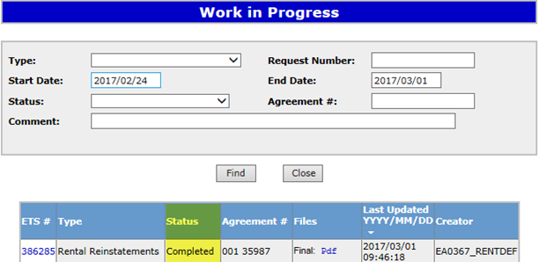
Rental / Surrender Reinstatement Letter
Select Final Pdf and the Reinstatement Letter will populate.
Rental Reinstatements
1. Select PDF
001 0000100001

Slide 17
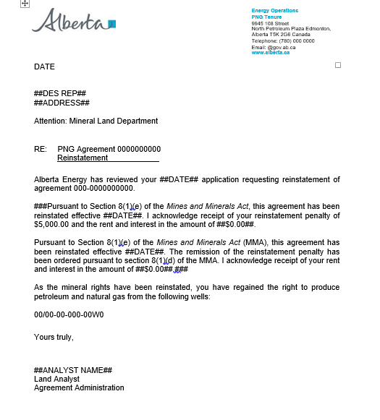
Rental Reinstatement Letter

Slide 18
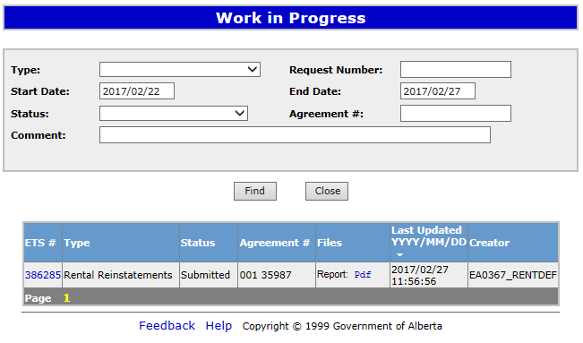
Rental Reinstatement - Withdraw
By either selecting the Rental / Surrender Reinstatement Type or by entering the Request Number you may access your submission and Withdraw your request.
To Withdraw your Rental / Surrender Reinstatement request, the Status will need to be Submitted. At this point you will access the Work in Progress screen and click on the ETS Request Number. You may Withdraw your Rental / Surrender Reinstatement at anytime while the Status is Submitted or Processing.
1. Select Request Number
001 0000100001

Slide 19
The Administration Information screen will populate displaying the Company Information and the Agreement to Reinstate. Click on the Withdraw button at the bottom of the screen.
ABC Company
1. Click Withdraw
001 0000100002
ABC Company
1-01-001:1

Slide 20
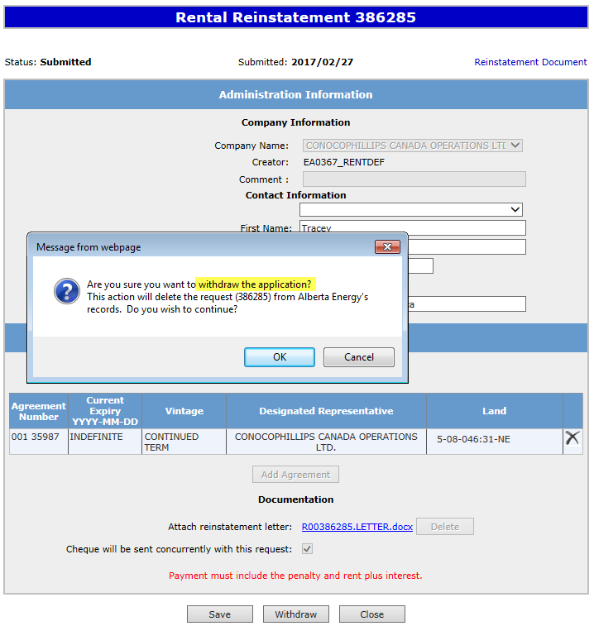
A Message box will populate confirming the Withdrawal of your Rental / Surrender Reinstatement application. To proceed click the Ok button.
ABC Company
1. Click Ok
001 0000100002
ABC Company
1-01-001:1

Slide 21
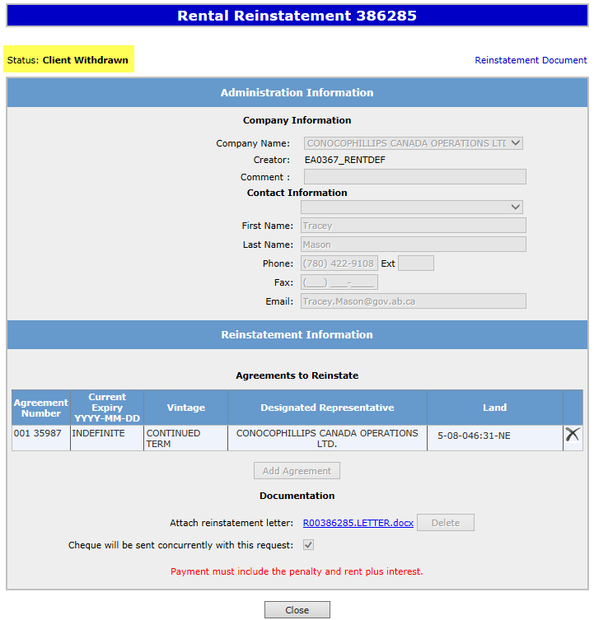
Once you select Ok, the Administration Information screen will populate with the Status of Client Withdrawn. The information has been deleted from Alberta Energy’s records. Select Close, you will be taken back to Work In Progress.
Please note: By selecting the Reinstatement Document a PDF electronic version of your form will populate.
ABC Company
001 0000100002
ABC Company
1-01-001:1
1. Select Close

Slide 22
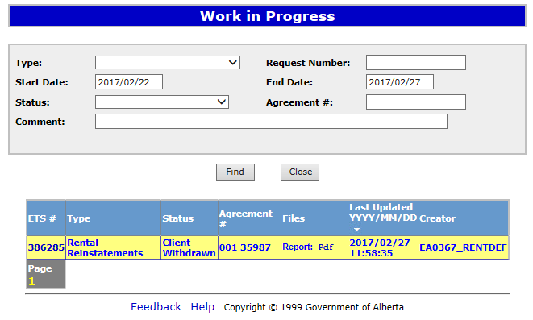
The Work in Progress screen will confirm the Rental / Surrender Reinstatement Status has been changed to Client Withdrawn and the information has been deleted from Alberta Energy’s records.
001 0000100002

Slide 23
RESOURCES
ETS Support and Online Learning provides access to relevant guides, courses and other information.
If you have questions, please contact Energy.Rentals@gov.ab.ca
or the PNG Tenure Help Desk at 780-644-2300 and by selecting option #3.

Slide 24

Congratulations!
You have completed the ETS
Agreement Management
Rental/Surrender Reinstatement
Online Training Course
To access Courses, Guides and Forms for all your ETS Business please see ETS Support and Online Learning.
If you have any comments or questions on this training course,
please contact:
Crown Agreement Management
Helpdesk: (780) 644-2300
Email inquires: ENERGY.Rentals@gov.ab.ca

