Slide 1
Welcome!
To the ETS – Encumbrance
Registration of Prompt Payment and Construction Lien (PPCL), Certificate of Lis Pendens and Discharge of PPCL
(Full or Partial)
Online Training Course
This is the process of submitting a statement of lien upon interest in Crown minerals, Certificate of Lis Pendens and discharge of PPCL for registration.
Page 1 of 36

Slide 2
Revision Page
Revisions Table
Date | Revisions Type | Page Number
May 3, 2018 | Initial Creation | All
April 2020 | Update links and Header | All
February 2023 | Updated reference of Builder’s Lien to Prompt Payment and Construction Lien (PPCL) | Pages that had reference to Builder's Lien
Page 2 of 36

Slide 3
Introduction
In this module, you will learn how to:
Register a Prompt Payment and Construction Lien (PPCL)
Register a Certificate of Lis Pendens
Register a Full/Partial Discharge of a PPCL
Use Query by Land
View Work In Progress
Track the ETS Encumbrance Request Status
Retrieve Final Document(s)
Click on any of the above to be directed to the corresponding instructions in the module.
Prerequisite Learning Module
Prior to proceeding we recommend to review the Encumbrance Overview Module located on the Online Learning portal.
Page 3 of 36

Slide 4
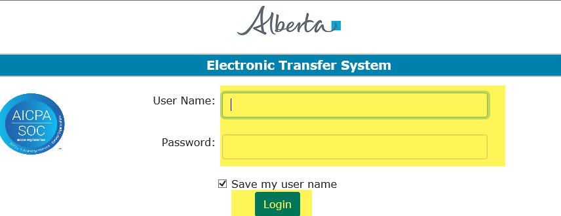
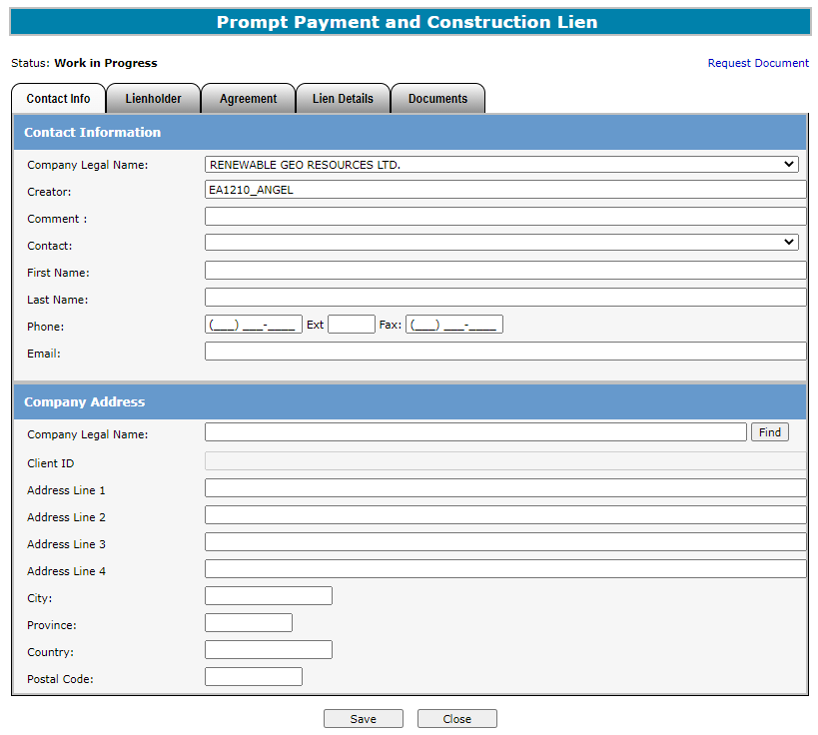
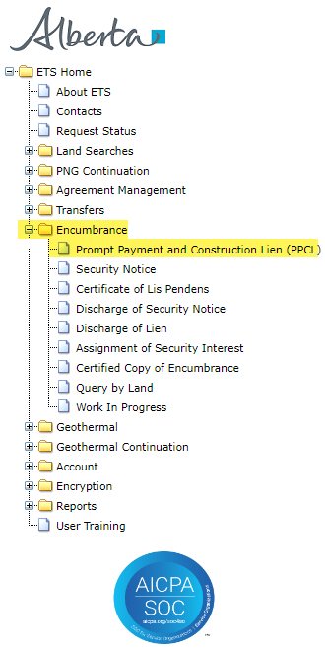
PROMPT PAYMENT AND CONSTRUCTION LIEN (PPCL)
1. Login to ETS with your user name and password.
2.Click on Encumbrance.
3. Click on PPCL
Page 4 of 36

Slide 5
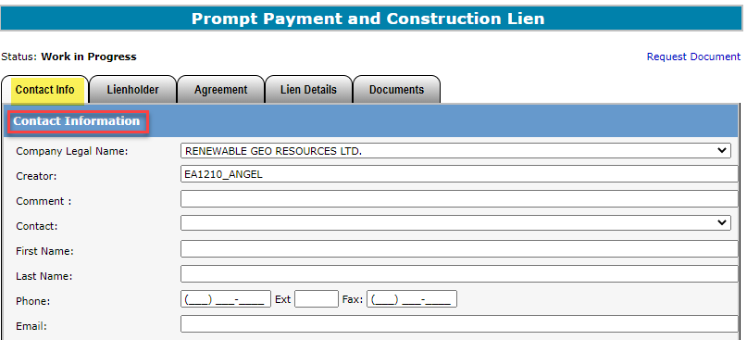

Enter Contact Information
1. Select Company Name from drop down menu.
2. Select Contact from drop down list. This will auto generate the information below.
Users can also manually enter in Contact Information by typing into the fields above.
Status will remain Work in Progress until user completes all tabs and submits request.
Page 5 of 36

Slide 6
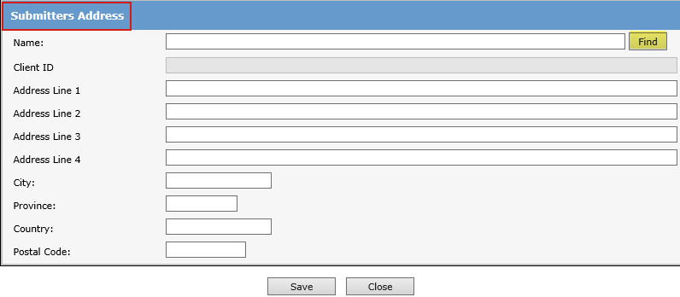
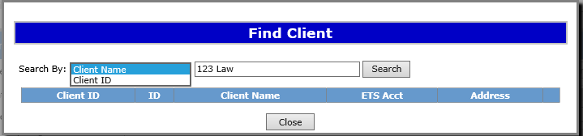
Enter Submitters Address
1. Type in Company Name and hit Enter or click Find to search for the applicable Client Name.
User can Search Submitter info by Client Name or Client ID.
2. Type in Client Name or DOE Client ID.
3. Click Search.
If mandatory fields are not entered (displayed with a red asterisk *) or validation fails, a red error message will appear at the top of the page. Input must be corrected in order to save Contact and Submitter Information.
Page 6 of 36

Slide 7
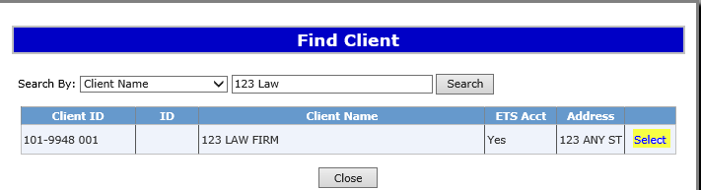
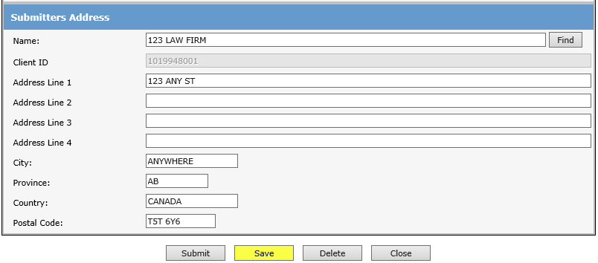
Enter Submitter Address Cont.
A pop up window will generate a list of Client Names and addresses. Scroll to find the relevant client and address.
1. Click on Select to continue.
The submitters address of the selected Client will auto generate. Verify the address is correct.
2. Click Save to proceed.
User can manually enter Submitters Address, if the correct address is not displayed in the search.
Saving periodically is recommended as the screen will timeout after 15 minutes of inactivity.
Page 7 of 36

Slide 8
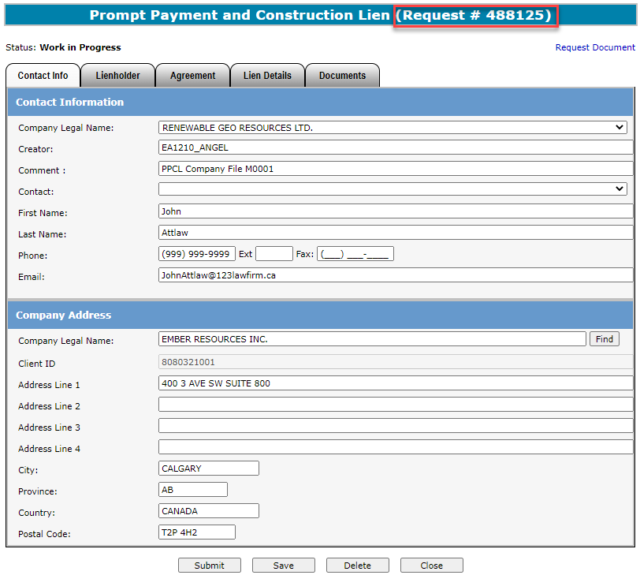
ETS Request Number
Ensure the contact information and submitters address are correct. Also ensure the Company Name and Submitters Address Name is the same.
Click Save.
An ETS request number will be displayed at the top of the screen.
The ETS request Number will be used to track your request in the Work in Progress node (Slide 30).
Page 8 of 36

Slide 9
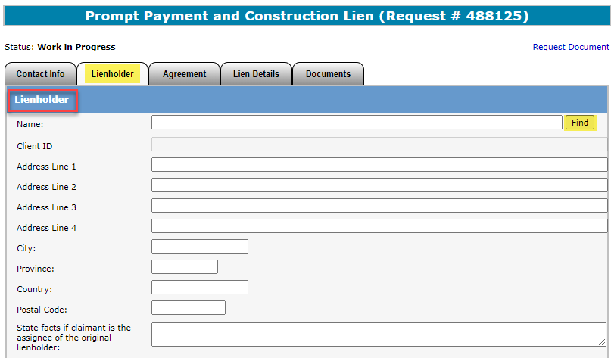
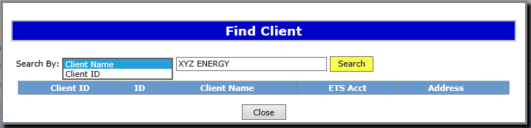
Enter Lienholder
Click on the Lienholder Tab to enter the lienholders information.
By clicking Find users can search by client name or client ID as in previous pages. If the desired client is not found, the Submitter can enter the lienholder’s name and address manually by clicking in the fields.
1. Click Find to search by Client Name or Client ID.
2. Type in Client Name or Client ID and click Search.
Page 9 of 36

Slide 10
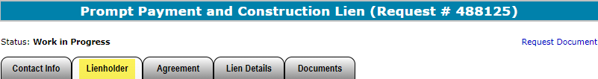
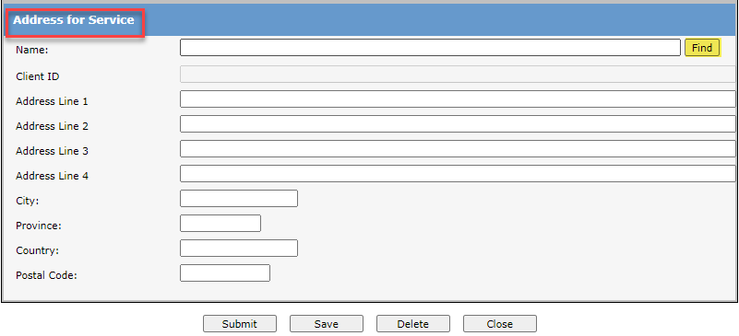
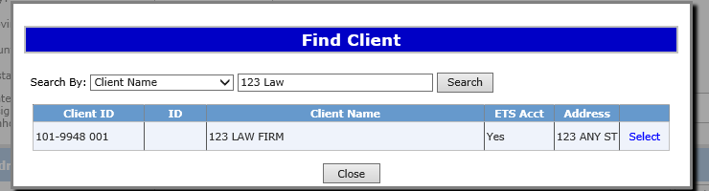
Lienholders Address for Service
1.Type in company name and hit Enter or Click Find button to search manually.
Users will enter the Lienholder’s Address for Service.
If client’s address cannot be found, user can manually type in the address.
Click Save at the bottom of the screen.
A list with client name and address will appear. Click on Select to choose which address to use.
Page 10 of 36

Slide 11
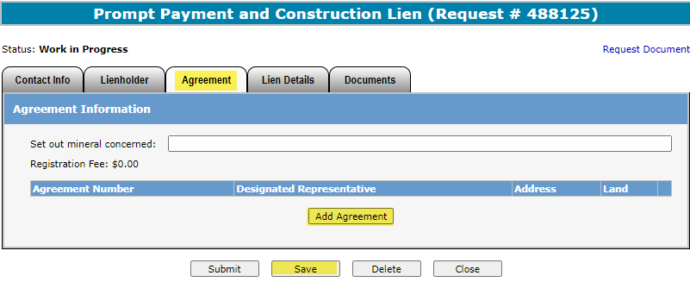
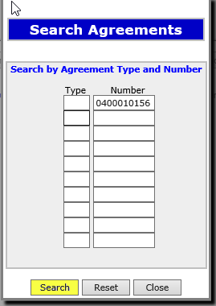
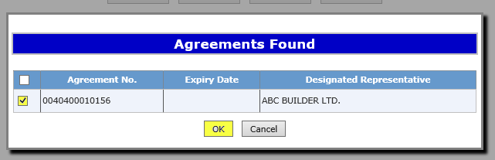
Enter Agreement & Land Information
1. Enter the mineral concerned.
3. Enter the Type and Agreement number(s) in the Search Agreement screen and Click Search.
2. Click on Add Agreement to search the agreement(s) which the lien will be registered against.
4. Select the agreements that will be placed on the lien using the check box and click OK.
If unable to locate the agreement number a Query by Land search can be done.
Please see slides 12 - 13 for guide.
Page 11 of 36

Slide 12

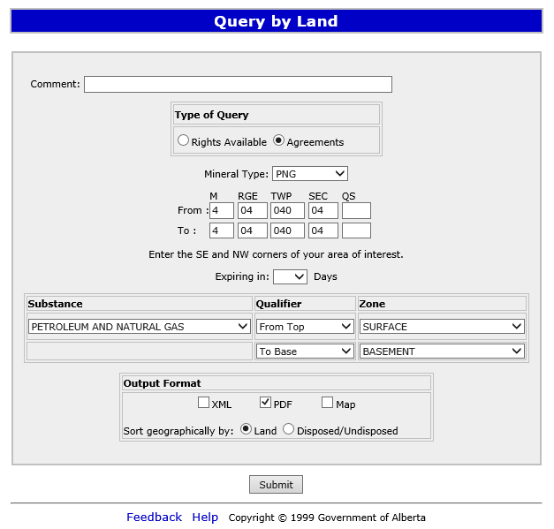
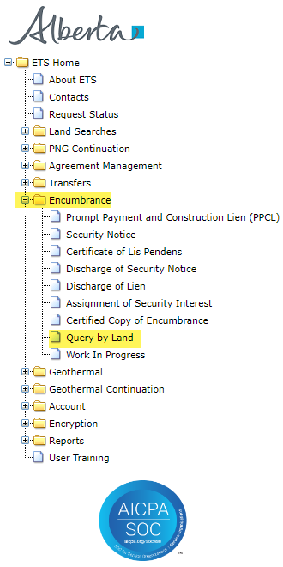
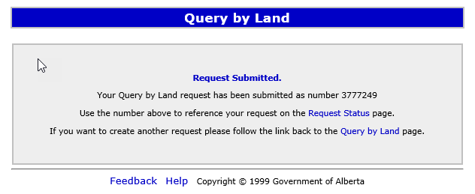
Encumbrance
Government of Alberta
QUERY BY LAND
1. Click on Agreements
2. Choose mineral type
3. Enter land description
4. Click on PDF
5. Click Submit
A request number will display on the screen. Keep this request number to locate your search on the Request Status screen.
Page 12 of 36

Slide 13
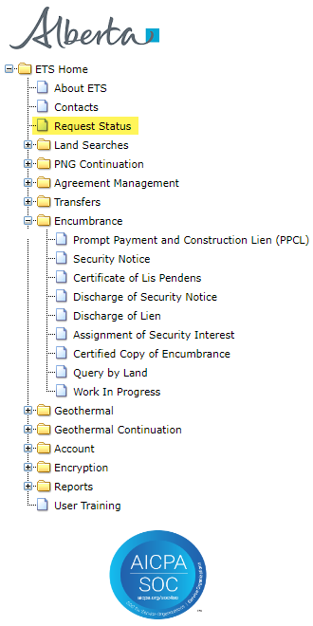
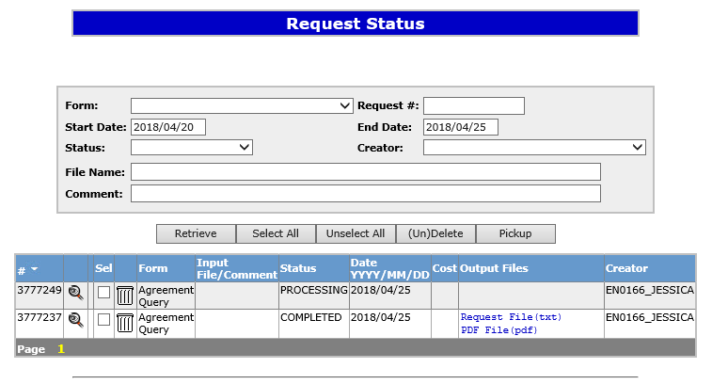
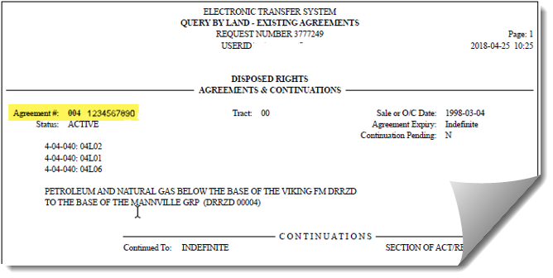
Encumbrance
Government of Alberta
1. Enter request number, or click Retrieve to display all requests.
2. Click on PDF File (pdf) to display results
Sample
Active agreement numbers on the lands requested will be displayed.
Page 13 of 36

Slide 14
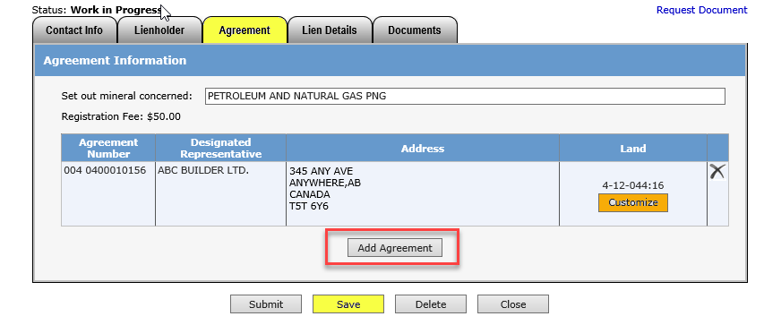
Enter Agreement & Land Information Continued
Agreement information (Agreement Number, Designated Representative and Land Description) will be displayed.
Click on the “X” to delete the agreement.
Click Add Agreement. You may add multiple agreements. Click Save to update the information recently entered.
Click on Customize if the lien is not being registered on all of the agreement lands.
(See slide 15)
The fee for registration is $50.00 per agreement. Invoices for registration charges will be mailed out monthly to the submitter of the request.
Page 14 of 36

Slide 15
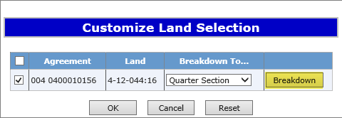
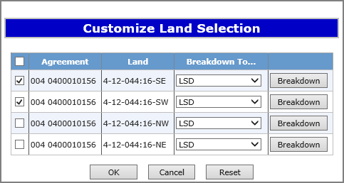
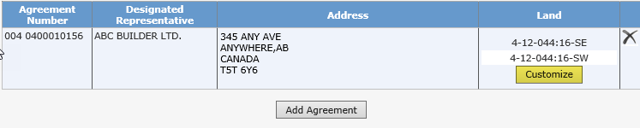
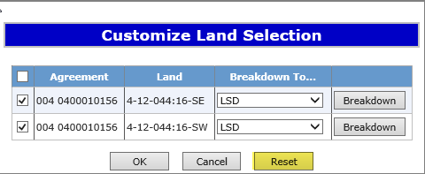
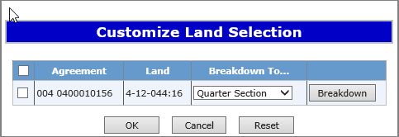
Encumbrance
Government of Alberta
Enter Agreement & Land Information Continued
1. Click Breakdown to select smaller portions of land.
3. Only the lands selected will display.
2. Select land with the check boxes and Click OK.
4. To display all the lands, Click Customize, then Click Reset.
Page 15 of 36

Slide 16
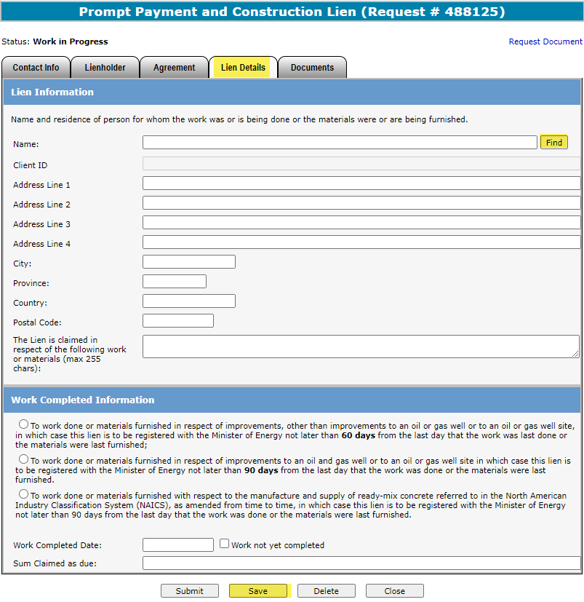
1. Click Find to search for client name, or manually enter client’s name and address if not found.
The information on this tab includes:
Name and residence who the work was done for.
Description of work done or materials furnished.
If work done was in respect to improvement to an oil and gas well or well site, or improvement other than an oil and gas well or well site.
Date the work was completed.
Sum claimed.
2. Enter description of work done or materials furnished.
3. Select applicable choice.
4. Enter work completed date or work not yet completed and sum claimed as due.
5. Verify information and Click Save.
Page 16 of 36

Slide 17
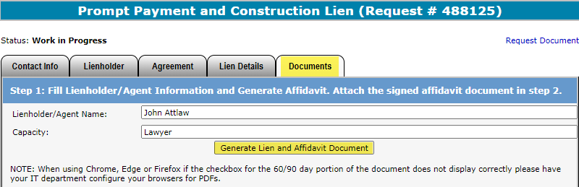
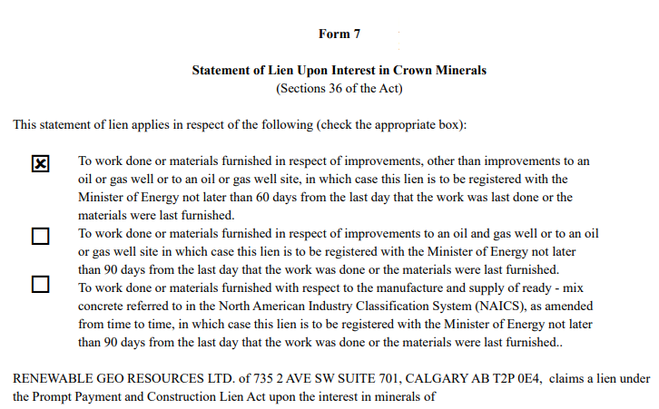
Generate and Sign Lien
Click on the Documents tab to enter the name of the person signing the lien.
1. Enter name and capacity of signor.
2. Click on Generate Lien and Affidavit Document.
Sample
The request will be validated to make sure all necessary information has been entered. If anything is missing, an error will appear on the top of the screen.
Review and print the Lien and Affidavit form.
Page 17 of 36

Slide 18

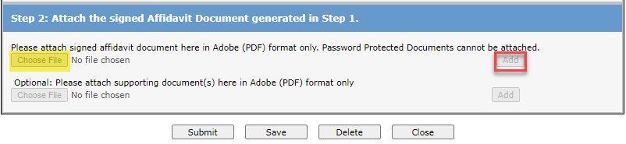
Uploading Documents
1. Select Choose File to upload the signed lien and affidavit form. (Must be PDF formatting)
2. Click Add.
3. Click Save and then Submit.
If you would like to add additional documents, you may attach cover letters, etc. in the optional supporting documents line prior to submitting by following the same process above. Do not add password protected documents.
Page 18 of 36

Slide 19
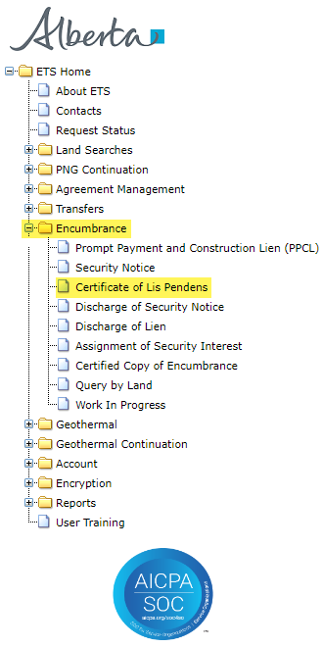
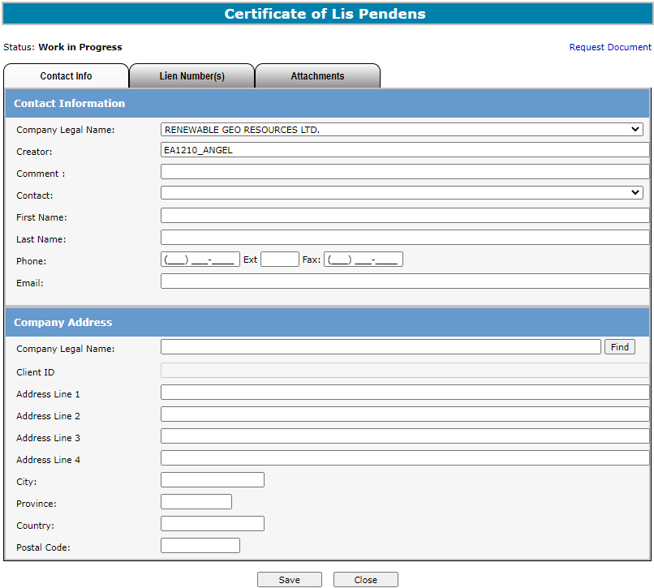
Encumbrance
Government of Alberta
CERTIFICATE OF LIS PENDENS
1. Click on Encumbrance.
2. Click on Certificate of Lis Pendens.
Page 19 of 36

Slide 20
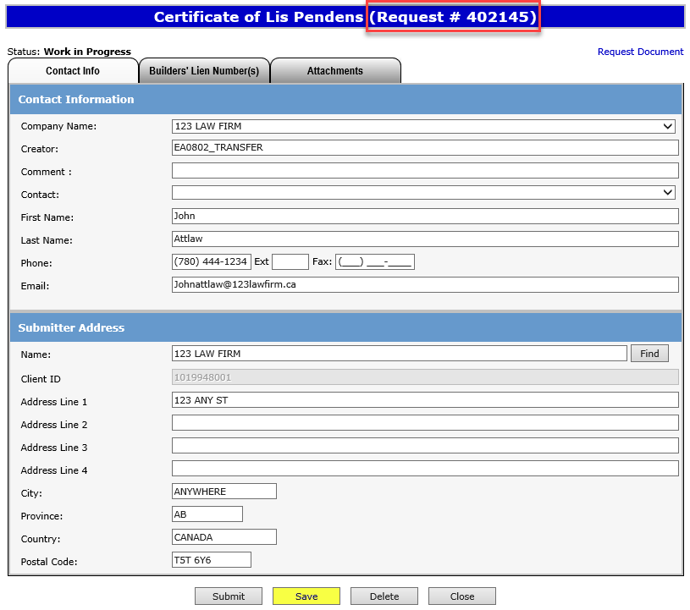
Encumbrance
Government of Alberta
ETS Request Number
Ensure the contact information and submitters address are correct. Also ensure that the Company Name and Submitters Address Name are the same.
Click Save.
An ETS request number will be displayed at the top of the screen.
The ETS request Number will be used to track your request in the Work in Progress node.
(Slide 30)
Page 20 of 36

Slide 21
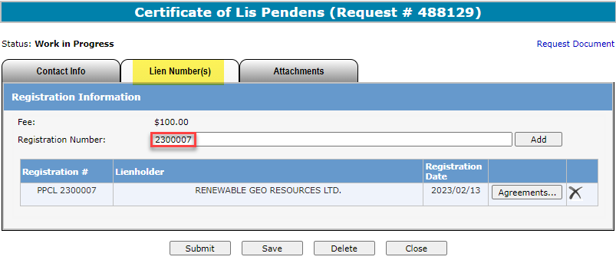
Encumbrance
Government of Alberta
Enter PPCL Number(s)
The PPCL number, lienholder name and registration date will appear on this screen.
Note: All lienholders must be the same if multiple builders’ liens are added.
2. Click Add.
11. Enter PPCL Registration Number.
To view the agreements that are registered on the PPCL, you can click here.
The fee for registration is $50.00 per active agreement that the PPCL is registered against. Invoices for registrations will be mailed out monthly to the submitter of the request.
Page 21 of 36

Slide 22
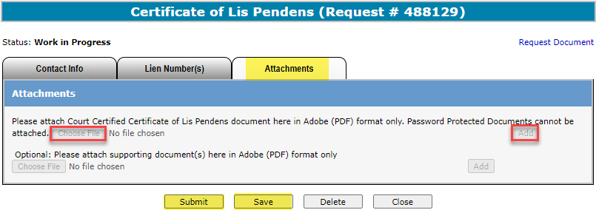
Encumbrance
Government of Alberta
Upload Document
1. Click Choose File to upload a Court Certified Certificate of Lis Pendens in PDF format.
2. Click Add
3. Save and Submit
If you would like to add additional documents, you may attach cover letters, etc. in the optional supporting documents line. Please do not attach any password protected documents.
Page 22 of 36

Slide 23
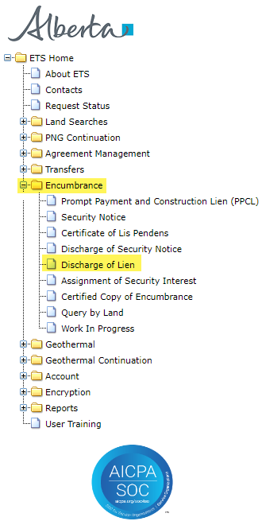
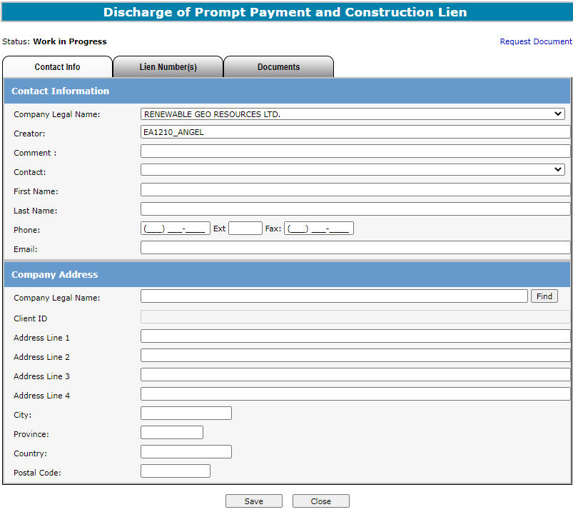

DISCHARGE OF PPCL
1. Click on Encumbrance.
Click on
Discharge of Lien.
NOTE: A Withdrawal of Certificate of Lis Pendens is not necessary to send in. Any related Certificate of Lis Pendens that is registered on the PPCL will also be discharged or partially discharged.
Page 23 of 36

Slide 24
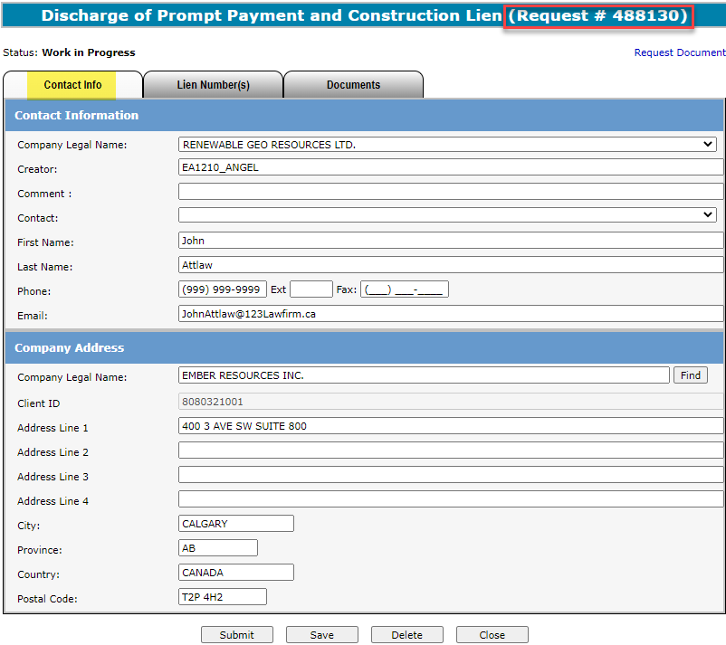
ETS Request Number
Ensure the contact information and submitters address are correct. Also ensure the Company Name and the Submitter Address Name is the same.
Click Save.
An ETS request number will be displayed at the top of the screen.
The ETS request Number will be used to track your request in the Work in Progress node.
(Slide 30)
Page 24 of 36

Slide 25
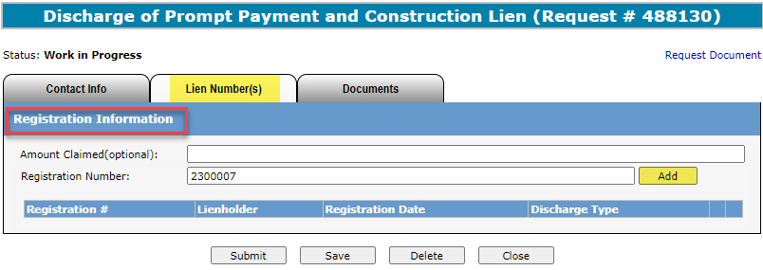
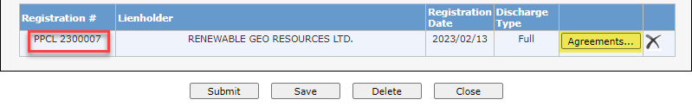
Enter Registration Number
2. Click Add.
1. Enter in PPCL Registration Number.
The system will default to a full discharge. For a partial discharge, click on Agreements to customize agreements and lands. (Slide 26).
Page 25 of 36

Slide 26
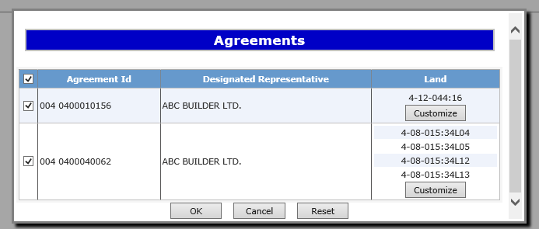
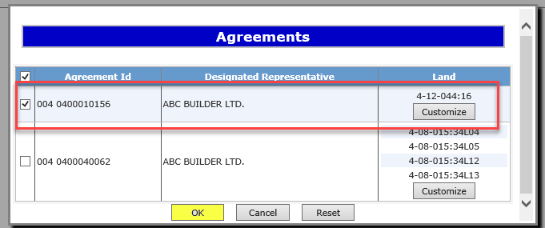
Encumbrance
Government of Alberta
Partial Discharge
In the Agreements screen, you can select which agreements are being discharged.
To discharge specific land, click Customize. You will be able to select specific lands.
Click OK once the correct lands/agreements are selected.
Click Customize to select specific land.
Page 26 of 36

Slide 27
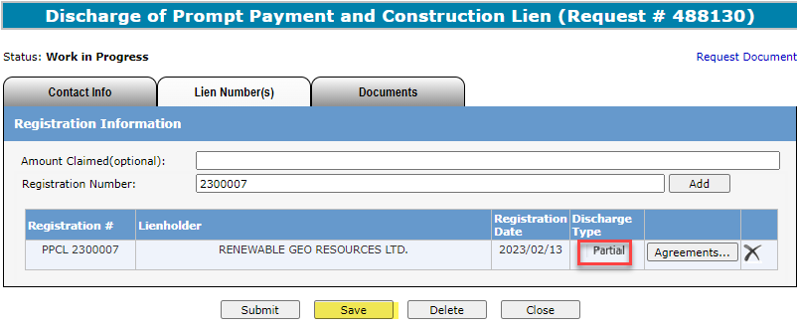
Discharge Type
On the Lien Number(s) Tab, the type of discharge will be displayed by each lien that has been added.
In the above example, the discharge type will show partial as some of the agreements are not selected.
Click Save to continue.
Page 27 of 36

Slide 28
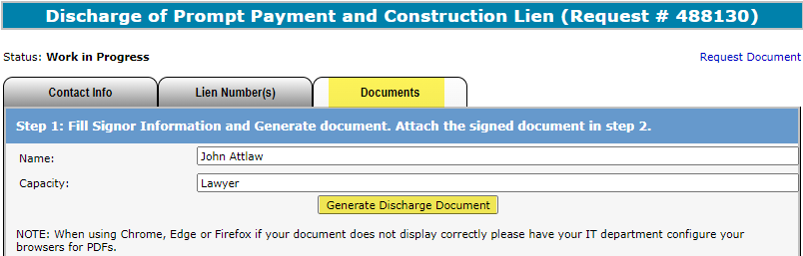
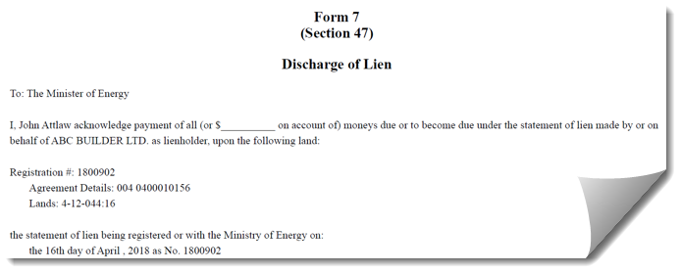
Generate and Sign Discharge Document
Click on the Documents Tab to enter the name of the person signing the Discharge.
1. Enter name and capacity of signor
2. Click on “Generate Discharge Document”
Sample
The request will be validated to make sure all necessary information has been entered.
If anything is missing, an error will appear on the top of the screen.
Print & review the Discharge document.
Page 28 of 36

Slide 29
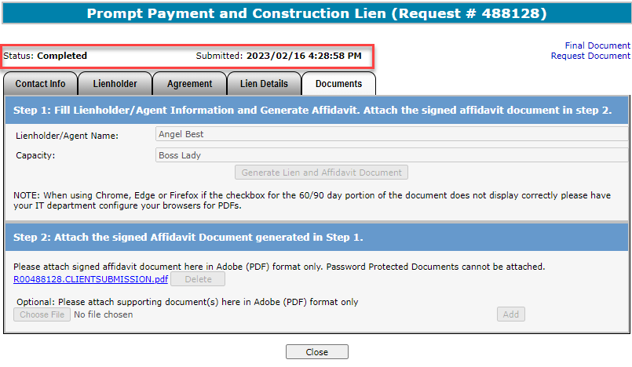
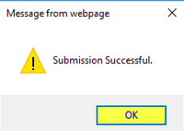

Request Document
The Request Document link will show the date and time your request was submitted, which will become the registration date if approved. Please retain a copy for your records.
The request status outlined above will show the date and time the request was submitted.
Sample
Click OK to view the status of your submission.
If are you unable to submit a request, please ensure you have the proper ETS roles assigned by your site administrator.
Page 29 of 36

Slide 30



WORK IN PROGRESS
3. Enter your ETS request number and click Find.
1. After logging into ETS Select Encumbrance.
4. Click on the ETS # link to retrieve the encumbrance request.
2. Click on Work In Progress.
Users can retrieve saved encumbrance requests by clicking on Work in Progress (WIP) in the side menu.
Page 30 of 36

Slide 31

ETS ENCUMBRANCE REQUEST STATUS
The status of an encumbrance is also available when searching an ETS request number.
There are 5 types of statuses:
Work in Progress (WIP) – request is created but not submitted.
Submitted – request is submitted. (Submitted date & time will be the registration date.)
Processing – request is received and being processed by Alberta Energy.
Completed – request has been registered and documents are available to be viewed/printed.
Department Rejected – request has been rejected by Alberta Energy and documents are available to be viewed/printed.
Client Cancelled – request has been cancelled by client.
The WIP screen will show the ETS Request Number, Application Type, Status, Comments, files, when the request was last updated and the Creator.
Page 31 of 36

Slide 32

Encumbrance
Government of Alberta
RETRIEVING FINAL DOCUMENTS
Sample
An email notification (sample above) will be sent to notify users that the encumbrance request has either been completed or department rejected.
The user will be able to access the registration advice and registered documents by signing into the ETS website.
Page 32 of 36

Slide 33


Retrieving Final Documents Continued
1. After Logging onto ETS Select Encumbrance.
3. Enter in ETS Request Number and Click Find.
4. Click on PDF link beside Final.
2. Click on Work In Progress.
Final documents will also be available to view inside the ETS request screen.
Page 33 of 36

Slide 34


Retrieving Final Documents Continued
Sample
Sample
The documents returned will include a Registration Advice Letter and a registered copy of the encumbrance form that was submitted. Please print these documents for your records as they will be removed from ETS after 90 days.
Page 34 of 36

Slide 35
Encumbrance
Government of Alberta
Resources
ETS Support and Online Learning provides access to relevant guides, course and other information
If you have questions, please contact Transfers.Energy@gov.ab.ca or the Transfer Helpdesk at (780)644-2300
Page 35 of 36

Slide 36

Encumbrance
Government of Alberta
Congratulations!
You have completed the ETS – Encumbrance
Registration of Builders’ Lien, Certificate of Lis Pendens and Discharge of Builders’ Lien (Full or Partial)
Online Training Course
If you have any comments or questions on this training course,
please forward them to the following email address:
Transfers.Energy@gov.ab.ca
Page 36 of 36

