Slide 1

Welcome
PNG Continuation – Third Party Request: This is the process to complete and submit an Online Third Party Request via ETS. The process begins with the creation of a new request through to submission. The request progresses through various stages (statuses) until completion.
To the ETS – PNG Continuation:
Third Party Request
Online Training Course

Slide 2
Revisions
Revisions Table
Date | Revisions Type | Page Number
March 10, 2017 | Initial Creation | All
June 2020 | Updated Banner and Resource Page | All
September 2020 | Various | All

Slide 3
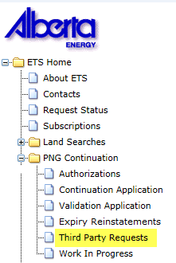

Introduction
In this module you will learn how to:
Create and submit an Online Third Party Request.
Cancel or withdraw an Online Third Party Request.
View a Third Party Response document.

Slide 4
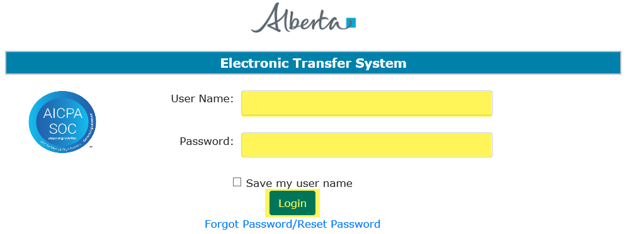
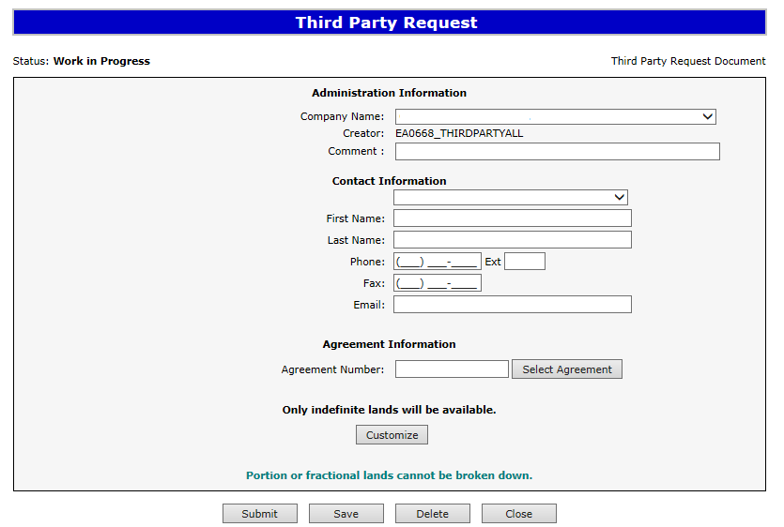
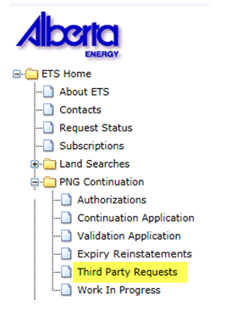
Login to ETS
1. Login to ETS with your user name and password
2. Expand PNG Continuation
3. Select Third Party Requests
Only lands under indefinite continuation are available for selection.

Slide 5
Create and Submit a Third Party Request
You must have the Creator role to create or withdraw a request and the Submitter role to submit a request.
Only lands under indefinite continuation can be reviewed for non-productivity and will be available to select.

Slide 6
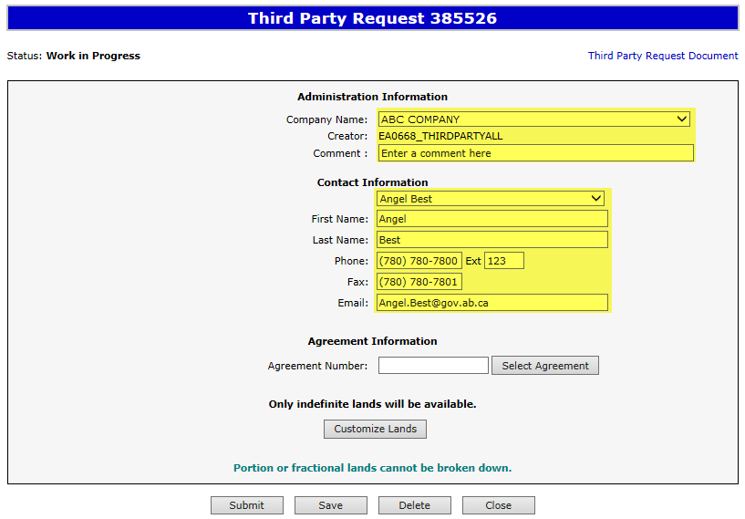

Create Third Party Request– Administration Information
1. Select Company Name and optionally enter Comment
When a request is created, its status is “Work in Progress.”
2. Select Contact Information and edit if required
3. Click Save
Only lands under indefinite continuation are available for selection.
Use the Save button after completing information.

Slide 7
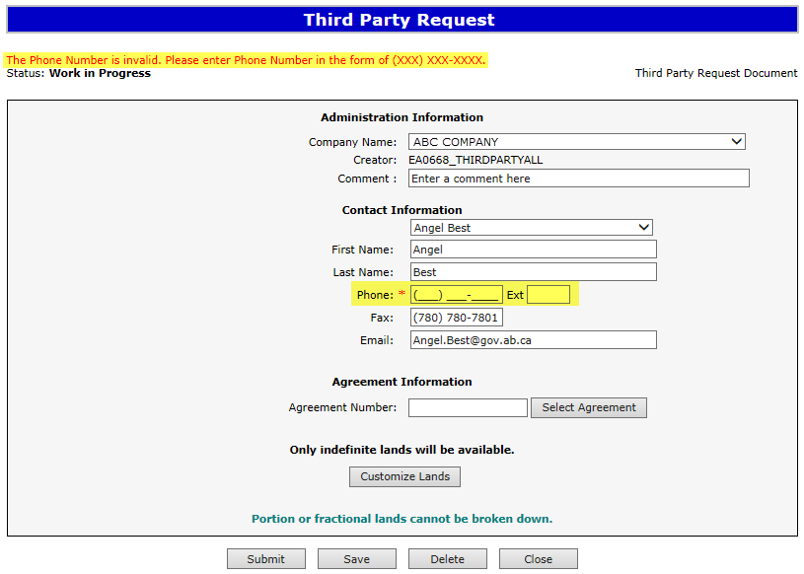
If information is not entered into a mandatory field, or the request validation fails, the screen will display a red error message. The request must be corrected and then you can try to save again.
Error
Message
Only lands under indefinite continuation are available for selection.

Slide 8
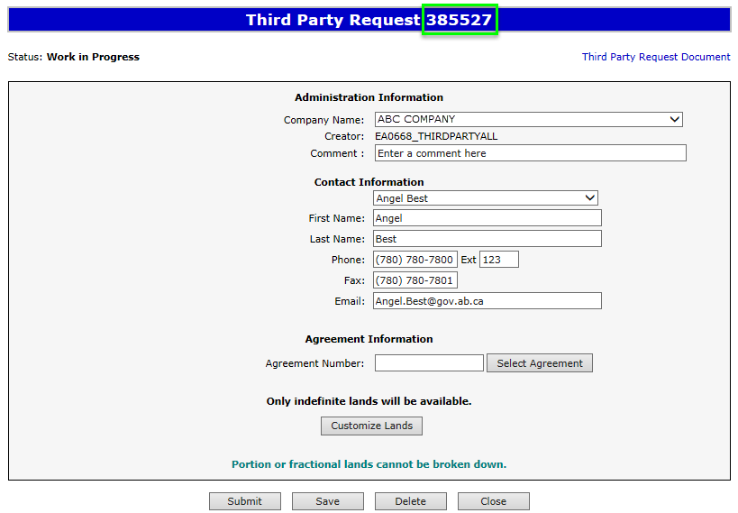
ETS request number is generated and displayed upon successful save. At this time, the request can be retrieved and opened from your Work In Progress list.
Only lands under indefinite continuation are available for selection.

Slide 9
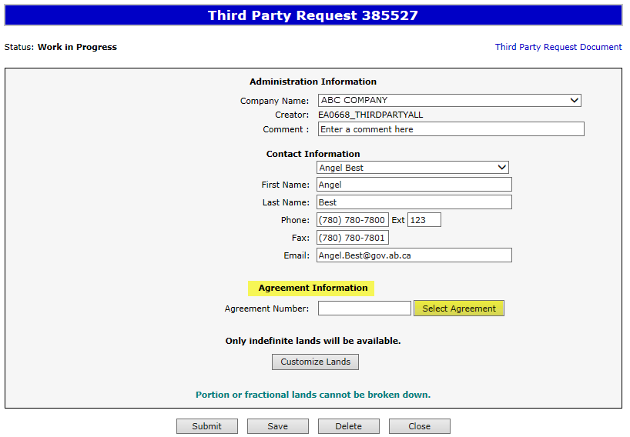
Create Third Party Request– Agreement Information – Select Agreement
1. Click on Select Agreement
Only lands under indefinite continuation are available for selection.

Slide 10
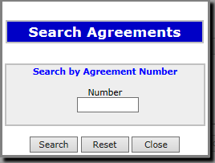
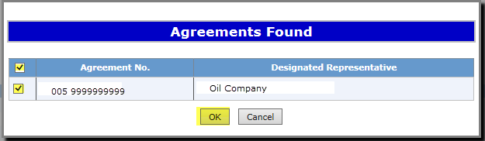
Create Third Party Request– Agreement Information – Select Agreement (continued)
4. Click on Checkbox to select agreement
2. Enter Agreement Number
5. Click OK
3. Click Search

Slide 11
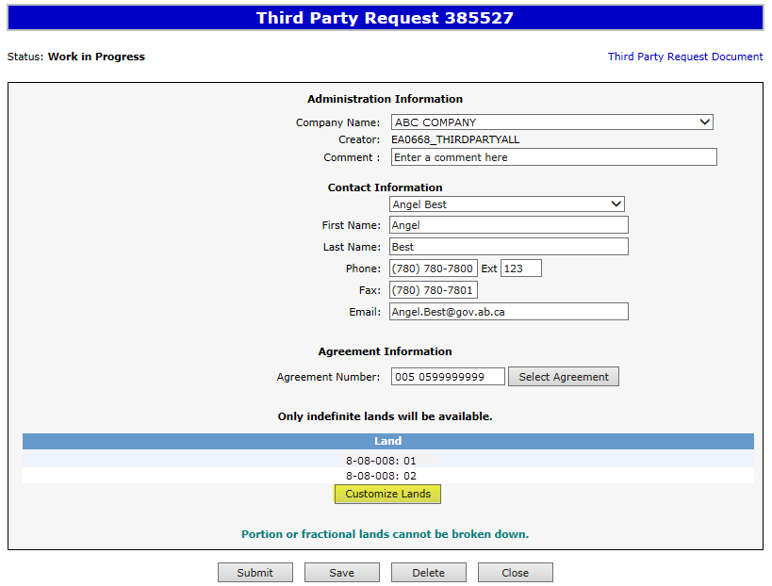
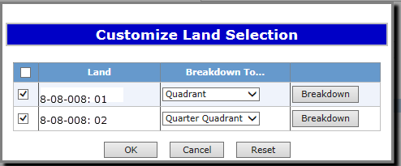
Create Third Party Request – Only indefinite lands will be available – Customize Lands
Only land under indefinite continuation are available for selection. To customize or breakdown land you must select Customize Lands.
Only lands under indefinite continuation are available for selection.
2. Select “Breakdown To” if applicable.
3. Click Breakdown if applicable
1. Click Customize Lands
No more than four agreements or 1,024 hectares (whichever is less) requested for review per company per month
is allowed.

Slide 12
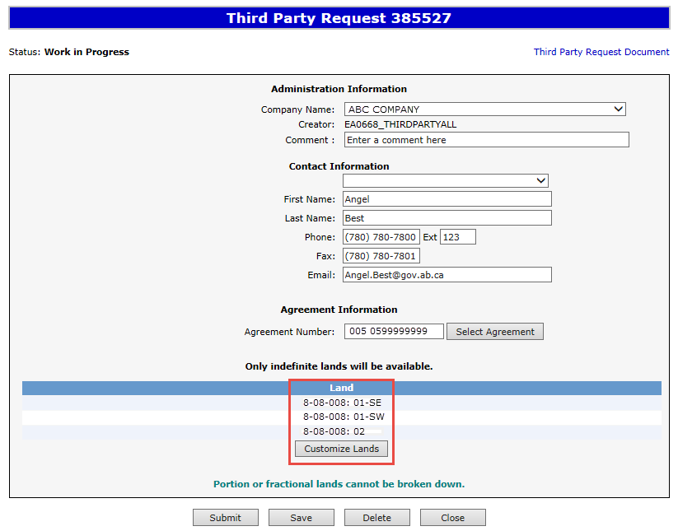
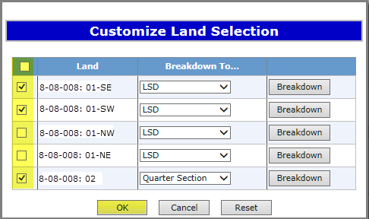
Create Third Party Request – Only indefinite lands will be available – Customize Lands (continued)
Result of customization/breakdown is displayed.
4. Click on the checkbox to select lands you want to use for non-productivity review.
Only lands under indefinite continuation are available for selection.
5. Click OK
Use the Reset button to clear the screen.

Slide 13
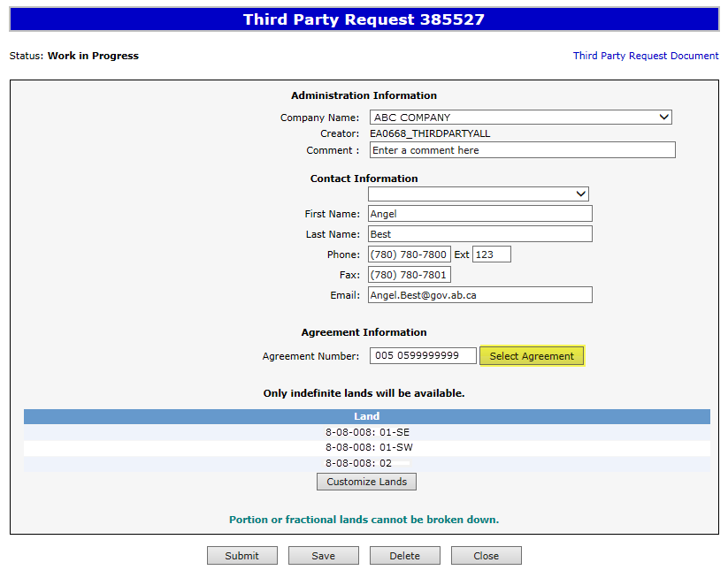
Create Third Party Request – Agreement Information – Change Agreement
If needed, simply Select Agreement again and search a new agreement. The agreement will be replaced.
Ensure the lands you want reviewed are correct. You may wish to customize again.
Only lands under indefinite continuation are available for selection.

Slide 14
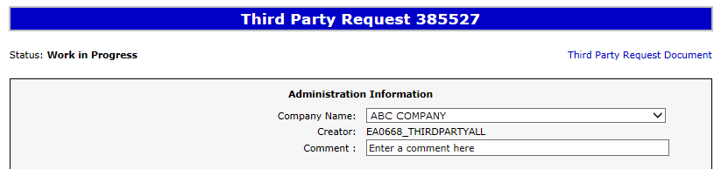
View Third Party Request Document
The Third Party Request Document is a PDF document which details the information in your request.
Please do not mail a printed request to Alberta Energy.
To view the document click on this link.
The Third Party Request Document can be viewed at any time after the application has been saved.

Slide 15

Submit Third Party Request
You must have the Submitter role to submit a request.
When the request is complete, click the submit button.
If there are errors, the request goes back into work in progress so it can be corrected and resubmitted.
Only lands under indefinite continuation are available for selection.
1. Click Submit

Slide 16
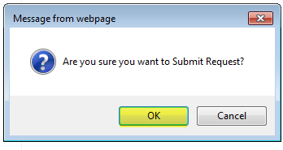
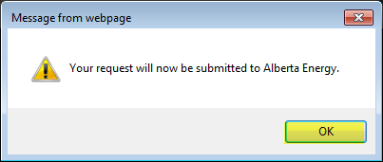
Submit Third Party Request (continued)
2. Click OK
3. Click OK

Slide 17
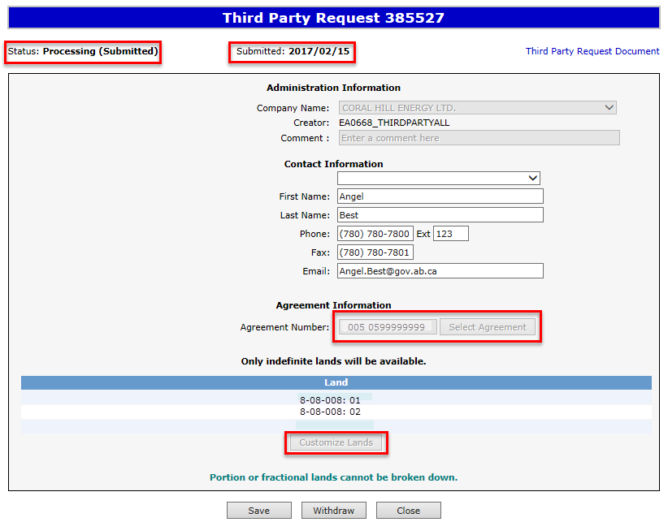
Submit Third Party Request (continued)
Alberta Energy has received the request when when the status becomes Processing (Submitted). The request remains in this status until the request is reviewed.
Submission Date is now displayed.
Only lands under indefinite continuation are available for selection.
At this stage the request cannot be edited (except Contact Information).

Slide 18

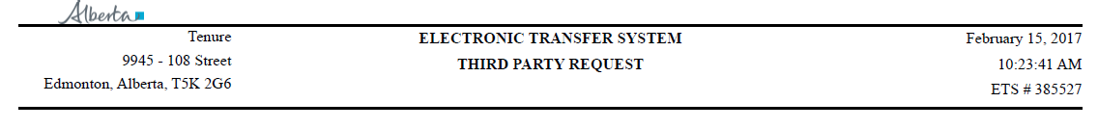
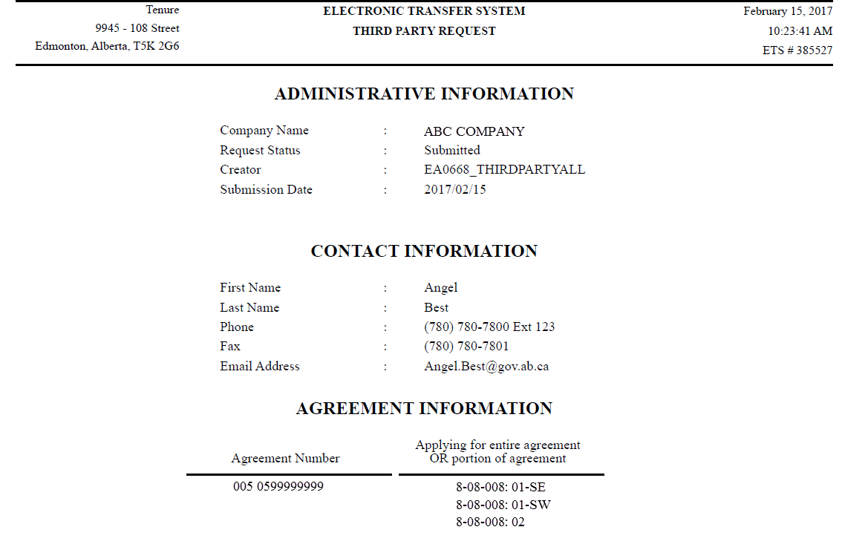
Submit Third Party Request (continued)
After the request has been submitted, you can open the document and print a copy for your records. It is suggested that you save an electronic copy for future reference as once an ETS Request is completed they are removed from the Work in Progress screen after 90 days.

Slide 19
Work In Progress
You can use the Work In Progress screen to retrieve all active requests associated with your company.
Please note that certain requests may have been archived and will no longer be in your Work in Progress list.

Slide 20
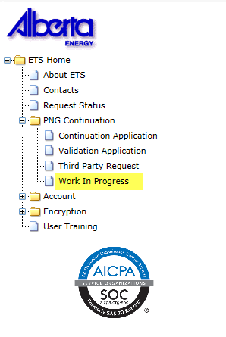
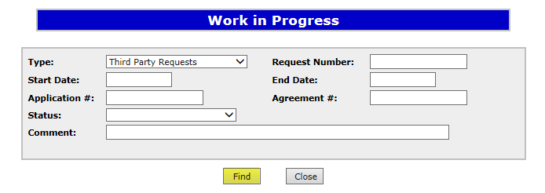
Work In Progress
2. Optionally choose your search parameters
1. Select Work In Progress
3. Click Find
Remove the default date search parameters if you wish to retrieve all active Third Party Requests.

Slide 21
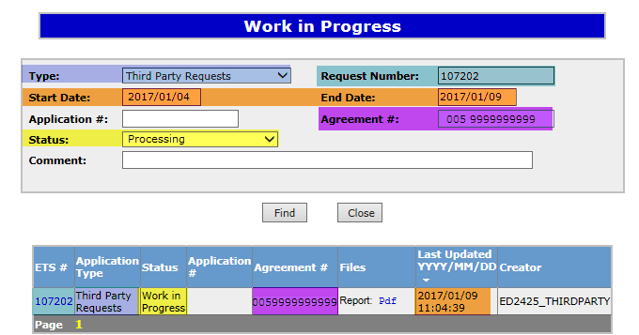
Work In Progress – Search Parameters and Result
Parameter Field | Result Column
Type | Form Type
Request Number | ETS #
Start/End Date | Last Updated
Application # | Application #
Agreement # | Agreement #
Status | Status
Comment | (not shown as a result column)
You can utilize the search parameter fields to filter search results.
The table on the right shows the correlation between the parameter fields and each corresponding result column.
Below is a color-highlighted illustration of the Work in Progress search screen to further demonstrate the relationship between the data.
Application # does not pertain to Third Party Requests.

Slide 22
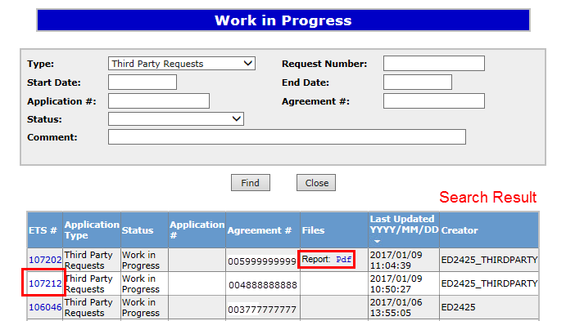
Work In Progress – Search Result
To load a request click on the ETS request number link.
To open a document click on the report Pdf link.
Navigate with these page numbers if there are multiple pages of search result.

Slide 23
Cancel or Withdraw a Third Party Request
You can:
Cancel a request in Work in Progress status.
Withdraw a previously submitted request with a status of Processing (Submitted). Please note that withdrawing a request will remove it from Alberta Energy’s records.
Note:
You must have the Submitter role to cancel or withdraw a request.

Slide 24
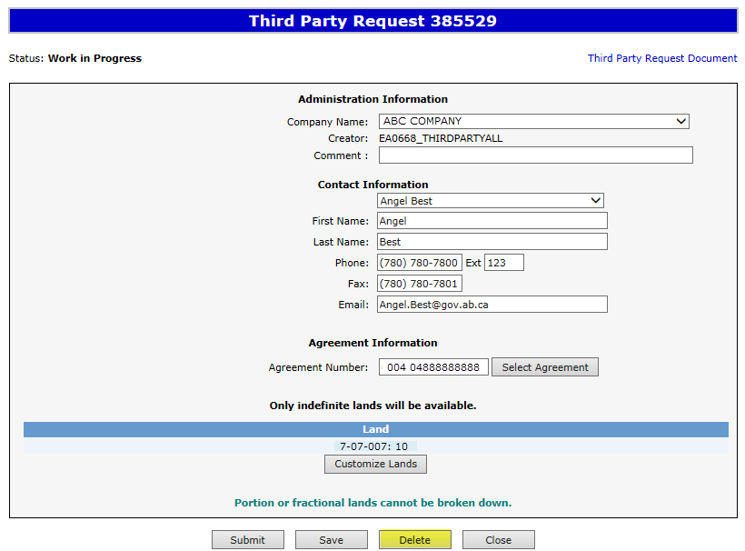
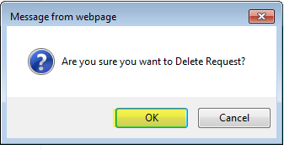
Cancel Request
Only lands under indefinite continuation are available for selection.
1. Click Delete
2. Click OK

Slide 25
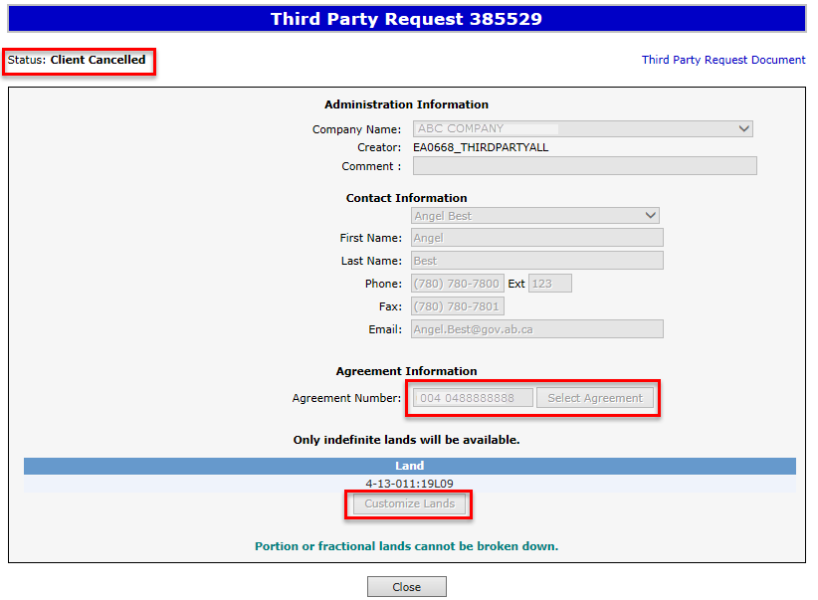
Cancel Request (continued)
Status becomes Client Cancelled.
Only lands under indefinite continuation are available for selection.
At this stage, the request is no longer editable.

Slide 26
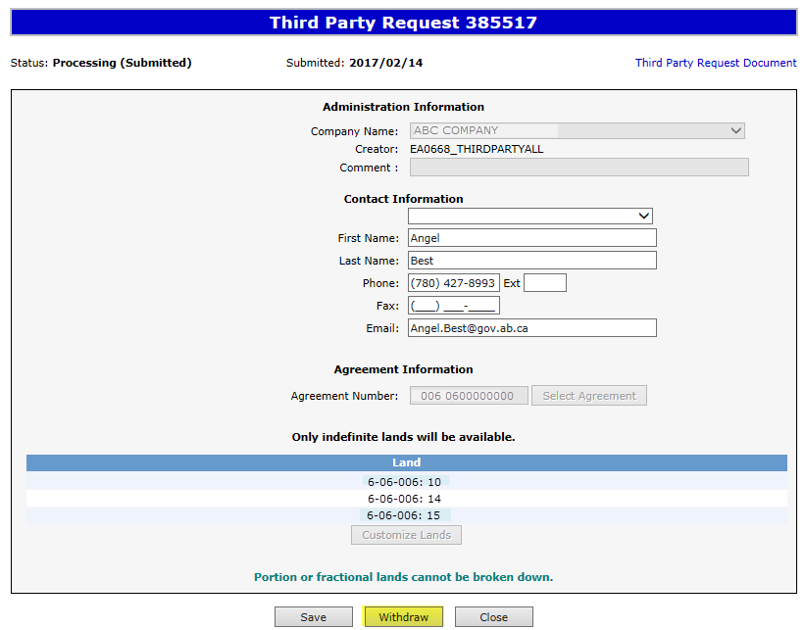
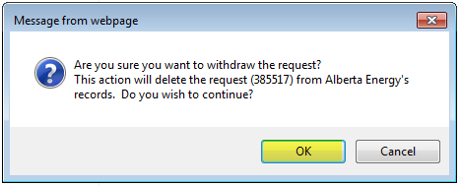
Withdraw Request
When a request is withdrawn, it is removed from Alberta Energy’s records.
When submitting a new request for the agreement, you must select all lands that you want reviewed.
Only lands under indefinite continuation are available for selection.
1. Click Withdraw
2. Click OK

Slide 27
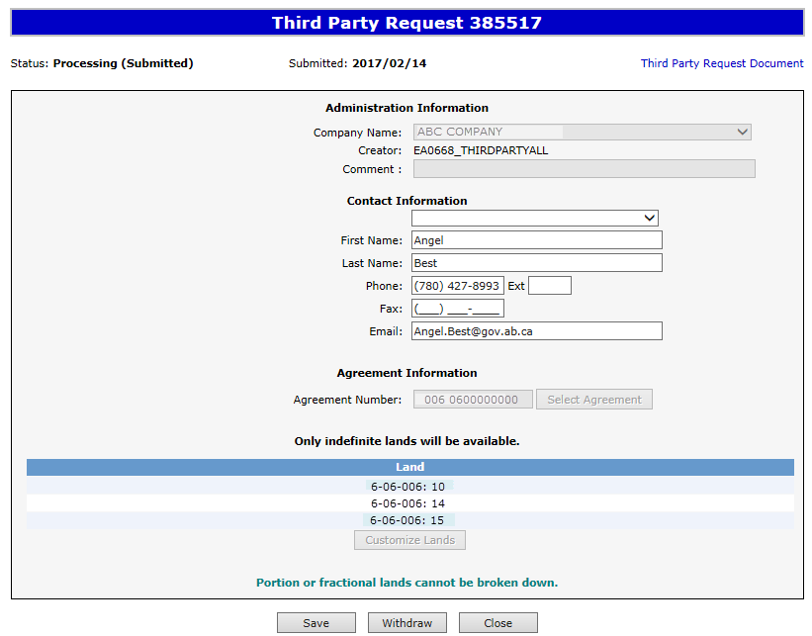

Withdraw Request (continued)
Status becomes Client Withdrawn.
Only lands under indefinite continuation are available for selection.
At this stage, the request cannot be edited.

Slide 28
Third Party Response
Once the review is processed, a Third Party Response document will be sent to ETS, and the request status becomes Completed.
An email may be sent from ETS informing your company that a Third Party Response document is available for viewing. These email notifications are considered a courtesy and should not be relied on to track PNG Continuation Third Party Requests in ETS.

Slide 29
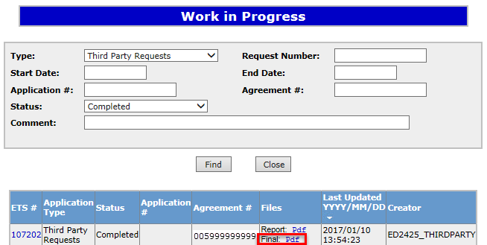
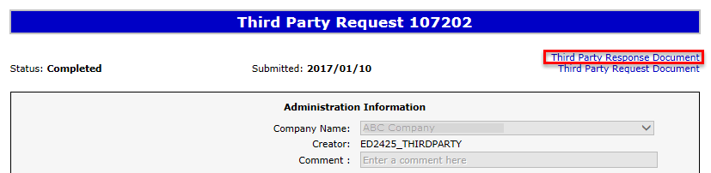
View Third Party Response Document
To view the Third Party Response document click on either link.

Slide 30
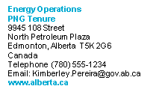
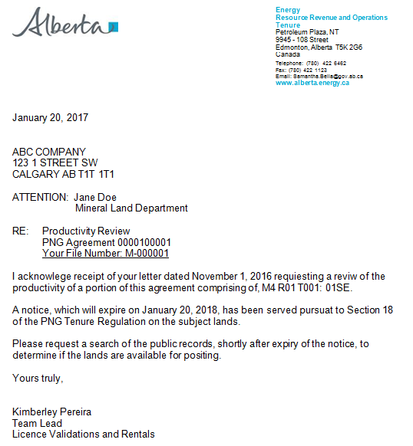
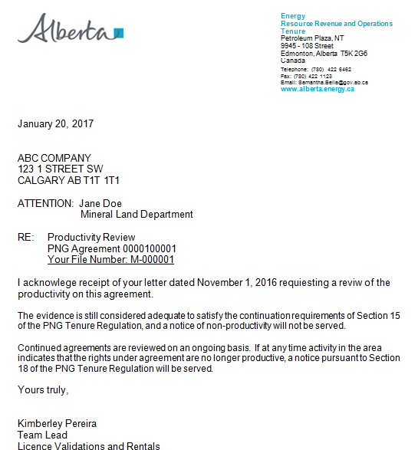
SAMPLES

Slide 31
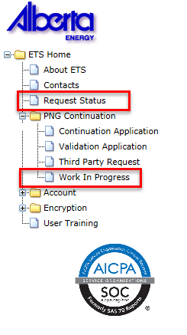
List of ETS Statuses
Third Party Requestors can find all ETS Requests under “Work in Progress”

Slide 32
List of ETS Statuses (continued)
Status Group | Status Name | Description | Party | Location
Creating a Request | Work in Progress | Request has yet to be submitted to the internal system. | Third Party Requestor | Work in Progress
 | Submitted | Request has been submitted but not yet received by the internal system. | Third Party Requestor | Work in Progress
 | Processing (Submitted) | Request has been received by the internal system. | Third Party Requestor | Work in Progress
Cancelling/ Withdrawing a Request | Client Cancelled | Request has been cancelled from your Work In Progress list by you. | Third Party Requestor | Work in Progress
 | Client Withdrawn | An already submitted request has been withdrawn by you prior to completion. | Third Party Requestor | Work in Progress

Slide 33
List of ETS Statuses (continued)
Status Group | Status Name | Description | Party | Location
Rejected | Department Rejected | Request has been rejected by Alberta Energy. | Third Party Requestor | Work in Progress
Final/Response | Completed | Request is now completed and the Third Party Response document is available for your retrieval. | Third Party Requestor | Work in Progress

Slide 34
Resources
ETS Support and Online Learning provides access to relevant guides, courses and other information.
If you have questions, please contact PNGContinuations.Energy@gov.ab.ca
or the PNG Tenure Help Line at (780) 644-2300.

Slide 35

Congratulations!
Congratulations!
You have completed the ETS – PNG Continuation: Third Party Request
Online Training Course
To access Courses, Guides and Forms for all your ETS Business please see ETS Support and Online Learning.
If you have any comments or questions on this training course,
please contact:
Crown Agreement Management
Helpdesk: (780) 644-2300
Email inquires: PNGContinuations.Energy@gov.ab.ca

