Slide 1

Welcome
PNG Continuation – Validation: This is the process to complete and submit an Online Validation Application via ETS. The process begins with the creation of a new application through to submission. The application progresses through various stages (statuses) until completion.
To the ETS – PNG Continuation: Validation
Online Training Course

Slide 2
Revisions
Revisions Table
Date | Revisions Type | Page Number
October 20, 2014 | Initial Creation | All
September 2015 | Updated | All
March 2016 | Updated | Various
June 2020 | Updated Banner and Resource Page | All
September 2020 | Updated | Various
August 2025 | Updated | Various

Slide 3
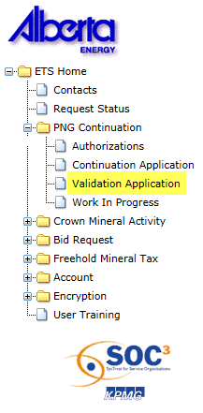

Introduction
In this module you will learn how to:
Create and submit an Online Validation Application.
Cancel or withdraw an Online Validation Application.
Review and respond to an offer.
Amend a Processing (Submitted) application that has well(s) drilling over expiry and the agreement has expired.
View a final document.

Slide 4
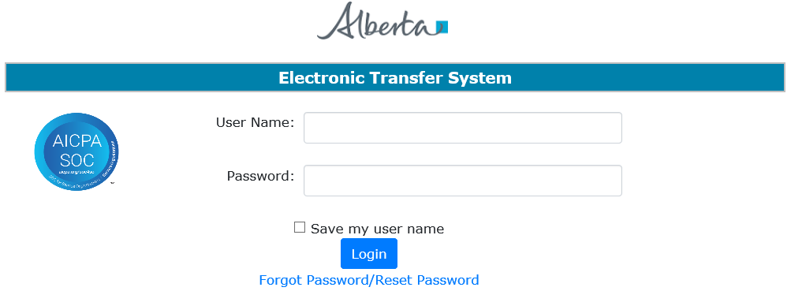
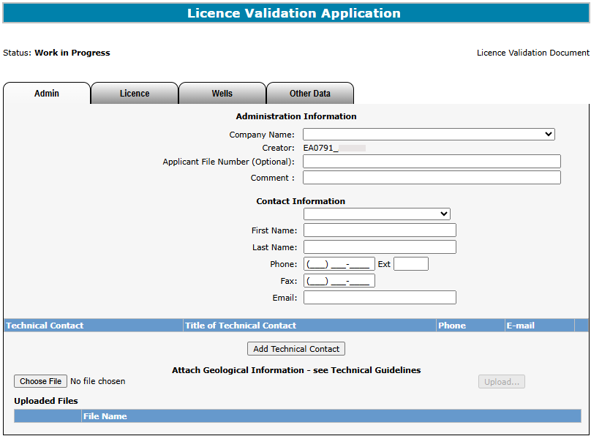
Login to ETS
1. Login to ETS with your user name and password
2. Expand PNG Continuation
3. Select Validation Application

Slide 5
Create and Submit a Validation Application
You must be assigned the Creator role to create (or amend) an application and the Submitter role to submit an application.
All lands (or pieces of land) within your application must be associated with all of the well(s) you are applying on.

Slide 6
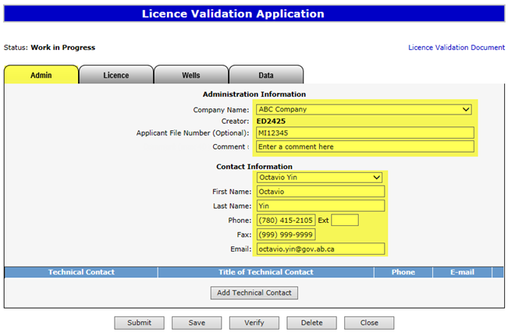

Create Validation Application – Administration Information
1. Select Company Name, Applicant File Number (optional), and Comment (option and for your records only)
2. Select Contact information and edit if required
When an application is created, its status is “Work in Progress.”
Contact Information can be updated at anytime. The notification emails will be sent to the email provided here

Slide 7
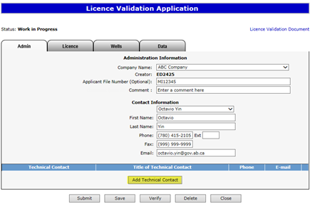
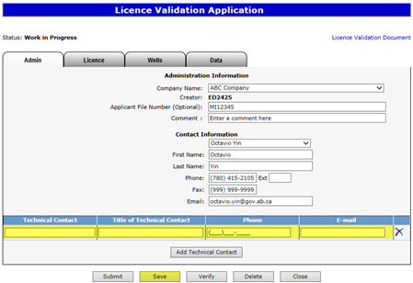
Create Validation Application – Administration Information
– Add Technical Contact
4. Enter Technical Contact (all fields are required)
3. Click on Add Technical Contact
5. Click Save
Use the Save button after completing information on each tab.

Slide 8
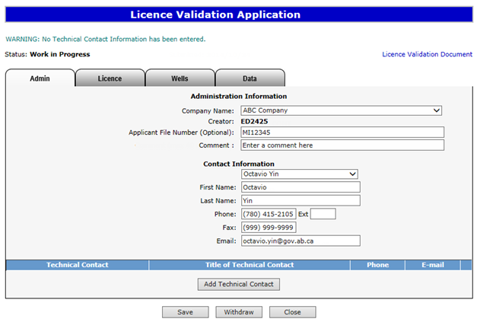
If information is not entered into an optional field, the screen may display a blue/green warning message. However, warning messages do not prevent you from saving the application data.
Warning Message

Slide 9
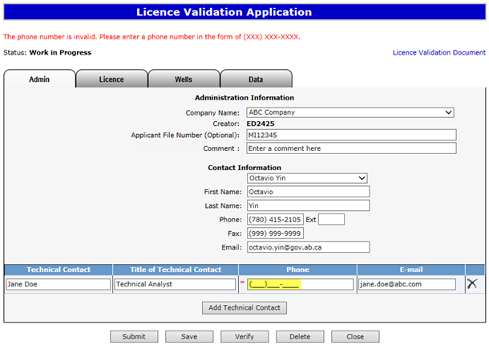
If information is not entered into a mandatory field, or the application fails validation, the screen will display a red error message. The application must be corrected and then you can try to save again.
Error
Message

Slide 10
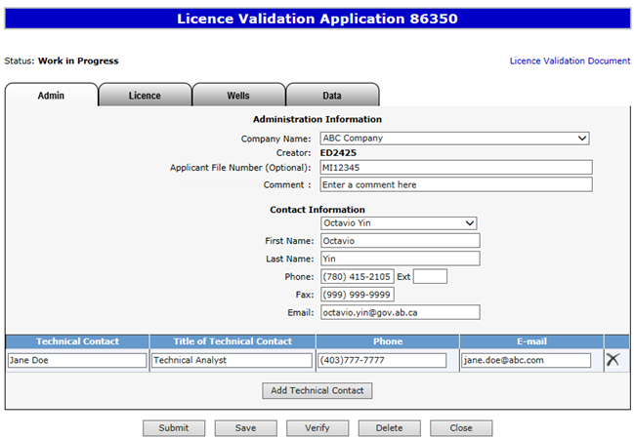
An ETS request number for the application is generated and displayed upon successful save.
At this time, the application can be retrieved and opened from your Work In Progress list.

Slide 11
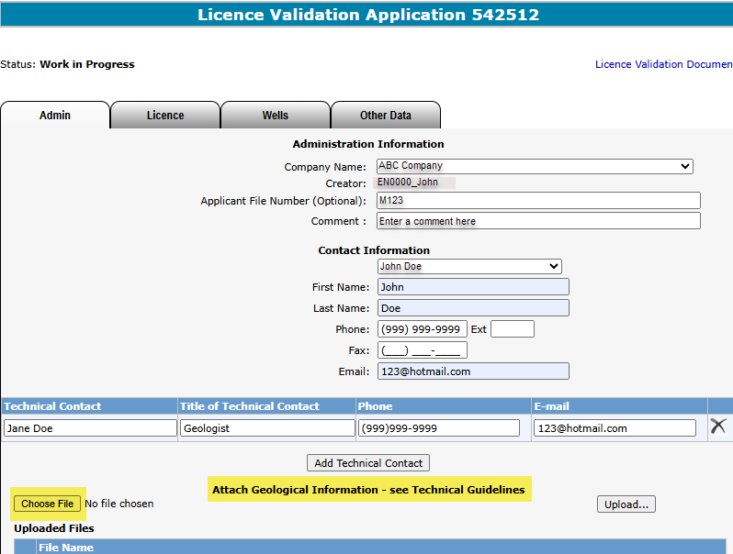
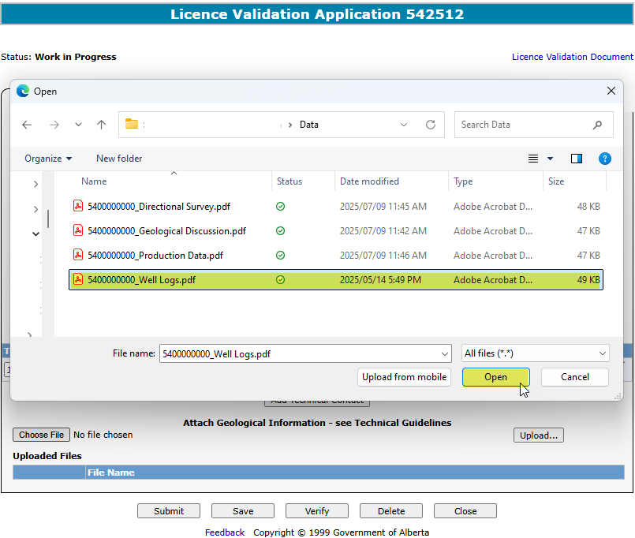
Create Validation Application – Attach Geological Information
– See Technical Guidelines
2. Select the document.
3. Select Open.
1. Select Choose File
Data from the Applicant to support the Application will be entered under the Attach Geological Information; this includes the Geological Discussion.
It is highly recommended the data uploaded is separated into the data types. The Geological Discussion must be uploaded separately from the data.

Slide 12
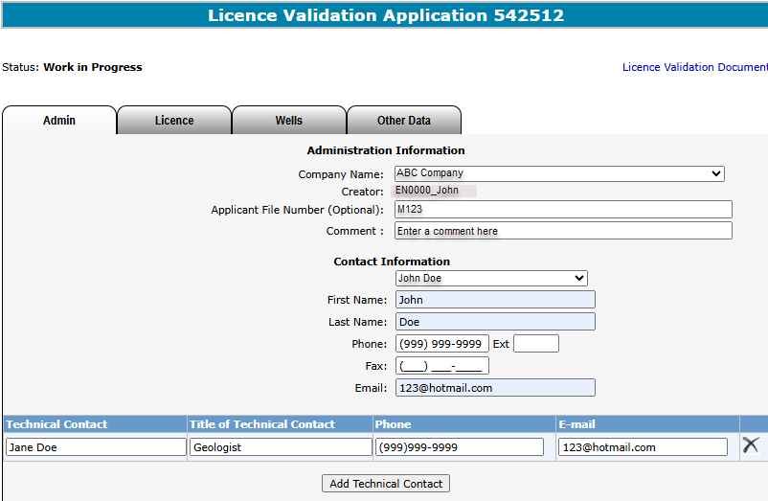
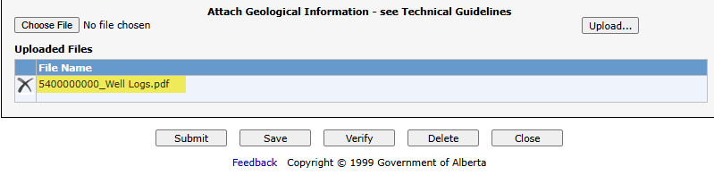
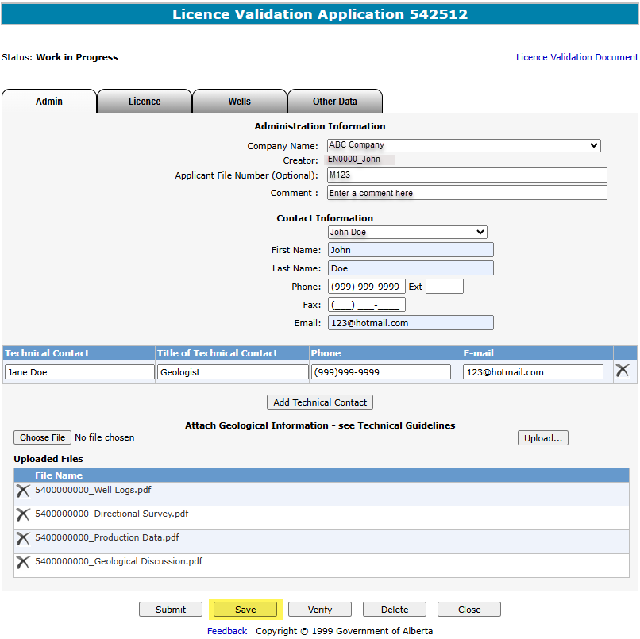
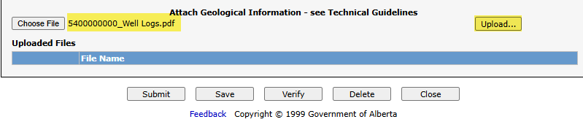
Create Validation Application – Attach Geological Information
– See Technical Guidelines (continued)
5. You will see the uploaded document here.
4. Select Upload.
6. Once all documents are uploaded, press Save.
You can only upload one document at a time.

Slide 13
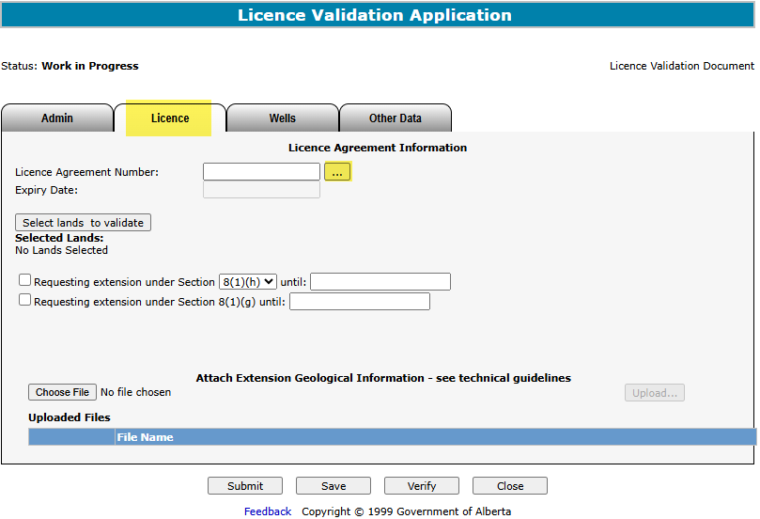
Create Validation Application – Licence Agreement Information
– Add Agreement
1. Click on Licence tab
2. Click on Ellipsis to search agreements

Slide 14
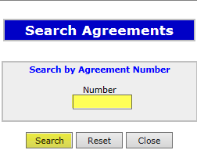
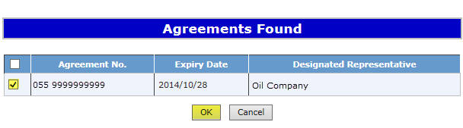
Create Validation Application – Licence Agreement Information
– Add Agreement (continued)
3. Enter Agreement Number
4. Click Search
5. Click on Checkbox
6. Click OK

Slide 15
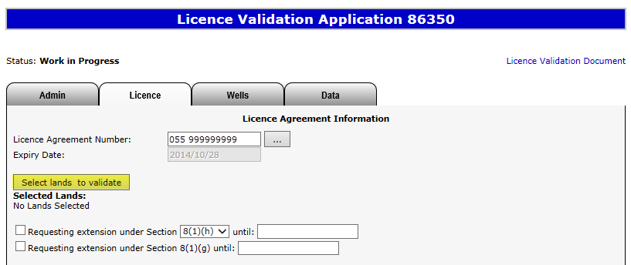
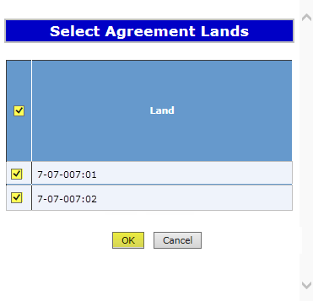
Create Validation Application – Licence Agreement Information
– Select Lands to Validate
1. Click on Select lands to validate
2. Click on Checkbox to select all lands or each individual land
After an agreement is added, the Expiry Date is automatically populated.
3. Click OK

Slide 16
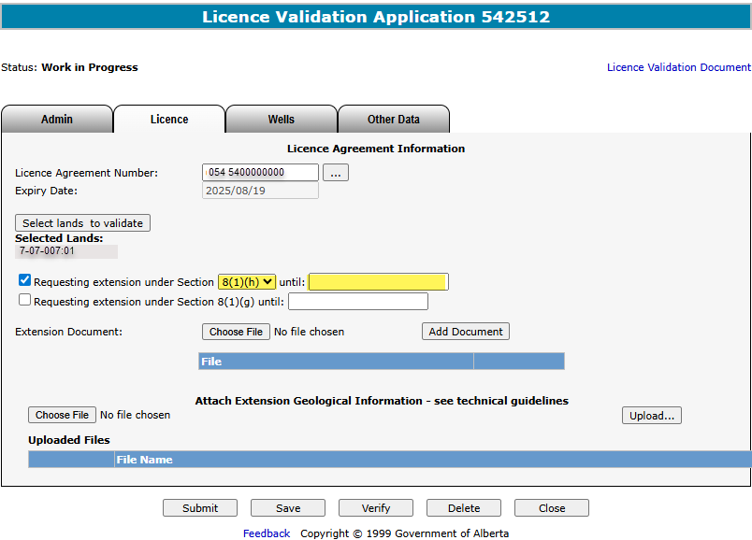
Create Validation Application – Licence Agreement Information
– Request Extension
If requesting an extension under 8(1)(h) or 26, select one of the options in the Section dropdown list and provide the date you are requesting the agreement be extended to.
If requesting an 8(1)(g), provide the date you require the extension until. An 8(1)(g) extends the period of time you can submit your application, and it must be requested with either section 8(1)(h), 26, or 11 (by completing the Wells tab.)
1. Click Checkbox
3. Select Extension Date
2. Select Section

Slide 17
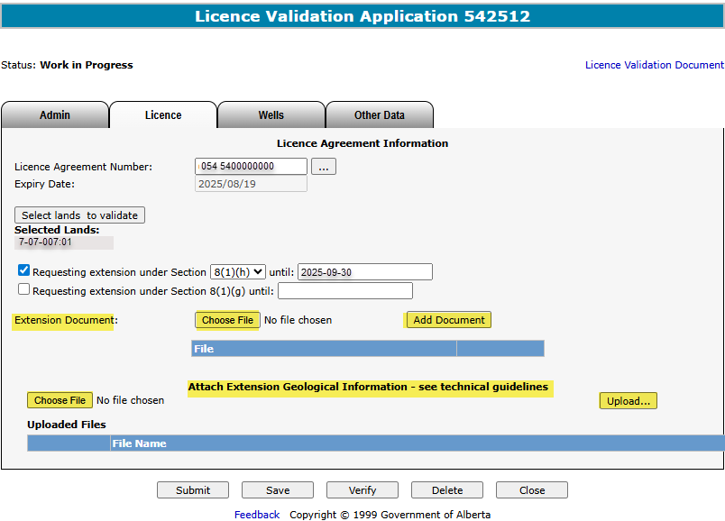
Create Validation Application – Licence Agreement Information
– Request Extension (continued)
5. Click Add Document
4. Click Choose File
6. Optionally
The Extension Document, which supports the extension request, must be attached in a PDF format.
Technical data that supports the extension request, can be attached under the Attach Extension Geological Information by selecting Choose File and then Upload.

Slide 18
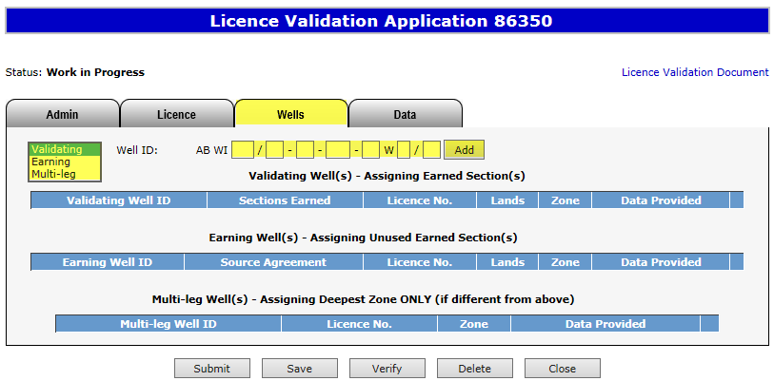
Create Validation Application – Wells Tab
– Add Well
1. Click on Wells tab
3. Enter Well ID
4. Click Add
2. Select Well Type
You can add multiple validating, earning or multi-leg wells. If your validating well has already been used to validate another licence, you will receive an error upon verification. This well would then need to be added as an earning well.

Slide 19
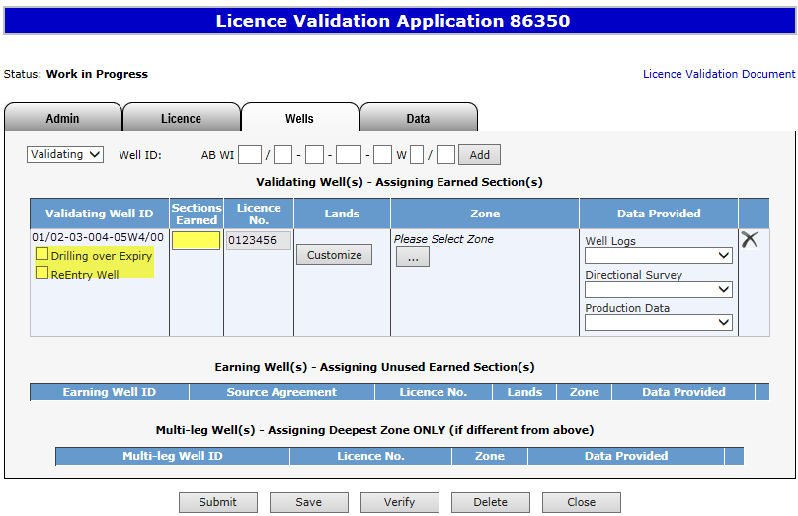
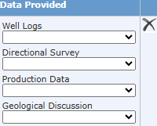
Create Validation Application – Wells Tab
– Add Well (continued)
6. Optionally enter Sections Earned (for Validating Well)
After a well is added, the Licence No. is automatically populated.
5. Click on checkbox if applicable
For additional information on Drilling Over Expiry refer to the corresponding section later in the training module.

Slide 20
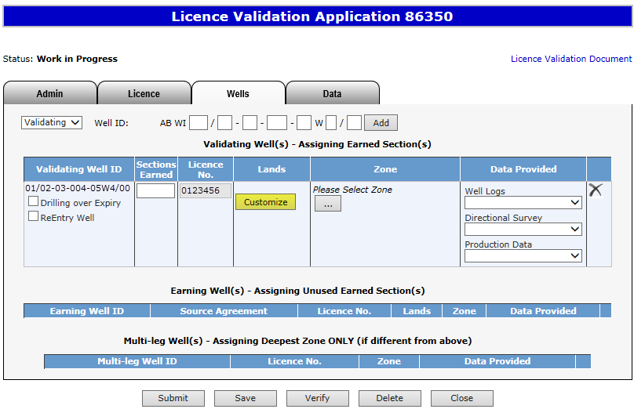
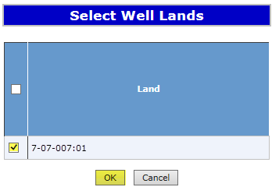
Create Validation Application – Wells Tab
– Add Well (continued)
8. Click on Checkbox to select all lands or each individual land
7. Click Customize
9. Click OK

Slide 21
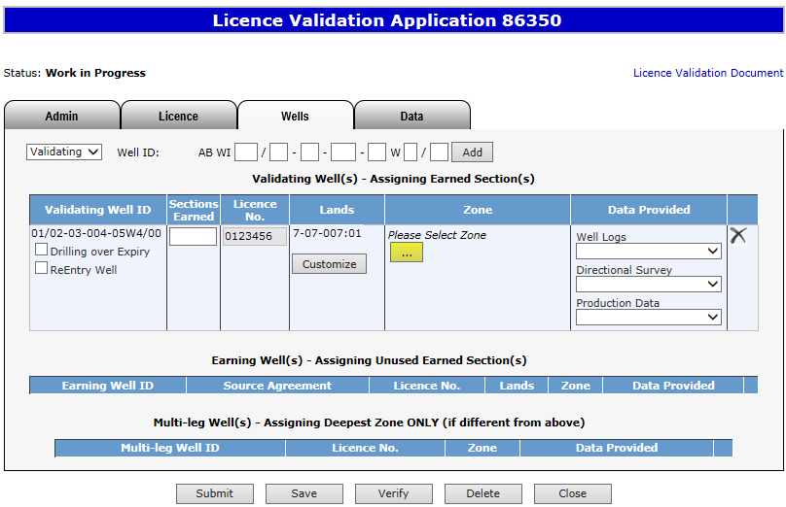
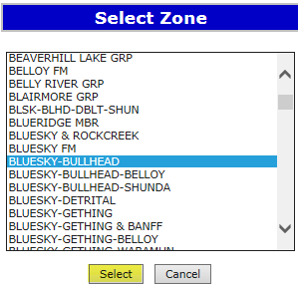
Create Validation Application – Wells Tab
– Add Well (continued)
10. Click on ellipsis
11. Select Zone
12. Click Select
When selecting a zone from the list, first click on any zone and type the first letter of the zone you are searching for. The system will navigate alphabetically.

Slide 22
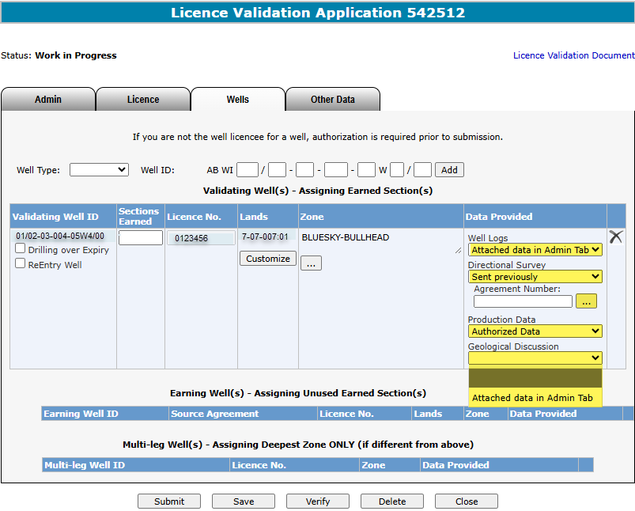
Create Validation Application – Wells Tab
– Add Well (continued)
At least one type of data must be provided.
All technical data that the Applicant is submitting, must be uploaded in the Admin Tab.
For previously submitted technical data, you need to enter the agreement number that the data was originally used for.
If the technical data is being submitted by a different company, you would select Authorized Data.
The Applicant’s Geological Discussion must be attached in the Admin Tab.
13. Select a method of delivery
14. Enter the agreement number that the data was originally used for

Slide 23
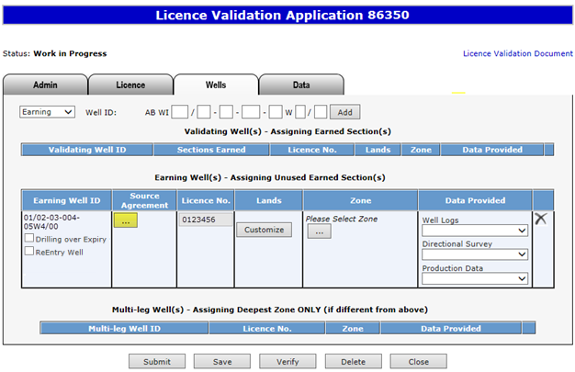
Create Validation Application – Wells Tab
– Add Source Agreement for Earning Well
Adding a Source Agreement for the Earning Well is optional.
1. Click on the Ellipsis to add the Source Agreement

Slide 24
Create Validation Application – Wells Tab
– Add Source Agreement for Earning Well (continued)
2. Enter Agreement Number
3. Click Search
4. Click on Checkbox
5. Click OK
To complete the rest of the Earning Well information, repeat the steps listed on pages 18 through 21.

Slide 25
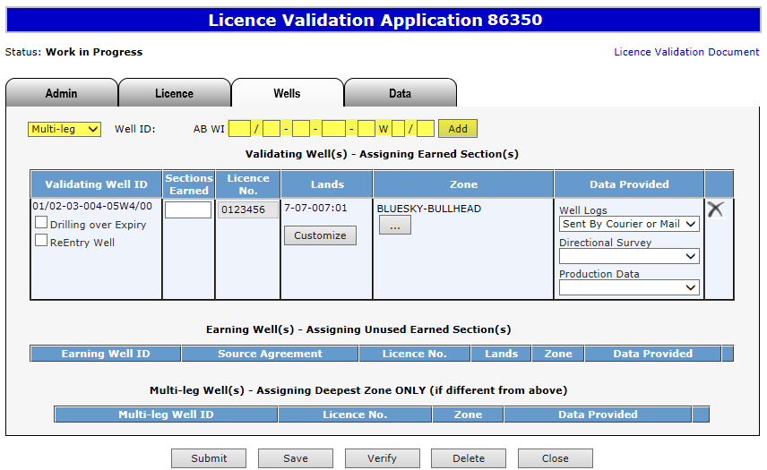
Create Validation Application – Wells Tab
– Add Multi-leg Well
Add a Multi-leg Well if applicable.
2. Enter Well ID
3. Click Add
1. Select Multi-leg

Slide 26
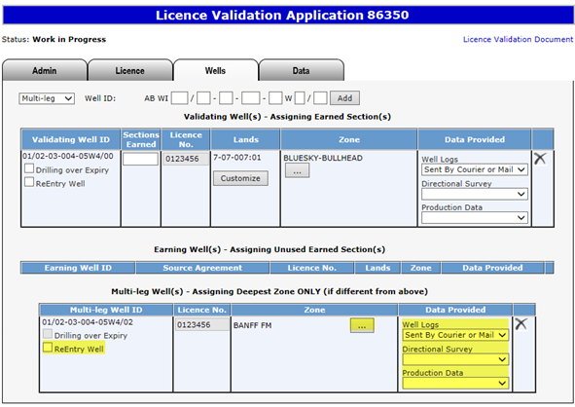
Create Validation Application – Wells Tab
– Add Multi-leg Well (continued)
A Multi-leg Well must have a corresponding Validating Well or Earning Well, and the Well Licence Number must match the Validating Well or Earning Well entered. A Multi-leg well is only required if the zone is deeper than either the Validating or Earning well
4. Click on checkbox if applicable
6. Select a method of delivery
The drilling over expiry option for the multi-leg well is only available if the validating or earning well is drilling over expiry.
5. Select Zone

Slide 27
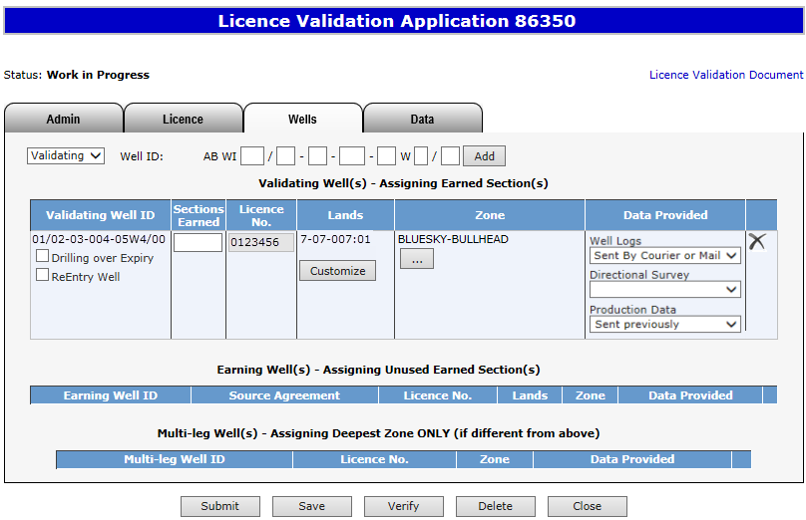
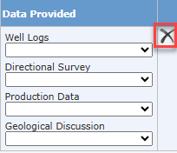
Create Validation Application – Wells Tab
– Remove Well
If required, use this button to remove the added well.

Slide 28
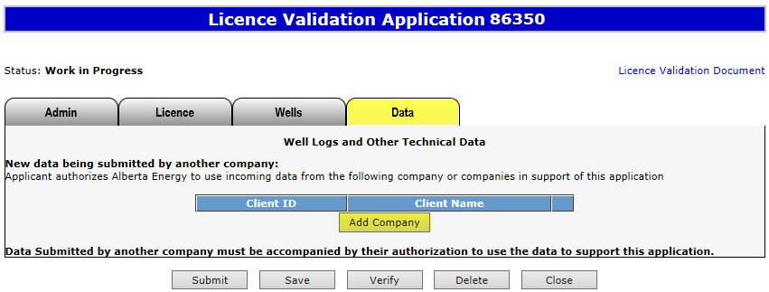
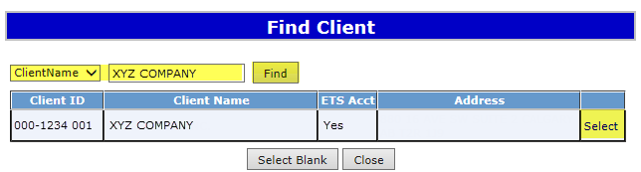
Create Validation Application – Other Data Tab
– Add Company
This tab is only required if the data is being submitted by another company.
An authorization request is required (see Request Authorization for Data in PNG Continuation: Authorization online training course) and authorized data will need to be emailed to the department via EM.DatasubmissionPNGContinuation@gov.ab.ca
1. Click Other Data tab
3. Choose and enter search parameters and click Find
4. Click Select
2. Click Add Company

Slide 29
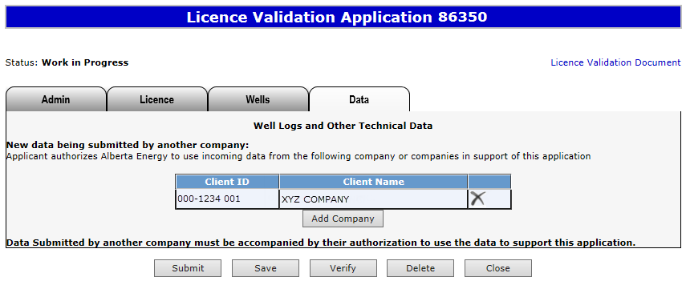
Create Validation Application – Data Tab
– Remove Company
Use this button to remove the added company, if required

Slide 30

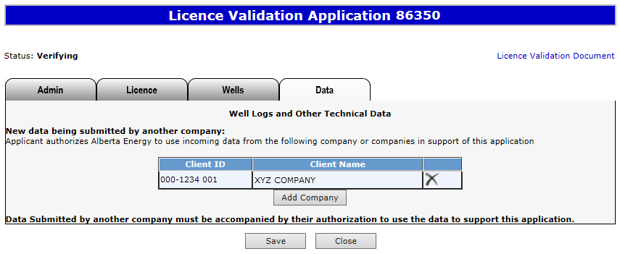
Verify Validation Application
This process verifies information within the application using internal validations to ensure data is correct. Any errors or warnings will be displayed on the screen. You may click the Verify button after completing the application.
Click Verify
Status becomes Verifying.
Once the verification process is complete, load the application again from your Work In Progress list, and the status should return to “Work in Progress.”
At this stage, you may continue working on your application.

Slide 31
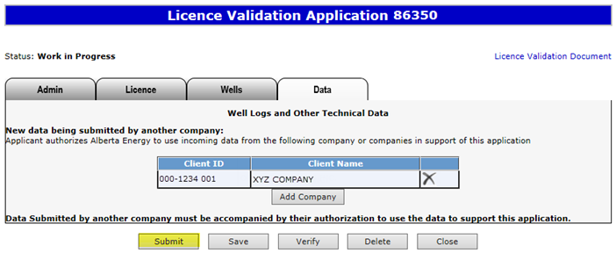
Submit Validation Application
You must have the Submitter role to submit an application.
Verifying your application at various steps when completing can be a useful tool; however, verification is not required prior to submission.
When the application is complete, click the submit button. The application will go through the verification process and if no errors are identified, the application will automatically be submitted.
If there are errors, the application goes back into work in progress so it can be corrected and resubmitted. The contact person identified on the application will also receive an email indicating that action is required.
1. Click Submit

Slide 32
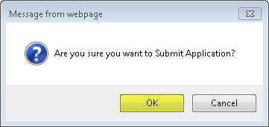
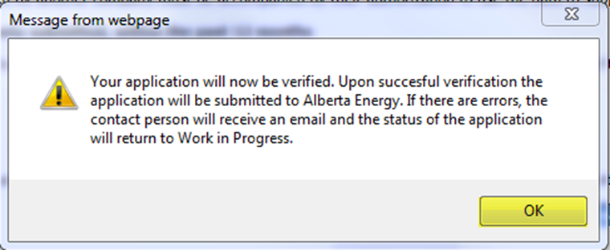
Submit Validation Application (continued)
2. Click OK
3. Click OK

Slide 33
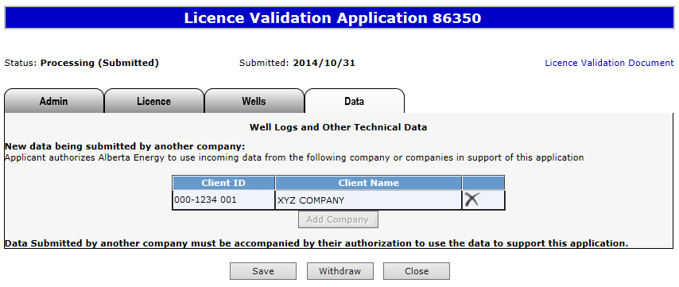
Submit Validation Application (continued)
Alberta Energy has received the application when the status becomes Processing (Submitted). The application remains in this status until the application is reviewed.
Submission Date is now displayed.
At this stage the application cannot be edited (except Contact Information).

Slide 34
View Licence Validation Document
The Licence Validation Document is a PDF document which details the information contained within your application.
Please do not mail a printed application to Alberta Energy.
To view the document click on this link.
The Licence Validation Document can be viewed any time after the application has been saved.

Slide 35
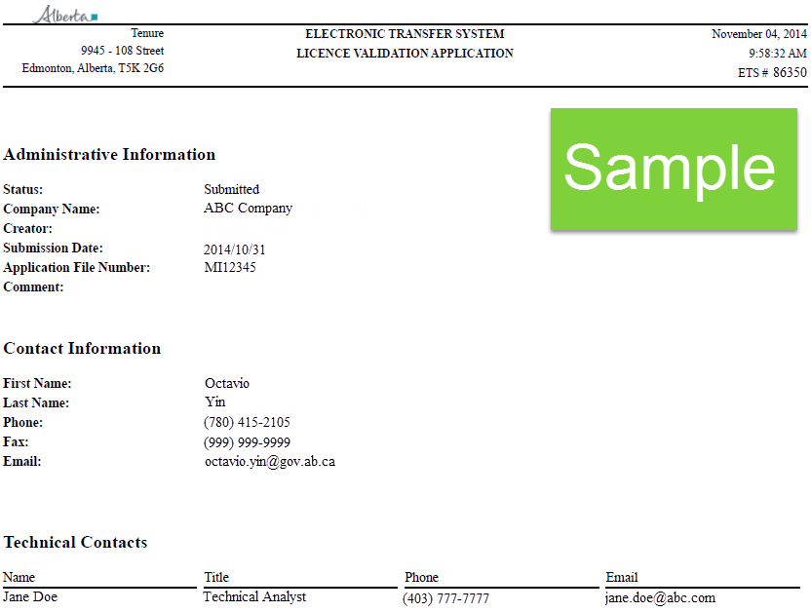
View Licence Validation Document (continued)
After the application has been submitted, you should print a copy for your records.
If an application is amended (e.g., drilling over expiry) this document will reflect the amended information.

Slide 36
Work In Progress
You can use the Work In Progress screen to retrieve all active applications associated with your company.
Please note that certain applications may have been archived and will no longer be in your Work in Progress list.

Slide 37
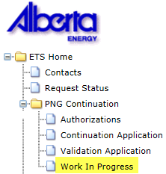
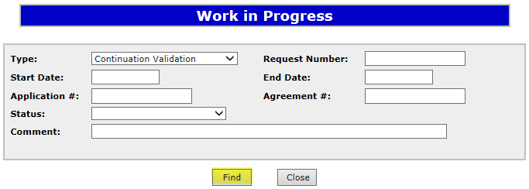
Work In Progress
2. Optionally choose your search parameters
1. Select Work In Progress
3. Click Find
Remove the default date search parameters if you wish to retrieve all active Validation applications.

Slide 38
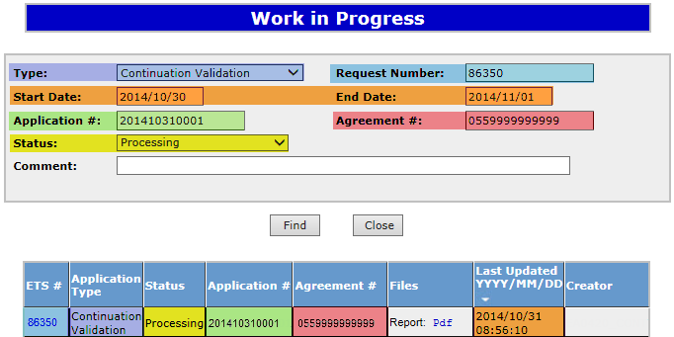
Work In Progress – Search Parameters and Result
Parameter Field | Result Column
Type | Application Type
Request Number | ETS #
Start/End Date | Last Updated
Application # | Application #
Agreement # | Agreement #
Status | Status
Comment | (not shown as a result column)
You can utilize the search parameter fields to filter search results.
The table on the right shows the correlation between the parameter fields and each corresponding result column.
Below is a colour-highlighted illustration of the Work in Progress search screen to further demonstrate the relationship between the data.

Slide 39
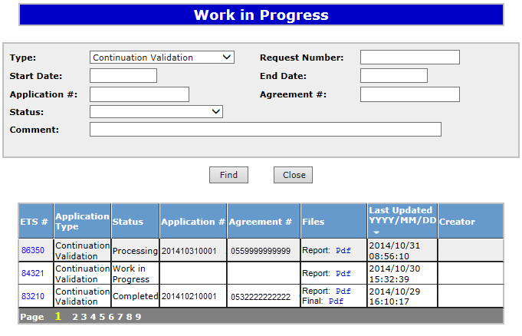
Work In Progress – Search Result
To load an application or view an offer click on the ETS request number link.
Search Result
To open a document click on the report or final Pdf link.
Navigate with these page numbers if there are multiple pages of search result.

Slide 40
Cancel or Withdraw an Application
You can:
  Cancel an application in Work in Progress status.
  Withdraw a previously submitted application prior to expiry. Please note that withdrawing an application will remove it from Alberta Energy’s records, including the technical data.
You must have the Submitter role to cancel or withdraw an application.

Slide 41
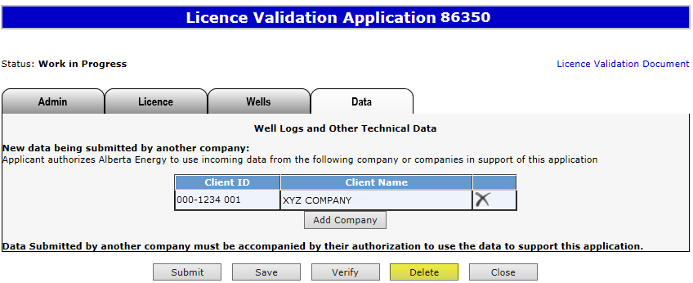
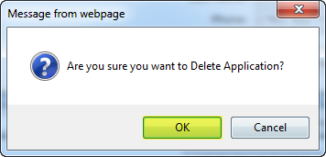
Cancel Application
1. Click Delete
2. Click OK

Slide 42

Cancel Application (continued)
Status becomes Client Cancelled.
At this stage, the application cannot be edited.

Slide 43


Withdraw Application
When an application is withdrawn, it is removed from Alberta Energy’s records. Any offers made by Alberta Energy on the agreement are also rescinded. When submitting a new application for the agreement, you must apply for all lands and/or zones that you want reviewed, including the technical data.
2. Click OK
1. Click Withdraw

Slide 44

Withdraw Application (continued)
Status becomes Client Withdrawn.
At this stage, the application cannot be edited.
Please note that if an application was withdrawn, any offers by Alberta Energy are also rescinded. All lands and zones must be re-applied for and the technical data re-submitted.

Slide 45



Copy Application
The copy functionality assists you in creating a new application by copying information from a cancelled, withdrawn or rejected application. Once OK is clicked the new application is created and all information is copied over.
When submitting the new application ensure that you refer to any previously submitted data.
1. Click Copy
2. Click OK

Slide 46
Offer
If an offer is received by ETS, the application status becomes Offer.
An email may be sent from ETS informing your companies contact that an offer is available for review and response. These email notifications are considered a courtesy and should not be relied on to track PNG Continuation Applications in ETS.
When submitting an application through ETS, it is your responsibility to continually check your Work in Progress to determine if an offer has been sent.
The offer can have one or more options for you to choose from.
You have until the Offer Expiry Date to respond to the offer.
If the Offer Expiry Date has passed without a response, the application will be sent back to the internal system, and the status will become “Processing (No Response).” The agreement expiry will be processed as set out in the offer letter.

Slide 47

Review Offer
Status has become Offer
Access the Offer in this tab.
The date the offer expires
Click this link to view the offer letter.
Offer land options
Attach Data if required
Early Response checkbox for authorizing Alberta Energy to review your Offer Response prior to the Offer Expiry Date. Once checked your decision CANNOT be changed unless it is prior to agreement expiry.

Slide 48

Respond to Offer
For each offer option, you can choose one of the following responses:
Accept
Decline
Attach Geological Information
Customize
1. Choose option

Slide 49

Respond to Offer with Additional Data/Request for Review
Add a supporting document
1. Select Attach Geological Information
3. Click Upload
2. Click Choose File
You may add as many documents as required.

Slide 50


Respond to Offer – Customize
1. Select Customize
2. Choose Response
If “Attach Geological Information” is chosen as the response, you must add at least one supporting document.

Slide 51

View Offer Response Document
When you have completed your offer response, review it with the Offer Response Document.
The Offer Response Document is a PDF file that shows your offer response.
Click this link to view the offer response document.
The Early Response checkbox authorizes Alberta Energy to review your Offer Response prior to the Offer Expiry Date. Once checked, your decision CANNOT be changed unless it is prior to expiry.

Slide 52


View Offer Response Document (continued)

Slide 53

Respond to Offer – Early Response Checkbox
If the early offer response box is unchecked, changes can be made to the offer response, up to and including, the Offer Expiry Date. The Status will become “Offer Response Pending.” Once the Offer Expiry Date passes, the offer response is sent to the internal system and the status will become “Processing (Offer Response Submitted)”.
If the early offer response box is checked, NO changes can be made to the offer response unless it is prior to expiry as the offer response has been submitted to the internal system. Once the internal system has received the offer response, the status will become “Processing (Offer Response Submitted).” At this point Alberta Energy may finalize the agreement at any point after agreement expiry.
If you are submitting additional geological information, it is advantageous to check the Early Response box because this ensures that your response is sent right away. If you do not check the early response box, the response is not sent until after the offer expiry date.
Note: Authorizing Alberta Energy to finalize the agreement before the Offer Expiry Date does not flag the agreement as a rush. It simply means that the agreement is placed into the offer response work list sooner. Alberta Energy has one month from the Offer Response received date to process.

Slide 54


Submit Offer Response
You must have the Submitter role to submit an offer response.
Submit once the offer response is complete.
If you only save your offer response it will not come to Alberta Energy. After the offer expiry date the status will become processing (no response)
1. Click Submit
2. Click OK
3. Click OK

Slide 55
Final
If a final document is received by ETS, application status becomes Completed.
An email may be sent from ETS informing your company, and the applicant if applicable, that a final document is available for viewing. These email notifications are considered a courtesy and should not be relied on to track PNG Continuation Applications in ETS.
Where the Designated Representative and the Authorized Applicant are the same, the email goes to the company’s contact person for the request.
Where the Designated Representative and the Authorized Applicant are different, the Designated Representative email goes to whomever has PNG Continuation Documents form type (assigned by the Site Admin) and the Authorized Applicant email goes to the company’s contact person for the request.
A final document contains a final letter and an amended appendix if applicable.

Slide 56


View Final (as Applicant)
To view the final document click on either link.

Slide 57


View Final (as Designated Representative)
1. Select Request Status
2. Choose your search parameters
Search Result
3. Click Retrieve
To view the final document click on this link.
In order to view documents in Request Status you must have PNG Continuation Documents form type assigned.

Slide 58
Offer Withdrawn
If an offer is withdrawn, Alberta Energy will contact the company. ETS will not send an email notification.
Once the offer is withdrawn, it is removed and is no longer accessible (cannot be seen in the Offer tab.)
Offer Withdrawn Applications will return to Processing (Submitted) status.
“No Application” or Correction Application with the offer withdrawn will become Offer Withdrawn status.

Slide 59
Drilling Over Expiry
You can only amend a Processing (Submitted) application that has well(s) drilling over expiry and the agreement has expired.
You must have the Creator role to amend an application and the Submitter role to submit it.
You have up to 1 month from the rig release date to amend the application. If the amendment is not submitted within this timeframe, the application is processed as originally submitted.

Slide 60


Amend Validation Application – Drilling Over Expiry
1. Click Amend
2. Click OK

Slide 61

Amend Validation Application – Drilling Over Expiry (continued)
Status becomes Amendment in Progress.
When amending the following information can be edited:
Agreement land selection
Number of sections earned, land, zone, and data information for the well(s) drilling over expiry
Add a multi-leg well if applicable
Apply for an 8(1)(h) or 26 extension
Once the amendment is completed, click Submit to send the application back to the internal system.
Status will become Processing (Amended).

Slide 62
No Application
If you fail to apply for validation and we determine there is an obligation under the PNG Tenure Regulation, Alberta Energy will initiate the process by creating an application, offer or final through our internal system. The system generated application will have a request number assigned and the Designated Representative name populated.
If there is an offer it will be available in the Work in Progress.
If only a cancellation letter is sent it will be available in the Request Status. Some of the agreements that you receive a final cancellation letter for may also appear on the monthly Agreement Cancellation Report.
ETS will send an email informing your company’s site administrator that an application has been created and action is required.
You may review the offer and if satisfactory, complete all the required information and submit it back to Alberta Energy. If no response is submitted by the Offer Expiry date, the agreement will be cancelled. A Request for Review is not available on a no application offer.
Contact Information must be provided in order to submit No Application Offers.

Slide 63

No Application
The Offer screen for a “no application” would display similar to the example below:
Review the offer letter and then follow similar approach as Create and Submit a Validation Application to complete the “no application” and send it to Alberta Energy.
The information you can edit for a “no application” is:
Contact information
Technical contact
Agreement land selection
Information and data provided for the existing validation well
The well if drilling over expiry
The Data tab if applicable
Add a multi-leg well if applicable

Slide 64
Correction Application
At times Alberta Energy may create a correction application on your company’s behalf in order to send an amended offer or final. This will occur when an agreement was previously finalized by Alberta Energy and a correction is required.
An email may be sent from ETS informing your company that an offer or a final is available for review and/or action.
If an offer is sent, it will be available in the ETS Work In Progress list. The process to respond to the offer remains the same. If a final is sent, you must retrieve it from the Request Status page.
Contact Information must be provided in order to submit Correction Task Offers.

Slide 65

Designated Representatives can find Completed (Finals) ETS Requests submitted by an Authorized Applicant under “Request Status”
Designated Representatives can find Completed (Finals) ETS Requests for applications that have expired without submission under “Request Status”
Designated Representatives can find all other ETS Requests under “Work in Progress”
Authorized Applicants can find all ETS Requests under “Work in Progress”

Slide 66
List of ETS Statuses (continued)
Status Group | Status Name | Description | Party | Location
Creating an Application | Work in Progress | Application has yet to be submitted to the internal system. | Designated Representative Authorized Applicant | Work in Progress
 | Verifying | Application is being verified by the internal system. | Designated Representative Authorized Applicant | Work in Progress
 | Submitted | Application has been submitted but not yet received by the internal system. | Designated Representative Authorized Applicant | Work in Progress
 | Processing (Submitted) | Application has been received by the internal system. | Designated Representative Authorized Applicant | Work in Progress
Cancelling/ Withdrawing an Application | Client Cancelled | Application has been cancelled from your Work In Progress list by you. | Designated Representative Authorized Applicant | Work in Progress
 | Client Withdrawn | An already submitted application has been withdrawn by you prior to expiry. | Designated Representative Authorized Applicant | Work in Progress

Slide 67
List of ETS Statuses (continued)
Status Group | Status Name | Description | Party | Location
Offer | Offer | Offer has been received by ETS and is available for your action. This includes a correction offer or a “no app offer” | Designated Representative Authorized Applicant | Work in Progress
 | Offer Response Pending | Offer response has been submitted, however it will not be with the internal system as the early response is not selected. Offer Expiry Date has not passed. | Designated Representative Authorized Applicant | Work in Progress
 | Offer Response Submitted | Offer response has been submitted. Early response is selected or Offer Expiry Date has passed and has not been received by the internal system. | Designated Representative Authorized Applicant | Work in Progress
 | Processing (Offer Response Submitted) | Offer response has been received by the internal system. Early response selected or Offer Expiry Date has passed. | Designated Representative Authorized Applicant | Work in Progress
 | No Response | Offer Expiry Date has passed without your response. This has not yet been received by the internal system. | Designated Representative Authorized Applicant | Work in Progress
 | Processing (No Response) | Offer Expiry Date has passed without your response. This has been received by the internal system. | Designated Representative Authorized Applicant | Work in Progress

Slide 68
List of ETS Statuses (continued)
Status Group | Status Name | Description | Party | Location
Department Withdrawn | Processing (Submitted) | Offer for an application has been withdrawn by Alberta Energy. | Designated Representative Authorized Applicant | Work in Progress
 | Offer Withdrawn | Offer for a “no application” or correction application has been withdrawn by Alberta Energy. | Designated Representative Authorized Applicant | Work in Progress
Rejected | Department Rejected | Application has been rejected by Alberta Energy. | Designated Representative Authorized Applicant | Work in Progress
Amendment | Amendment in Progress | Amendment has been activated and is work in progress. | Designated Representative Authorized Applicant | Work in Progress
 | Amended | Amendment has been submitted but not yet received by the internal system. | Designated Representative Authorized Applicant | Work in Progress
 | Processing (Amended) | Amendment has been received by the internal system. | Designated Representative Authorized Applicant | Work in Progress

Slide 69
List of ETS Statuses (continued)
Status Group | Status Name | Description | Party | Location
Final | Completed | Application is now completed and the final document is available for your retrieval. Application was made by the Authorized Applicant, not the Designated Representative Application is now completed and the final document is available for your retrieval. Application was made by the Authorized Applicant. Application is now completed and the final document is available for your retrieval. Application was made by the Designated Representative. Application was not made and the agreement or a portion of the agreement has expired. This includes Cancellation letters from no application files. A correction final is sent. | Designated Representative Authorized Applicant Designated Representative Designated Representative Designated Representative Authorized Applicant | Request Status Work in Progress Work in Progress Request Status Request Status Request Status

Slide 70
Resources
ETS Support and Online Learning provides access to relevant guides, courses and other information.
Authorized data can be emailed to EM.DatasubmissionPNGContinuation@gov.ab.ca
If you have questions, please contact PNGContinuations.Energy@gov.ab.ca
or the PNG Tenure Help Line at (780) 644-2300.

Slide 71

Congratulations!
Congratulations!
You have completed the ETS – PNG Continuation: Validation
Online Training Course
To access Courses, Guides and Forms for all your ETS Business please see ETS Support and Online Learning.
If you have any comments or questions on this training course,
please contact:
Crown Agreement Management
Helpdesk: (780) 644-2300
Email inquires: PNGContinuations.Energy@gov.ab.ca

