Slide 1
PNG Continuation-Authorization
Government of Alberta
Welcome!
To the ETS – PNG Continuation: Authorization
Online Training Course
PNG Continuation – Authorization: This process involves authorizing a company to act on behalf of the designated representative for a Crown petroleum and natural gas licence or lease (PNG agreement). This process is also for authorizing another company to use your company’s well or data relating to a PNG agreement.

Slide 2
PNG Continuation-Authorization
Government of Alberta
Revisions
Revisions Table
Date | Revisions Type | Page Number
October 6, 2014 | Initial Creation | All
August 2015 | Updated | All
March 2016 | Updated | Various
September 2020 | Updated | Various
August 2025 | Updated | Page 23, 34, 41

Slide 3
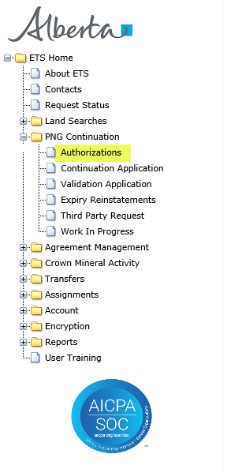
PNG Continuation-Authorization
Government of Alberta
INTRODUCTION
In this module you will learn how to:
As the company submitting the request for Authorization:
  Complete a PNG Continuation Authorization Request
  Check the status of your request
As the company authorizing the request:
  How to concur
  How to reject
  How to revoke

Slide 4
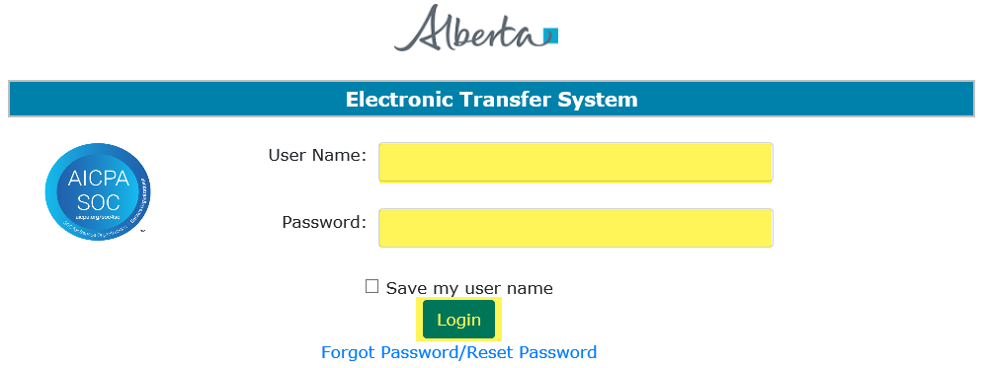
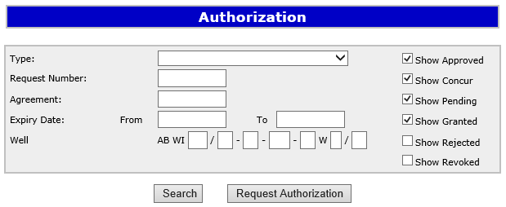
PNG Continuation-Authorization
Government of Alberta
Login to ETS
1. Login to ETS with your user name and password
2. Expand PNG Continuation
3. Select Authorizations

Slide 5
PNG Continuation-Authorization
Government of Alberta
As the company submitting the request for Authorization, the following set of slides demonstrates how to complete a PNG Continuation Request Authorization form.

Slide 6
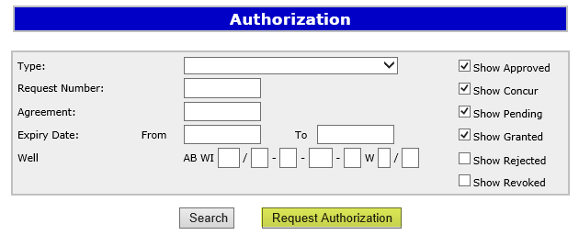
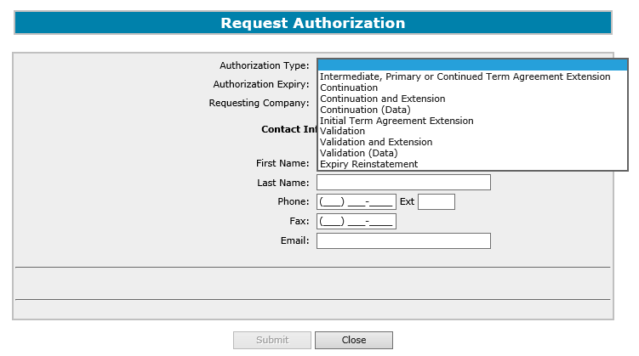

PNG Continuation-Authorization
Government of Alberta
Request Authorization
2. Select Authorization Type
1. Click Request Authorization
You have to chose the authorization type before the agreement and if applicable the well information displays.

Slide 7
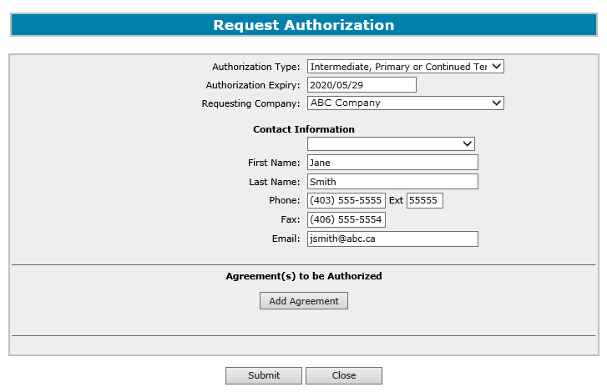
PNG Continuation-Authorization
Government of Alberta
3. Select Authorization Expiry and Requesting Company
4. Enter Contact information
The authorization expiry date must be a future date, it cannot be a past date or the current date. The authorization expiry date is how long the authorization to be valid. It cannot be more than a year.

Slide 8
PNG Continuation-Authorization
Government of Alberta
Type | Description
Intermediate, Primary or Continued Term Agreement Extension | If the agreement is not an initial term licence and you are applying for an extension, use this form type for authorizing the agreement.
Continuation | If the agreement is not an initial term licence, use this form type for authorizing the agreement and/or the well.
Continuation and Extension | If the agreement is not an initial term licence and you want to apply for a continuation and an extension, use this form type for authorizing the agreement and/or the well.
Continuation (Data) | If the agreement is not an initial term licence and you are requesting authorization from another company to use their data, use this form type.
Initial Term Agreement Extension | If the agreement is an initial term licence and you are applying for an extension, use this form type for authorizing the agreement.
Validation | If the agreement is an initial term licence, use this form type for authorizing the agreement and/or the well.
Validation and Extension | If the agreement is an initial term licence and you want to apply for a validation and an extension, use this form type for authorizing the agreement and/or the well.
Validation (Data) | If the agreement is an initial term licence and you are requesting authorization from another company to use their data, use this form type.
Expiry Reinstatement | If the agreement was cancelled due to continuation or validation expiry and you want to reinstate, use this form type for authorizing the agreement.
The following authorization form types are available for submission:
Authorization for Continuation, Validation, Extension and Reinstatement must be requested before an application can be submitted.
Authorization for Continuation (Data) or Validation (Data) is not required for submission but is required within 5 business days.

Slide 9
PNG Continuation-Authorization
Government of Alberta
Request Authorization – Intermediate, Primary or Continued Term Agreement Extension, Initial Term Extension or Expiry Reinstatement Form Type
The following slides demonstrate how to complete an “Intermediate, Primary or Continued Term Agreement Extension”, “Initial Term Extension” or “Expiry Reinstatement” form type.
Note: If you require authorization and want to apply for a Continuation or Validation with an extension you must select “Continuation and Extension” or “Validation and Extension” for the form type.

Slide 10
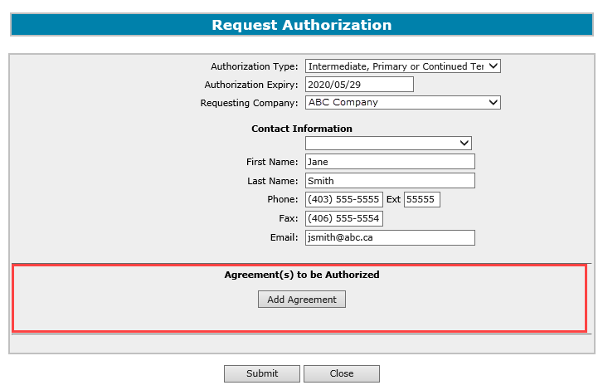
PNG Continuation-Authorization
Government of Alberta
Request Authorization – Add Agreement
An authorization can be requested for an agreement or for multiple agreements at the same time and can be for different companies.
A. Add Agreement
Agreement type must match the Authorization Type. (e.g. If you choose Validation as the Authorization Type the agreement
added must be an initial term licence.)

Slide 11
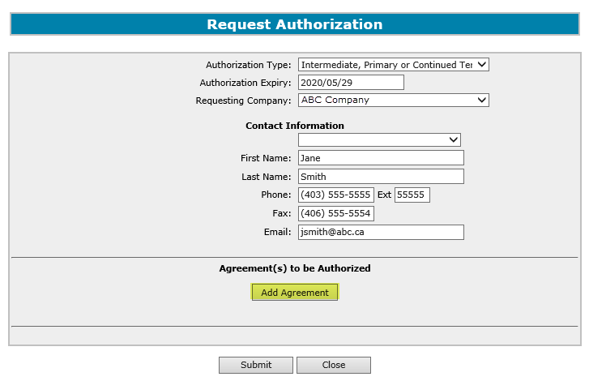
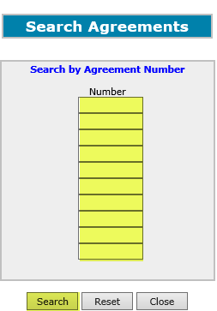
PNG Continuation-Authorization
Government of Alberta
Request Authorization – A. Add Agreement
1. Click Add Agreement to add a Crown agreement
2. Enter Crown agreement number
3. Click Search

Slide 12
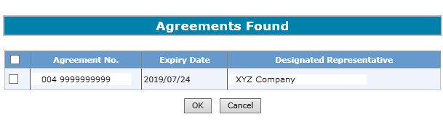
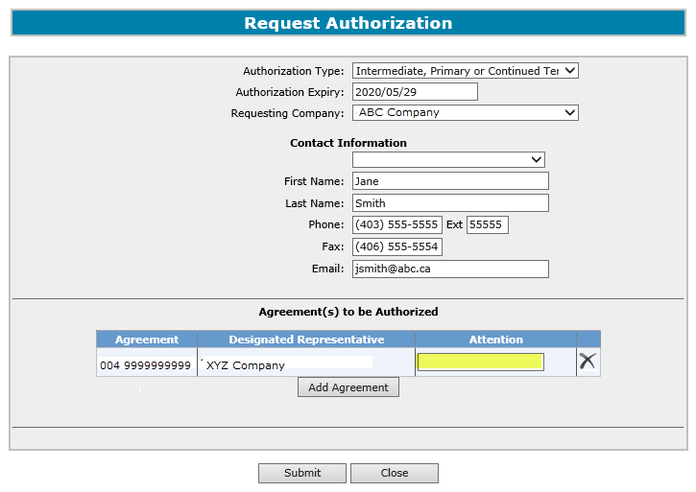
PNG Continuation-Authorization
Government of Alberta
Request Authorization – A. Add Agreement (continued)
4. Click on check box
5. Click OK
6. Optionally enter Attention Name for this Agreement

Slide 13
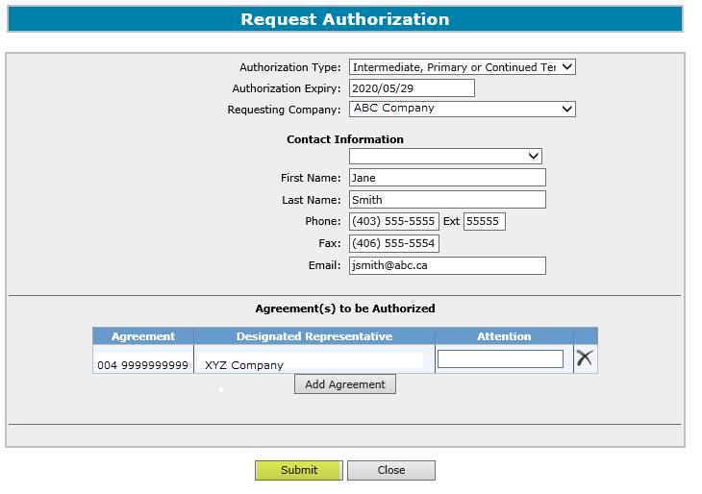

PNG Continuation-Authorization
Government of Alberta
Submit Request Authorization
The authorization is only verified when the application is submitted.
2. Click Close
1. Click Submit

Slide 14
PNG Continuation-Authorization
Government of Alberta
Request Authorization – Continuation or Validation Form Type
The following slides demonstrate how to complete a “Continuation” or “Validation” form type.
Note: If you require authorization and want to apply for a Continuation or Validation with an extension you must select “Continuation and Extension” or “Validation and Extension” for the form type.

Slide 15
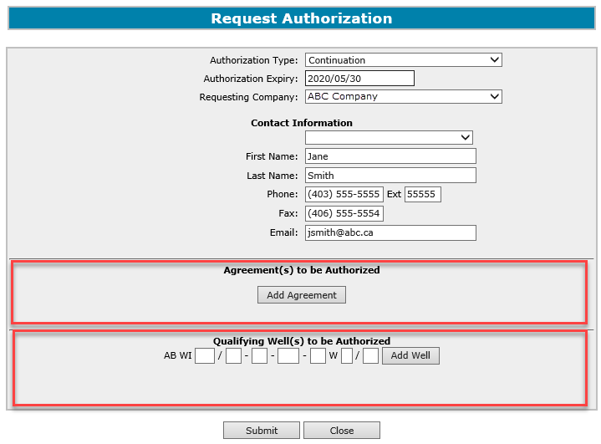
PNG Continuation-Authorization
Government of Alberta
Request Authorization – Add Agreement or Add Well
An authorization can be requested for either an agreement or for a well or both at the same time.
The authorization can be for multiple agreements and/or wells and can be for different companies.
A. Add Agreement
B. Add Well
Agreement type must match the Authorization Type. (e.g. If you choose Validation as the Authorization Type
the agreement added must be an initial term licence.)

Slide 16
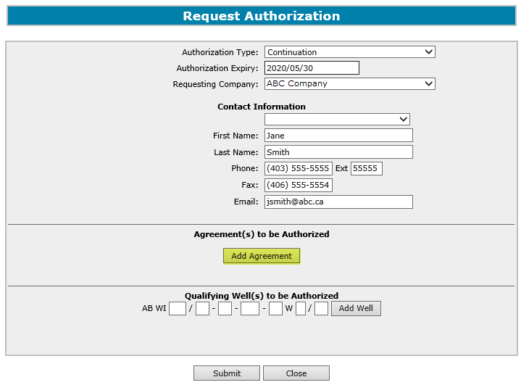
PNG Continuation-Authorization
Government of Alberta
Request Authorization – A. Add Agreement
1. Click Add Agreement to add a Crown agreement
2. Enter Crown agreement number
3. Click Search

Slide 17
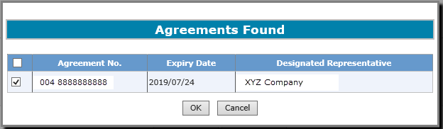
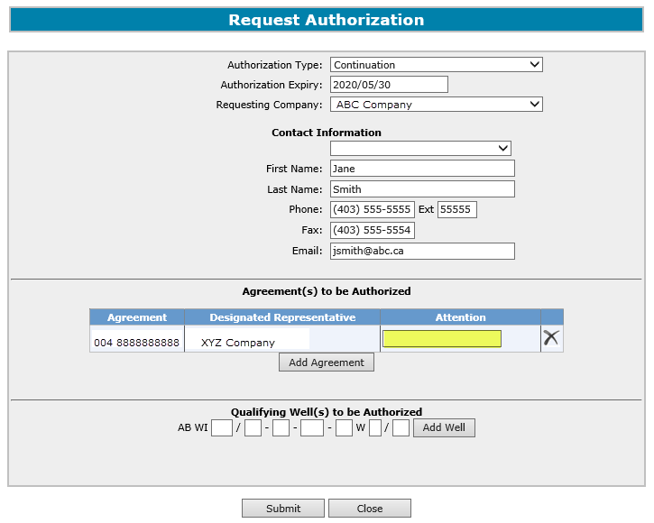
PNG Continuation-Authorization
Government of Alberta
Request Authorization – A. Add Agreement (continued)
4. Click on check box
5. Click OK
6. Optionally enter Attention Name for this Agreement

Slide 18
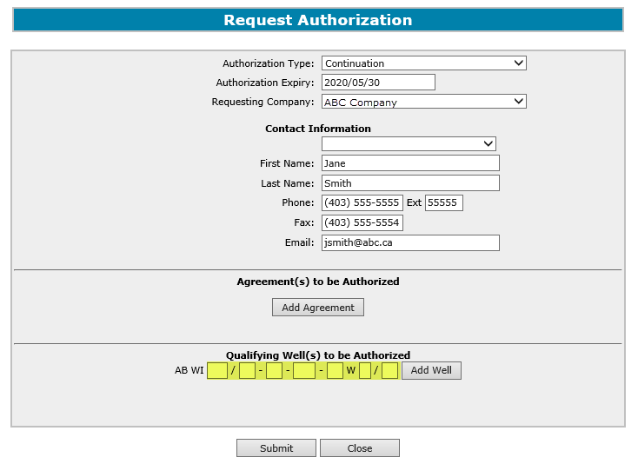
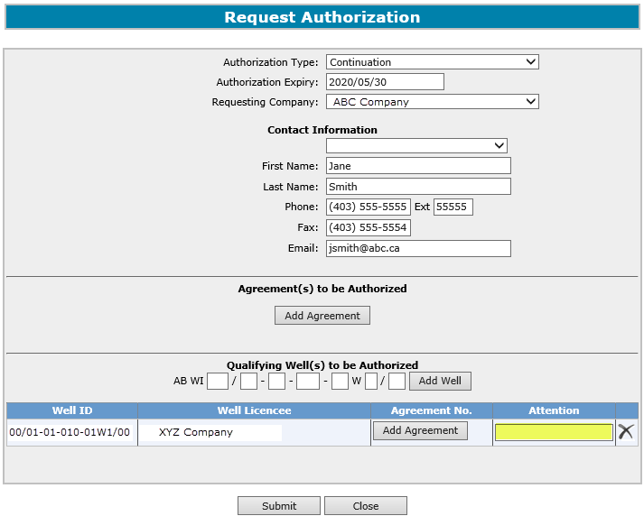
PNG Continuation-Authorization
Government of Alberta
Request Authorization – B. Add Well
1. Enter Well Information then click Add Well
2. Enter the Agreement number of the application that the well is going to be used on
3. Optionally enter Attention Name for the Well Licencee
If authorization form type is Continuation, it displays as “Qualifying Well(s) to be Authorized”.
If authorization form type is Validation, it displays as “Earning/Validating Well(s) to be Authorized”.

Slide 19
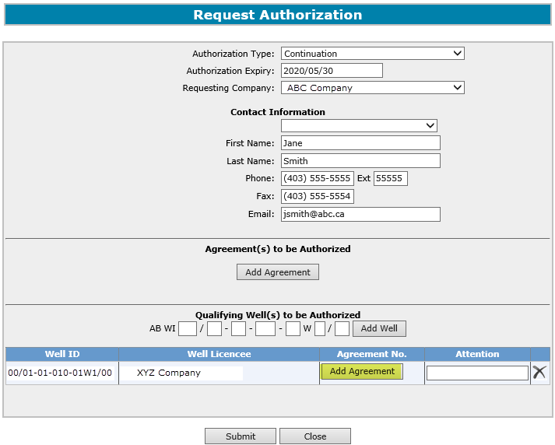
PNG Continuation-Authorization
Government of Alberta
Request Authorization – B. Add Well (continued)
2. Enter Crown agreement number
1. Click Add Agreement to add a Crown agreement
3. Click Search

Slide 20
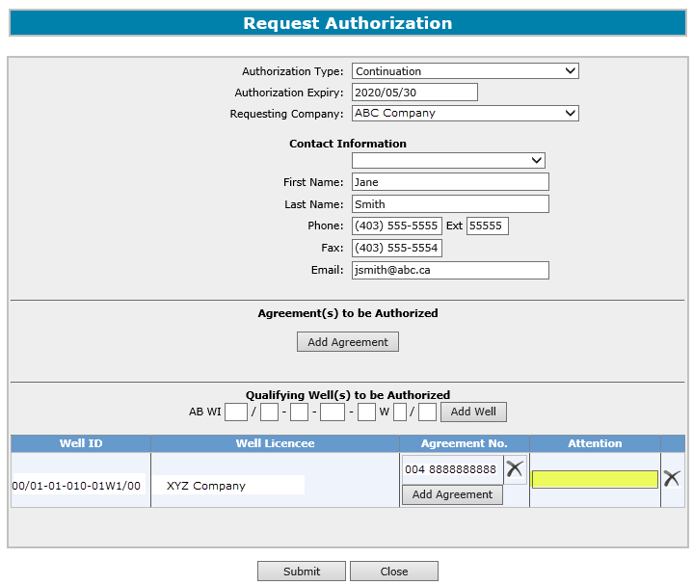
PNG Continuation-Authorization
Government of Alberta
Request Authorization – B. Add Well (continued)
4. Click on check box
5. Click OK
6. Optionally enter Attention Name for this Agreement

Slide 21
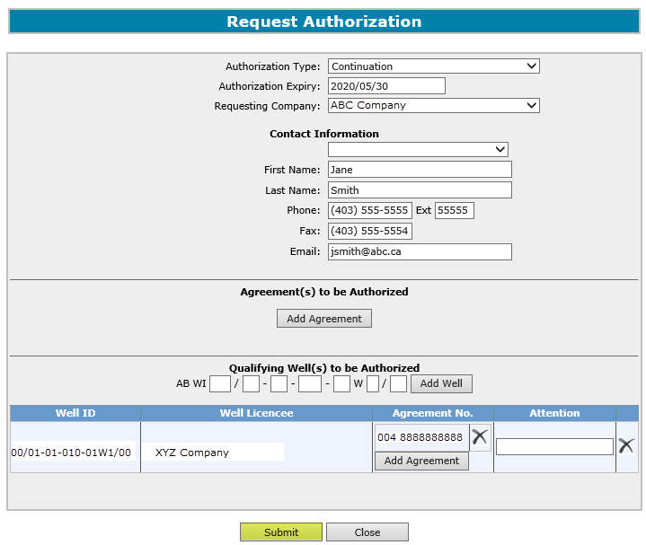
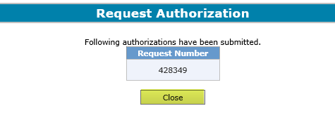
PNG Continuation-Authorization
Government of Alberta
Submit Request Authorization
2. Click Close
1. Click Submit
Note: The authorization is only verified when the application is submitted.

Slide 22
PNG Continuation-Authorization
Government of Alberta
An email will be sent from the ETS System advising the authorizing company that there is an authorization request available for concurrence.

Slide 23
PNG Continuation-Authorization
Government of Alberta
Request Authorization – Continuation (Data) or Validation (Data) Form Type
The following slides demonstrate how to complete a “Continuation (Data)” or “Validation (Data)” form type.
Note: Data Authorization should be requested on an agreement by agreement basis. When Data Authorization is granted, all agreements in the Add Agreement portion of the Request Authorization screen will be authorized to use all data entered in the Data portion of the Request Authorization screen. See technical guidelines for submitting authorized data.

Slide 24
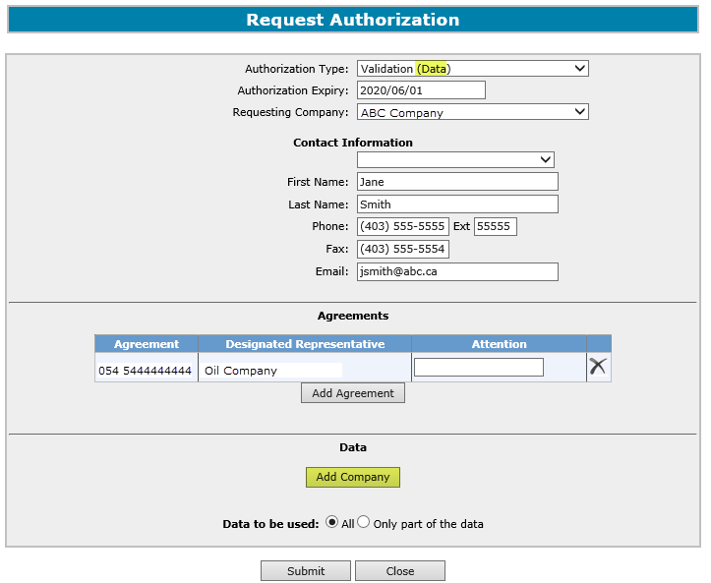
PNG Continuation-Authorization
Government of Alberta
Request Authorization for Data
Follow the same process as Request Authorization and also Add Agreement. This is the Agreement you will be applying with.
1. Click Add Company
Agreement type must match the Authorization Type. (e.g. If you choose Validation (Data) as the Authorization Type the
agreement added must be an initial term licence).

Slide 25
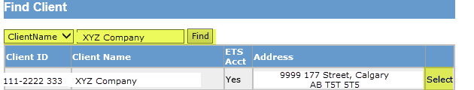
PNG Continuation-Authorization
Government of Alberta
Request Authorization for Data (continued)
2. Choose and enter search parameters and click Find
3. Click Select

Slide 26
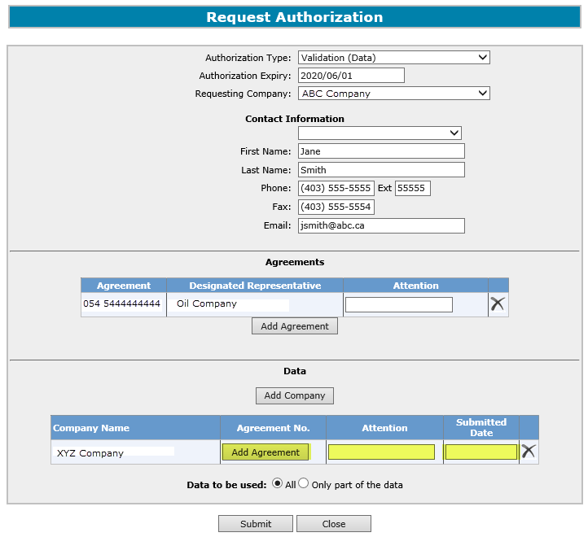
PNG Continuation-Authorization
Government of Alberta
Request Authorization for Data (continued)
5. Optionally enter Attention name for the company.
4. Add the Agreement Number the data was previously submitted with.
Enter the Submitted Date. This is the date the data was/will be submitted to Alberta Energy.
6. Select an option for Data to be used. If “Only a part of the data” is selected, a description of the data to be used will need to be entered.

Slide 27
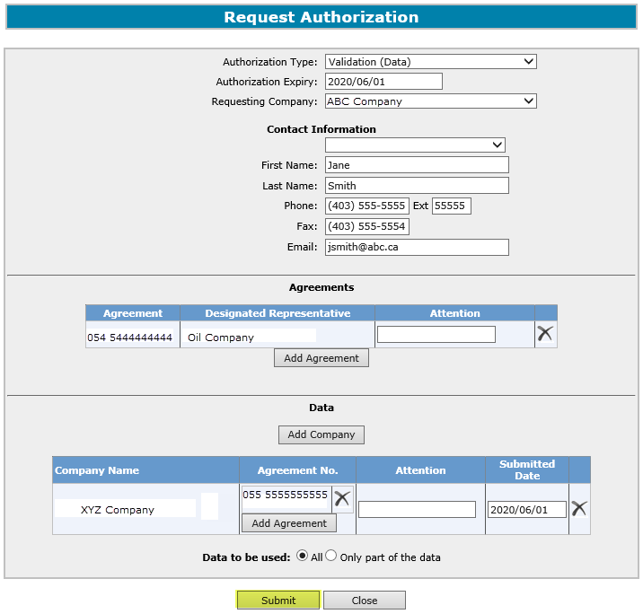
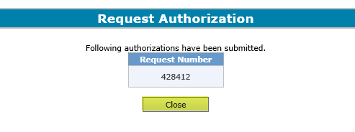
PNG Continuation-Authorization
Government of Alberta
Request Authorization for Data (continued)
2. Click Close
1. Click Submit

Slide 28
PNG Continuation-Authorization
Government of Alberta
An email will be sent from the ETS System advising the authorizing company that there is an authorization request available for concurrence.

Slide 29
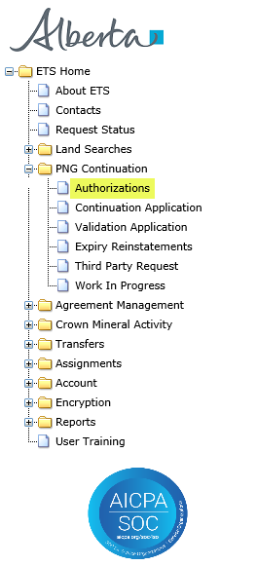
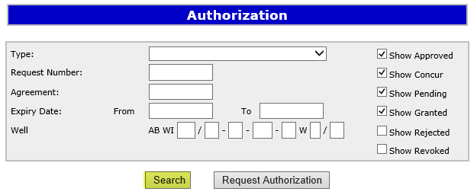
PNG Continuation-Authorization
Government of Alberta
Check Status of Authorization Request
2. Optionally choose your search parameters
1. Select Authorizations
3. Click on Search

Slide 30
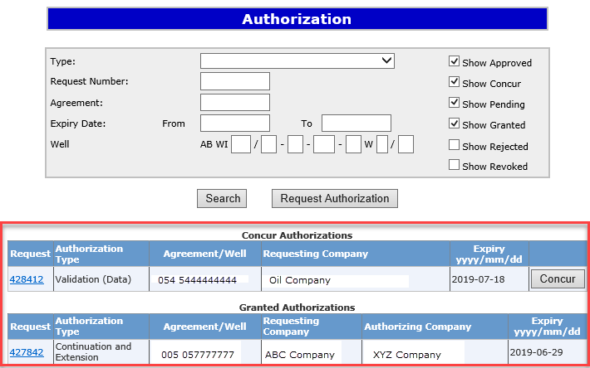
PNG Continuation-Authorization
Government of Alberta
Check Status of Authorization Request – Search Results
Search Results

Slide 31
PNG Continuation-Authorization
Government of Alberta
As the company authorizing the request, the following slides demonstrate how to
  Concur
  Reject
  Revoke

Slide 32
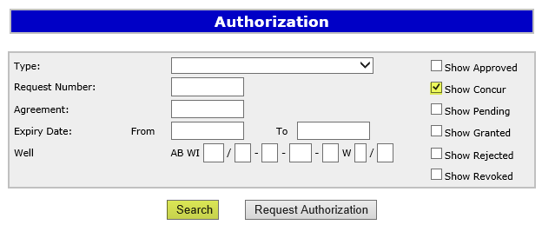
PNG Continuation-Authorization
Government of Alberta
Concur Authorization
1. Select Authorizations
2. Select Show Concur
3. Click on Search

Slide 33
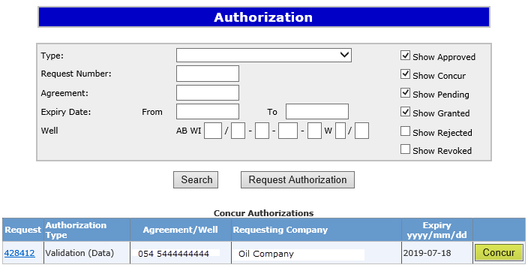
PNG Continuation-Authorization
Government of Alberta
Concur Authorization (continued)
Search Result
4. Click on Concur

Slide 34
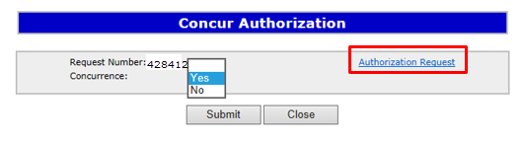
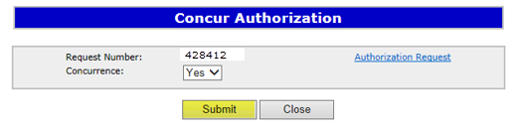
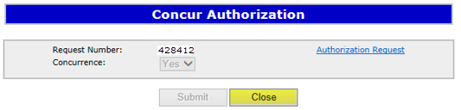
PNG Continuation-Authorization
Government of Alberta
Concur Authorization – Submit
Click on this link to view the authorization request report.
1. Click on the dropdown and select Yes
2. Click on Submit
3. Click on Close
Upon submission of the request, ETS will send an email to the requesting company advising that the request has
been concurred. The authorized company will email their data to EM.DatasubmissionPNGContinuation@gov.ab.ca.

Slide 35
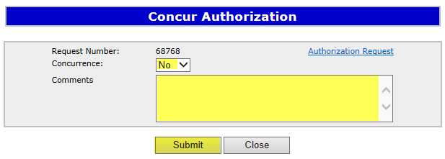
PNG Continuation-Authorization
Government of Alberta
Reject Authorization
Follow the same process to select the Authorization to Concur, but select No in the Concurrence dropdown list.
1. Click on the dropdown and select No
2. Enter Comments for rejecting the authorization request
3. Click on Submit
Upon submission of the request, ETS will send an email to the requesting company advising that the request has been rejected.

Slide 36
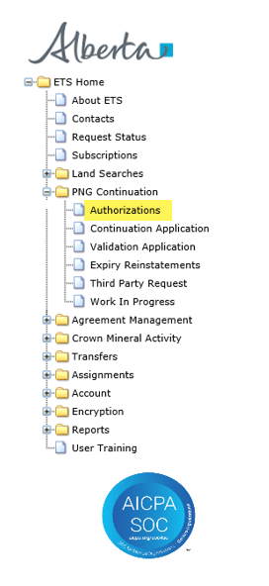
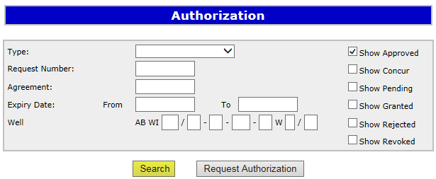
PNG Continuation-Authorization
Government of Alberta
Revoke a previously Granted Authorization
1. Select Authorizations
2. Check Show Approved (as only approved requests can be revoked)
3. Click on Search

Slide 37
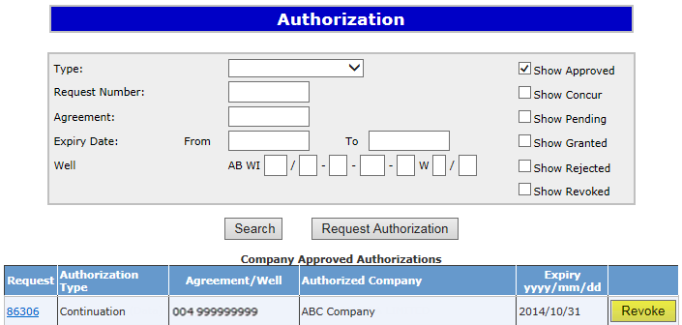
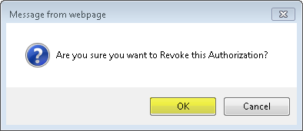
PNG Continuation-Authorization
Government of Alberta
Revoke a previously Granted Authorization (continued)
1. Click on Revoke
Note: Revoke only means the authorization can not be used again; however, it does not revoke previously authorized applications already submitted.
2. Click OK
Upon confirming, ETS will send an email to the requesting company advising that the request that has been Revoked.

Slide 38
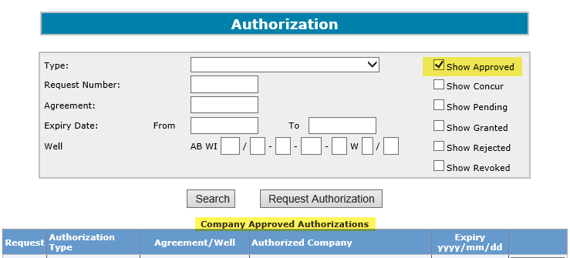
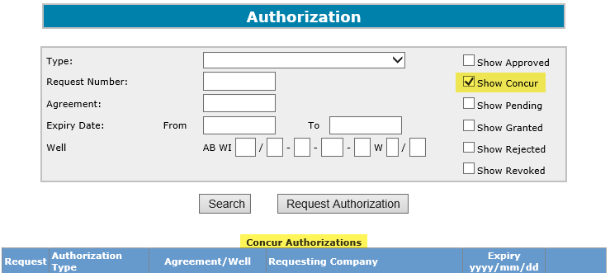
PNG Continuation-Authorization
Government of Alberta
Locating Requests in the Authorization Search Screen
Previously concurred authorization requests can be found under the Company Approved Authorizations portion of the authorization Search screen. This is also where you will find authorization requests that you may wish to revoke.
Authorization requests awaiting concurrence can be found under the Concur Authorizations portion of the authorization Search screen.

Slide 39
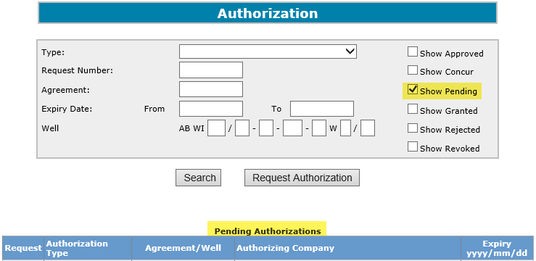
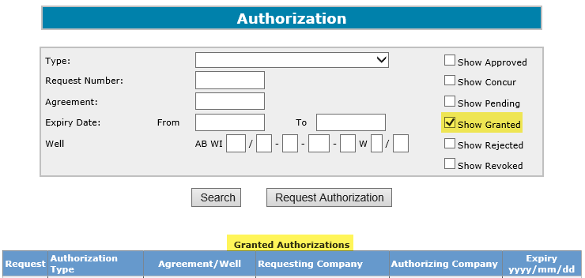
PNG Continuation-Authorization
Government of Alberta
Locating Requests in the Authorization Search Screen (continued)
Once you request an authorization, you can look under the Pending Authorizations portion of the authorization Search screen to see if it is still awaiting concurrence.
Once an authorization request has been Concurred, it can be found under the Granted Authorizations portion of the authorization Search screen.

Slide 40
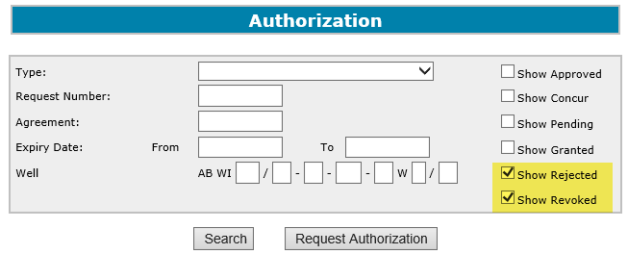
PNG Continuation-Authorization
Government of Alberta
Locating Requests in the Authorization Search Screen (continued)
Authorization requests that your company has rejected and/or revoked can be found under the Rejected and Revoked Authorizations portion of the authorization Search screen.
Authorizations that were requested by your company which were rejected and/or revoked by the concurring company can be found under the Company Rejected and Revoked Authorizations portion of the authorization Search screen.

Slide 41
PNG Continuation-Authorization
Government of Alberta
Resources
ETS Support and Online Learning provides access to relevant guides, courses and other information.
Authorized Data submissions can be emailed to EM.DatasubmissionPNGContinuation@gov.ab.ca
If you have questions, please contact PNGContinuations.Energy@gov.ab.ca
or the PNG Tenure Help Line at (780) 644-2300.

Slide 42

PNG Continuation-Authorization
Government of Alberta
Congratulations!
You have completed the ETS – PNG Continuation- Authorization
Online Training Course
Please proceed to the subsequent modules detailing the
functionality contained within each module of the application.
To access Courses, Guides and Forms for all your ETS Business please see ETS Support and Online Learning.
If you have any comments or questions on this training course,
please contact:
Crown Agreement Management
Helpdesk: (780) 644-2300
Email inquires: PNGContinuations.Energy@gov.ab.ca

