Slide 1
Welcome
Welcome!
Each company has an assigned ETS Site Administrator who is responsible to create their company's user accounts. They also manage the assignment of roles within the company.
This module will discuss the different roles required to properly create, edit or submit an OSR Project Application.
To the OASIS Roles
Online Training Course

Slide 2
Revisions
Date | Revisions Type | Page Number
September 31, 2012 | Conversion | All

Slide 3

Introduction
In this module, you will learn how to:
Assign OASIS Roles
Copy OSR Project Assignments
Assign OSR Projects
Assign users to Roles tab
Prerequisite Learning Modules
We recommend that you view the following modules before proceeding:
OASIS Overview
ETS Account Setup and Preferences

Slide 4
Site Administrator – Assign Roles
Before a role can be assigned, the Site Administrator must use the Form Type "OSR Project Application Request".
The Site Administrator assigns one or more of the following OASIS roles to a Client Account:
Coordinator
Creator
Delegate
Submitter
Viewer
ETS Account Setup and Preferences (For Site Administrators)

Slide 5
Coordinator Role
The role of a Coordinator is to:
Assign OSR Projects and new Project Applications within the company or client group to those client accounts with a Creator role
View all Application Requests within the company or client group and re-assign them to another Creator
Assign roles within the company or client groups

Slide 6
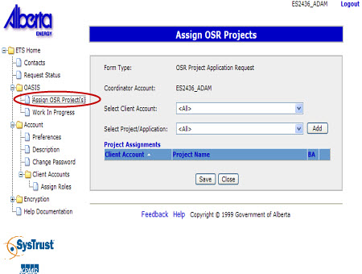

Coordinator – Assign OSR Project
More Information (Page 7 to 10)
The Assign OSR Project enables the Coordinator to assign and manage projects and new pending applications to their Creators.
Upon adding the Project to the selected Creator Account, Project Assignments are displayed. This list shows the existing assignments.
Click on More Information to view how to assign an OSR Project.

Slide 7
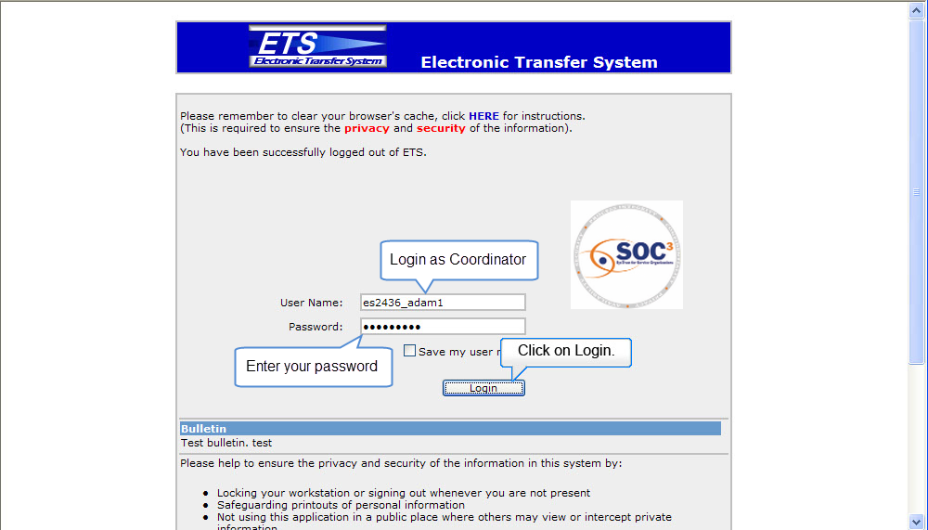
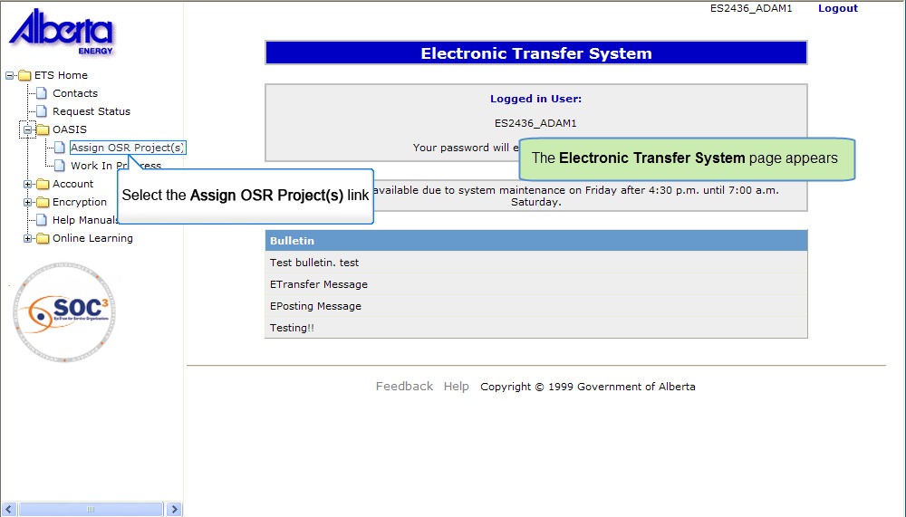
Back to Assign OSR Project

Slide 8
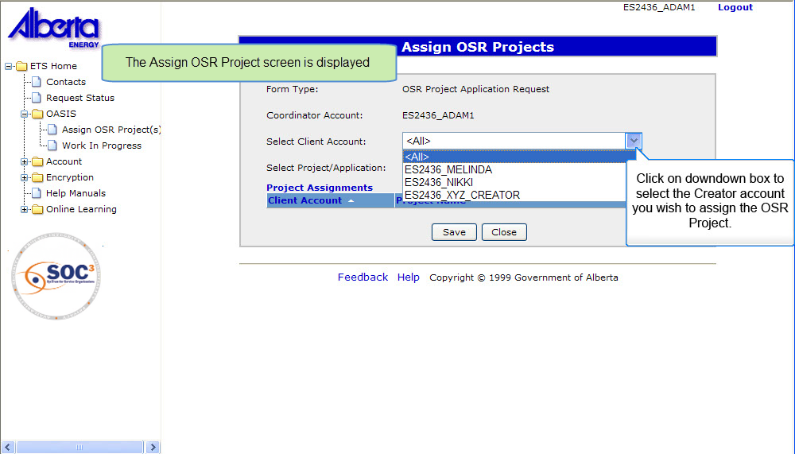
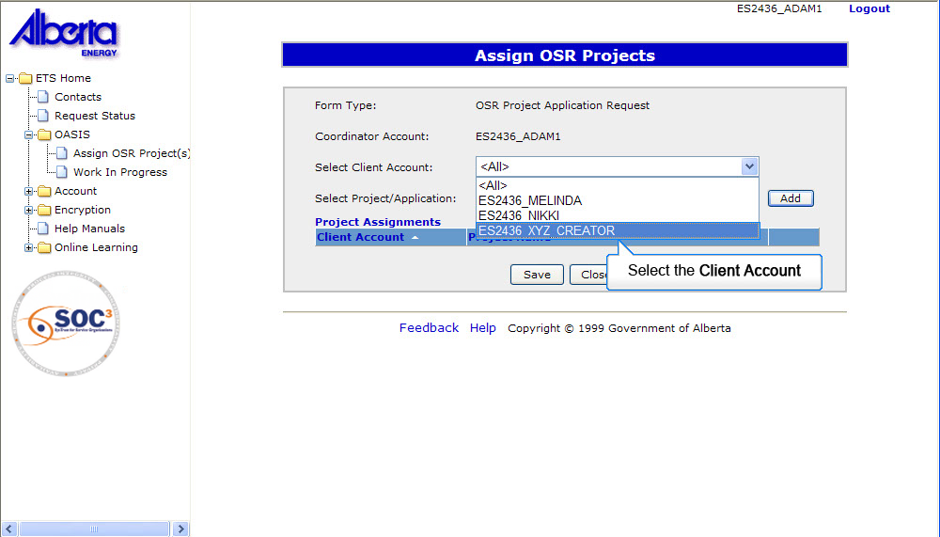
Back to Assign OSR Project

Slide 9
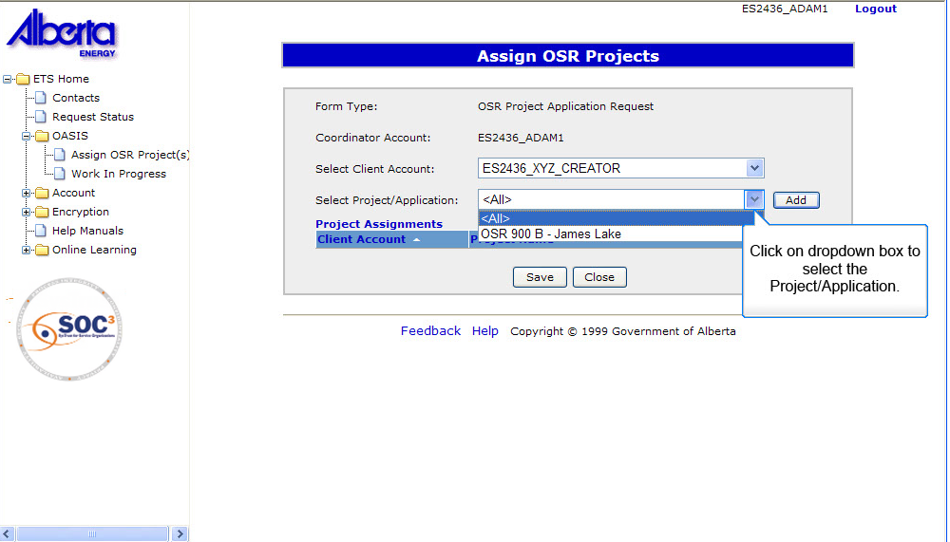
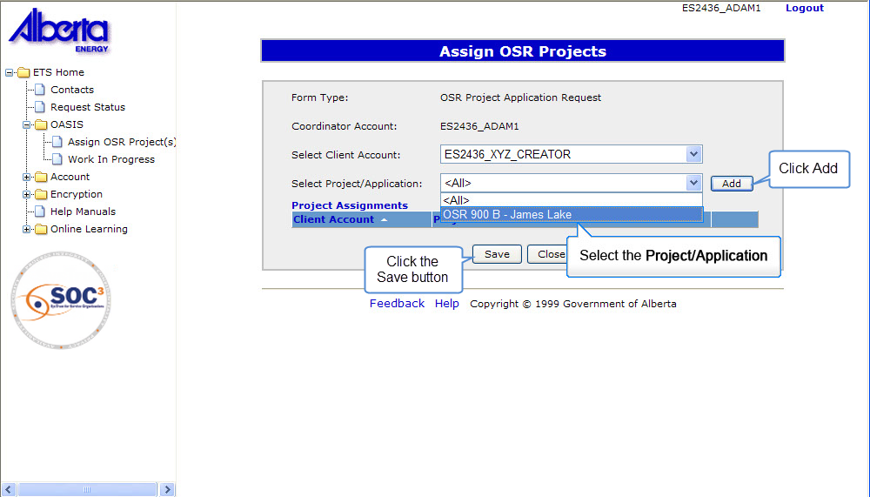
Back to Assign OSR Project

Slide 10
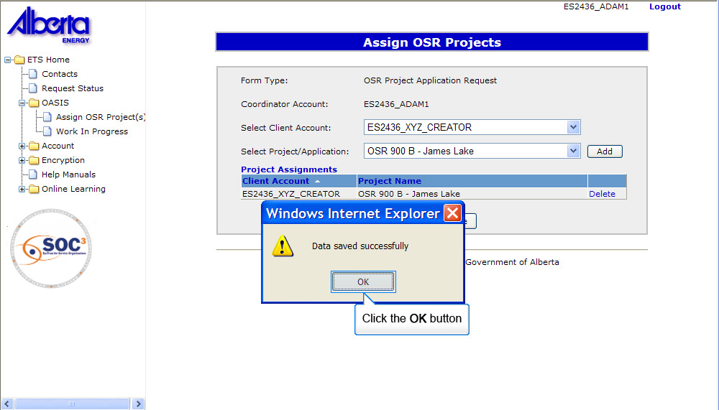
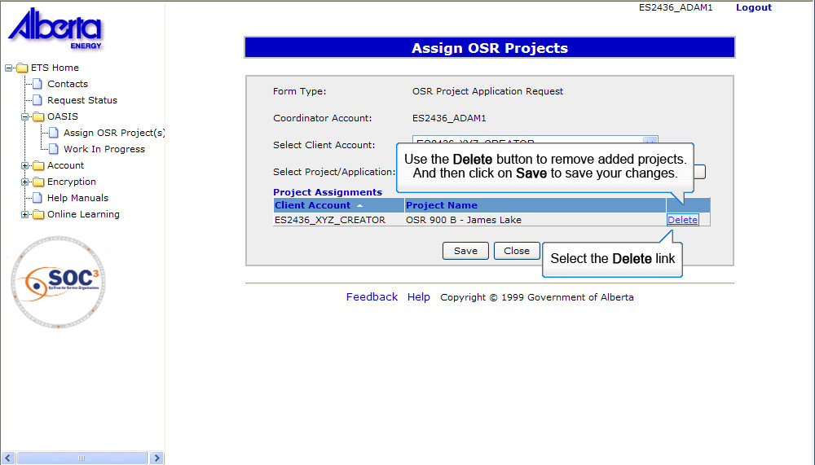
Back to Assign OSR Project

Slide 11
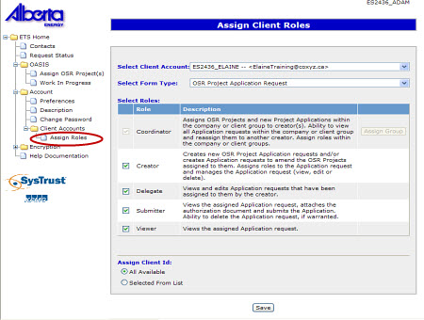
Coordinator – Assign Roles
More Information (Page 12 to 17)
The Assign Client Roles functionality allows the Coordinator to assign roles within his Coordinator group.
The Client Account displayed in this screen comes from the assigned group that was assigned to him by the Site Administrator.
The Client ID represents the Client Registry Id that will be used for creating an OSR Application Request.
By selecting the Selected From List option, individual Client Ids can be added to the Client Account.

Slide 12
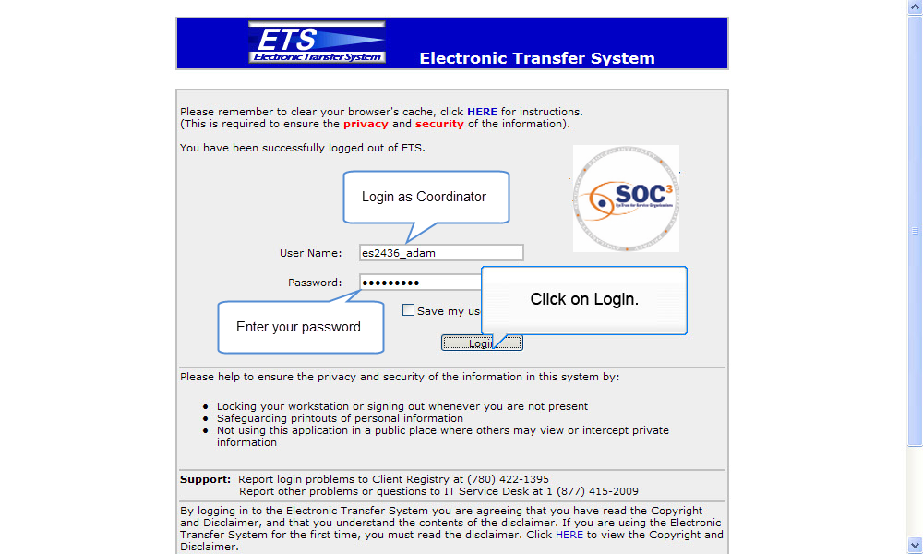
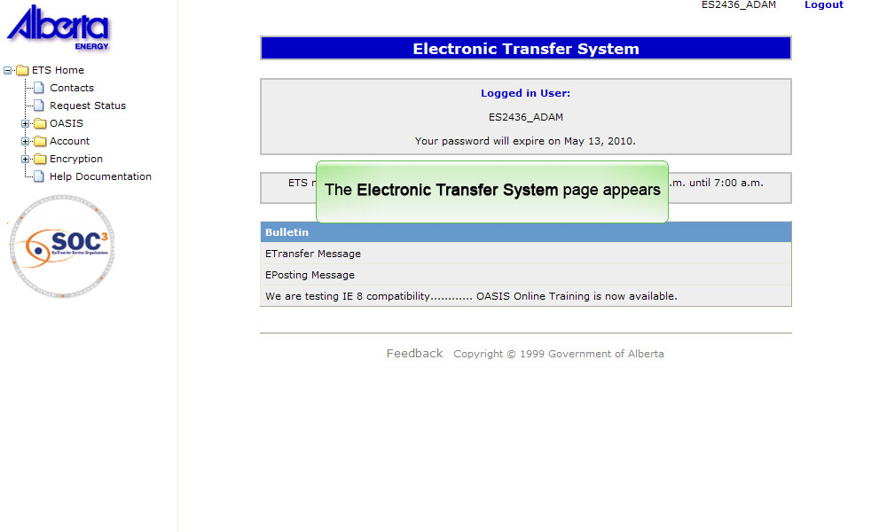
Back to Assign Roles

Slide 13
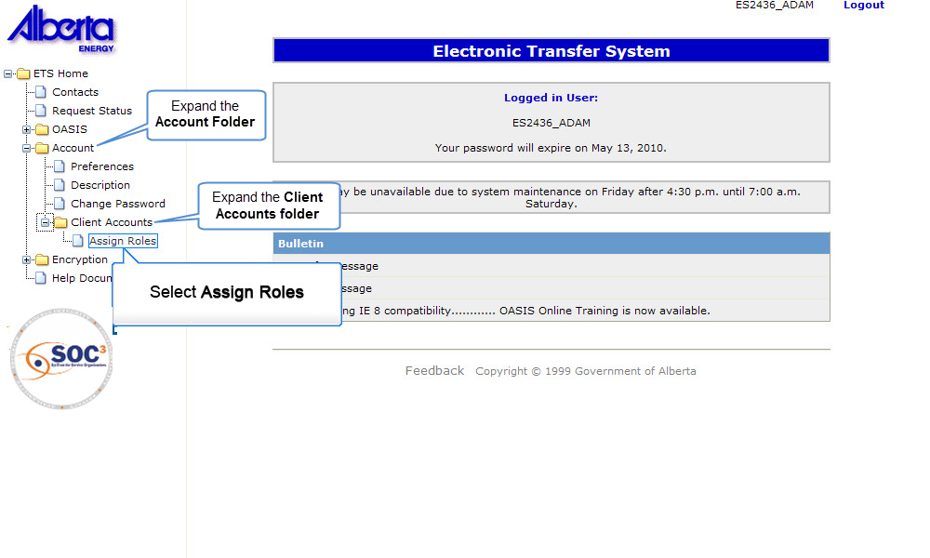
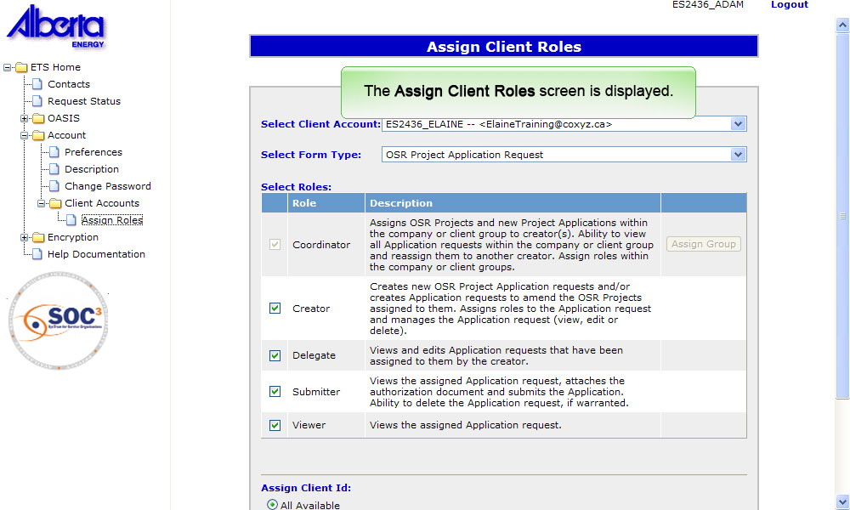
Back to Assign Roles

Slide 14
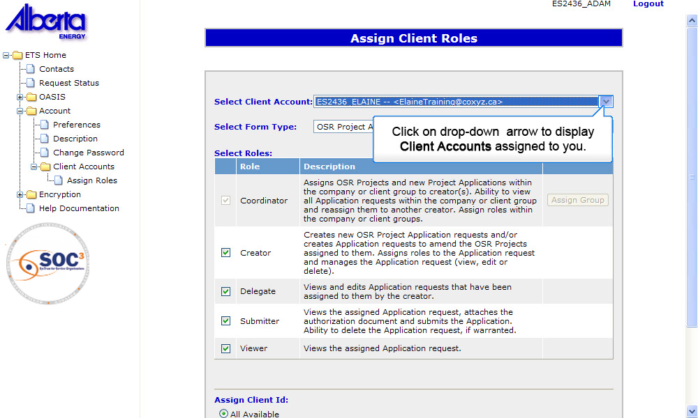
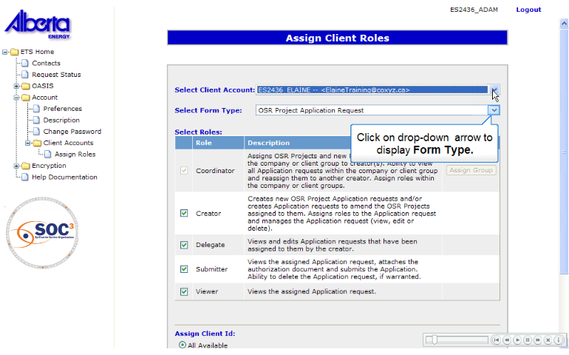
Back to Assign Roles

Slide 15
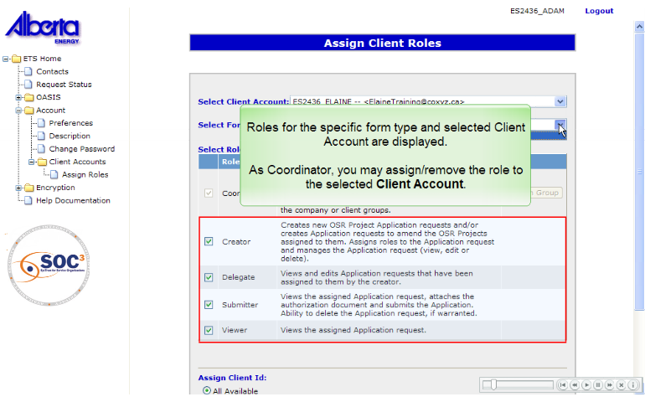
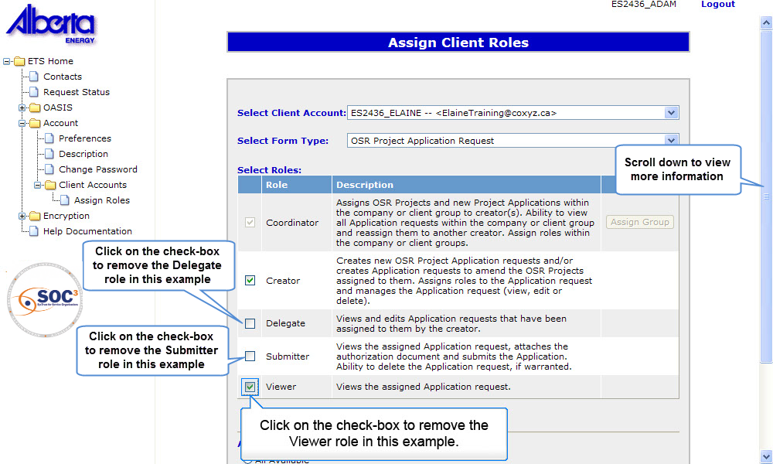
Back to Assign Roles

Slide 16
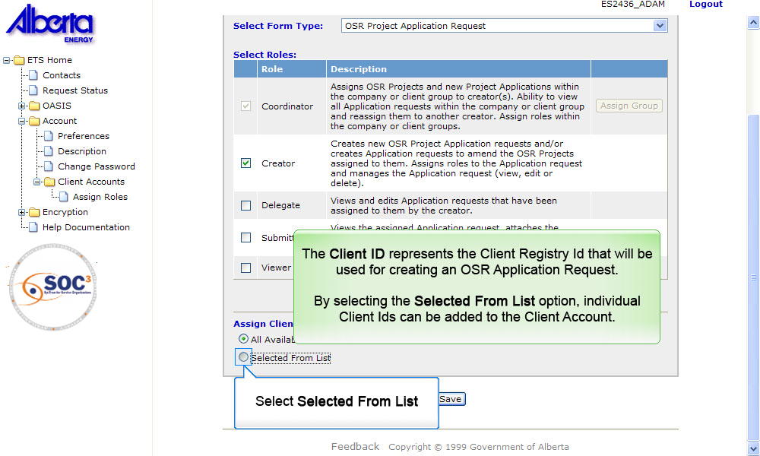
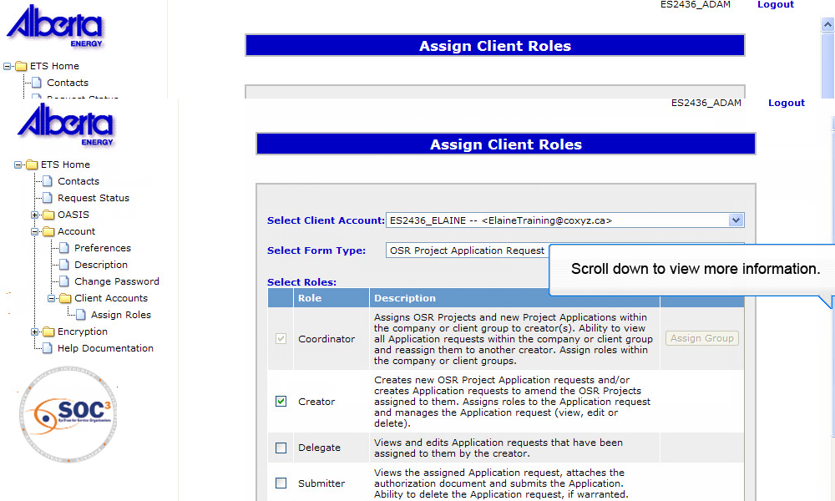
Back to Assign Roles

Slide 17
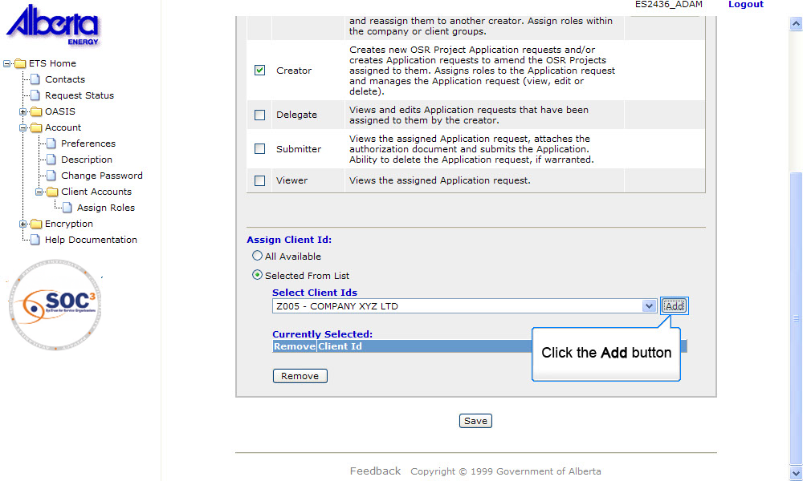
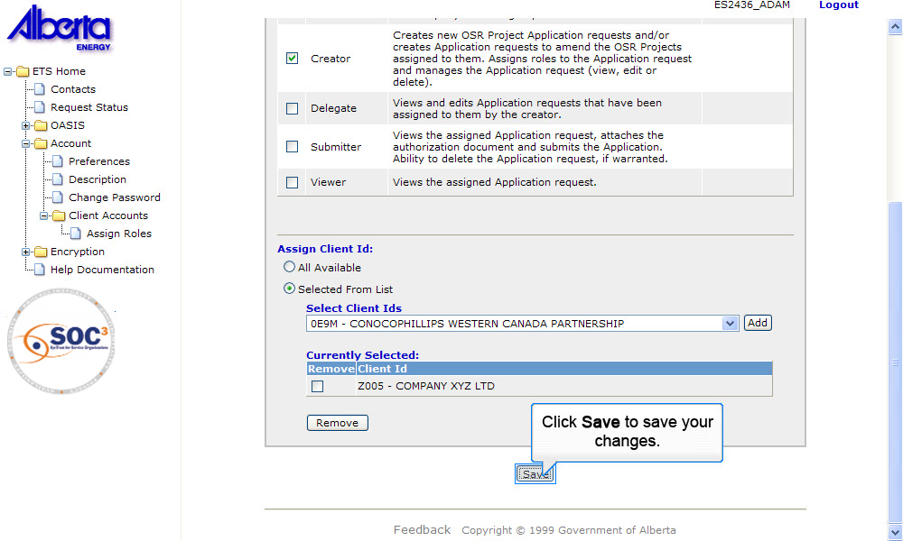
Back to Assign Roles

Slide 18
Creator Role
Any Creator within the company can create and edit a new project.
Only Creators assigned to a specific project can create, edit and delete amendments to that project.
The Creator can assign roles to the Application request through the following:
ETS - Account Preferences
Within the Application Request

Slide 19
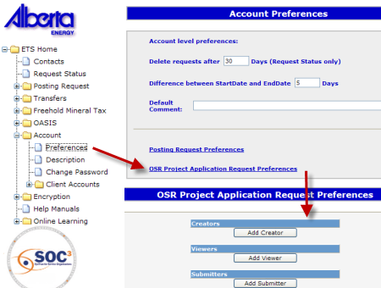
Creator Role – Assign Role using ETS Preferences
The OSR Project Application Request Preferences screen is set up within ETS Account Preferences. The account preferences allow a Creator's account to set up defaults that will be used by the system for that account.
The values entered in this screen are populated in the "Roles" tab of the OSR Project Application request based on that request's BA Id.
This screen is only available to the "Creator" role.
ETS Account Setup and Preferences (For Site Administrators)

Slide 20
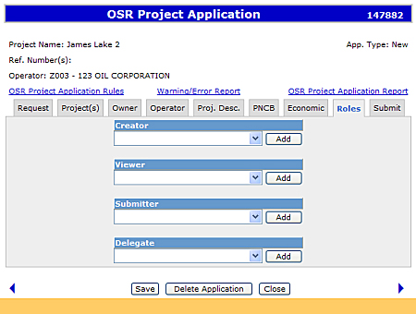
Creator Role – Assign Roles within Application
The Creator can add or delete users to their respective roles in the application.
The "Roles" tab in the OSR Project Application will be pre-populated by the preferences; if it exists.
The roles are filtered based on the BA Id in the Request tab.
Roles assigned are for the current application only.

Slide 21
Delegate Role
After a Delegate has been added to an existing application, they can view and edit the application.
The Delegate has limited editing capabilities.
The Delegate role can be used to allow a company to restrict access to a specific project for consultants.

Slide 22
Submitter Role
After a Submitter has been assigned to an existing application, the Submitter has the following responsibilities:
View the Application Request for completeness;
Record comments on the Remarks section, if any;
Attach the signed authorization document, if not already done so;
Submit the Application request to the Department of Energy;
Delete the Application request, if warranted
Prior to submitting the application, the Submitter should check the application for completeness by reviewing the Warning/Error Report.

Slide 23
Viewer Role
The Viewer has read-only access to the Application Request.
The Viewer can not add, edit, or delete information on the Application Request.

Slide 24
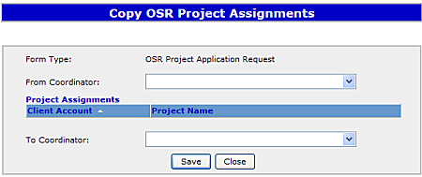
Site Administrator – Copy OSR Project Assignments
More Information (Page 25 to 28)
Copy OSR Project Assignments functionality allows Site Administrators to copy project assignments from one Coordinator to another.
Project assignments are appended to the existing project assignments of the destination Coordinator; it will not remove or overwrite existing assignments.
Once saved, a listing of Project Assignments is displayed. This list shows the existing Creator approved projects and/or pending new project application list for the destination Coordinator.
Click on More Information to view how to copy OSR Project Assignments.

Slide 25
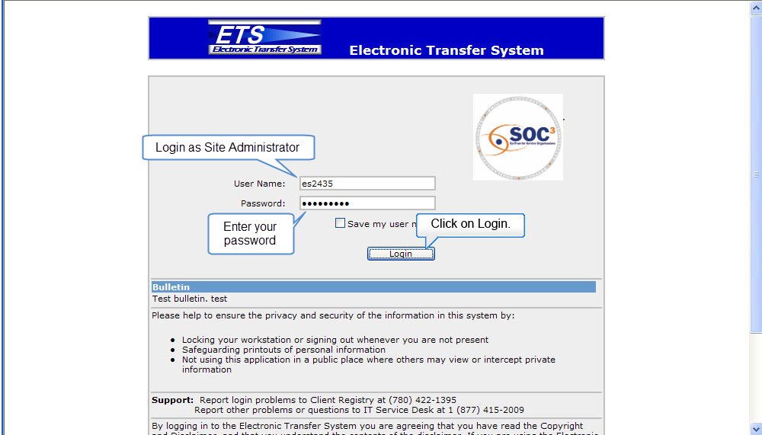
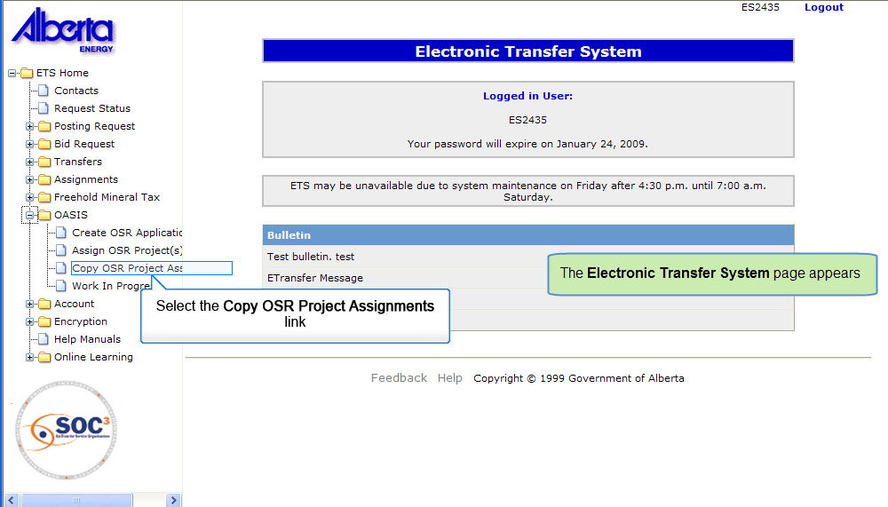
Back to Copy OSR Project Assignments

Slide 26
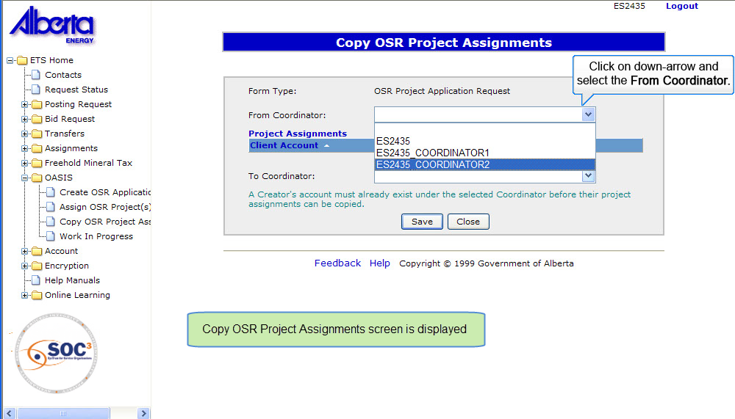
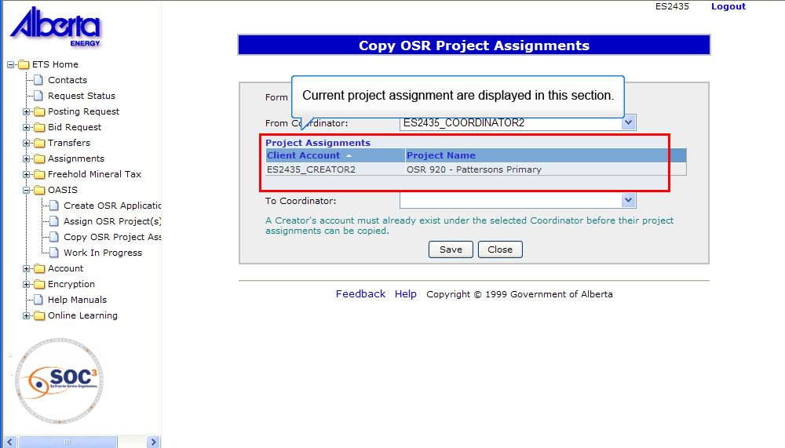
Back to Copy OSR Project Assignments

Slide 27
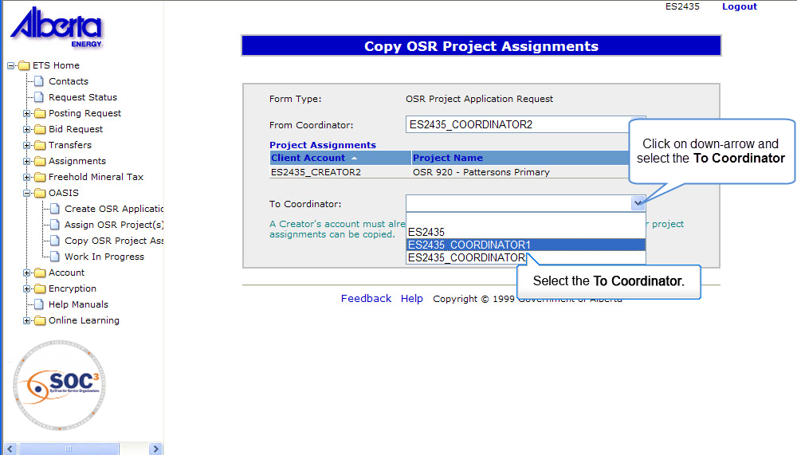
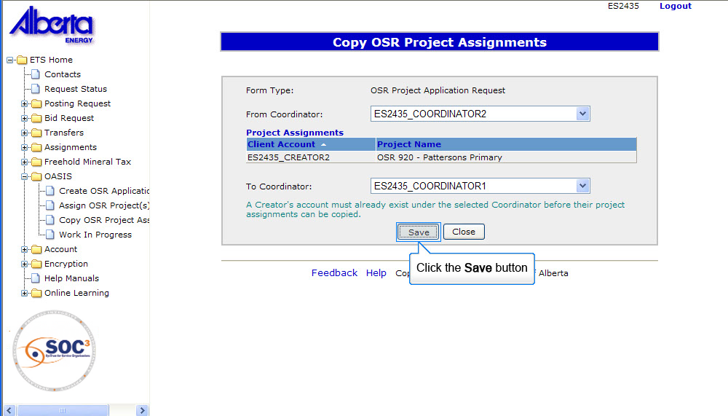
Back to Copy OSR Project Assignments

Slide 28
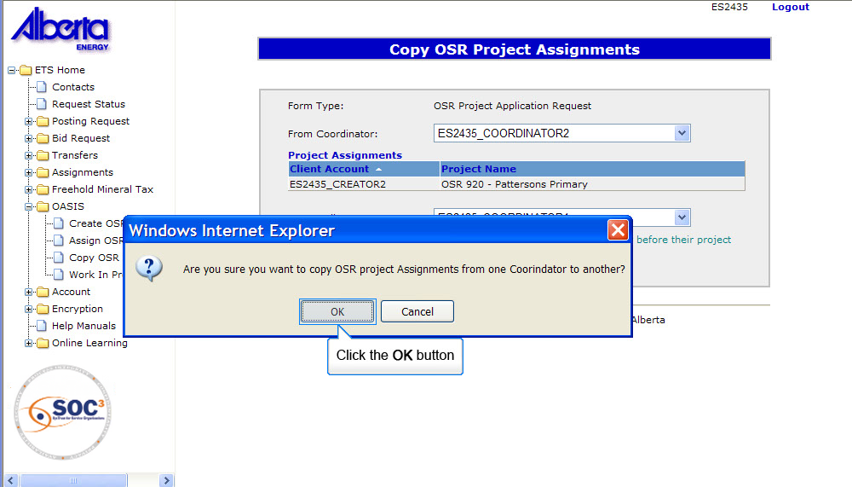
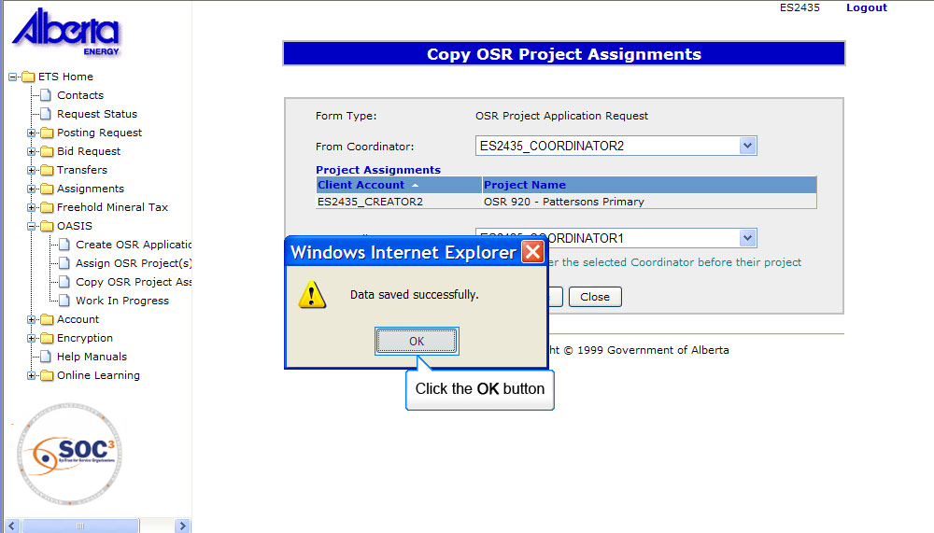
Back to Copy OSR Project Assignments

Slide 29

Conclusion
Congratulations!
You have completed the OASIS Roles
Online Training Course
Please proceed to the subsequent courses detailing other functionality of the OASIS application.
If you have any comments or questions on this training course,
please forward them to the following email address:
OSODmailbox@gov.ab.ca

