Slide 1
Welcome
Welcome!
This module outlines the processes required to create an Amendment for an OSR Project, and Amalgamation for one or more OSR Projects.
Project Amendments include adding and/or removing lands, wells, technologies and/or facilities to an approved OSR Project or to a pending new project application. Project Amalgamations combine two or more approved OSR Projects into a single project for the purposes of royalty calculation.
Prerequisites:
OASIS Roles
ETS Accounts
Create New OSR Project Application
GeoView Overview
GeoView Editing
To the OASIS Create an Amendment OSR Application
Online Training Course

Slide 2
Revisions
Date | Revisions Type | Page Number
September 31, 2012 | Conversion | All
July 2, 2013 | Updated | All

Slide 3
Introduction
In this module, you will learn how to:
Create an amendment or amalgamation OSR application by completing the following:
Logon to ETS
Request Tab
Project(s) Tab
Owner Tab
Operator Tab
Project Description Tab
How to use GeoView to edit lands
PNCB Tab
Economic Tab
Roles Tab
Submit Tab

Slide 4
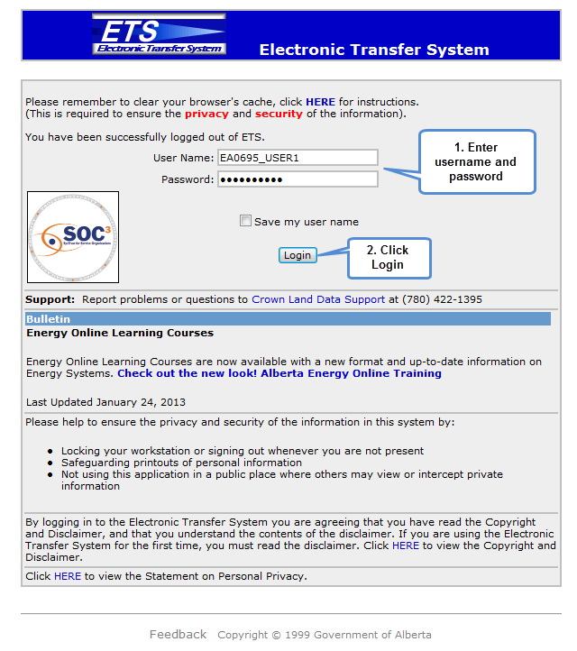
Logon to Electronic Transfer System (ETS)
To Log on to the ETS web site: Enter the ETS User ID issued by the Site Administrator (EN####_Accountname) into the User Name field. This field is NOT case-sensitive.
Enter the Password: This field IS case-sensitive.
Click the Login button:
Save my user name: If you check this box, ETS will save your user name on the site so you do not have to enter it every time you log in.

Slide 5
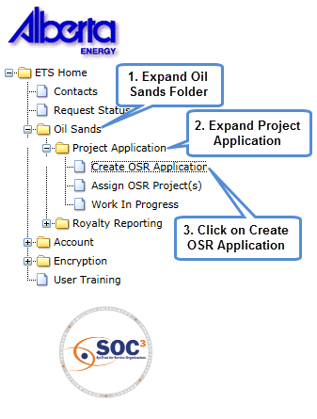

ETS Tree Node
The entry point to OASIS OSR Applications is by selecting:
‘Oil Sands’, then ‘Project Application’.
The choices available are determined by the OSR Application roles assigned to the user by the Site Administrator or the Coordinator.
Create OSR Application, the user must have the Creator Role.
Assign OSR Project(s), the user must have the Coordinator Role
Work In Progress, this feature is available to all OSR Application roles.
For more information on roles, see OASIS Roles training module.

Slide 6
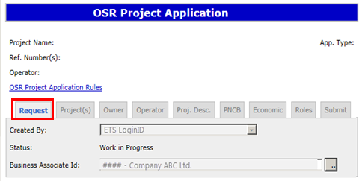
Request Tab
After the Create OSR Application has been selected, the Request Tab is displayed.
Created by: This field defaults to the user who created the application record.
Status: This field defaults to Work In Progress (WIP).
Business Associate ID: This field defaults to the company/ies assigned to users ETS account for OSR Project Applications.
Upon saving, a Request Number will be assigned to the application, and some of the tabs enabled.
The Request Number can be used to locate this application after the user has exited.

Slide 7
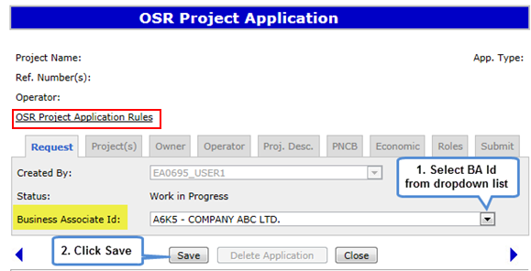
Request Tab (Continued)
Where multiple companies are assigned to the Creator, a selection can be made by using the dropdown list located on the right of the Business Associate ID field.
Select the dropdown option, choose a company and save.
Note: The company entered will be used to populate the Owner tab.
An overview of what is needed to complete an OSR project application may be found by clicking on the text OSR Project Application Rules

Slide 8
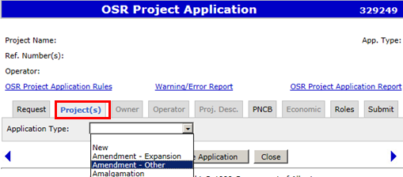
Project(s) Tab
When the Project(s) tab is selected, the Project screen will be displayed. Select the application type from the dropdown box.
The Project Application choices are New, Amendment – Expansion, Amendment – Other, or Amalgamation. Upon making a selection, the remainder of the screen will be expanded to accommodate your choice.
Amendment – Expansion, Amendment – Other, and Amalgamation choices are explained in the following slides.

Slide 9
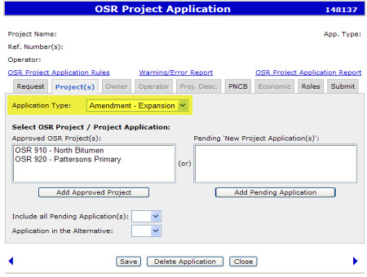
Project Application - Amendment - Expansion
For an expansion to an existing or pending OSR Project select Amendment - Expansion from the Application Type dropdown list. The system will display a list of Approved OSR Projects and Pending New Project Applications assigned to the logged in user. Approved OSR Projects: Lists the latest project approval.
Pending New Project Application(s): Lists OSR Project Applications submitted as ‘New’, which are not yet approved.
Note: Approved OSR Projects are 3 digits and begin with OSR. Pending applications are 4 digits and begin with ‘R’.
Upon making a selection, choose ‘Add’.

Slide 10
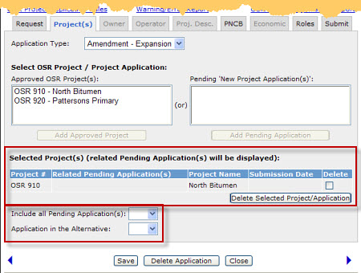
Project Application - Amendment - Expansion (Continued)
Only one approved OSR Project OR Pending New Project Application can be selected from the grid(s). The selected project and any pending applications related to the selected Approved OSR Project will automatically display in the grid. To change the selection, choose the ‘Delete’ toggle, and select “Delete Selected Project/Application”. Make another selection and choose ‘Add’.
The "Include All Pending Application(s)" and "Application in the Alternative" are defaulted to blank. Values must be selected. See more information on the next page.

Slide 11
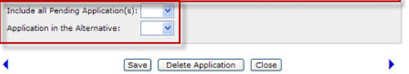
Project Application – Amendment – Expansion (Continued)
Include all Pending Application(s)
Selecting "Yes" will display the pending application information in the following screens; ERBC Approvals, Lands, Wells,
Recovery Methods, Oil Sands Products, Facilities.
As well, the Project Ownership and Operator fields will be updated based on the latest pending application
Application in the Alternative
Selecting "Yes" allows the Department to consider the application as a New Project in the event it is not approved as an expansion. The original receipt date of the application for expansion is retained and will be used to establish the effective date of the new project. Selecting "No" only allows the Department to deny or approve the application without consideration towards a new stand-alone project.

Slide 12
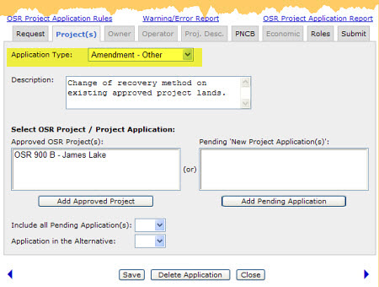
Project Application - Amendment - Other
If the application is an amendment to an existing or pending OSR Project but is not a project expansion, select Amendment – Other from the Application Type dropdown list.
A Description text box is provided. A brief description of the amendment is required.
The remainder of the application process for ‘Project Amendment – Other’ is the same as for
‘Project Amendment – Expansion’.

Slide 13
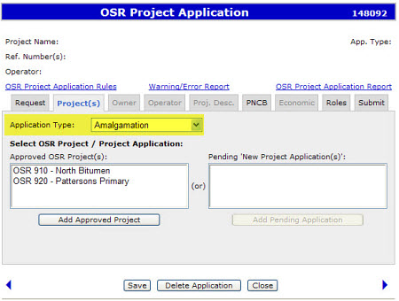
Project Application - Amalgamation
To merge two approved OSR Projects, select Amalgamation from the Application Type dropdown list.
Only approved projects that have no pending applications will be available for selection. Two or more Approved OSR Projects must be selected to amalgamate into one new OSR Project. Tip: If the selected projects are more than 50km apart, a warning message is displayed on the screen.

Slide 14
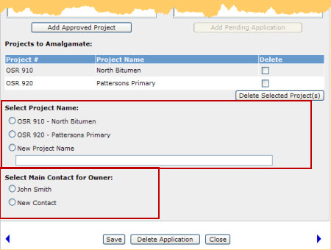
Project Application - Amalgamation (Continued)
You may select an existing project name for the amalgamated Project Application or create a new project name that is unique to the project owner. An existing contact may be selected or a new contact may be provided. The choice made on this page will be used to populate the Owner tab.
Note: if a new contact is provided the contact information is required on the Owner Tab.
On clicking the “Save” button at the bottom of the screen, the “Project(s)” tab is locked down.

Slide 15
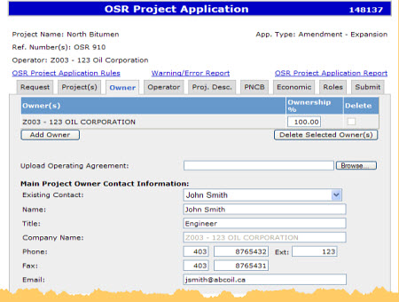
Owner Tab
For OSR Project Amendments, the Owner and Contact information is automatically updated based on the owners recorded in OASIS.
For OSR Project Amalgamations, the Owner and Contact information is automatically updated based on the choice made under the Project(s) tab.
The Owner recorded on the first line is considered to be the Primary Owner. Additional Owners can be added, and the ownership percentage adjusted.
An Operating Agreement may be required if there is more than one owner, or the Primary Owner is different than the Operator.
The Project Owner Contact may be changed. Choose from the dropdown menu provided for Existing Contact; includes the choice of ‘New’. .

Slide 16
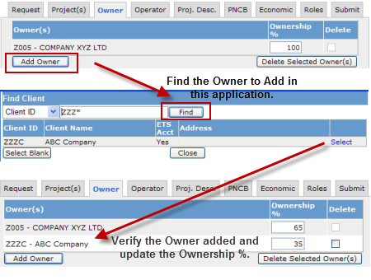
Owner Tab – Add Owner
If there are multiple owners for the project application, they need to be added.
Select the ‘Add Owner’ function and search by either company name or Client ID.
To find a company by name, enter the first four characters of that company and select ‘Find’.
To find a company by Client ID, change the first field from Client Name to Client ID, enter the four digit BA ID for that company and select Find.
A search will be made to match the search entry. Locate the company you want added to the Owner List and choose ‘Select’ (located beside the company name)
The Owner list will be updated. The corresponding Ownership % must also be updated. The total ownership % must always equal 100%.
Choose Save after changes have been made.

Slide 17
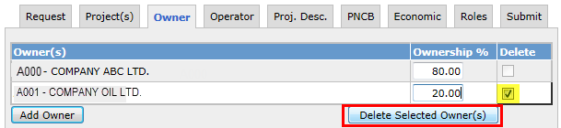

Owner Tab – Delete Owner
If an owner needs to be removed, the ‘Delete’ box is used.
To remove one or more of the owners, click on the ‘Delete’ box and select the ‘Delete Selected Owner(s)’ button.
The corresponding Ownership % must also be updated. The total ownership % must always equal 100%.
Choose Save after changes have been made.
The company on the first line is considered the Primary Owner; this record cannot be deleted. A request to change the project ownership needs to be submitted to the department.

Slide 18
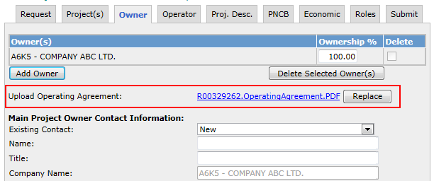
Owner Tab - Operating Agreement
An Operating Agreement is required when:
There is more than one owner on an OSR Project Application
The Owner is different from the Operator
Operating Agreement documents can be submitted in Microsoft Word (.doc) and Adobe PDF (.PDF) formats.

Slide 19
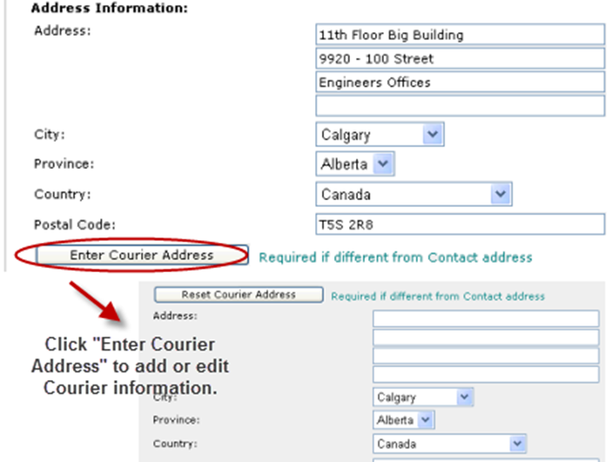
Owner Tab – Project Owner Contact and Courier Address
Update the Project Owner Contact address information if there are any changes.
Complete the Courier address only when it is different from the Contact address. The ‘Enter Courier Address’ button is available to access the Courier Address fields.
The following information is required:
Address
City
Province
Country
Postal Code
Note: If the Operator and Contact is the same as the Owner Tab, choose the option “Operator same as owner”.

Slide 20
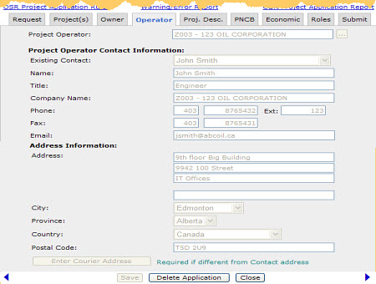
Operator Tab – Same as Owner
If the option “Operator same as owner” is selected on the Owner tab, this information will be not be editable.
To make changes on this screen, return back to the Owner tab and deselect the ‘Operator same as owner’.

Slide 21
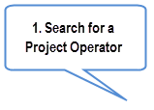

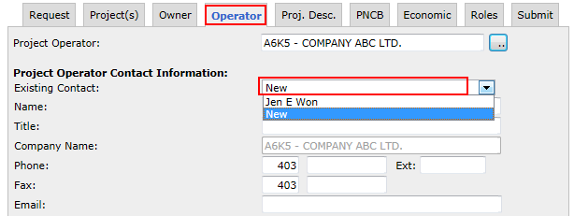
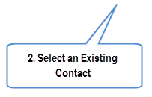

Operator Tab - Update
This screen allows you to change the Project Operator Contact Information for amendments or amalgamations. For Amalgamation, if the operator BA Id's for all projects are the same, the screen defaults to that operator information. If the operators are different, the relevant data must be entered.
To update the Project Operator, search by company name or Client ID, and select.
Recorded contacts for the company selected are provided in the Existing Contact dropdown menu. If not available, the default will be ‘New’.
Ensure the contact and address fields are updated; including an email address.
Project Operator Contact Information fields are enabled for update only if the "Operator same as owner" checkbox is not selected on the Owner screen.

Slide 22
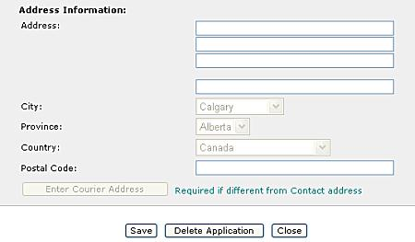
Operator Tab - Address Information
The following fields are mandatory for Operator Address Information:
Address: Address text (maximum 255 characters)
Postal code: Postal Code (maximum 12 characters)
City
Province

Slide 23
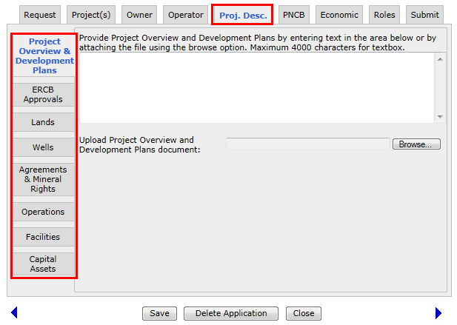
Project Description Tab
The Project Description tab shows a series of items displayed in a column on the left hand side of the screen. Clicking on each item displays a new screen which must be filled out. These are described in the following slides.
Project Overview and Development Plans
ERCB Approvals
Lands
Wells
Agreements and Mineral Rights
Operations
Facilities
Capital Assets

Slide 24
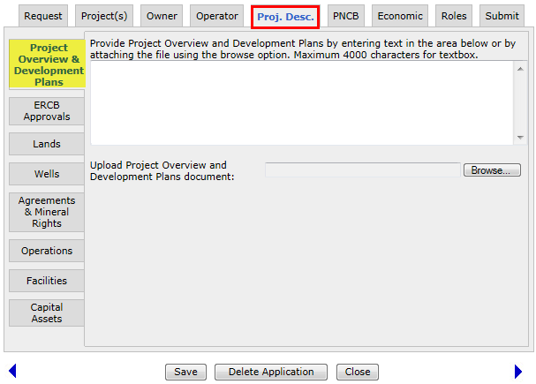
Project Description Tab - Project Overview & Development Plans
The Project Overview and Development Plans should contain the following information:
Summary of project’s history and developing plans
Description of lands and facilities included within the
proposed project
Dates when lands and leases were acquired
Locations of the first wells on project site and dates they were drilled
Annual Production to date and other relevant details
Future development plans for Project
Reservoir Properties information
Provide description of the Project Overview
Or upload the .txt, .doc, or .pdf
Project Overview and Development Plans can be provided by entering text (maximum of 4000 characters) or uploading the document ( Word, Text, or PDF are acceptable).

Slide 25
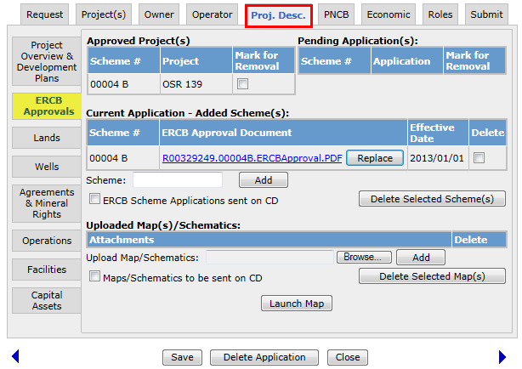

Project Description Tab - ERCB Approvals
The ERCB Approvals screen is used to manage schemes in the Approved Project(s), Pending Applications and those added/deleted from the Current Application.
For OSR Project Amendments: where lands or wells will be added, the latest ERCB Scheme(s) must be added. Application lands will be determined based on the availability of lands in the added Scheme(s). For OSR Project Amalgamations: the scheme(s) listed under the Approved Project(s) will be used to determine the Current Application lands.
Launch Map - Opens an interactive Map of the current Application. Edits to lands are made within this feature. The online map may be printed or exported.
If the latest ERCB approval is granted in the same month in which the application is created and submitted, the effective date of the application will be the first day of the following month.

Slide 26
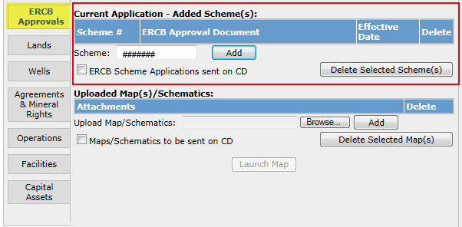
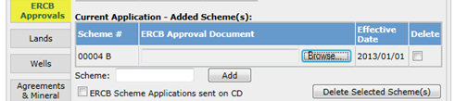
Project Description Tab - ERCB Approvals – Add Scheme
ERCB Schemes in the application can be added under Current Application – Added Scheme(s).
Enter the latest ERCB approval number, and select Add.
If the entry is the latest ERCB approval, the Scheme entry will be recorded.
If the entry is not the latest, the system will replace the entry with the latest approval stored in OASIS; select Add again to store the record.
Updates to information on the ERCB Approval tab must be saved; otherwise they are not applied.
2. Click on Add
1. Enter Scheme
3. Record is stored
Application lands will be defaulted to those lands which are in the added Scheme(s) Development Area, and are not 100% freehold, or already in an OSR Project, or Pending Application.

Slide 27

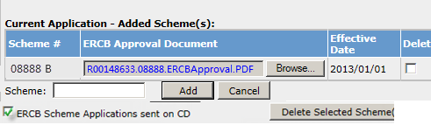
Project Description Tab - ERCB Approvals - Add Scheme (Continued)
1. Upload the Approval Document
Attachment of all added scheme approvals is required.
To attach a file, select the Browse option, select the file you want to attach. Save must be selected to store the file in the application.
Acknowledgment that you will send in the scheme applications to the Department on CD is required.
2. Check to acknowledge ERCB Scheme Application will be sent on CD
The file name will be replaced with a generic file name which includes the application request number along with the text ‘ERCBApproval’.

Slide 28
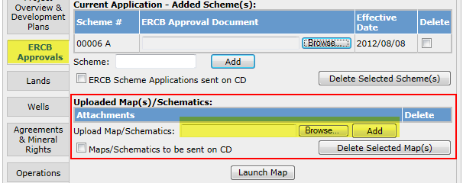
Project Description Tab - ERCB Approvals – Add Scheme (Continued)
If additional maps or schematics are to be included, select the checkbox to indicate this or attach files using the upload field.
1. Browse to search for the document and then click Add
2. Check this box if map information will be sent on CD

Slide 29
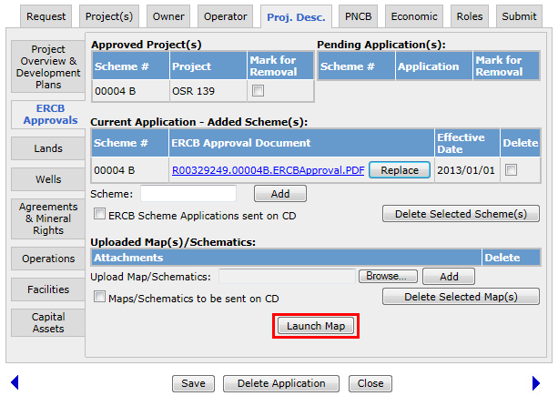
Project Description Tab - ERCB Approvals - Launch Map
At the bottom of the ERCB Approvals screen there is a Launch Map button. The Launch Map button will open the GeoView mapping tool allowing the user to add or remove land to show what is being applied for in this application. GeoView will display a graphical representation of the lands in the Approved Project(s), Pending Applications and Current Application. Use GeoView to edit lands included to show the land added or removed in this current OSR Project Application.
The following slides are a walkthrough on how to edit lands in GeoView.
Launch Map (Edit) is only available to the user who represents the Primary Owner, and has the role of Creator or Delegate. Delegate must be assigned to the application to conduct edits.

Slide 30
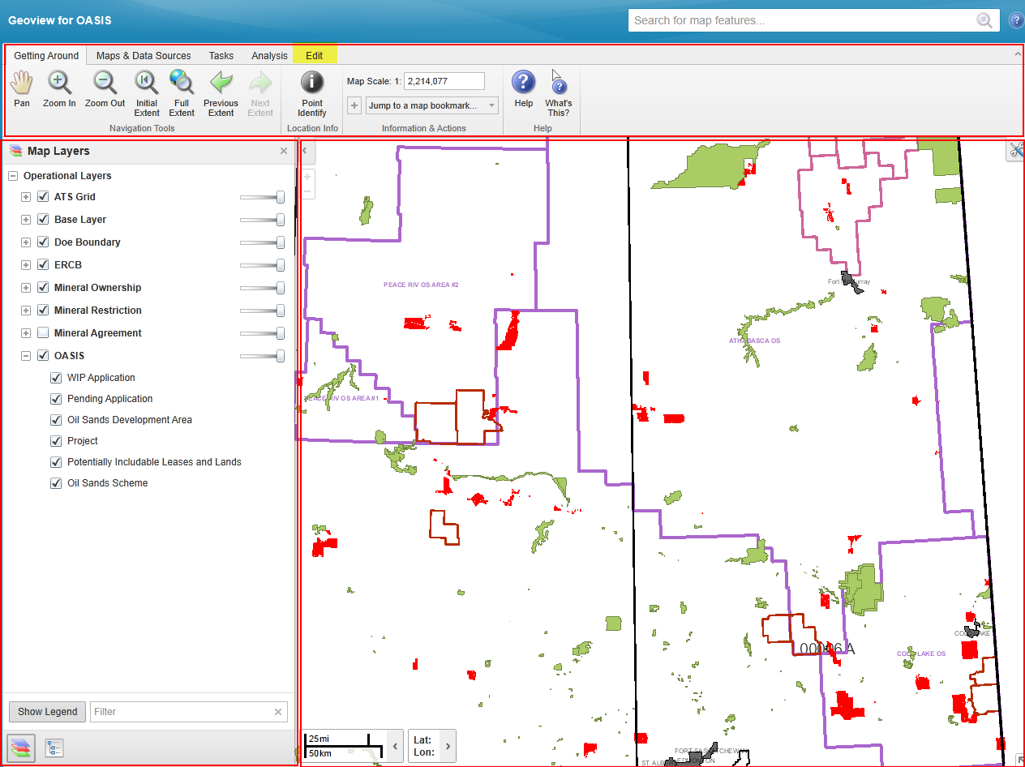
GeoView - Screen Layout
The GeoView screen display has three main sections:
Toolbar Area
Information Panel
Map Window
The Toolbar Area contains numerous tools that are used to move around the map, find or search information on the map, print the map, etc. These tools are categorized into high-level groups: Getting Around, Maps and Data Sources, Tasks and Analysis.
The Information Panel shows different kinds of information when you interact with the map. For example, this panel displays the Map Layers where you can select different layers to hide or show on the map.
The Map View shows the map window where you can interact with the map by zooming, panning, annotating or right-clicking to get more information.
1. Toolbar Area
2. Information Panel
3. Map View

Slide 31
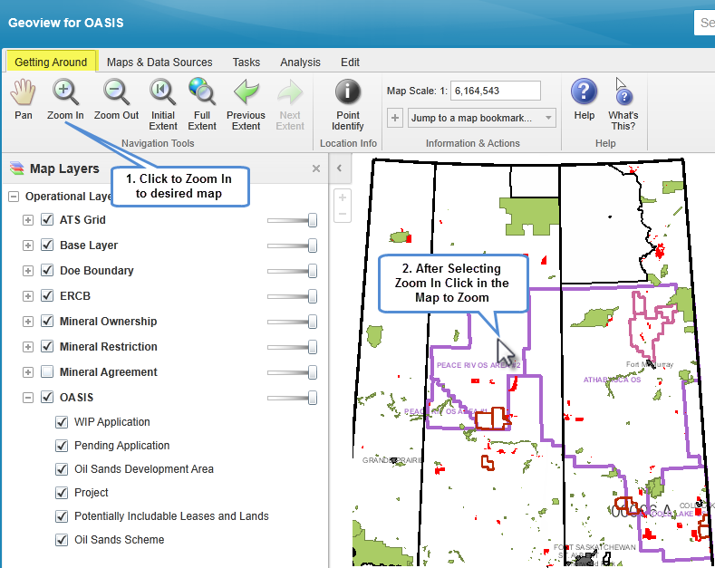
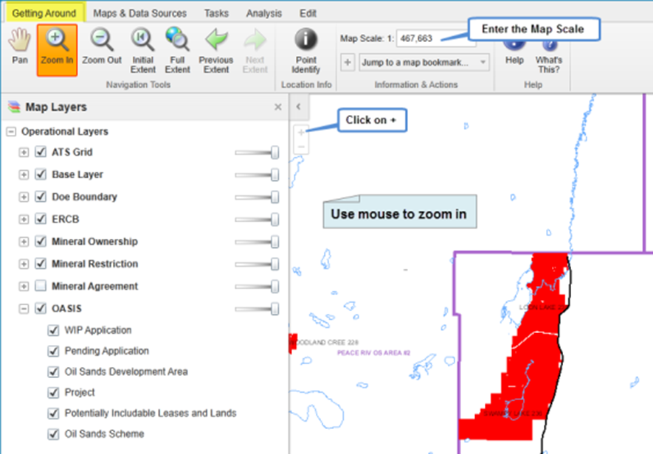
GeoView - Getting Around - Zoom In

Slide 32
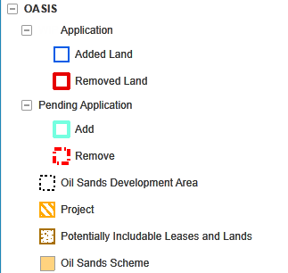
GeoView – Map Contents - Application Layer
The Map Contents panel will display layers specific to an OSR Project Application. This is useful as a legend to show what the various line colours and shading represent on the map. The layers can be turned on and off to see only what is required. Application– displays those land changes to be applied under the Current Application.
Added Land - lands to be added to Current Application.
Removed Land - lands to be removed, which are currently in the existing OSR Project, New Pending Project or Pending Application.
Pending Application– displays those lands requested under a prior submitted application on the same project.
Project– displays the existing OSR Project.
Potentially Includable Leases and Lands – displays those lands approved as PILL lands under the existing OSR Project.
Oil Sands Scheme – displays the ERCB Scheme lands
Oil Sands Development Area – displays the ERCB Scheme Development Area.

Slide 33
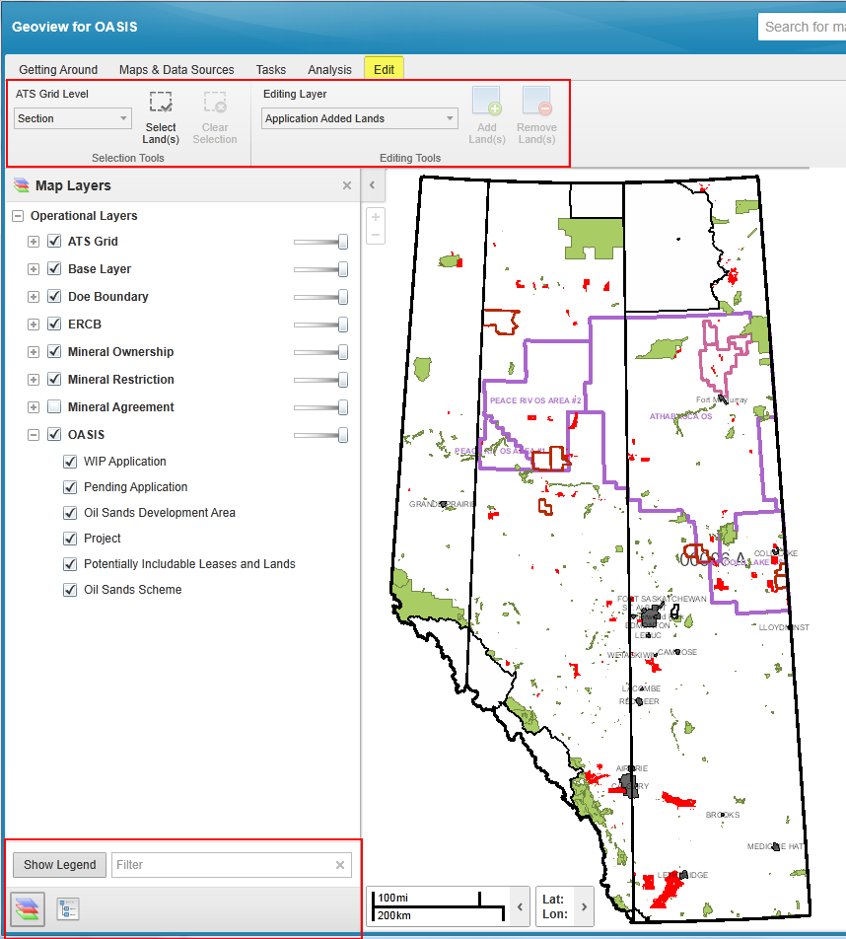
GeoView – Editing for OASIS
The GeoView map is edited by the user to show what changes are being applied for in this application. The changes made here are reflected in OASIS when the application is submitted.
GeoView edit tools are available only if:
Application has Project Lands, Potentially Includable lands & Leases (PILL), or available lands via the added Scheme.
User represents the Primary Owner, and
c) User is the Creator, or assigned Creator/Delegate.
LEFT Panel can display:
List of Map Layers or Legend
- Map Layers (Layer Display controls), or
- Show Legend: (Color/Patterns)
Lands Selected (via Edit)
Land Key Results (Application Lands)
Results of queries *
Results of land selection *
* For more information on GeoView, see GeoView Overview Module.

Slide 34
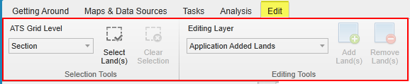
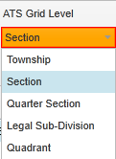


GeoView – Toolbar - Edit Tab
Use these tools: | To:
 | Defines at which level the lands can be selected. Eg. Section, ¼ section, LSD, or quadrant.
 | Select/Unselect lands: When option is selected, a mouse click or click and drag will either select or unselect lands. (1st click is to select, 2nd click on the same lands is to unselect).
 | Current selected lands are cleared.

Slide 35



GeoView – Toolbar - Edit Tab (Continued)
Use these tools: | To:
 | Editing Layer: Application Added Lands is used to modify the Current Application (added lands). Editing Layer: Application Removed Lands is used to modify the existing Approved Project or Approved Project (PILL) lands.
 | Add Selected lands to Editing Layer
 | Remove Selected lands from Editing Layer

Slide 36
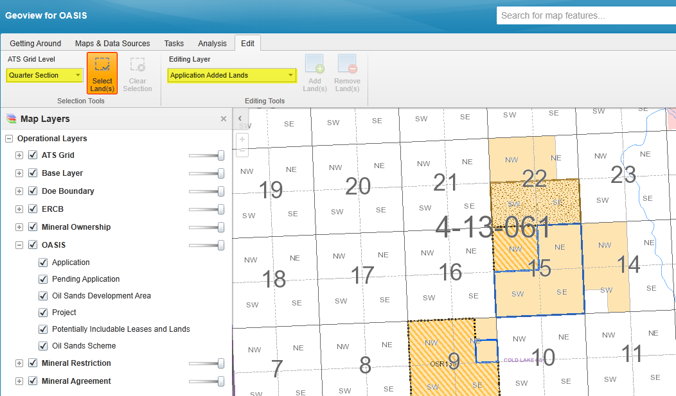
GeoView – Removing lands from the Current Application (Added Lands) record
Steps:
1. Select ATS Grid Level (e.g. Quarter Section)
2. Click Select Land(s)
3. Select appropriate Editing Layer (e.g. Application Added Land(s).
4. Click on the map to select the Land(s)
1. Select ATS Grid Level
2. Click Select Land(s)
3. Select Editing Layer
4. Click on map to select land

Slide 37
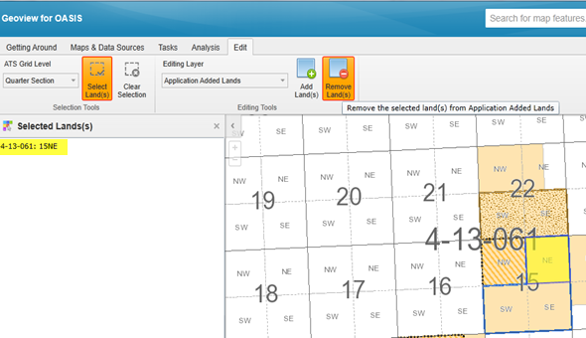
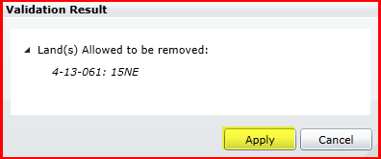
GeoView – Removing lands from… (Continued)
Selected Land(s) panel displays the lands selected and the map boundary is highlighted.
5. Click on Remove Land(s).
The validation result/ message is displayed.
Land(s) Allowed to be removed will be identified. Lands not allowed will have an error message.
Click on Apply to finalize.
Or
Click on Cancel to abandon action, and return to edit session.
5. Click on Remove Land(s)
6. Click on Apply

Slide 38
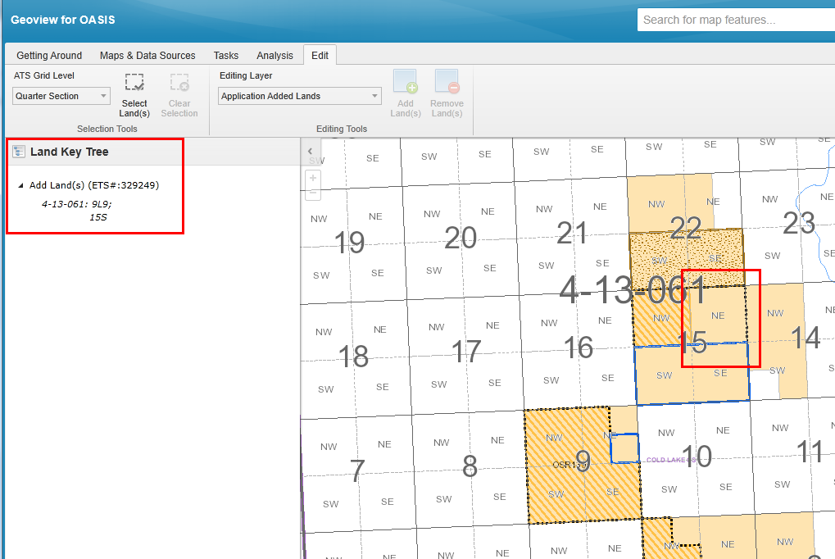
GeoView – Removing lands from… (Continued)
Choosing ‘Apply’ updates the Land Key Tree and Map Boundary; the land is no longer listed under the Add Land(s) heading.

Slide 39
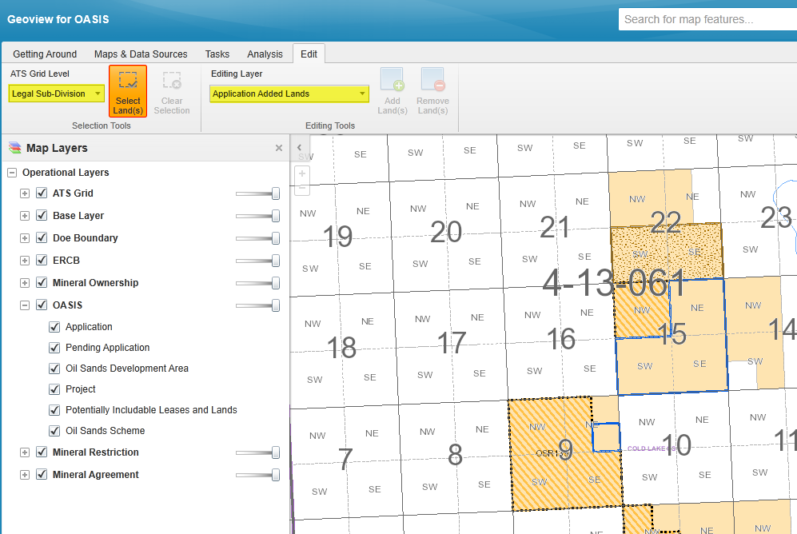
GeoView – Adding more lands to the Current Application (Added Lands) record
Steps:
1. Select ATS Grid Level (e.g. Legal Sub-Division)
2. Click Select Land(s)
3. Select appropriate Editing Layer (e.g. Application Added Land(s).
4. Click on the map to select the Land(s)
1. Select ATS Grid Level
2. Click Select Land(s)
3. Select Editing Layer
4. Click on map to select land

Slide 40
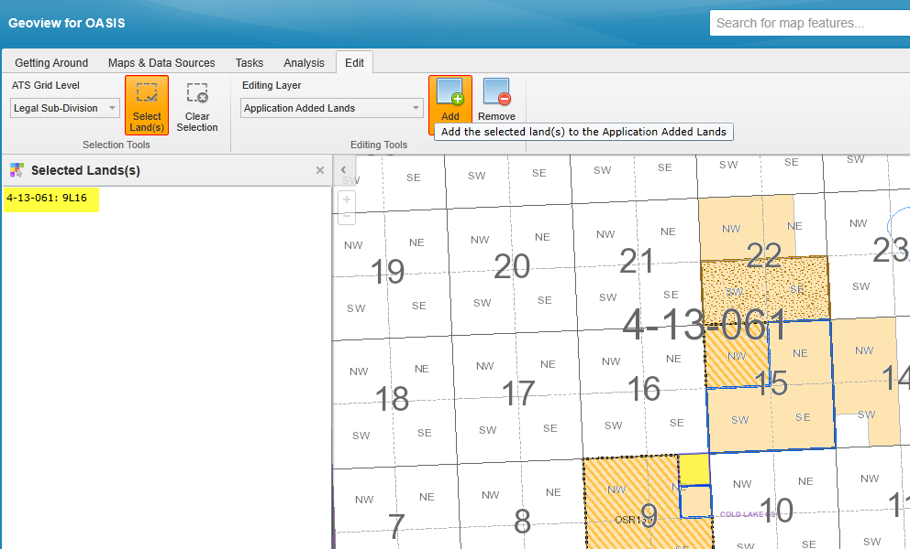
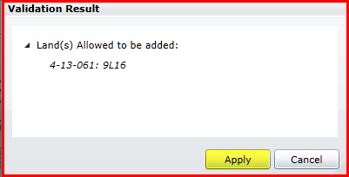
GeoView - Adding more lands to …(Continued)
Selected Land(s) panel displays the lands selected and the map boundary is highlighted.
5. Click on Add Land(s).
The validation result/ message is displayed.
Land(s) Allowed to be added will be identified. Lands not allowed will have an error message.
Click on Apply to finalize.
Or
Click on Cancel to abandon action, and return to edit session.
5. Click on Add Land(s)
6. Click on Apply

Slide 41
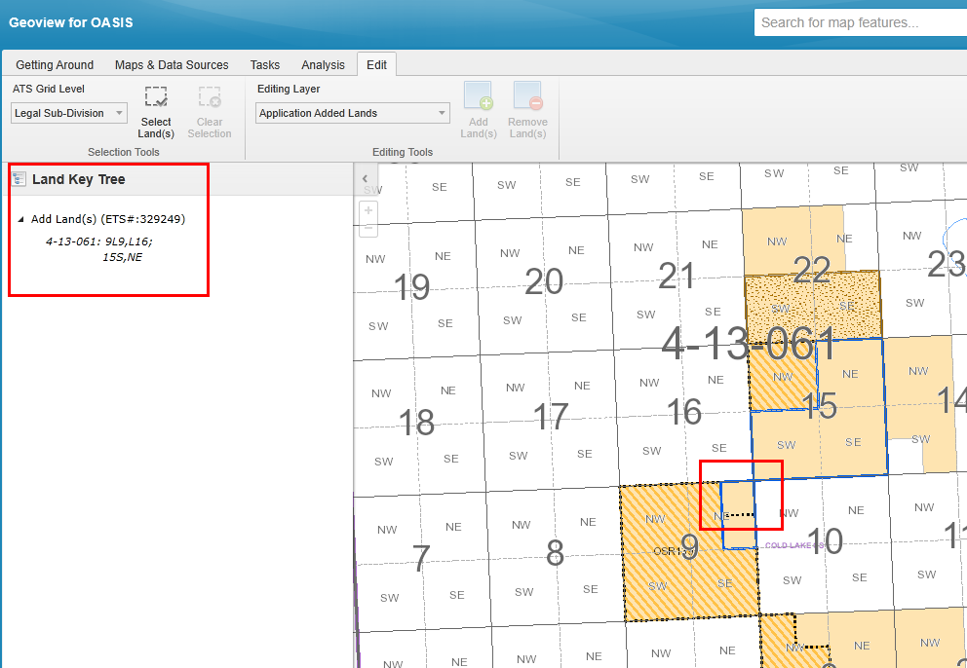
GeoView – Adding more lands to…(Continued)
Choosing ‘Apply’ updates the Land Key Tree and Map Boundary; the land added is listed under the Add Land(s) heading.

Slide 42
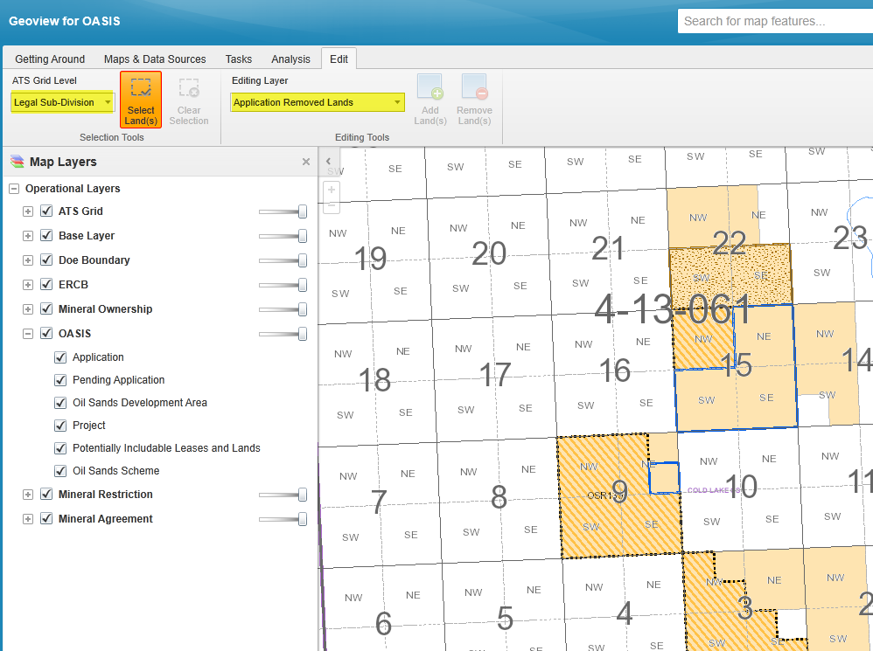
GeoView - Removing lands from the Approve Project / Project(PILL) lands
Approved Project or Approved Project (PILL) lands – may be marked for removal by adding lands to the Edit Layer ‘Application Removed Lands’.
Steps:
1. Select ATS Grid Level (e.g. Legal Sub-Division)
2. Click Select Land(s)
3. Select appropriate Editing Layer (e.g. Application Removed Land(s).
4. Click on the map to select the Land(s)
1. Select ATS Grid Level
2. Click Select Land(s)
3. Select Editing Layer
4. Click on map to select land

Slide 43
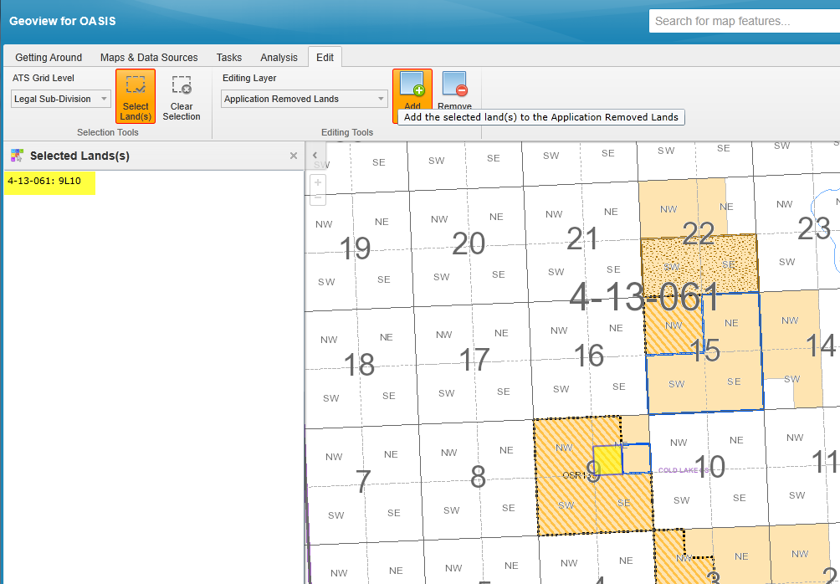
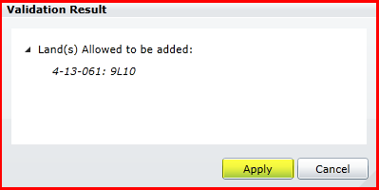
GeoView - Removing lands from the Approve … (Continued)
Selected Land(s) panel displays the lands selected and the map boundary is highlighted.
5. Click on Add Land(s).
The validation result/ message is displayed.
Land(s) Allowed to be added to the Remove Lands record will be identified. Lands not allowed will have an error message.
Click on Apply to finalize.
Or
Click on Cancel to abandon action, and return to edit session.
5. Click on Add Land(s)
6. Click on Apply

Slide 44
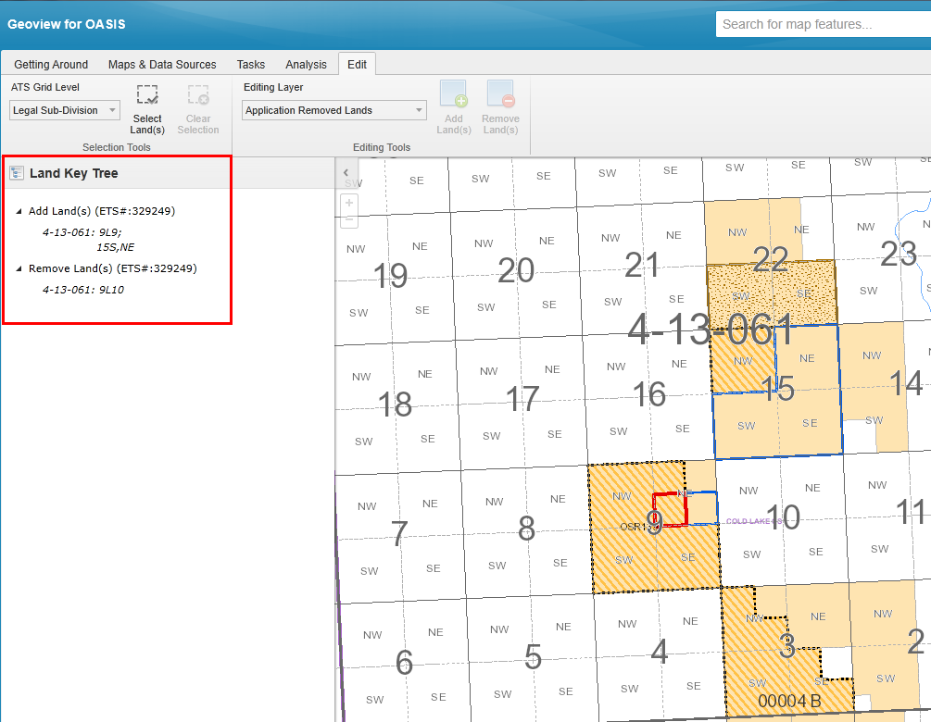
GeoView - Removing lands from the Approve…(Continued)
Choosing ‘Apply’ updates the Land Key Tree and Map Boundary; the land is listed under the Remove Land(s) heading.

Slide 45
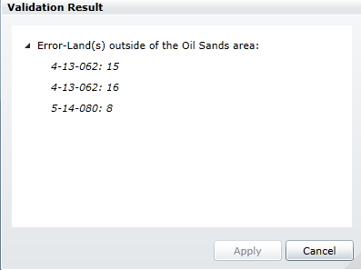
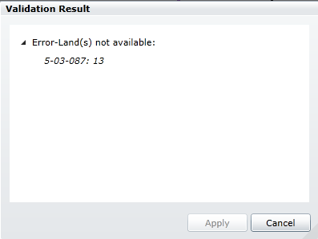

GeoView - Validation Results Errors
While editing, if an action is performed which is contrary to the Business Rules allowing the action, a warning window will appear. Here are some examples:
If the error returned is unexpected contact the Oil Sands Business Unit

Slide 46

GeoView - Closing the Map
Click to Close the map and to return to the ETS screen

Slide 47

Project Description Tab - Lands
The Land tab provides those lands which are recorded for the existing Approved Project, Approved Project PILL, and Pending Application.
The Current Application lands are initially defaulted based on the added Schemes, and will adjust as edits are made via the map (GeoView).

Slide 48

Project Description Tab - Wells
The Well tab provides a link to the Well Report (via hyperlinked text).
The Well Report will list potentially eligible wells. These wells must reside entirely within the application lands and are supported by the added Schemes; excludes wells on lands which are outside the Scheme Development Area lands.
The Current Application – Additional Well(s) can be used to add specific wells other than the ones that have already been displayed in the well report.
Observation & Delineation wells are not typically listed. Consult with Oil Sands Engineer if these are desired for the application.

Slide 49

Project Description Tab - Agreements & Mineral Rights
The Agreement tab will display Agreement Numbers associated with Application Land(s) added under the Current Application.
Warning messages will be displayed if the Lease Participants differ from the Project Owners or if there are currently no Oil Sands leases held for the selected lands.

Slide 50

Project Description Tab - Operations
The Operations tab displays the recovery methods for Approved OSR Project(s), Pending Application(s) and the Current Application based on the associated schemes. The system populates all OS products associated with the selected projects. The product list can be changed with an amendment application.
Product(s) must have at minimum ‘Clean Crude Bitumen’ added. Selections may be made from the product list provided.
After making changes, select Save.

Slide 51

Project Description Tab - Facilities
The Facilities tab displays facilities associated with Approved OSR Project(s), Pending Application(s), and the Current Application. Facilities can be removed from the Project by selecting Mark For Removal. Facilities can be added by entering the unique Facility Code, Function, and the Project's Equity Share. Provide a Pseudo Facility Code (AB XX 9999999) and location for any facilities which have not received the ERCB Facility Code at the time of the application but is included in the project.

Slide 52

Project Description Tab - Capital Assets
The Capital Assets tab provides a text box, or upload document function.
Allowed attachment types are: Word, Text and PDF.
Capital Assets must contain the following information:
Asset
Location
Function
Usage (%)

Slide 53



PNCB Tab
PNCB (Prior net cumulate Balance) is the net difference between the cumulative costs (capital and operating costs) and cumulative revenue for the eligible period prior to the effective date of the project.
If PNCB Data is not required, select Not Applicable.
If PNCB data is being provided, upload the completed PNCB excel sheet. Choose ‘Load’ after the file has been selected.
(extensions allowed; *.xls or *.xlsx).
PNCB Supporting Data needs to be provided if there is a submitted PNCB Data file.
( This data can be uploaded or sent to the Department on a CD.)
Updates need to be saved.
Use the DOE PNCB Excel template located on the Alberta Energy Website.

Slide 54
PNCB Tab (Continued)
An uploaded document may be replaced by selecting ‘Replace’ and repeating the steps for uploading the file.
After uploading the file and saving, a report can be generated by clicking on the hyperlink text; top right of screen.

Slide 55


Economic Tab
The Economic tab is used to report Economic Evaluation data.
If Economic Evaluation Data is not required, select Not Applicable.
If Economic Evaluation Data data is being provided, upload the completed Economic Evaluation excel sheet.
(extensions allowed; *.xls or *.xlsx).
An uploaded document may be replaced by selecting ‘Replace’ and repeating the steps for uploading the file.
After uploading the file and saving, a report can be generated by clicking on the hyperlink text; top right of screen.
Use the DOE Economic Evaluation Excel template located on the Alberta Energy Website.

Slide 56

Roles Tab
The Roles tab allows the application to be accessed by other OSR Application users who are not the Creator of the Current Application.
Roles allowed are: Creator(s), Viewer(s), Submitter(s) and Delegate(s). The fields will be populated from the User's Preferences if preferences have been filled out as shown in OASIS Roles training course. Note: At least one Submitter must be entered for the Application to be submitted.
For more information on Roles, see OASIS Roles Module.

Slide 57

Submit Tab
The Submit button will only be enabled for those added as a Submitter under the Roles Tab. The submitter can validate that all pertinent information has been captured by viewing the OSR Application Report. Prior to submitting, a description or specific instructions may be provided in the text box provided.
A Signed Authorization Form (PDF format) must be uploaded.

Slide 58



Submit Tab - Confirmation
Upon submitting, the application will be validated to ensure all the mandatory fields have been completed.
If the validation encounters any warnings, a message will be provided. The submitter can cancel the submit operation, or continue.
Upon a successful submission, a confirmation message will appear. This is the only confirmation that will be transmitted.
The Work In Progress screen may be accessed to access files generated by the system; Application Report, Warning, Well, PNCB, Economic Evaluation.

Slide 59

Report Links
There are three hyperlink options above the application tabs. They can be accessed any time during the application process. The links are described below:
OSR Project Application Rules:
This report identifies the components of the application which are required before submission.
Warning/Error Report:
This report Identifies any mandatory fields which are not yet populated, as well as information which are not mandatory but are contrary to standard practises i.e. lands selected are 50 km apart.
OSR Project Application Report:
A summary of the Current Application content, which includes the contents of each tab in the Current Application.
For more information on reports, see Generate OSR Project Application Reports Module.

Slide 60

Conclusion
Congratulations!
You have completed the OASIS Create an Amendment OSR Application
Online Training Course
Please proceed to the subsequent courses detailing other functionality of the OASIS application.
If you have any comments or questions on this training course,
please forward them to the following email address:
OSODmailbox@gov.ab.ca
Also see the related courses:
Create New OSR Application
OASIS Roles

