Slide 1
Welcome
Welcome!
The Work in Progress screen enables the user to search for, view or open for editing applications not yet submitted, and view applications and its reports that have been submitted.
The screen displays all In Progress, Completed, and Cancelled Applications assigned to the logged in user.
To the OASIS Work in Progress
Online Training Course

Slide 2
Revisions
Date | Revisions Type | Page Number
September 31, 2012 | Conversion | All

Slide 3

Introduction
In this module, you will learn how to:
Access the Work in Progress (WIP) screen
Retrieve OSR Project applications from the Work in Progress screen
Prerequisite Learning Modules
We recommend that you view the following modules before proceeding:
Create New OSR Application
Create an Amendment OSR Application

Slide 4
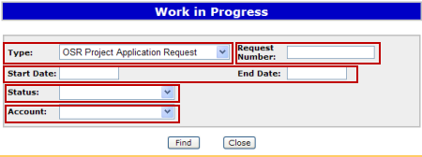
Accessing the WIP Screen
More Information (Pages 5 and 6)
The Work in Progress (WIP) screen allows the user to retrieve, view, and open saved OSR applications associated with their User Id. They can only view or edit those applications for which they were assigned permissions via their ETS account.
The Find button retrieves the applications identified.
Click on More Information to view how to access the Work in Progress Screen.
Type - defaults to OSR Project Application Request.
Request Number – (if known) is provided in the email notification of a transaction, or on-screen when conducting a query.
Start and End Date - narrows the time frame during which the application was created. Dates defaulted depend on the Start and End dates in the preferences screen. These date fields can be left blank.
Status - reflects the status of a WIP transaction. It can be left blank to select all Requests created during the specified date range.
Account - has a dropdown list which will be available for Coordinators only and will default to users assigned to the Coordinator by the Site Administrator.

Slide 5
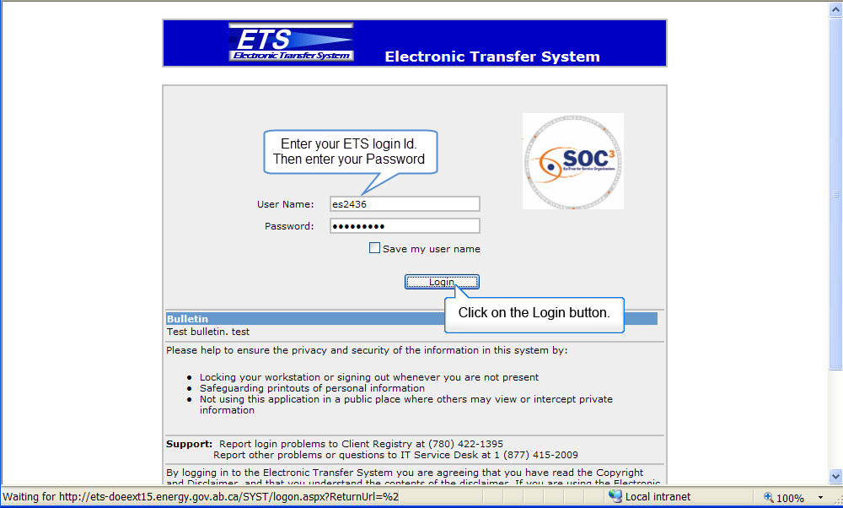
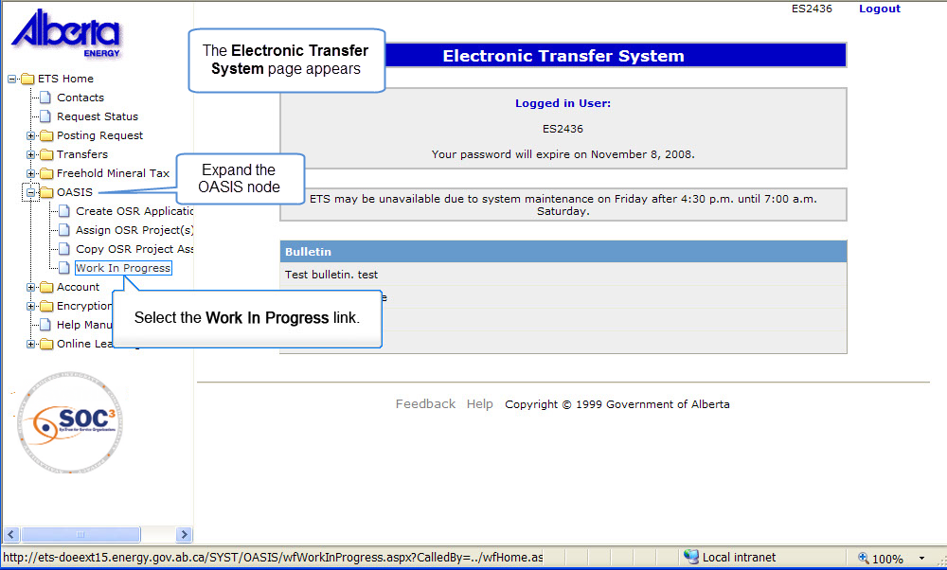
WIP1
Back to Accessing the WIP Screen

Slide 6
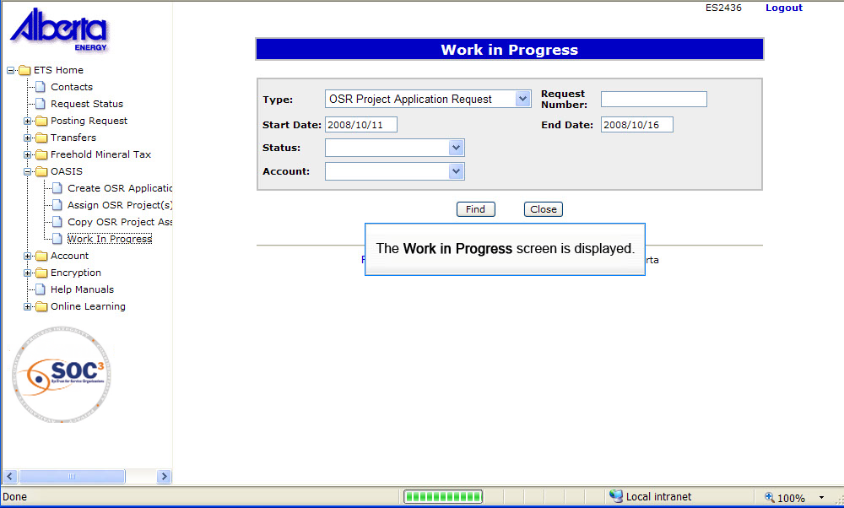
WIP2
Back to Accessing the WIP Screen

Slide 7
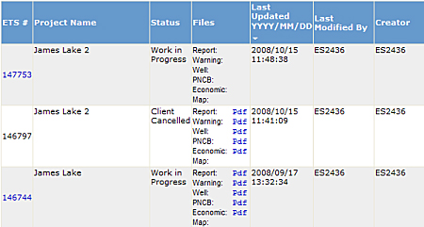
Review Search Results
More Information (Pages 8 to 13)
The Work in Progress screen provides active ETS Request links for the displayed applications that have a status of Work in Progress. Clicking on the active ETS Request links for a project application will allow you to view, edit or delete an application.
The Work in Progress screen will only display OSR Project Applications created or updated in the last 6 months.
You can also click on the active links to the Pdf reports displayed in the Files column. The reports must be generated before they can be accessed in this screen. Since all reports are generated upon submission, submitted applications will have all reports available.
Click on More Information to view how to retrieve an OSR Project application from the Work in Progress Screen.

Slide 8
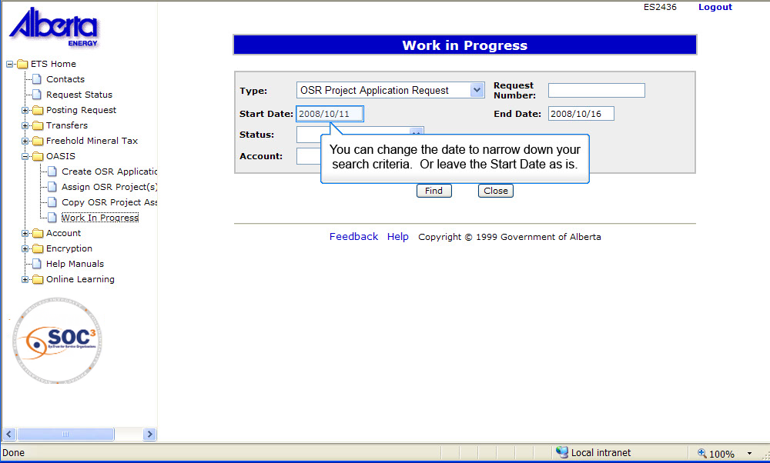
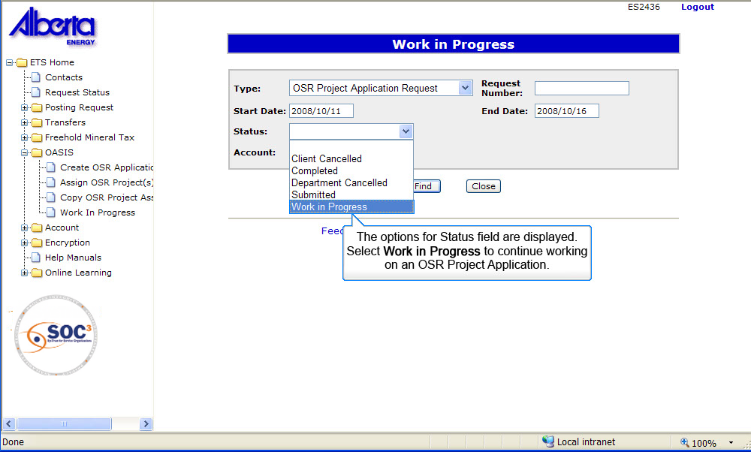
RSR1
Back to Review Search Results

Slide 9
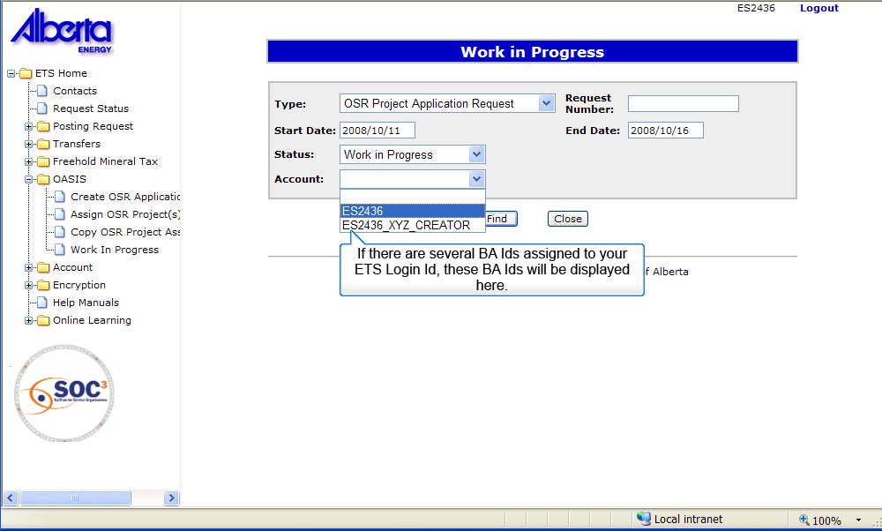
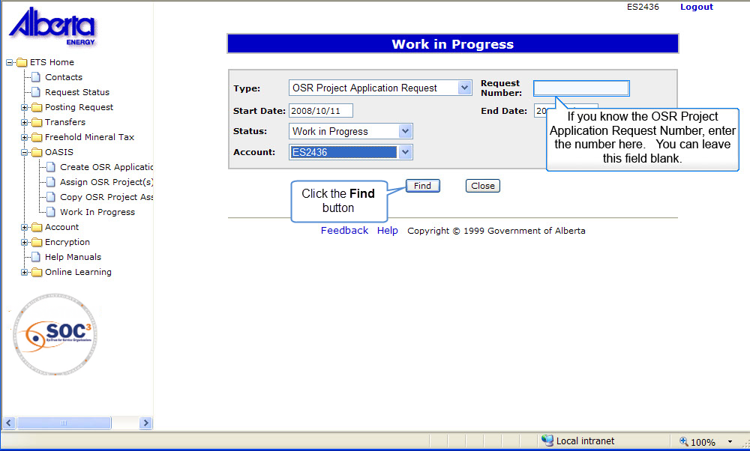
RSR2
Back to Review Search Results

Slide 10
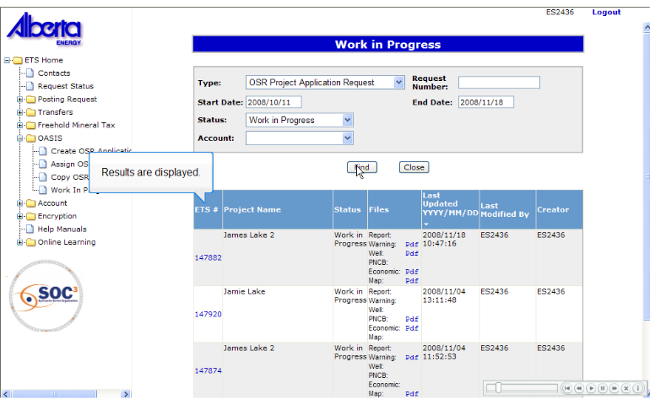
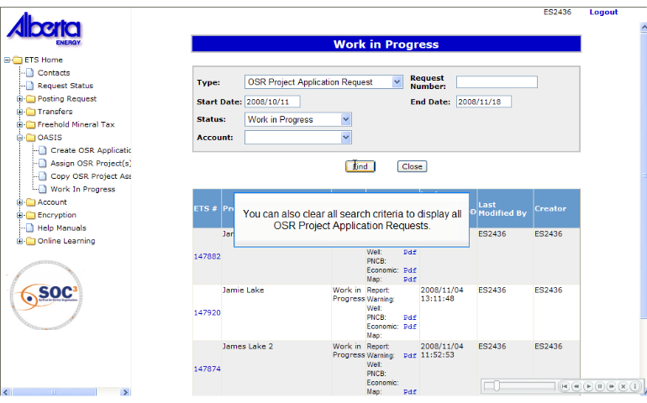
RSR3
Back to Review Search Results

Slide 11
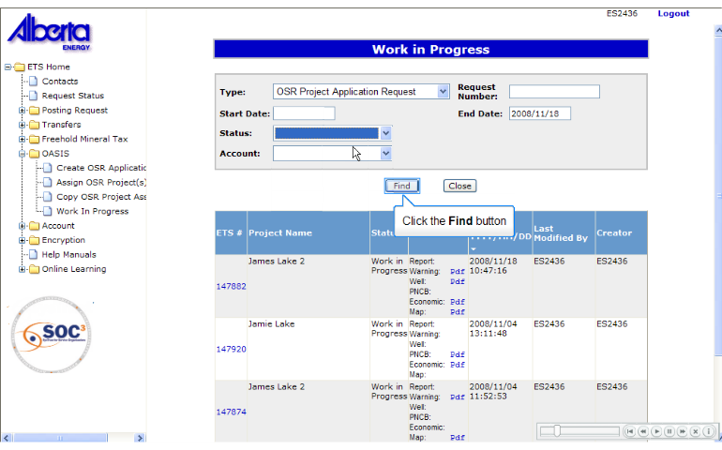
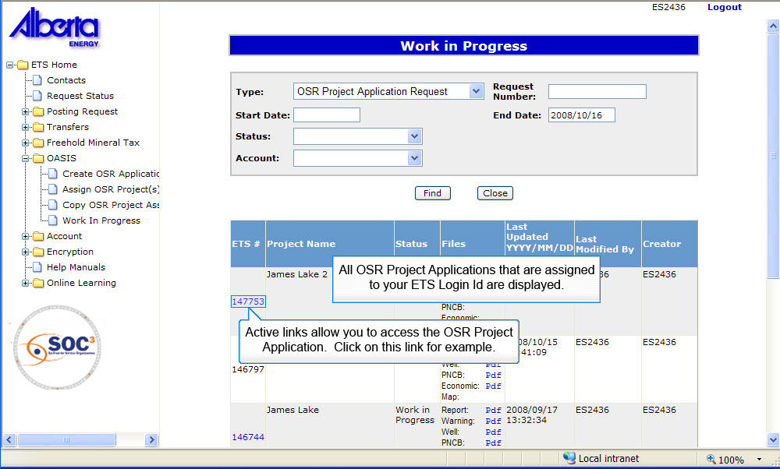
RSR4
Back to Review Search Results

Slide 12
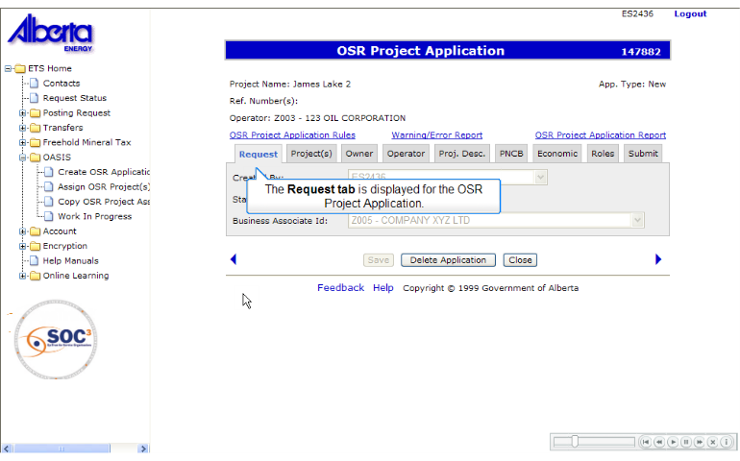
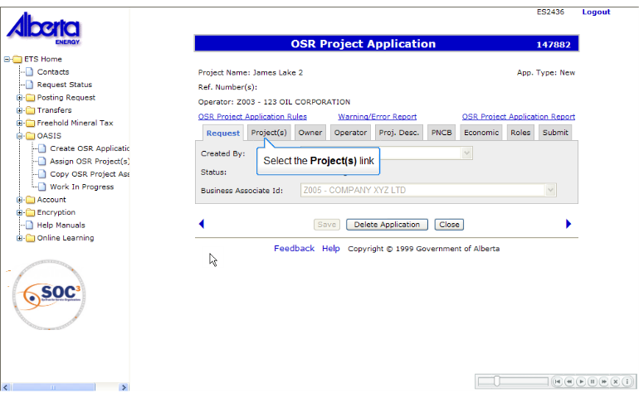
RSR5
Back to Review Search Results

Slide 13
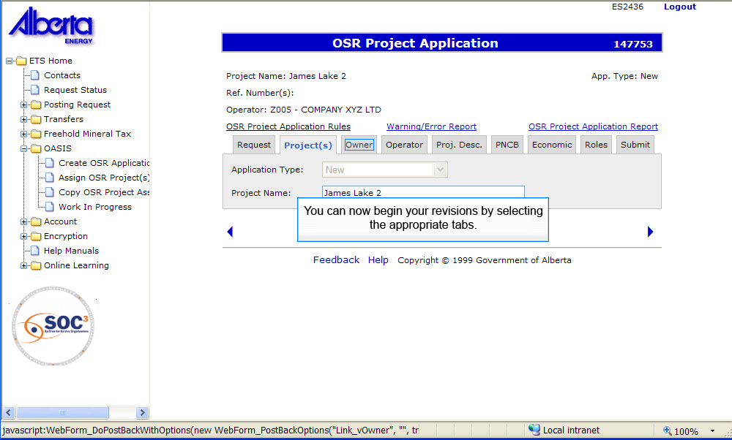
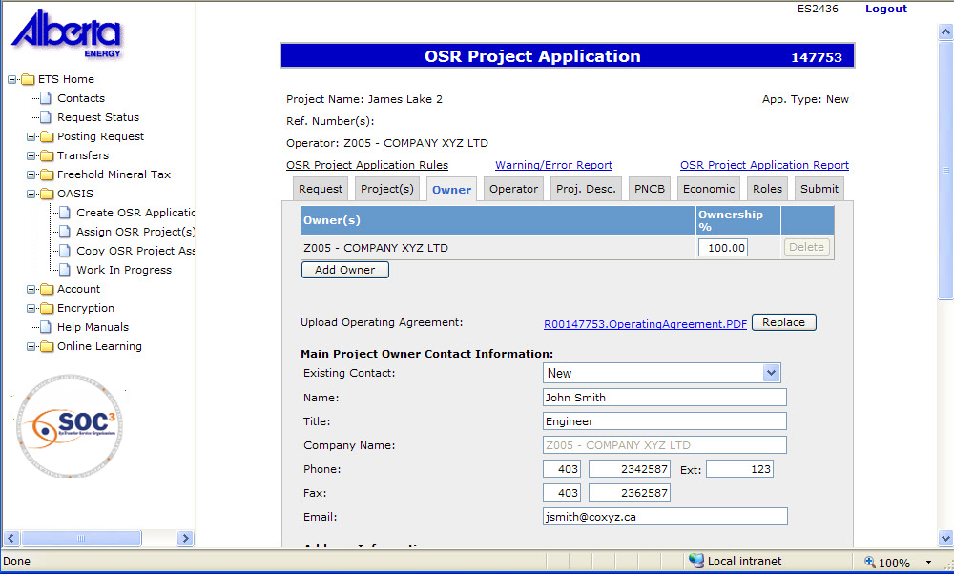
RSR6
Back to Review Search Results

Slide 14

Conclusion
Congratulations!
You have completed the OASIS Work in Progress
Online Training Course
Please proceed to the subsequent courses detailing other functionality of the OASIS application.
If you have any comments or questions on this training course,
please forward them to the following email address:
OSODmailbox@gov.ab.ca

