Slide 1
Welcome
Welcome!
Links to reports are available in the appropriate screens as soon as the data is saved successfully. After an application has been submitted, all reports are generated and available for up to six months from the time of submission in the Work in Progress screen. The following reports are available in OASIS in PDF format:
Application Report
Warning/Error Report
PNCB Report
Economic Evaluation Report
Well Report
GeoView Map Report
To the OASIS Generate OSR Project Application Reports Online Training Course

Slide 2
Revisions
Date | Revisions Type | Page Number
September 31, 2012 | Conversion | All

Slide 3
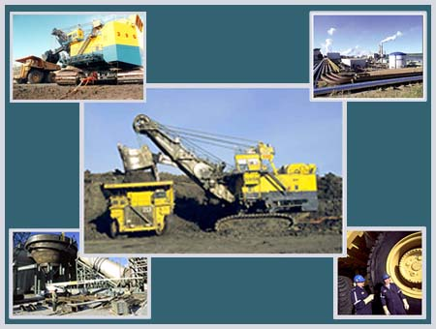
Introduction
In this module, you will learn:
How to generate and retrieve reports that are available in OASIS
OASIS Report description and parameters

Slide 4
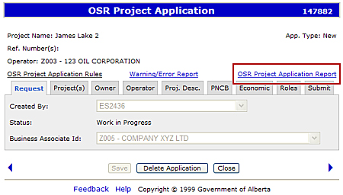
Application Report
Report Example
The OSR Project Application Report can be generated at any time and saved locally while the OSR Application is in progress. The report is also automatically generated when the application is submitted. Click on Report Example to view report.

Slide 5
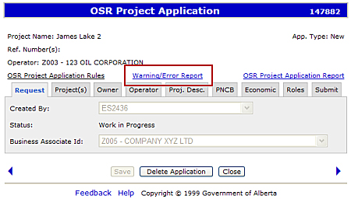
Warning/Error Report
Report Example
The Warning/Error Report displays all the warnings and errors related to the currently open OSR Project Application. The report can be generated at any time in PDF format and can also be saved locally. Note: Errors must be cleared before the application can be submitted, whereas, warnings will not stop submission. Click on Report Example to view report.

Slide 6
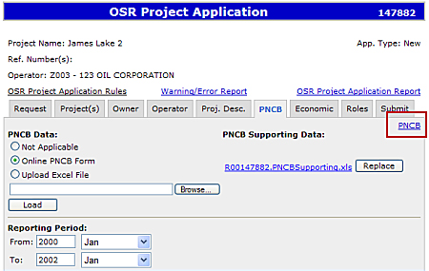
PNCB Report
Report Example
The PNCB Report shows the Operating Cost, Capital Cost and Revenue Details as well as the Total Costs Summary of the PNCB period. The report is retrieved from the last saved PNCB data. The report is in PDF format and can also be saved locally. Once generated, the report is available in the Work In Progress screen too. Click on Report Example to view report.

Slide 7
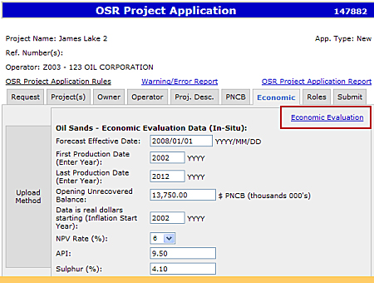
Economic Evaluation Report
Report Example
The Economic Evaluation Report shows the Economic data for each of the three data sheets: New/Existing; Amend; and Amended, if necessary. Report data is retrieved from the last saved Economic Evaluation data. The report can only be generated from the Economic Evaluation screens. The report is in PDF format and can also be saved locally. Once generated, the report is available in the Work in Progress screen too. Click on Report Example to view report.

Slide 8
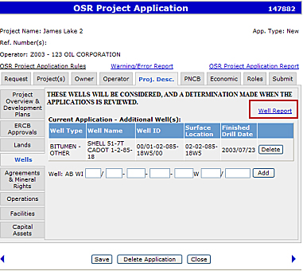
Well Report
Report Example
The Well Report provides all the wells associated with current application lands and any added explicit wells. The report can only be generated in the ‘Wells’ sub-tab of the ‘Project Description’ tab and once generated, is accessible from the Work in Progress screen. Report data is retrieved from OASIS based on Application Lands. The report is in PDF format and can also be saved locally. Click on Report Example to view report.

Slide 9
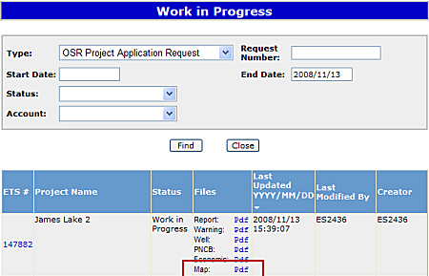
GeoView Map Report
Report Example
The GeoView Map Report displays the following layers of information:
Approved Project Lands and Potentially Includable Leases and Lands along with Meridian, Range, Township, Section, Project borders with project numbers and its applicable amendment letter.
Pending Project Application Lands along with Meridian, Range, Township, Section, Pending Application borders with application numbers and its applicable amendment letter.
Current Project Application Lands for newly added lands and removed lands along with Meridian, Range, Township and Section.
Well-specific Schemes contain only project wells along with Meridian, Range, Township and Section.
This report is generated from the ERCB sub-tab and can only be accessed from the Work in Progress screen.

Slide 10

Conclusion
Congratulations!
You have completed the OASIS Generate OSR Project Application Reports
Online Training Course
Please proceed to the subsequent courses detailing other functionality of the OASIS application.
If you have any comments or questions on this training course,
please forward them to the following email address:
OSODmailbox@gov.ab.ca

