Slide 1
Welcome
Welcome!
This module outlines the processes required to create an application for a New OSR Project. An OSR (Oil Sands Royalty) Project is considered new if the lands, leases, wells, facilities, and operations within an application have not formed any part of an existing OSR Project.
Prerequisites:
OSR Application Roles
ETS Accounts
Geoview System Overview
Geoview Editing for OSR Applications
To the Create New OSR Project Application
Online Training Course

Slide 2
Revisions
Date | Revisions Type | Page Number
September 31, 2012 | Conversion | All
July 2, 2013 | Content Updated | All
June , 2016 | Content Updated | Edit Lands & AER Approvals

Slide 3


Introduction
In this module, you will learn how to:
Create an OSR Project Application by completing the following:
Logon to ETS
Request Tab
Project(s) Tab
Owner Tab
Operator Tab
Project Description Tab
AER Approvals, Lands, Wells Agreements and Mineral Rights, Operations, Facilities, Capital Assets
PNCB Tab
Economic Tab
Documents Tab
Roles Tab
AER Approvals, Lands, Wells Agreements and Mineral Rights, Operations, Facilities, Capital Assets
Submit Tab
For more information on OSR Project Application, see Oil Sands Overview and Oil Sands Roles

Slide 4
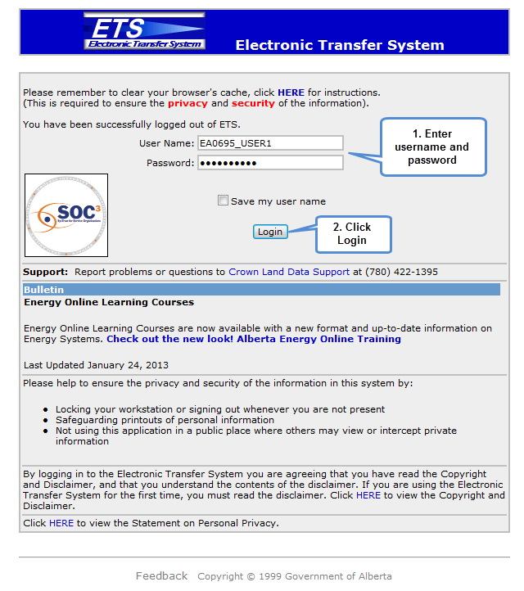
Logon to Electronic Transfer System (ETS)
To Log on to the ETS web site: Enter the ETS User ID issued by the Site Administrator (EN####_accountname) into the User Name field. This field is NOT case-sensitive.
Enter the Password: This field IS case-sensitive.
Click the Login button: Save my user name: If you check this box, ETS will save your user name on the site so you do not have to enter it every time you log in.

Slide 5
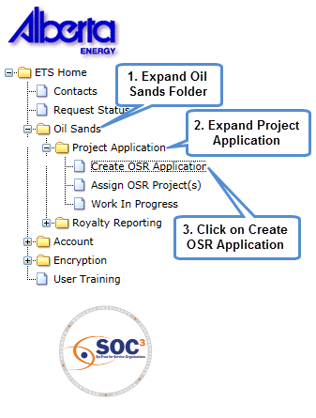
ETS Tree Node
The entry point to OASIS OSR Applications is by selecting:
‘Oil Sand’s, then ‘Project Application’.
The choices available are determined by the OSR Application roles assigned to the user by the Site Administrator or the Coordinator.
Create OSR Application, the user must have the Creator Role.
Assign OSR Project(s), the user must have the Coordinator Role
Work In Progress, this feature is available to all OSR Application roles.
For more information on roles, see OASIS Roles training module.

Slide 6
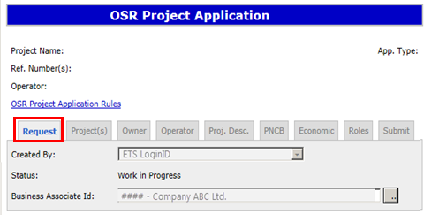
Request Tab
After Create OSR Application has been selected the Request Tab is displayed.
Created by: This field defaults to the user who created the application record.
Status: This field defaults to Work In Progress (WIP).
Business Associate ID: This field defaults to the company/companies assigned to the users ETS account for OSR Project Applications.
Upon saving, a Request Number will be assigned to the application, and some of the tabs enabled.
The Request Number can be used to locate this application after the user has exited this application or ETS.

Slide 7
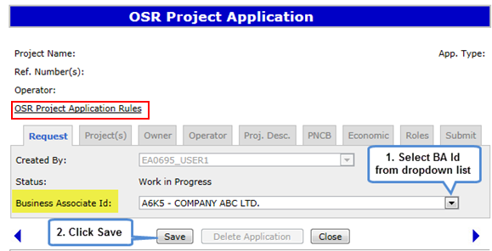
Request Tab (Continued)
Where multiple companies are assigned to the Creator, a selection can be made by using the dropdown list located on the right of the Business Associate ID field.
Select the dropdown option, choose a company and save.
Note: The company entered will be used to populate the Owner tab.
An overview of what is needed to complete an OSR project application may be found by clicking on the text OSR Project Application Rules.

Slide 8
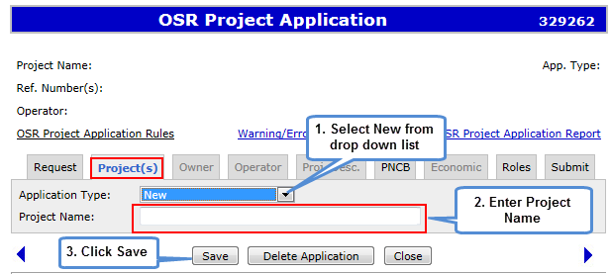
Project(s) Tab
When the Project(s) tab is selected, the Project screen will be displayed. Select the application type from the dropdown box.
The Project Application choices are New, Amendment – Expansion, Amendment – Other, or Amalgamation.
Select "New" from the Application Type dropdown box.
Enter the Project Name. The project name must be unique and must be less than 60 characters in length. After the initial save, the remaining tabs become available. These tabs provide the project details required to complete a New OSR Project Application.

Slide 9
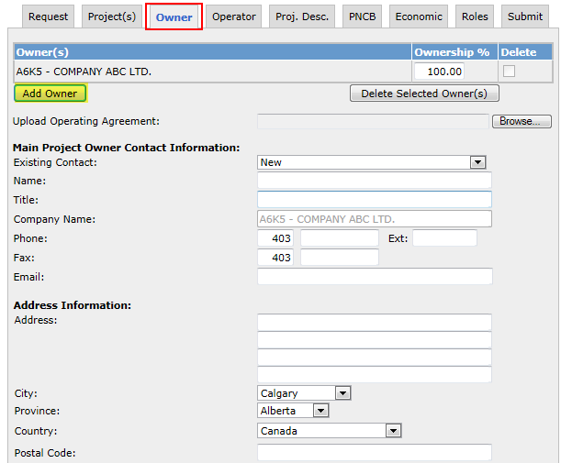
Owner Tab
The Owner recorded on the first line is defaulted from the Company entered on the Request tab, and is considered to be the Primary Owner.
The Primary Owner cannot be deleted in the application process.
Additional Owners can be added, and the ownership percentage adjusted.
An Operating Agreement is required if there is more than one owner, or the Primary Owner is different than the Operator.
The Project Owner Contact information must be provided.

Slide 10
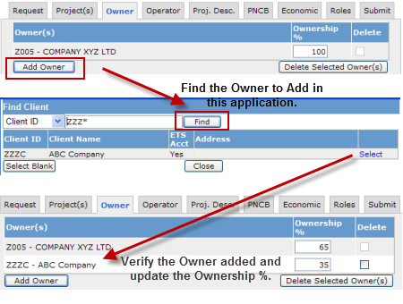
Owner Tab – Add Owner
If there are multiple owners for the project application, they need to be added.
Select the ‘Add Owner’ function and search by either company name or Client ID.
To find a company by name, enter the first four characters of that company and select ‘Find’.
To find a company by Client ID, change the first field from Client Name to Client ID, enter the four digit BA ID for that company and select Find.
A search will be made to match the search entry. Locate the company you want added to the Owner List and choose ‘Select’ (located beside the company name)
The Owner list will be updated. The corresponding Ownership % must also be updated. The total ownership % must always equal 100%.
Choose Save after changes have been made.

Slide 11
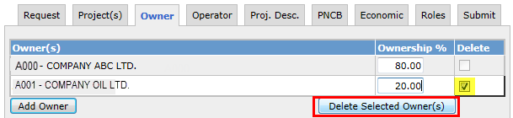

Owner Tab – Delete Owner
If an owner needs to be removed, the ‘Delete’ box is used.
To remove one or more of the owners, click on the Delete box and select the ‘Delete Selected Owner(s)’ button.
The corresponding Ownership % must also be updated. The total ownership % must always equal 100%.
Choose Save after changes have been made.
The company on the first line is considered the Primary Owner; this record cannot be deleted. A request to change the project ownership needs to be submitted to the department.

Slide 12
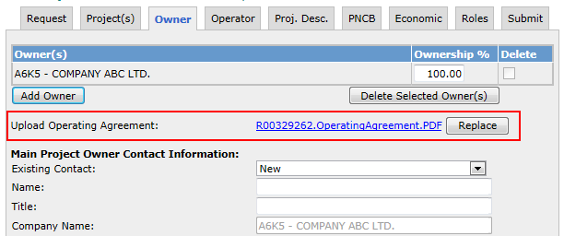
Owner Tab - Operating Agreement
An Operating Agreement is required when:
There is more than one owner on an OSR Project Application
The Owner is different from the Operator
Operating Agreement documents can be submitted in Microsoft Word (.doc) and Adobe PDF (.PDF) formats.

Slide 13
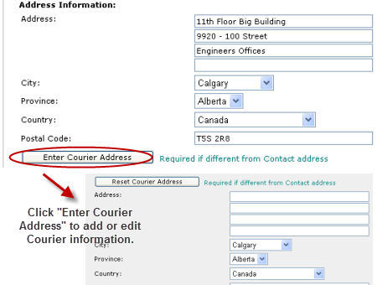
Owner Tab - Project Owner Contact and Courier Address
Update the Project Owner Contact address information if there are any changes.
Complete the Courier address only when it is different from the Contact address. The ‘Enter Courier Address’ button is available to access the Courier Address fields.
The following information is required:
Address
City
Province
Country
Postal Code
Note: If the Operator and Contact is the same as the Owner Tab, choose the option “Operator same as owner”.

Slide 14
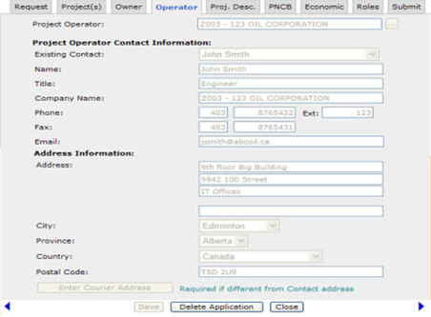
Operator Tab – Same as Owner
If the option “Operator same as owner” is selected on the Owner tab, this information will be not be editable.
To make changes on this screen, return back to the Owner tab and deselect the ‘Operator same as owner’.

Slide 15
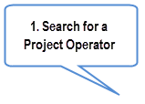

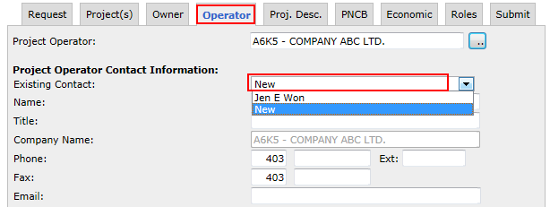
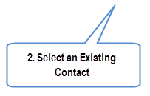
Operator Tab - New
To update the Project Operator, search by company name or Client ID, and select.
Recorded contacts for the company selected are provided in the Existing Contact dropdown menu. If not available, the default will be ‘New’. Existing contacts associated to the Project Operator can be selected and the system will populate the contact and address information fields with the Project Operator details. Ensure the contact and address fields are updated; including an email address.
Project Operator Contact Information fields are enabled for update only if the "Operator same as owner" checkbox is not selected on the Owner screen.

Slide 16
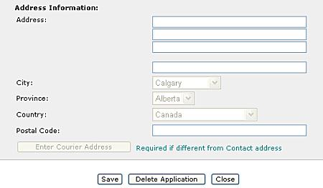
Operator Tab - Address Information
The following fields are mandatory for Operator Address Information:
Address: Address text (maximum 255 characters)
Postal code: Postal Code (maximum 12 characters)
City
Province

Slide 17
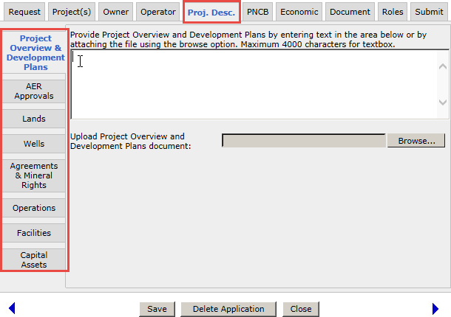
Project Description Tab
The Project Description tab shows a series of items displayed in a column on the left hand side of the screen. Clicking on each item displays a new screen which must be filled out. These are described in the following slides.
Project Overview and Development Plans
AER Approvals
Lands
Wells
Agreements and Mineral Rights
Operations
Facilities
Capital Assets
Project Overview and Development Plan text cannot exceed 4000 characters.

Slide 18
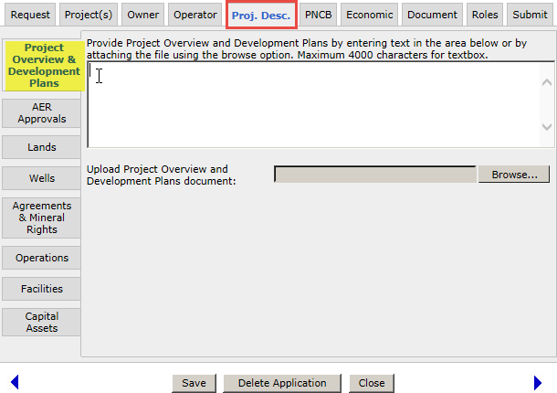
Project Description Tab - Project Overview & Development Plans
The Project Overview and Development Plans should contain the following information:
Summary of project’s history and developing plans
Description of lands and facilities included within the proposed project
Dates when lands and leases were acquired
Locations of the first wells on project site and dates they were drilled
Annual Production to date and other relevant details
Future development plans for Project
Reservoir Properties information
Project Overview and Development Plans can be provided by entering text (maximum of 4000 characters) or uploading the document (Word, Text, or PDF are acceptable).

Slide 19
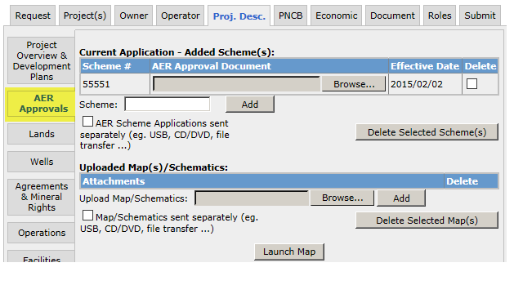
Project Description Tab – AER Approvals
The AER Approvals screen is used to update scheme information for the Current Application. The latest scheme can be added. Added Schemes can be deleted.
Each schemes must be accompanied by a copy of the AER Approval document”.
Launch Map - Opens an interactive Map of the current Application. Edits to lands are made within this feature. The online map may be printed or exported.
If additional maps or schematics are to be included, upload the map, or use the checkbox to indicate it is being sent separately (eg. CD)
Added Schemes by a Primary Owner user will automatically update the Application lands with available Development Area lands; you can change the lands using the Launch Map function.

Slide 20
AER Approvals – Add Scheme (...continued)
Attachment of all added scheme approvals is required.
To Attach a file, select the ‘Browse’ option, select the file you want to attach. Save must be selected to store the file in the application.
Acknowledgment that you will send in the scheme applications to the Department on CD is required.
1. Upload the Approval Document
2. Check to acknowledge AER Scheme Application will be sent separately

Slide 21
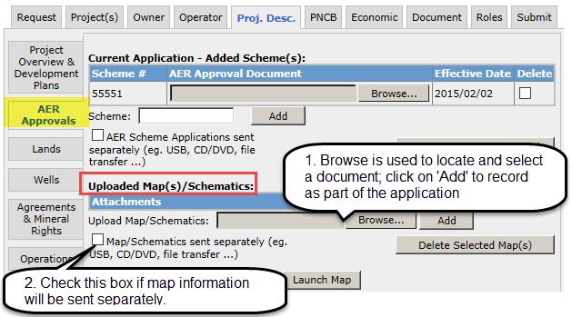
AER Approvals – Add Scheme (Continued)
If additional maps or schematics are to be included, select the checkbox to indicate this or attach files using the upload field.

Slide 22
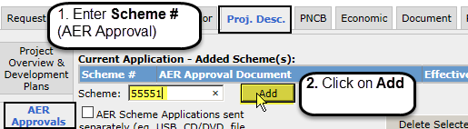
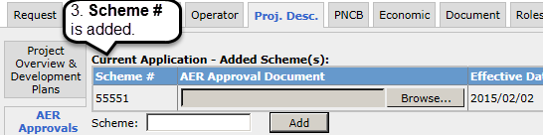


Project Description Tab – AER Approvals – Add Scheme
Schemes added to the OSR Application will be listed in the section Current Application – Added Scheme(s).
Enter the latest AER approval number, and click on the Add button.
a) If the entry is the latest AER approval, the number is the list.
b) If the entry is not the latest, the system will replace the entry with the latest approval stored in OASIS; click on Add again to store the record.
Any edits to this page requires a Save action before moving onto another page.
Save will
store the latest edits made on the page,
update the land list for the Current Application, and
update the map
Application lands will be defaulted to those lands which are in the added Scheme(s) Development Area, and are not 100% freehold, or already in an OSR Project, or Pending Application.

Slide 23
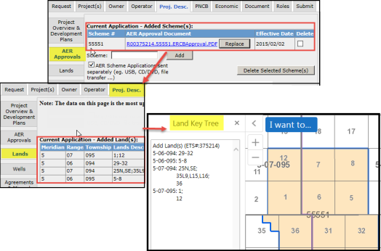
Current Application – Scheme/Land and Map (Geoview)
Schemes added to the current application will be used for determining the lands available.
By default, if a scheme is added which has available lands both the Land Tab, and the Map will be updated.
The defaulted lands are limited to the Development Area of the scheme record.
Lands are recorded in the current application as either;
Added lands, or Removed lands.
Added land(s) – these are lands treated as application lands.
Removed land(s) – these are lands which are part of an existing OSR Project, PILL, Pending Project, or Pending New Project which have been selected for removal in the current application.
Application lands will be defaulted to those lands which are in the added Scheme(s) Development Area, and are not 100% freehold, or already in an OSR Project, Pending Application, or Pending New Project.

Slide 24
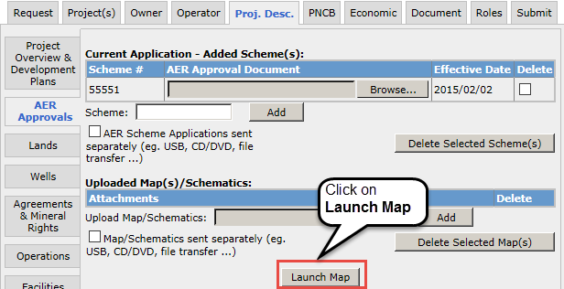
AER Approvals (Schemes) - Launch Map
The map can be launched from the Project Description tab / sub-tab AER Approval. The Launch Map function is located at the bottom of page.
The map will provide a graphical representation of the subject application by displaying all associated scheme land as well as the application ‘Added Lands’ (if applicable).
For Amendments or Amalgamations, additional information would be provided for the Approved Project(s), Pending Applications or Pending New Projects. Use the map Edit tools to modify lands for the Current Application.
The following pages demonstrate how to edit the application lands.
Launch Map is only available to the user who represents the Primary Owner, and has the role of Creator or Delegate. For a Delegate to make edits, they must be assigned to the application.

Slide 25

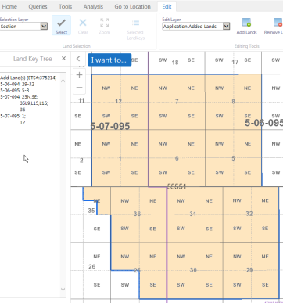
Map – Initial Map View
Edit tool function will be enabled if;
Application has Project, Potentially Includable lands & Leases (PILL), or available lands via the added Scheme,
User represents the Primary Owner,
And
c) User is the Creator, or assigned Creator/Delegate.
Left Panel of the map screen defaults to the
Land Keys in the application. If there are no lands added, the panel will be empty.
* details in Geoview Overview module

Slide 26
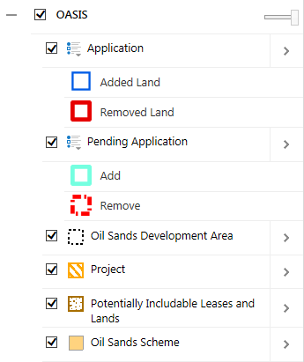
Geoview – Map Contents - Application Layer
The Map Contents panel will display layers specific to the current project application under the heading OASIS. Each layer can be turned On or Off.
The layers under OASIS are:
Application – represents the lands recorded for the Current Application.
Added Land – land added in the Current Application.
Removed Land - lands to be removed from an existing record; eg. Approved OSR Project, Approved PILL, Pending New Project, or Pending Application.
Pending Application– displays those lands requested under a prior submitted application on the same project.
Project– displays the existing OSR Project.
Potentially Includable Leases and Lands – displays those lands approved as PILL lands under the existing OSR Project.
Oil Sands Scheme – displays the AER Approval lands
Oil Sands Development Area – displays the Development Area lands for the AER Approval.

Slide 27
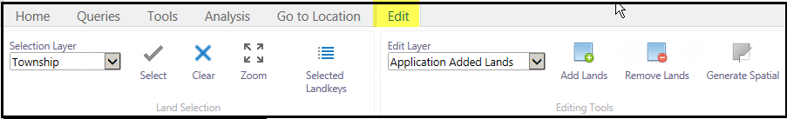
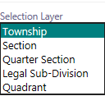


GeoView - Toolbar - Edit Tab
Use these tools: | To:
 | Defines at which level the lands can be selected. Eg. Section, ¼ section, LSD, or quadrant.
 | Activates the map selection tool. Upon activation, a R-mouse click will either select or unselect lands. (1st click is to select, 2nd click on same lands is to unselect).
 | Current selected lands are cleared.

Slide 28




GeoView - Toolbar - Edit Tab (Continued)
Use these tools: | To:
 | Edit Layer: Used to identify what land record is being modified. a) Application Added Lands – lands that are newly applied for lands. b) Application Remove Lands – lands being requested for removal from an existing record (eg. Project, Pending application, PILL)
 | Add Land(s) – Action to add the selected lands to the Edit Layer.
 | Remove Land(s) – Action to remove the selected lands from the Editing Layer
 | Displays the Selected Land keys in the Left panel. [ used when a previous instance was closed ]

Slide 29
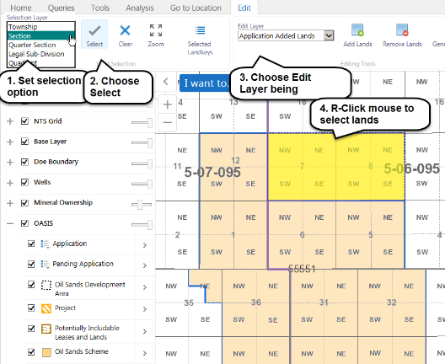
Map – Add Lands to the Current Application
Lands can be added to the application by way of the ‘Application Added Lands’ Edit Layer.
Steps:
Set Selection layer
Click on the Select tool
Choose Appl.Added Lands [Edit Layer]
Click on the map to select Land(s)
Click Add Lands

Slide 30
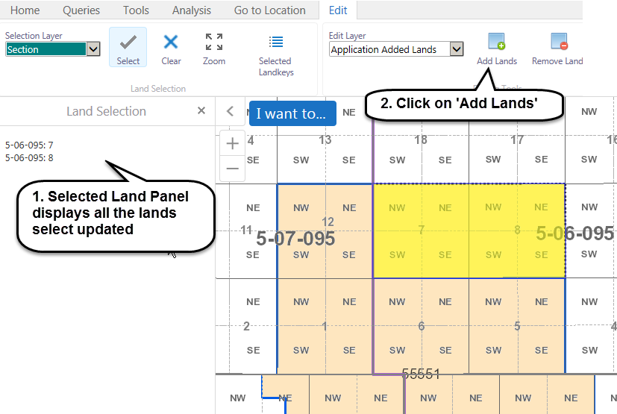
Map – Add Lands to the Current Application (...continued)
Selected Lands will be identified in Information Panel under Land Selection
After Land has been selected, click on Add Land(s)

Slide 31
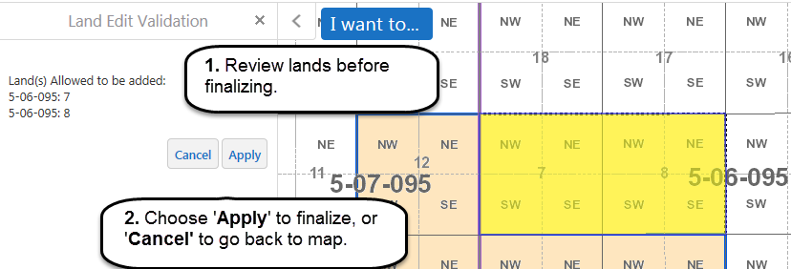
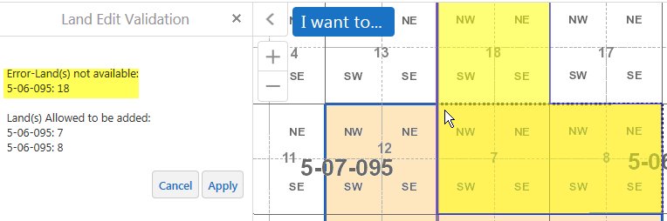
Map – Add Lands to the Current Application (...continued)
After clicking on Add Land(s), a validation screen is displayed.
Click on Apply to finalize the lands being added, or Cancel to return back to map.
Note: Validation will identify whether selected lands are allowed, if not an error message will appear.

Slide 32
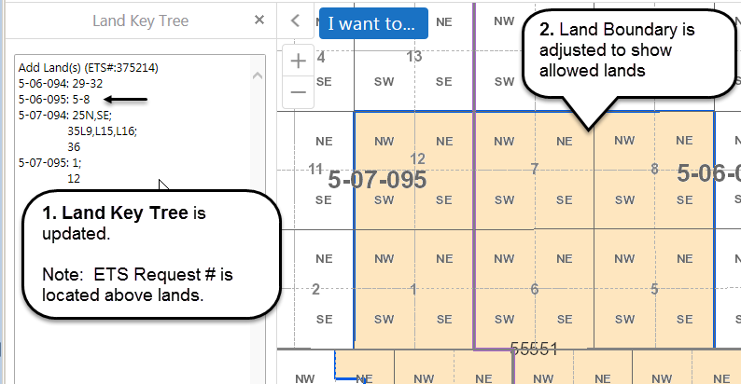
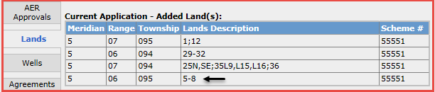
Map – Add Lands to the Current Application (...continued)
After Applying the land changes;
the Map information (Land key tree & Land boundary) is updated
and
b) the Lands tab in the application is updated.

Slide 33
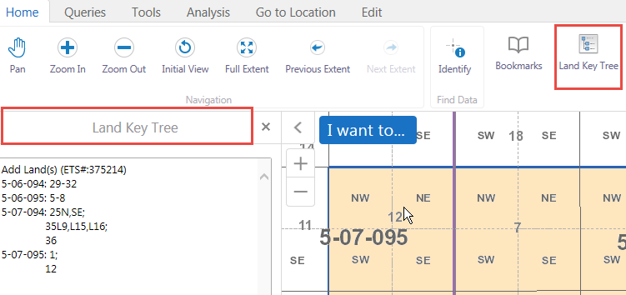
Map – Land Key Tree (sort order)
The Land Key Tree will display those lands which are in the application at the time of last saved action and land boundary will be adjusted accordingly.
Land Keys sort order are as follows:
Meridian
Range
Township
Sections
Quarter Sections
Legal Sub Divisions
Quadrants
The icon for the Land Key Tree may be selected to display the lands.

Slide 34
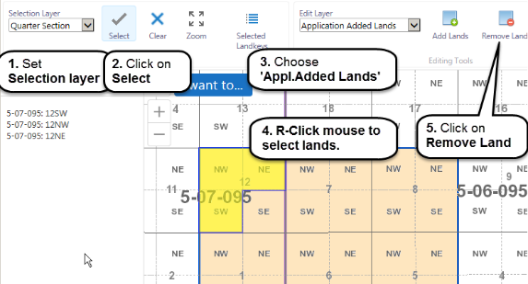
Map – Remove Lands from the Current Application record
Lands which are recorded in the application as Added Lands can be removed.
Steps:
Set Selection layer
Click on the Select tool
Choose Appl.Added Lands [Edit Layer]
Click on the map to select Land(s)
Click Remove Land

Slide 35
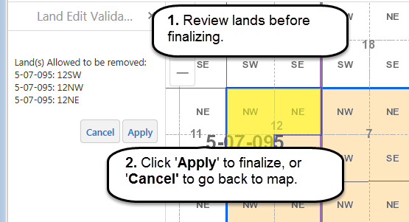
Map– Remove Lands from the Current Application record (...continued)
After clicking on Remove Land(s), a validation screen is displayed.
Click on Apply to finalize the lands being removed, or Cancel to return back to map.
Note: Validation will identify whether selected lands are allowed for removal, if not an error message will appear.
Cancel will close the popup window and return back to edit session.

Slide 36
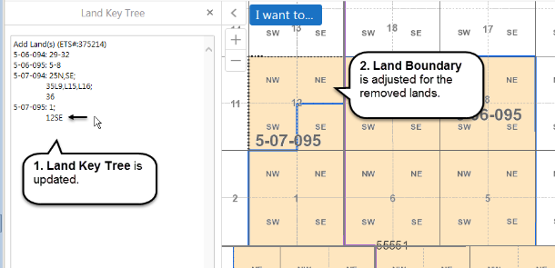
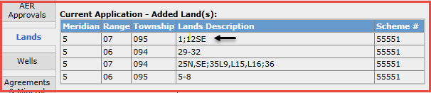
Map– Remove Lands from the Current Application record (...continued)
After Applying the land changes;
the Map information (Land key tree & Land boundary) is updated
and
b) the Lands tab in the application will is updated.

Slide 37
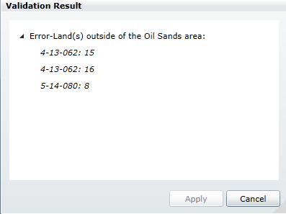
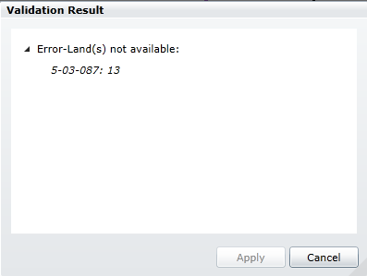
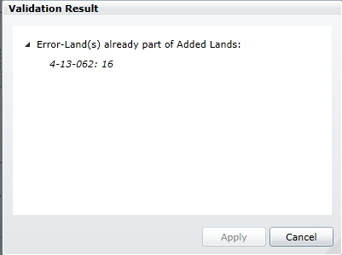
Validation Results - Errors
While editing, if an action is performed which is contrary to the Business Rules allowing the action, a warning window will appear. Here are some examples:

Slide 38
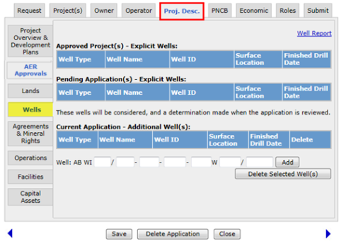
Project Description Tab - Wells
The Well tab provides a link to the Well Report (via hyperlinked text).
The Well Report will list potentially eligible wells which reside entirely within the application lands (excludes wells on lands which are outside the Scheme Development Area lands.)
The Current Application – Additional Well(s) can be used to add specific wells other than the ones have already been displayed in the well report

Slide 39
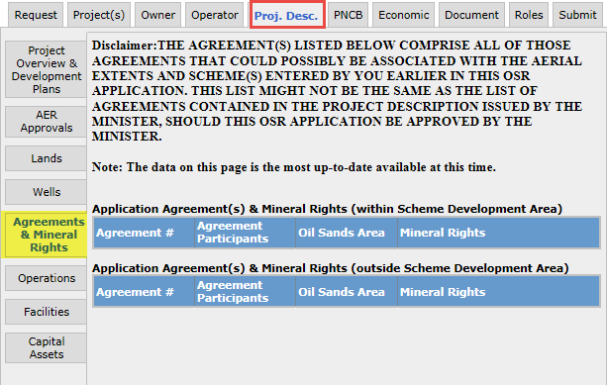
Project Description Tab - Agreement and Mineral Rights
The Agreement tab will display Agreement Numbers associated with Application Land(s) added under the Current Application.
Warning messages will be displayed if the Lease Participants differ from the Project Owners or if there are currently no Oil Sands leases held for the selected lands.

Slide 40
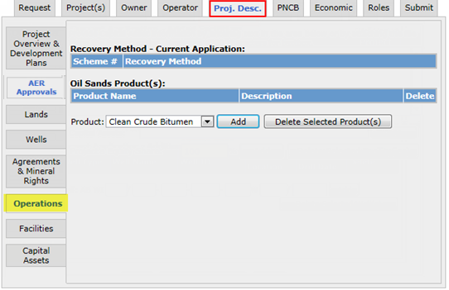
Project Description Tab - Operations
The Operations tab displays the recovery methods for the Current Application based on the associated schemes.
Product(s) must have at minimum ‘Clean Crude Bitumen’ added. Selections may be made from the product list provided.
After making changes, select Save.
1. Select product from drop down list
2. Click Add

Slide 41
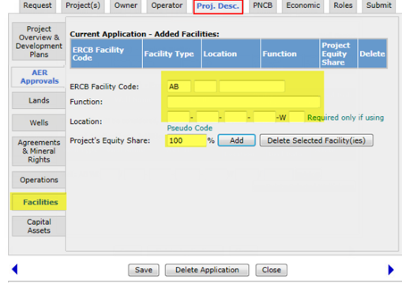
Project Description Tab - Facilities
Provide information about Facilities required to produce the project's oil sand products. Add facilities to the project by typing the unique facility code and the function for each facility and its equity share if it is not equal to 100%
Provide a Pseudo Facility Code (AB XX 9999999) and location for any facilities which have not received the AER Facility Code at the time of the application but is included in the project.
.
Enter Facility Code, Function, Location and Project Equity Share
The Facility Code must exist. If the Facility Code has not been set up by AER, a pseudo facility code of "AB XX 9999999" can be used. An update to the application will be required once the Facility Code is available from ERCB.

Slide 42
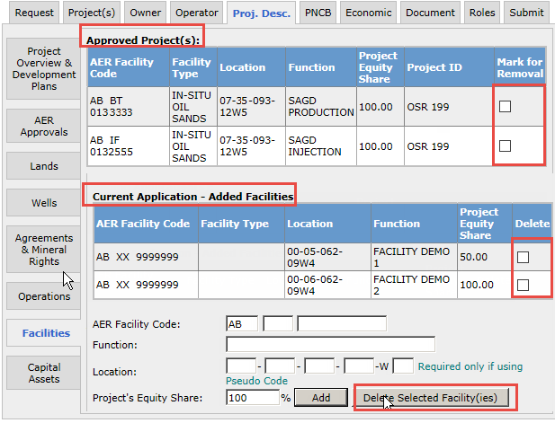
Project Description Tab – Facilities (Continued)
To request the removal of a Facility from an existing Approved Project, choose the ‘Mark For Removal’
box.
To Delete a Facility which was added in the Current Application choose ‘Delete’ box, followed by the Delete Selected Facility(ies) button.
click on Save.

Slide 43
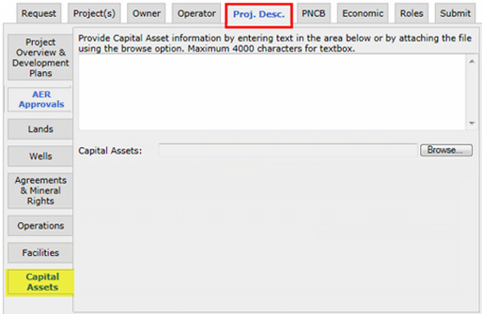
Project Description Tab - Capital Assets
Capital Asset information can be uploaded or text can be entered in the textbox, up to a maximum 4000 characters.
Allowed attachment types are: Word, Text and PDF.
Capital Assets must contain the following information:
Asset
Location
Function
Usage (%)

Slide 44
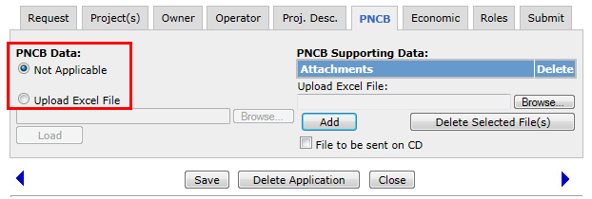
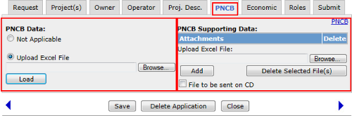
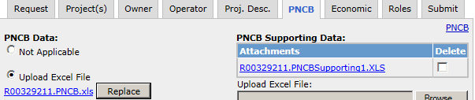
PNCB Tab
PNCB (Prior net cumulate Balance) is the net difference between the cumulative costs (capital and operating costs) and cumulative revenue for the eligible period prior to the effective date of the project.
If PNCB Data is not required, select Not Applicable.
If PNCB data is being provided, upload the completed PNCB excel sheet. Choose ‘Load’ after the file has been selected.
(extensions allowed; *.xls or *.xlsx).
PNCB Supporting Data needs to be provided if there is a submitted PNCB Data file.
( This data can be uploaded or sent to the Department on a CD.)
Updates need to be saved.
Use the DOE PNCB Excel template located on the Alberta Energy Website.

Slide 45
PNCB Tab (Continued)
An uploaded document may be replaced by selecting ‘Replace’ and repeating the steps for uploading the file.
After uploading the file and saving, a report can be generated by clicking on the hyperlink text; top right of screen.
Use the DOE PNCB Excel template located on the Alberta Energy Website.

Slide 46


Economic Tab
The Economic tab is used to report Economic Evaluation data.
If Economic Evaluation Data is not required, select Not Applicable.
If Economic Evaluation Data data is being provided, upload the completed Economic Evaluation excel sheet.
(extensions allowed; *.xls or *.xlsx).
An uploaded document may be replaced by selecting ‘Replace’ and repeating the steps for uploading the file.
After uploading the file and saving, a report can be generated by clicking on the hyperlink text; top right of screen.

Slide 47

Roles Tab
The Roles tab allows the application to be accessed by other OSR Application users who are not the Creator of the Current Application.
Roles allowed are: Creator(s), Viewer(s), Submitter(s) and Delegate(s). The fields will be populated from the User's Preferences if preferences have been filled out as shown in OASIS Roles training course. Note: At least one Submitter must be entered for the Application to be submitted.
For more information on Roles, see OASIS Roles Module.

Slide 48

Submit Tab
The Submit button will only be enabled for those assigned the role of Submitter. The submitter can validate that all pertinent information has been captured by viewing the OSR Application Report. Prior to submitting, a description or specific instructions may be provided in the text box provided.
A Signed Authorization Form (PDF format) must be uploaded.
The Submit button is only enabled if you have authorization to submit an application.

Slide 49



Submit Tab - Confirmation
Upon submitting, the application will be validated to ensure all the mandatory fields have been completed.
If the validation encounters any warnings, a message will be provided. The submitter can cancel the submit operation, or continue.
Upon a successful submission, a confirmation message will appear. This is the only confirmation that will be transmitted.
The Work In Progress screen may be accessed to access files generated by the system; Application Report, Warning, Well, PNCB, Economic Evaluation

Slide 50

Validate Warning/Error Reports
There are three hyperlink options above the application tabs. They can be accessed any time during the application process. The links are described below:
OSR Project Application Rules:
Identifies the components of the application which are required before submission.
Warning/Error Report:
Identifies any mandatory fields which are not yet populated, as well as information which are not mandatory but are contrary to standard practises. e.g.. lands selected are 50 km apart.
OSR Project Application Report:
A summary of the Current Application content, which includes the contents of each tab in the Current Application.
For more information, see Generate OSR Project Application Reports Module.

Slide 51
Application Checklist
Provide Operating Agreement when:
A new project application has more than one owner or operator
The operator is different from the original operator
The operator is different from the primary owner
Before submitting the application, make sure you complete the following:
Project Overview – has either Description entered and/or an attached file
OS Product - at least one OS product is listed.
Capital Assets – has either Description entered and/or an attached file
Contact Owner & Operator fields are completed.
PNCB & Supporting Data is uploaded; ( if applicable )
Economic Evaluation data and supporting documents are uploaded. ( if applicable )
AER Approval document is uploaded for each added scheme.
Lands and/or wells are listed (if applicable).
Agreements as expected by the client.
Additional Documents (if applicable)
Upload Signed Authorization Form in PDF format

Slide 52
Conclusion
Congratulations!
You have completed the Create New OSR Application
Online Training Course
Please proceed to subsequent courses detailing other functionality of the Oil Sands application.
If you have any comments or questions on this training course,
please forward them to the following email address:
OSRApplications.energy@gov.ab.ca
Also see the related courses:
Create an Amendment OSR Application
OSR Application Roles
Manage Work in Progress
Generate OSR Project Application Reports
Geoview – Editing for OSR Applications

