Slide 1
Welcome
Welcome!
OASIS (Oil sands Administration and Strategic Information System) is a comprehensive automated system that allows the Oil Sands Operations Division to better manage strategic and administrative activities. OASIS clients will be able to create, edit and submit an OSR (Oil sands Royalty) Project Application online. OASIS collects specific project information to ensure a complete up-to-date application for each OSR Project Application is submitted. The OASIS online training modules contain business information on using OASIS as well as "Show Me" movies which are short videos that walk you through the system functionality.
To the OASIS Overview
Online Training Course

Slide 2
Revisions
Date | Revisions Type | Page Number
September 31, 2012 | Conversion | All

Slide 3
Introduction
In this module, you will learn about:
OASIS Online External Training Courses
ETS - OASIS Login
OASIS Roles
OASIS Tree Node
OSR Project Application tabs and sub-tabs
Prerequisite Learning Modules We recommend that you view the following module before proceeding:
ETS Account Setup

Slide 4
Online External Training Courses
The courses follow a standard structure of screen images, an explanation of the functionality, and a video demo, when helpful, to guide the learner through the system navigation. The OASIS Online External Training courses available are:
OASIS Roles
Create New OSR Project Application
Create an Amendment OSR Project Application
Manage Work in Progress
Generate OSR Project Application Reports

Slide 5
Roles
Each Client Account is given access to Form Types and assigned a role that defines the functionality that is required. For OASIS, these are the roles that can be assigned to you:
Coordinator
Creator
Delegate
Submitter
Viewer
Review OASIS Roles module to learn more about the different roles in OASIS.
OASIS Roles

Slide 6
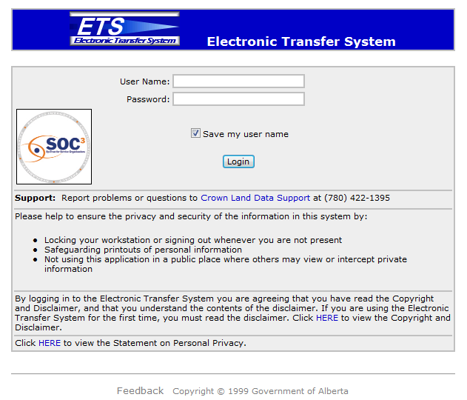
Login
To login to ETS, the user must have an active ETS account.

Slide 7
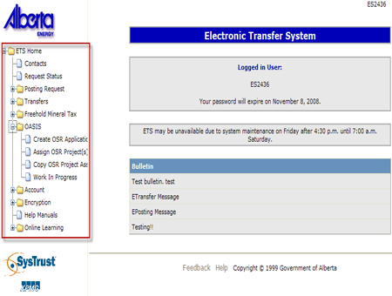

Tree Node
In order for a Client Account to access OASIS functionality on the web, the Site Administrator must first assign a role to the Client Account. Roles are based on the Form Types that are associated to the Site Administrator as defined by the initial application filed within the DOE. Depending on your role, the following OASIS functions are available upon clicking on the OASIS Tree node:
Create OSR Application (Creator only)
Assign OSR Project(s) (Coordinator only)
Copy OSR Project Assignment (Coordinator only)
Work in Progress

Slide 8
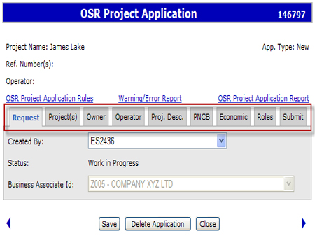
OSR Project Application
OSR Project Application consists of several screens requiring information from an authorized project owner and/or operator. This grouping of information is called tabs. The OSR Project Application consists of the following tabs:
Request
Project(s)
Owner
Operator
Project Description
PNCB
Economic
Roles
Submit

Slide 9
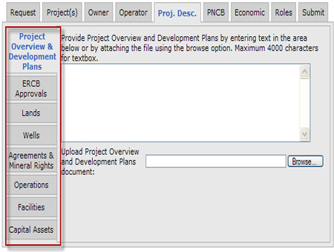
OSR Project Application – sub tabs
Some tabs can be further broken down into sub-tabs which provides more detailed information from that screen. For example, the Project Description tab contains the following sub-tabs:
Project Overview & Development Plans
ERCB Approvals
Lands
Wells
Agreements & Mineral Rights
Operations
Facilities
Capital Assets

Slide 10
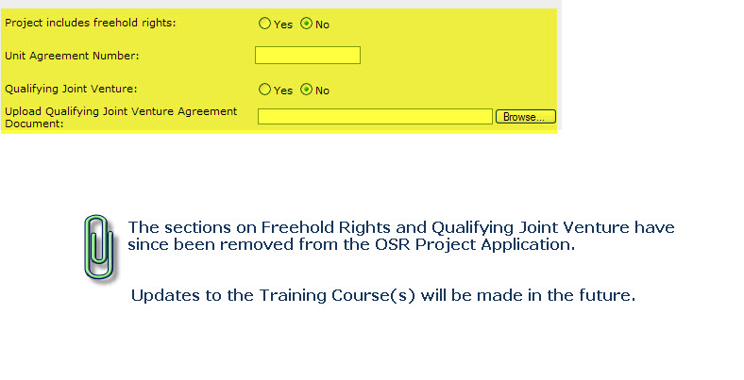
Future notice

Slide 11

Conclusion
Congratulations!
You have completed the OASIS System Overview
Online Training Course
Please proceed to the subsequent courses detailing other functionality of the OASIS application.
If you have any comments or questions on this training course,
please forward them to the following email address:
OSODmailbox@gov.ab.ca

