Slide 1
Offset
Government of Alberta
Welcome!
to the
ETS - Offset Notice Response Form
Online Training Course
This process describes how to retrieve documents sent by Alberta Energy and Minerals (the department); and how to create, update and submit offset notice response form.

Slide 2
Offset
Government of Alberta
Revision Page
Revisions Table
Date | Revisions Type | Page Number
September 5, 2014 | Initial Creation | All
October 3, 2014 | Update | 5
February 3, 2020 | Update | 29
October 9, 2020 | Update headers and contents | All
July 11, 2023 | Update contents | 1,6-7,13-14,16,20-22,36
July 8, 2025 | Update contents | 16-18,20,27-28,32-33,37

Slide 3
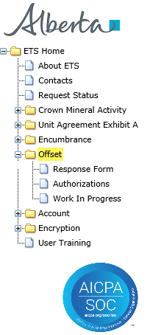
Offset
Government of Alberta
INTRODUCTION
In this module, you will learn how to:
retrieve documents, which include:
Offset Notice Letters
Statements of Account
Other Letters
create, submit and delete offset notice response form
Page 3 of 37

Slide 4
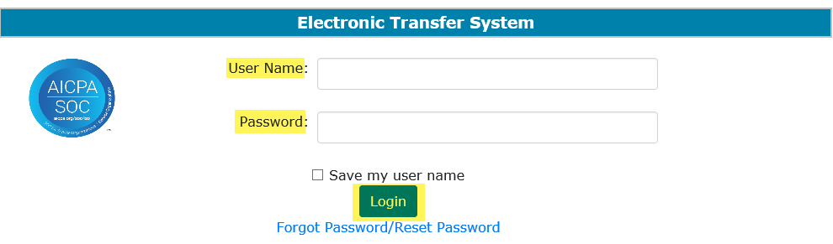
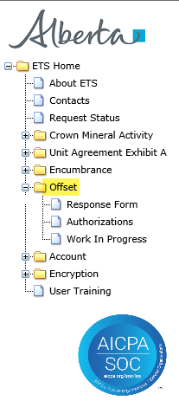
Offset
Government of Alberta
OFFSET – LOGIN
1. Login to ETS with your user name and password
2. Expand Offset
Page 4 of 37

Slide 5
Offset
Government of Alberta
The following slides show how to retrieve the following documents:
Offset Notice Letters
Statements of Account
Other Letters
Page 5 of 37

Slide 6
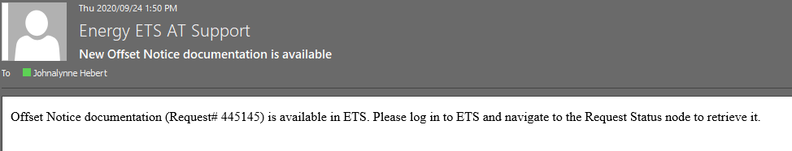
Offset
Government of Alberta
OFFSET – RETRIEVE DOCUMENT – REQUEST STATUS
The department upload documents to ETS. An e-mail notification is sent to the administrator or to the user who has the creator or viewer role for the form types: Offset Response Form or Offset Response Authorization.
Offset Notice letters and Statement of Accounts are retrieve in ETS/Request Status node.
Email notification sample:
Page 6 of 37

Slide 7
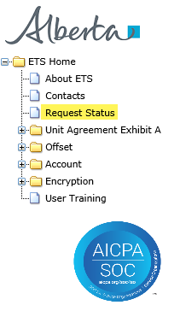
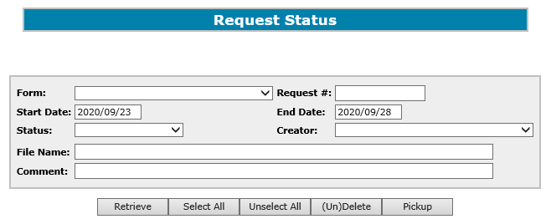
Offset
Government of Alberta
OFFSET – RETRIEVE DOCUMENT – REQUEST STATUS
1. Select the Request Status node
The following documents are uploaded by the department and can be retrieved in the Request Status node:
Offset Notice Letters
Statements of Account and Billing Sheets
other letters not related to offset notice response form
The offset notice letters and other letters contain pertinent information as to specific due dates for requests.
For example:
The Offset Notice letter must be responded within six (6) months of the date of the letter.
Letters requesting additional data must be responded within 30 days of the date of the letter.
Note: Letters that relate to a response form are found in the Offset/Work In Progress subnode.
Page 7 of 37

Slide 8
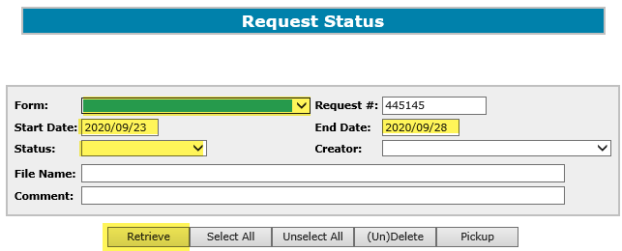

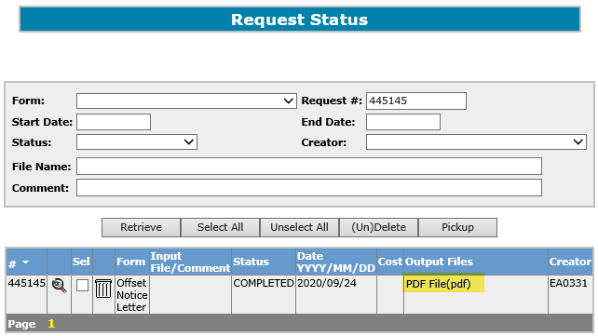
Offset
Government of Alberta
OFFSET – RETRIEVE DOCUMENT – REQUEST STATUS
1. Enter search criteria
All records are returned, if all criteria fields are blank.
2. Click Retrieve
3. Click the PDF file link to view the document.
Tip: To maintain your records, download and save a copy in your personal or internal directory.
The documents here will be visible only for the number of days as set in your Preferences.
Search results
Page 8 of 37

Slide 9
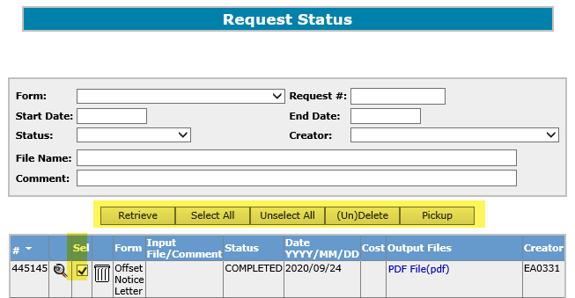
Offset
Government of Alberta
OFFSET – RETRIEVE DOCUMENT – REQUEST STATUS
Retrieve - retrieves all record based on the entered search criteria.
Select All - checkmarks the “Sel” box column of all returned records, which allows the user to select for viewing or deletion.
Unselect All – clears all check boxes from the “Sel” box column.
(Un)Delete - marks the selected records for deletion, (the item will be in red font until it is deleted from the system). A daily automated process will delete the selected records. Clicking the (Un)Delete button will remove the indicator for deletion.
Pickup - opens all selected record in a zip format.
This is a good opportunity to save these records in your personal directory.
Page 9 of 37

Slide 10
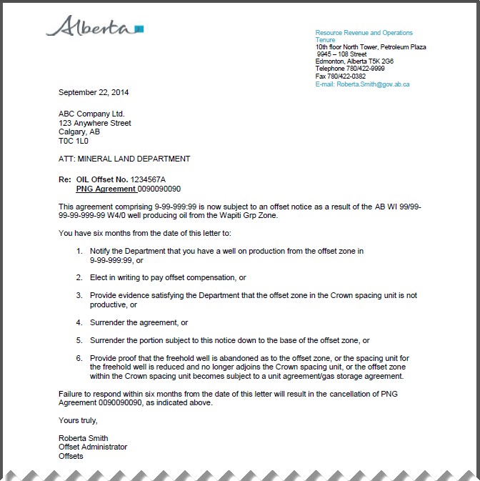
Offset
Government of Alberta
OFFSET RETRIEVE DOCUMENT – REQUEST STATUS - SAMPLE DOCUMENTS
Offset Notice Letter
Page 10 of 37

Slide 11
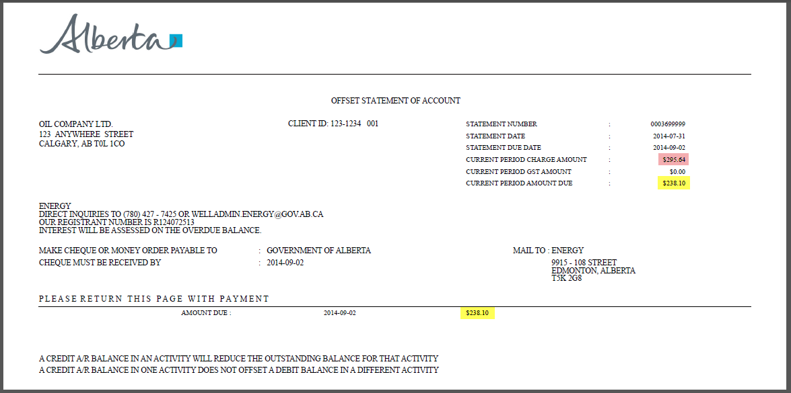
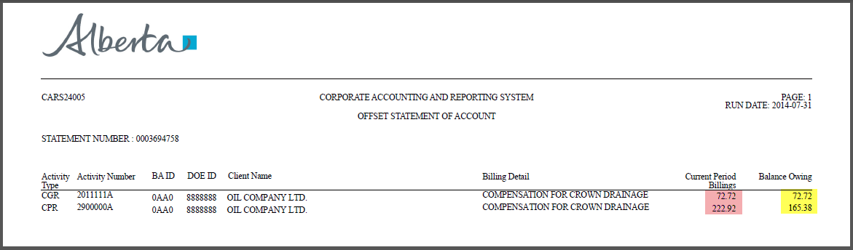
Offset
Government of Alberta
OFFSET RETRIEVE DOCUMENT – REQUEST STATUS - SAMPLE DOCUMENTS
Statement of Account (OSA)
The OSA is retrieved from the Request Status node on the first business day of every month.
Please note: There is no e-mail notification for this form type.
Page 11 of 37

Slide 12
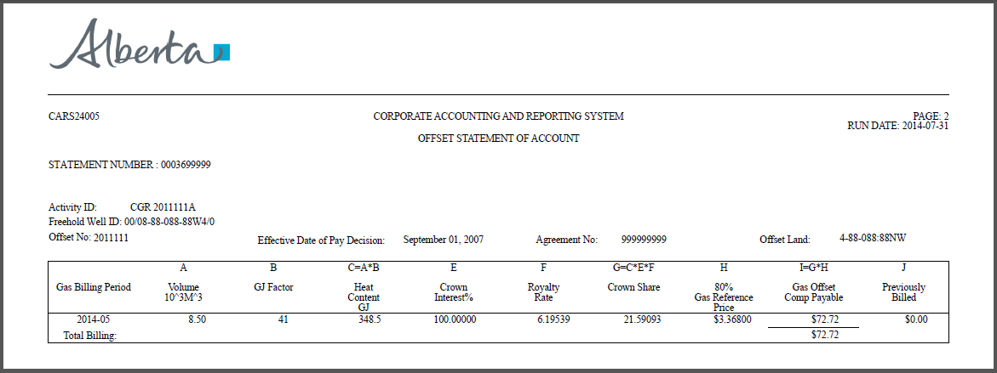
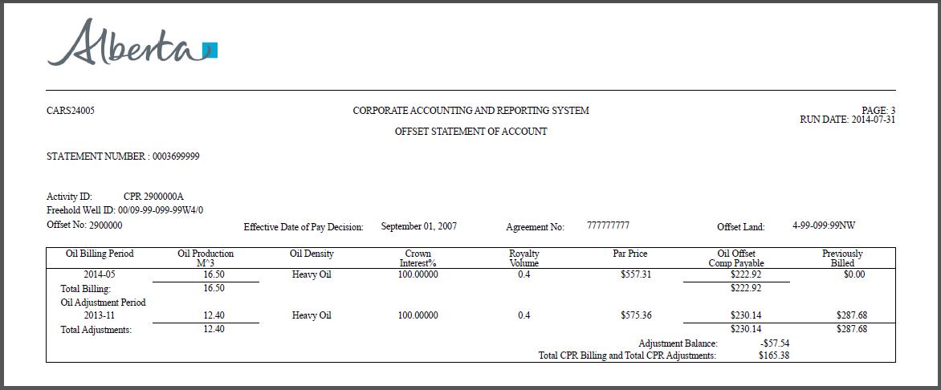
Offset
Government of Alberta
OFFSET RETRIEVE DOCUMENT – REQUEST STATUS - SAMPLE DOCUMENTS
Billing Sheets
Page 12 of 37

Slide 13
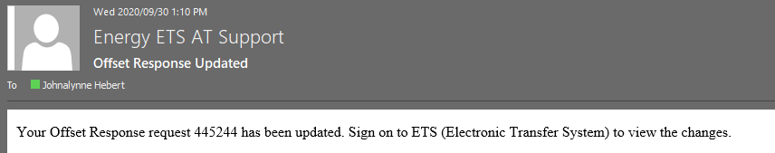
Offset
Government of Alberta
OFFSET – RETRIEVE OTHER DOCUMENT – WORK IN PROGRESS
The department upload documents to ETS. An e-mail notification is sent to the administrator or to the user who has the creator or viewer role for the form types: Offset Response Form or Offset Response Authorization.
Other Letters are retrieve in ETS/Offset/Work in Progress node.
These letters are responses to client’s submitted Offset Notice response form and uploaded to the specific ETS Request number.
Email notification sample:
Page 13 of 37

Slide 14
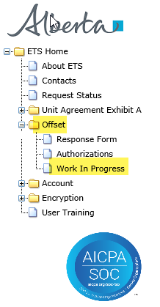
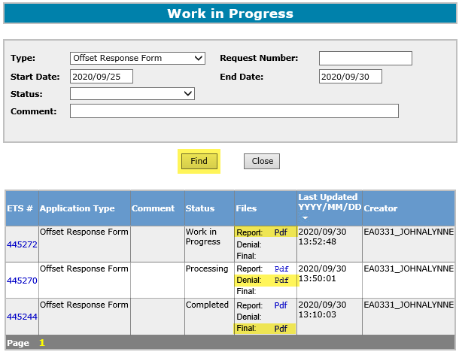
Offset
Government of Alberta
OFFSET – RETRIEVE OTHER DOCUMENT – WORK IN PROGRESS
1. Select Work In Progress
Report – ETS report with the details of the Offset Notice Response Form based on the last save.
2. Click Find
Denial – The department’s letters requesting further information to support the clients response.
Search results
Final – The department's final decision to either approve or deny the client’s response.
To display all ETS requests regardless of its status, leave all fields blank except for the Type field.
Page 14 of 37

Slide 15
Offset
Government of Alberta
The following slides show how to create, submit and delete offset notice response form.
Page 15 of 37

Slide 16
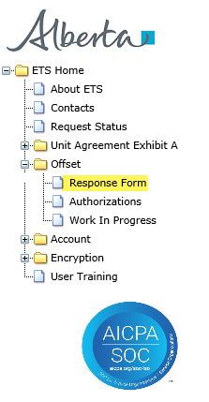
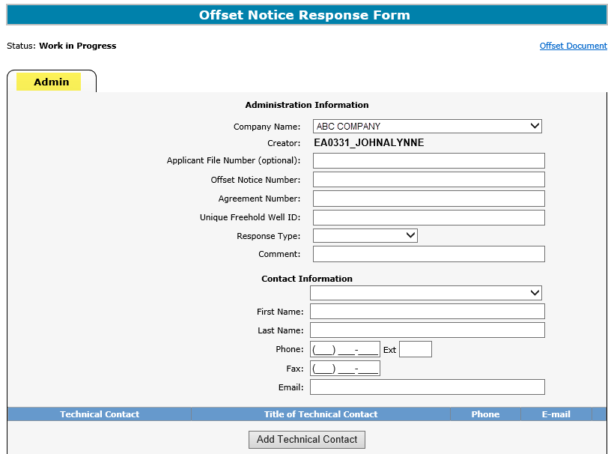
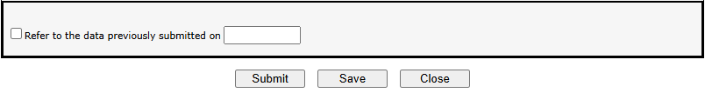
Offset
Government of Alberta
OFFSET NOTICE RESPONSE FORM – ADMIN TAB – CREATE
1. Select the Response Form tree node
2. Admin tab screen displays
When an Offset Notice Letter has been served, an Offset Notice Response Form must be submitted to the department within 6 months from the Offset Notice Letter date.
Page 16 of 37

Slide 17
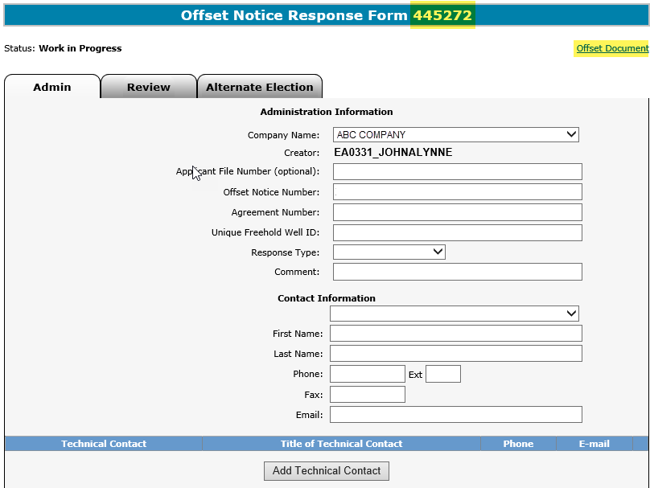
Offset
Government of Alberta
OFFSET NOTICE RESPONSE FORM – ADMIN TAB – CREATE
On the first save of the form, an ETS Request number is generated and displayed here.
When an Offset Notice Response Form is initiated by the user the system creates a report which captures all the details of the form based on the last save.
Double click on this link to view the report in .PDF format.
Page 17 of 37

Slide 18
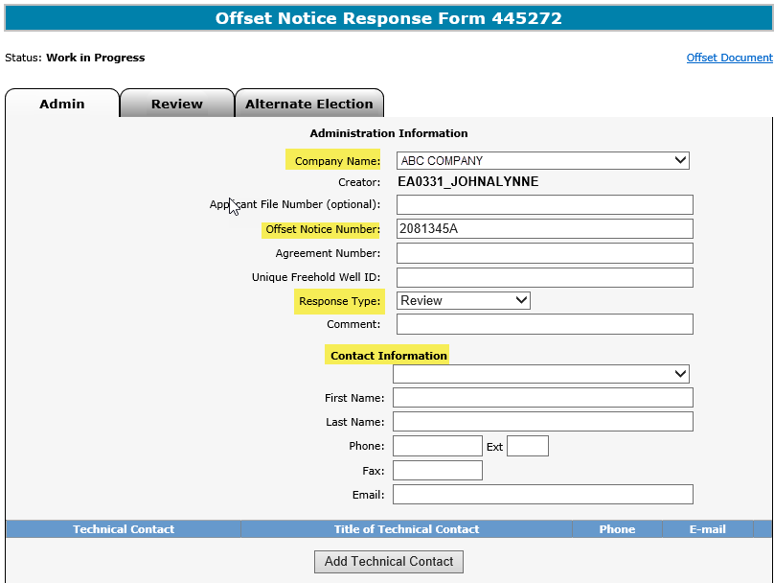
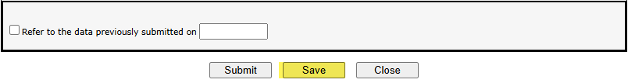
Offset
Government of Alberta
OFFSET NOTICE RESPONSE FORM – ADMIN TAB – ADMIN AND CONTACT INFORMATION
The Admin tab must be completed for all Offset Notice Response Forms.
Other tabs are dependent on the Response Type chosen.
1. Enter Administration Information
The Agreement Number and Unique Freehold Well ID auto populates based on the Offset Notice Number entered.
2. Enter the Offset Notice Number
3. Select the correct Response Type
Once saved, the Offset Notice Response Form has been created and its status in “Work In Progress.” You may continue to update and save this form until it is submitted.
4. Enter Contact Information
5. Click Save
Page 18 of 37

Slide 19
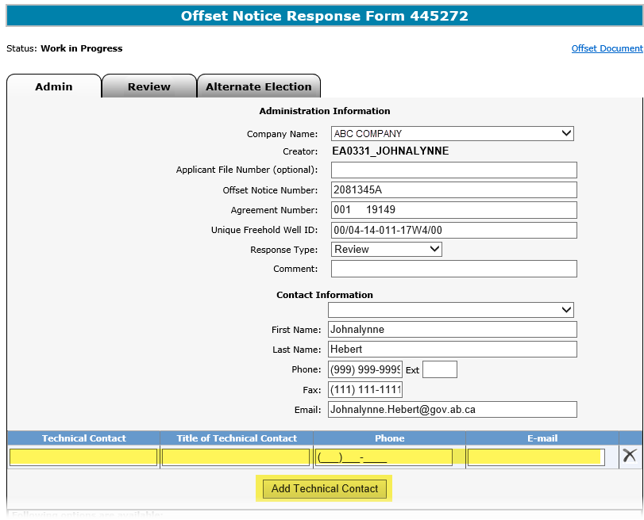
Offset
Government of Alberta
OFFSET NOTICE RESPONSE FORM – ADMIN TAB – TECHNICAL CONTACT
The Technical Contact is an optional field. If it is blank there will be a warning message, but it will not stop the submission of the form.
1. Select Add Technical Contact(s)
2. Enter the Technical Contact information
Page 19 of 37

Slide 20
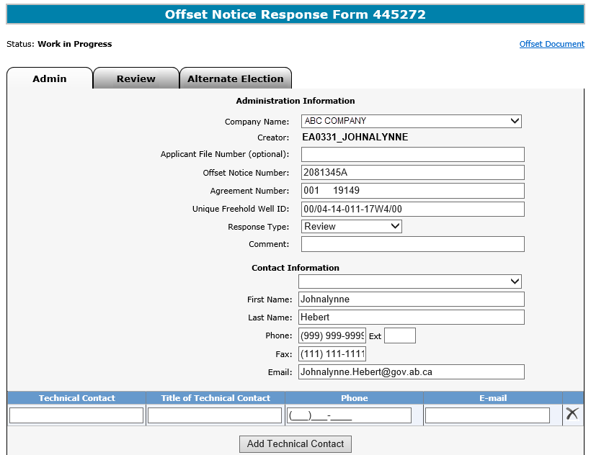
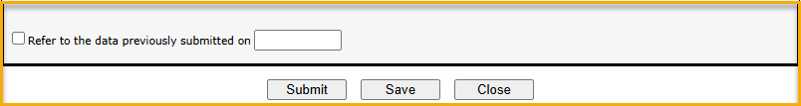
Offset
Government of Alberta
OFFSET NOTICE RESPONSE FORM – ADMIN TAB – DATA SUBMISSION
You may indicate by checking the checkbox for the department to Refer to the data previously submitted on date.
Page 20 of 37

Slide 21
Offset
Government of Alberta
The following slides show the details and more information on different Response Type.
Page 21 of 37

Slide 22
Offset
Government of Alberta
OFFSET NOTICE RESPONSE FORM – RESPONSE TYPES
The Offset Notice Response Types are:
Pay The client chooses to pay the offset compensation.
Surrender The client chooses to surrender all or a portion of the agreement.
Well on Production The Crown well is producing.
Review The client requests for the department to review and reconsider the Offset Notice.
Extension The client is requesting for an extension to the Offset Notice date.
Reinstatement The client did not respond to the original offset notice and their mineral rights were surrendered by the department; therefore, the client is requesting for the agreement to be reinstated.
Page 22 of 37

Slide 23
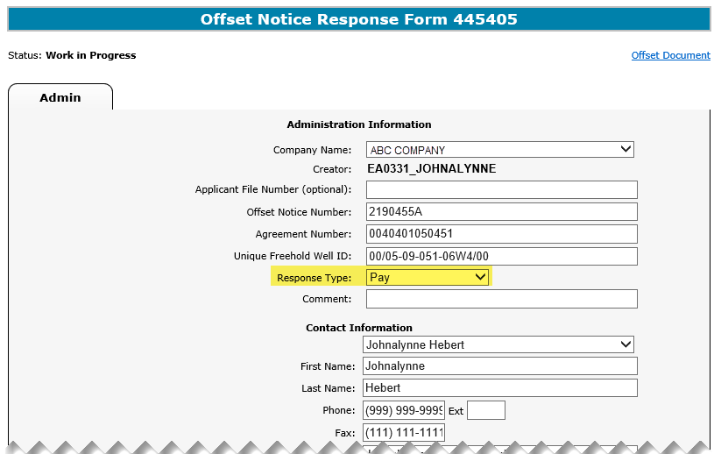
Offset
Government of Alberta
OFFSET NOTICE RESPONSE FORM – RESPONSE TYPE - PAY
The Pay response type does not require additional information.
Once the Admin tab is completed this Offset Notice Response Form can be submitted.
Page 23 of 37

Slide 24
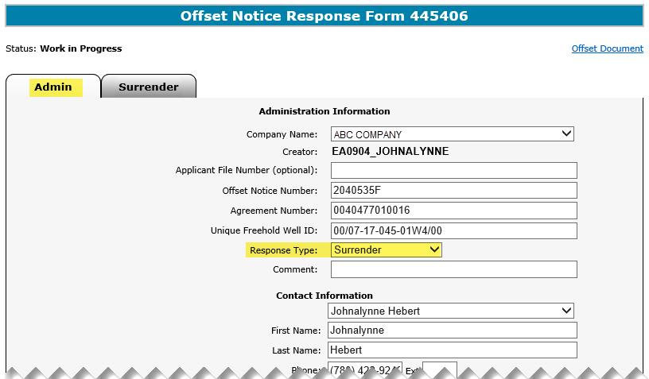
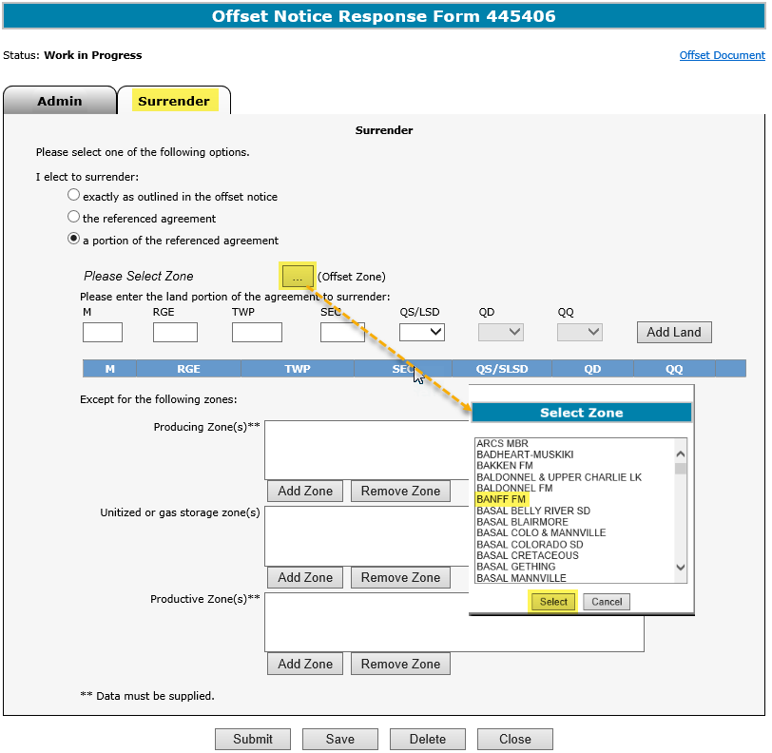
Offset
Government of Alberta
OFFSET NOTICE RESPONSE FORM – RESPONSE TYPE - SURRENDER
2. Enter data for the Surrender response type
1. Select Surrender as the Response Type
3. (for portion), click “ “ “ to select the Zone
3a. Select the Zone
Admin tab – The ‘Surrender’ tab is automatically displayed when the Response Type of Surrender.
Surrender tab – There is no further data required when “exactly as outlined in the offset notice” or “the referenced agreement,” is selected.
3b. Click Select
Page 24 of 37

Slide 25
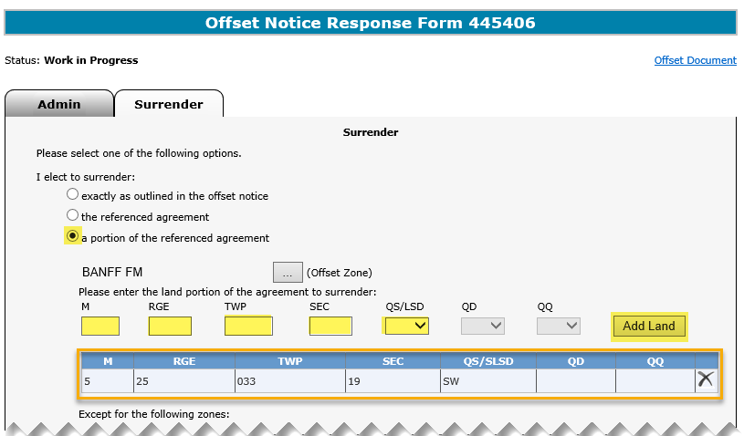
Offset
Government of Alberta
OFFSET NOTICE RESPONSE FORM – RESPONSE TYPE - SURRENDER - ADD PORTION LANDS
1. Enter land information
2. Click “Add Land”
3. Entered land
When “a portion of the reference agreement” is selected, the land key fields are enabled. The land portion of the agreement to surrender must be entered here.
To add more lands, repeat steps 1 and 2 above.
To remove a land key, click “ “ on the land row.
Page 25 of 37

Slide 26
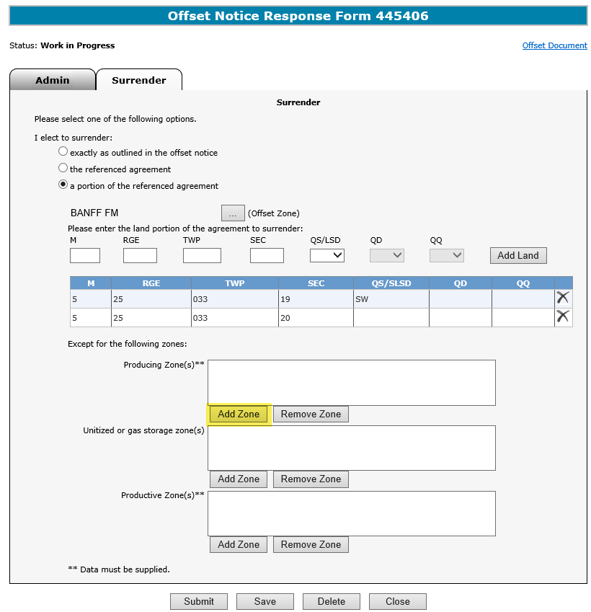
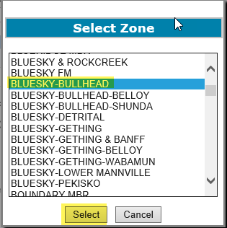
Offset
Government of Alberta
OFFSET NOTICE RESPONSE FORM – RESPONSE TYPE - SURRENDER - ADD ZONE EXCEPTIONS
1. Enter any exceptions for the Zones.
3. Select the Zone
2. Click Add Zone
4. Click Select
To add more than one exceptions, repeat steps 1 to 4 above.
To remove a zone from the exceptions, select the zone and click on Remove Zone.
Page 26 of 37

Slide 27
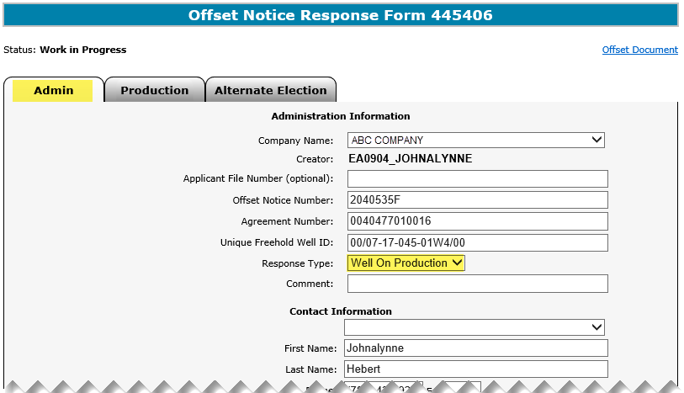
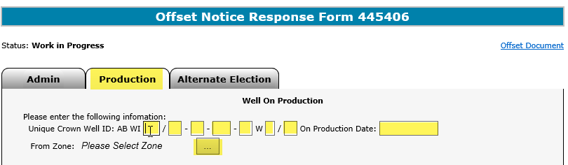
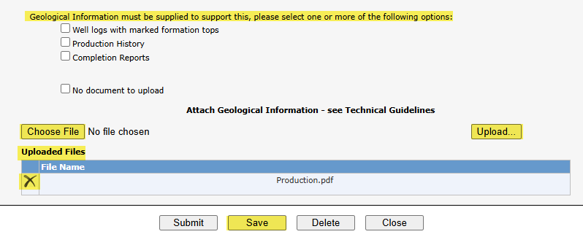
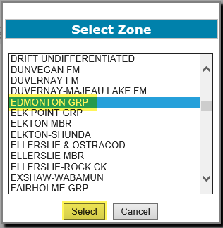
Offset
Government of Alberta
OFFSET NOTICE RESPONSE FORM – RESPONSE TYPE – WELL ON PRODUCTION
2. Enter the data for the Well on Production response type
3. To select the Zone click on the “ “
1. Select Well On Production as the Response Type
6. Click Choose File to browse file.
7. Click Upload…
4. Select the Zone
5. Click Select
9. Click X to remove attachment
8. Uploaded files are listed in the grid
Geological Information must be uploaded here in ETS.
An Alternate Election is required for this response type. Refer to the Alternate Election slide in this training module
Page 27 of 37

Slide 28
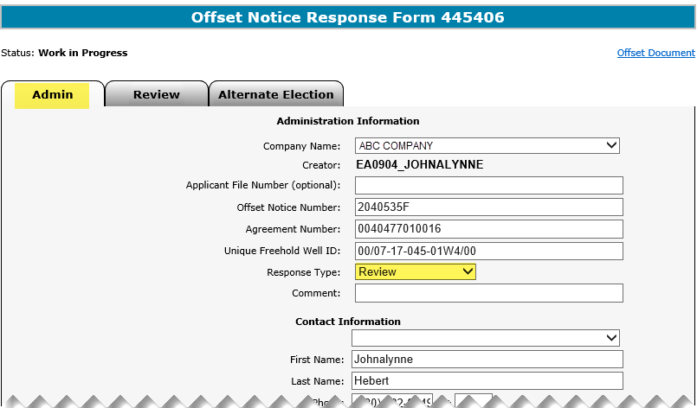
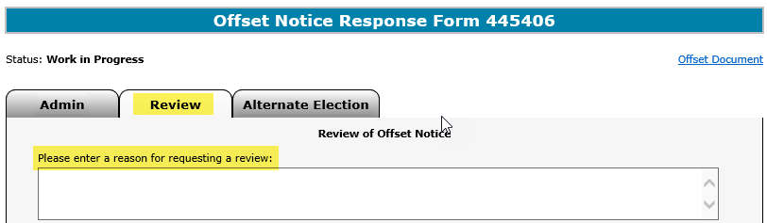
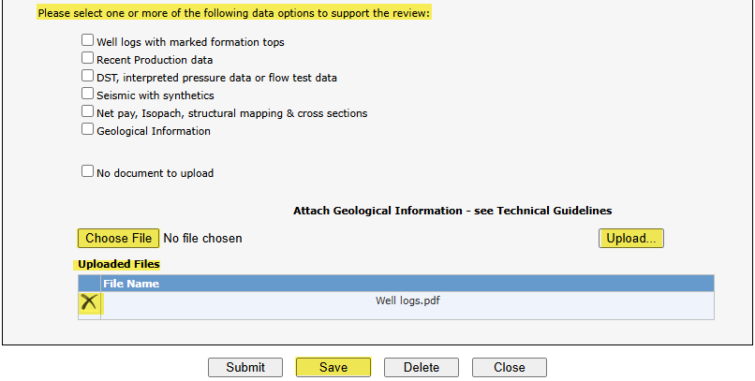
Offset
Government of Alberta
OFFSET NOTICE RESPONSE FORM – RESPONSE TYPE – REVIEW
2. Enter the data for the Well on Production response type
1. Select Extension as the Response Type
Geological Information must be uploaded here in ETS.
3. Click Choose File to browse file.
4. Click Upload…
The uploaded files are listed in the grid.
Click X to remove an attachment.
It is important to note to click Save before moving to the next tab.
An Alternate Election is required for this response type. Refer to the Alternate Election slide in this training module
Page 28 of 37

Slide 29
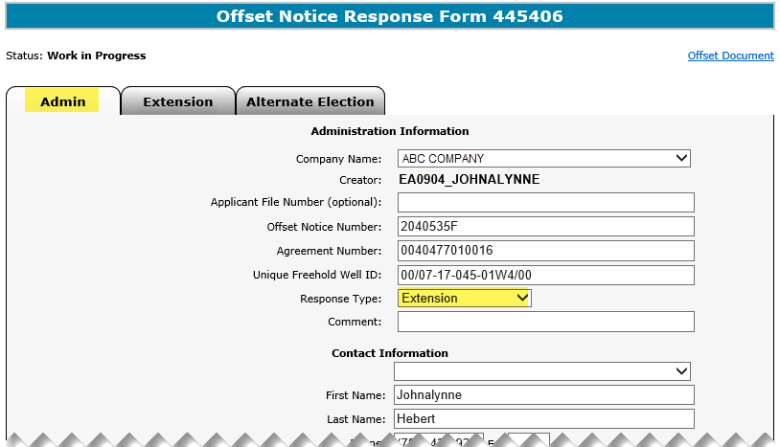
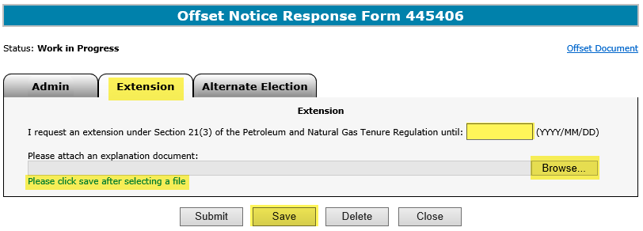
Offset
Government of Alberta
OFFSET NOTICE RESPONSE FORM – RESPONSE TYPE – EXTENSION
2. Enter the data for the Well on Production response type
1. Select Extension as the Response Type
3. Click Browse to select and upload the .PDF file.
It is important to note to click Save after selecting a file.
An Alternate Election is required for this response type. Refer to the Alternate Election slide in this training module
Page 29 of 37

Slide 30
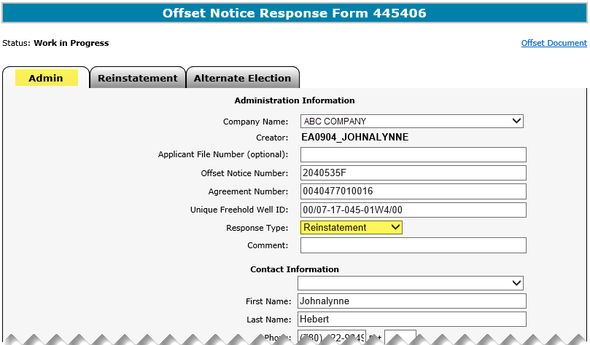
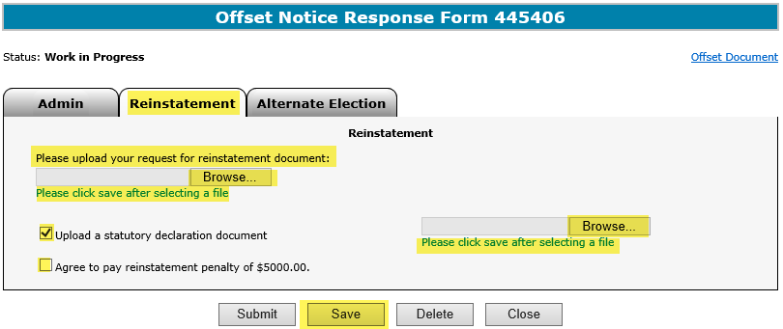
Offset
Government of Alberta
OFFSET NOTICE RESPONSE FORM – RESPONSE TYPE – REINSTATEMENT
2. Enter data for the Reinstatement response type
1. Select Reinstatement as the Response Type
3. Click Browse to select and upload the .PDF file. It is It is important to note to click Save after selecting each file.
Mineral agreement reinstatement decisions with offset obligation(s) are at the Minister’s discretion. It is up to the reinstatement applicant to submit a convincing case, which may include a statutory declaration. The declaration document is a notarized legal document. The applicant is also required to include the $5,000.00 reinstatement fee payment with the reinstatement request.
An Alternate Election is required for this response type. Refer to the Alternate Election slide in this training module.
Page 30 of 37

Slide 31
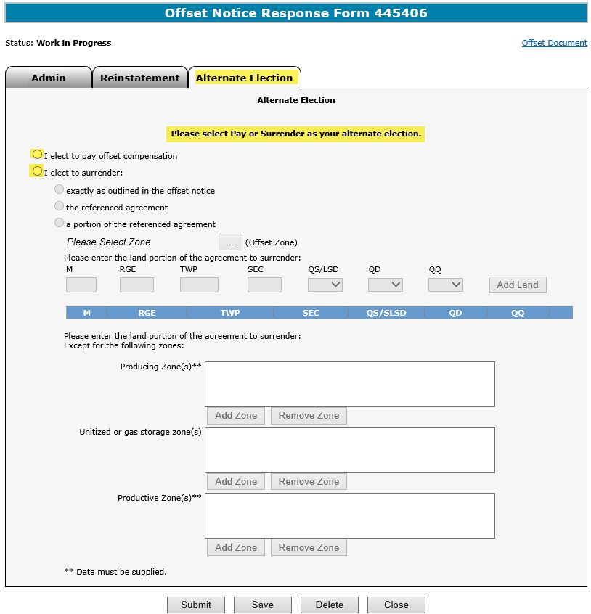
Offset
Government of Alberta
OFFSET NOTICE RESPONSE FORM – ALTERNATE ELECTION
Enter the Alternate Election
The Alternate Election tab is required when the selected Response Type is any of the following:
Well on Production
Review
Extension
Reinstatement
The Alternate Election can only be Pay or Surrender.
If you elect to surrender, follow the same steps as detailed for Surrender response type.
Page 31 of 37

Slide 32
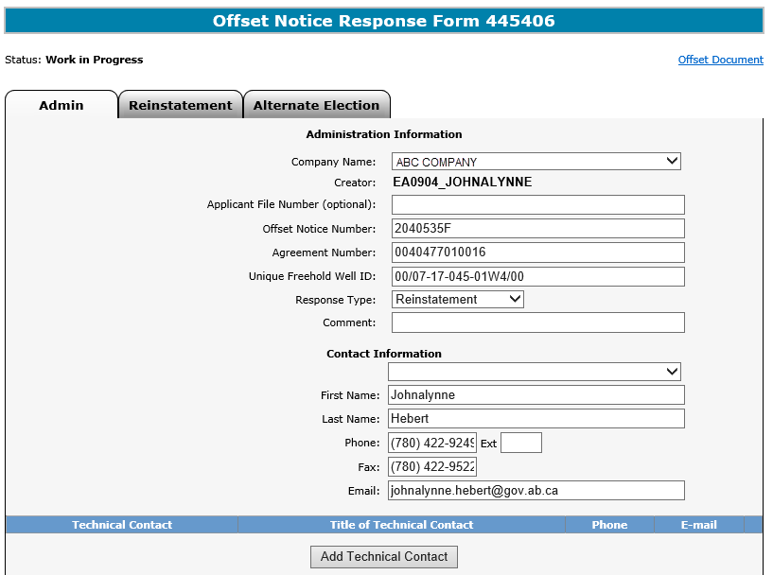
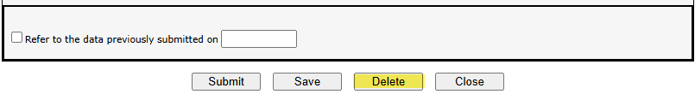
Offset
Government of Alberta
OFFSET NOTICE RESPONSE FORM – DELETE
You may delete the form only when it is at the status of Work In Progress.
Once it is deleted the status of the Offset Notice Response form is Client Cancelled.
The form is converted to read-only with available buttons of Copy and Close.
Copy button is to copy the deleted form and re-enter the required information.
1. Click Delete
Page 32 of 37

Slide 33
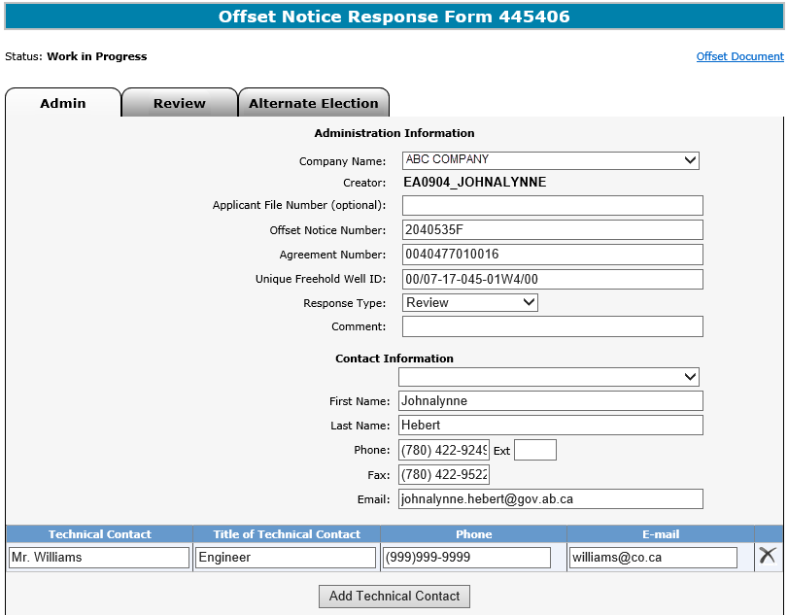
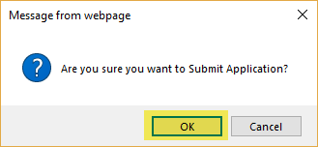
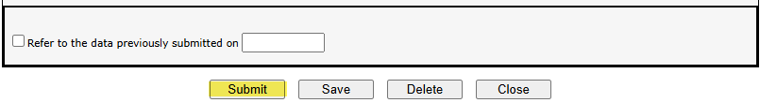
Offset
Government of Alberta
OFFSET NOTICE RESPONSE FORM – SUBMIT
Once all pertinent information has been entered, you can submit the Offset Notice Response Form.
The system will perform a validation to ensure all mandatory data has been provided.
Upon successful submission, the status is updated to Submitted.
Once the form is submitted, it cannot be modified or deleted.
1. Click Submit
2. Click OK
Page 33 of 37

Slide 34

Offset
Government of Alberta
OFFSET NOTICE RESPONSE FORM – LIFECYCLE
Work In Progress
ETS Request status at the initiation stage of the request.
Submitted
The status changes to Submitted once the request was successfully submitted.
Processing
Once it successfully submitted, the ETS request is now received in our internal applications for further review to determine the approval or denial of the Offset Notice Response.
Completed
When the internal review is completed, a letter is uploaded to ETS confirming the approval or denial of the offset response or request for further information/detailed data.
Page 34 of 37

Slide 35
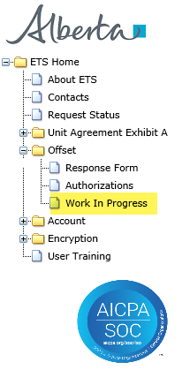

Offset
Government of Alberta
OFFSET NOTICE RESPONSE FORM – WORK IN PROGRESS SCREEN
The Work in Progress screen contains all different status depending on the state of each ETS Request.
Continued on the next slide…
Page 35 of 37

Slide 36
Offset
Government of Alberta
OFFSET NOTICE RESPONSE FORM – WORK IN PROGRESS STATUS
ETS Request Status:
Work in Progress
The creator can modify and save the form.
Client Cancelled
The creator has Deleted the form. The request is now converted to read-only and cannot be modified.
Submitted
The creator or submitter has Submitted the form. The request is now converted to read-only and cannot be modified.
Processing
The form has been received and validated by the department’s internal systems and is undergoing the review process.
Completed
The department completed the internal review process. The decision is communicated through letters which are uploaded to ETS Request # under Work in Progress.
Rejected
Internal applications has rejected the form due to validation/edit checks.
Page 36 of 37

Slide 37

Offset
Government of Alberta
CONCLUSION
Congratulations!
You have completed the
Offset Notice Response Form
Online Training Course
If you have any comments or questions on this training course,
please forward them to the following email address:
Energy.Offsets@gov.ab.ca
Page 37 of 37

