Slide 1
Offset
Government of Alberta
Welcome!
to the
Offset Authorization
Online Training Course
This process describes how an applicant can request authorization from the designated representative to create and submit an Offset Notice Response Form on their behalf.

Slide 2
Offset
Government of Alberta
Revision Page
Revisions Table
Date | Revisions Type | Page Number
September 5, 2014 | Initial Creation | All
September 22, 2020 | Updated header and contents | All

Slide 3
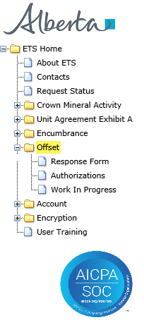
Offset
Government of Alberta
INTRODUCTION
In this module you will learn how to:
submit the request for authorization:
  complete Offset authorization request
  check the status of your request
authorize the request:
  concur
  reject
  revoke
Page 3 of 17

Slide 4
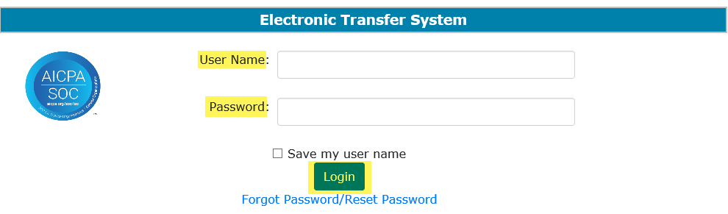
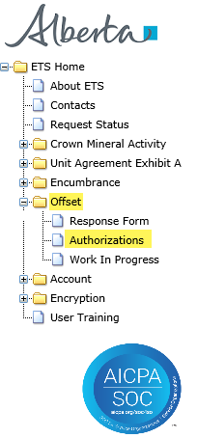
Offset
Government of Alberta
AUTHORIZATION – LOGIN
2. Expand Offset
1. Login to ETS with your user name and password
3. Select
Authorizations
Page 4 of 17

Slide 5
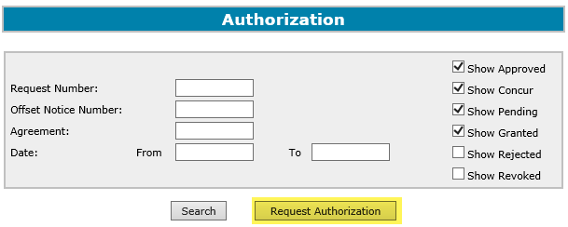
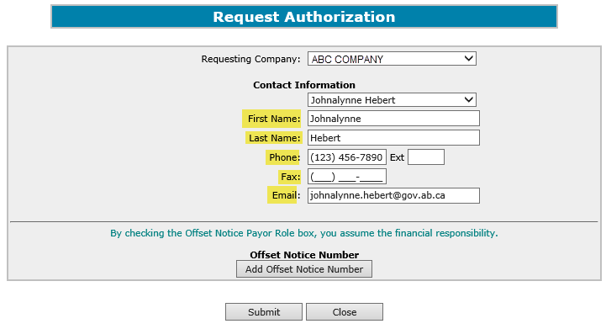

Offset
Government of Alberta
REQUEST AUTHORIZATION
2. Select the
Requesting Company
1. Click Request Authorization
3. Enter Contact information
You may either select an existing contact from the drop down list or enter a new contact information.
If the contact exists, the information will auto populate.
Page 5 of 17

Slide 6
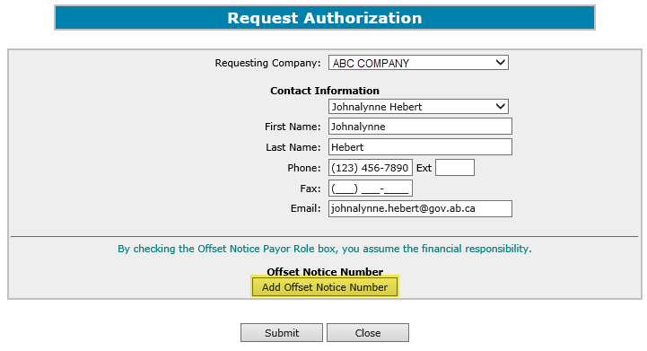
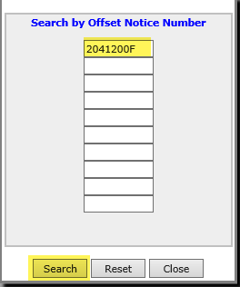
Offset
Government of Alberta
REQUEST AUTHORIZATION – ADD OFFSET NOTICE NUMBER
1. Click Add Offset Notice Number to select the offset
2. Enter the Offset Notice Number
3. Click Search
Page 6 of 17

Slide 7
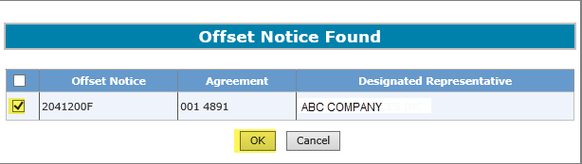
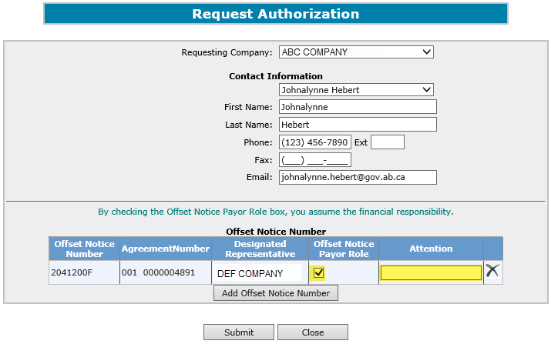
Offset
Government of Alberta
REQUEST AUTHORIZATION – ADD OFFSET NOTICE NUMBER - CONTINUED
4. Click the check box
5. Click OK
7. Enter the Attention Name for this Offset, if available. This is an optional field.
6. Check Offset Notice Payor Role, if applying for Payor Role.
Page 7 of 17

Slide 8
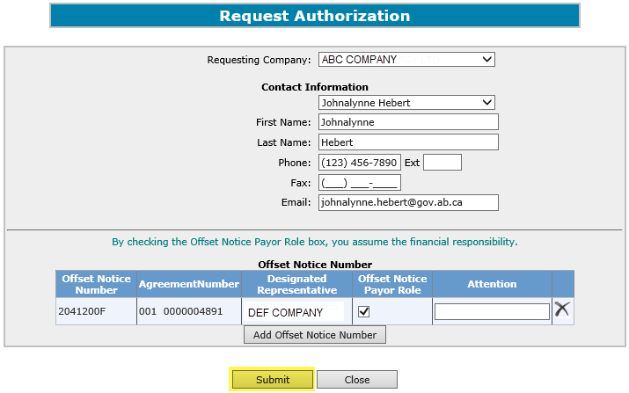
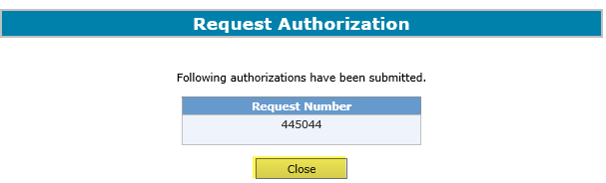
Offset
Government of Alberta
REQUEST AUTHORIZATION - SUBMIT
1. Click Submit
2. Click Close
Page 8 of 17

Slide 9
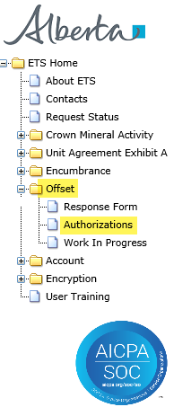
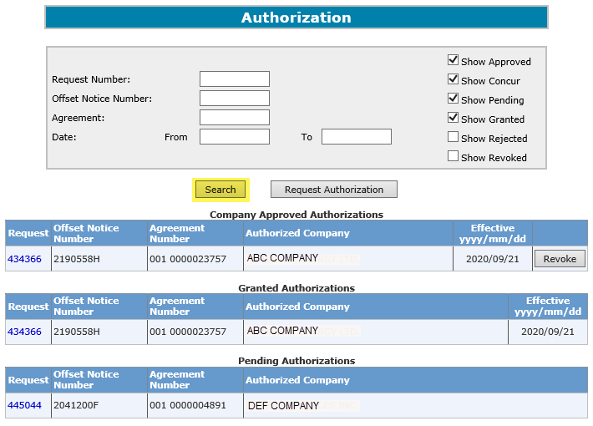
Offset
Government of Alberta
REQUEST AUTHORIZATION – CHECK STATUS
2. Enter search Parameters
1. Select Authorizations
3. Click Search
Search result.
Page 9 of 17

Slide 10
Offset
Government of Alberta
REQUEST AUTHORIZATION – STATUS DEFINITIONS
Approved
The Designated Representative has concurred the offset authorization request.
Pending
The authorization request is submitted but the Designated Representative has not yet Approved nor Rejected the offset authorization request.
Concur
The authorization request is submitted by the applicant but is not yet concurred by the concurrer.
Granted
Shows which authorization requests have been concurred.
Rejected
The Designated Representative has rejected the offset authorization request.
Revoked
The Designated Representative has revoked a previously concurred (approved) authorization request.
Page 10 of 17

Slide 11
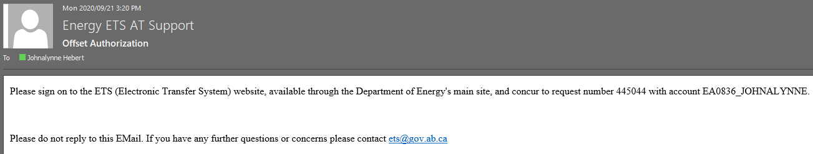
Offset
Government of Alberta
REQUEST AUTHORIZATION – EMAIL NOTIFICATION SAMPLE
ETS sends an email notification advising the authorizing company that there is an authorization request(s) that is available for concurrence.
Page 11 of 17

Slide 12
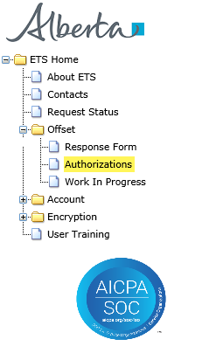
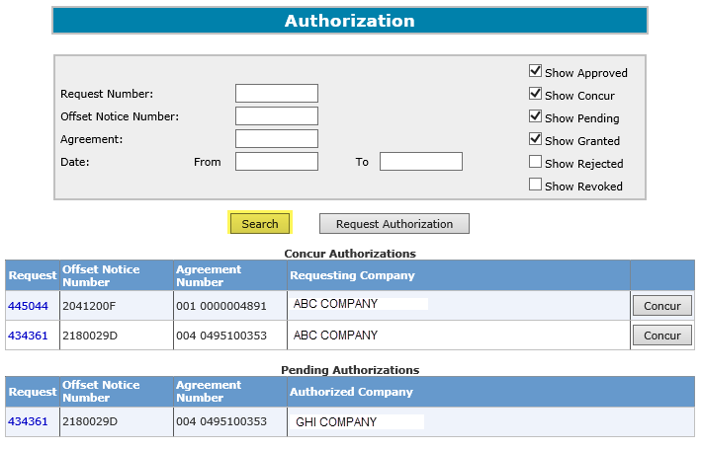
Offset
Government of Alberta
REQUEST AUTHORIZATION - CONCUR
1. Select Authorizations
2. Click Search
Search results.
The Concur Authorizations section displays the requests to Concur.
Page 12 of 17

Slide 13
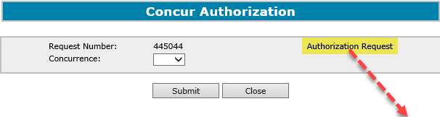
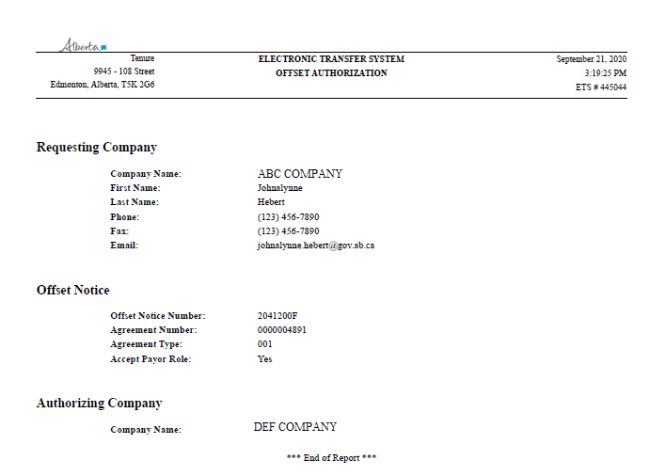
Offset
Government of Alberta
REQUEST AUTHORIZATION – AUTHORIZATION REQUEST REPORT
The Authorization Request report is in .PDF format and shows the details of the authorization request for your review.
Page 13 of 17

Slide 14
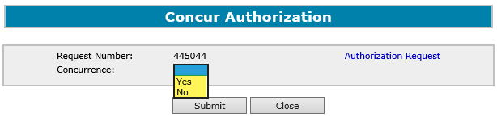
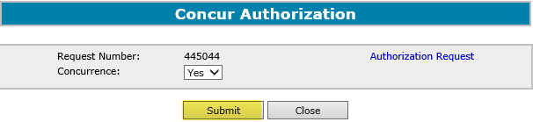
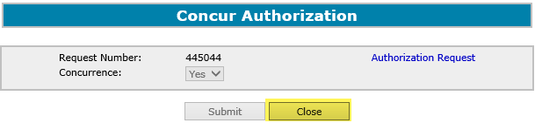
Offset
Government of Alberta
REQUEST AUTHORIZATION – CONCUR AND SUBMIT
1. Click the dropdown and select Yes
3. Click Close
2. Click Submit
Upon submission of the request, ETS sends an email to the applicant advising that the concur request is completed.
Page 14 of 17

Slide 15
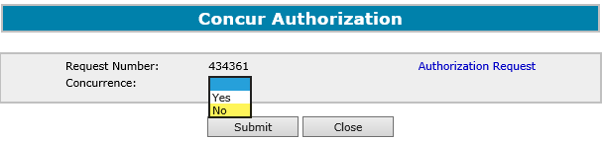
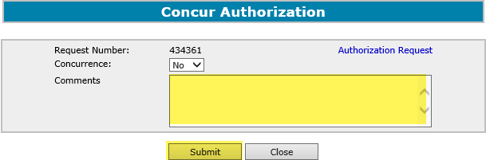
Offset
Government of Alberta
REQUEST AUTHORIZATION – REJECT AND SUBMIT
1. Click the dropdown and select No
2. Enter Comments for rejecting the authorization request
3. Click Submit
Upon submission of the request, ETS sends an email to the applicant advising that the request has been rejected.
Page 15 of 17

Slide 16
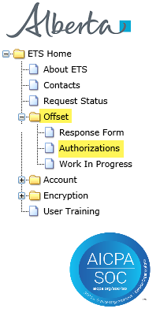
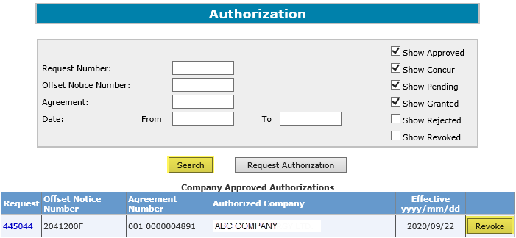

Offset
Government of Alberta
REQUEST AUTHORIZATION – REVOKE
1. Select Authorizations
2. Select your parameters.
3. Click Search
Click Revoke
Upon selecting “Revoke", ETS sends an email to the applicant advising of the request that has been revoked.
Page 16 of 17

Slide 17

Offset
Government of Alberta
CONCLUSION
Congratulations!
You have completed the
Offsets Authorizations
Online Training Course
Please proceed to the subsequent modules
detailing other functionality of Offset.
If you have any comments or questions on this training course,
please forward them to the following email address:
WellAdmin.Energy@gov.ab.ca
Page 17 of 17

