Slide 1

Welcome
Geothermal Continuation – Non-Productivity Notice:
This is the process to view and retrieve a Non-Productivity Notice (Section 7(1) of Geothermal Resource Tenure Regulation) or a Non-Productivity Notice Withdrawal via ETS.
To the ETS – Geothermal Continuation:
Non-Productivity Notice
Online Training Course

Slide 2
Revisions
Revisions Table
Date | Revisions Type | Page Number
September 2025 | Initial Creation | All

Slide 3
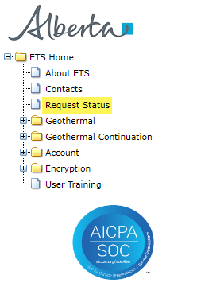
Introduction
In this module you will learn how to:
View and retrieve a Geothermal Non-Productivity Notice document.
View and retrieve a Geothermal Non-Productivity Notice Withdrawal document.

Slide 4
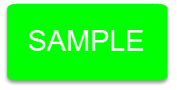
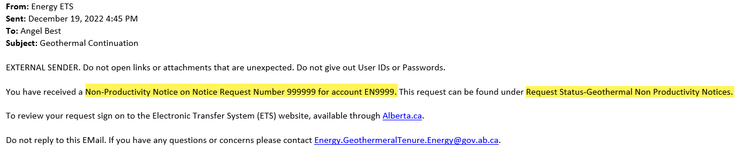
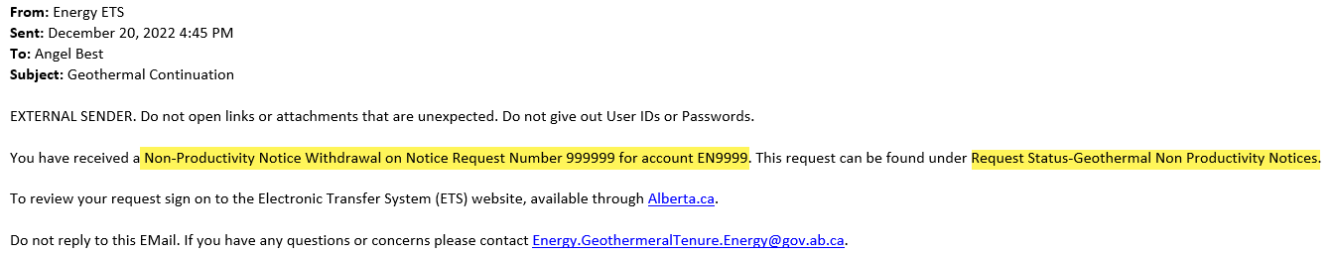
Email Notification
You will receive an Email Notification from ETS, when either a Geothermal Non-Productivity Notice or Geothermal Non-Productivity Notice Withdrawal Letter is sent to your ETS account.

Slide 5
View and Retrieve a Non-Productivity Notice
You must have the Viewer role to view or retrieve a Geothermal Non-Productivity Notice
A Non-Productivity Notice is served under Section 7(1) of the Geothermal Resource Tenure Regulation.

Slide 6
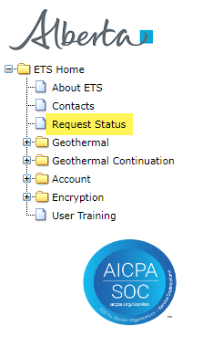
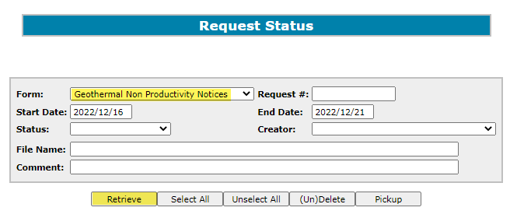
Request Status
After you receive an Email Notification from ETS, you would access the Request Status screen. Choose your Search Parameters and select Retrieve. You must have Geothermal Non-Productivity Notices form type to retrieve Geothermal Non-Productivity Notices and Geothermal Non-Productivity Withdrawal Letters.
2. Choose your Search Parameters
1. Select Request Status
3. Select Retrieve

Slide 7
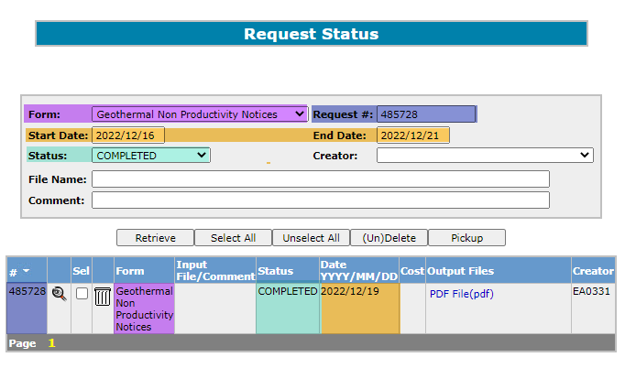
Request Status – Search Parameters and Result
You can utilize the search parameter fields to filter search results.
The table on the right shows the correlation between the parameter fields and each corresponding result column.
Below is a color-highlighted illustration of the Work in Progress search screen to further demonstrate the relationship between the data.
Parameter Field | Result Column
Type | Form Type
Request Number | ETS #
Start/End Date | Last Updated
Status | Status
File Name | (not shown as a result column)
Comment | (not shown as a result column)

Slide 8
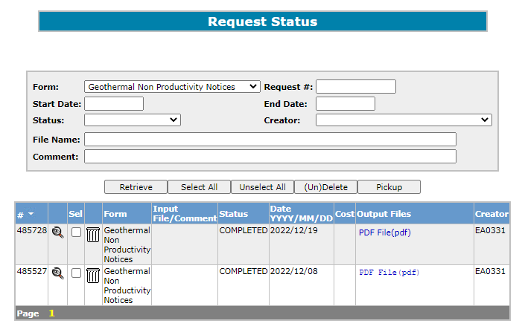
Request Status – Search Result
Search Result
To open a document, click on the report PDF link.
Navigate with the page numbers, if there are multiple pages of search results.

Slide 9
Request Status – Search Result
The Request Status screen will populate all Completed requests. Select the PDF relating to the Reference Number detailed in the Email Notification. The corresponding letter will populate.
2. Select PDF
1. Reference Number

Slide 10
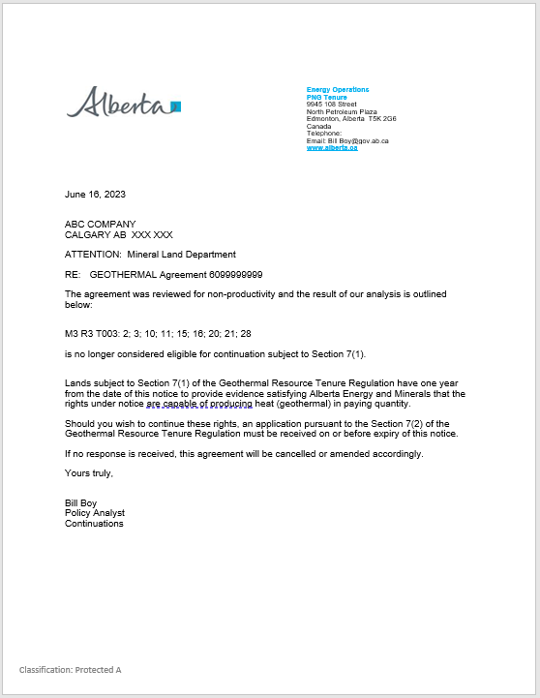
Non-Productivity Notice Letter

Slide 11
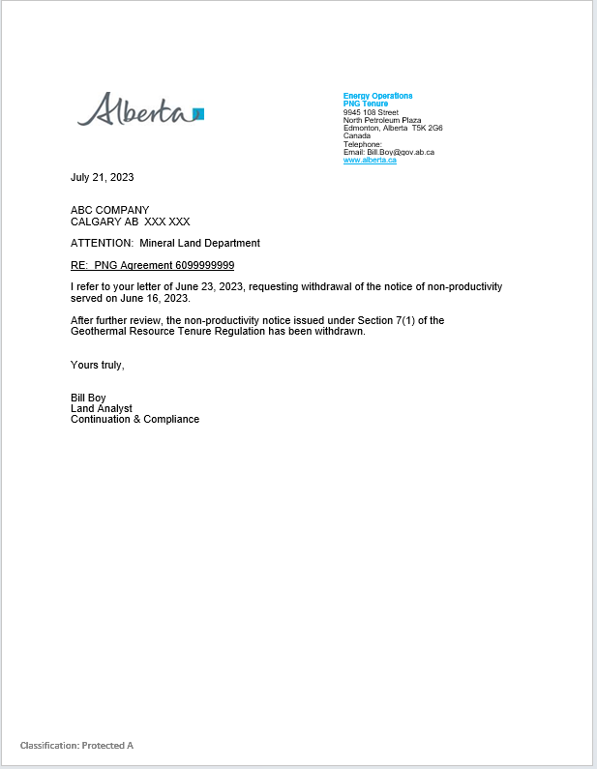
Non-Productivity Notice Withdrawal Letter

Slide 12

Congratulations!
Congratulations!
You have completed the ETS – Geothermal Continuation:
Non-Productivity Notice Online Training Course
To access Courses, Guides and Forms for all your ETS Business please see Alberta Online Learning .
If you have any comments or questions on this training course,
please contact: Energy.GeothermalTenure@gov.ab.ca

