Slide 1

Welcome
Geothermal Continuation – Expiry Reinstatement:
This is the process to complete and submit an Online Expiry Reinstatement request via ETS for a Geothermal Agreement. The process begins with the creation of a new request through to submission. The request progresses through various stages (statuses) until completion.
To the ETS – Geothermal Continuation:
Expiry Reinstatement
Online Training Course

Slide 2
Revisions
Revisions Table
Date | Revisions Type | Page Number
September 2025 | Initial Creation | All

Slide 3
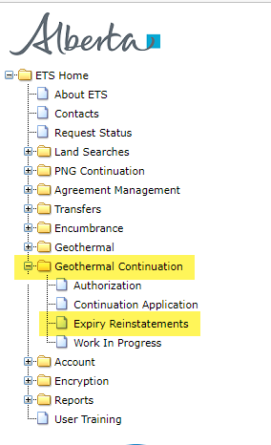
Expiry Reinstatement - Introduction
In this module, you will learn how to:
Create and submit an Online Expiry Reinstatement request
Cancel or withdraw an Online Expiry Reinstatement request
View response document(s)
Course Pre-requisites:
Training System Overview
ETS Account Setup and Preferences (For Site Administrators)
You must have the Creator role to create or withdraw a request and the Submitter role to submit a request.

Slide 4
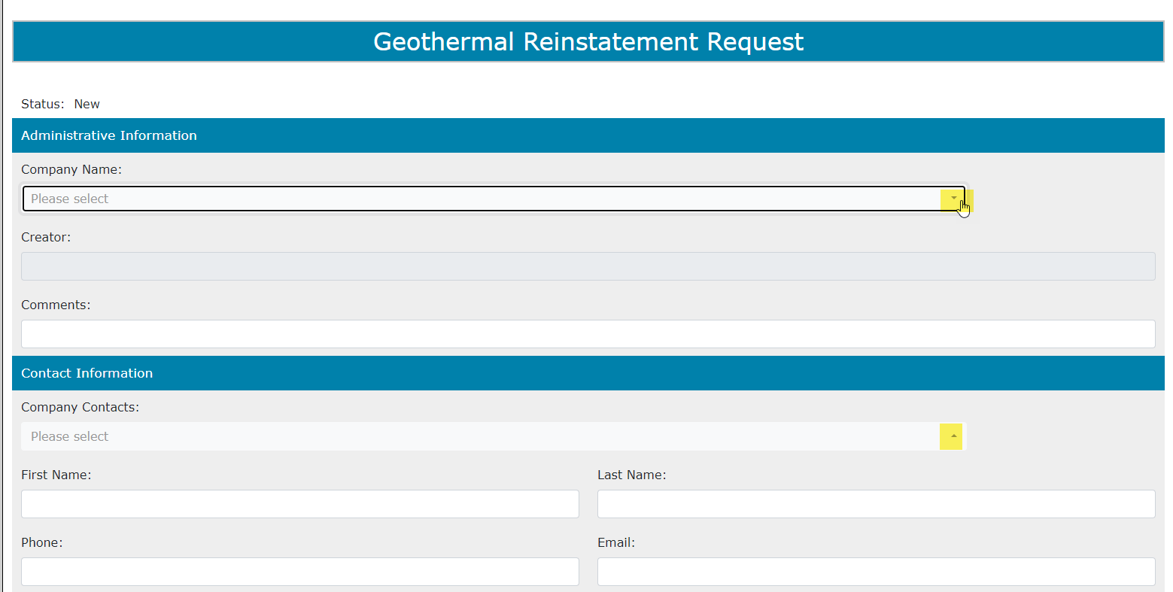
Create – Expiry Reinstatement
Select the Expiry Reinstatements node under Geothermal Continuation. Complete the Company Information, then under the Agreement Information select the dotted box to enter your agreement number.
1. Complete Company and Contact Information

Slide 5
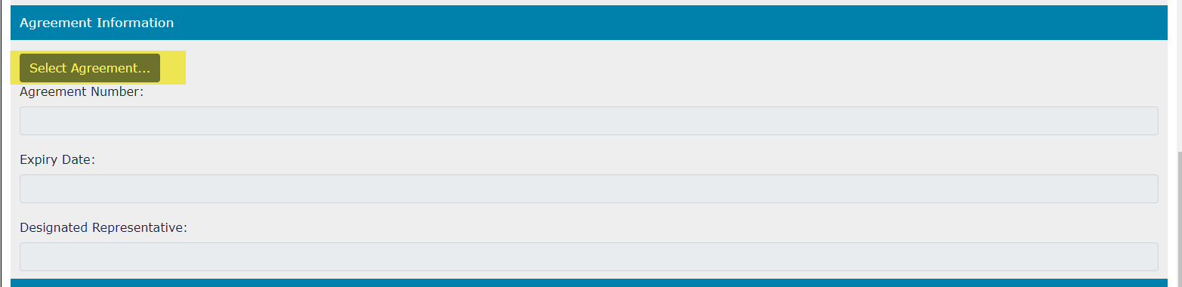
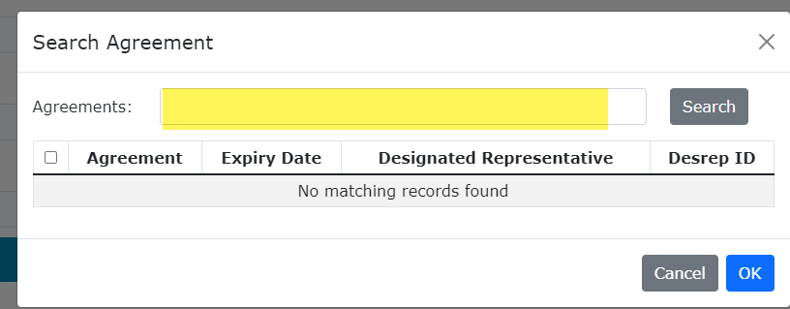
Create – Expiry Reinstatement (continued)
Type in the Geothermal agreement number in the Search Agreements screen, select Search. The Agreements Found screen will populate the Agreement Number. Select the Agreements Found number Check Box, then select OK.
2. Enter Agreement number
1. Select Agreement Number
3. Select OK

Slide 6
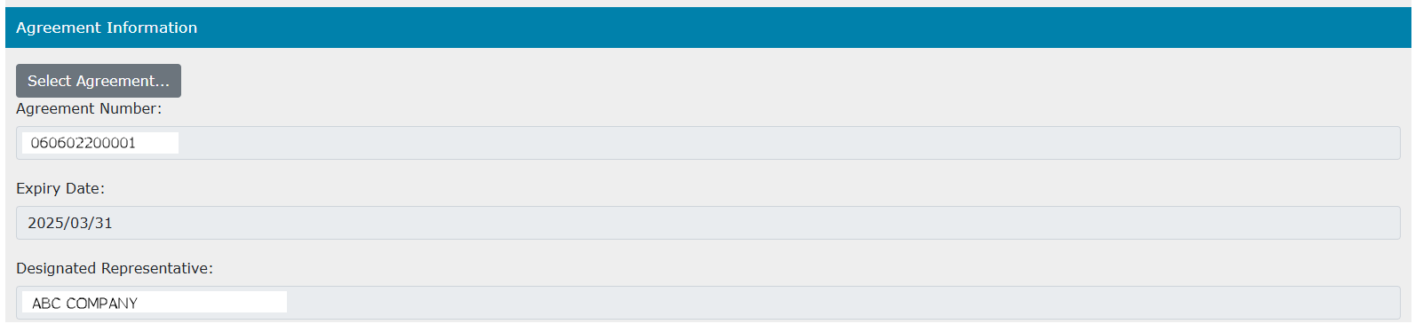
Create – Expiry Reinstatement (continued)
The Agreement number will then display on the Geothermal Reinstatement Request. Along with the Expiry Date and Designated Representative.

Slide 7
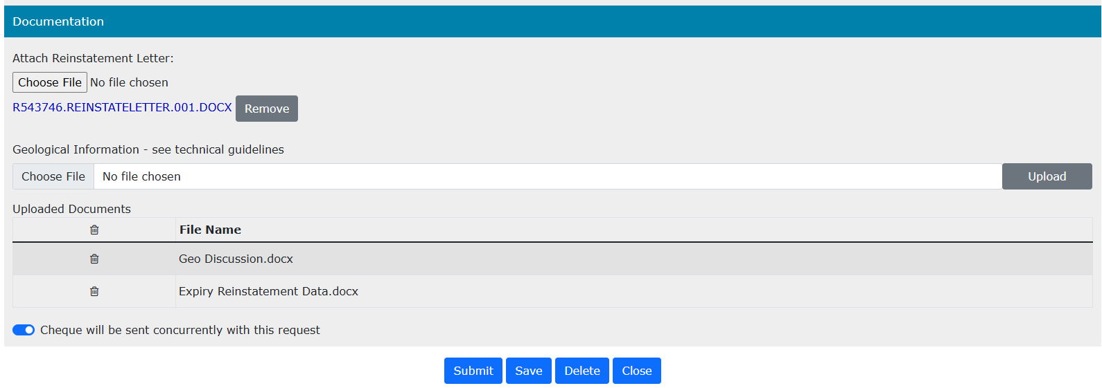

Create – Expiry Reinstatement
Documentation and Submission
1. Select Choose File to attach a reinstatement letter
2. Select Choose File to upload a geological discussion and/or data
3. Select Cheque will be sent Concurrently
5. Select Submit
4. Select Save
If a reinstatement letter is not attached or Cheque will be sent concurrently is not toggled for the request, an error will display, and you will not be able to submit your reinstatement request.

Slide 8
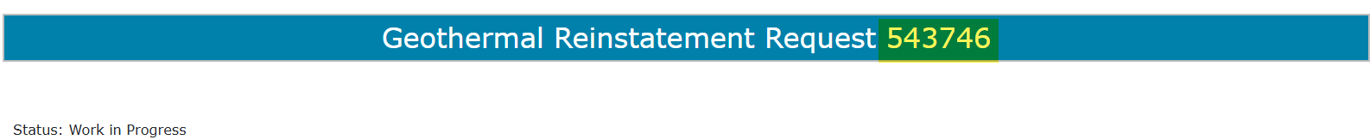
Create – Expiry Reinstatement
Documentation and Submission (continued)
Once you save your request, an ETS Request number will be assigned.

Slide 9
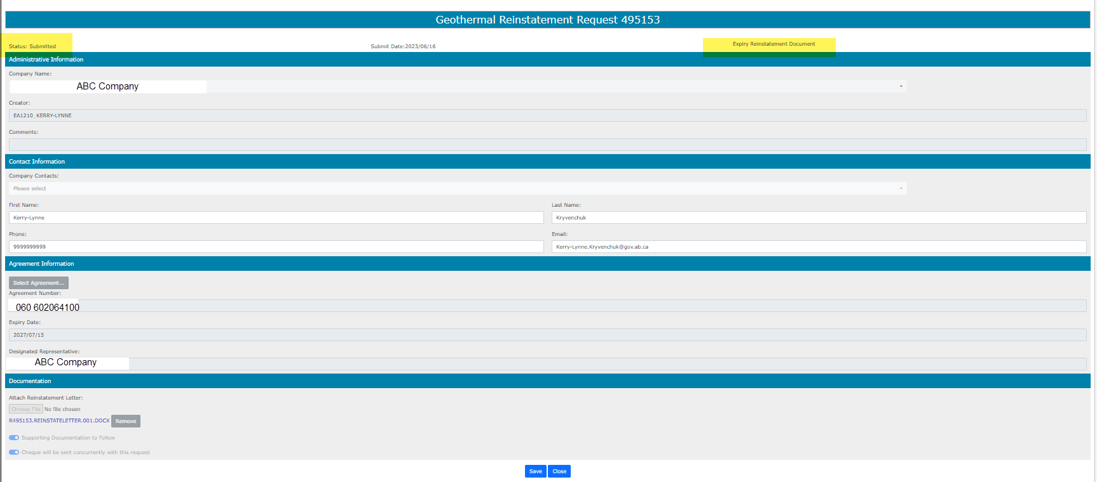
Create – Expiry Reinstatement
Documentation and Submission (continued)
A Message Box will populate stating are you sure you want to submit your request. Select Ok. Your Expiry Reinstatement status will now be Submitted.
If you wish to print out or save an electronic copy of your request, please select the “Expiry Reinstatement Document” on the top right hand of the screen.

Slide 10
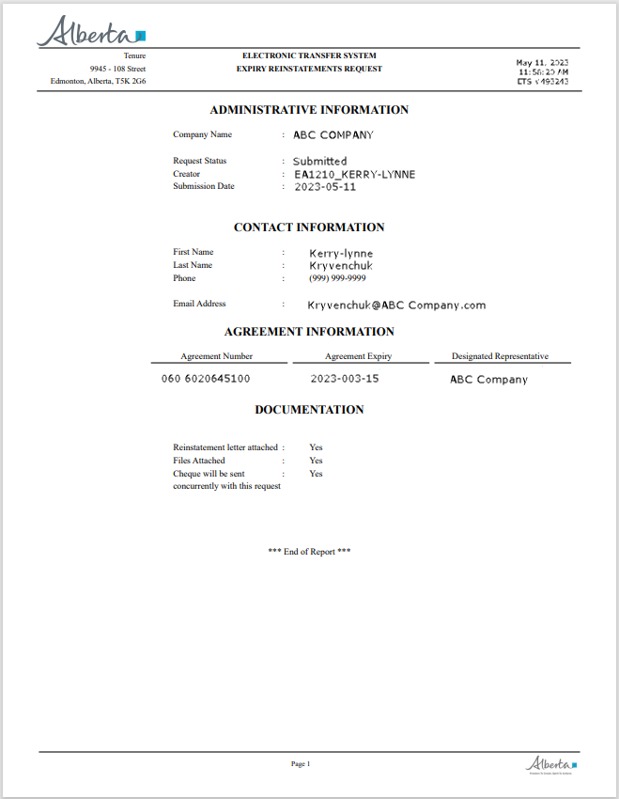
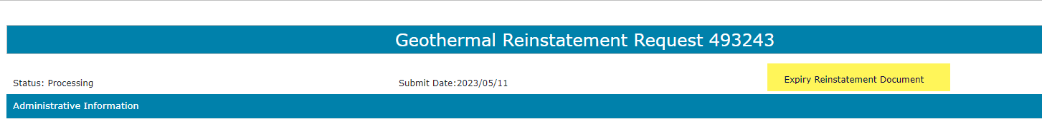
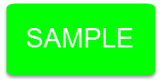
By selecting Expiry Reinstatement Document, the following PDF document will populate for your records.

Slide 11
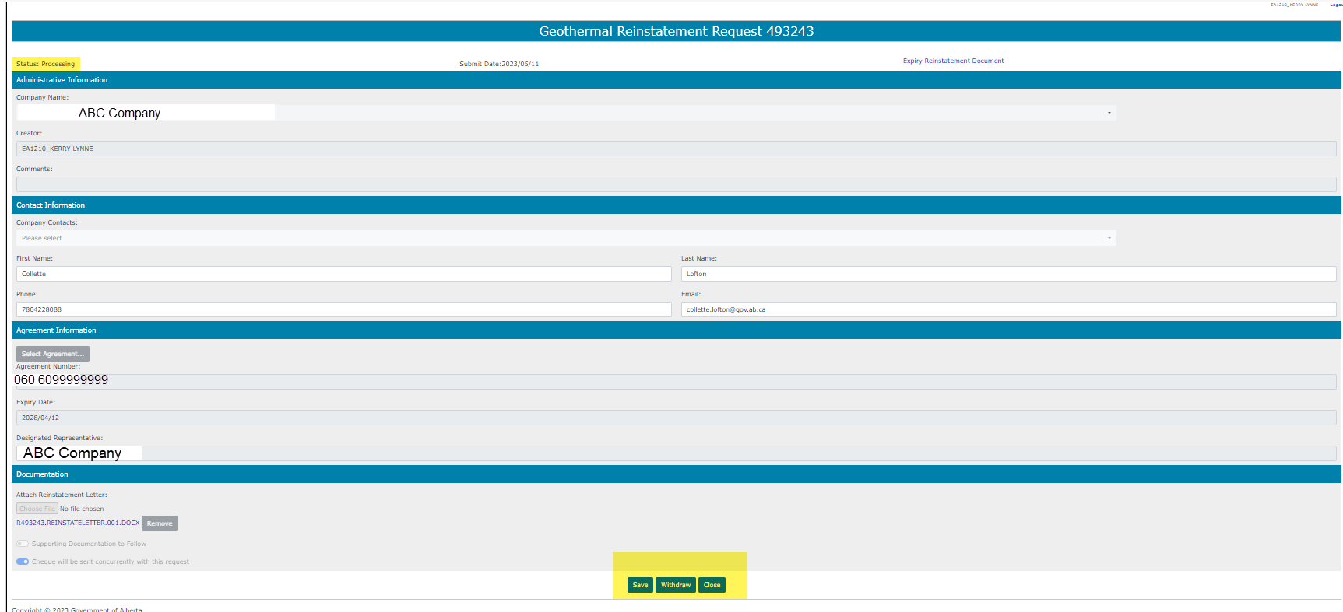
After submitting your request, the Status will change to Processing. At the bottom of the screen, you must select either Save, Withdraw or Close Button.

Slide 12
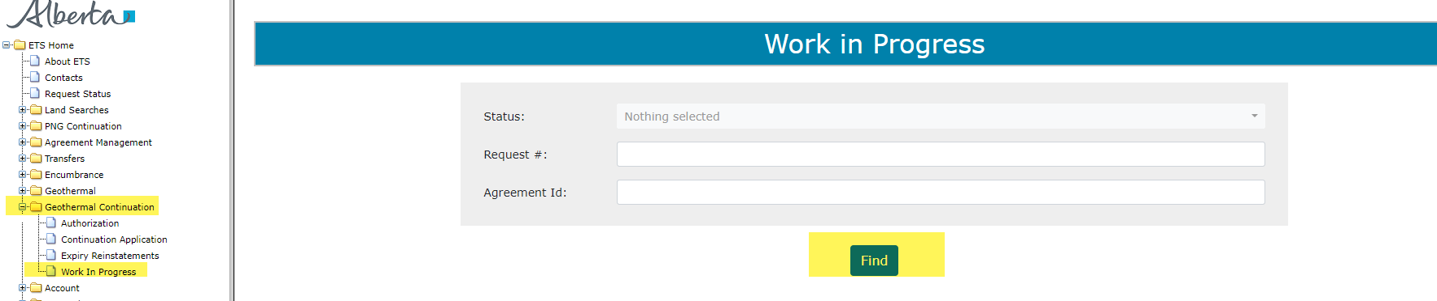
Work in Progress
The Work in Progress screen will populate, select Find and all your reinstatements currently in ETS will generate. By changing the parameters on the Work in Progress screen varying results will populate. You can also search by the ETS Request Number.
1. Select Find

Slide 13
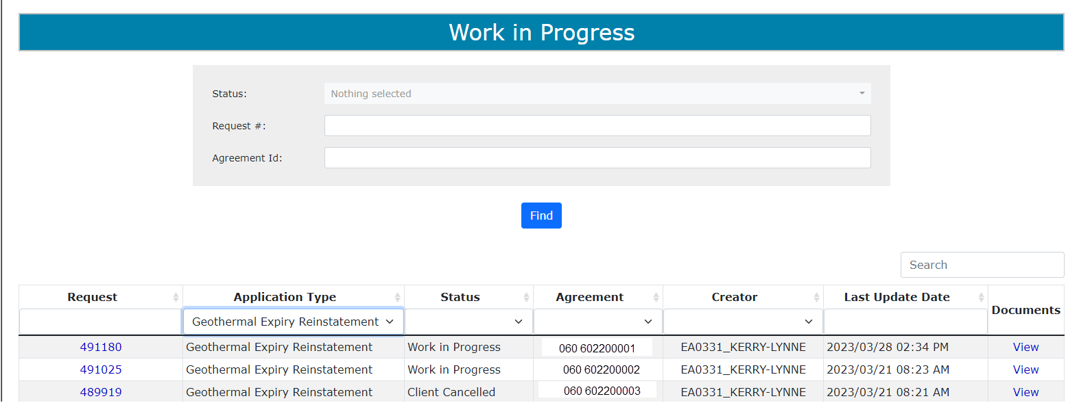
Request Status – Search Parameters and Result
Parameter Field | Result Column
Type | Application Type
Request Number | ETS #
Start/End Date | Last Updated
Status | Status
Agreement # | Agreement#
Documents | View documents
You can utilize the search parameter fields to filter search results.
The table on the right shows the correlation between the parameter fields and each corresponding result column.
Our File 1234

Slide 14
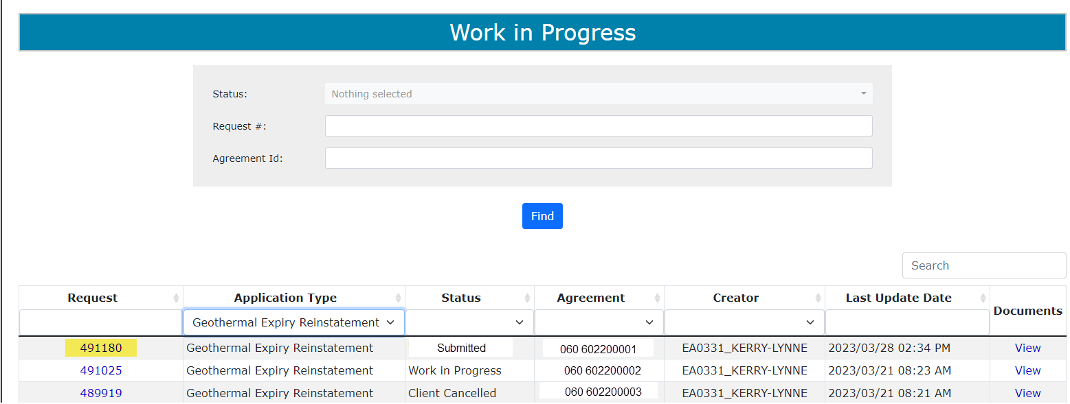

Request Status – Search Result
To load a request, click on the ETS Request number link.
Search Results
To open a document click on the Documents Pdf link.
Navigate with this page number, if there are multiple pages of search results.

Slide 15
Reinstatement Completed
If a decision is received by ETS, the request status becomes Completed.
An email will be sent from ETS informing your company’s contact that the decision has been made. These email notifications are considered a courtesy and should not be relied on to track Geothermal Continuation requests in ETS.
When submitting a request through ETS, it is your responsibility to continually check your Work in Progress to determine if any decisions have been sent.

Slide 16
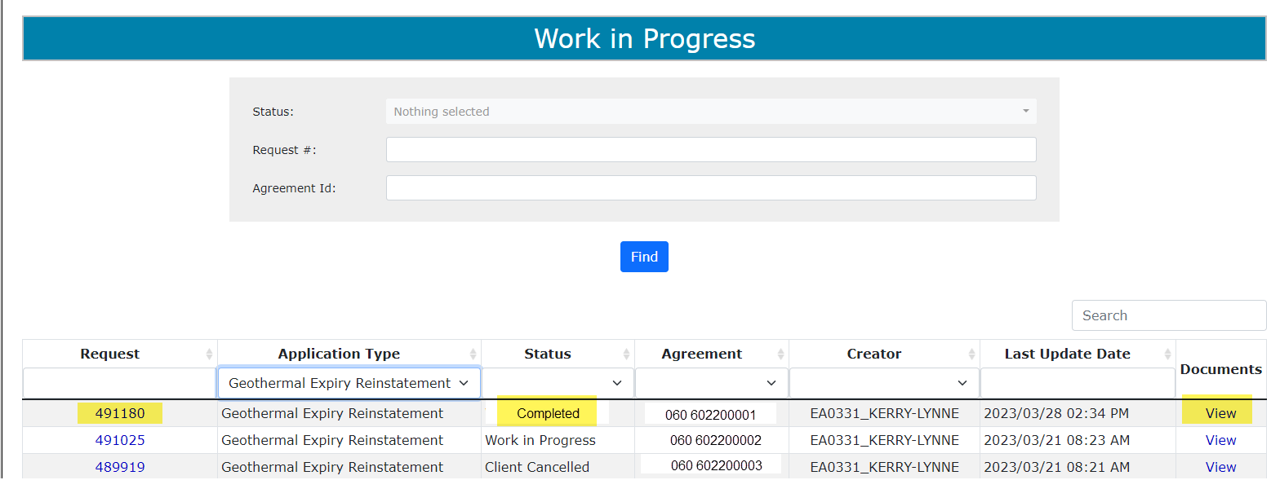
Select Work in Progress under the Geothermal Continuation node, the Work In Progress screen will populate. Select Find, and all of your Reinstatements currently in ETS will generate. You may also search your request using the Request Number provided to you with your original submission.
1. Select Find

Slide 17
Expiry Reinstatement Letter
Select View from the Documents column and the Reinstatement Letter will populate.
1. Select View

Slide 18
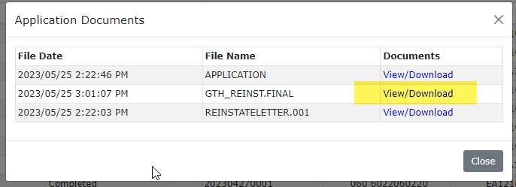

Slide 19
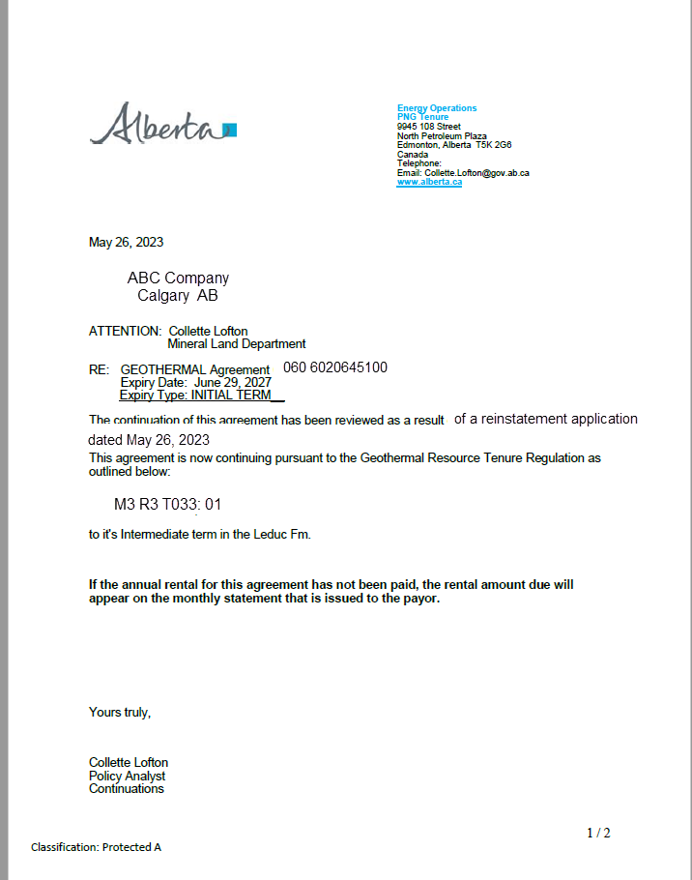
Expiry Reinstatement Letter

Slide 20
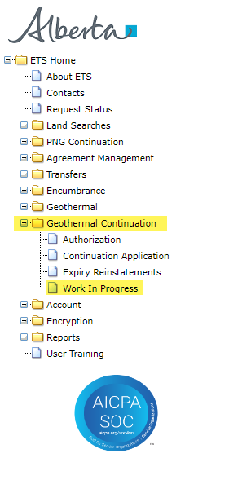
Expiry Reinstatement - Withdraw
By selecting either the Expiry Reinstatement Type or by entering the Request Number you may access your submission and Withdraw your request.
To Withdraw your Expiry Reinstatement request, the Status will need to be Submitted. At this point you will access the Work in Progress screen and click on the ETS Request Number. You may Withdraw your Expiry Reinstatement at anytime while the Status is Submitted or Processing (Submitted).
. Select Request Number

Slide 21
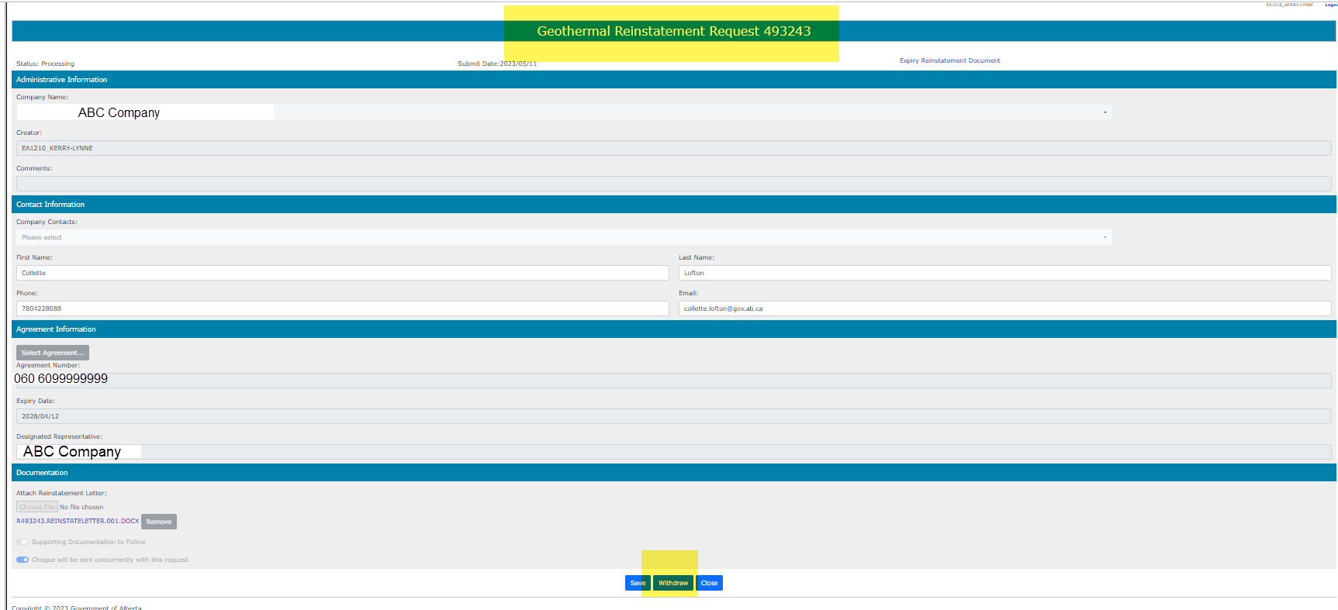
The Administration Information screen will populate displaying the Company Information and the Agreement Information to Reinstate. Click on the Withdraw button at the bottom of the screen.
005
1. Click Withdraw

Slide 22
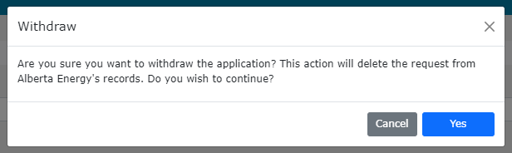
A Message box will populate confirming the Withdrawal of your Expiry Reinstatement application. To proceed click the Yes button.
2. Click Yes

Slide 23
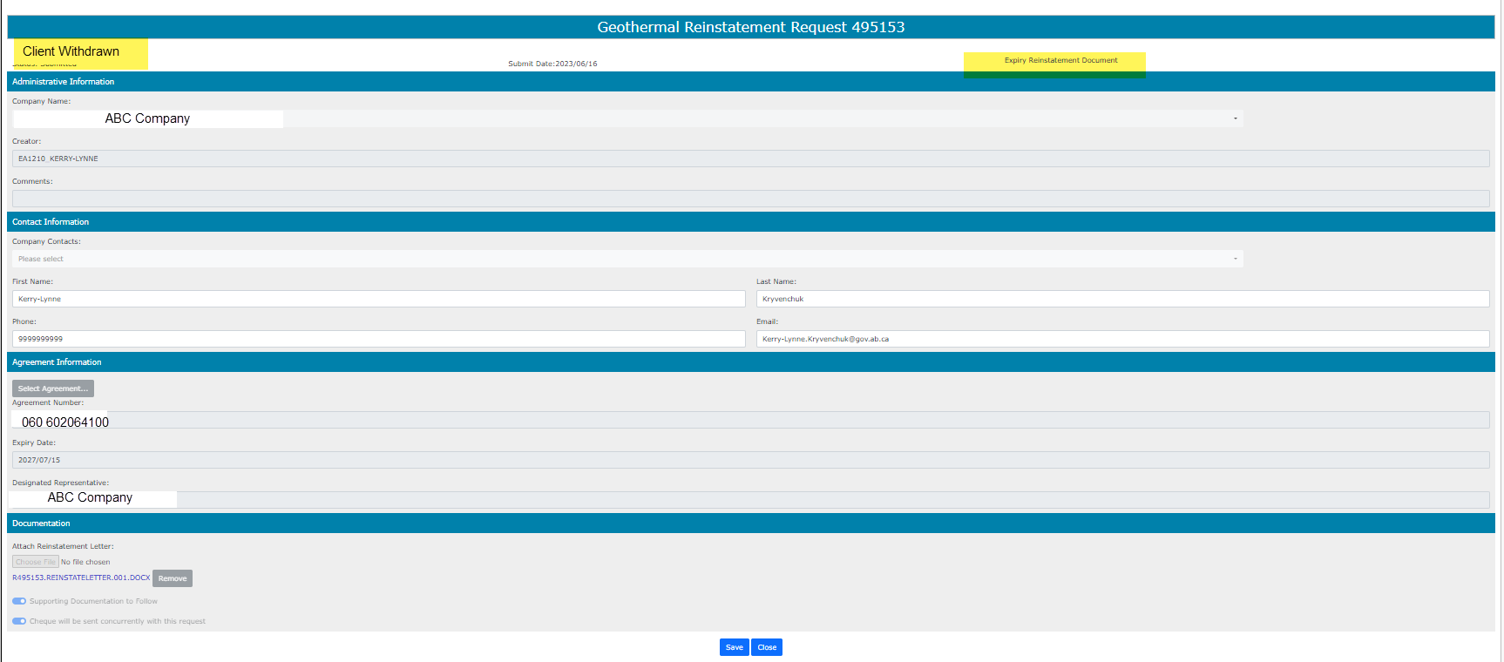

Once you select Yes, the screen will populate with the Status of Client Withdrawn. All information has been deleted from Alberta Energy & Mineral’s records. Select Close, you will be taken back to Work In Progress.
1. Select Close
By selecting the Reinstatement Document a PDF electronic version of your form will populate.

Slide 24
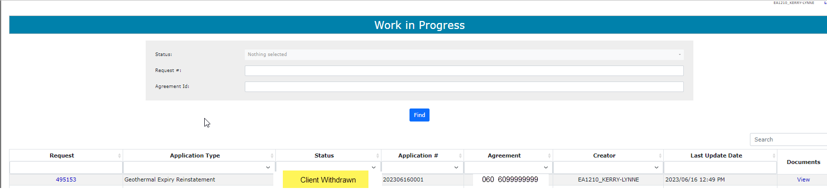
The Work in Progress screen will confirm the Expiry Reinstatement has been Client Withdrawn.

Slide 25

Congratulations!
Congratulations!
You have completed the ETS – PNG Continuation: Expiry Reinstatement
Online Training Course
To access Courses, Guides and Forms for all your ETS Business please see ETS Support and Online Learning.
If you have any comments or questions on this training course,
please contact:
Email inquiries:
Energy.GeothermalTenure@gov.ab.ca

