Slide 1
Geothermal Application
Government of Alberta
Welcome!
To the
Geothermal Application
Online Training Course
The Geothermal Application functionality allows users to submit a request to acquire a Geothermal agreement without going through the public offering process.

Slide 2
Geothermal Application
Government of Alberta
Revision Page
Revisions Table
Date | Revisions Type | Page Number
November 18, 2022 | Initial Creation | All

Slide 3
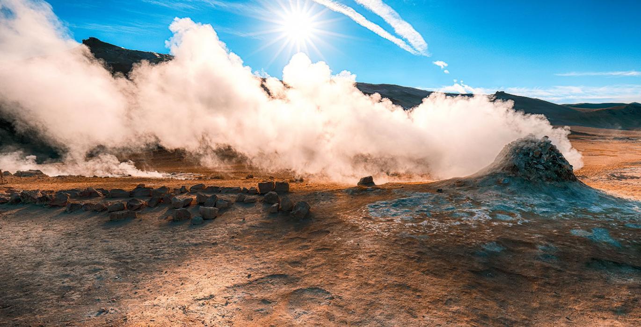
Geothermal Application
Government of Alberta
INTRODUCTION
In this module you will learn how to:
Enter a Geothermal Application into ETS.
Update a Geothermal Application by adding or removing information while the application is a Work in Progress status.
Retrieve and View Agreement Documents

Slide 4
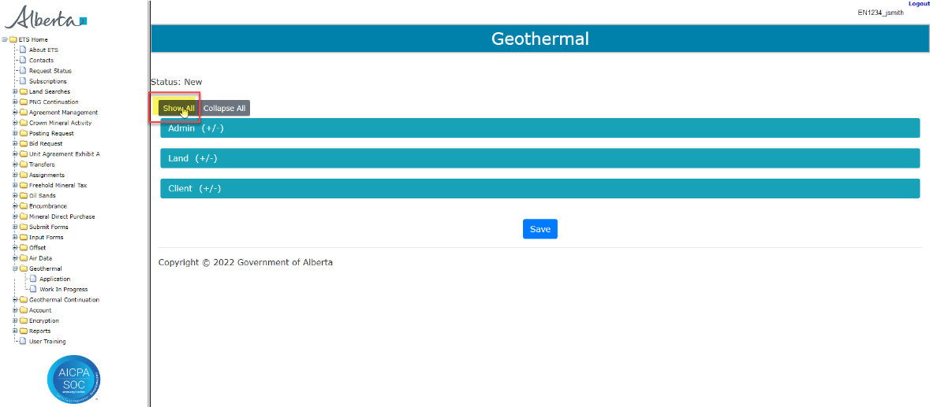
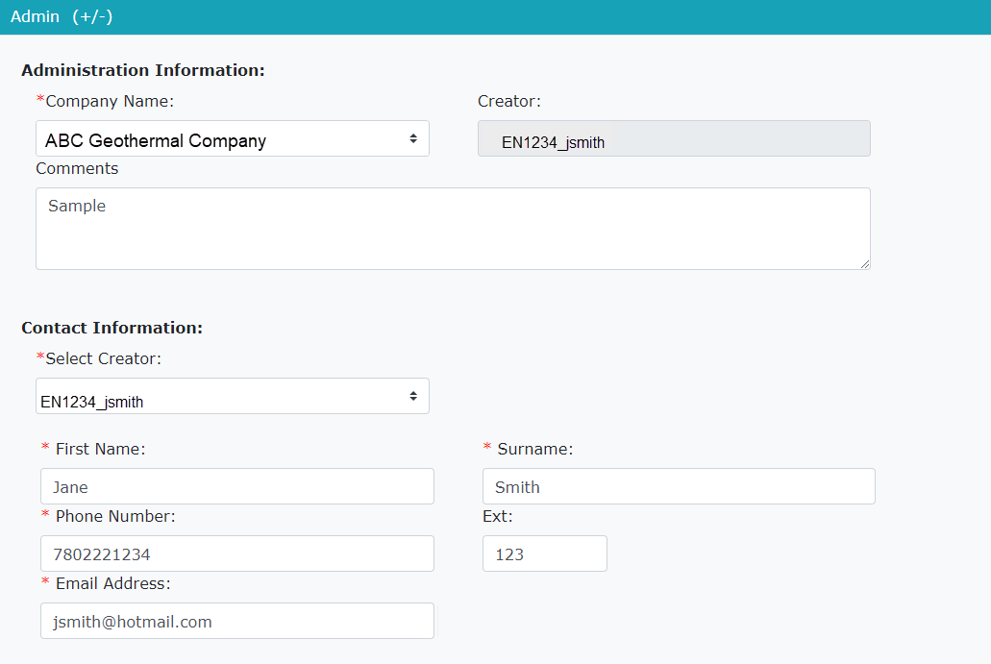

Geothermal Application
Government of Alberta
Entering a Geothermal Application on Admin Screen
Log into ETS and select the Geothermal node on the left-hand side of the screen, then select Application. This will display the Geothermal Application screen.
Under the Status click on the Show All tab. This will display the entire application.
The first part of the application to complete is the Administration Information. Select from the drop-down the Company Name, the Creator will be displayed from your login ID.
Under the Contact Information select the Creator of the application from the drop-down. The balance of the Contact Information will automatically populate.
Note: Any field with a red*asterisk is a mandatory field to be completed.
Continued onto next page

Slide 5
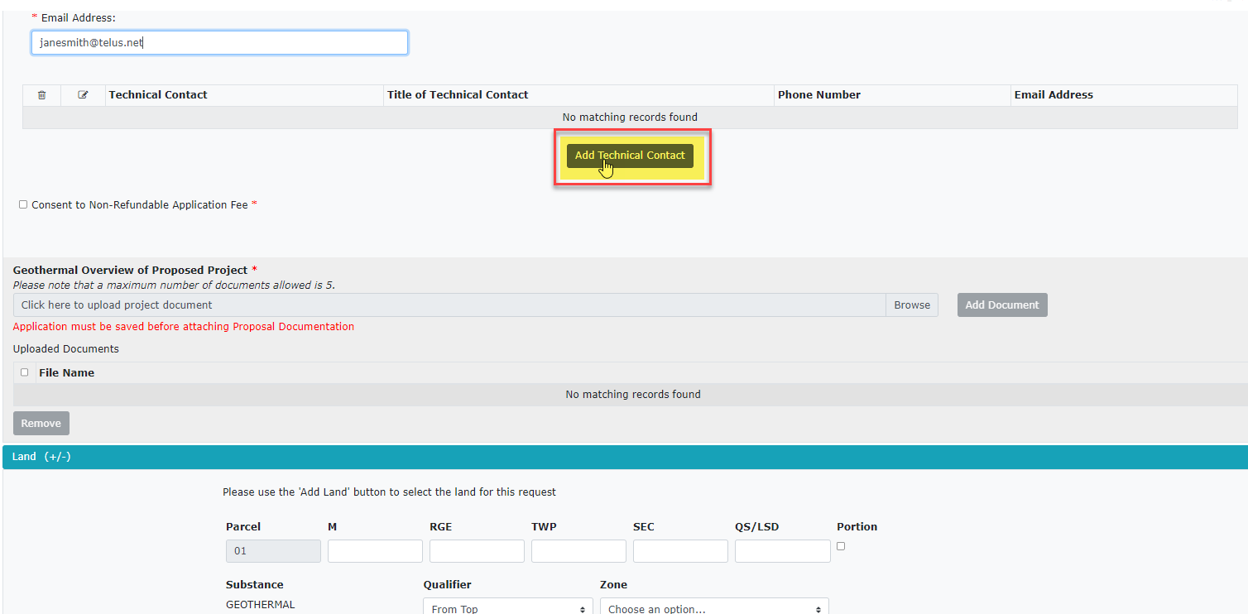
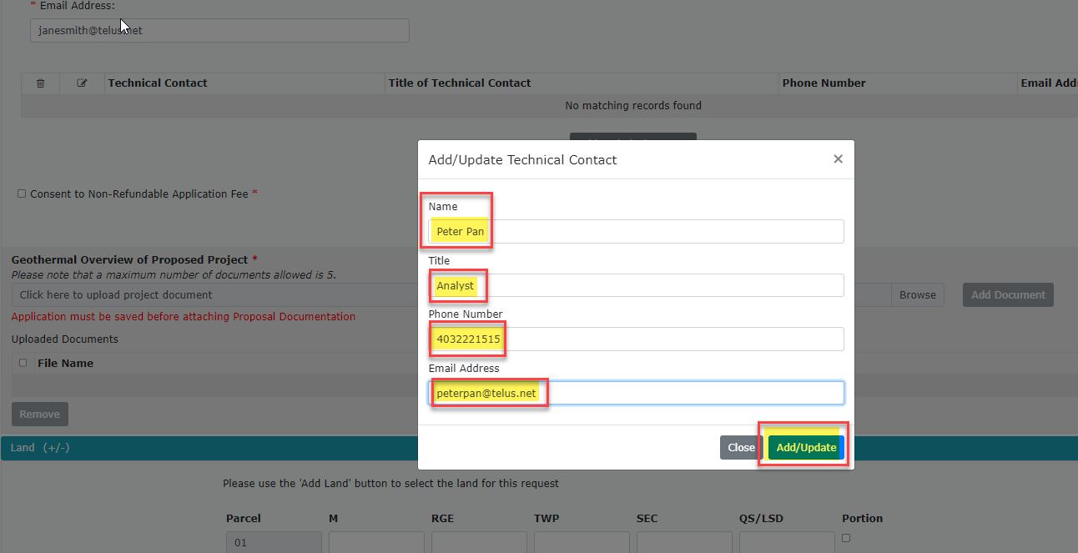
Geothermal Application
Government of Alberta
Entering a Geothermal Application – Admin continued
After completing the Administration Information the next field is to add a Technical Contact. (not a mandatory field)
Click on the Add Technical Contact, a new window will open. Enter the Technical Contact information:
Name
Title
Phone Number
Email Address
click Add/Update.
Continued onto next page

Slide 6
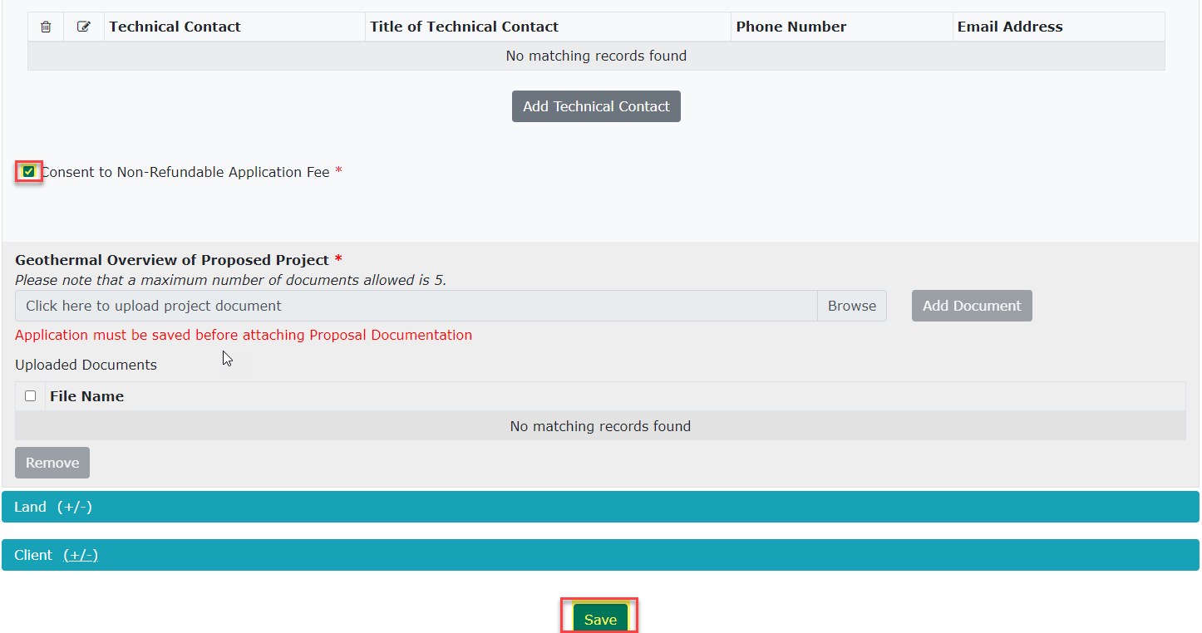
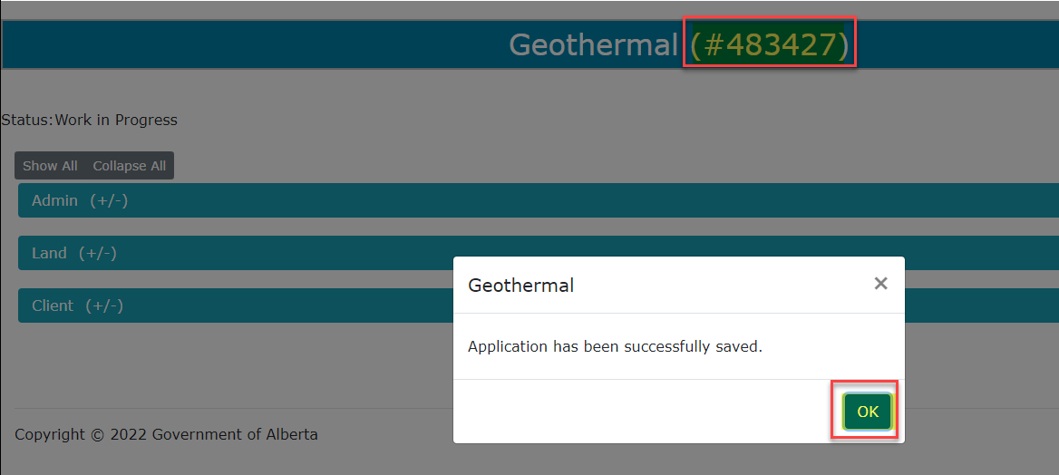
Geothermal Application
Government of Alberta
Entering a Geothermal Application – Admin continued
Step 1 Check Box
Consent to Non-Refundable Application Fee is a mandatory field and must be checked off to continue with your application.
Once the box has been checked off you must Save your application before moving forward with completing your application.
Step 2 Select Save
Once the application is Saved it will display with an ETS Request Number at the top of the page. You will use this Request Number to track the progress of your application in ETS.
Continued onto next page

Slide 7
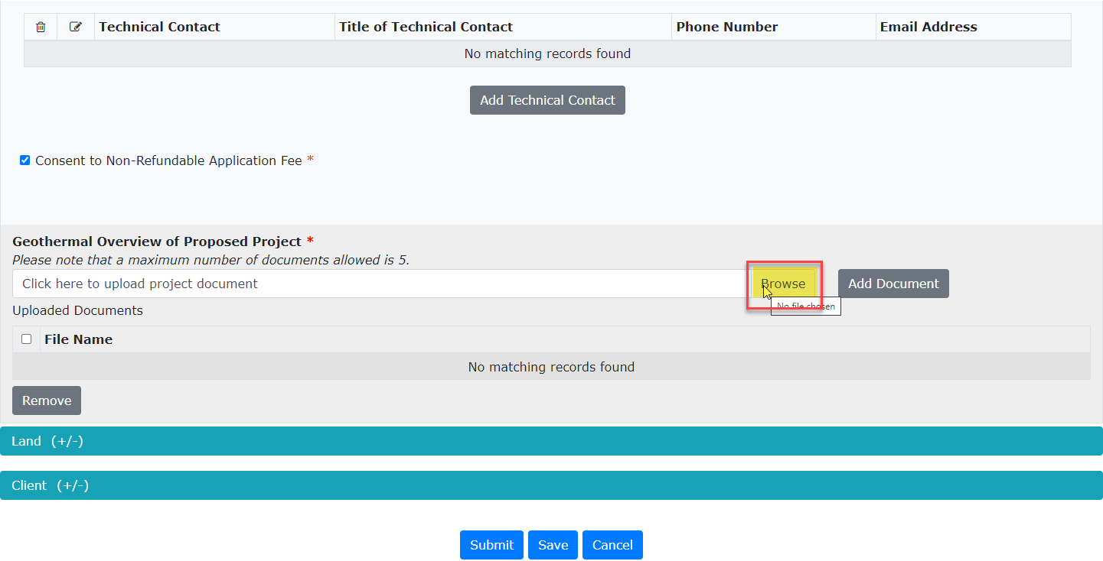
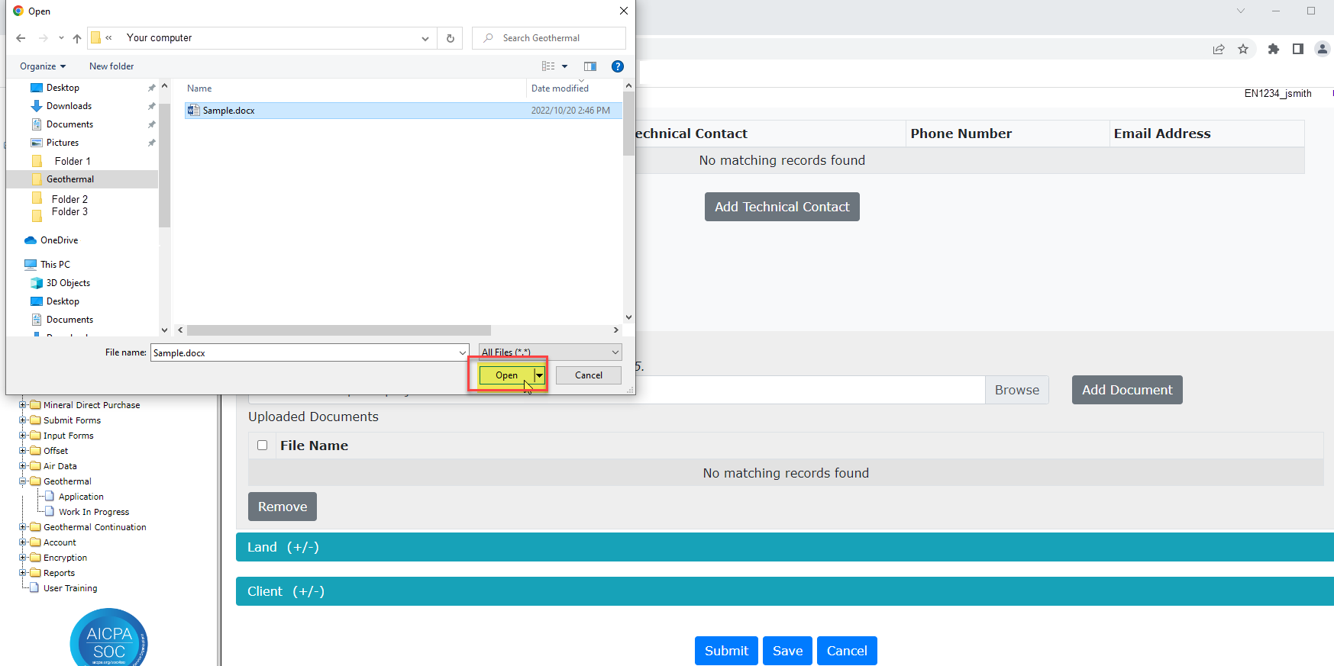
Geothermal Application
Government of Alberta
Entering a Geothermal Application – Admin continued
Step 1 Select Browse
After saving your application you will need to add your Geothermal Overview of Proposed Project documentation, this is a mandatory field.
Select the Browse button, this will open a window for you to choose a document to be upload to the application. Click on the document file name and then select the Open button.
Step 2 Select Open
Note: You may select up to five documents to be added to your application.
Continued onto next page

Slide 8
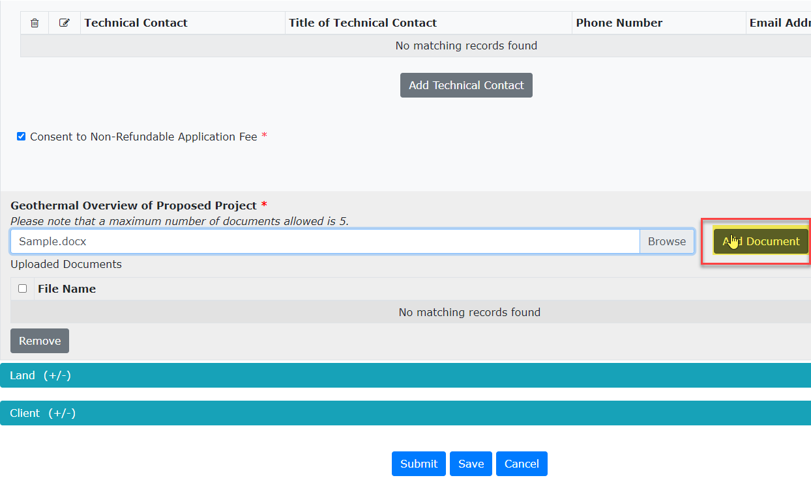
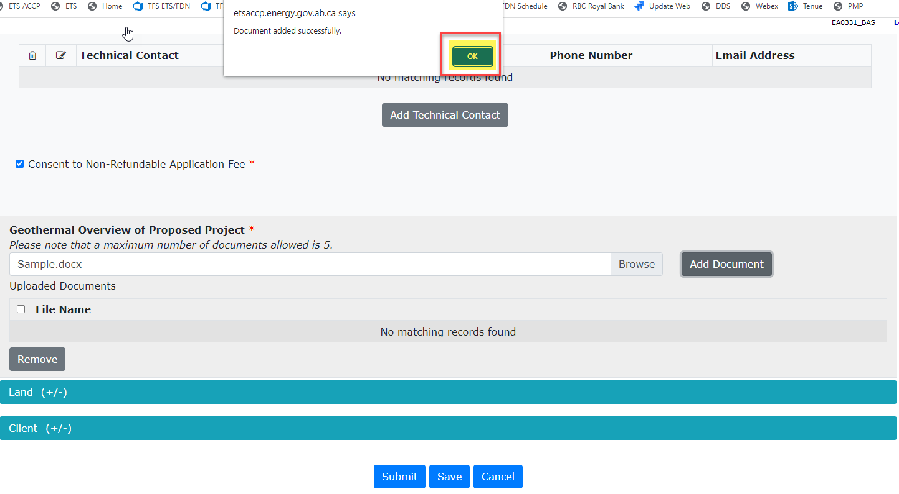
Geothermal Application
Government of Alberta
Entering a Geothermal Application – Admin continued
You will then select Add Document to add the file to your application.
Step 1 Add Document
Step 2 Select OK
A pop-up will display indicating you have successfully added your document to your application. Select Ok.
Continued onto next page

Slide 9
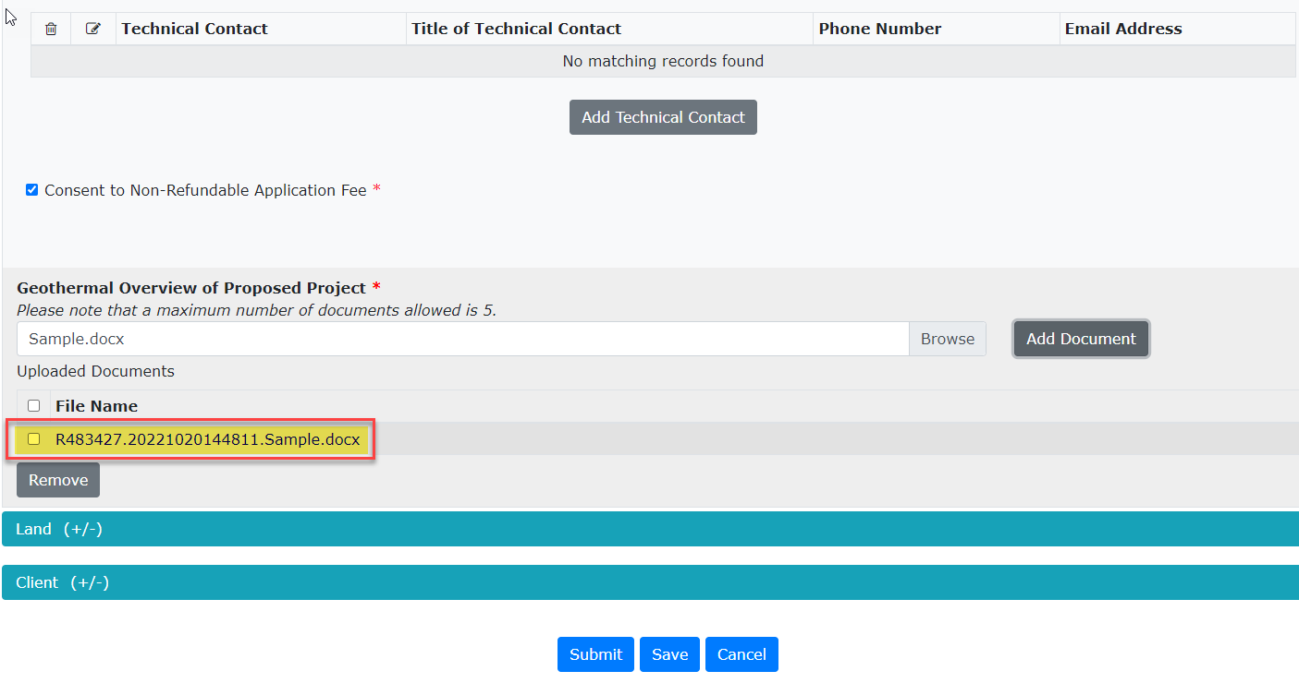
Geothermal Application
Government of Alberta
Entering a Geothermal Application – Admin continued
The file you attached to your application will now be displayed under the File Name of the application.
This completes the Admin portion of the application. The next portion of the application is adding the requested land to your application.
Continued onto next page

Slide 10
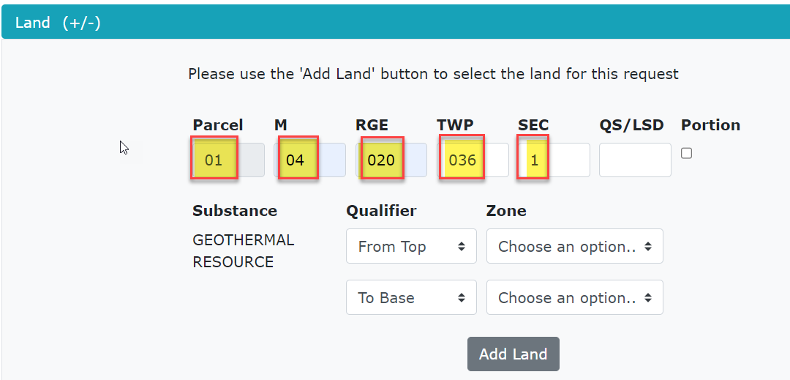
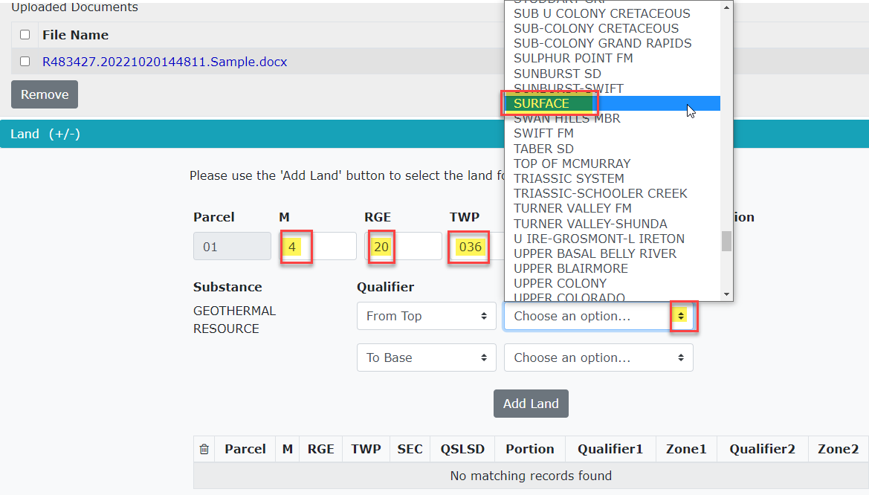
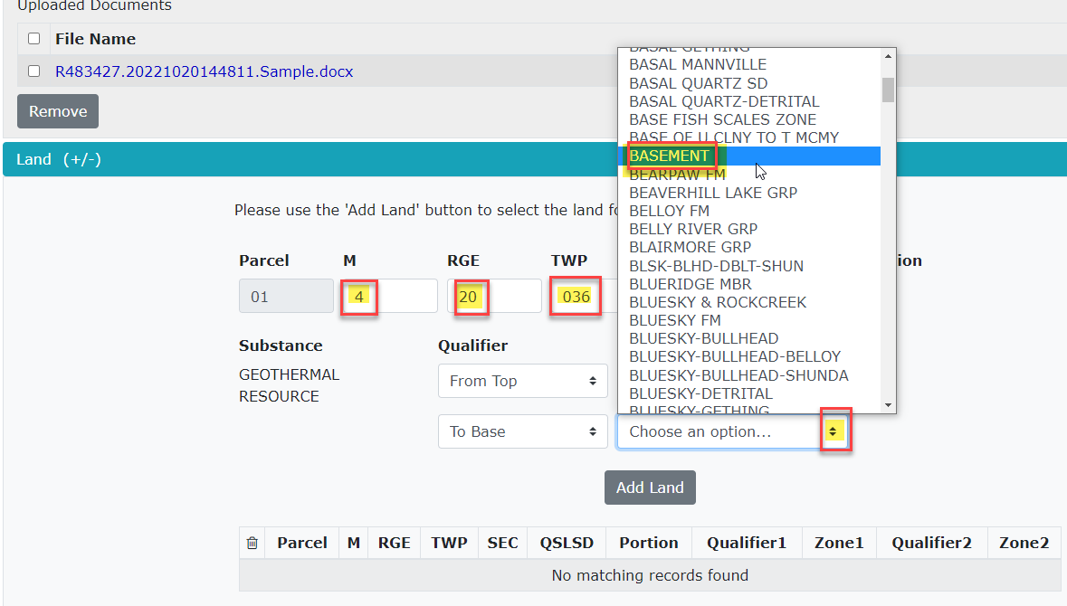
Geothermal Application
Government of Alberta
Entering a Geothermal Application – Land
Enter your requested land keys using the format M RGE TWP SEC QS/LSD. If you have a Portion of land check off the portion box for that piece of land.
Select if Portion
Then select the Qualifier and Zone for the Land Key entered above. Using the drop-down arrows for both the Qualifier and Zone.
Continued onto next page

Slide 11
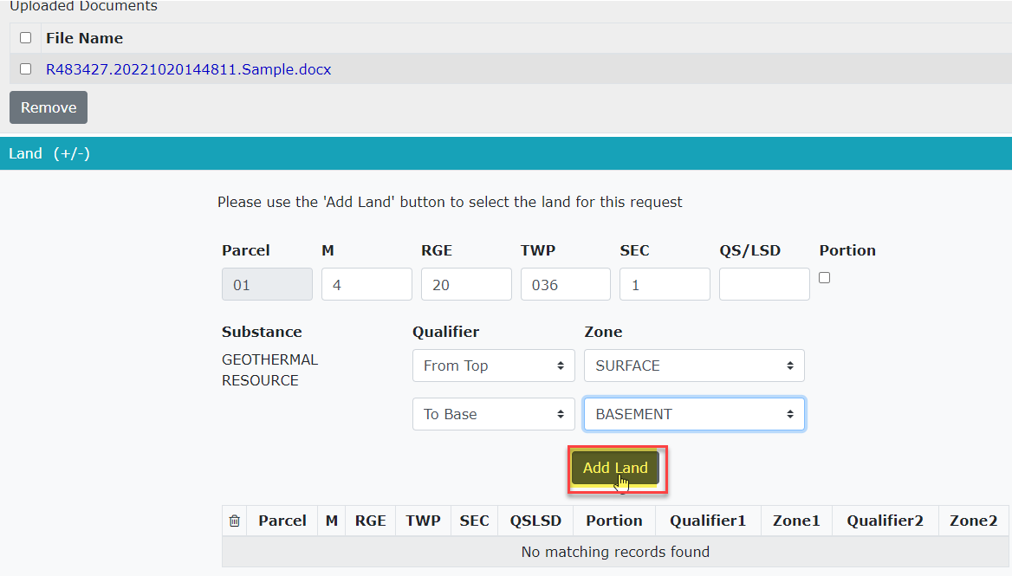
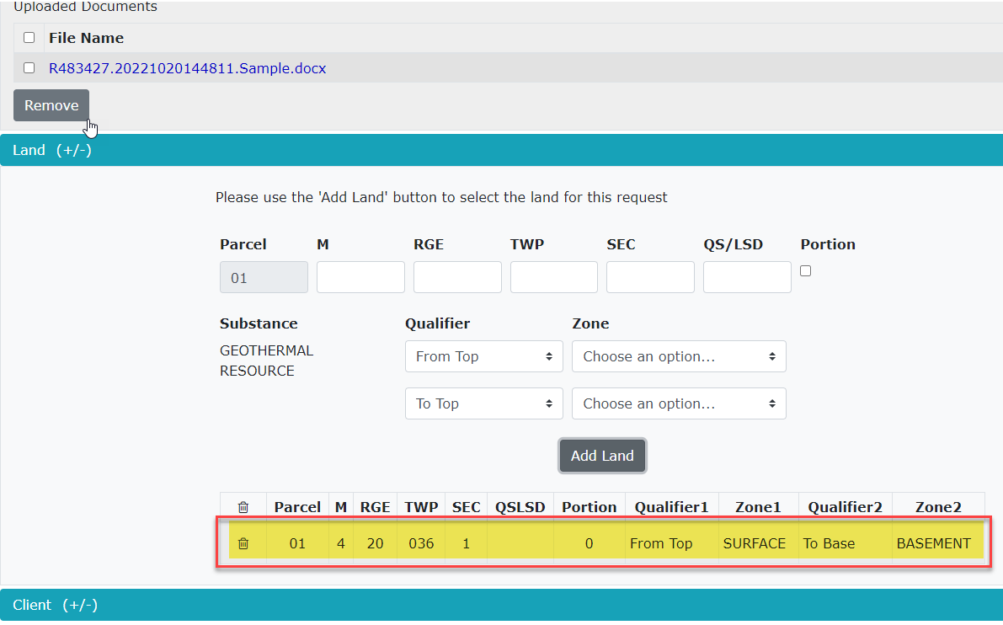
Geothermal Application
Government of Alberta
Entering a Geothermal Application – Land continued
Step 1 Add Land
Select the Add Land button
After selecting the Add Land button the Land will now display at the bottom of the section.
Continued onto next page

Slide 12
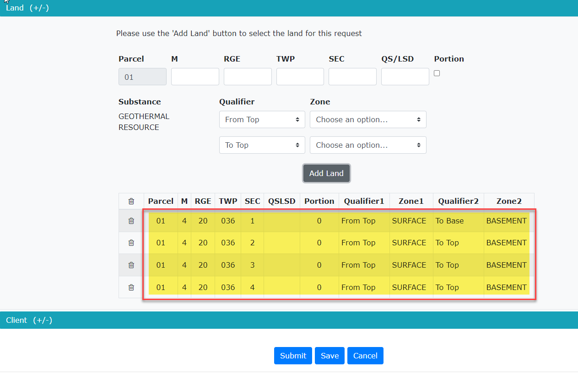
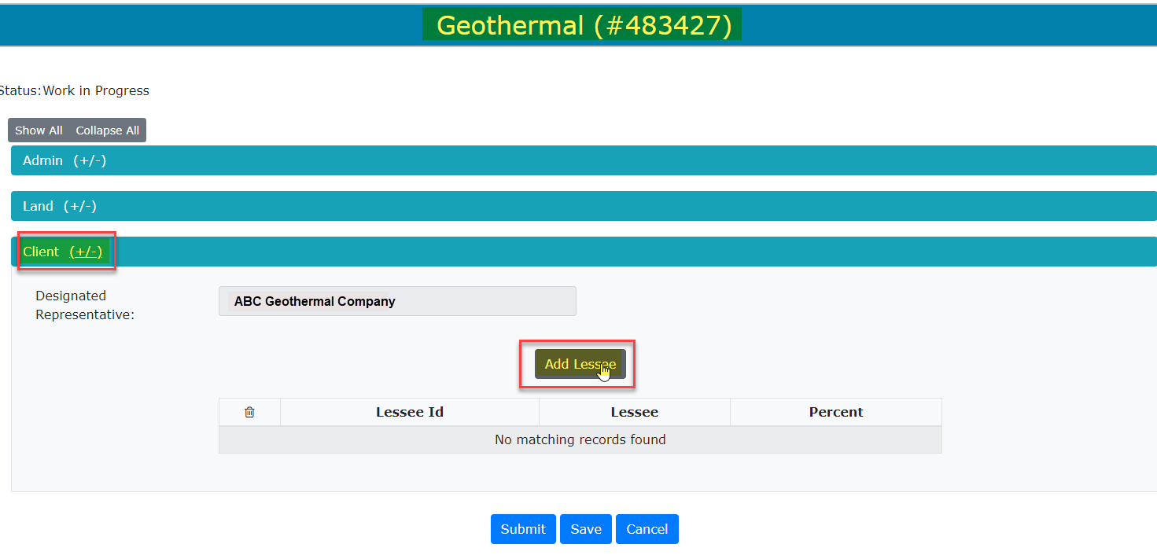
Geothermal Application
Government of Alberta
Entering a Geothermal Application – Land continued
Continue to add each of your land keys. They will display at the bottom under the Add Land button.
Note: A maximum of nine sections can be added to the application.
The final portion of your application is the Client information.
The Designated Representative will automatically populate. Select the Add Lessee button.
Step 1 Select Add Lessee
Continued onto next page

Slide 13
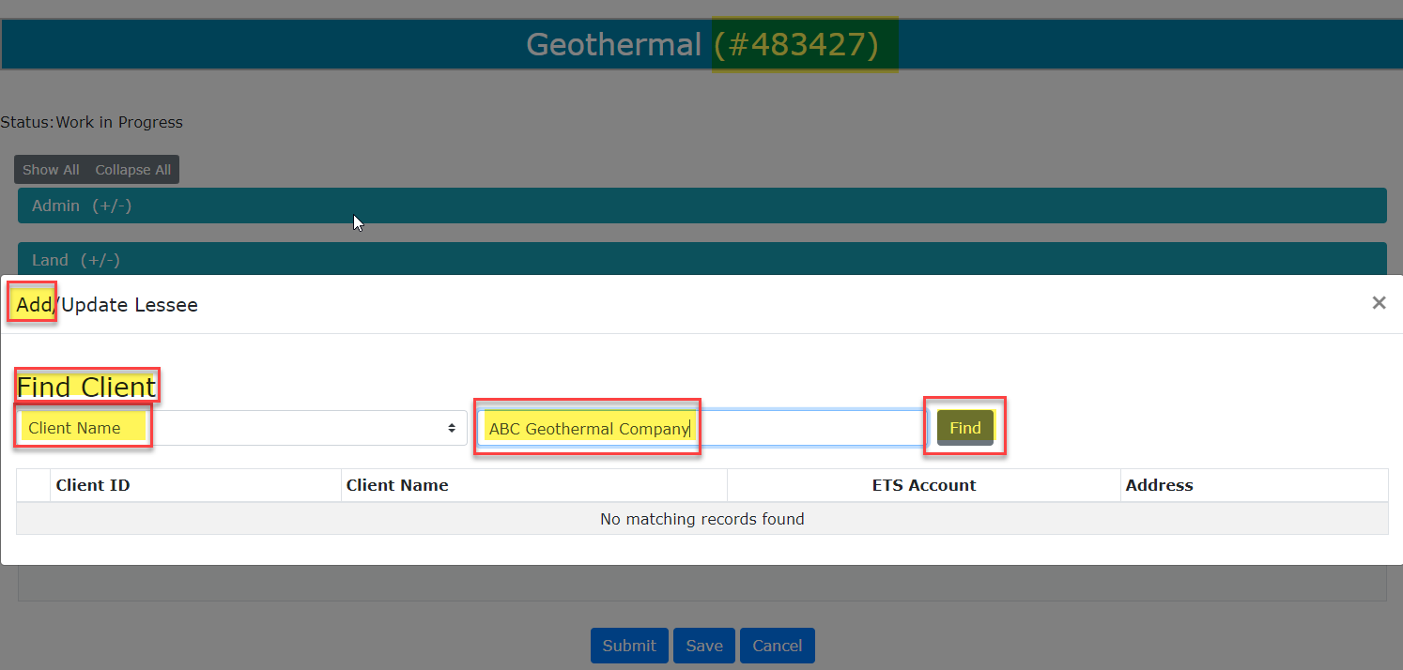
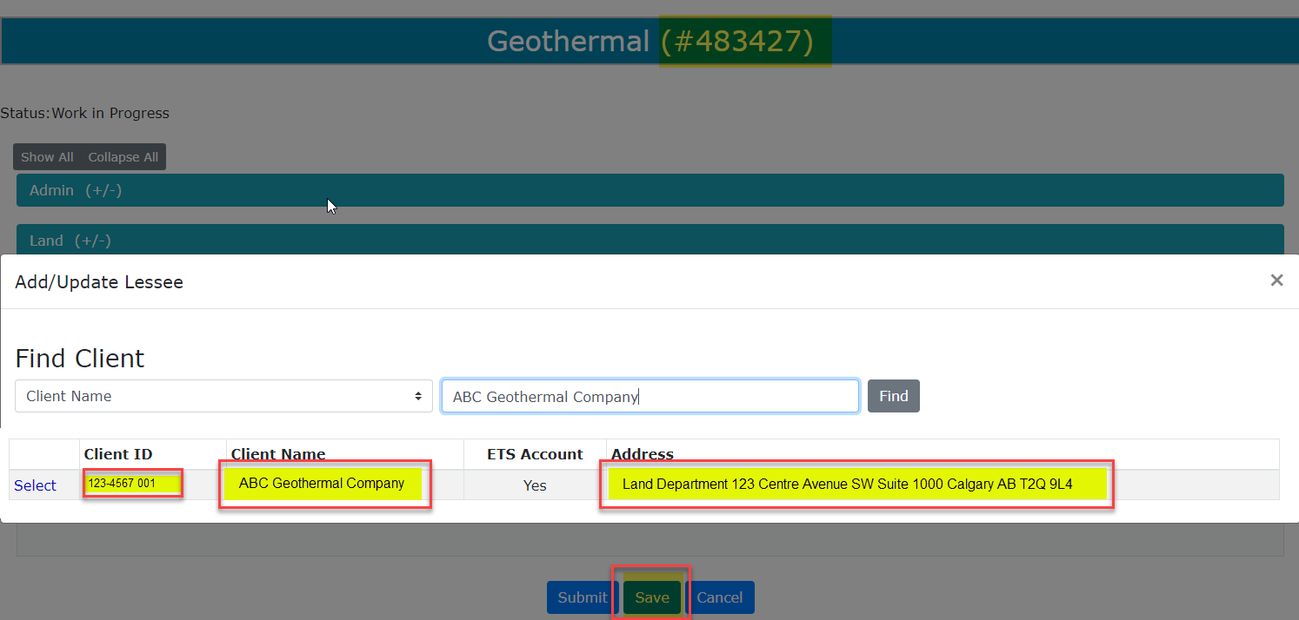
Geothermal Application
Government of Alberta
Entering a Geothermal Application – Client
The Add/Update Lessee window will populate with Find Client information. You can either search by Client Name or Client ID by using the drop-down arrows.
Type in the Client in the box provided beside the drop-down arrows then select Find.
ETS will find the Client Name and display the Client ID, Client Name and Address and it will indicate if the client has an ETS Account.
Select the Save button to save the Client information for the application.
Step 1 Type the Client Name
Step 2 Select Find
Step 3 Select Save
Continued onto next page

Slide 14
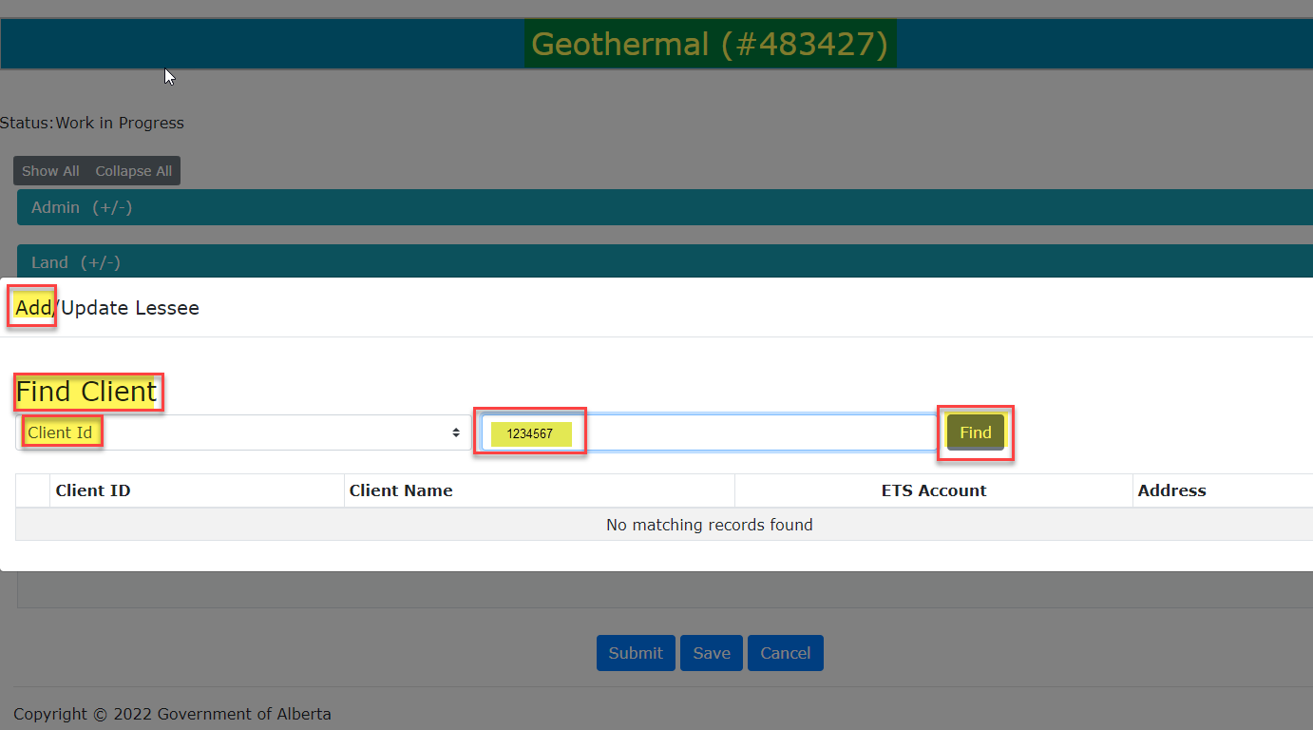
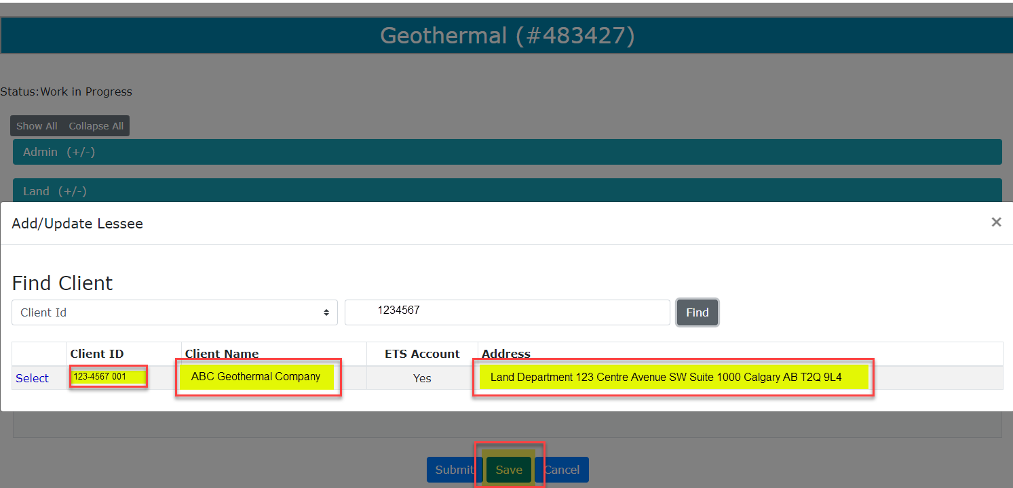
Geothermal Application
Government of Alberta
Entering a Geothermal Application – Client continued
Here is a sample of how you would search by Client ID rather than Client Name.
You would enter the Client ID rather the name in the box and select Find. The information would display the same as before and you would select Save.
Step 1 Type the Client ID
Step 2
Save
Continued onto next page

Slide 15
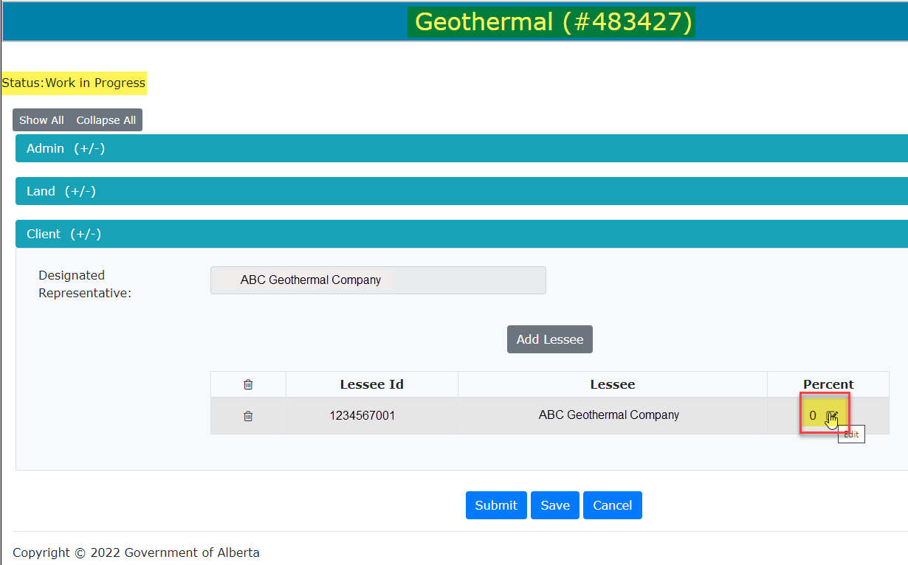
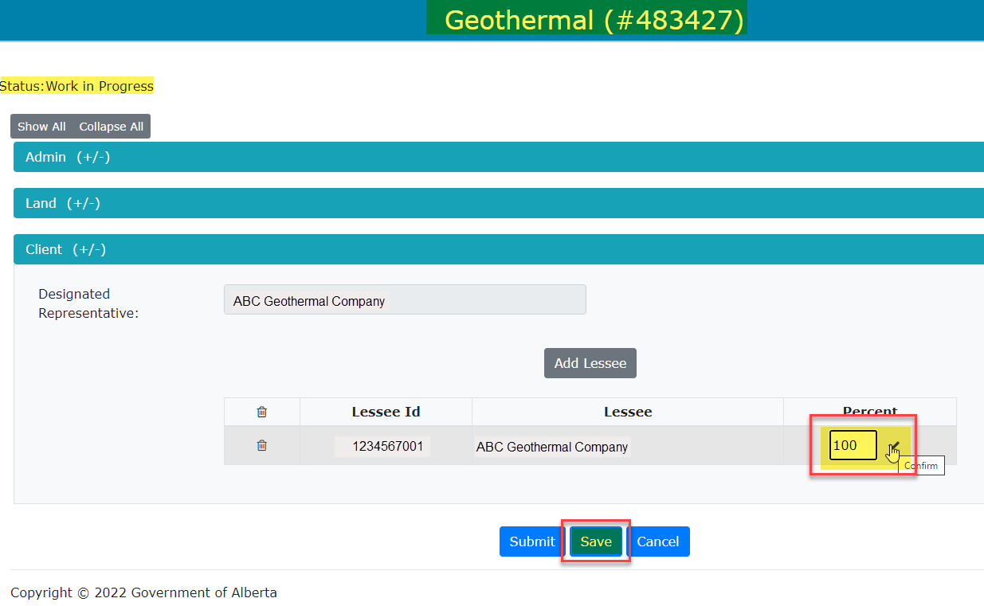
Geothermal Application
Government of Alberta
Entering a Geothermal Application – Client continued
Step 1 Enter 100
Now the Lessee ID and Lessee name are displayed. The Percentage of the Lessee is currently displaying 0. You will click on the box with the pencil and enter 100.
You must then click the Check Mark to accept the percentage entered.
Next step is to select Save.
Step 2 Must Check Off
Note: If you do not click the check mark after entering the percentage it will not save the information.
Continued onto next page

Slide 16
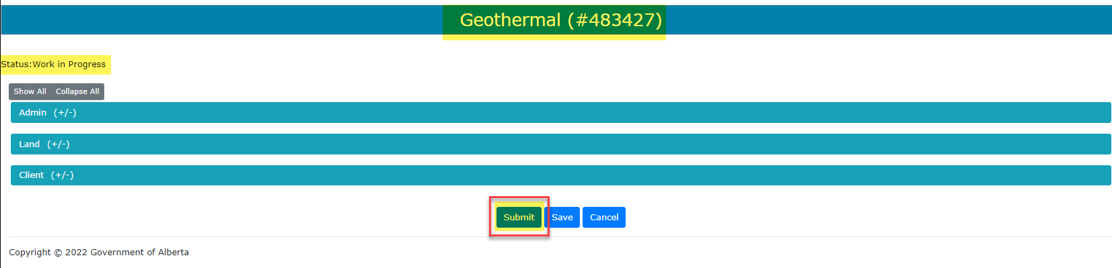
Geothermal Application
Government of Alberta
Entering a Geothermal Application – Client continued
You have now completed the information for your application. Select the Save button to save all the information you have entered for your application. Now select Submit, this will submit your application to Alberta Energy for processing. The Status of your application will now be displayed as Work in Progress in the top left-hand portion of the application.
Note: You may save your information during the application at anytime and as often as you may require.
Continued onto next page

Slide 17
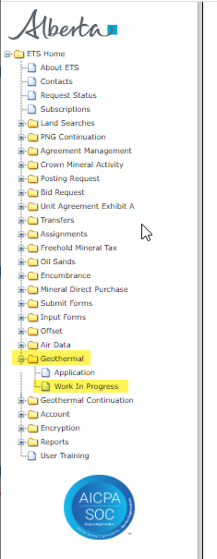
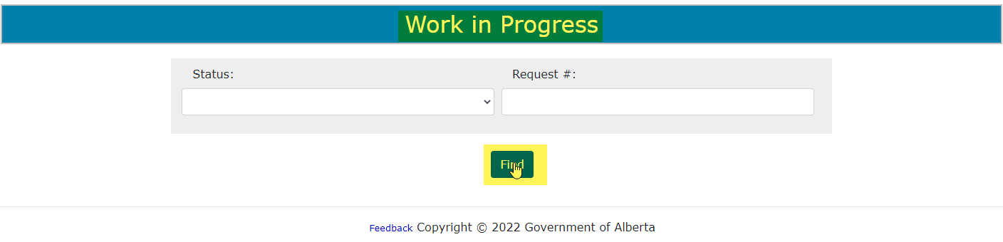
Geothermal Application
Government of Alberta
Work in Progress
When you are working on an application and it has been saved it will appear in the Work in Progress screen as Work in Progress. Once you have submitted your application it will appear in the Work in Progress screen as Submitted.
All of your Geothermal applications will display on this screen with different Statuses, depending on the status of the application. Example: Work in Progress, Submitted, Processing, Client Cancelled, Department Rejected, Completed.
Select Find
Select Work in Progress
To view your applications go to the Work in Progress node under Geothermal. The Work in Progress screen will display, select Find.
Continued onto next page

Slide 18
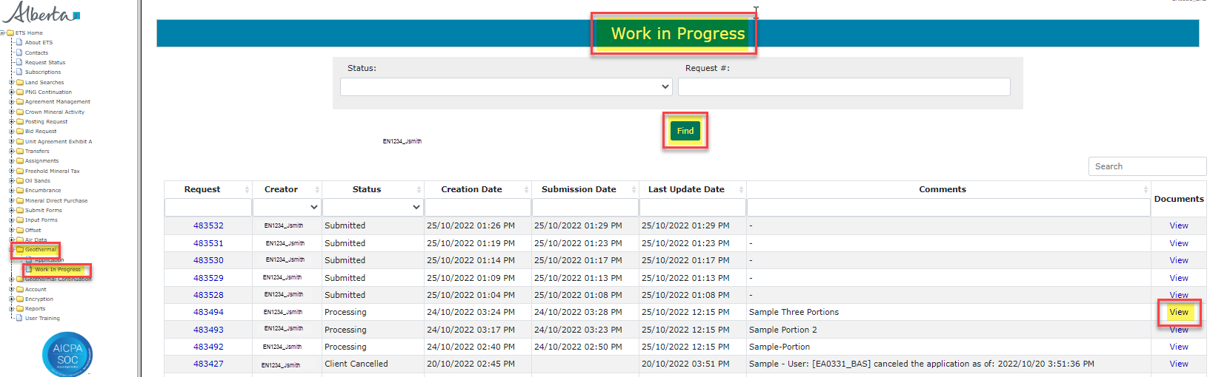
Geothermal Application
Government of Alberta
Work in Progress – continued
To view the documents attached to a particular application in the Work in Progress screen, go to the right-hand side of the request number under Documents select the View button.
Click on View
Continued onto next page

Slide 19
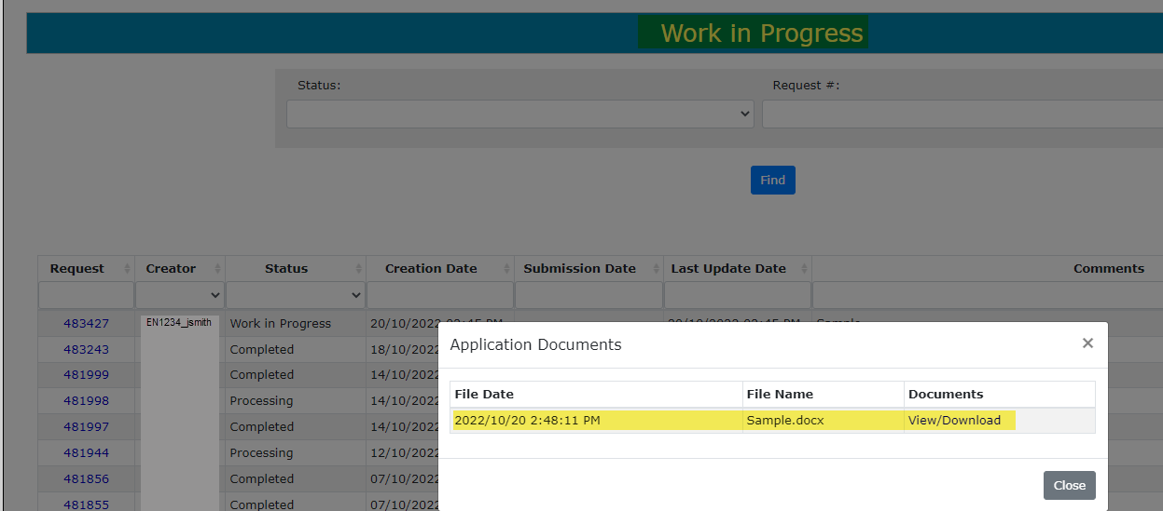
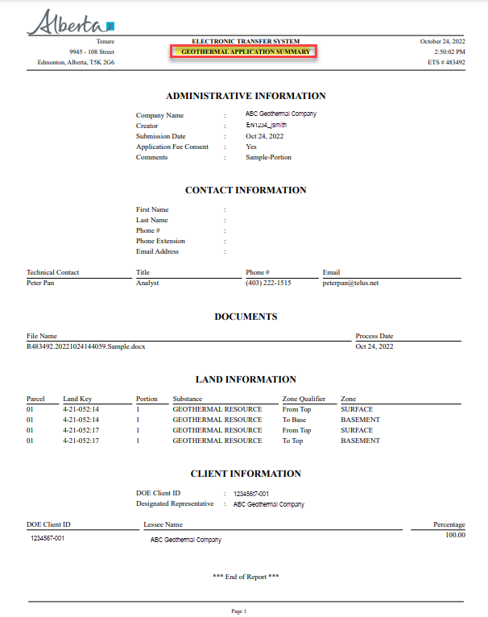
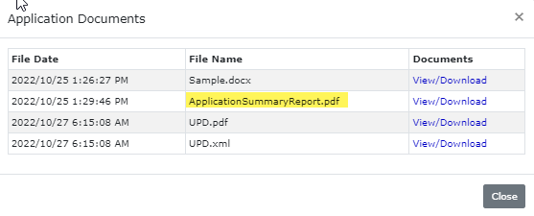
Geothermal Application
Government of Alberta
Work in Progress – continued
Once you select the View button the Application Documents screen will appear with all the documents attached to that application. To view the document(s) select View/Download on the file you would like to see the document.
Select View/Download
The Application Summary Report is a report of the information submitted on the application. There is also a link on the application page on the top right-hand of the application when you are completing the application.
Select View/Download
Continued onto next page

Slide 20
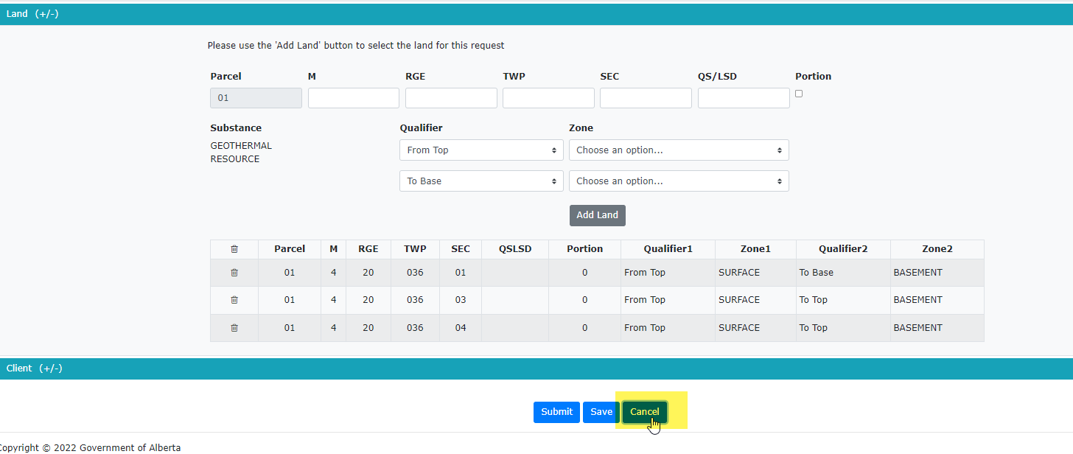
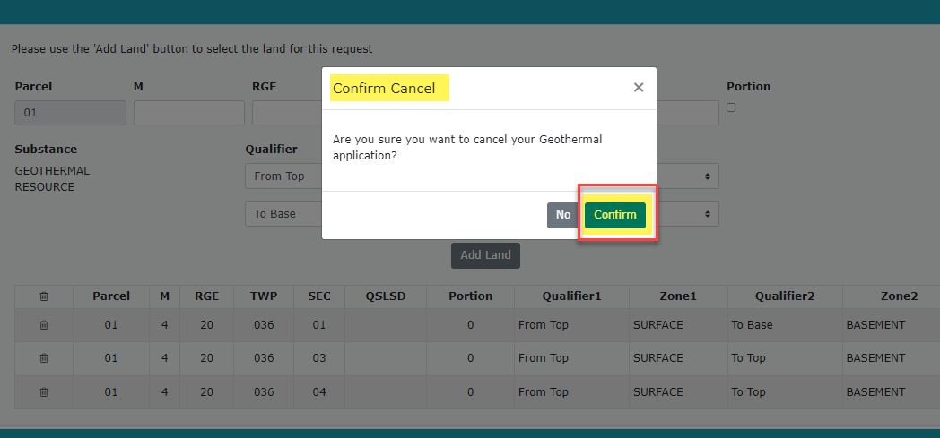
Geothermal Application
Government of Alberta
Work in Progress – continued
From the Work in Progress page you can see your application is in the Work in Progress stage, if you have not yet submitted your application. At this point you can “Cancel” your application. Select the ETS Request Number.
Select
This will populate your Geothermal Application. At the bottom of the page you will see you have three options: Submit, Save or Cancel. Select Cancel to cancel you application, a pop-up screen will display to confirm you want to Cancel your application. Select Confirm.
Select Confirm
Select Cancel
Continued onto next page

Slide 21
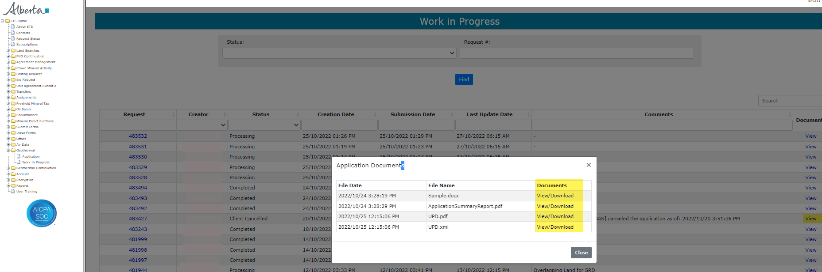
Geothermal Application
Government of Alberta
Work in Progress - continued
The first file listed in the Application Documents above (Sample.docx) is the document that was attached to the application for the Geothermal Project Overview section.
The second file listed (Application Summary Report.pdf) is the report created of the application information submitted.
The third file listed in PDF and XML format is the Mineral Rights Posting Detail report created when the application has been accepted by Alberta Energy and processed.
Document samples are displayed on the next page.
Continued onto next page

Slide 22
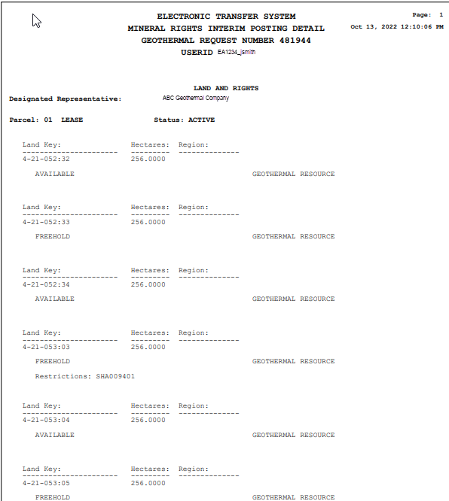
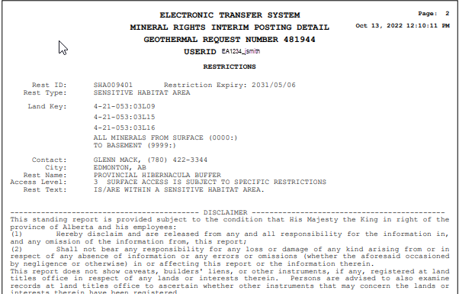
Geothermal Application
Government of Alberta
Mineral Rights Posting Detail
Work in Progress - continued
Geothermal Application Summary
Continued onto next page

Slide 23
Geothermal Application
Government of Alberta
Work in Progress - Technical Contact
Select
Add
Technical Contact
From the Work in Progress screen you can see your application is in the Work in Progress stage, you have not submitted your application. To add a Technical Contact, go to the Work in Progress screen and select the application you want to update by clicking on the ETS Request number.
The application will open. Expand the Admin view by selecting (+/-). Click on the Add Technical Contact button.
Select
Add/Update
The Add/Update Technical Contact window will display. Add the information for your Technical Contact and select the Add/Update button to save the information to the application.
Continued onto next page

Slide 24
Geothermal Application
Government of Alberta
Work in Progress - Updating Technical Contact continued
To remove a Technical Contact from the application go to the Work in Progress screen. If your application is in the Work in Progress stage and you have not submitted your application you can remove the Technical Contact. Select the application you want to update by clicking on the ETS Reference number.
The application will open, expand the Admin view by selecting (+/-). Click on the Add Technical Contact button.
The Technical Contact will display in the application, select the garbage can on the left-hand side of the line to delete the Technical Contact.
Select
to remove Technical Contact
Continued onto next page

Slide 25
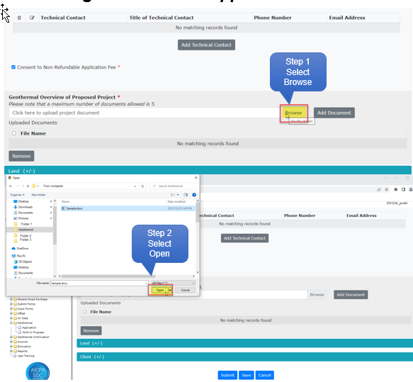
Work in Progress – Adding or Removing Document(s)
To add/remove Document(s) from the application go to the Work in Progress screen. If your application is in the Work in Progress stage and you have not submitted your application you can add/remove Document(s). Select the application you want to update by clicking on the ETS Reference number.
The application will open, expand the Admin view by selecting (+/-).
To add a document Select the Browse button, this will open a window for you to choose a document to be upload to the application. Click on the document file name and then select the Open button.
Continued onto next page

Slide 26
Geothermal Application
Government of Alberta
Work in Progress – Adding or Removing Document(s) continued
You will then select Add Document to add the file to your application.
Step 1 Add Document
Step 2 Select OK
A pop-up will display indicating you have successfully added your document to your application. Select Ok.
Continued onto next page

Slide 27
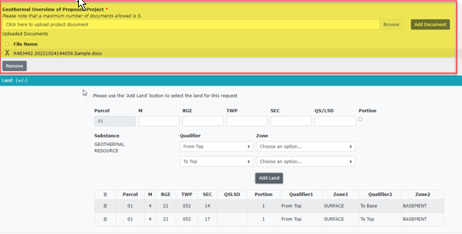
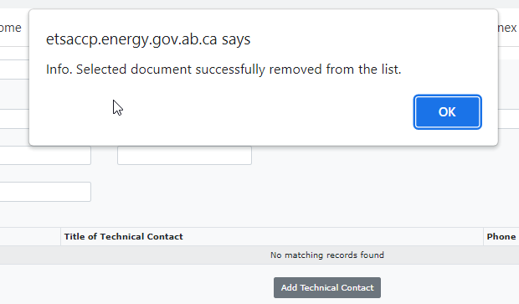
Work in Progress – Adding or Removing Documents continued
To remove a Document click the box beside the file name you want to remove, then select the Remove button.
Step 1 Select Document
Step 2 Select Remove
Once the Remove button has been selected a pop-up screen will display indicating the selected document has been removed. Select OK
Continued onto next page

Slide 28
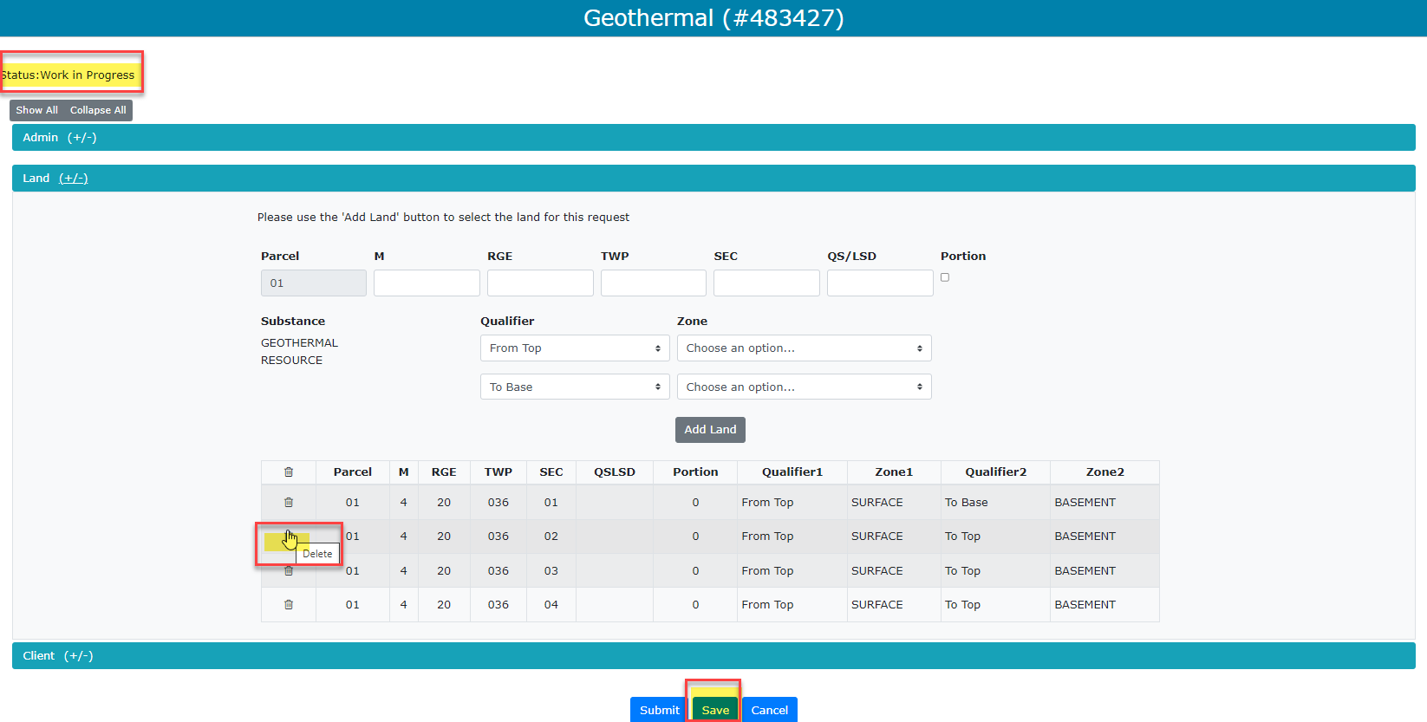
Geothermal Application
Government of Alberta
Work in Progress – Adding or Removing Land
Step 1 Select
Step 2 Save
To add/remove Land from the application go to the Work in Progress screen. If your application is in the Work in Progress stage and you have not submitted your application you can add/remove Land. Select the application you want to update by clicking on the ETS Reference number.
The application will open, expand the Land view by selecting (+/-).
To remove a Land Key from the Land Grid, click on the Garbage Can to select and remove the Land Key from the Grid. It will be removed then select Save.
Continued onto next page

Slide 29
Geothermal Application
Government of Alberta
Work in Progress – Adding or Removing Land continued
To Add Land enter your requested land keys using the format M RGE TWP SEC QS/LSD. If you have a Portion of land, check off the portion box for that piece of land.
Select if Portion
Then select the Qualifier and Zone for the Land Key entered above. Using the drop-down arrows for both the Qualifier and Zone.
Continued onto next page

Slide 30
Geothermal Application
Government of Alberta
Work in Progress – Adding or Removing Land continued
Step 1 Add Land
Select the Add Land button
After selecting the Add Land button the Land will now display at the bottom of the section.
Continued onto next page

Slide 31
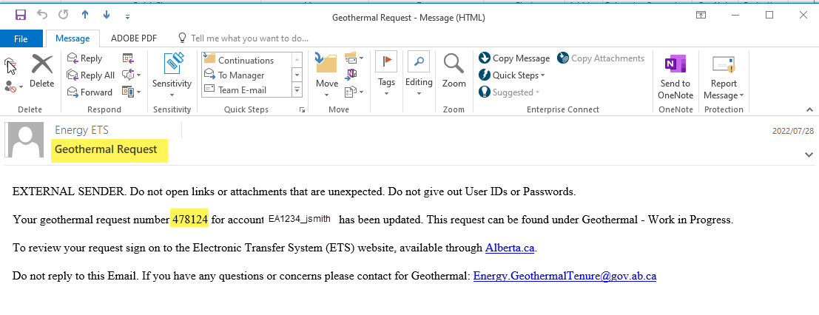
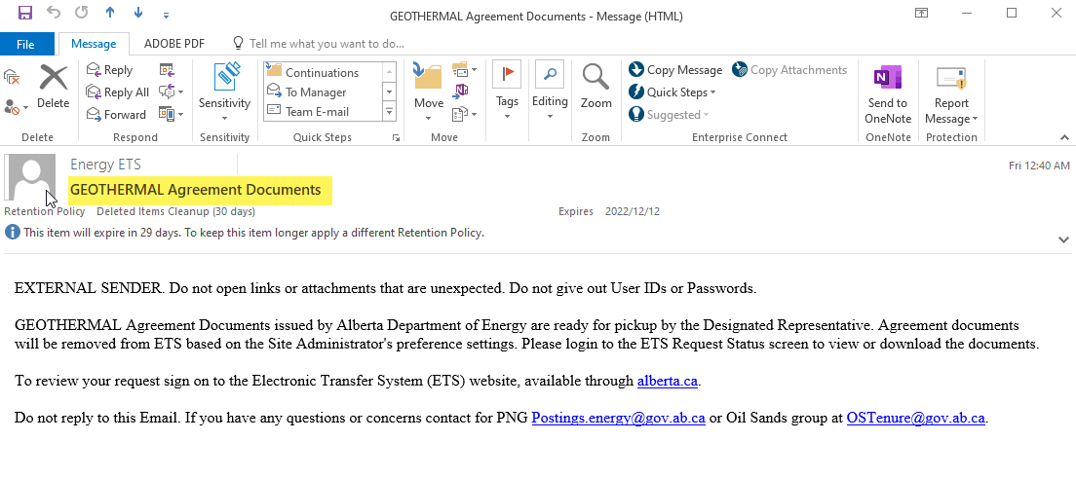
Geothermal Application
Government of Alberta
ETS Email Notifications
Geothermal Request email Notifications will be sent to the User when there is an update to the application. When an email is received, log into ETS and go to Geothermal Work in Progress and review the ETS Request number highlighted in the notification.
Geothermal Agreement Documents email Notification will be sent to the User when the Agreement Documents have been issued.
Continued onto next page

Slide 32
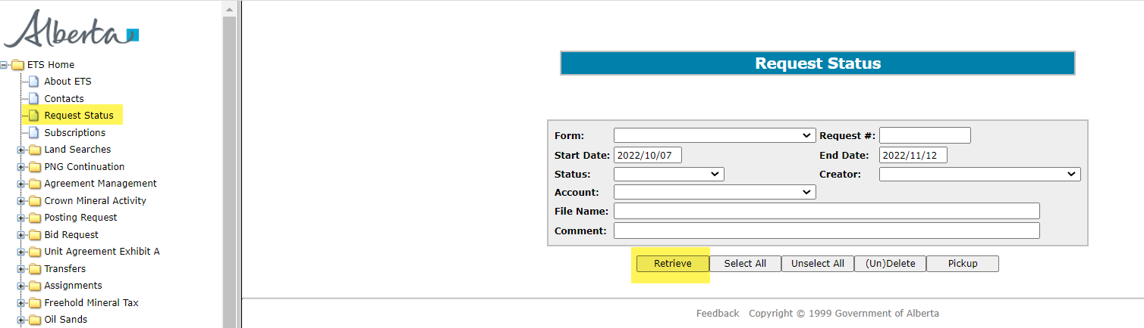
Geothermal Application
Government of Alberta
Retrieve Agreement Documents
To Retrieve Agreement Documents log into your ETS Account and select Request Status from the Tree Node. Then select the Retrieve button. You can retrieve documents using the Form Type, Request #, Start Date, End Date and any of the options on the Request Status screen.
Step 1
Retrieve
Continued onto next page

Slide 33
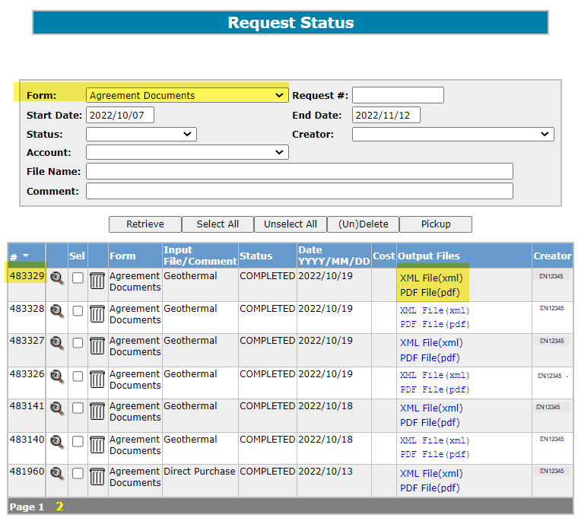
Geothermal Application
Government of Alberta
Retrieve Agreement Documents - Continued
The screen below displays Agreement Documents from Start Date 2022/10/07 to End Date 2022/11/12. To Retrieve the Agreement Documents using the drop-down arrow for ETS Request #483329 select either the XML File or the PDF File to View.
Step 1
Form Type
Agreement Documents
Step 3
Select either XML File or
PDF File
Step 2
Retrieve
Continued onto next page

Slide 34
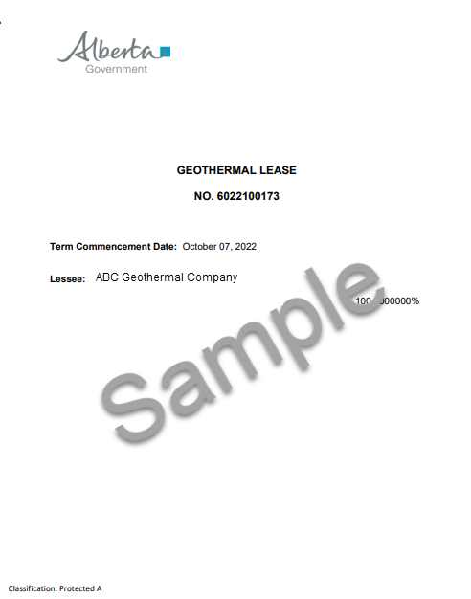
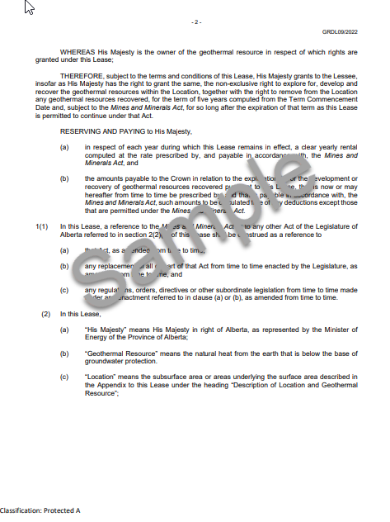
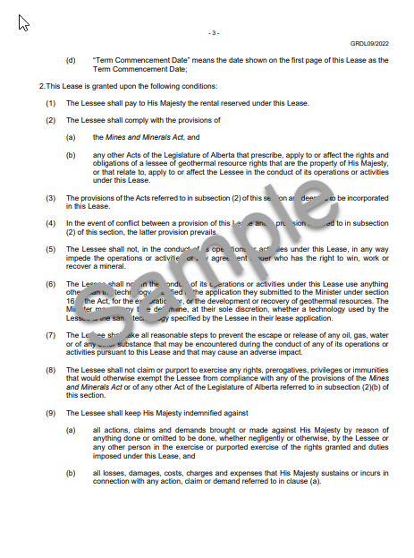
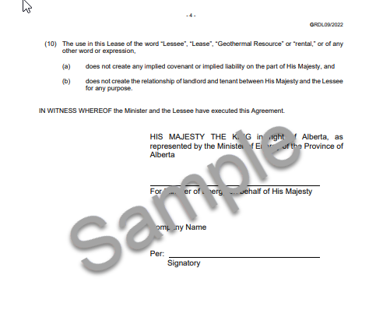
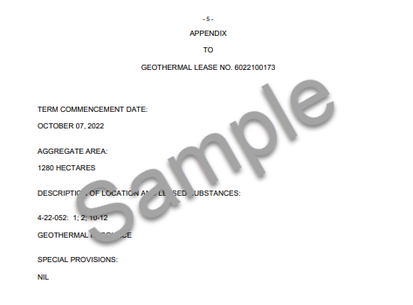
Geothermal Application
Government of Alberta
Retrieve Agreement Documents - continued
When you select PDF File the Agreement Document will display.
Continued onto next page

Slide 35

Geothermal Application
Government of Alberta
CONCLUSION
Congratulations!
You have completed the Geothermal Application
Online Training Course
If you have any comments or questions on this training course,
please forward them to the following email address:
Energy.GeothermalTenure@gov.ab.ca

