Slide 1
Welcome!
To the ETS – Encumbrance
Encumbrance Overview
Online Training Course
This module will provide an overview of the various types of Encumbrances, the ETS Encumbrance user roles and form-types for registering encumbrances against Crown mineral rights.

Slide 2
Revision Page
Revisions Table
Date | Revisions Type | Page Number
May 3, 2018 | Initial Creation | All
April 2020 | Update to links and header | All
February 2023 | Updated reference of Builder’s Lien to Prompt Payment and Construction Lien (PPCL) | 4, 6, 7

Slide 3
Introduction
This module includes:
Introduction To Encumbrances
Encumbrance Form-Types
Assign User Roles
Prerequisite Learning Modules:
Before proceeding we recommend that you view the ETS Account Setup and Preferences module located at the Online Learning Portal

Slide 4
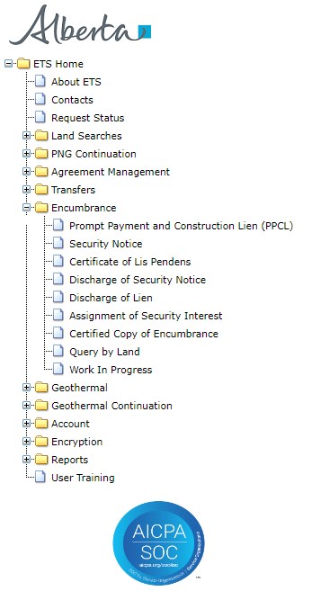
ETS ENCUMBRANCES
The following described Encumbrances are available for registration on the Electronic Transfer System (ETS).
Prompt Payment and Construction Lien (PPCL)
A PPCL relating to Crown minerals is a claim for payment registered against a Crown mineral agreement for work done or materials furnished by a contractor.
Security Notice
Security Notices are registered against a Crown mineral agreement(s) to record an interest in an agreement(s) used as collateral to secure a debt or loan.
Certificate of Lis Pendens
A notice of pending litigation in respect to a PPCL.
Discharge of Security Notice
A request to cancel a Security Notice. A Security Notice can be either fully or partially discharged.
Discharge of PPCL
Request to cancel a PPCL. A PPCL can be either fully or partially discharged.
Assignment of Security Interest
A Security Notice can be either fully or partially assigned to another lender.
Certified Copy of Encumbrance
Request for a certified copy of an encumbrance from Alberta Energy.
4

Slide 5
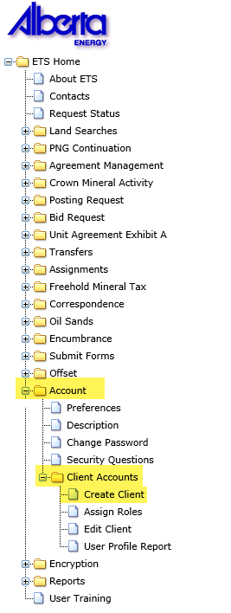
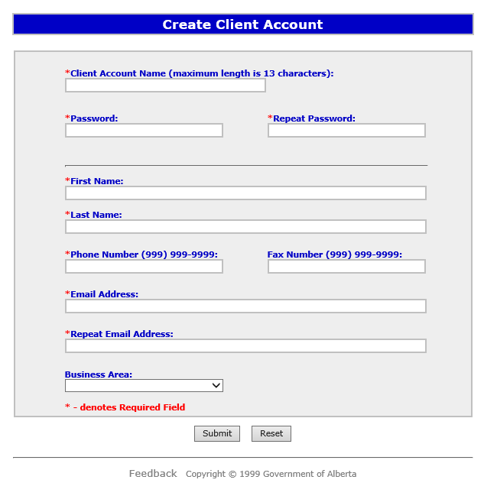
CREATING A CLIENT ACCOUNT
Individual ETS accounts (called a Client Account) are subsets of the Site Administrator and Back up Administrator Account(s). Each Client Account is given access to form-types and assigned a role that defines the required functionality.
The Site Administrator(s) for a company are responsible for creating and maintaining Client Accounts. The Site Administrator(s) assigns levels of access to ETS based on the role an individual has within the company.
Once the Client Account is created, the individual can login to the secure ETS website using this new Client Account login Id and password.
.
Please see the ETS Account Setup and Preferences module for more detailed information.

Slide 6
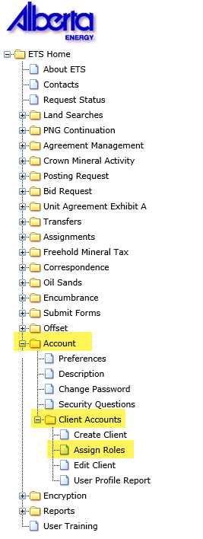
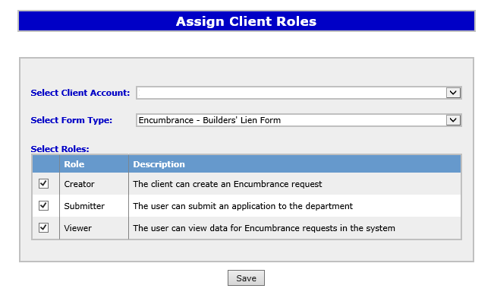
ETS ENCUMBRANCE FORM TYPES
In order for a Client Account (Individual Account) to access the Encumbrance functionality on the ETS web site, the Site Administrator must first assign a role to the Client Account.
Encumbrance Form-Types:
Encumbrance – Assignment of Security Interest
Encumbrance – Prompt Payment and Construction Lien (PPCL) Form
Encumbrance – Certified Copy
Encumbrance – Discharge of PPCL
Encumbrance – Discharge of Security Interest
Encumbrance – Cancellation Letter
Encumbrance – Certificate of Lis Pendens
Encumbrance – Security Notice Form

Slide 7
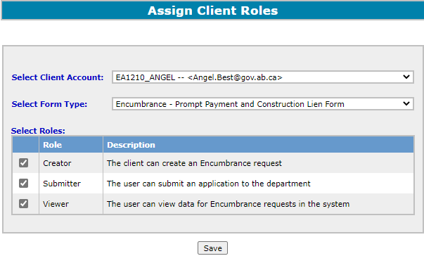
ETS ENCUMBRANCE ROLES
Each form-type must be assigned roles.
NOTE: In order to activate the Query by Land function, user must be assigned a Submitter role for either the Encumbrance – Prompt Payment and Construction Lien Form or Encumbrance – Security Notice Form.
 | can create and amend encumbrance requests. can view requests they created (Viewer role should also be assigned to them).
 | can submit encumbrance requests to Alberta Energy (Viewer role should also be assigned to them).
 | can view all encumbrance requests and their related documents.

Slide 8

Congratulations!
You have completed the ETS – Encumbrance
Encumbrance Roles and Form-Types
Online Training Course
If you have any comments or questions on this training course,
please forward them to the following email address:
Transfers.Energy@gov.ab.ca
8

