Slide 1
Transfer of Pore Space Lease Lessee
Government of Alberta
Welcome!
To the
Transfer of Pore Space Lease Lessee
Online Training Course
In this module you will learn how to:
Create a Transfer application
Concur ETS request
Retrieve and view agreement documents.

Slide 2
Transfer of Pore Space Lease Lessee
Government of Alberta
Revisions Table
Date | Revisions Type | Page Number
February 3, 2025 | Initial Creation | All

Slide 3
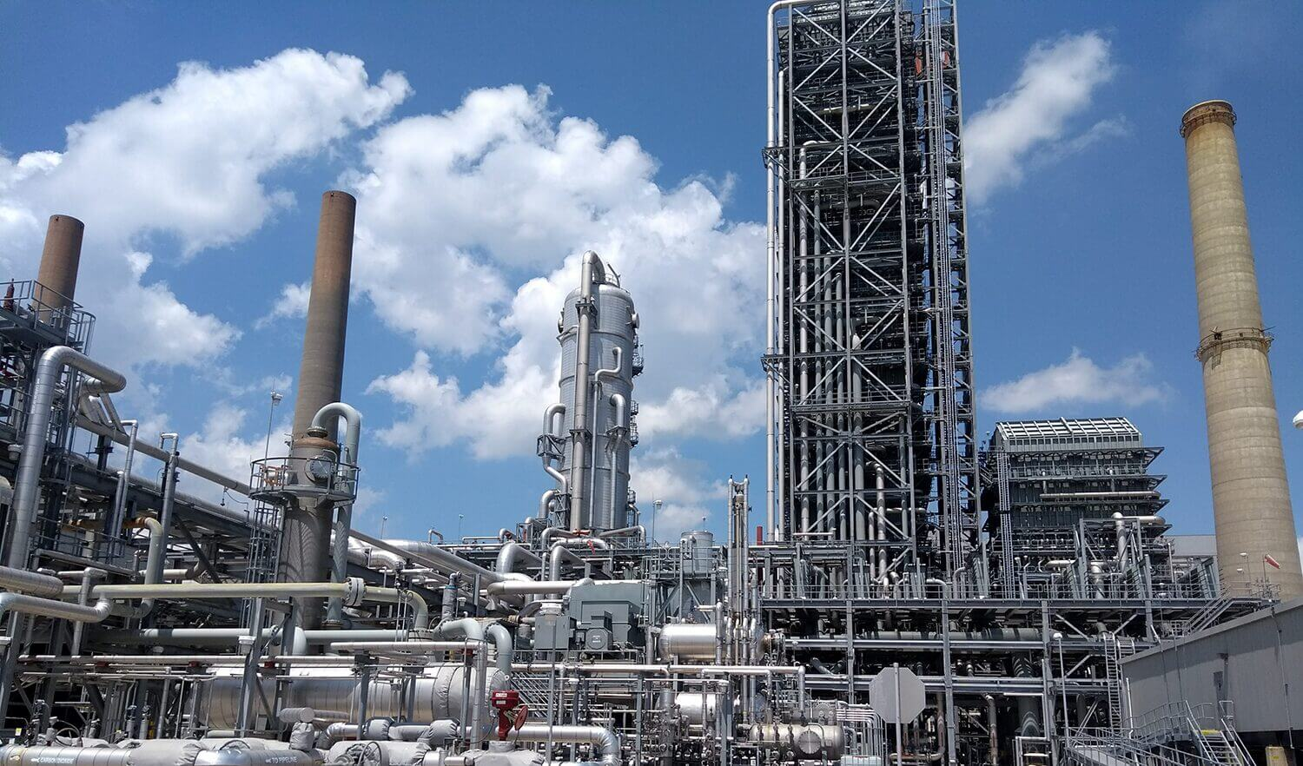
Transfer of Pore Space Lease Lessee
Government of Alberta
INTRODUCTION
The Transfer form allows current lessee to transfer to a new lessee on Pore Space Lease (061 agreement type).
Note:
For Carbon Sequestration Evaluation Agreement (058) and Carbon Sequestration Agreement (059), refer to Assignment Agreement online training module.

Slide 4
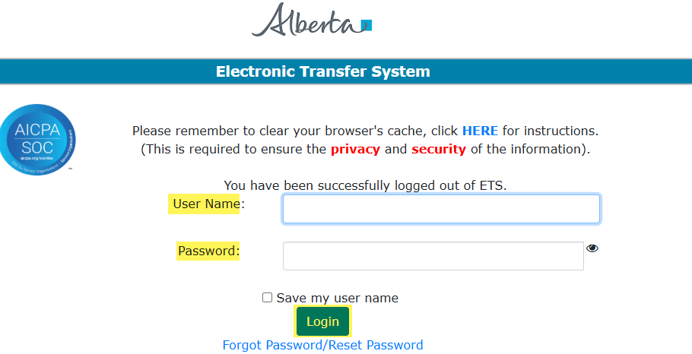
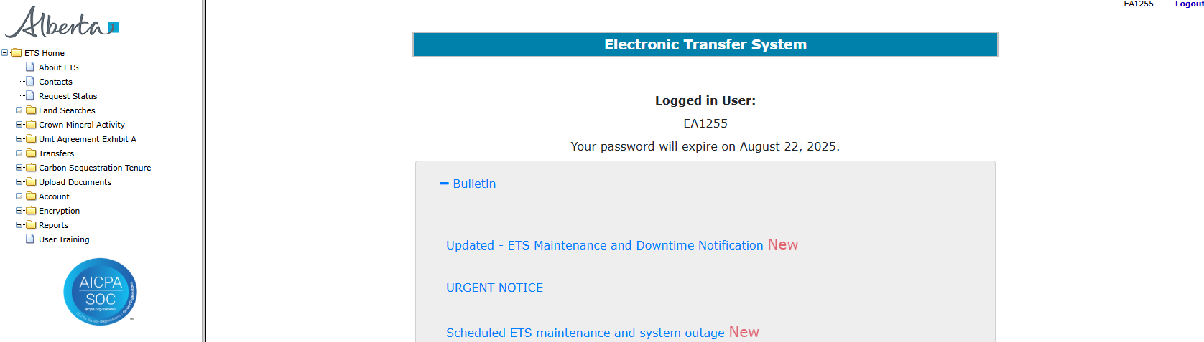
Transfer of Pore Space Lease Lessee
Government of Alberta
LOGIN TO ETS
Go to ETS (https://ets.energy.gov.ab.ca/logon.aspx)
Enter your login credentials: User Name (EN account) and Password.
Once logged in, the screen below is displayed.

Slide 5
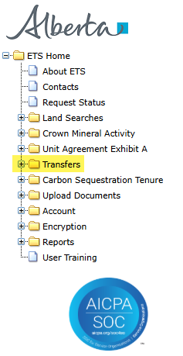
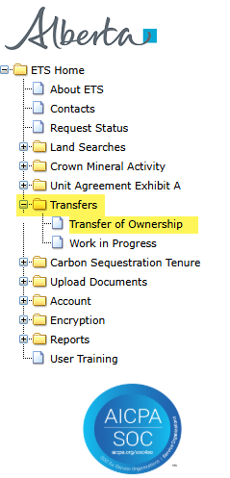
Transfer of Pore Space Lease Lessee
Government of Alberta
NAVIGATION TO TRANSFER
In the treenode (left-hand side of the screen), navigate to Transfer node.
Expand Transfer node to display its subnodes.
Click Transfer of Ownership subnode.
2.
1.
3.

Slide 6
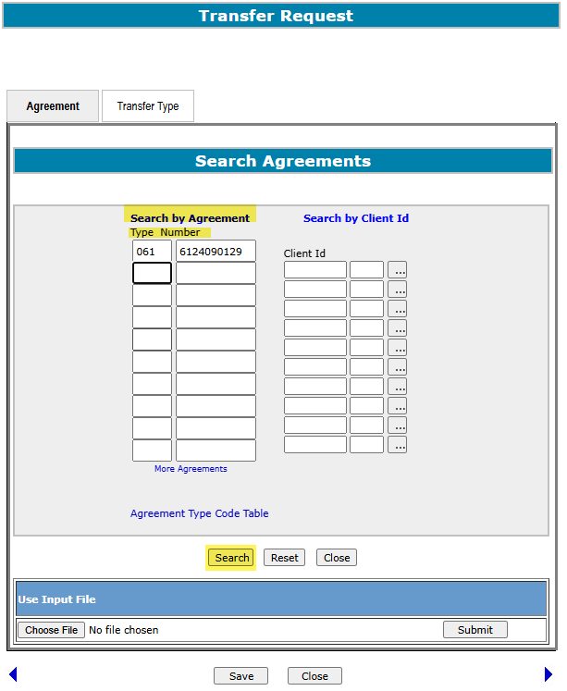
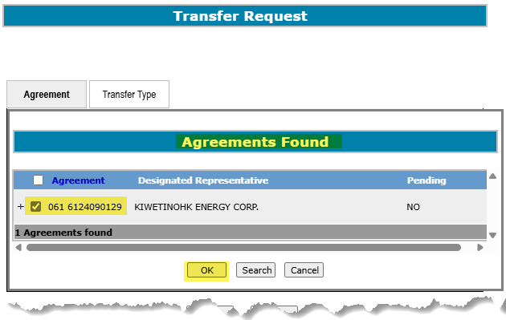
Transfer of Pore Space Lease Lessee
Government of Alberta
AGREEMENT TAB - SEARCH AGREEMENTS
3. Ensure that there is no Pending transfer. If there is, follow up.
4. Checkmark the found PSL agreement
1. Enter the Agreement Type and Number
2. Click Search
5. Click OK
Note: Pore Space Lease type is 061.

Slide 7
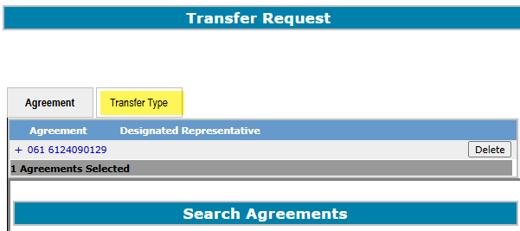
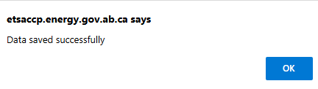
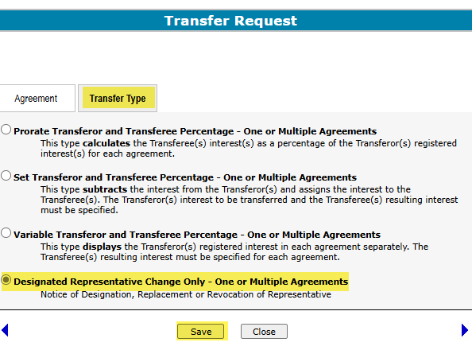
Transfer of Pore Space Lease Lessee
Government of Alberta
TRANSFER TYPE TAB
For PSL, only choose Designated Representative Change Only.
5. Click Save
1. Click Transfer Type tab
2. Select Designated Representative Change Only
4. Click Save

Slide 8
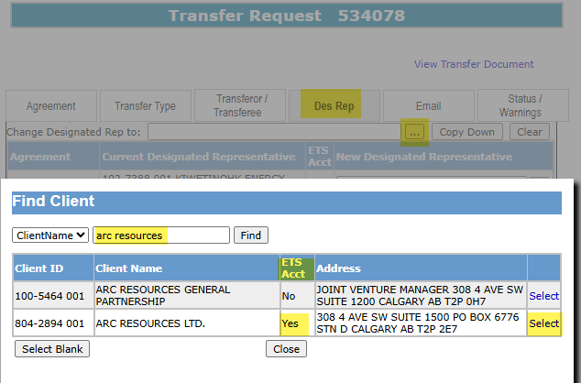
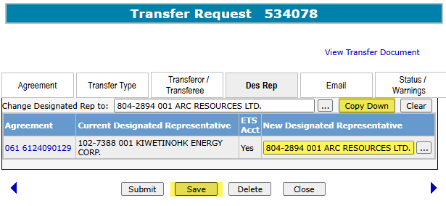
Transfer of Pore Space Lease Lessee
Government of Alberta
DES REP TAB - CHANGE PSL LESSEE
1. Click the search box to find new lessee.
2. Search by the default ClientName
4. Click Select
3. Ensure the client has an ETS Acct (this is required to concur the transfer.
5. Click Copy Down
6. The client is copied down under New Designated Representative
7. Click Save

Slide 9
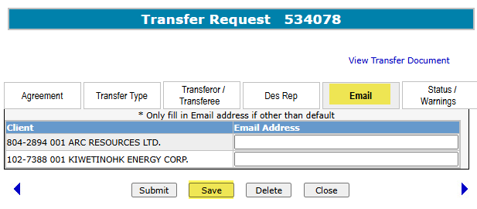
Transfer of Pore Space Lease Lessee
Government of Alberta
EMAIL TAB - OPTIONAL
The Email tab allows you to insert a specific email address that should receive the email requesting concurrence to a transfer request.
If an email address is not specified, then an email message will be sent to clientS with the concurrence role who are part of this transfer.
The default email address is associated with the individual/client account that the Site Administrator had set up. The email recipients can then access the transfer request using the Work In Progress (WIP) screen.

Slide 10
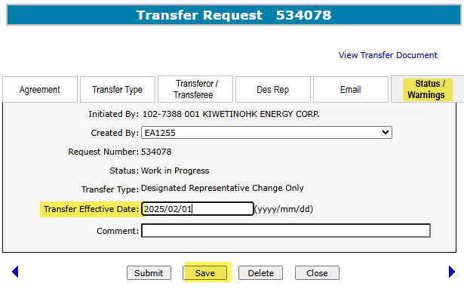
Transfer of Pore Space Lease Lessee
Government of Alberta
STATUS / WARNINGS TAB – TRANSFER EFFECTIVE DATE
1. Enter Transfer Effective Date
2. Click Save

Slide 11
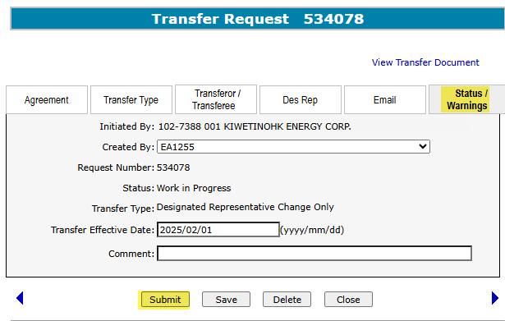
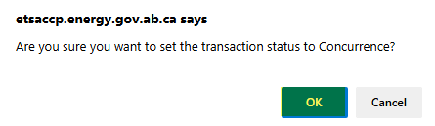
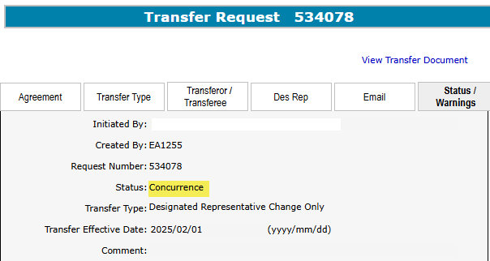
Transfer of Pore Space Lease Lessee
Government of Alberta
STATUS / WARNINGS TAB – SUBMIT APPLICATION
2. Click OK to submit for concurrence
1. Click Submit.
Upon successful submission of the application, the Status is changed to Concurrence

Slide 12
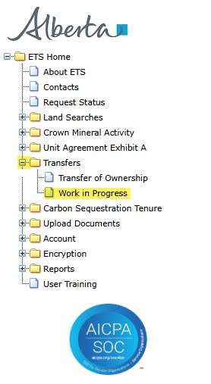
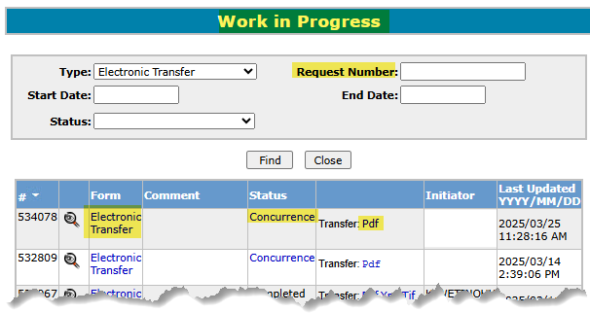
Transfer of Pore Space Lease Lessee
Government of Alberta
WORK IN PROGRESS
The Work in Progress subnode provides information on the request Status, view the transfer application form, view the Transfer pdf, which is the report of the application.
User can search by Request Number, by Last Updated or by Status.
1. Navigate to Transfers/Work in Progress subnode.

Slide 13
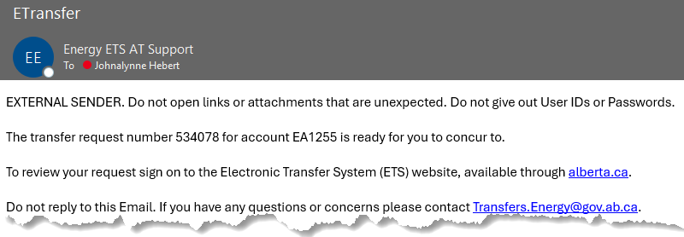
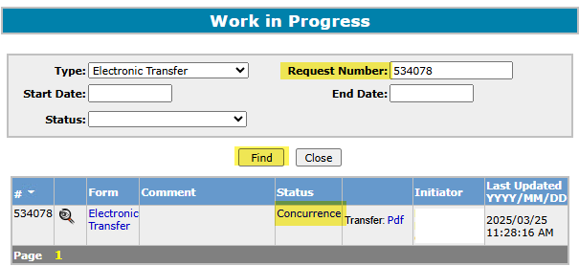
Transfer of Pore Space Lease Lessee
Government of Alberta
CONCURRENCE
The concurrer receives an email notification requesting to login to ETS to concur a specific request. If the creator of the request is the New Lessee, then the Current Lessee will concur and vice versa.
Login to ETS and navigate to Transfer/Work in Progress subnode.
1. Enter the Request Number quoted from the email notification.
2. Click Find.
3. Click the Request number to open the application and concur.

Slide 14
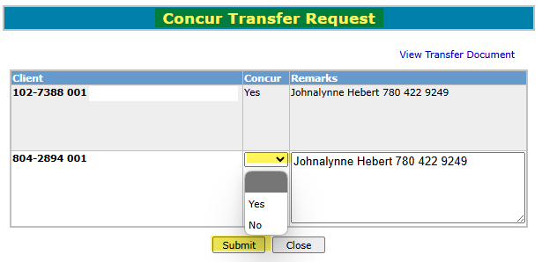
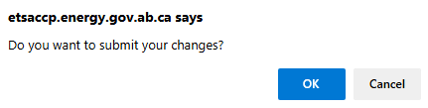
Transfer of Pore Space Lease Lessee
Government of Alberta
SUBMIT CONCURRENCE DECISION
1. Click dropdown arrow to concur (Yes/No)
2. Click Submit.
3. Click OK.
When the concurrer submits the concurrence decision, this will submit the application.
If the concurrence decision is No, the application is rejected and the creator is notified via email notification.

Slide 15
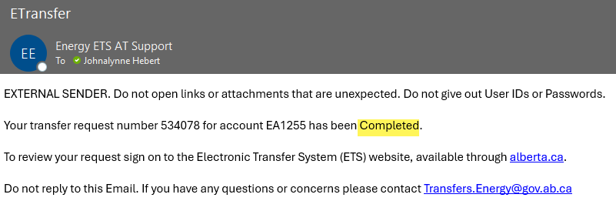
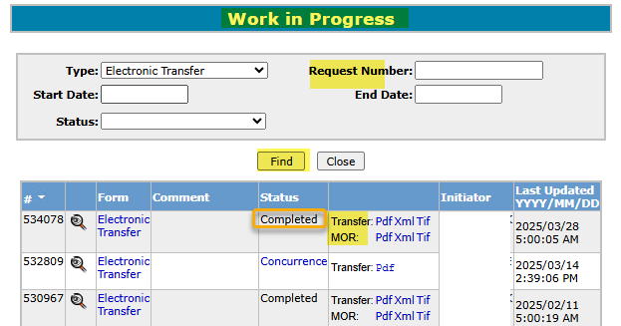
Transfer of Pore Space Lease Lessee
Government of Alberta
RETRIEVE DOCUMENTS
An email notification is sent to the creator when the transfer request is successfully completed.
1. Click dropdown arrow to concur (Yes/No)
1.
Login to ETS and navigate to Transfer/Work in Progress subnode.
Enter the Request Number from the email notification or click Find (this will display all requests).
Retrieve the documents (Transfer and/or Memorandum of Registration (MOR) by the version available, i.e. pdf, xml or tif.
1. Enter the Request number or click Find
2.
3. Click OK.
3.

Slide 16

Transfer of Pore Space Lease Lessee
Government of Alberta
Congratulations!
You have completed the
Transfer of Pore Space Lease Lessee
Online Training Course
If you have any comments or questions on this training course,
please forward them to:
energy.sequestrationhelpdesk@gov.ab.ca

