Slide 1
Pore Space Lease Application
Government of Alberta
Welcome!
To the
Pore Space Lease Application
Online Training Course
In this module you will learn how to:
Enter a PSL application and attaching a proposed PSUA into ETS.
Import land from Carbon Sequestration map.
Retrieve and view agreement documents.

Slide 2
Pore Space Lease Application
Government of Alberta
Revisions Table
Date | Revisions Type | Page Number
December 12, 2024 | Initial Creation | All

Slide 3
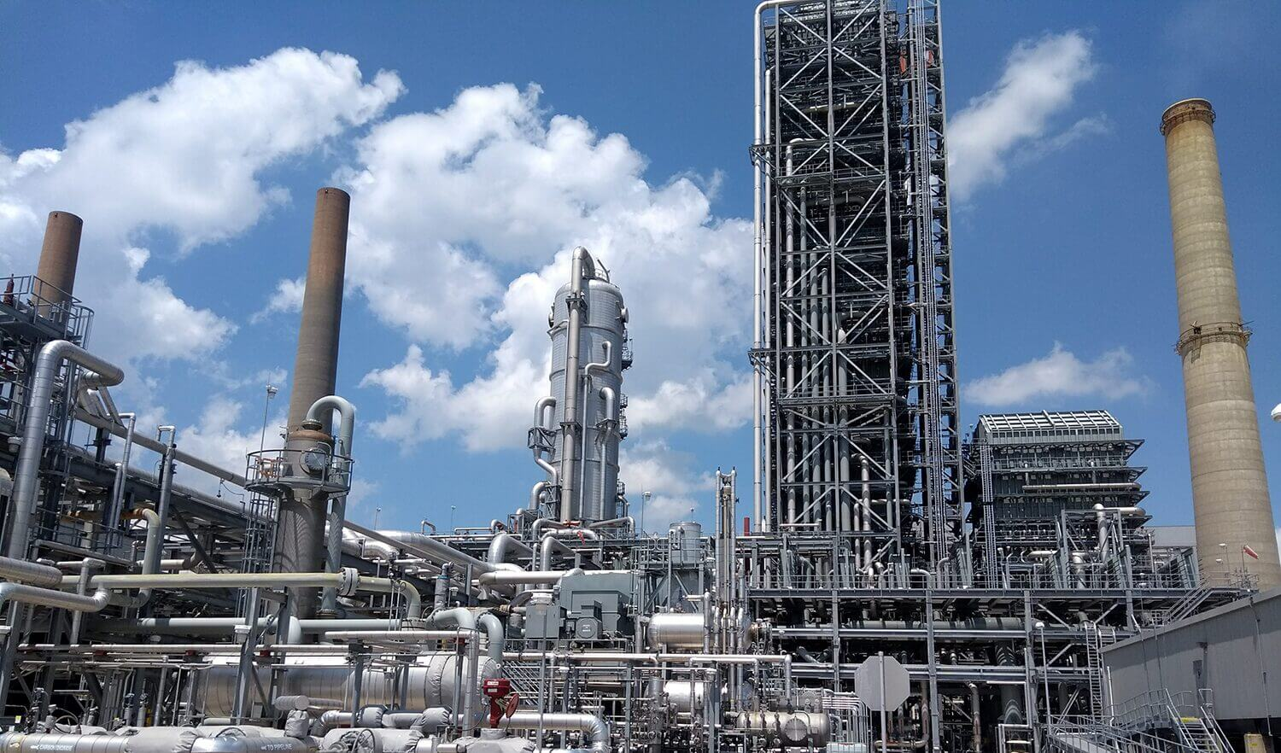
Pore Space Lease Application
Government of Alberta
INTRODUCTION
Proponents are required to provide information on the proposed activity and the requested lands and sequestration formation (the Location), which may include saline aquifers and/or depleted reservoirs. They will also be required to identify and address overlapping interests and activities in the Location. Ultimately, this process will facilitate the granting of two agreements, namely:
a Pore Space Lease (PSL) that grants the right to the pore space, and
a Pore Space Unit Agreement (PSUA) that addresses the varying interests and activities within the Location, including Crown interests

Slide 4
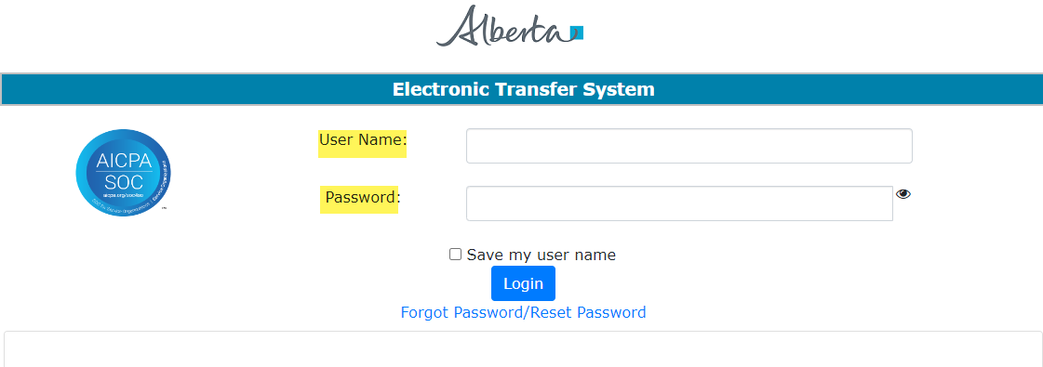
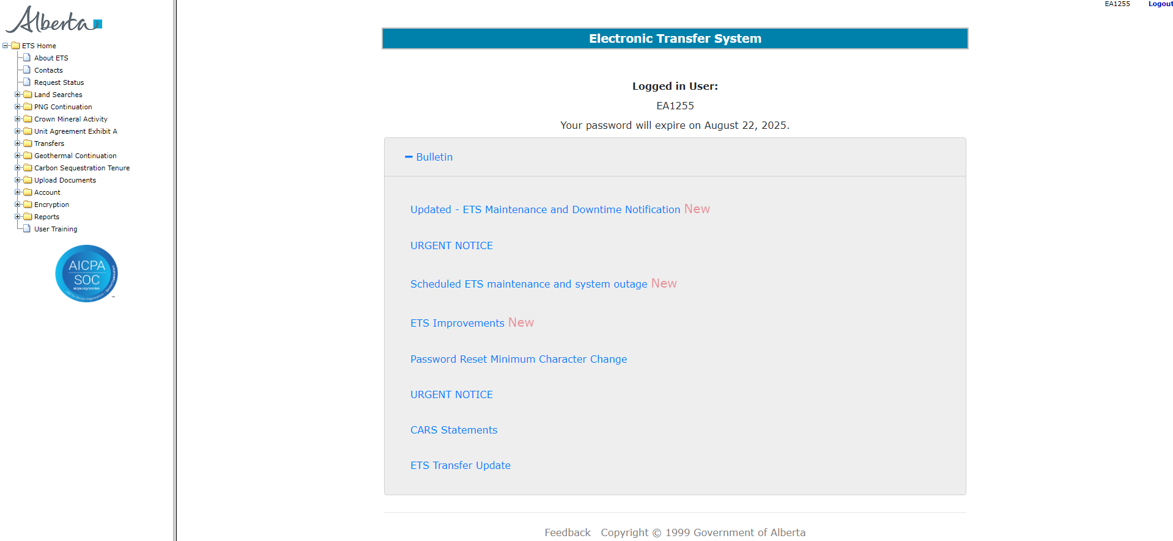
Pore Space Lease Application
Government of Alberta
LOGIN TO ETS
Go to ETS (https://ets.energy.gov.ab.ca/logon.aspx)
Enter your login credentials: User Name (EN account) and Password.
Once logged in, the screen below is displayed.

Slide 5
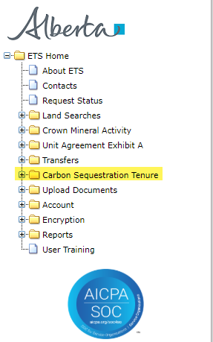
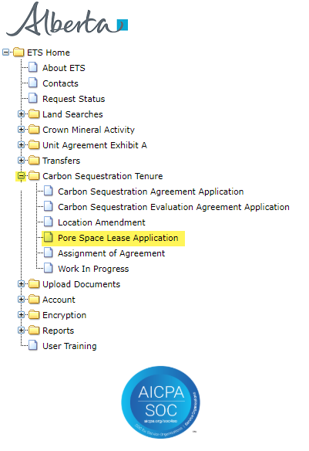
Pore Space Lease Application
Government of Alberta
NAVIGATION TO PORE SPACE LEASE APPLICATION
In the treenode (left-hand side of the screen), navigate to Carbon Sequestration Tenure node.
Expand Carbon Sequestration Tenure node to display its subnodes.
Click Pore Space Lease Application subnode.
2.
1.
3.

Slide 6
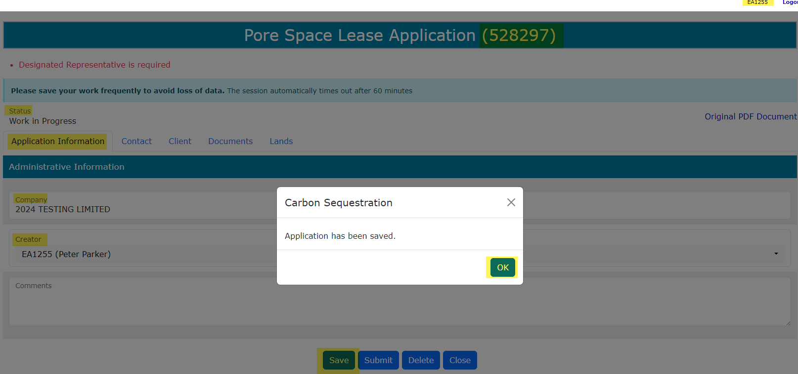
Pore Space Lease Application
Government of Alberta
APPLICATION INFORMATION TAB
On the main screen, a blank application form is displayed. ETS auto populates the Company and Creator fields. These information are generated from the login account information.
Under Application Information tab, click Save button to generate the ETS request number.
ETS account login ID
ETS request number

Slide 7
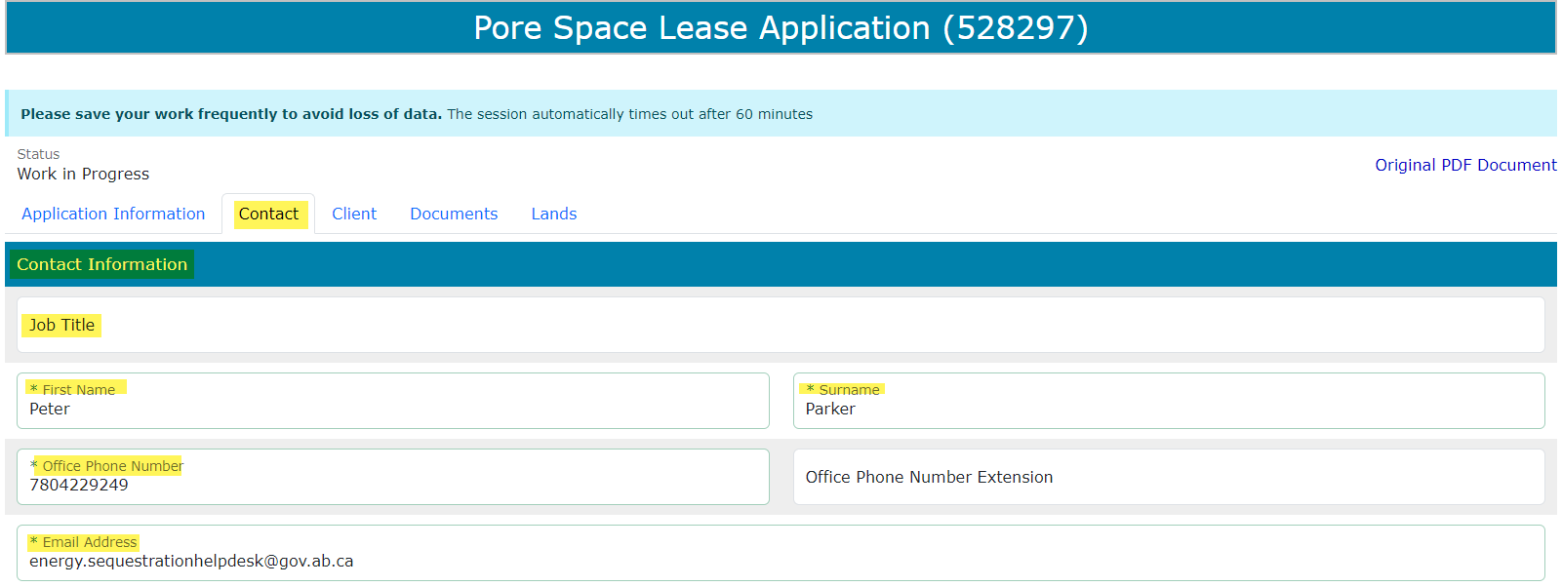

Pore Space Lease Application
Government of Alberta
CONTACT TAB – CONTACT INFORMATION SECTION
The Contact Information section is auto populated with the login information. These fields are editable. If required to change the contact information, you may do so.
Remember to click Save at the bottom of the form to save changes.

Slide 8
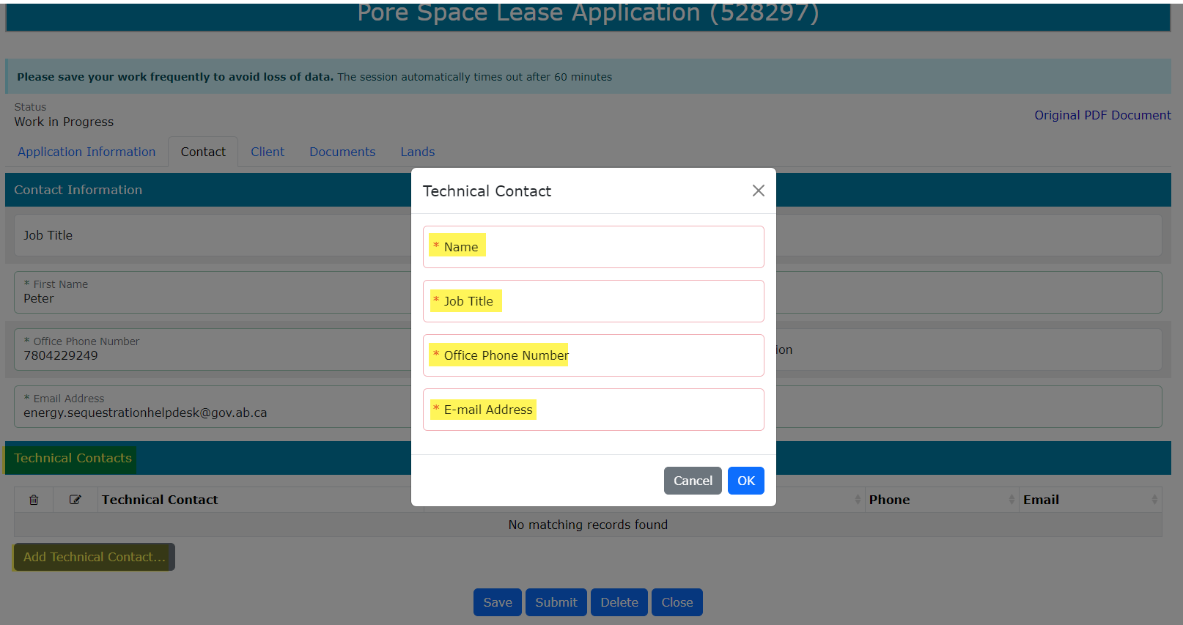
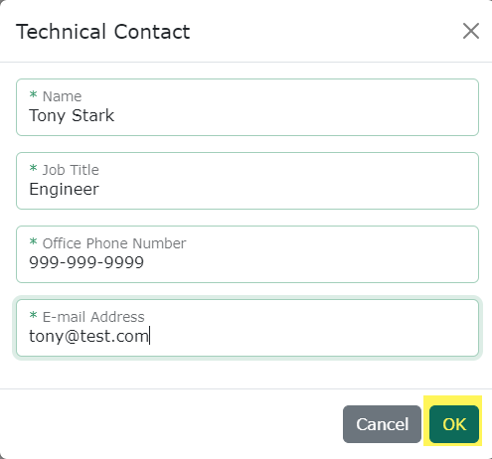
Pore Space Lease Application
Government of Alberta
CONTACT TAB – TECHNICAL CONTACT SECTION
Technical Contact(s) is mandatory for this PSL application.
2. Input the Technical Contact information. Mandatory fields are now outlined in green.
Note: Technical Contact prompt appears. Mandatory fields are outlined in red.
3. Click OK to save.
1. Click Add Technical Contact…

Slide 9
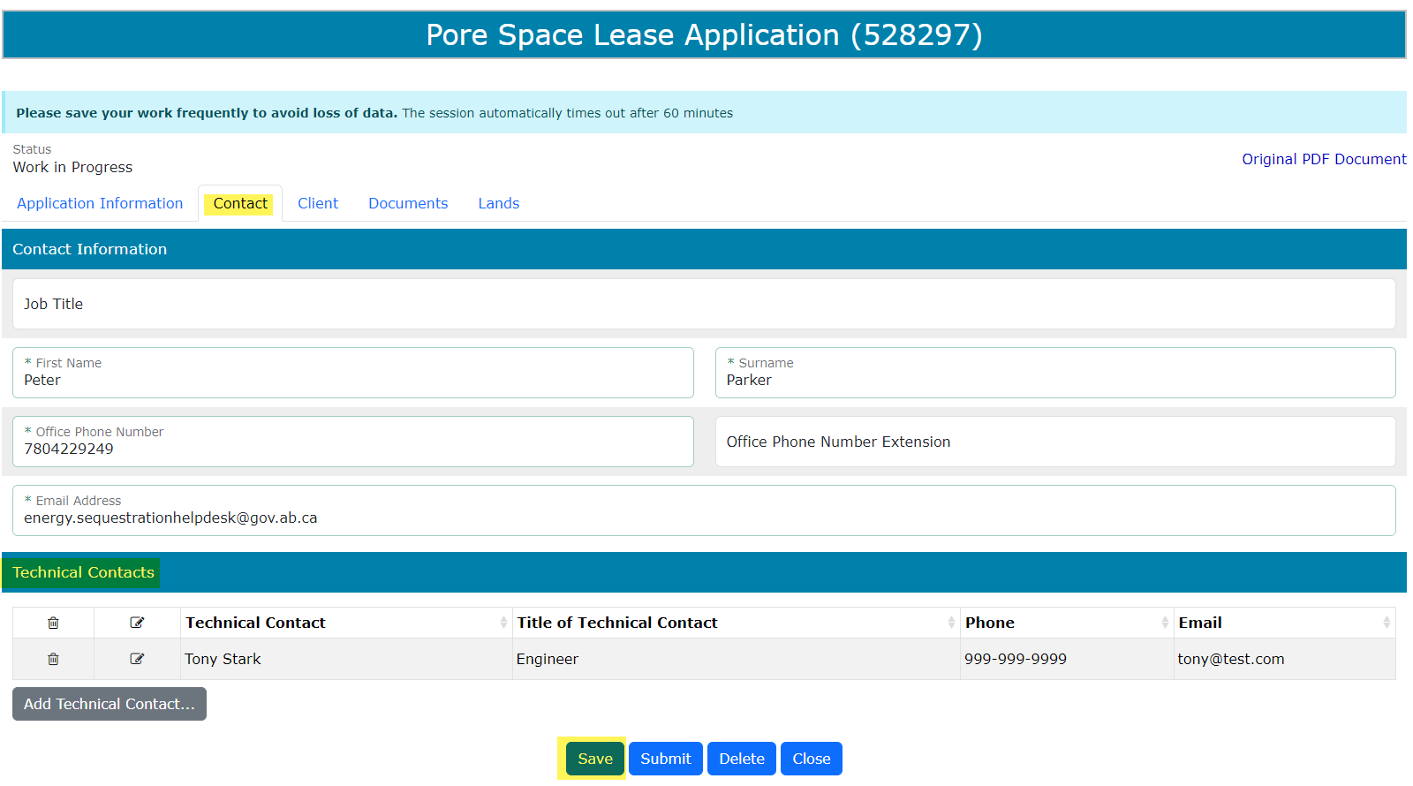
Pore Space Lease Application
Government of Alberta
CONTACT TAB – SAVE
Technical Contact is now added on the main application.
To delete an added contact information, simply click the corresponding trash bin icon.
To add, follow the steps from previous slide.
Click Save to save the Contact info on this tab.

Slide 10
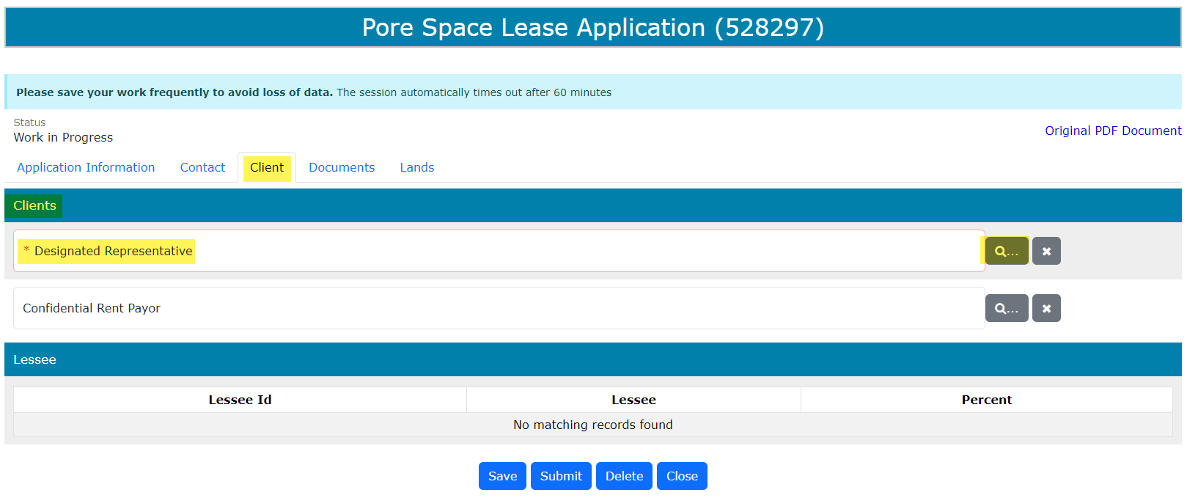
Pore Space Lease Application
Government of Alberta
CLIENT TAB
The Designated Representative is mandatory and the field is outlined in red. Once information is added, the field is outlined in green.
The Confidential Rent Payor is optional. This is used if another client is designated to pay the first time rental charge and issuance fee.
1. Click the magnifying glass to add a client.

Slide 11
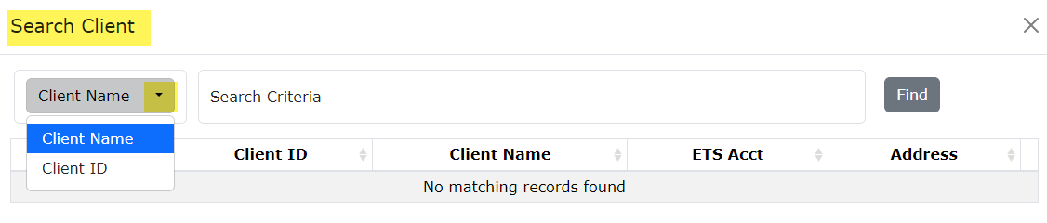
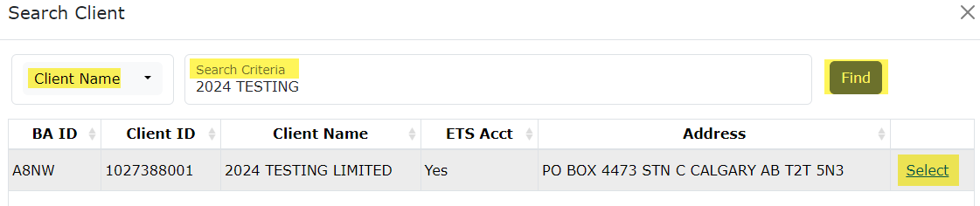
Pore Space Lease Application
Government of Alberta
CLIENT TAB – DESIGNATED REPRESENTATIVE
By default, Client Name search criteria displayed by default. Click the dropdown to select the desired search criteria.
1.
2. Depending on the search criteria chosen, enter the Client Name OR the Client ID in the corresponding field.
Click Find. Search result appears
Click Select to add the client as designated representative.
3.
2.
4.

Slide 12
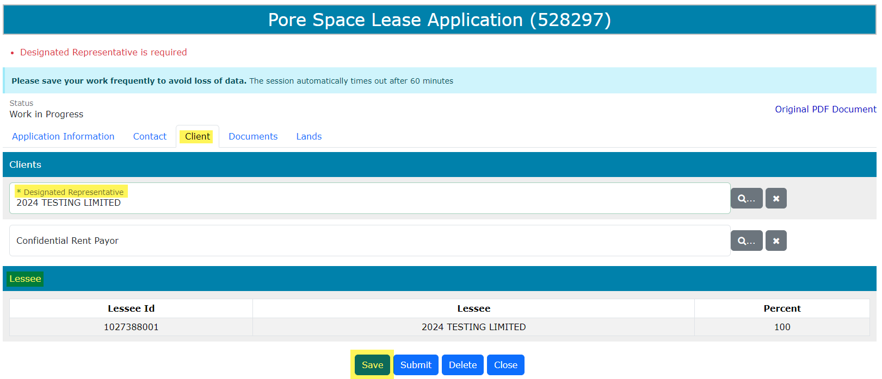
Pore Space Lease Application
Government of Alberta
CLIENT TAB – ADDED DESIGNATED REPRESENTATIVE
The Designated Representative is now added on the application. At the same time, the Lessee section is updated automatically based on the added Designated Representative and assigns 100% participation.
To add the optional Confidential Rent Payor, follow the previous slide.
Click Save at the bottom of the screen to save the changes. This clears up the validation error (in red font color).
Click Save

Slide 13
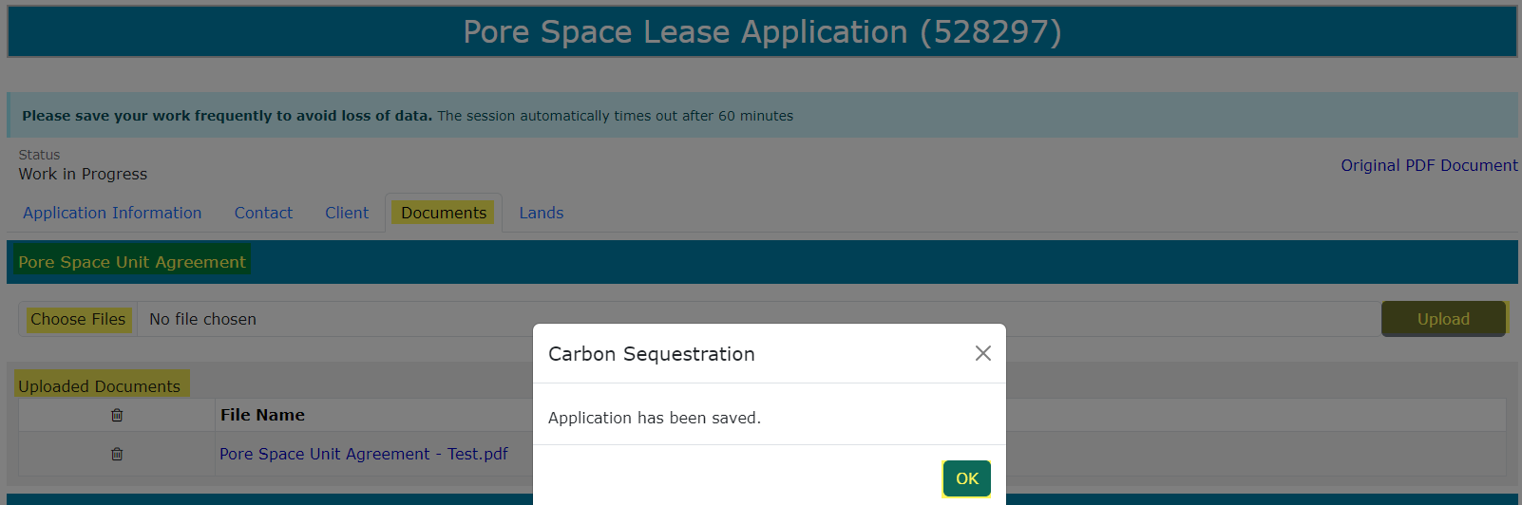
Pore Space Lease Application
Government of Alberta
DOCUMENT TAB – UPLOAD PORE SPACE UNIT AGREEMENT
Under Pore Space Unit Agreement section, click Choose Files. File Explorer folders opens. Locate the file to upload.
Back to the ETS request application, the name of the file is added on the ‘No file chosen’ field.
Click Upload.
Save prompt appears, click OK. The document is added in the Uploaded Documents grid.
To delete an uploaded document, simply click the corresponding trash bin icon.
To add, follow the steps above.
1.
2.
3.
4.

Slide 14
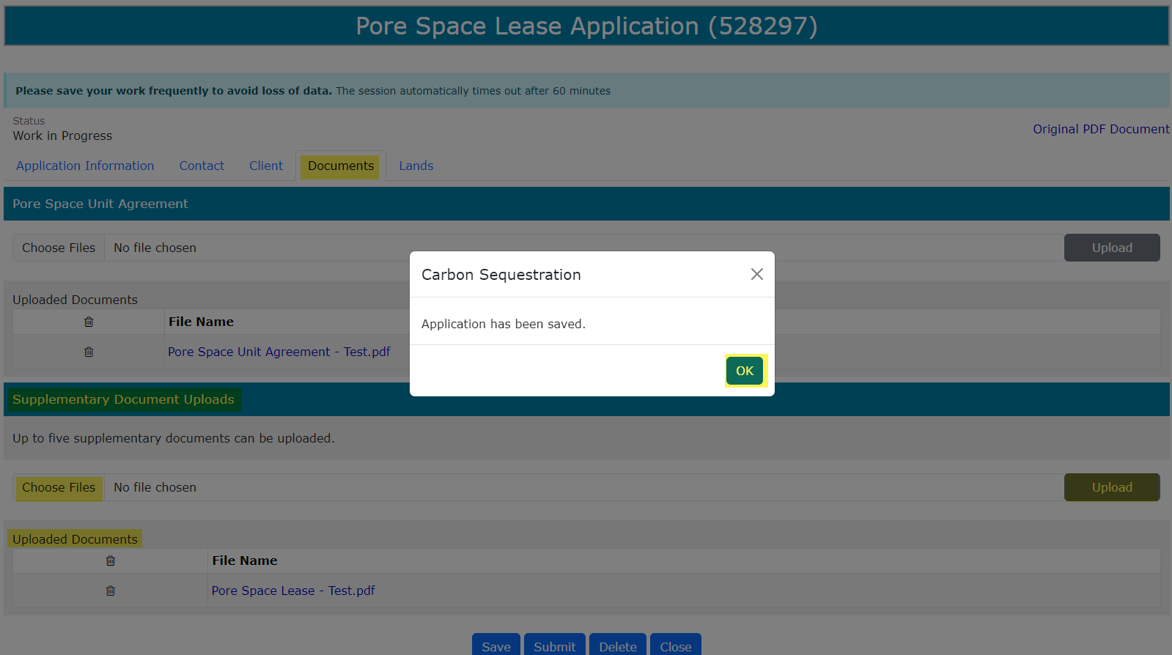
Pore Space Lease Application
Government of Alberta
DOCUMENT TAB – UPLOAD SUPPLEMENTARY DOCUMENT
Under Supplementary Document Uploads section, click Choose Files. File Explorer folders opens. Locate the file to upload. Note: up for 5 supplementary documents can be uploaded.
Back to the ETS request application, the name of the file is added on the ‘No file chosen’ field.
Click Upload.
Save prompt appears, click OK. The document is added in the Uploaded Documents grid.
To delete an uploaded document, simply click the corresponding trash bin icon.
To add, follow the steps above.
4.
3.
2.
1.

Slide 15
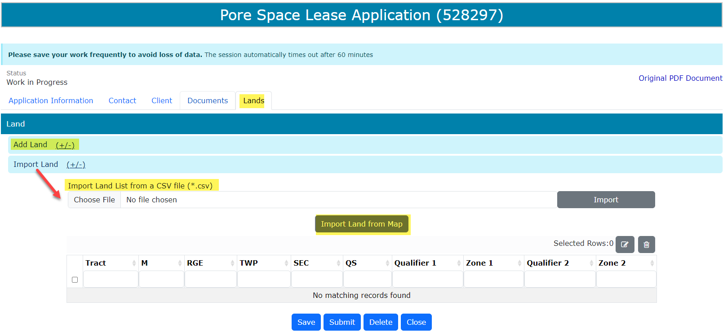
Pore Space Lease Application
Government of Alberta
LANDS TAB
Adding lands have 3 options:
Import Land (+/-)
1. Import Land from Map
2. Import Land List from a CSV file (*.csv)
3. Add Land (+/-)
3.
2.
1.

Slide 16
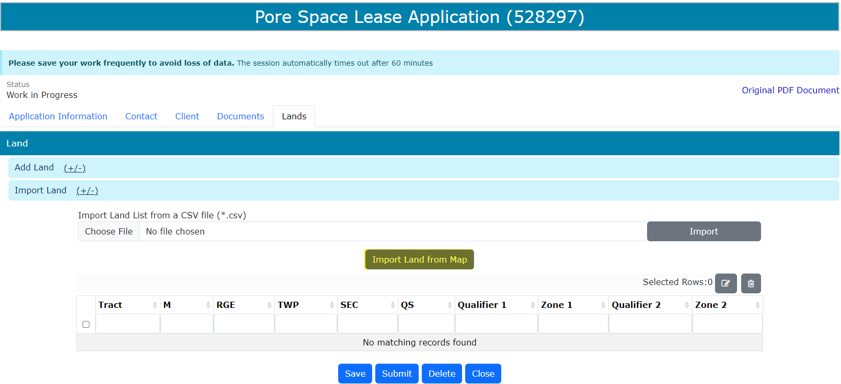
Pore Space Lease Application
Government of Alberta
LANDS TAB – OPTION 1: IMPORT LAND FROM MAP
Click Import Land from Map.

Slide 17
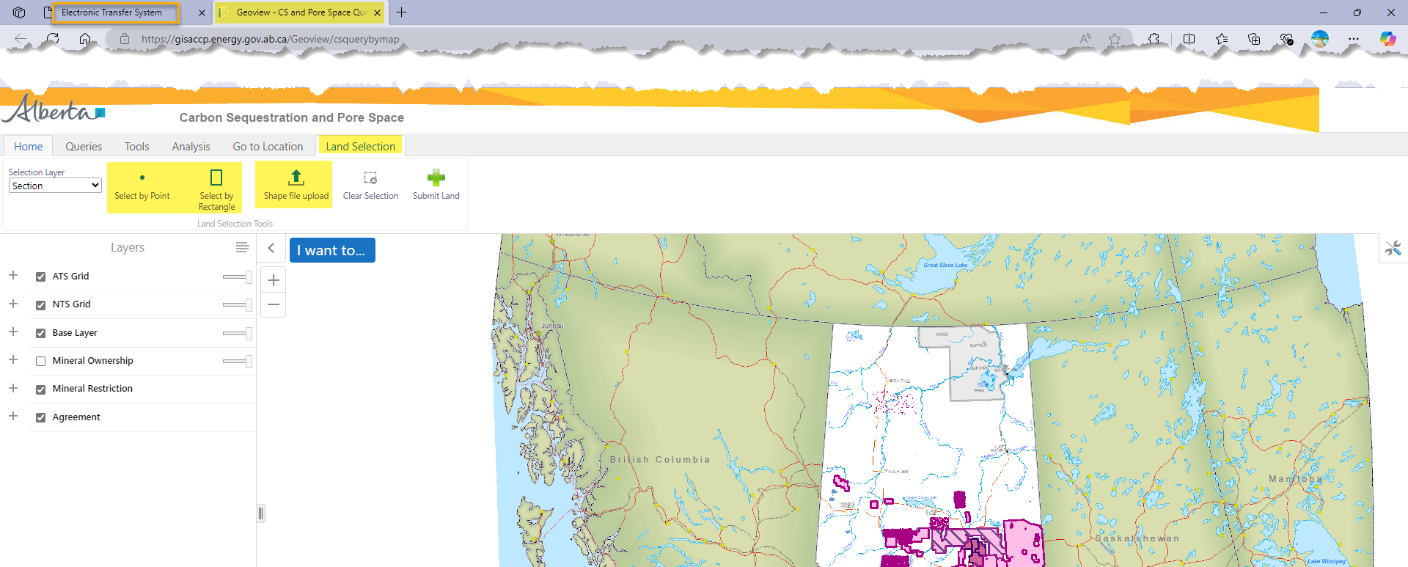
Pore Space Lease Application
Government of Alberta
LANDS TAB – OPTION 1: IMPORT LAND FROM MAP
Geoview – Carbon Sequestration and Pore Space Query map is opened on a new browser page.
Under Land Selection tab, there are 2 option to import land from Map: selecting the lands directly from the map (Select by Point or Select by Rectangle) or shape file upload.
1.
2.

Slide 18
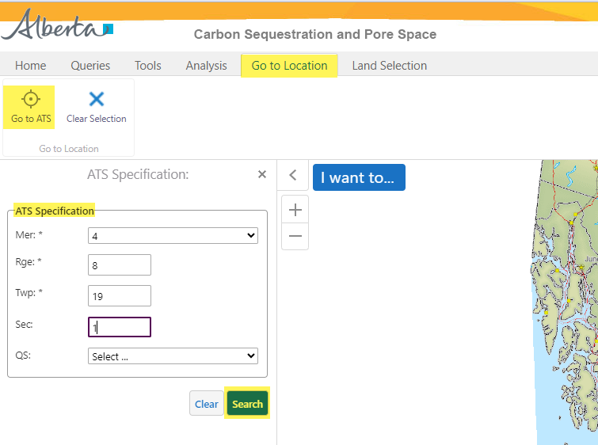
Pore Space Lease Application
Government of Alberta
LANDS TAB – OPTION 1: IMPORT LAND FROM MAP – NAVIGATE TO THE TARGET LOCATION
2. Click Go to ATS.
1. Navigate to Go to Location tab.
3. Input the landkey.
4. Click Search.

Slide 19
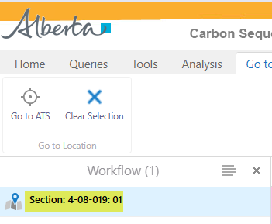
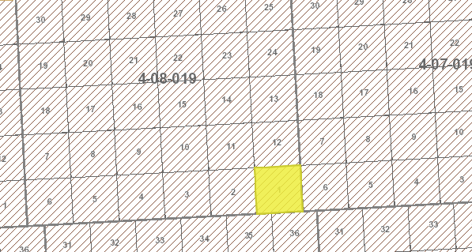
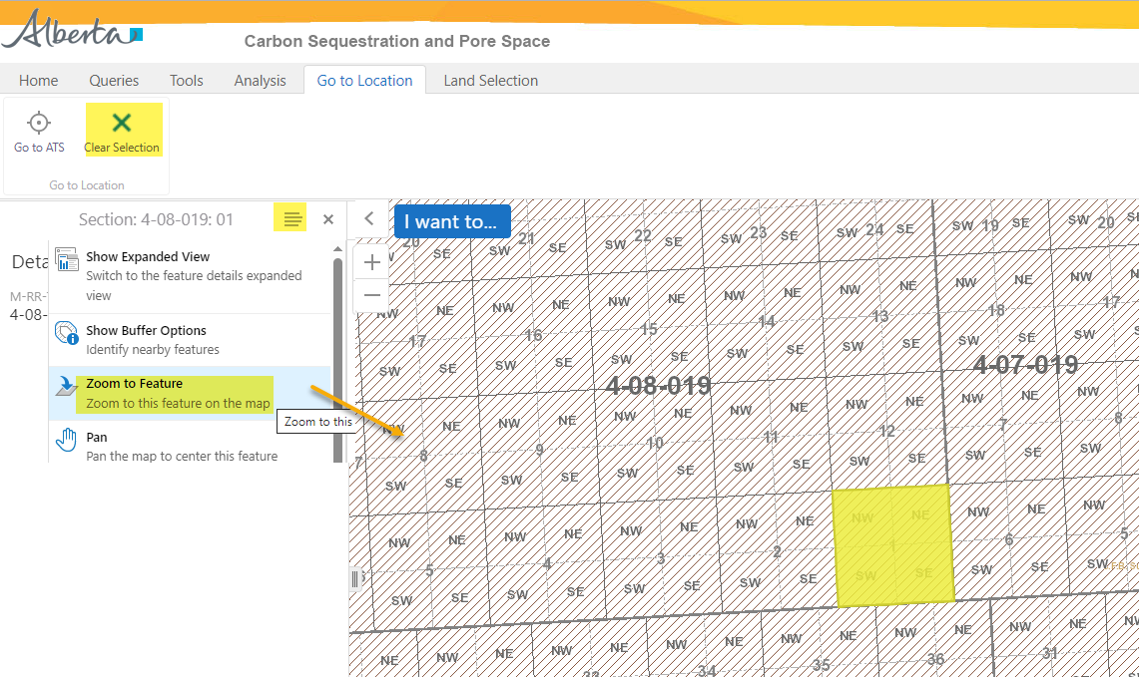
Pore Space Lease Application
Government of Alberta
LANDS TAB – OPTION 1: IMPORT LAND FROM MAP – NAVIGATE TO THE TARGET LOCATION
5. Click Clear Selection
2. Click the hamburger icon.
1. Select the land result.
4. Zoom in or Zoom out on the target location.
3. Click Zoom to Feature.

Slide 20
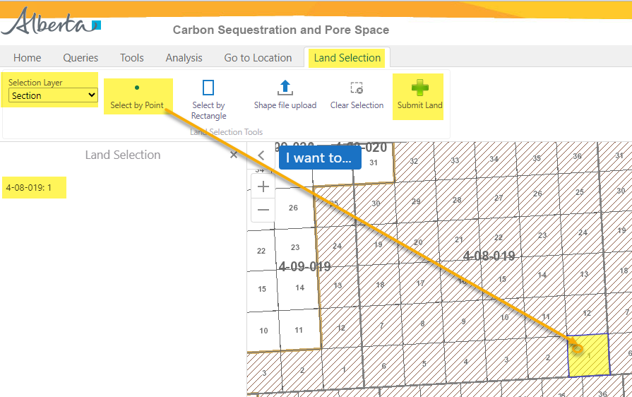
Pore Space Lease Application
Government of Alberta
LANDS TAB – OPTION 1A: IMPORT LAND FROM MAP – ADD LAND - SELECT BY POINT
Once a target location is searched, add the land. There are 2 options:
Select by Point (use this option if selecting lands not adjacent to each other.)
Select by Rectangle
1. Navigate to Land Selection tab.
3. Click Select by Point.
2. Change Selection Layer, if required before selecting land(s).
6. Click Submit Land.
Note: only click this button once. Do not click repeatedly as the lands will be listed more than once on the ETS request.
5. As land is selected, the land node displays the selected landkeys here.
Repeat steps 1-4 to add remaining lands.
4. Point and click the section to add

Slide 21
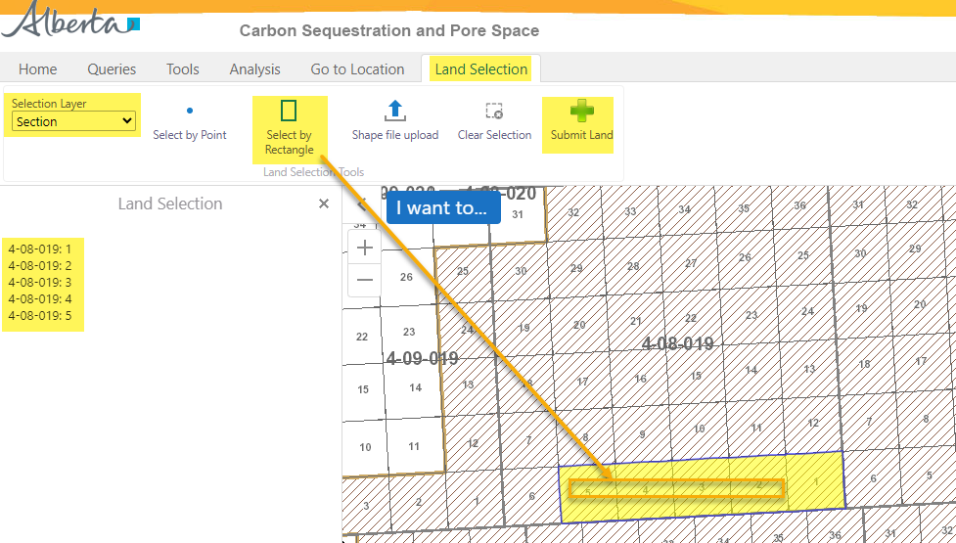
Pore Space Lease Application
Government of Alberta
LANDS TAB – OPTION 1A: IMPORT LAND FROM MAP – ADD LAND - SELECT BY RECTANGLE
Once a target location is searched, add the land. There are 2 options:
Select by Point
Select by Rectangle (use this if selecting adjacent lands.)
1. Navigate to Land Selection tab.
2. Change Selection Layer, if required before selecting land(s).
6. Click Submit Land.
Note: only click this button once. Do not click repeatedly as the lands will be listed more than once on the ETS request.
3. Click Select by Rectangle
4. Draw a rectangle on top of the sections required to select.
5. As land is selected, the land node displays the selected landkeys here.
Repeat steps 1-4 to add remaining lands.

Slide 22
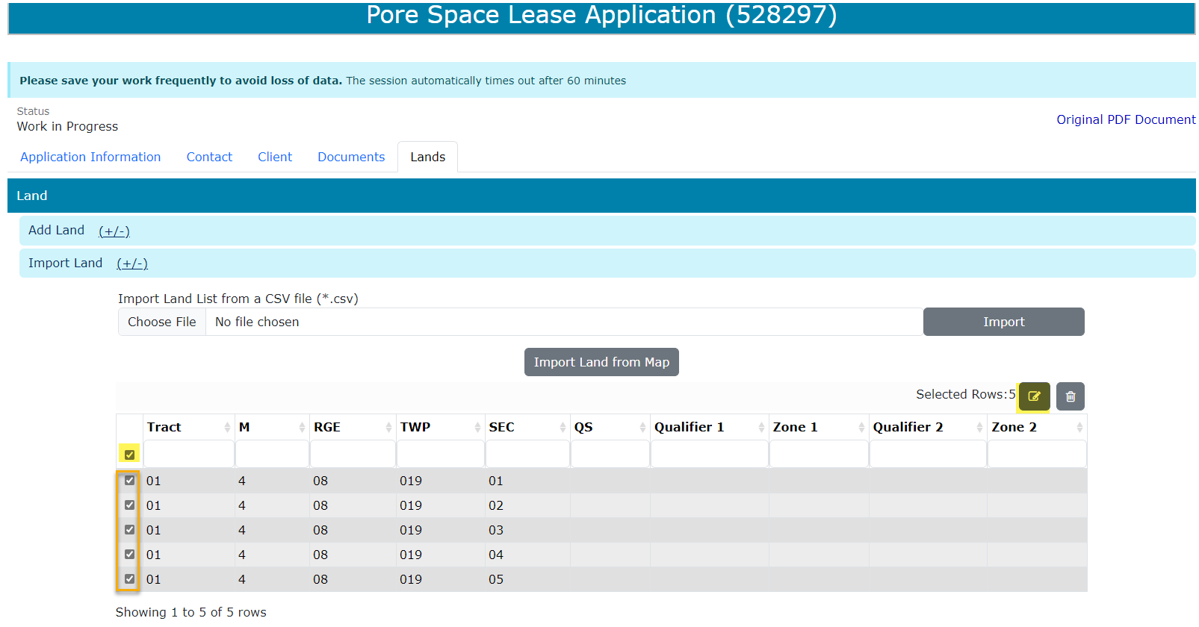
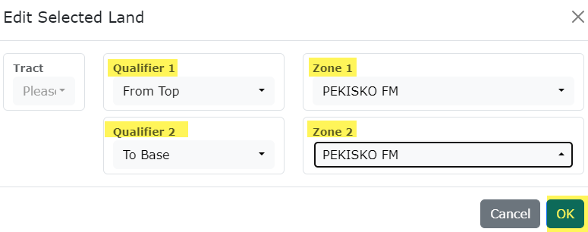

Pore Space Lease Application
Government of Alberta
LANDS TAB – OPTION 1A: IMPORT LAND FROM MAP – EDIT SELECTED LANDS
3. Add the Qualifiers and Zones
4. Click OK to apply the changes
1. Click the checkbox column to select all landkeys that has missing Qualifiers and Zones.
2. Click the modify land icon
5. Click Save.

Slide 23
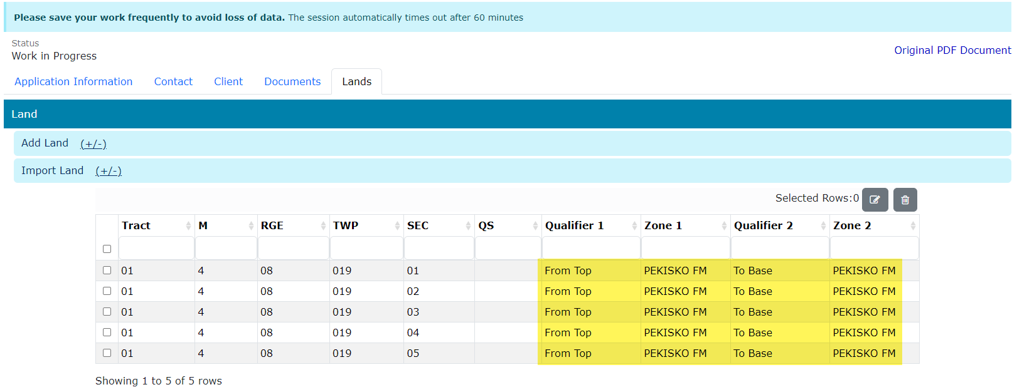
Pore Space Lease Application
Government of Alberta
LANDS TAB – OPTION 1A: IMPORT LAND FROM MAP – EDIT SELECTED LANDS… continued
Qualifiers and Zones are now added.

Slide 24
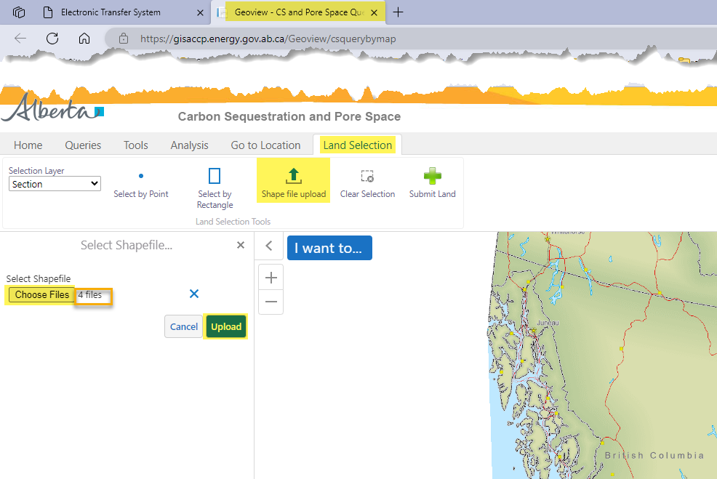
Pore Space Lease Application
Government of Alberta
LANDS TAB – OPTION 1B: IMPORT LAND FROM MAP – SHAPE FILE UPLOAD
1. Navigate to Land Selection tab.
3. Click Choose Files. File Explorer opens. Browse to the location of the shape file to upload.
2. Click Shape file upload.
4. Number of files to upload are indicated in this field.
5. Click Upload.

Slide 25
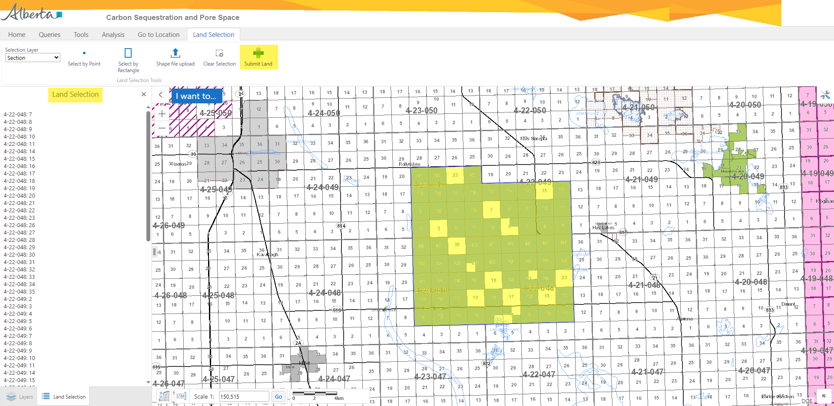
Pore Space Lease Application
Government of Alberta
LANDS TAB – OPTION 1B: IMPORT LAND FROM MAP – SHAPE FILE UPLOAD
1. Click Submit Land
Land Selection treenode list all landkeys uploaded via shape file.
Landkeys uploaded via shape file.
Once submitted, edit the lands added in ETS. Refer to Slide 27 & 28, ‘Edit Selected Lands’.

Slide 26
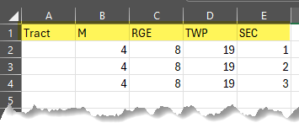
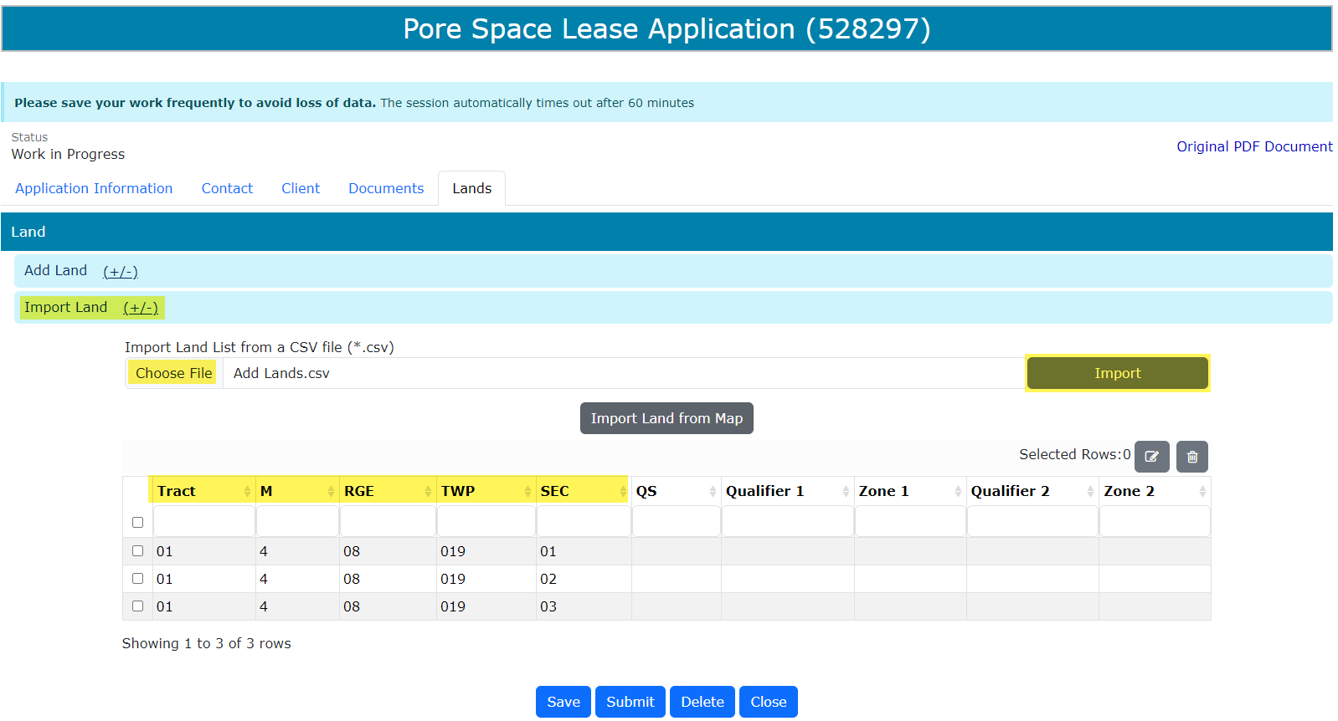
Pore Space Lease Application
Government of Alberta
LANDS TAB – OPTION 2: IMPORT LAND LIST FROM A CSV FILE (*.csv)
Create a .csv file. The format must be as follows: Tract, M, RGE, TWP and SEC.
To import, navigate to the ETS request/ Lands tab.
Click Import Land (+/-).
Click Choose File to browse the .csv file on your personal computer.
Navigate to the File Explorer and select the .csv file and click Open. The file is now chosen.
Click Import to add the lands into the grid.
1.
2.
3.
4.
6.
5.
6.

Slide 27
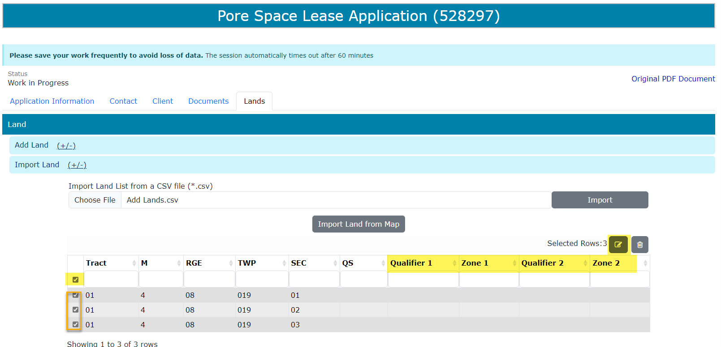
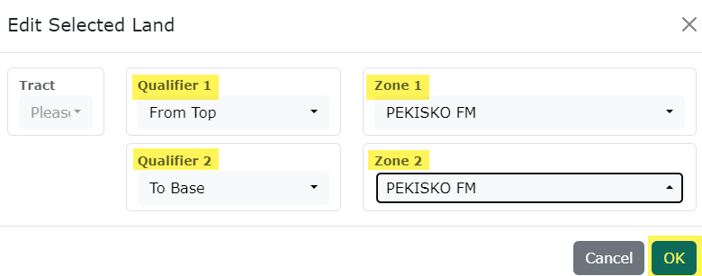
Pore Space Lease Application
Government of Alberta
LANDS TAB – OPTION 2: IMPORT LAND LIST FROM A CSV FILE (*.csv)… continued
Lands are now added into the grid. Qualifiers are required.
Select all landkeys. Checkmark all.
Click the modify landkey icon. Edit Selected Land box appears.
“Edit Selected Land’ box appears. Add the Qualifiers and Zones.
Click OK.
4.
5.
3.
2.
1.

Slide 28
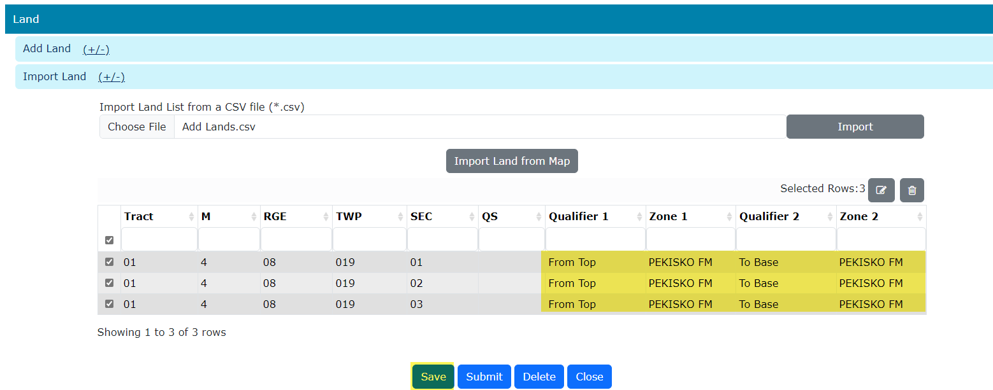
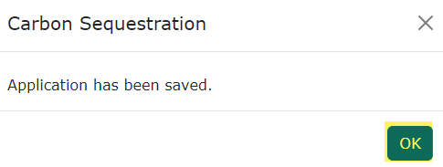
Pore Space Lease Application
Government of Alberta
LANDS TAB – OPTION 2: IMPORT LAND LIST FROM A CSV FILE (*.csv)… continued
Lands are now modified.
Click Save to save the changes.
Click OK on the save prompt box.
3.
1.
2.

Slide 29
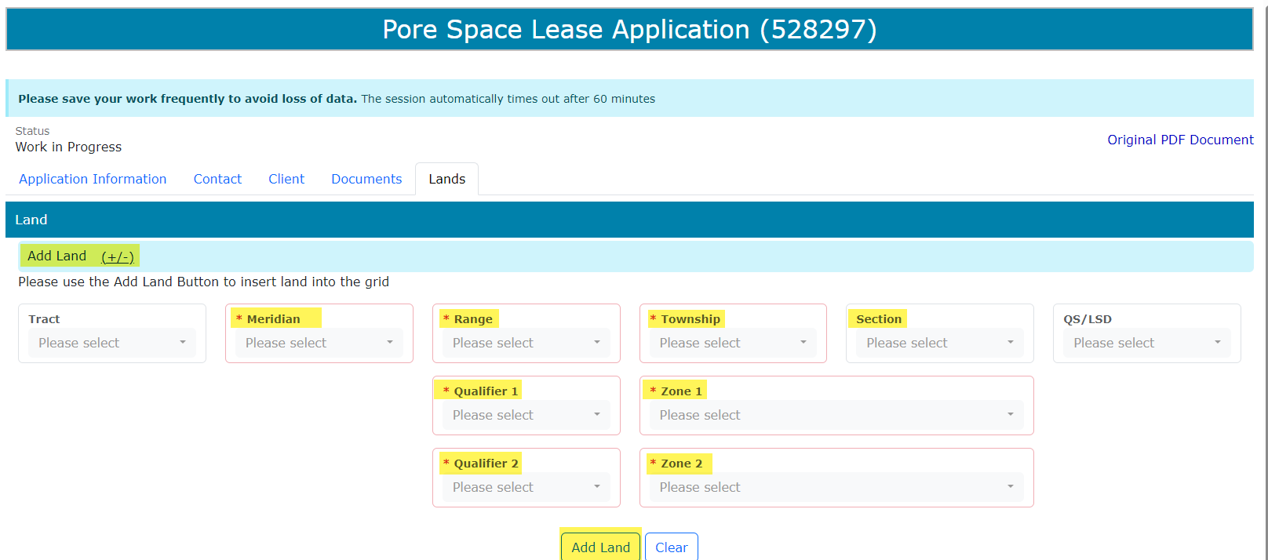
Pore Space Lease Application
Government of Alberta
LANDS TAB – OPTION 3: ADD LAND (+/-)
Use this option if prefer to enter lands one landkey at a time.
Click Add Land (+/-). The screen below appears.
Input the required information (flagged with asterisk and outlined in red)
Click Add Land to add the land into the grid.
1.
2.
3.

Slide 30
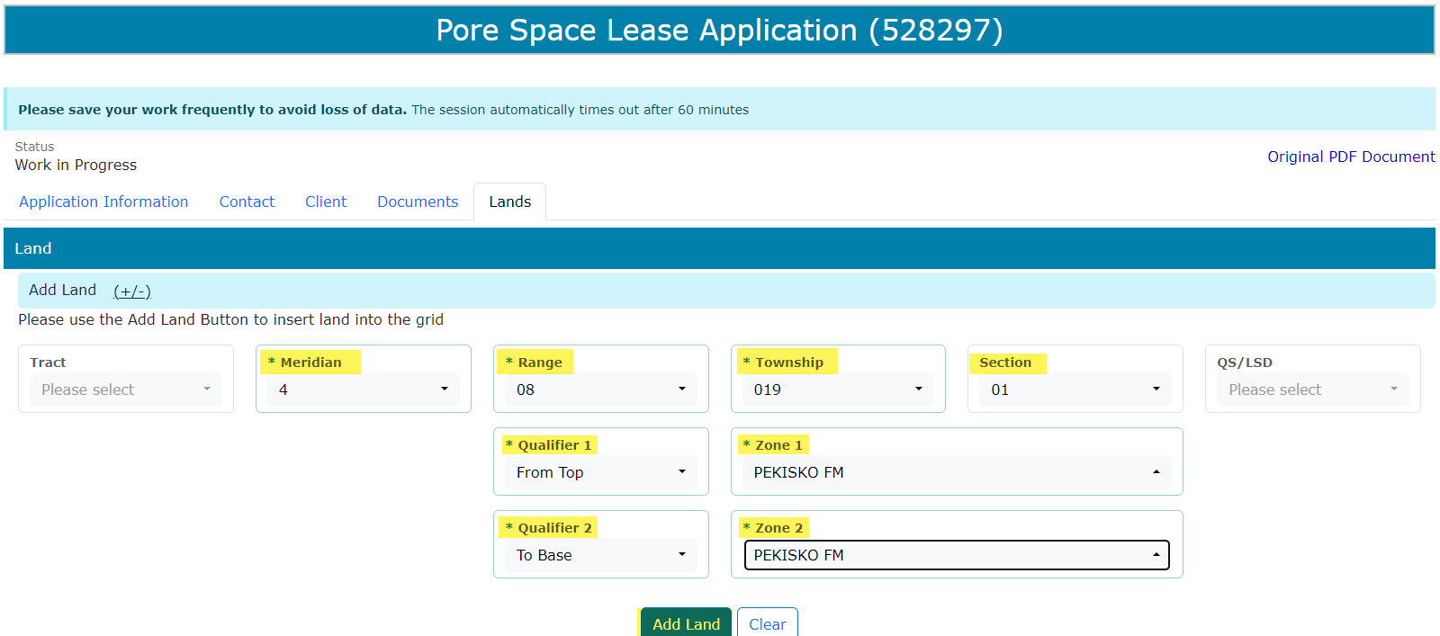
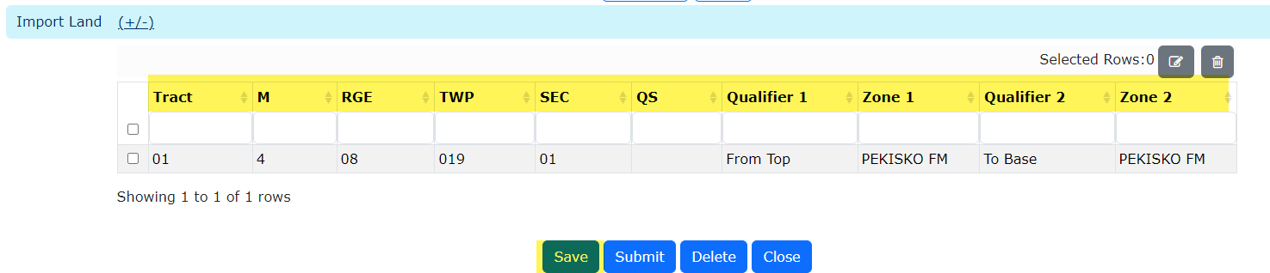
Pore Space Lease Application
Government of Alberta
LANDS TAB – OPTION 3: ADD LAND (+/-) …continued
Required information inputted and added into the land grid. Repeat previous steps to add remaining lands.
Click Save.

Slide 31
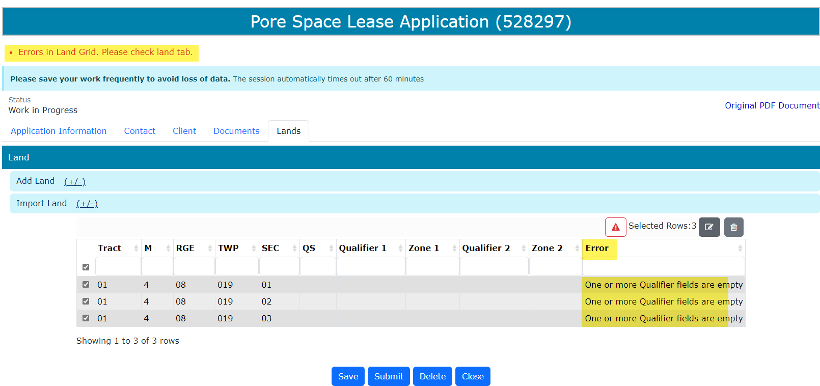
Pore Space Lease Application
Government of Alberta
VALIDATION ERRORS – ERRORS IN LAND GRID
Any validation errors are displayed at the top of the application in red. These require attention before proceeding to the next step of the application.
Validation error: One or more Qualifier fields are empty
Refer to Slide 22 & 23, ‘Edit Selected Lands’.

Slide 32
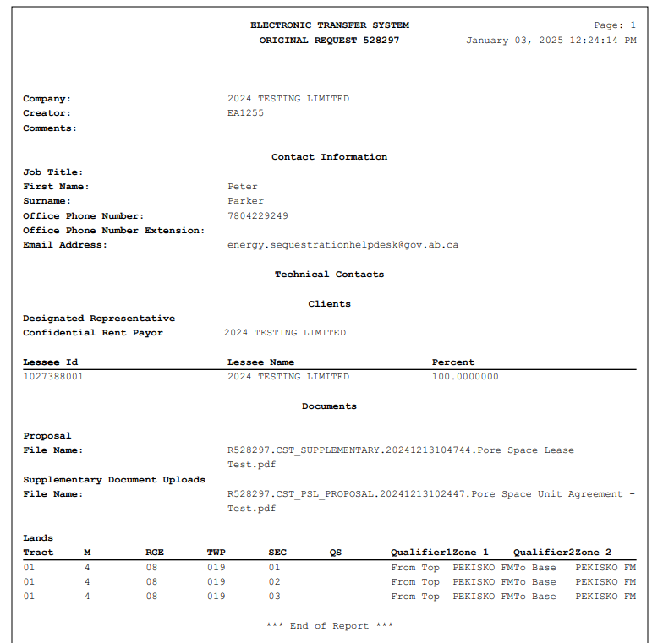
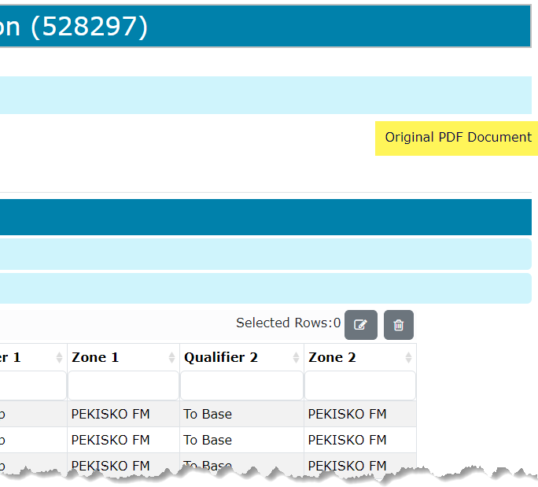
Pore Space Lease Application
Government of Alberta
APPLICATION SUMMARY REPORT
The Original PDF Document link is the application summary report. It contains all data entered on the application.
This tool is useful to review the entire application before clicking Submit.
Click Original PDF Document to generate the report.

Slide 33
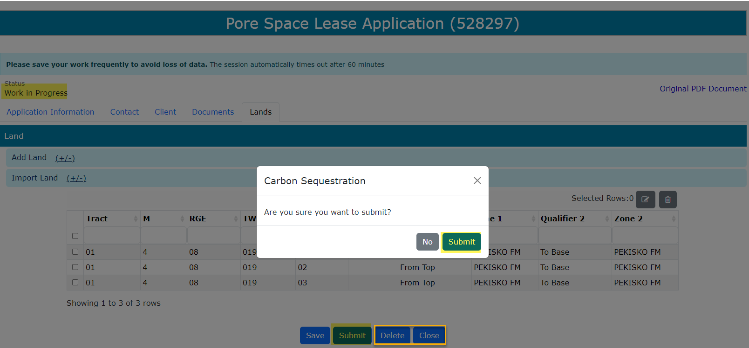
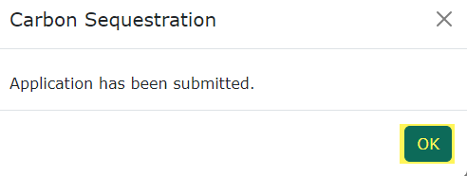
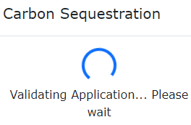
Pore Space Lease Application
Government of Alberta
SUBMIT APPLICATION
Once all pertinent information has been entered, submit the Pore Space Lease Application.
The system performs validation check to ensure all mandatory data has been provided.
Upon successful submission, the status is updated to Submitted.
3. Click OK
2. Click Submit
1. Click Submit
Delete (deletes entire application) is available when the request Status is at Work in Progress.
Close (closes application).

Slide 34
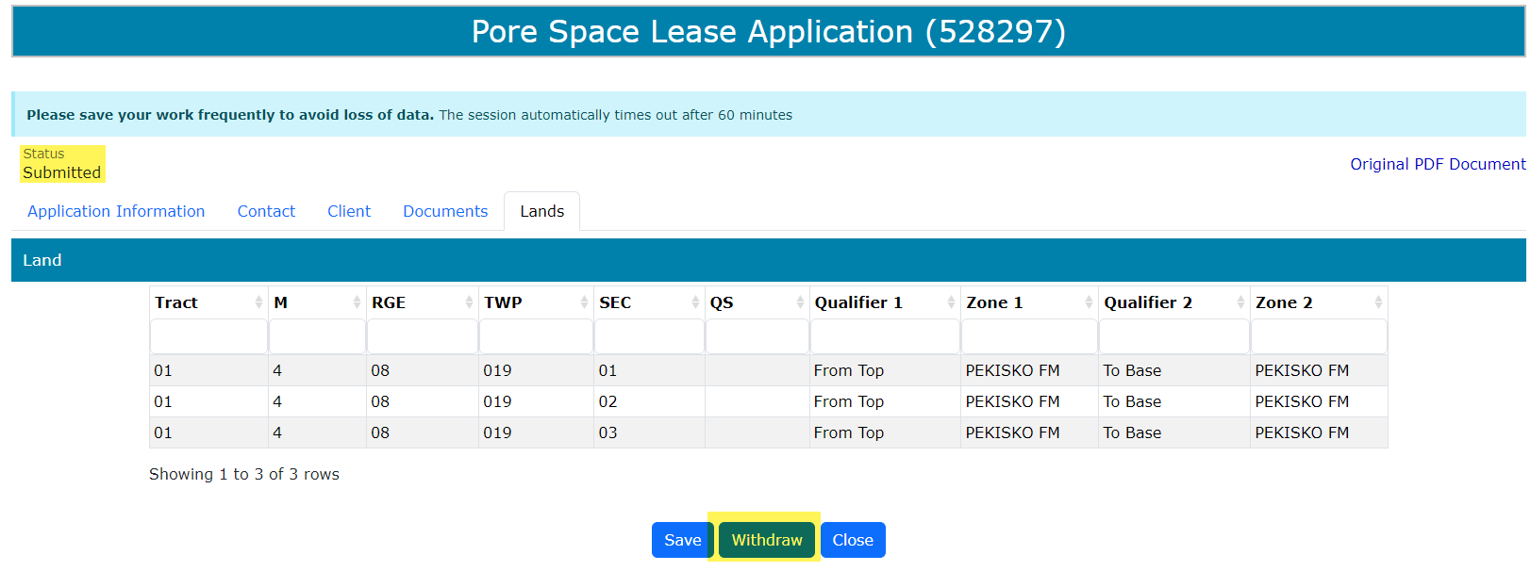
Pore Space Lease Application
Government of Alberta
WITHDRAW APPLICATION
The Withdraw button is only available when the Status is Submitted.
The creator or submitter has the option to withdraw the application during the duration of the status Submitted.

Slide 35
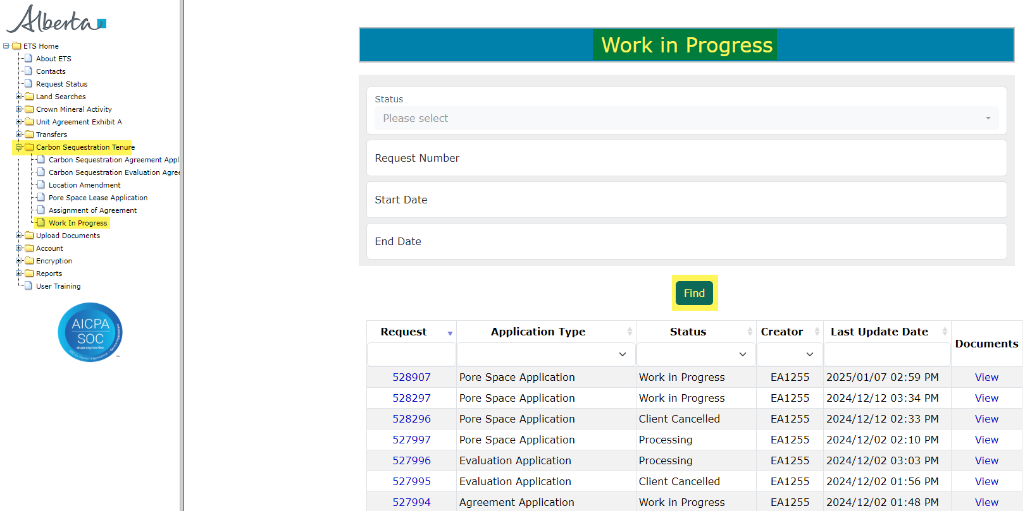
Pore Space Lease Application
Government of Alberta
WORK IN PROGRESS
The Work in Progress screen contains all different status depending on the state of each ETS Request.
To search all ETS requests, select the Find icon on the Work in Progress screen.
User can also narrow the search by the following search parameters: Status, Request Number, Start Date and End Date.
Click the Request link to view the application.

Slide 36
Pore Space Lease Application
Government of Alberta
WORK IN PROGRESS – continued…
Work in Progress
The creator can modify and save the form.
Submitted
The creator or submitter has Submitted the form.
Processing
The request has been submitted to Alberta Energy and Minerals. Only the contact information can be modified at this point. The rest of the application is read-only.
Completed
Application has been completed and agreements documents have been issued.
Client Withdrawn
Client has withdrawn the ETS application. This notifies Alberta Energy and Minerals they no longer want to proceed with the application.
Department Rejected
Alberta Energy and Minerals has rejected the client’s requested application.

Slide 37
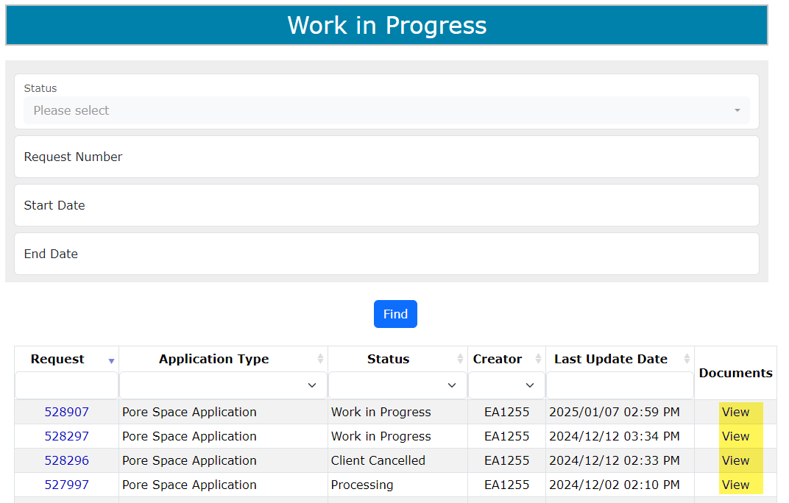
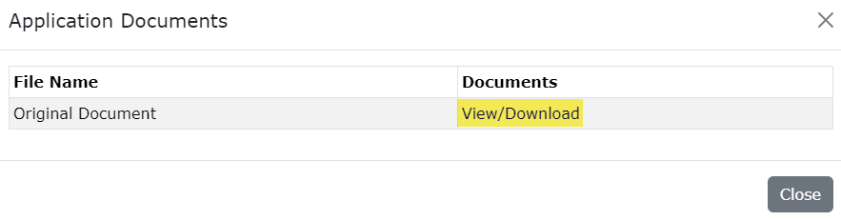
Pore Space Lease Application
Government of Alberta
WORK IN PROGRESS – View Documents
User has the option to view all documents for the corresponding ETS request. The Application Documents box list all attached documents from the application.
2. Click View/Download
1. Click View

Slide 38
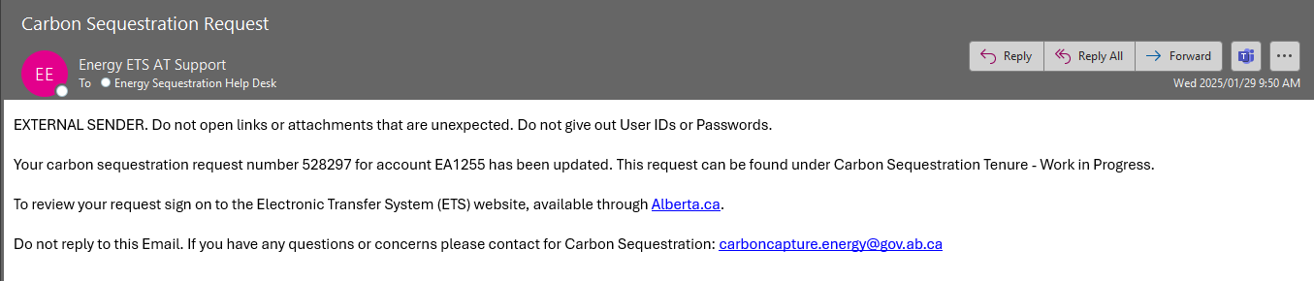

Pore Space Lease Application
Government of Alberta
ACCEPT OFFER AND FUNDS CONFIRMATION
Before the application can be approved, client is required to accept the offer and funds confirmation. An email notification is sent to the client similar to below.
1. Navigate to Carbon Sequestration Tenure/ Work In Progress subnode.
2. Enter the request number quoted from the email notification.
3. Click Find.
3. Click the hyperlinked request number to view the request.

Slide 39


Pore Space Lease Application
Government of Alberta
ACCEPT OFFER AND FUNDS CONFIRMATION continued…
Navigate to Offers and Funds Confirmation tab.
2. Input the response by clicking the arrow.
4. Click Save.
3. Select a response.

Slide 40


Pore Space Lease Application
Government of Alberta
ACCEPT OFFER AND FUNDS CONFIRMATION continued…
1. Click OK.
2. Input the response by clicking the arrow.
2. Click OK.

Slide 41
Pore Space Lease Application
Government of Alberta
EXECUTION OF AGREEMENT DOCUMENT
Agreement document requires signature from the proponent. This agreement document can be retrieved in ETS/Request Status. ETS email notification is sent to the proponent.
Once agreement document is signed, proponent is required to upload this signed agreement document via ETS/Upload Documents. Refer to Information Request – Upload Documents online module.

Slide 42

Pore Space Lease Application
Government of Alberta
Congratulations!
You have completed the
Pore Space Lease Application
Online Training Course
If you have any comments or questions on this training course,
please forward them to:
energy.sequestrationhelpdesk@gov.ab.ca

