Slide 1
Carbon Sequestration Evaluation Agreement Application
Government of Alberta
Welcome!
To the
Carbon Sequestration
Evaluation Agreement (CSEA)
Application
Online Training Course
In this module you will learn how to:
Enter a CSEA application into ETS.
Import land from Carbon Sequestration map.
Update a CSEA application by adding or removing information while the application is in a Work in Progress status.
Retrieve and view agreement documents.

Slide 2
Carbon Sequestration Evaluation Agreement Application
Government of Alberta
Revisions Table
Date | Revisions Type | Page Number
August 25, 2025 | Initial Creation | All

Slide 3
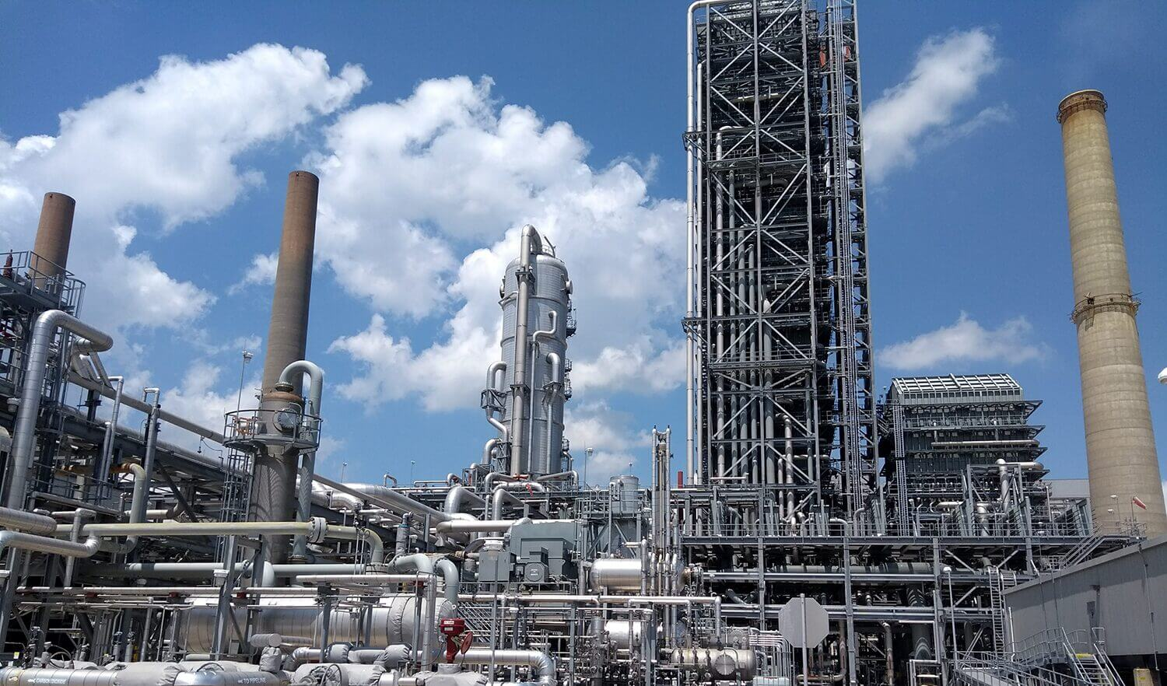
Carbon Sequestration Evaluation Agreement Application
Government of Alberta
INTRODUCTION
Carbon Sequestration Evaluation Agreement (CSEA) allows lessee to evaluate suitability of the location by conducting tests in the pore space​. CSEA grants the right to apply for a Carbon Sequestration Agreement, which allows a lessee to sequester Carbon Dioxide (CO2) into the pore space.
The lessee is required to submit a CSEA application via the Electronic Transfer System (ETS).

Slide 4
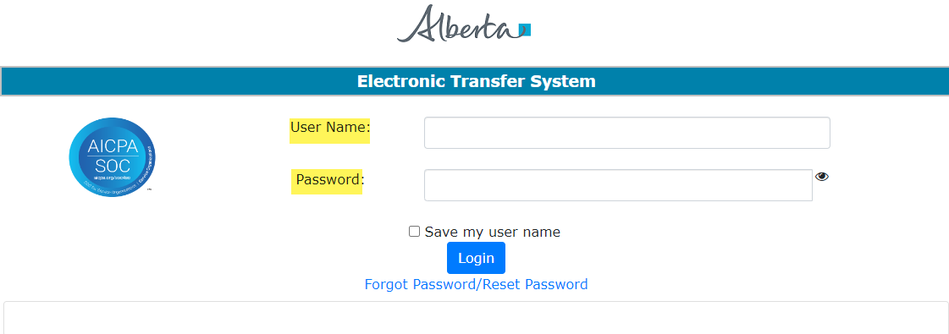
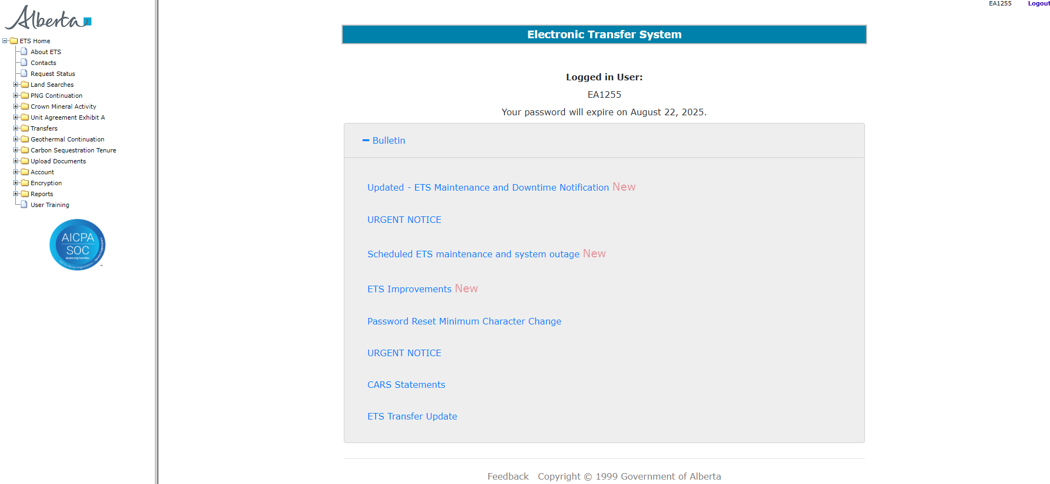
Carbon Sequestration Evaluation Agreement Application
Government of Alberta
LOGIN TO ETS
Go to ETS (https://ets.energy.gov.ab.ca/logon.aspx)
Enter your login credentials: User Name (EN account) and Password.
Once logged in, the screen below is displayed.

Slide 5
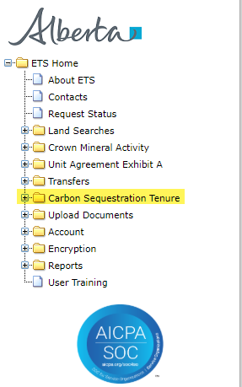
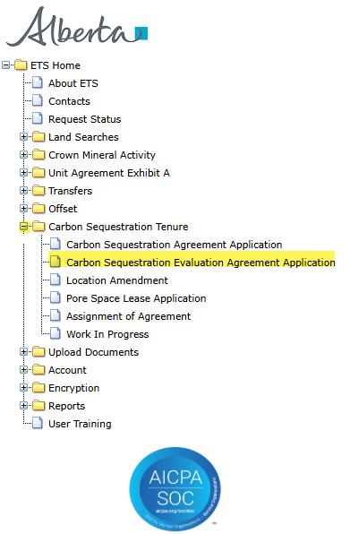
Carbon Sequestration Evaluation Agreement Application
Government of Alberta
NAVIGATION TO CARBON SEQUESTRATION EVALUATION AGREEMENT (CSEA) APPLICATION
In the treenode (left-hand side of the screen), navigate to Carbon Sequestration Tenure node.
Expand Carbon Sequestration Tenure node to display its subnodes.
Click Carbon Sequestration Evaluation Agreement Application subnode.
2.
3.
1.

Slide 6
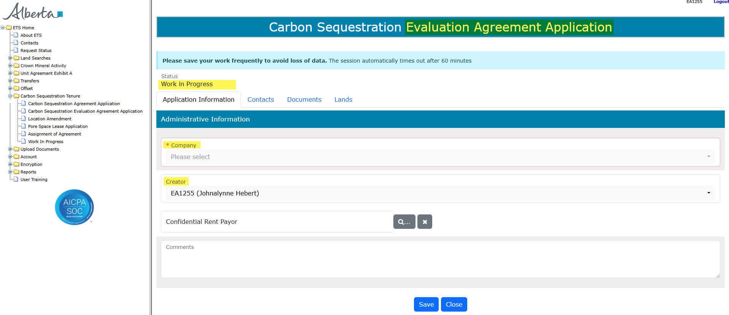
Carbon Sequestration Evaluation Agreement Application
Government of Alberta
APPLICATION INFORMATION TAB
On the main screen, a blank application form is displayed. ETS auto populates the Company (if the ETS account is only for one company; if there are more than one company on the account, the field is converted to dropdown list) and Creator fields. These information are generated from the login account information.
At the creation stage, the status of the request is set to Work in Progress.
Note: Enter the required information indicated with asterisk (or outlined in red). Once information is entered, the outline turns in green).
Click the magnifying glass under CS Evaluation Agreement field to add CSEA.

Slide 7
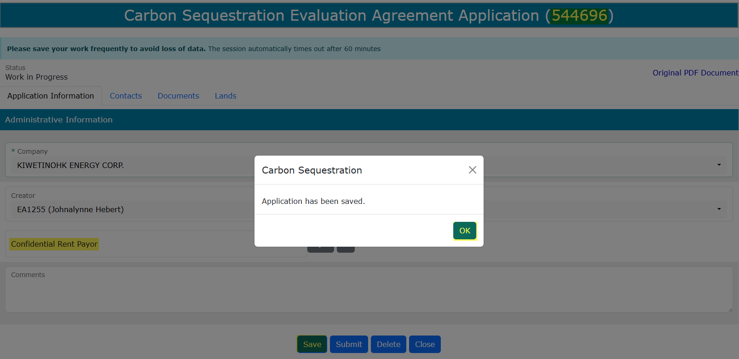
Carbon Sequestration Evaluation Agreement Application
Government of Alberta
APPLICATION INFORMATION TAB – ASSIGN ETS REQUEST NUMBER
Click Save at the bottom of the form. This will save the application and generate the ETS Request Number included in the heading.
Confidential Rent Payor field is optional. Only fill this in if payor is different than the agreement holder. This payor is responsible in paying the first time rent and issuance fee charges.
Click the magnifying glass to search a client.

Slide 8
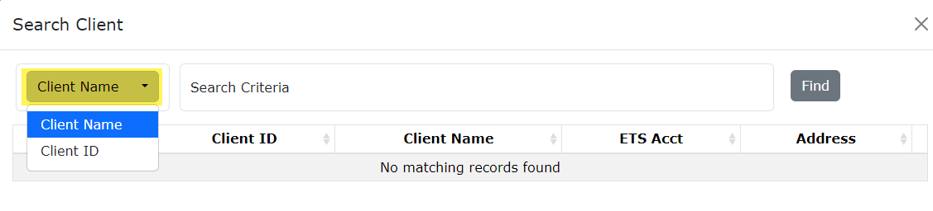
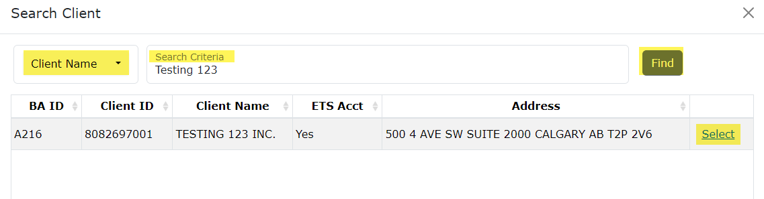
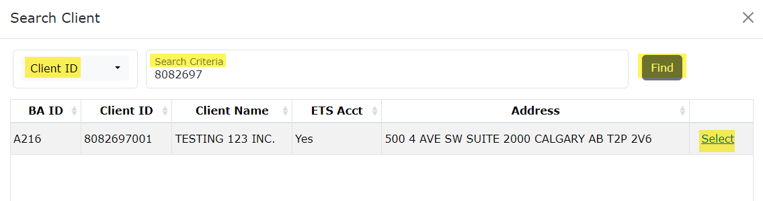
Carbon Sequestration Evaluation Agreement Application
Government of Alberta
APPLICATION INFORMATION TAB – CONFIDENTIAL RENT PAYOR
The Confidential Rent Payor can be searched by either the Client Name or the Client Number.
1.
By default, Client Name search criteria displayed by default. Click the dropdown to select the desired search criteria.
Depending on the search criteria chosen, enter the Client Name OR the Client ID in the corresponding field.
Click Find.
Search result appears and displays the Business Associate ID, Client ID, Client Name, ETS Acct Yes/No, Address
4. Click Select to add the client as confidential rent payor.
2.
3.
4.

Slide 9
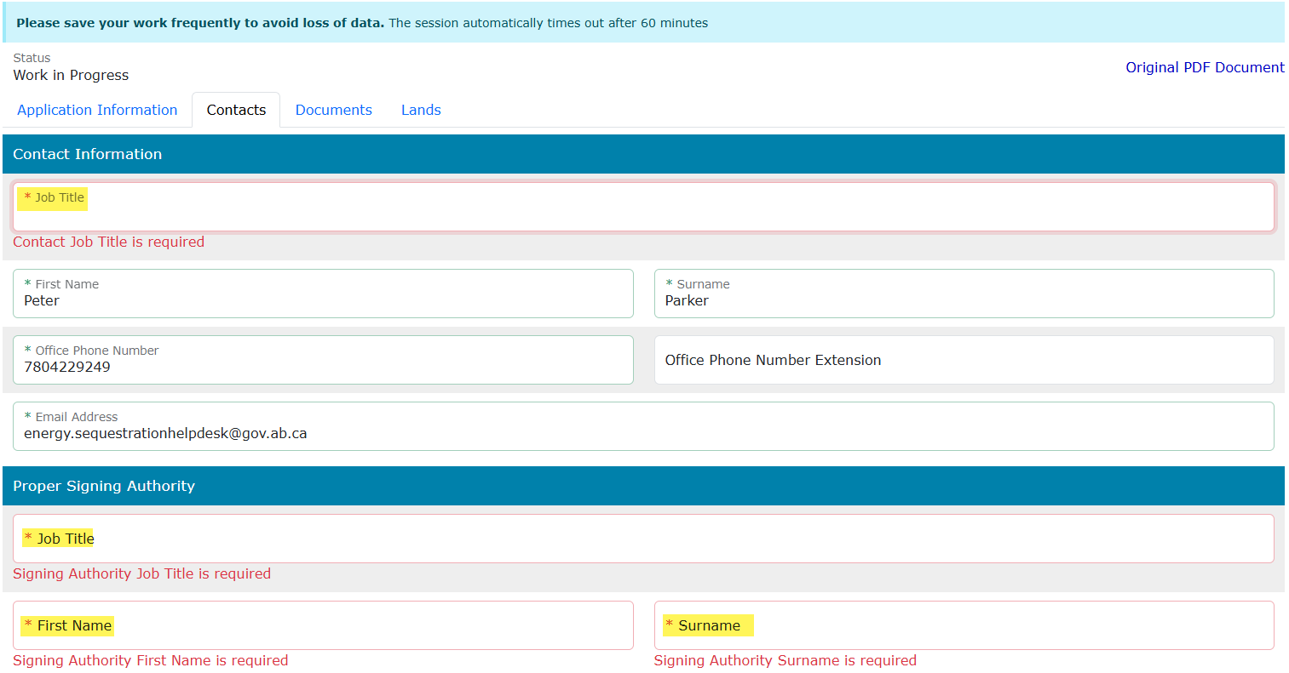
Carbon Sequestration Evaluation Agreement Application
Government of Alberta
CONTACTS TAB – CONTACT INFORMATION AND PROPER SIGNING AUTHORITY
Note: Enter the required information indicated with asterisk (or outlined in red). Once information is entered, the outline turns in green).
Contact Information section – ETS auto populates the Name and Contact information. These information are generated from the login account information. Update the Job Title.
Proper Signing Authority – Enter the required information indicated with asterisk. The Signing Authority is a person who has the authority to sign documents on behalf of the company.

Slide 10
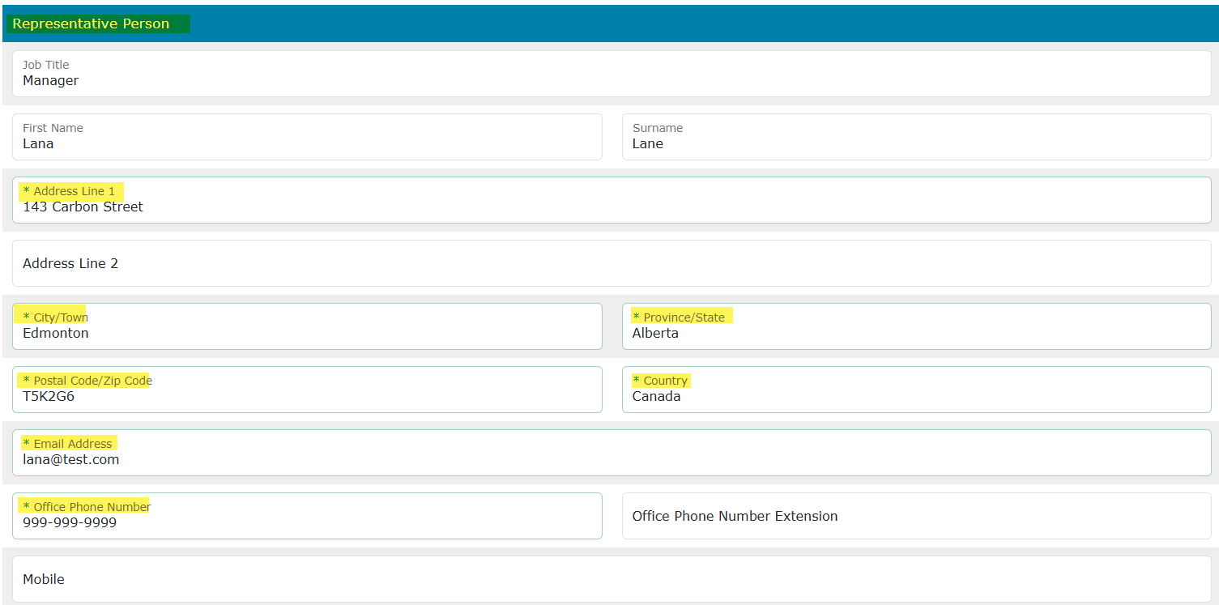
Carbon Sequestration Evaluation Agreement Application
Government of Alberta
CONTACTS TAB – REPRESENTATIVE PERSON
This person is the appointed representative by the company who is responsible in answering any questions regarding the application.
Note: Enter the required information indicated with asterisk (or outlined in red). Once information is entered, the outline turns in green)

Slide 11
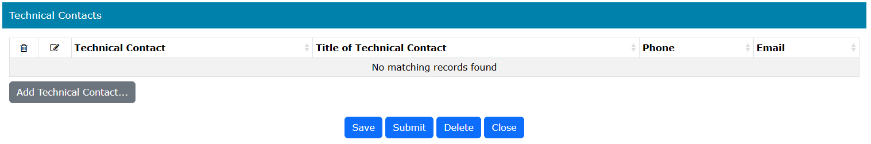
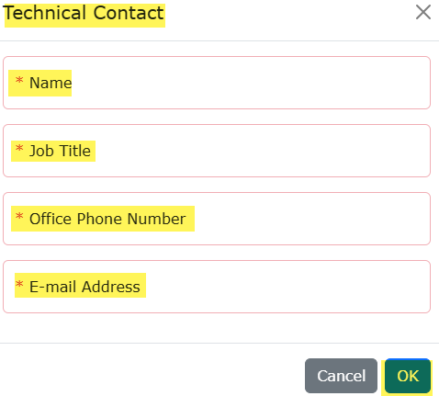
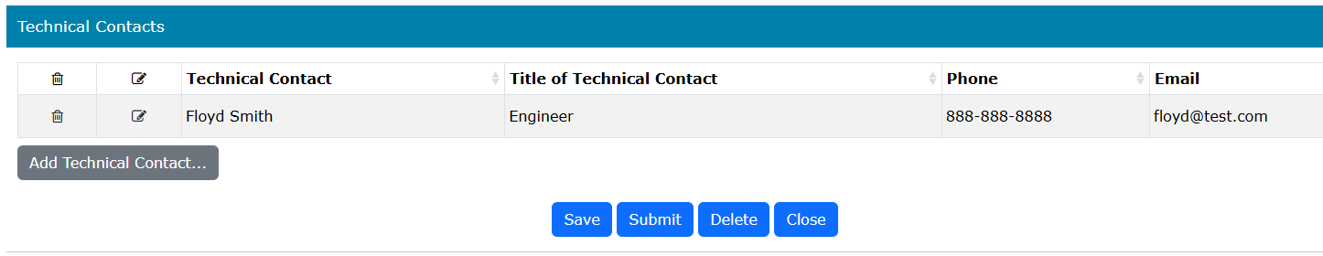
Carbon Sequestration Evaluation Agreement Application
Government of Alberta
CONTACTS TAB – TECHNICAL CONTACTS
1.
2.
Click Add Technical Contact... A new window appears.
Enter the required information indicated with asterisk (or outlined in red). Once information is entered, the outline turns in green)
Click OK to add the Technical Contact in the main grid.
Back to the application form, scroll down and click Save to save all added information.
3.
Note: Enter the required information indicated with asterisk (or outlined in red). Once information is entered, the outline turns in green)
4.

Slide 12
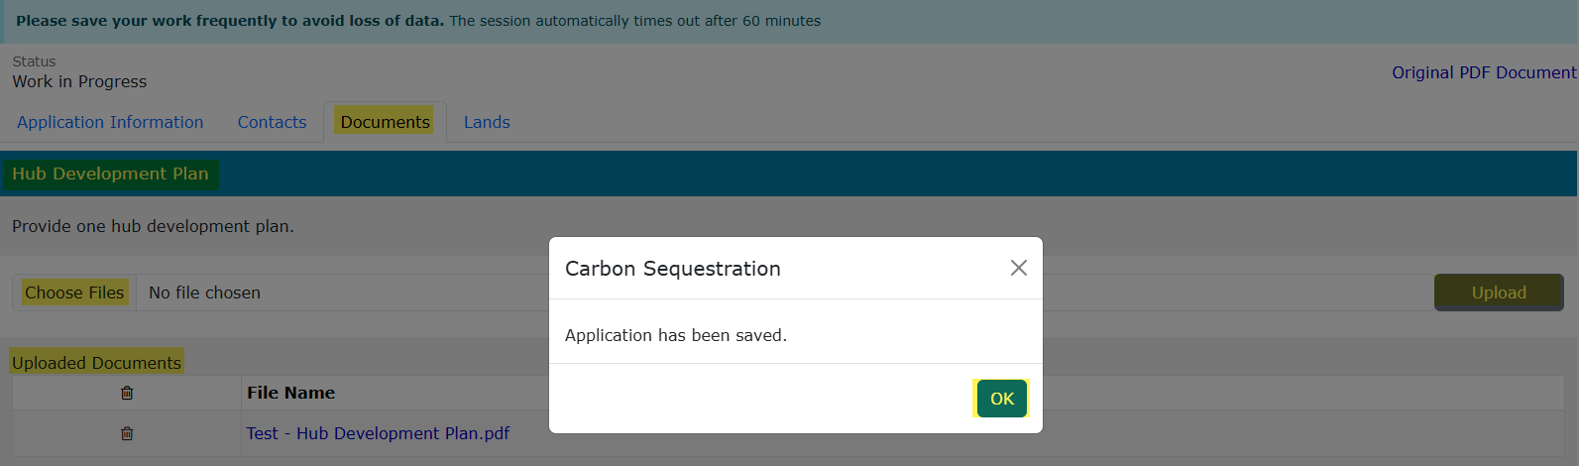
Carbon Sequestration Evaluation Agreement Application
Government of Alberta
DOCUMENT TAB – HUB DEVELOPMENT PLAN
Under Hub Development Plan section, click Choose Files. File Explorer folders opens. Locate the file to upload.
Back to the ETS request application, the name of the file is added on the ‘No file chosen’ field.
Click Upload.
Save prompt appears, click OK. The document is added in the Uploaded Documents grid.
To delete an uploaded document, simply click the corresponding trash bin icon.
To add, follow the steps above.
3.
1.
2.
4.

Slide 13
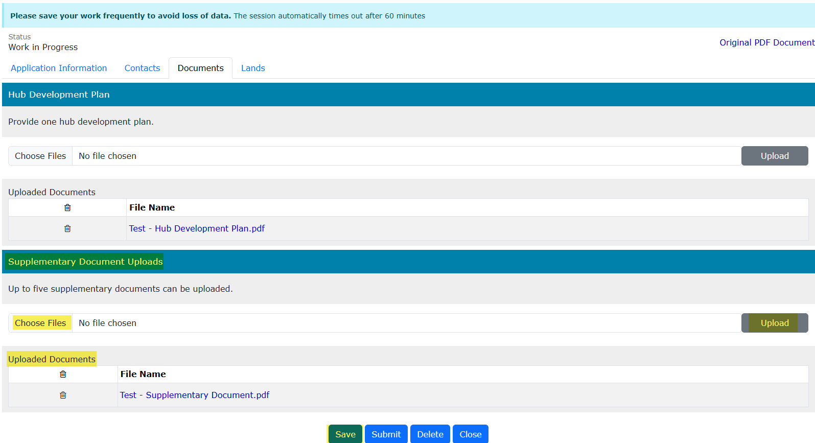
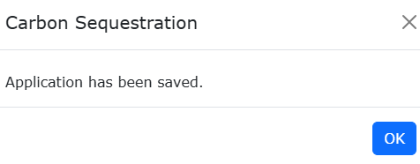
Carbon Sequestration Evaluation Agreement Application
Government of Alberta
DOCUMENT TAB – UPLOAD SUPPLEMENTARY DOCUMENT
Under Supplementary Document Uploads section, click Choose Files. File Explorer folders opens. Locate the file to upload. Note: up for 5 supplementary documents can be uploaded.
Back to the ETS request application, the name of the file is added on the ‘No file chosen’ field.
Click Upload.
Save prompt appears, click OK. The document is added in the Uploaded Documents grid.
To delete an uploaded document, simply click the corresponding trash bin icon.
To add, follow the steps above.
4.
3.
2.
1.

Slide 14

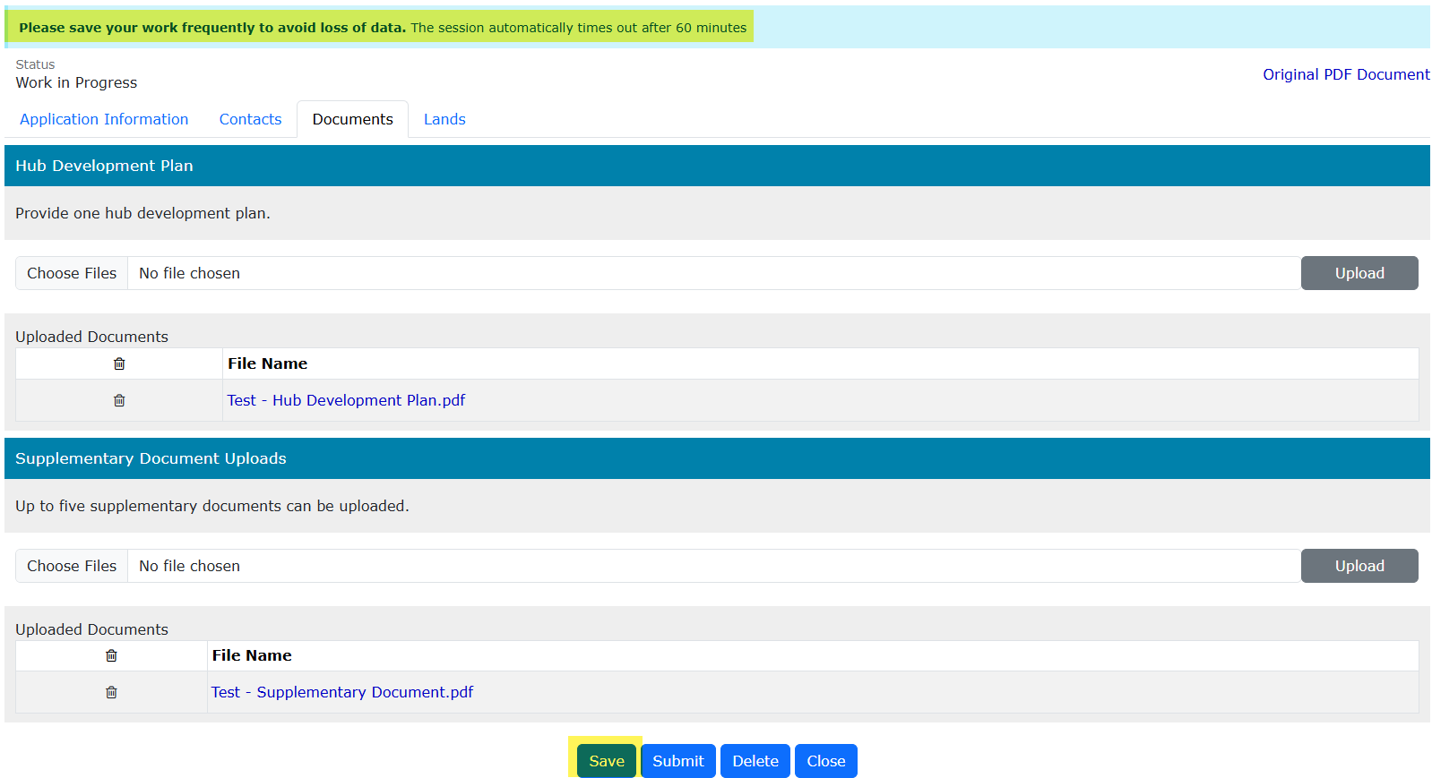
Carbon Sequestration Evaluation Agreement Application
Government of Alberta
DOCUMENTS TAB – SAVE
Once your documents have been uploaded and displayed in the Uploaded Documents grid, select Save.
Save your work frequently to avoid the loss of data. The session will automatically time out after 60 minutes.

Slide 15
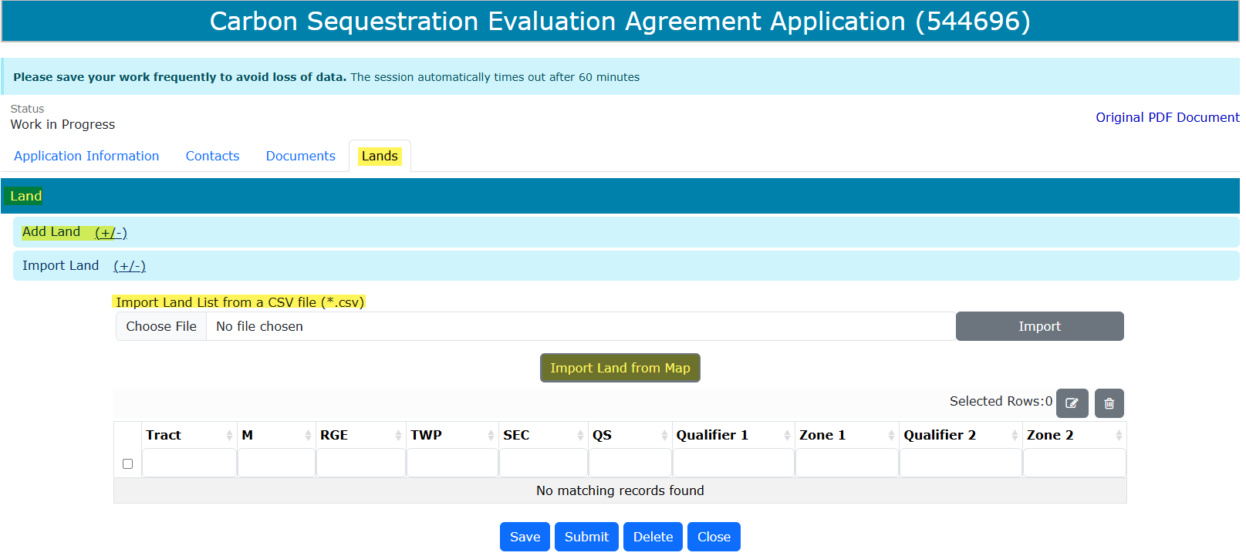
Carbon Sequestration Evaluation Agreement Application
Government of Alberta
LANDS TAB
Adding lands have 3 options:
Import Land (+/-)
Import Land from Map
Import Land List from a CSV file (*.csv)
Add Land (+/-)
3.
2.
1.

Slide 16
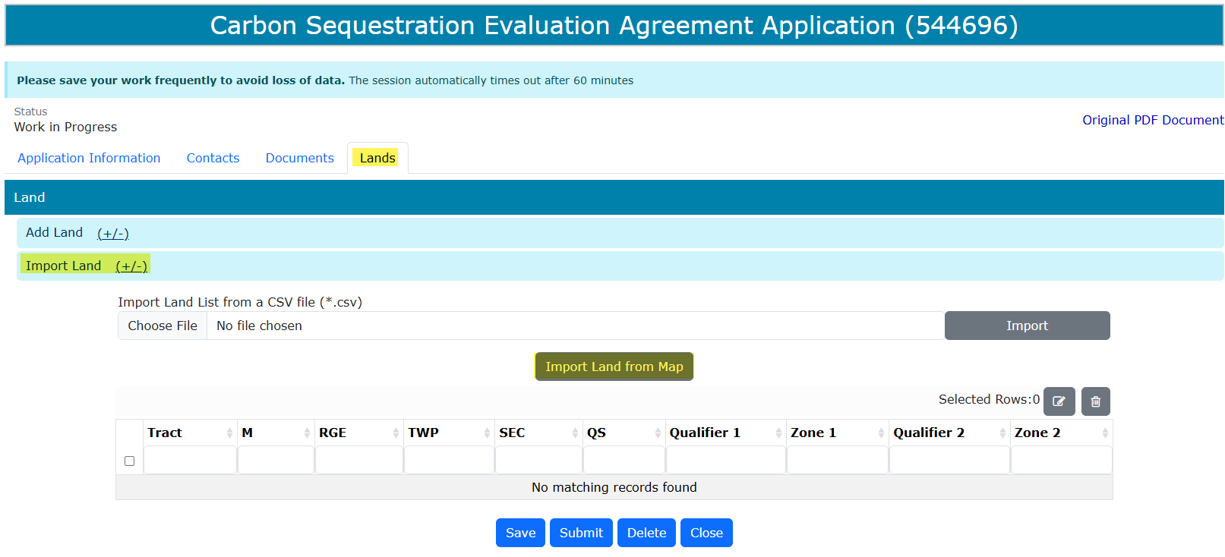
Carbon Sequestration Evaluation Agreement Application
Government of Alberta
LANDS TAB – OPTION 1: IMPORT LAND FROM MAP
Click Import Land (+/-). Two options appear: Import Land List from a CSV file and Import Land from Map.
Click Import Land from Map. Carbon Sequestration and Pore Space Map of Alberta opens on a new tab.

Slide 17
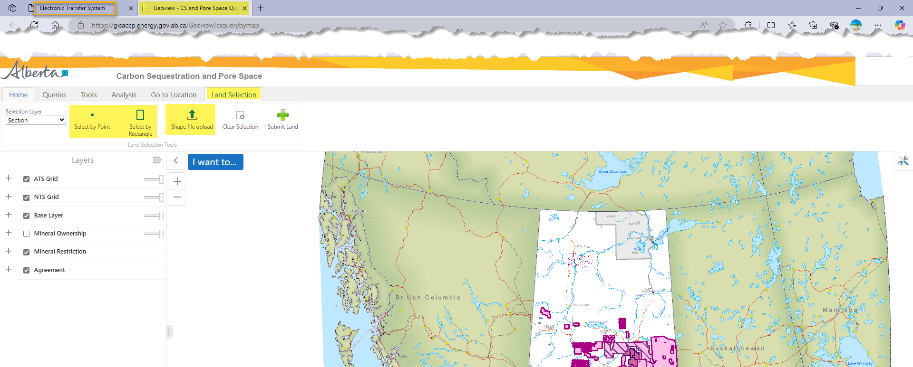
Carbon Sequestration Evaluation Agreement Application
Government of Alberta
LANDS TAB – OPTION 1: IMPORT LAND FROM MAP
Geoview – Carbon Sequestration and Pore Space Query map is opened on a new browser page.
Under Land Selection tab, there are 2 option to import land from Map: selecting the lands directly from the map (Select by Point or Select by Rectangle) or shape file upload.
1.
2.

Slide 18
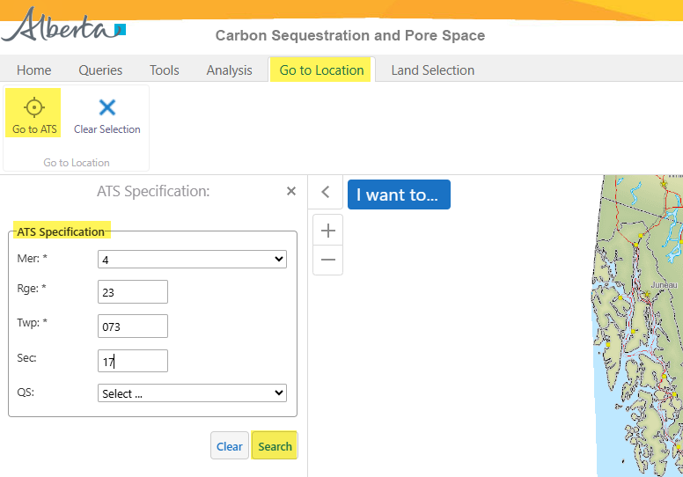
Carbon Sequestration Evaluation Agreement Application
Government of Alberta
LANDS TAB – OPTION 1: IMPORT LAND FROM MAP – NAVIGATE TO THE TARGET LOCATION
2. Click Go to ATS.
1. Navigate to Go to Location tab.
3. Input the landkey.
4. Click Search.

Slide 19
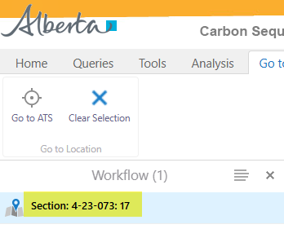
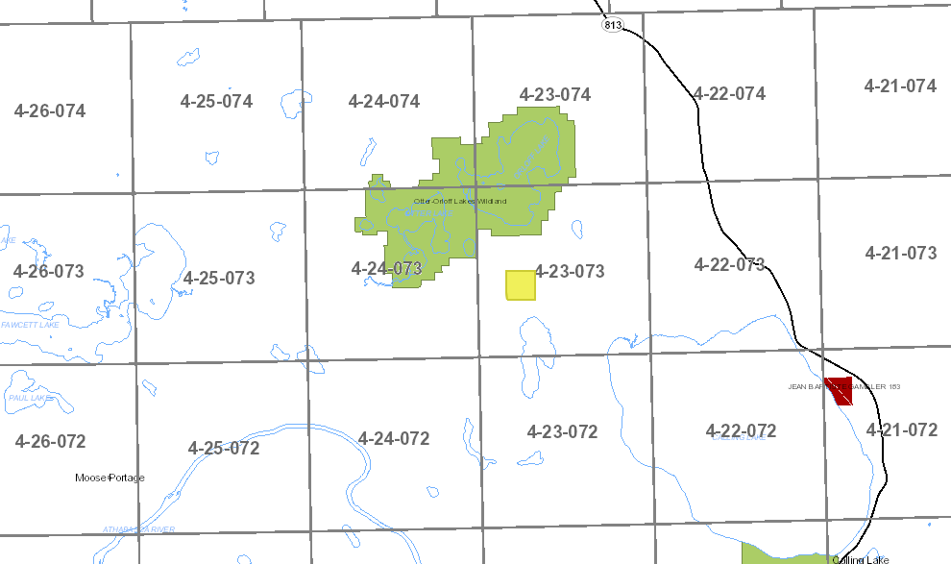
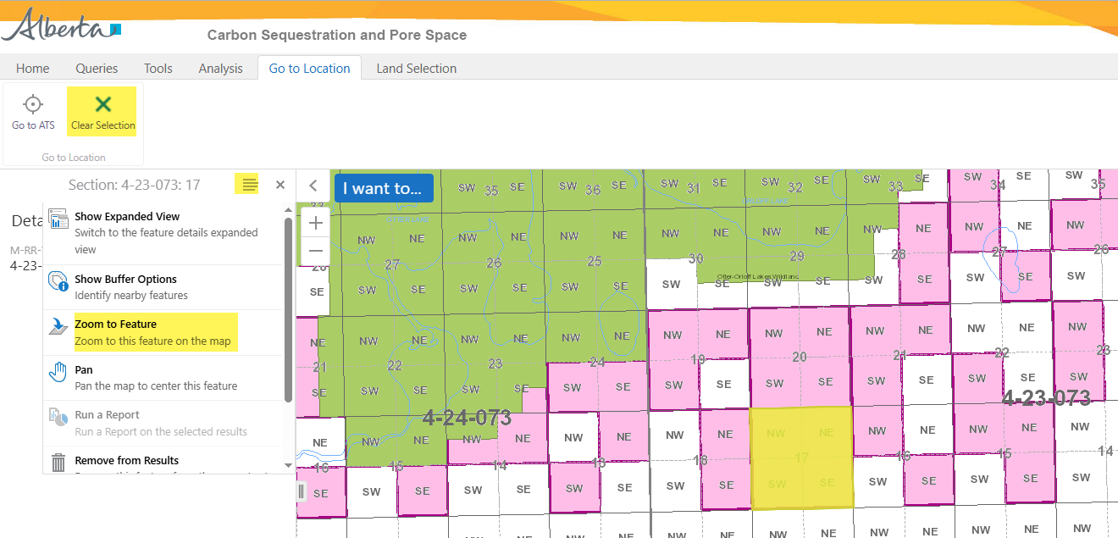
Carbon Sequestration Evaluation Agreement Application
Government of Alberta
LANDS TAB – OPTION 1: IMPORT LAND FROM MAP – NAVIGATE TO THE TARGET LOCATION
5. Click Clear Selection.
1. Select the land result.
4. Zoom in or Zoom out on the target location.
2. Click the hamburger icon.
3. Click Zoom to Feature.

Slide 20
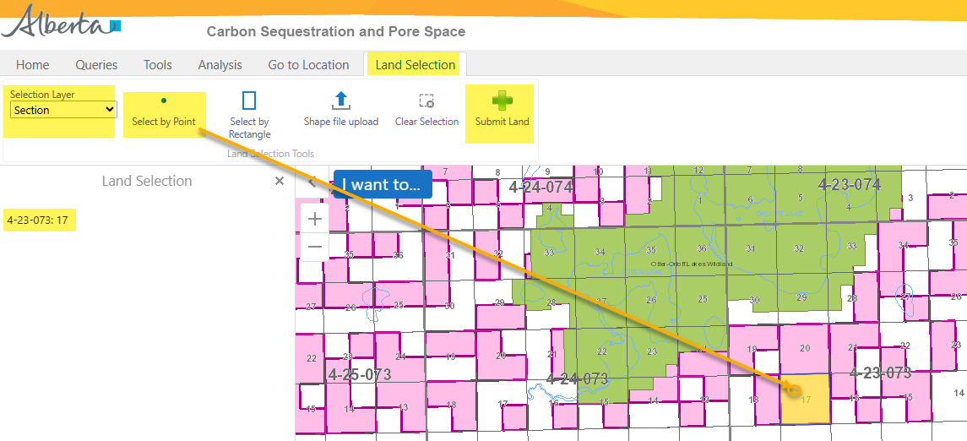
Carbon Sequestration Evaluation Agreement Application
Government of Alberta
LANDS TAB – OPTION 1A: IMPORT LAND FROM MAP – ADD LAND - SELECT BY POINT
Once a target location is searched, add the land. There are 2 options:
Select by Point (use this option if selecting lands not adjacent to each other.)
Select by Rectangle
Once submitted, edit the lands added in ETS. Refer to Slide 24, ‘Edit Selected Lands’.
3. Click Select by Point.
1. Navigate to Land Selection tab.
6. Click Submit Land.
Note: only click this button once. Do not click repeatedly as the lands will be listed more than once on the ETS request.
2. Change Selection Layer, if required before selecting land(s).
5. As land is selected, the land node displays the selected landkeys here.
Repeat steps 1-4 to add remaining lands.
4. Point and click the section to add.

Slide 21
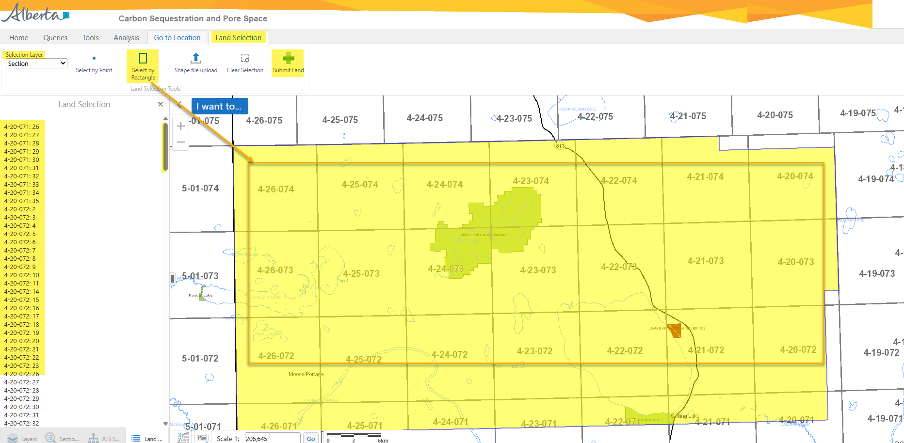
Carbon Sequestration Evaluation Agreement Application
Government of Alberta
LANDS TAB – OPTION 1A: IMPORT LAND FROM MAP – ADD LAND - SELECT BY RECTANGLE
Once a target location is searched, add the land. There are 2 options:
Select by Point
Select by Rectangle (use this if selecting adjacent lands.)
Once submitted, edit the lands added in ETS. Refer to Slide 24, ‘Edit Selected Lands’.
1. Navigate to Land Selection tab.
6. Click Submit Land.
Note: only click this button once. Do not click repeatedly as the lands will be listed more than once on the ETS request. If the area is large, you may have to wait for the map to load the lands in the ETS application.
2. Change Selection Layer, if required before selecting land(s).
3. Click Select by Rectangle
4. Draw a rectangle on top of the area required to multi-select.
5. As land is selected, the land node displays the selected landkeys in the treenode.
Repeat steps 1-4 to add remaining lands.

Slide 22
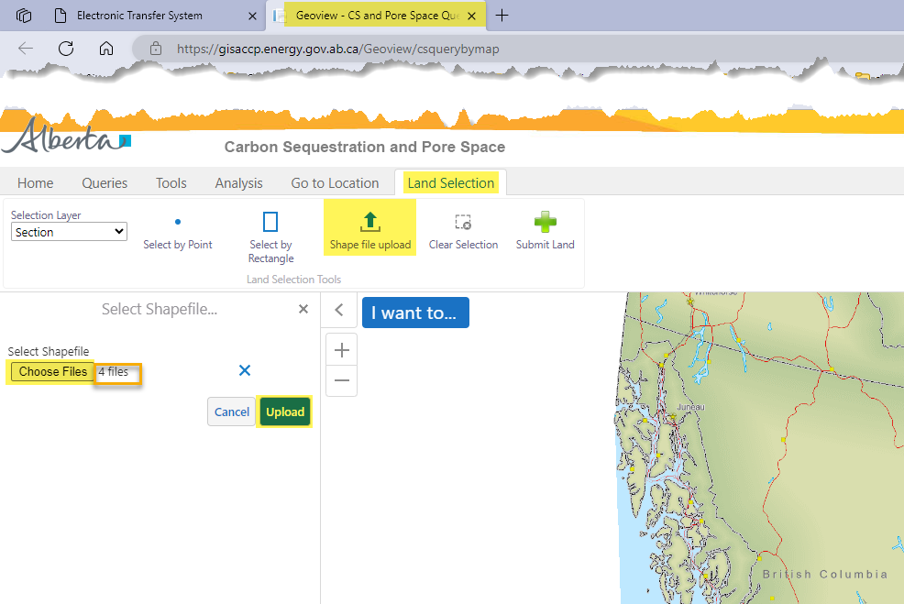
Carbon Sequestration Evaluation Agreement Application
Government of Alberta
LANDS TAB – OPTION 1B: IMPORT LAND FROM MAP – SHAPEFILE UPLOAD
1. Navigate to Land Selection tab.
3. Click Choose Files. File Explorer opens. Browse to the location of the shapefiles to upload.
2. Click Shape file upload.
4. Number of files browsed to upload are indicated in this field.
5. Click Upload.

Slide 23
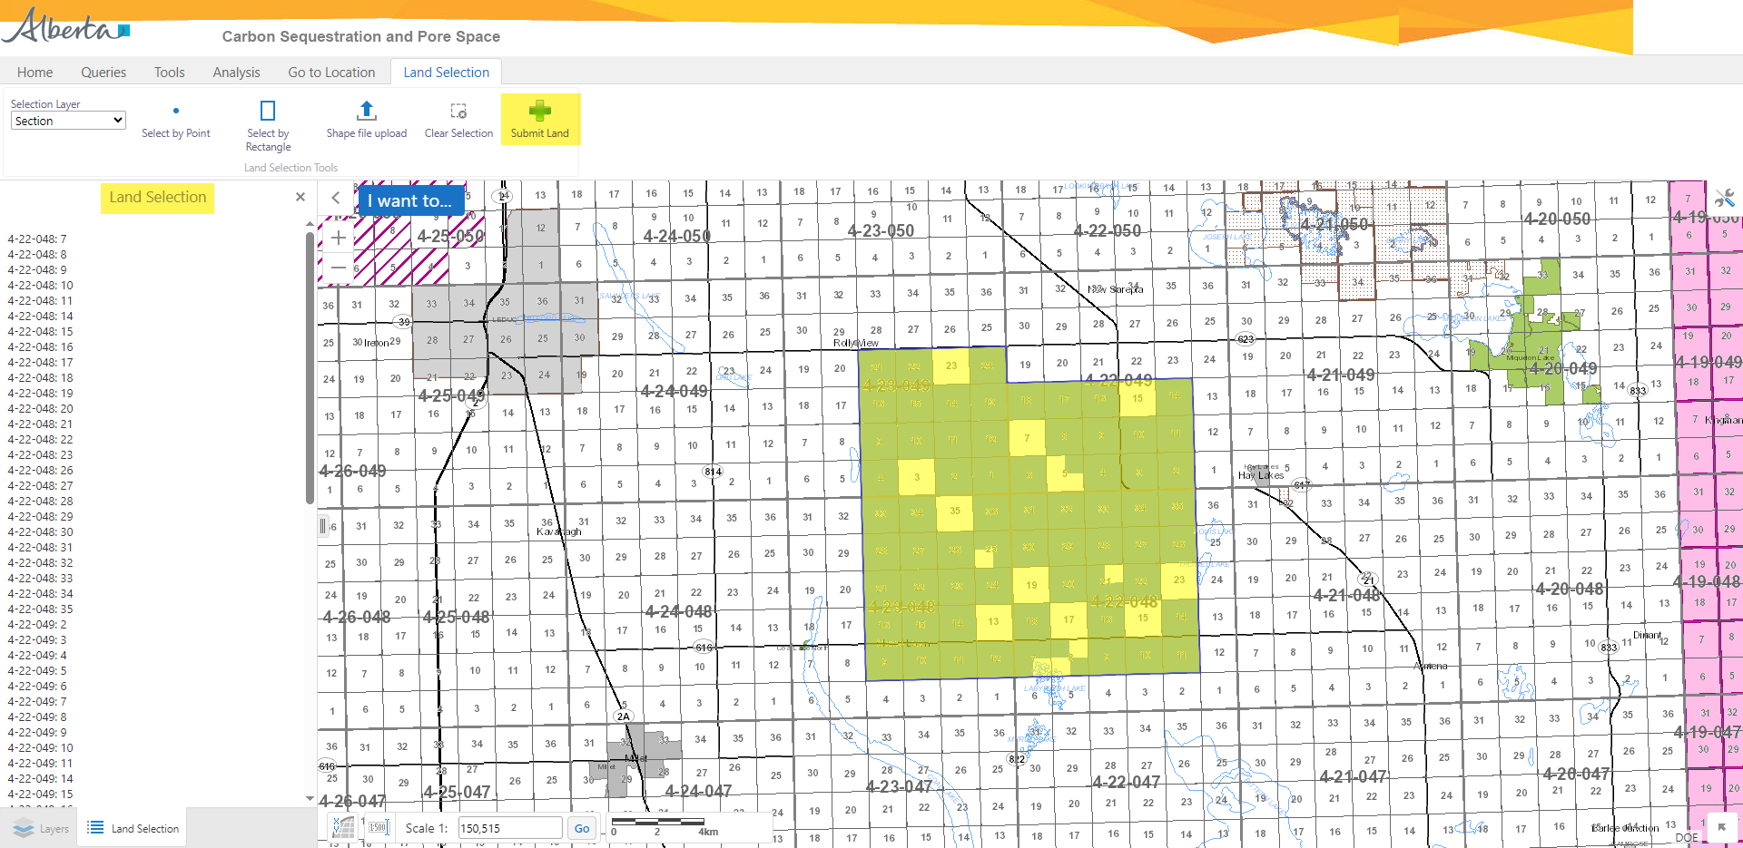
Carbon Sequestration Evaluation Agreement Application
Government of Alberta
LANDS TAB – OPTION 1B: IMPORT LAND FROM MAP – SHAPEFILE UPLOAD
6. Click Submit Land.
Note: only click this button once.
Do not click repeatedly as the lands will be listed more than once on the ETS request. If the area is large, you may have to wait for the map to load the lands in the ETS application.
Land Selection treenode list all landkeys uploaded via shapefile.
Landkeys uploaded via shapefile.
Once submitted, edit the lands added in ETS. Refer to Slide 24, ‘Edit Selected Lands’.

Slide 24
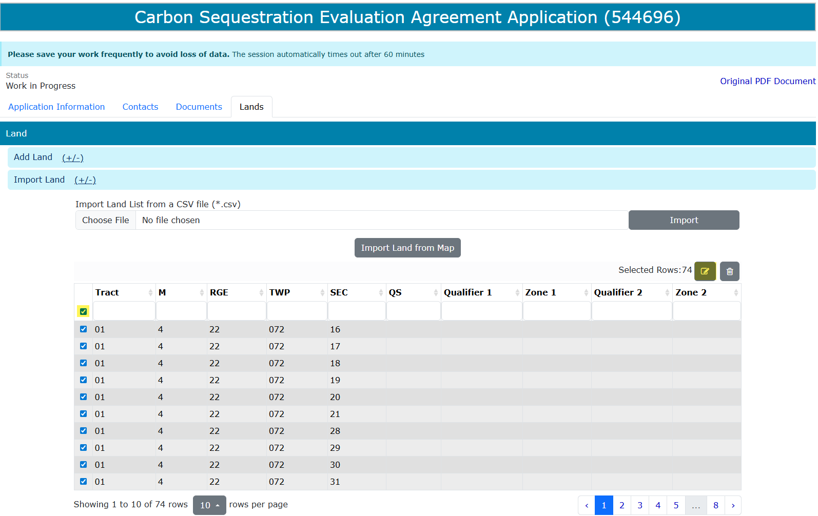
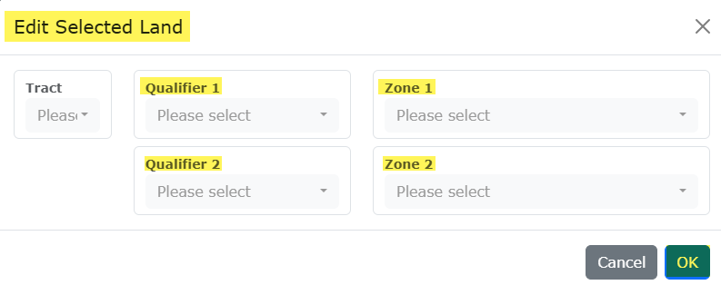

Carbon Sequestration Evaluation Agreement Application
Government of Alberta
LANDS TAB – IMPORT LAND FROM MAP – EDIT SELECTED LANDS
Once lands added are submitted from the Geoview map, the lands are loaded back into the ETS request land grid.
3. Add the Qualifiers and Zones
4. Click OK to apply the changes
1. Click the checkbox column to select all landkeys that has missing Qualifiers and Zones.
Note:
On the land grid, an option to show number of lands is available (view in 10s, 50s or 100s).
Creator can navigate by page.
2. Click the modify land icon
5. Click Save.

Slide 25
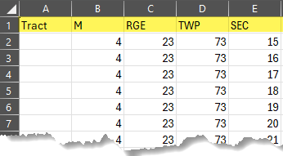
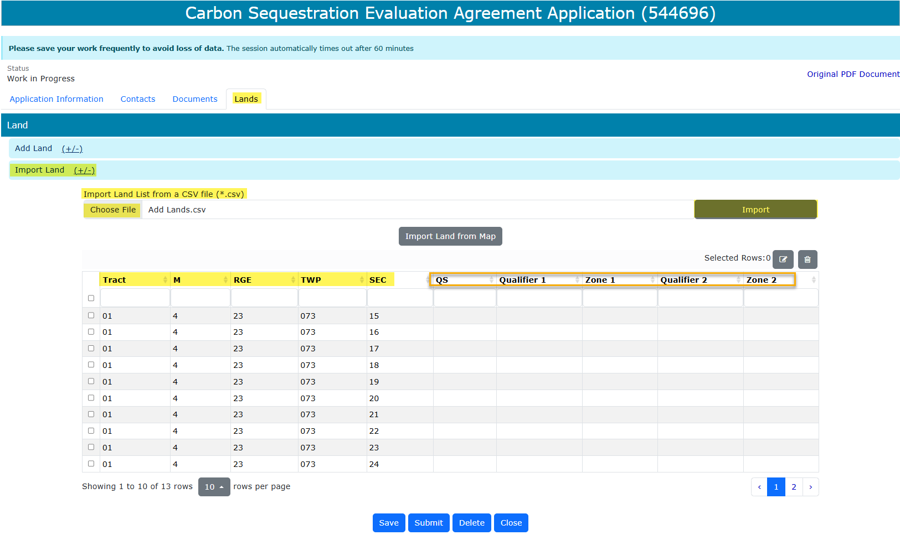
Carbon Sequestration Evaluation Agreement Application
Government of Alberta
LANDS TAB – OPTION 2: IMPORT LAND LIST FROM A CSV FILE (*.csv)
Create a .csv file. The format must be as follows: Tract, M, RGE, TWP and SEC.
To import, navigate to the ETS request/ Lands tab.
Click Import Land (+/-).
Click Choose File to browse the .csv file on your personal computer.
Navigate to the File Explorer and select the .csv file and click Open. The file is now chosen.
Click Import to add the lands into the grid.
1.
2.
3.
6.
4.
5.
6.
7. Edit the added lands. Refer to Slide 24.

Slide 26
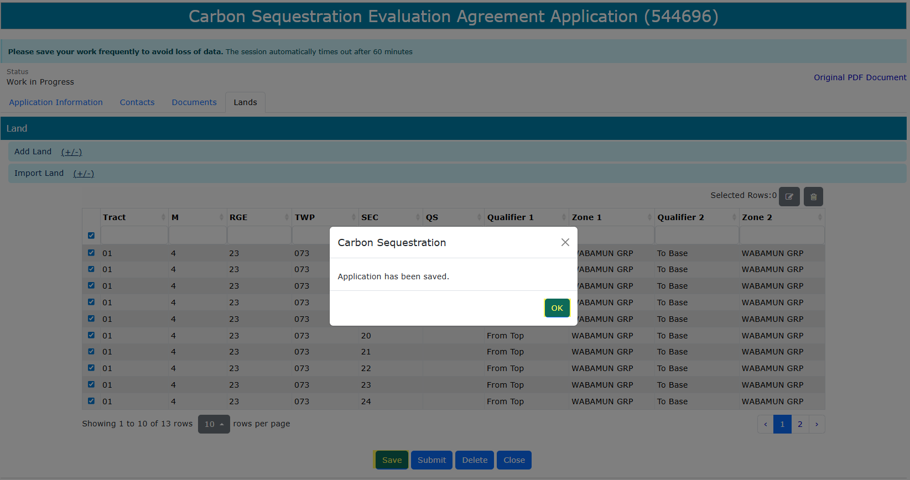
Carbon Sequestration Evaluation Agreement Application
Government of Alberta
LANDS TAB – OPTION 2: IMPORT LAND LIST FROM A CSV FILE (*.csv) – SAVE LANDS
Lands are now modified.
Click Save to save the changes.
Click OK on the save prompt box.
3.
1.
2.

Slide 27
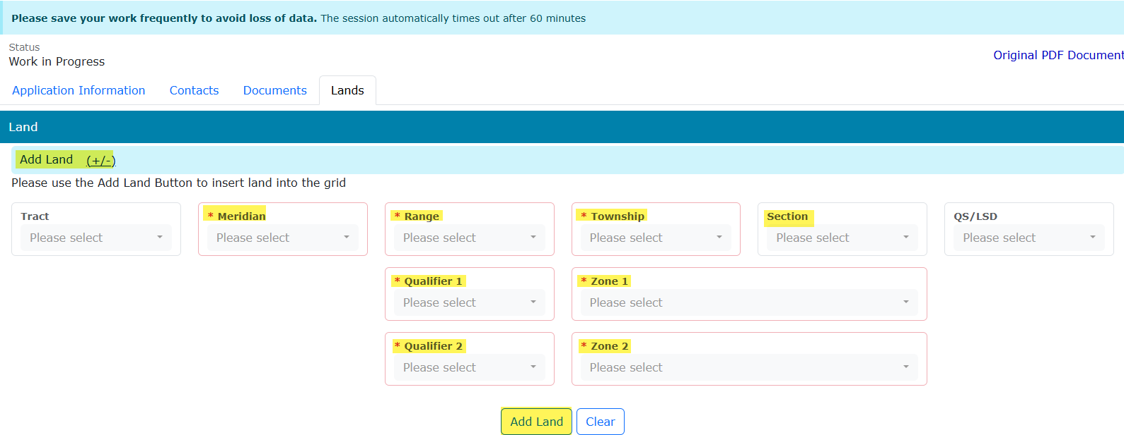
Carbon Sequestration Evaluation Agreement Application
Government of Alberta
LANDS TAB – OPTION 3: ADD LAND (+/-)
Use this option if prefer to enter lands one landkey at a time.
Click Add Land (+/-). The screen below appears.
Input the required information (flagged with asterisk and outlined in red)
Click Add Land to add the land into the grid.
1.
2.
3.

Slide 28
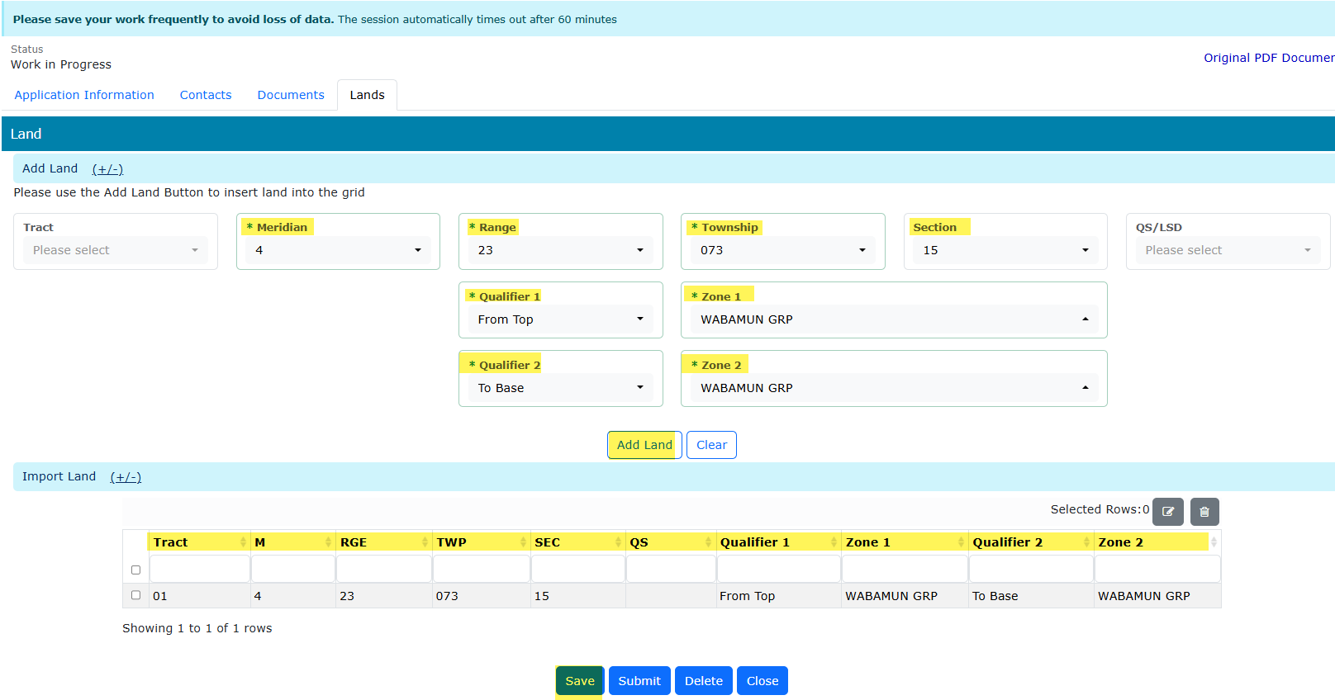
Carbon Sequestration Evaluation Agreement Application
Government of Alberta
LANDS TAB – OPTION 3: ADD LAND (+/-) …continued
Required information inputted and added into the land grid. Repeat previous steps to add remaining lands.
Click Save.

Slide 29
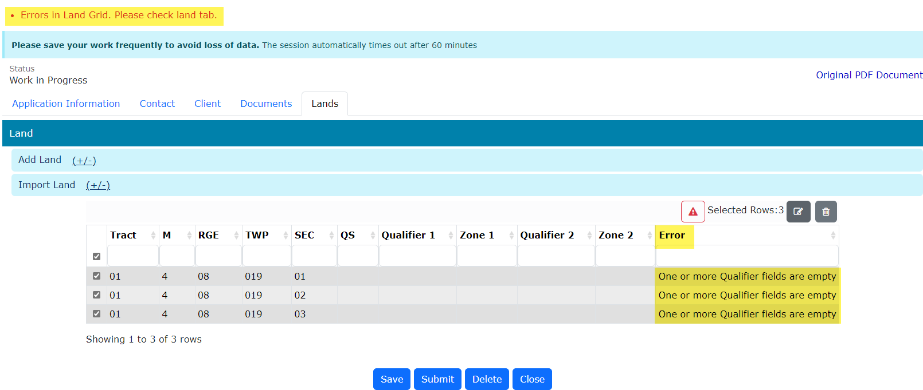
Carbon Sequestration Evaluation Agreement Application
Government of Alberta
VALIDATION ERRORS – ERRORS IN LAND GRID
Any validation errors are displayed at the top of the application in red. These require attention before proceeding to the next step of the application.
Validation error: One or more Qualifier fields are empty
Refer to Slide 24 ‘Edit Selected Lands’.

Slide 30
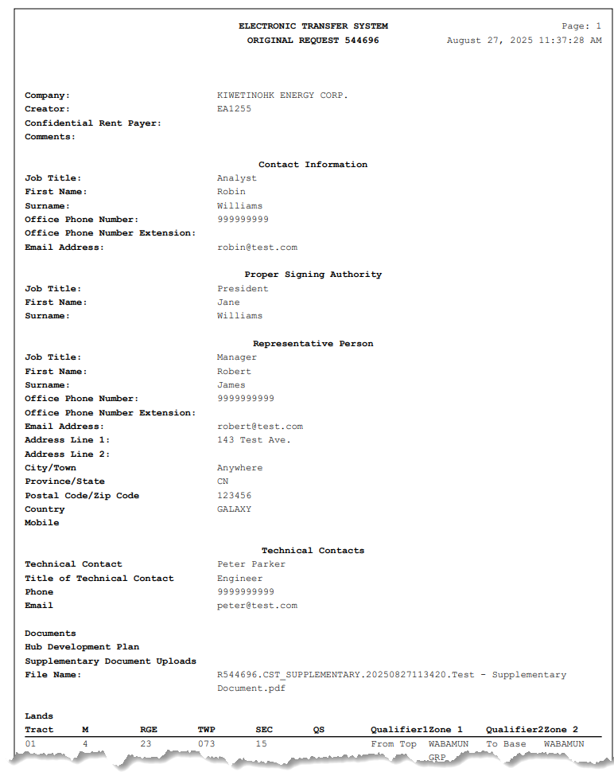
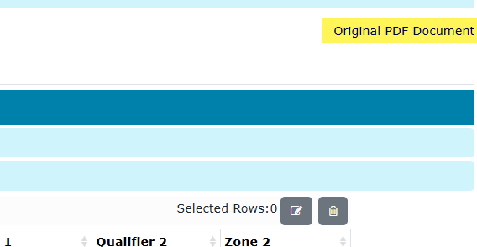
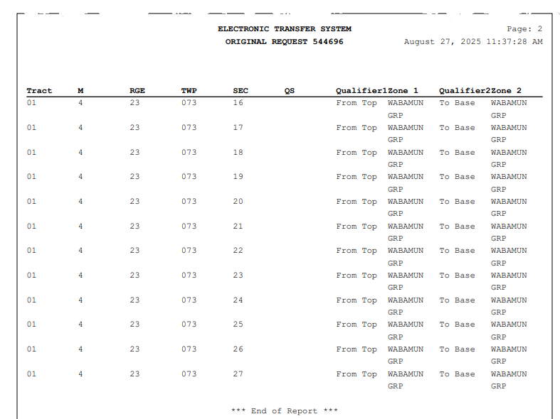
Carbon Sequestration Evaluation Agreement Application
Government of Alberta
APPLICATION SUMMARY REPORT
The Original PDF Document link is the application summary report. It contains all data entered on the application.
This tool is useful to review the entire application before submitting the application.
Click Original PDF Document to generate the report.

Slide 31
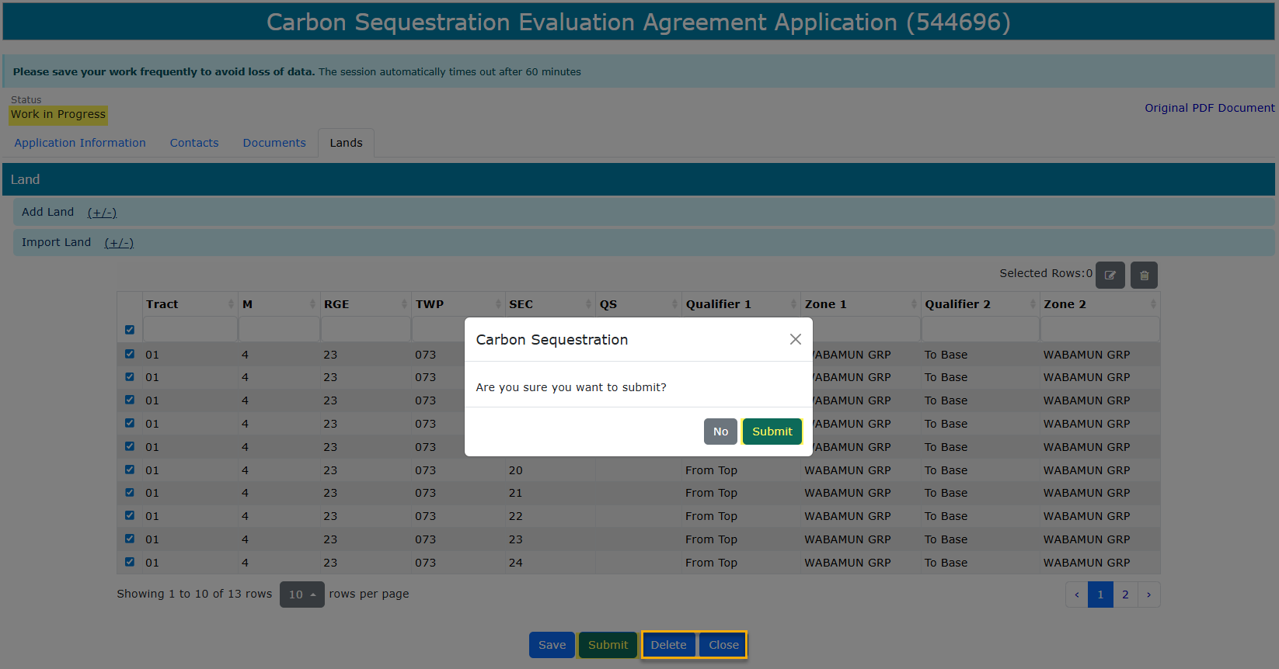
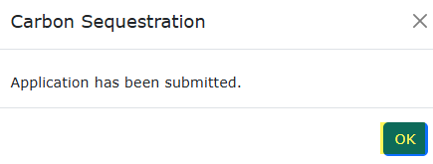
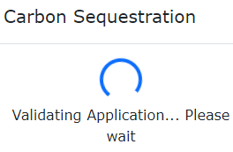
Carbon Sequestration Evaluation Agreement Application
Government of Alberta
SUBMIT APPLICATION
Once all pertinent information has been entered, submit the Carbon Sequestration Evaluation Agreement Application.
The system performs validation check to ensure all mandatory data has been provided.
Upon successful submission, the request status is updated to Submitted.
3. Click OK
2. Click Submit
1. Click Submit
Delete (deletes entire application) is available when the request Status is at Work in Progress.
Close (closes application).

Slide 32
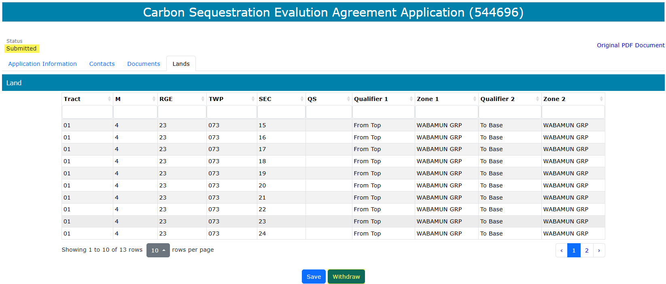
Carbon Sequestration Evaluation Agreement Application
Government of Alberta
WITHDRAW APPLICATION
The Withdraw button is only available when the Status is at Submitted.
The creator or submitter has the option to withdraw the application during the duration of the status of Submitted.
When the request status is changed from Submitted to Processing, the Withdraw button is no longer available.

Slide 33
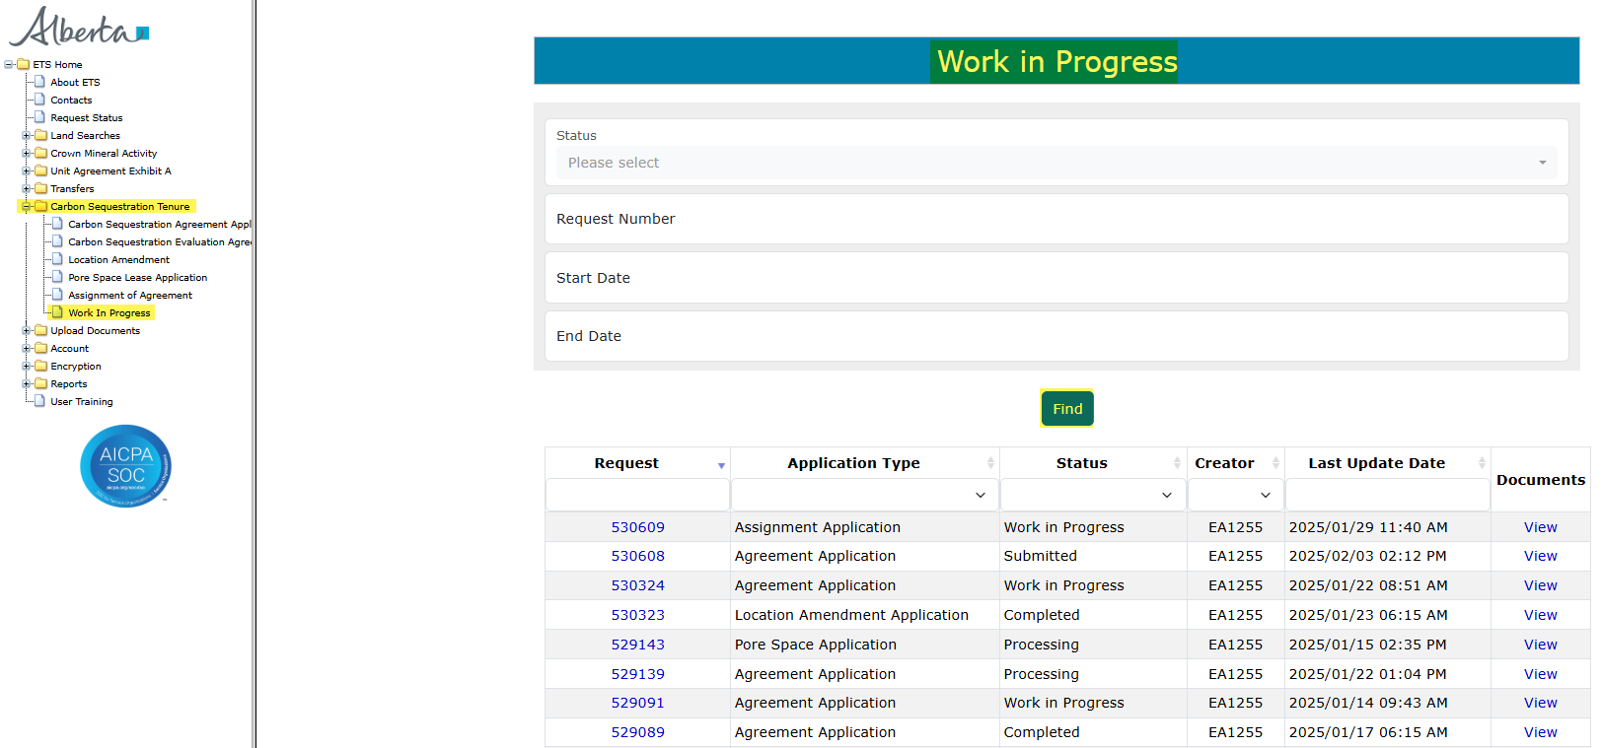
Carbon Sequestration Evaluation Agreement Application
Government of Alberta
WORK IN PROGRESS
The Work in Progress screen contains all different status depending on the state of each ETS Request.
To search all ETS requests, select the Find icon on the Work in Progress screen.
User can also narrow the search by the following search parameters: Status, Request Number, Start Date and End Date.
Click the Request link to view the application.

Slide 34
Carbon Sequestration Evaluation Agreement Application
Government of Alberta
WORK IN PROGRESS – continued…
Work in Progress
The creator can modify and save the form.
Submitted
The creator or submitter has Submitted the form.
Processing
The request has been submitted to Alberta Energy and Minerals. Only the contact information can be modified at this point. The rest of the application is read-only.
Completed
Application has been completed and agreements documents have been issued.
Client Withdrawn
Client has withdrawn the ETS application. This notifies Alberta Energy and Minerals they no longer want to proceed with the application.
Department Rejected
Alberta Energy and Minerals has rejected the client’s requested application.

Slide 35
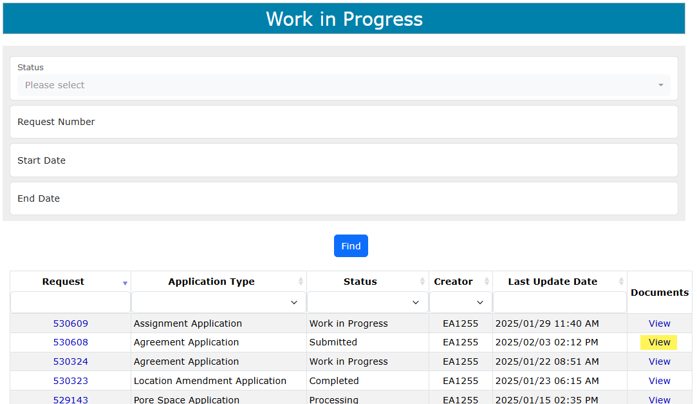
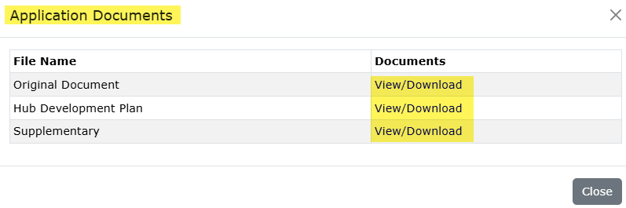
Carbon Sequestration Evaluation Agreement Application
Government of Alberta
WORK IN PROGRESS – View Documents
User has the option to view all documents for the corresponding ETS request. The Application Documents box list all attached documents from the application.
2. Click View/Download
1. Click View

Slide 36
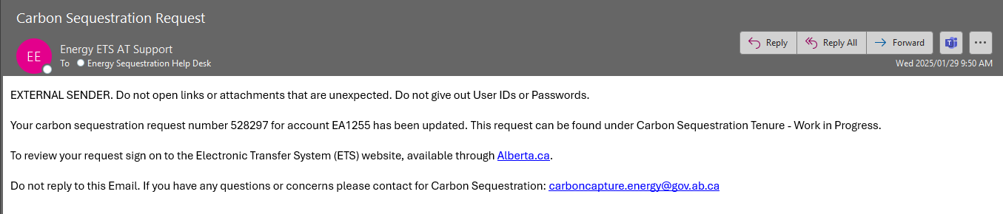
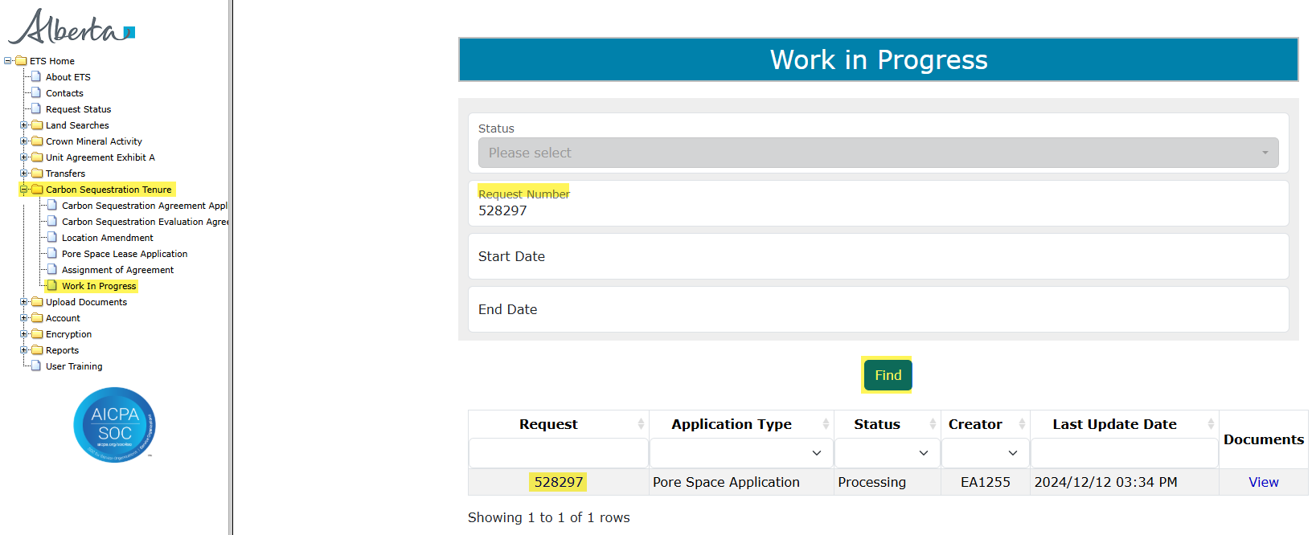
Carbon Sequestration Evaluation Agreement Application
Government of Alberta
ACCEPT OFFER AND FUNDS CONFIRMATION
Before the application can be approved, client is required to accept the offer and funds confirmation. An email notification is sent to the client (example below).
1. Navigate to Carbon Sequestration Tenure/ Work In Progress subnode.
2. Enter the request number quoted from the email notification.
3. Click Find.
3. Click the hyperlinked request number to view the request.

Slide 37


Carbon Sequestration Evaluation Agreement Application
Government of Alberta
ACCEPT OFFER AND FUNDS CONFIRMATION continued…
Navigate to Offers and Funds Confirmation tab.
2. Input the response by clicking the arrow.
4. Click Save.
3. Select a response.

Slide 38


Carbon Sequestration Evaluation Agreement Application
Government of Alberta
ACCEPT OFFER AND FUNDS CONFIRMATION continued…
1. Click OK.
2. Input the response by clicking the arrow.
2. Click OK.

Slide 39
Carbon Sequestration Evaluation Agreement Application
Government of Alberta
EXECUTION OF AGREEMENT DOCUMENT
Agreement document requires signature from the proponent. This agreement document can be retrieved in ETS/Request Status. ETS email notification is sent to the proponent.
Once agreement document is signed, proponent is required to upload this signed agreement document via ETS/Upload Documents. Refer to Information Request – Upload Documents online module.

Slide 40

Carbon Sequestration Evaluation Agreement Application
Government of Alberta
Congratulations!
You have completed the
Carbon Sequestration
Evaluation Agreement
Application
Online Training Course
If you have any comments or questions on this training course,
please forward them to:
energy.sequestrationhelpdesk@gov.ab.ca

