Slide 1
Carbon Sequestration - Crown Mineral Activity
Government of Alberta
Welcome!
To the
Carbon Sequestration (CS) -
Crown Mineral Activity (CMA)
Online Training Course
In this module, you will learn how to:
Create and submit CS CMA application
Upload required geological information
Review and retrieve documents

Slide 2
Carbon Sequestration - Crown Mineral Activity
Government of Alberta
Revisions Table
Date | Revisions Type | Page Number
December 16, 2024 | Initial Creation

Slide 3
Carbon Sequestration - Crown Mineral Activity
Government of Alberta
INTRODUCTION
The Crown Mineral Activity (CMA) form was modified to include the submission of CMA relating to Carbon Sequestration agreement.
CS CMA includes the following sequestration-related activities:
Sequestration Evaluation (SEV) – As part of a Carbon Sequestration Evaluation Agreement (CSEA), an industry is granted the right to evaluate their rights to assess suitability for permanent carbon sequestration. This means that industry can drill into and conduct some tests within those rights. However, to better understand how the carbon dioxide will behave post-injection, some industries want to extract core and conduct tests in zones above the rights granted in their CSEA. Approval can be granted to do this in the form of a CMA authorization, provided that the applicable rights are undisposed.
Sequestration Monitoring/Observation (SMO) – Industries are required to have Measurement, Monitoring and Verification (MMV) plan as part of their operations. The Alberta Energy Regulator is responsible for assessing MMV plans. However, the ‘monitoring’ component of MMV may require drilling wells in undisposed Crown rights to allow for ongoing monitoring of the subsurface.
Page 3

Slide 4
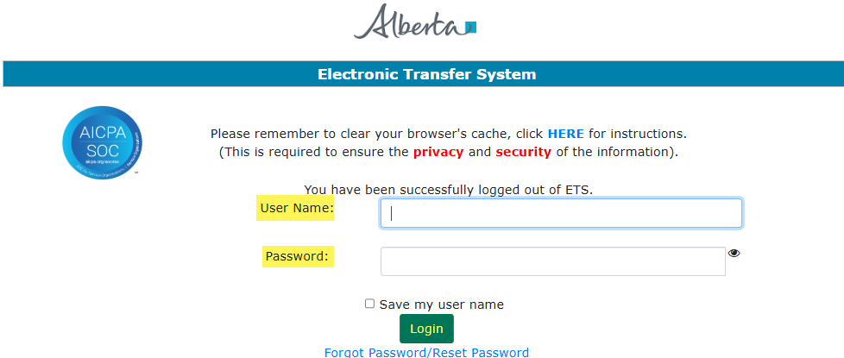
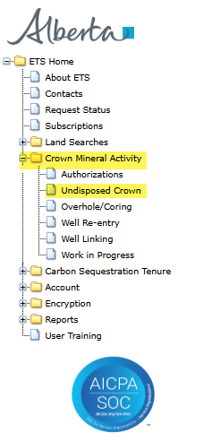
Carbon Sequestration - Crown Mineral Activity
Government of Alberta
LOGIN TO ETS
1. Login to ETS with your user name and password
2. Expand Crown Mineral Activity
Undisposed Crown form
Use this form to submit request on Sequestration Evaluation OR Sequestration Monitoring and Observation.
3. Select either Undisposed Crown
Page 4

Slide 5

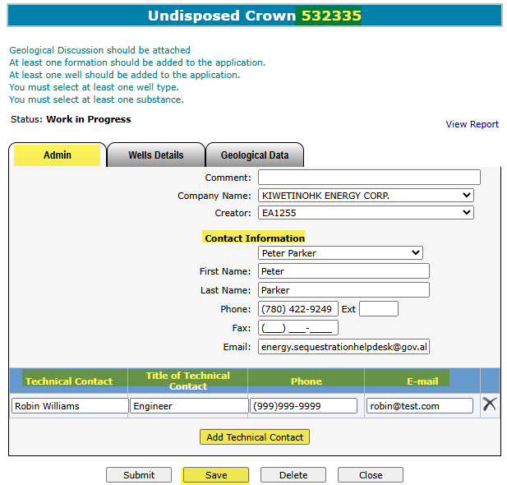
Carbon Sequestration - Crown Mineral Activity
Government of Alberta
ADMIN TAB
This tab is required for all requests.
The Company Name and Creator is autopopulated based on the login information of the creator.
1. Add the Contact Information either by selecting from the dropdown list or entering it manually.
To delete a contact entry, click the X.
3. Click Save. ETS request number is generated at the header.
2. Click Add Technical Contact. Input the Technical Contact info on the grid.
Page 5

Slide 6
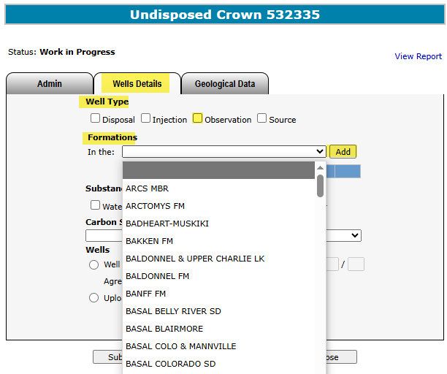
Carbon Sequestration - Crown Mineral Activity
Government of Alberta
WELLS DETAILS TAB - WELL TYPE and FORMATION (SEQUESTRATION EVALUATION and SEQUESTRATION MONITORING AND OBSERVATION)
1. Well Type, checkmark Observation
3. Click Add
2. Click Formation dropdown to choose an option
Page 7

Slide 7
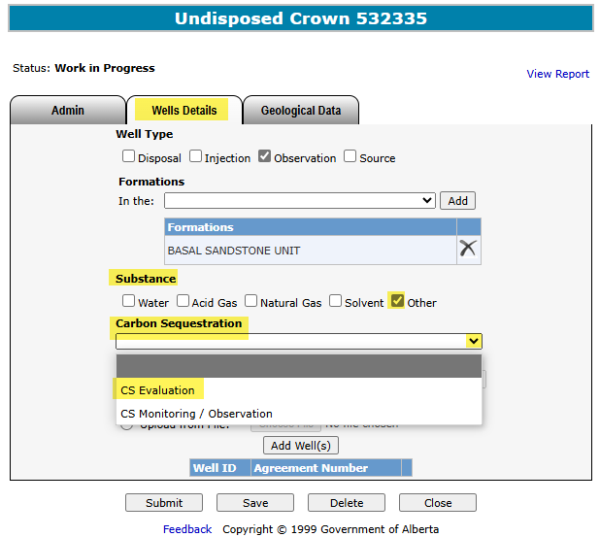
Carbon Sequestration - Crown Mineral Activity
Government of Alberta
WELLS DETAILS TAB – SUBSTANCE and CS CMA TYPE (SEQUESTRATION EVALUATION and SEQUESTRATION MONITORING AND OBSERVATION)
1. Substance, checkmark Other
2. Click Carbon Sequestration dropdown to choose a CS CMA type wanting to apply.
Page 8

Slide 8
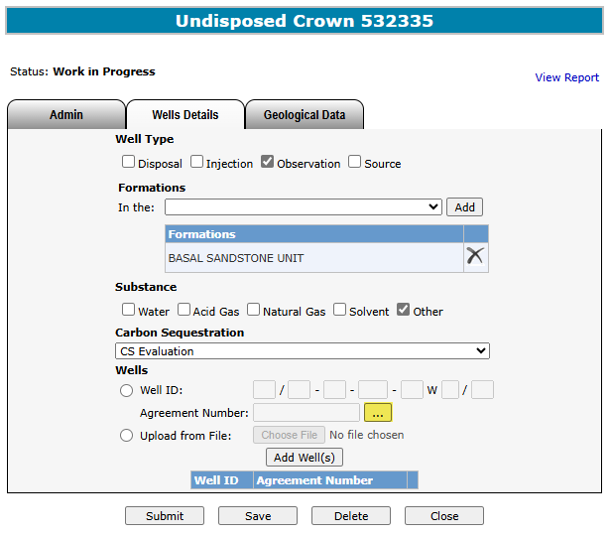
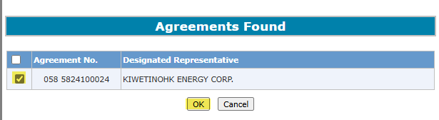
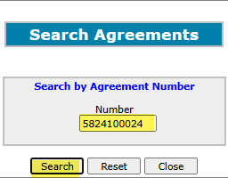
Carbon Sequestration - Crown Mineral Activity
Government of Alberta
WELLS DETAILS TAB – SEARCH and ADD CS AGREEMENT (SEQUESTRATION EVALUATION and SEQUESTRATION MONITORING AND OBSERVATION)
4. Checkmark the agreement
5. Click OK
1. Add CS Agreement. Click the (…)
2. Enter the CS Agreement number
3. Click Search
Page 8

Slide 9
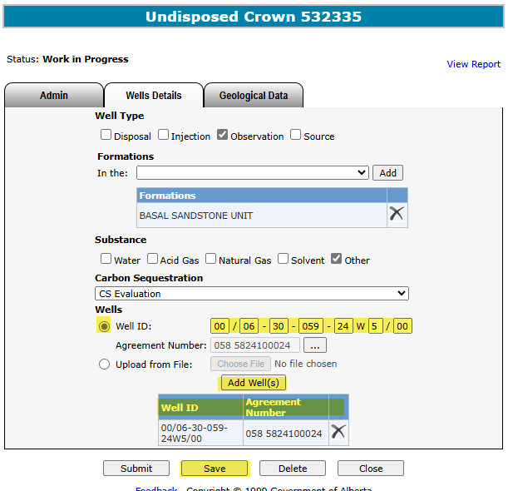
Carbon Sequestration - Crown Mineral Activity
Government of Alberta
WELLS DETAILS TAB – ADD WELL(S) (SEQUESTRATION EVALUATION and SEQUESTRATION MONITORING AND OBSERVATION)
1. Click Well ID button
2. Enter the Well ID
3. Click Add Well(s)
4. Well is added on the well grid. If adding more than one wells, repeat steps 1 to 3.
To delete a well, click the X.
5. Click Save
Page 9

Slide 10
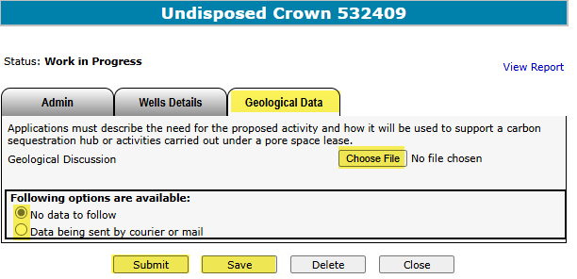

Carbon Sequestration - Crown Mineral Activity
Government of Alberta
GEOLOGICAL DATA TAB
2. Check the
appropriate box
1. Browse and upload document. Once document is uploaded, click Save.
4. Click Submit
3. Click Save
You may click on the View Report link to review the details of this CMA Application.
Delete – This deletes the entire application. The Status changes to Client Deleted.
Close – This closes the application form.
Page 10

Slide 11
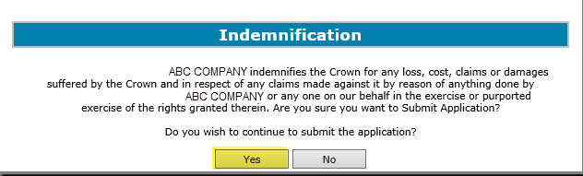
Carbon Sequestration - Crown Mineral Activity
Government of Alberta
INDEMNIFICATION
In order to continue to submit the application, click Yes on the Indemnification box.
Click Yes
Page 12

Slide 12
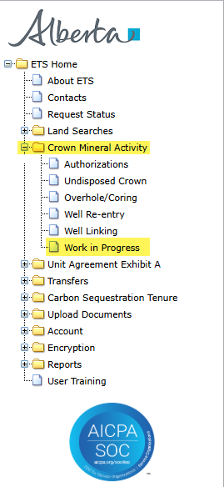
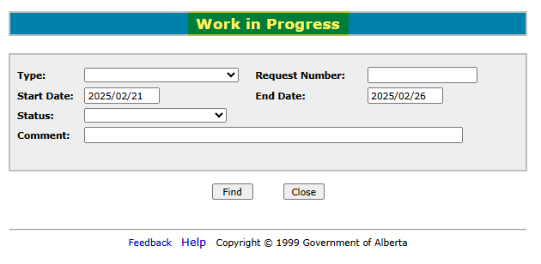
Carbon Sequestration - Crown Mineral Activity
Government of Alberta
WORK IN PROGRESS
The Work In Progress functionality of CMA enables you to retrieve a request/documents and view the request status.
Expand Crown Mineral Activity node and click Work in Progress subnode.
Page 12

Slide 13
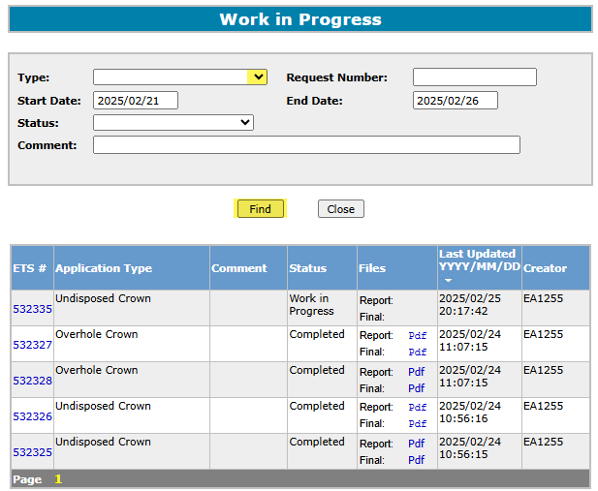

Carbon Sequestration - Crown Mineral Activity
Government of Alberta
WORK IN PROGRESS – RETRIEVE and VIEW REQUESTS
1. Retrieve Requests.
Choose the request Type.
Click the drop down arrow. Enter other request parameters to narrow your search, if needed.
2. Click Find. Search result is displayed in the grid below.
Select the Report: Pdf link to see the details of your request.
Click on the ETS request number link to view each request.
All parameters are searchable. The Start and End dates default depending on the range of days chosen in your Account Preferences. To see all available requests remove the Start Date.
Page 5

Slide 14
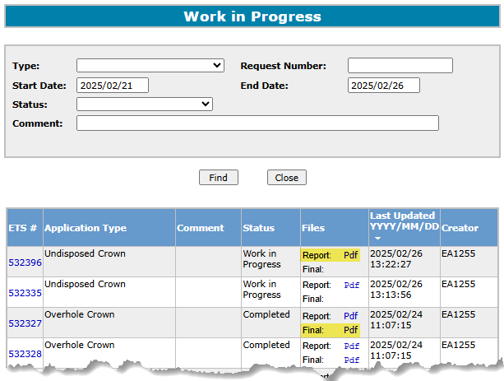
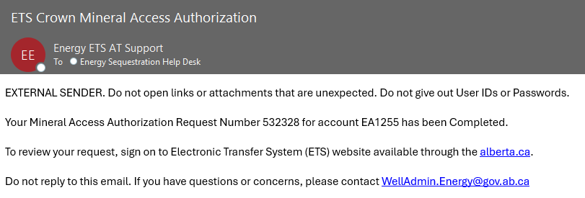
Carbon Sequestration - Crown Mineral Activity
Government of Alberta
WORK IN PROGRESS – SEARCH RESULTS and EMAIL NOTIFICATION
The information on the screen can be re-sorted by clicking on the column headers. For each request, there will be two PDF documents available in the Files column: Report and Final.
Report Pdf is the application summary report
Final Pdf is the Final letter in .PDF format uploaded from the department.
The request will remain at Processing until the Final Letter has been received from the department. Then, the Status changes to Complete.
When Final letter is uploaded, an email notification is sent to the client stating that the request has been completed.
Login to ETS/CS Tenure Sequestration/Work in Progress.
Enter the quoted Request Number from the email notification under the Request Number field.
Page 9

Slide 15

Carbon Sequestration - Crown Mineral Activity
Government of Alberta
Congratulations!
You have completed the
CS CMA –
Evaluation, Monitoring and Observation
Online Training Course
If you have any comments or questions on this training course,
please forward them to:
energy.sequestrationhelpdesk@gov.ab.ca
Page 13

