Slide 1
Carbon Sequestration Agreement Application
Government of Alberta
Welcome!
To the
Carbon Sequestration Agreement Application
Online Training Course
In this module you will learn how to:
Enter a CSA application into ETS.
Import land from CSEA or Carbon Sequestration map.
Update a CSA application by adding or removing information while the application is in a Work in Progress status.
Retrieve and view agreement documents.

Slide 2
Carbon Sequestration Agreement Application
Government of Alberta
Revisions Table
Date | Revisions Type | Page Number
October 28, 2024 | Initial Creation | All

Slide 3
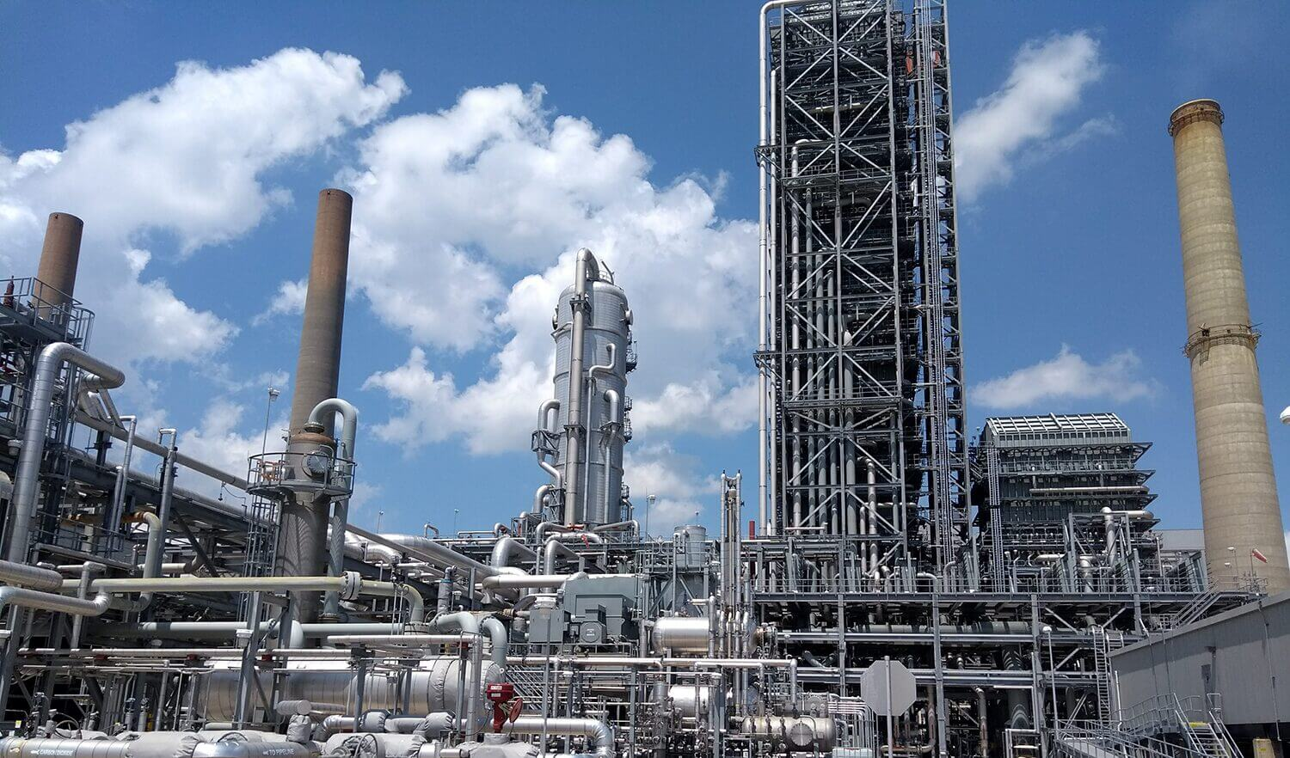
Carbon Sequestration Agreement Application
Government of Alberta
INTRODUCTION
Carbon Sequestration Agreement (CSA) allows a lessee to sequester Carbon Dioxide (CO2) into the pore space. The lessee is required to submit a CSA application via the Electronic Transfer System (ETS). These CSA lands originate from the lessee’s existing Carbon Sequestration Evaluation Agreement (CSEA).

Slide 4
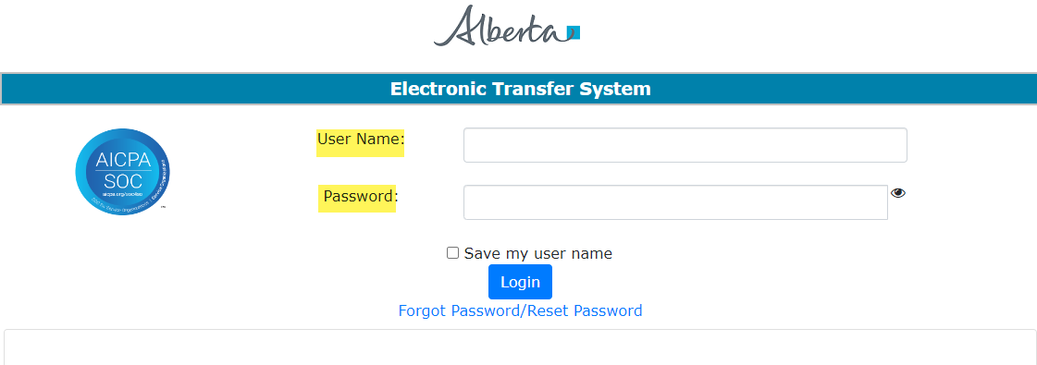
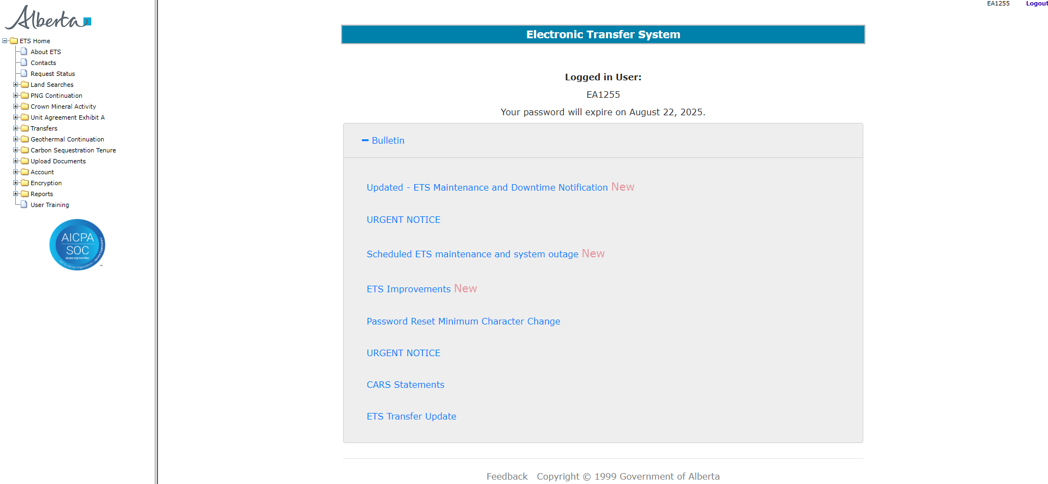
Carbon Sequestration Agreement Application
Government of Alberta
LOGIN TO ETS
Go to ETS (https://ets.energy.gov.ab.ca/logon.aspx)
Enter your login credentials: User Name (EN account) and Password.
Once logged in, the screen below is displayed.

Slide 5
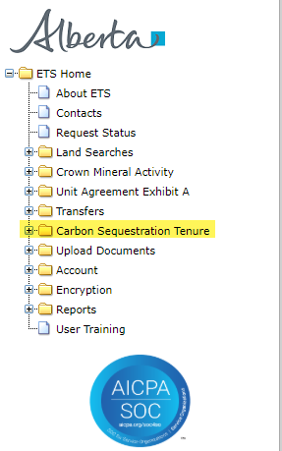
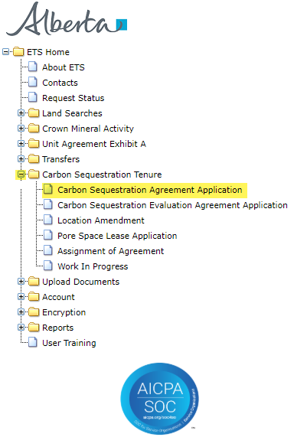
Carbon Sequestration Agreement Application
Government of Alberta
NAVIGATION TO CARBON SEQUESTRATION AGREEMENT (CSA) APPLICATION
In the treenode (left-hand side of the screen), navigate to Carbon Sequestration Tenure node.
Expand Carbon Sequestration Tenure node to display its subnodes.
Click Carbon Sequestration Agreement Application subnode.
2.
3.
1.

Slide 6
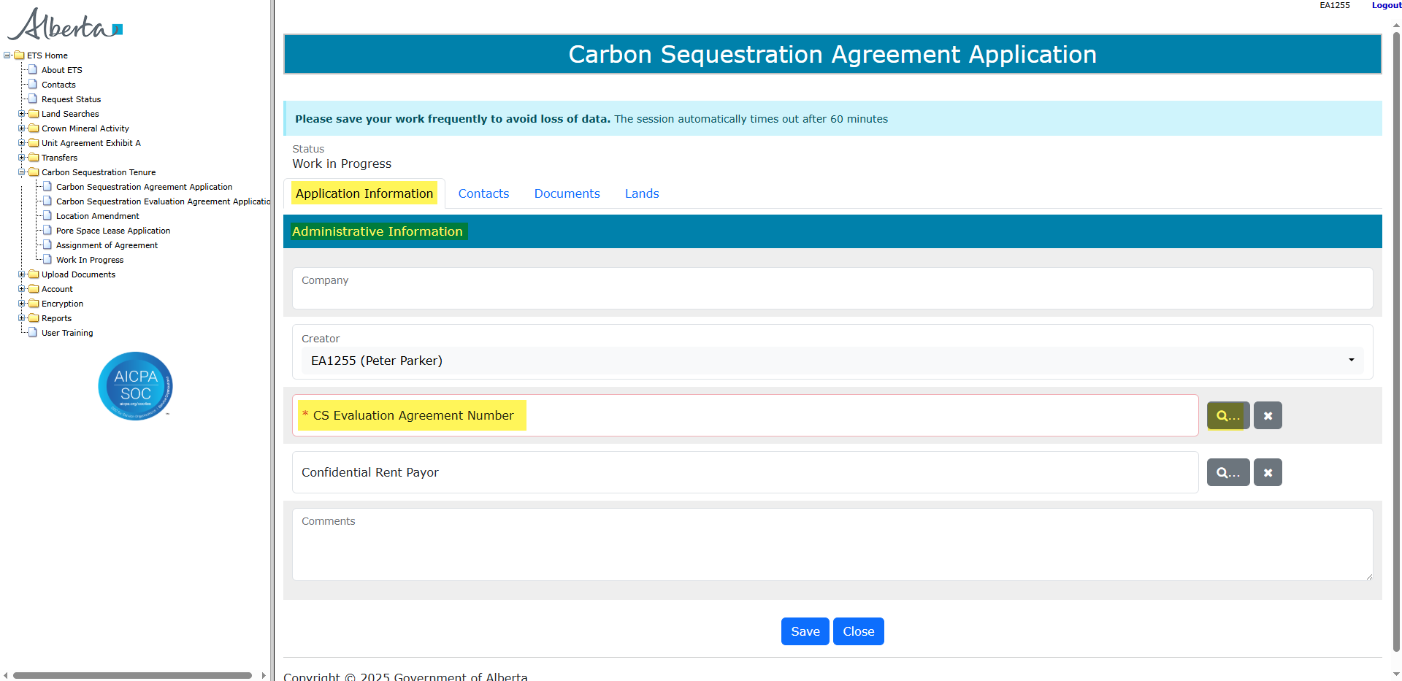
Carbon Sequestration Agreement Application
Government of Alberta
APPLICATION INFORMATION TAB
On the main screen, a blank application form is displayed. ETS auto populates the Company (if the ETS account is only for one company; if there are more than one company on the account, the field is converted to dropdown list) and Creator fields. These information are generated from the login account information.
At the creation stage, the status of the request is set to Work in Progress.
Carbon Sequestration Evaluation Agreement Number (CSEA) is required to proceed with the CSA application.
Note: Enter the required information indicated with asterisk (or outlined in red). Once information is entered, the outline turns in green).
Click the magnifying glass under CS Evaluation Agreement field to add CSEA.

Slide 7
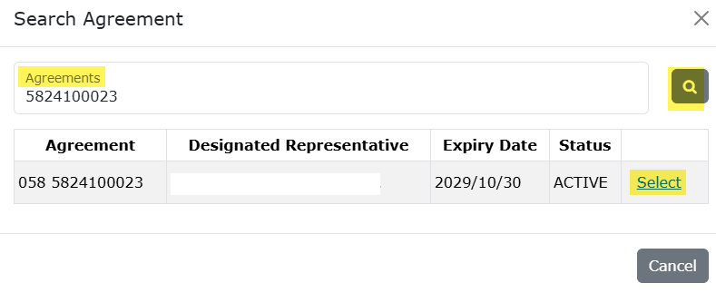
Carbon Sequestration Agreement Application
Government of Alberta
APPLICATION INFORMATION TAB – ADD CARBON SEQUESTRATION EVALUATION AGREEMENT (CSEA)
In the Search Agreement box,
Click the Agreements field and type in the CSEA number.
Select the magnifying glass to search the agreement.
Search result appears and displays the Designated Representative, Expiry Date and Status. If the information is correct, click Select.
Click Cancel if you need to restart the search.
2.
1.
3.

Slide 8
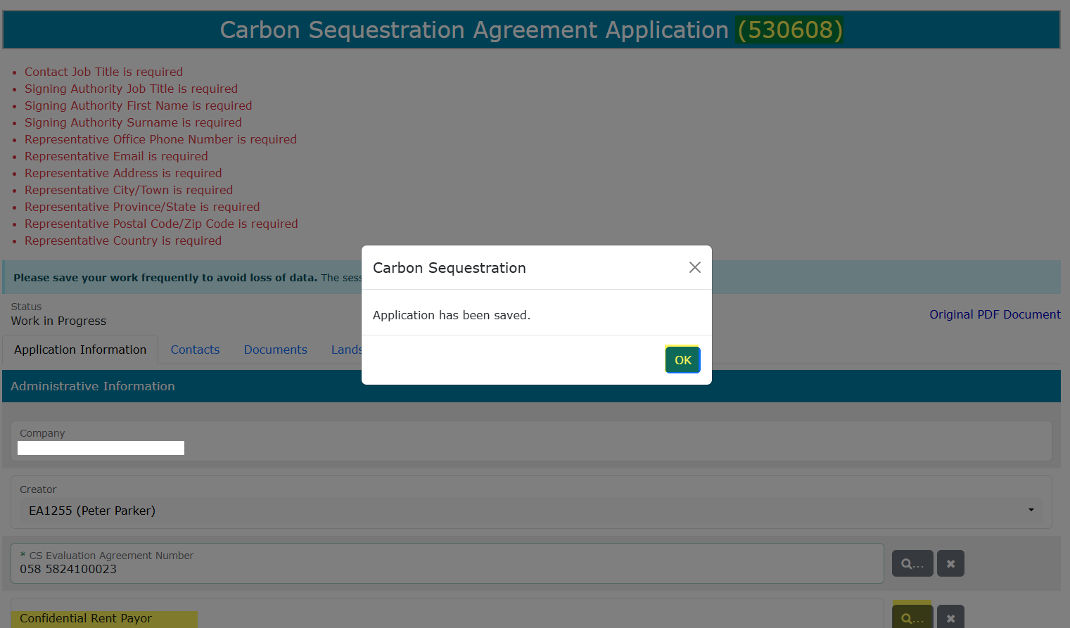

Carbon Sequestration Agreement Application
Government of Alberta
APPLICATION INFORMATION TAB – ASSIGN ETS REQUEST NUMBER
The CSEA number is now added in the application. Click Save at the bottom of the form. This will save the application and generate the ETS Request Number included in the heading.
Confidential Rent Payor field is optional. Only fill this in if payor is different than the agreement holder. This payor is responsible in paying the first time rent and issuance fee charges.
Click the magnifying glass to search a client.

Slide 9
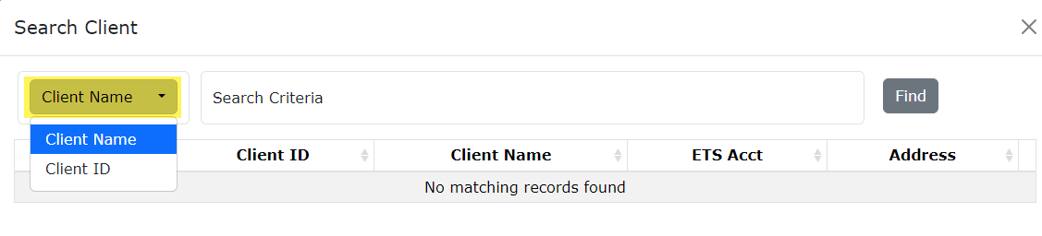
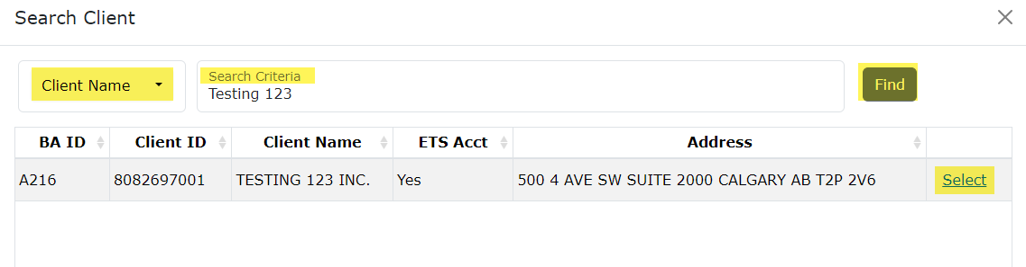
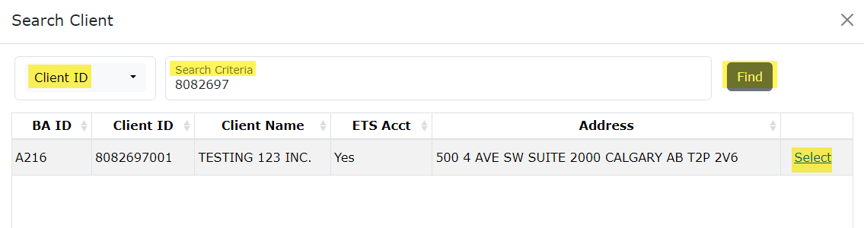
Carbon Sequestration Agreement Application
Government of Alberta
APPLICATION INFORMATION TAB – CONFIDENTIAL RENT PAYOR
The Confidential Rent Payor can be searched by either the Client Name or the Client Number.
1.
By default, Client Name search criteria displayed by default. Click the dropdown to select the desired search criteria.
Depending on the search criteria chosen, enter the Client Name OR the Client ID in the corresponding field.
Click Find.
Search result appears and displays the Business Associate ID, Client ID, Client Name, ETS Acct Yes/No, Address
4. Click Select to add the client as confidential rent payor.
2.
3.
4.

Slide 10
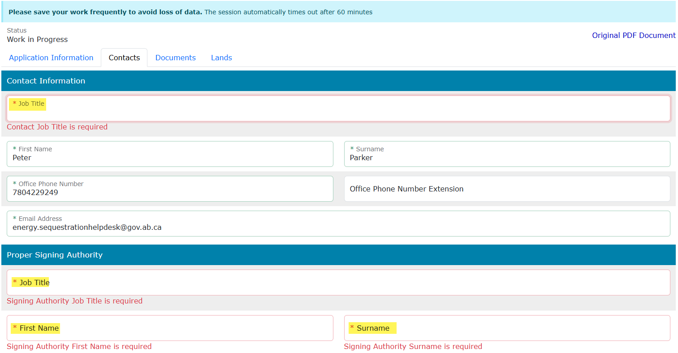
Carbon Sequestration Agreement Application
Government of Alberta
CONTACTS TAB – CONTACT INFORMATION AND PROPER SIGNING AUTHORITY
Note: Enter the required information indicated with asterisk (or outlined in red). Once information is entered, the outline turns in green).
Contact Information section – ETS auto populates the Name and Contact information. These information are generated from the login account information. Update the Job Title.
Proper Signing Authority – Enter the required information indicated with asterisk. The Signing Authority is a person who has the authority to sign documents on behalf of the company.

Slide 11
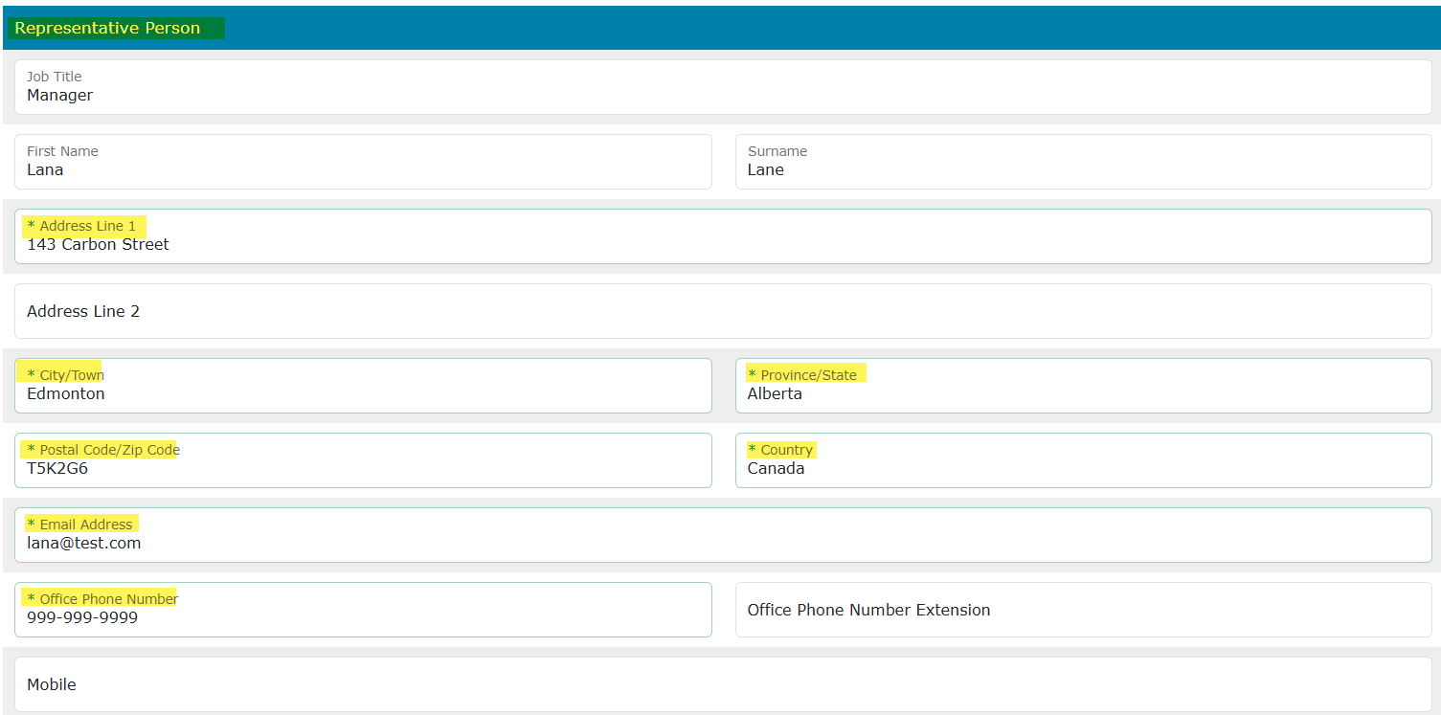
Carbon Sequestration Agreement Application
Government of Alberta
CONTACTS TAB – REPRESENTATIVE PERSON
This person is the appointed representative by the company who is responsible in answering any questions regarding the application.
Note: Enter the required information indicated with asterisk (or outlined in red). Once information is entered, the outline turns in green)

Slide 12
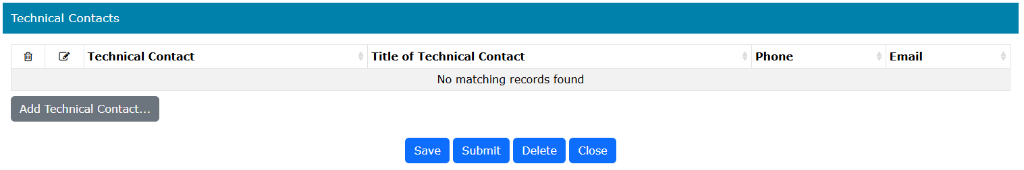
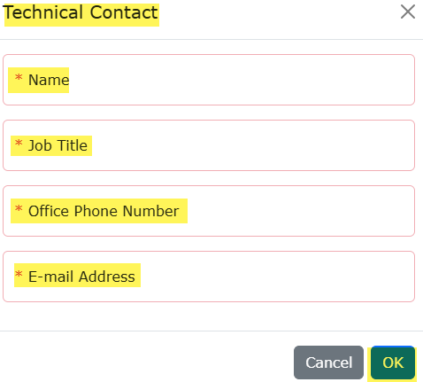
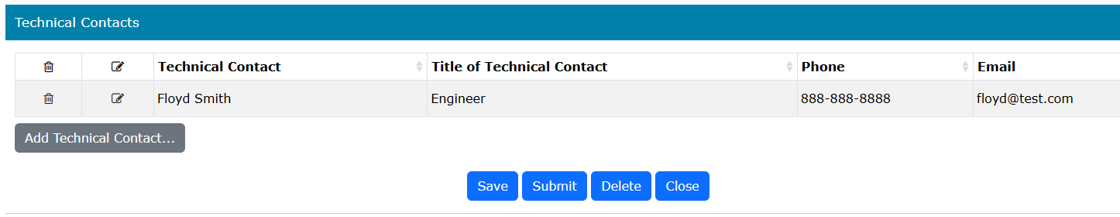
Carbon Sequestration Agreement Application
Government of Alberta
CONTACTS TAB – TECHNICAL CONTACTS
1.
2.
Click Add Technical Contact... A new window appears.
Enter the required information indicated with asterisk (or outlined in red). Once information is entered, the outline turns in green)
Click OK to add the Technical Contact in the main grid.
Back to the application form, scroll down and click Save to save all added information.
3.
Note: Enter the required information indicated with asterisk (or outlined in red). Once information is entered, the outline turns in green)
4.

Slide 13
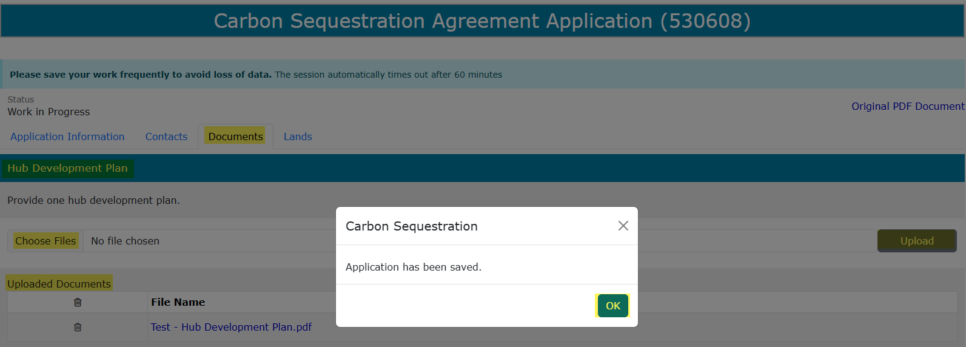
Carbon Sequestration Agreement Application
Government of Alberta
DOCUMENT TAB – HUB DEVELOPMENT PLAN
Under Hub Development Plan section, click Choose Files. File Explorer folders opens. Locate the file to upload.
Back to the ETS request application, the name of the file is added on the ‘No file chosen’ field.
Click Upload.
Save prompt appears, click OK. The document is added in the Uploaded Documents grid.
To delete an uploaded document, simply click the corresponding trash bin icon.
To add, follow the steps above.
1.
3.
2.
4.

Slide 14
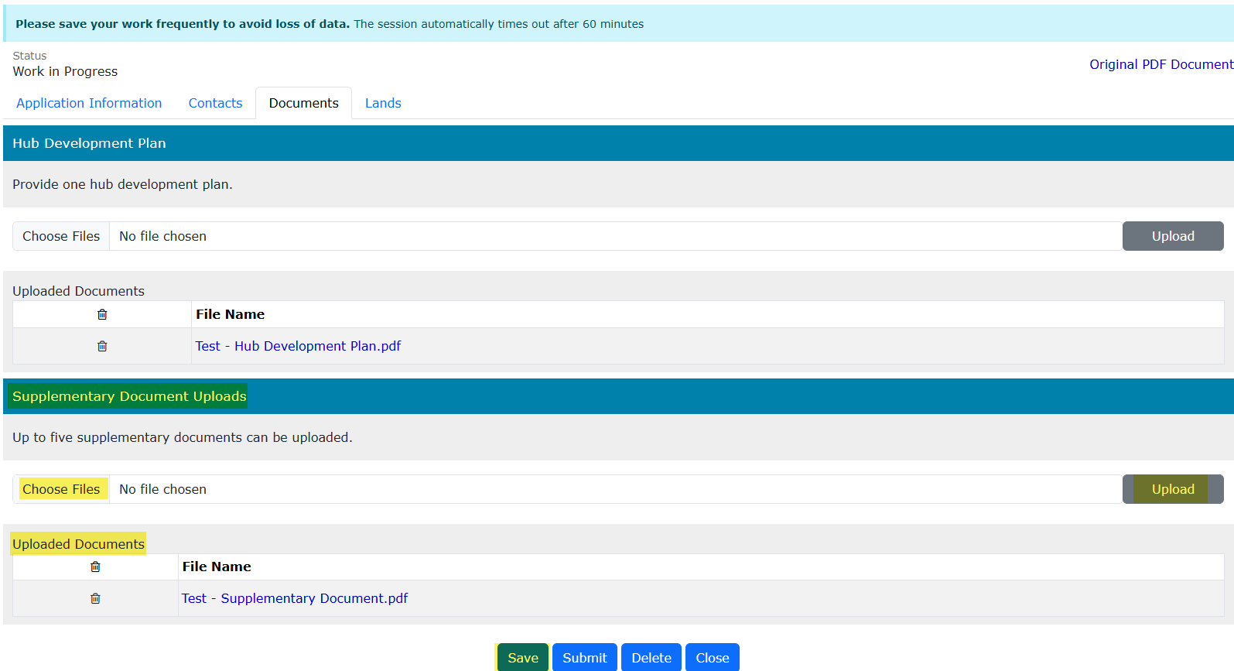
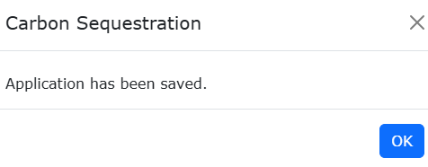
Carbon Sequestration Agreement Application
Government of Alberta
DOCUMENT TAB – UPLOAD SUPPLEMENTARY DOCUMENT
Under Supplementary Document Uploads section, click Choose Files. File Explorer folders opens. Locate the file to upload. Note: up for 5 supplementary documents can be uploaded.
Back to the ETS request application, the name of the file is added on the ‘No file chosen’ field.
Click Upload.
Save prompt appears, click OK. The document is added in the Uploaded Documents grid.
To delete an uploaded document, simply click the corresponding trash bin icon.
To add, follow the steps above.
4.
3.
2.
1.

Slide 15

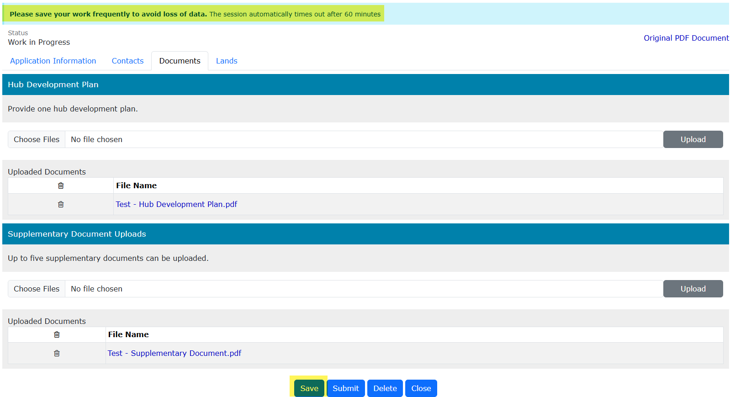
Carbon Sequestration Agreement Application
Government of Alberta
DOCUMENTS TAB – SAVE
Once your documents have been uploaded and displayed in the Uploaded Documents grid, select Save.
Save your work frequently to avoid the loss of data. The session will automatically time out after 60 minutes.

Slide 16
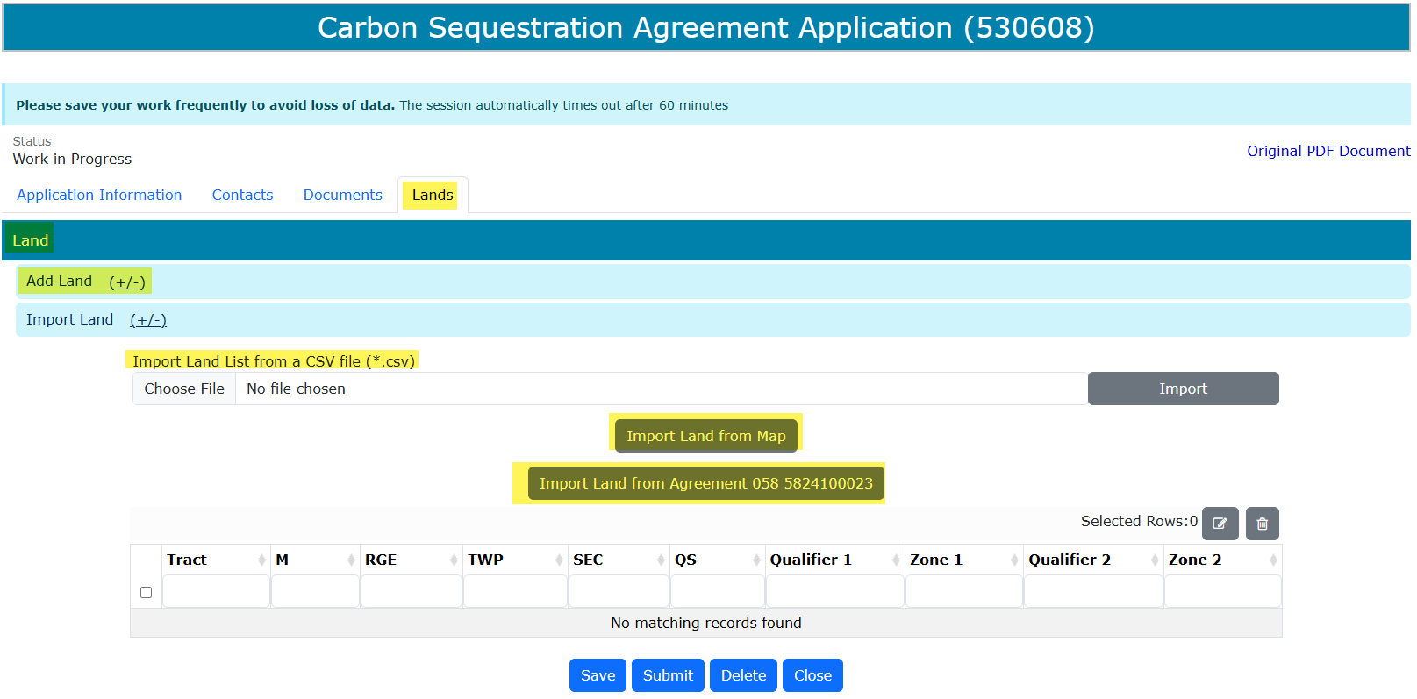
Carbon Sequestration Agreement Application
Government of Alberta
LANDS TAB
Adding lands have 4 options:
1. Import Land from the Agreement (Carbon Sequestration Evaluation Agreement (CSEA)) entered under Application Information tab. (*recommended)
Import Land (+/-)
2. Import Land from Map (shapefile)
3. Import Land List from a CSV file (*.csv)
4. Add Land (+/-)
4.
3.
2.
1.

Slide 17
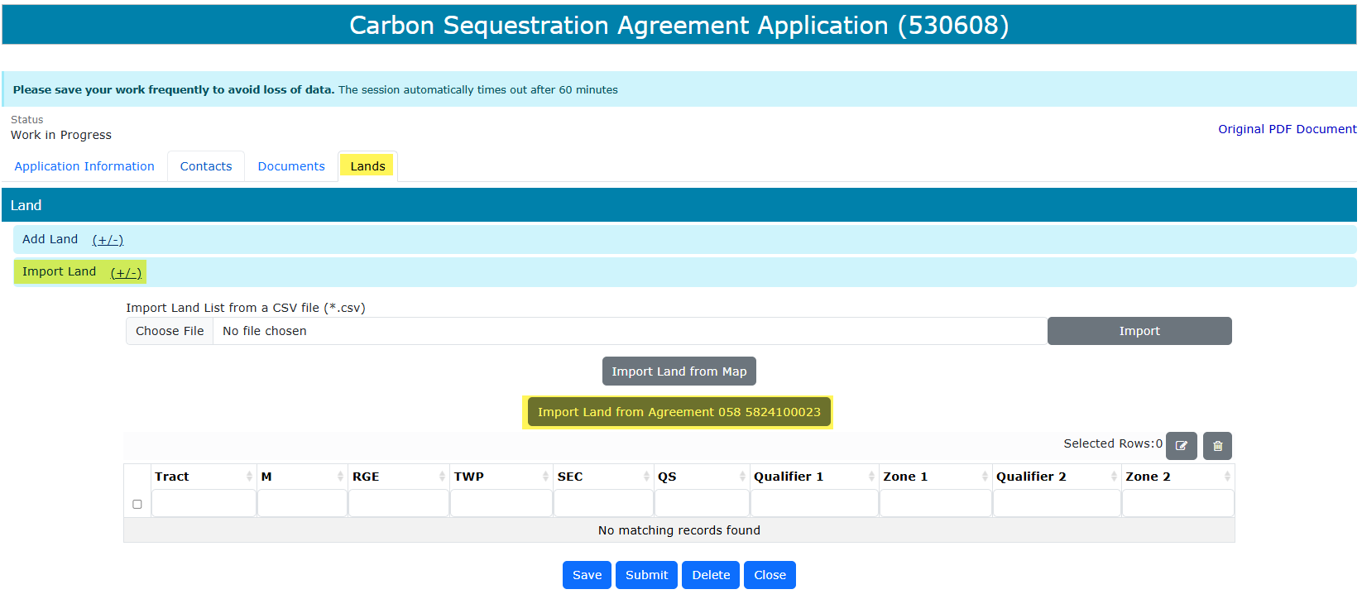
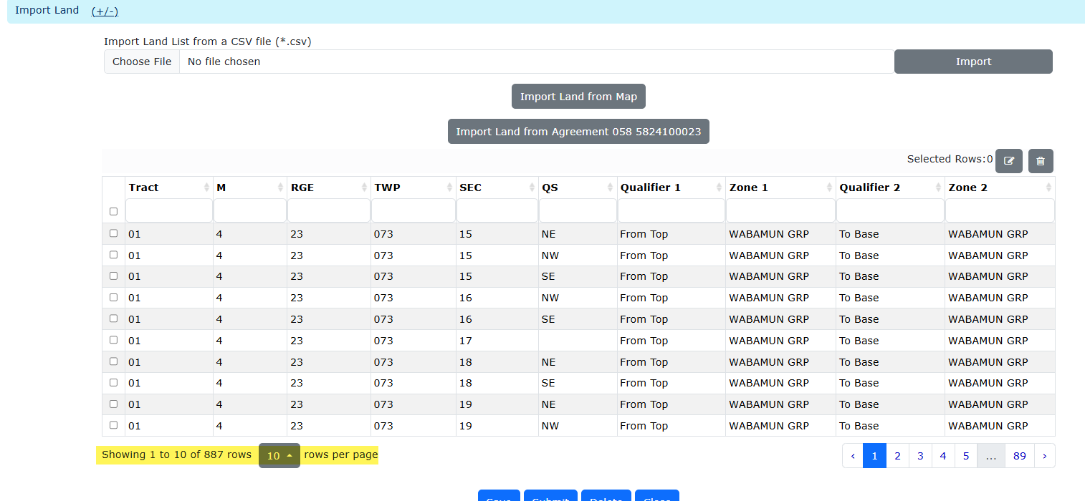
Carbon Sequestration Agreement Application
Government of Alberta
LANDS TAB – OPTION 1: IMPORT LAND FROM AGREEMENT (CSEA) - *RECOMMENDED
Note: Land(s) must be from the Carbon Sequestration Evaluation Agreement (CSEA) entered in the Application Information.
Click Import Land (+/-). Two options appear: Import Land from Map and Import Land from Agreement.
Click Import Land from Agreement. All lands from the CSEA entered in the Application Information tab are generated and displayed in the land grid.
1.
3. The land grid is populated with the CSEA agreement’s lands.
2.
Note:
On the land grid, an option to show number of lands is available (view in 10s, 50s or 100s).
Creator can also navigate by page.
Checkmark each land that are not applied for and click the trash bin icon.

Slide 18
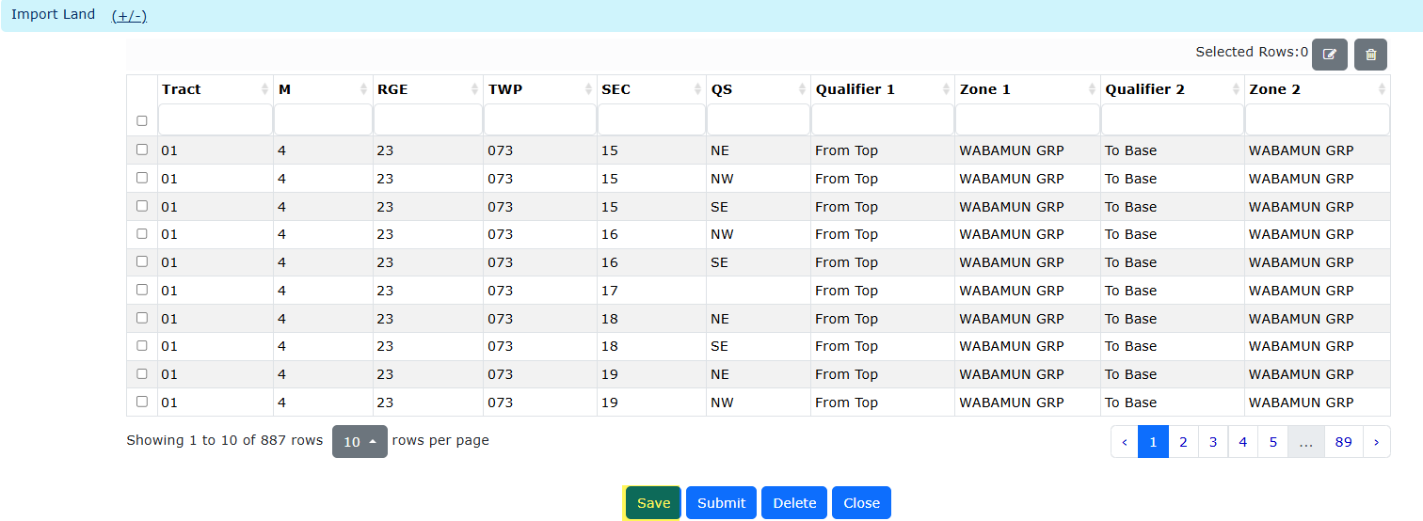
Carbon Sequestration Agreement Application
Government of Alberta
LANDS TAB – IMPORT LAND FROM AGREEMENT (CSEA) … continued
Entire CSEA lands are being applied for Carbon Sequestration Agreement (CSA):
All lands from the CSEA are listed on the land grid.
Click Save.
1.
2.

Slide 19
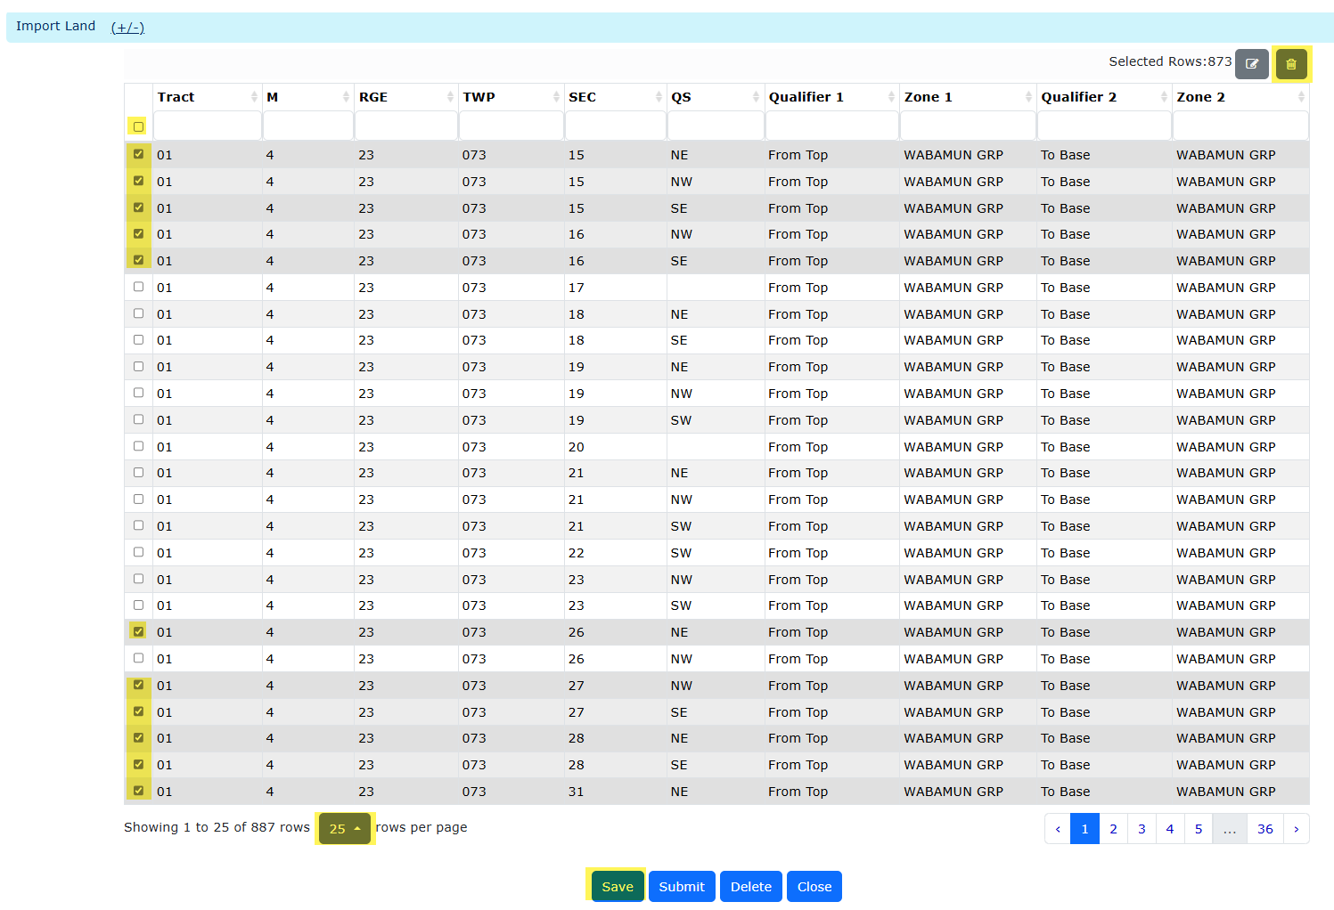
Carbon Sequestration Agreement Application
Government of Alberta
LANDS TAB – IMPORT LAND FROM AGREEMENT (CSEA) … continued
Partial CSEA lands are being applied for CSA:
Select the lands not being applied for by clicking the corresponding checkbox of each landkey. Depending on the number of lands not being applied for, you may select all lands and uncheck the landkeys that are being applied for.
Click the trash bin icon to remove from the lands from the grid. The remaining lands on the land grid will be submitted.
3. Click Save.
1. Click to Select all lands.
2. Trash bin icon to delete.
1. Uncheck lands will be submitted.
3.

Slide 20
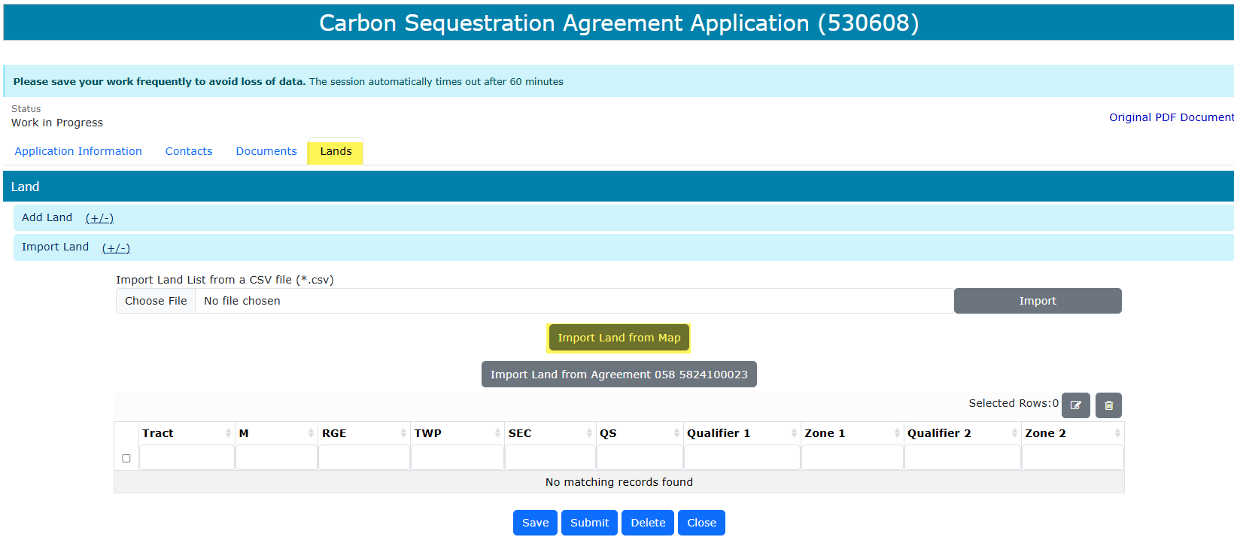
Carbon Sequestration Agreement Application
Government of Alberta
LANDS TAB – OPTION 2: IMPORT LAND FROM MAP
Note: Land(s) must be from the Carbon Sequestration Evaluation Agreement (CSEA) entered in the Application Information.
Click Import Land (+/-). Two options appear: Import Land from Map and Import Land from Agreement.
Click Import Land from Map. All lands from the Agreement entered in the Application Information tab are generated and displayed in the land grid.

Slide 21
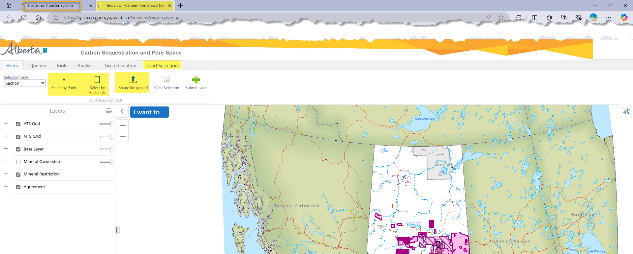
Carbon Sequestration Agreement Application
Government of Alberta
LANDS TAB – OPTION 2: IMPORT LAND FROM MAP
Geoview – Carbon Sequestration and Pore Space Query map is opened on a new browser page.
Under Land Selection tab, there are 2 option to import land from Map: selecting the lands directly from the map (Select by Point or Select by Rectangle) or shape file upload.
1.
2.

Slide 22
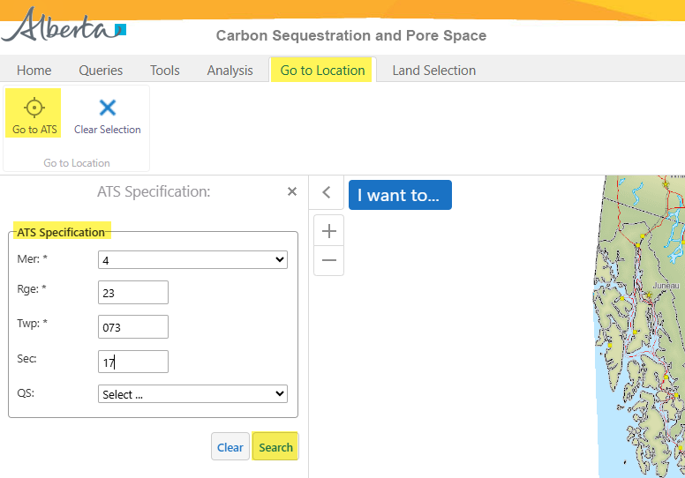
Carbon Sequestration Agreement Application
Government of Alberta
LANDS TAB – OPTION 2: IMPORT LAND FROM MAP – NAVIGATE TO THE TARGET LOCATION
2. Click Go to ATS.
1. Navigate to Go to Location tab.
3. Input the landkey.
4. Click Search.

Slide 23
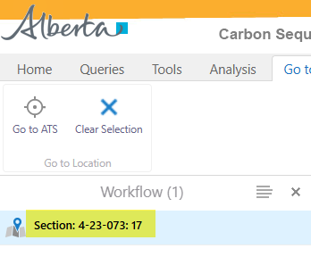
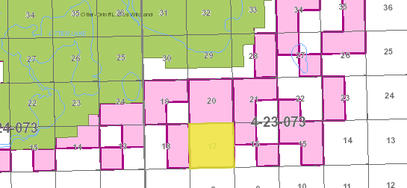
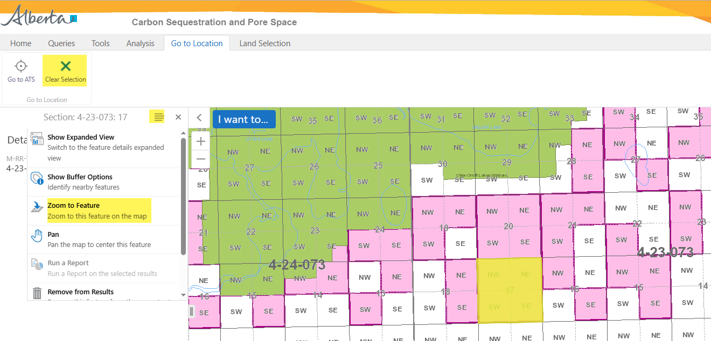
Carbon Sequestration Agreement Application
Government of Alberta
LANDS TAB – OPTION 2: IMPORT LAND FROM MAP – NAVIGATE TO THE TARGET LOCATION
5. Click Clear Selection.
1. Select the land result.
4. Zoom in or Zoom out on the target location.
2. Click the hamburger icon.
3. Click Zoom to Feature.

Slide 24
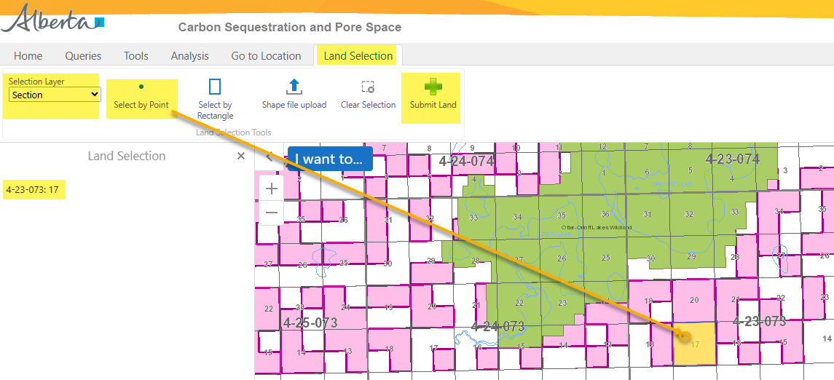
Carbon Sequestration Agreement Application
Government of Alberta
LANDS TAB – OPTION 2A: IMPORT LAND FROM MAP – ADD LAND - SELECT BY POINT
Once a target location is searched, add the land. There are 2 options:
Select by Point (use this option if selecting lands not adjacent to each other.)
Select by Rectangle
Once submitted, edit the lands added in ETS. Refer to Slide 26, ‘Edit Selected Lands’.
1. Navigate to Land Selection tab.
3. Click Select by Point.
6. Click Submit Land.
Note: only click this button once. Do not click repeatedly as the lands will be listed more than once on the ETS request.
2. Change Selection Layer, if required before selecting land(s).
5. As land is selected, the land node displays the selected landkeys here.
Repeat steps 1-4 to add remaining lands.
4. Point and click the section to add.

Slide 25
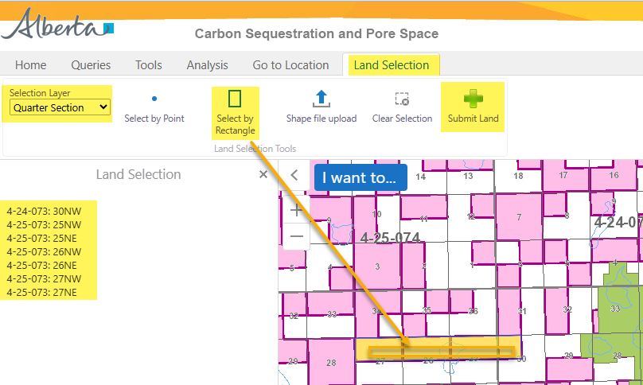
Carbon Sequestration Agreement Application
Government of Alberta
LANDS TAB – OPTION 2A: IMPORT LAND FROM MAP – ADD LAND - SELECT BY RECTANGLE
Once a target location is searched, add the land. There are 2 options:
Select by Point
Select by Rectangle (use this if selecting adjacent lands.)
Once submitted, edit the lands added in ETS. Refer to Slide 26, ‘Edit Selected Lands’.
1. Navigate to Land Selection tab.
2. Change Selection Layer, if required before selecting land(s).
6. Click Submit Land.
Note: only click this button once. Do not click repeatedly as the lands will be listed more than once on the ETS request.
3. Click Select by Rectangle
4. Draw a rectangle on top of the sections required to select.
5. As land is selected, the land node displays the selected landkeys here.
Repeat steps 1-4 to add remaining lands.

Slide 26
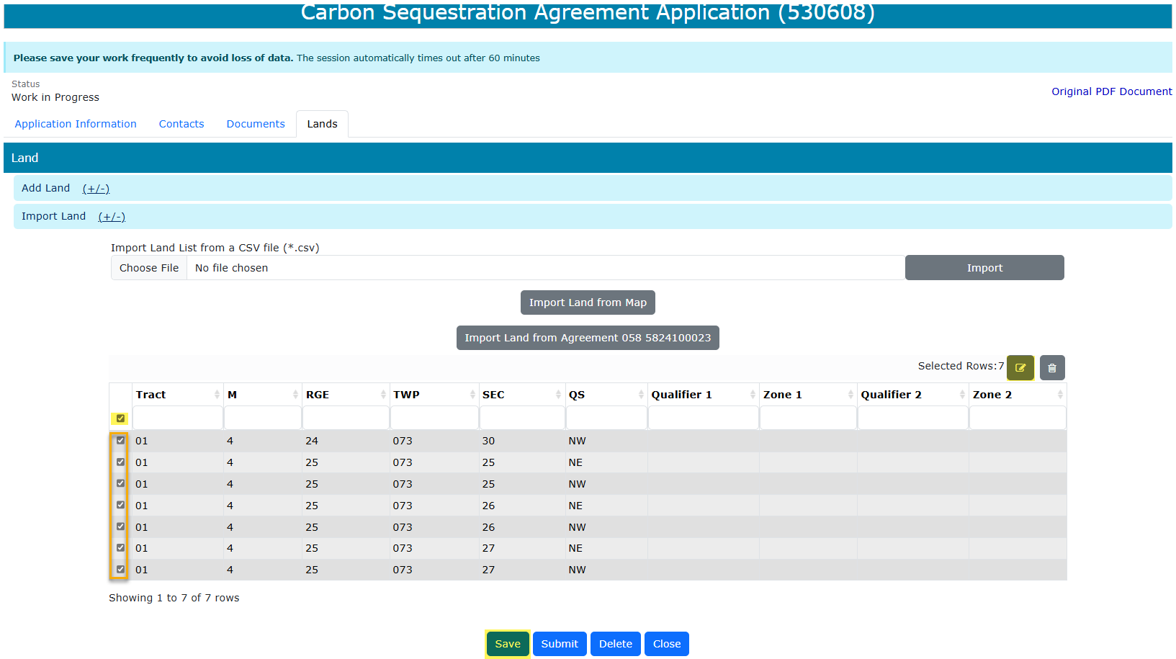
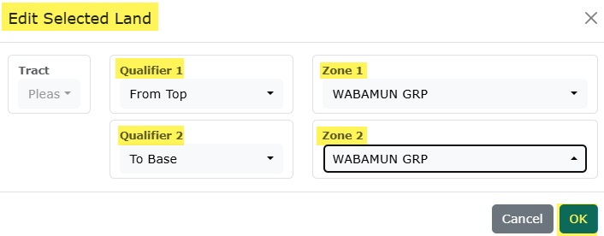
Carbon Sequestration Agreement Application
Government of Alberta
LANDS TAB – OPTION 2A: IMPORT LAND FROM MAP – EDIT SELECTED LANDS
Once lands added are submitted from the Geoview map, the lands are loaded back into the ETS request land grid.
3. Add the Qualifiers and Zones
4. Click OK to apply the changes
1. Click the checkbox column to select all landkeys that has missing Qualifiers and Zones.
2. Click the modify land icon
5. Click Save.

Slide 27
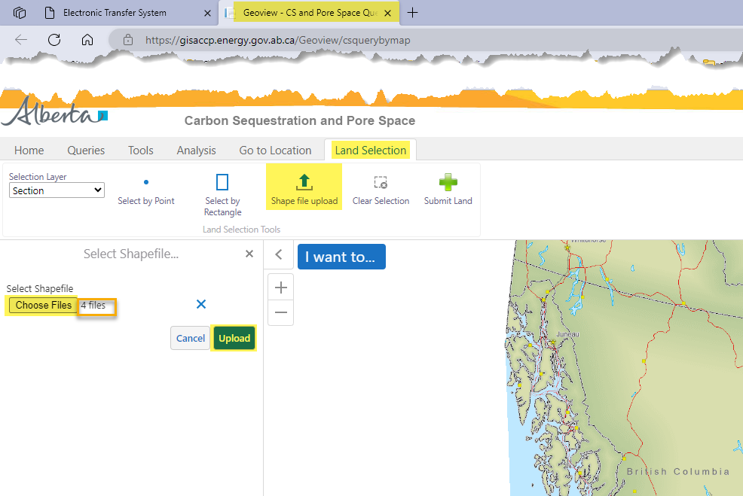
Carbon Sequestration Agreement Application
Government of Alberta
LANDS TAB – OPTION 2B: IMPORT LAND FROM MAP – SHAPEFILE UPLOAD
1. Navigate to Land Selection tab.
3. Click Choose Files. File Explorer opens. Browse to the location of the shapefile to upload.
2. Click Shape file upload.
4. Number of files to upload are indicated in this field.
5. Click Upload.

Slide 28
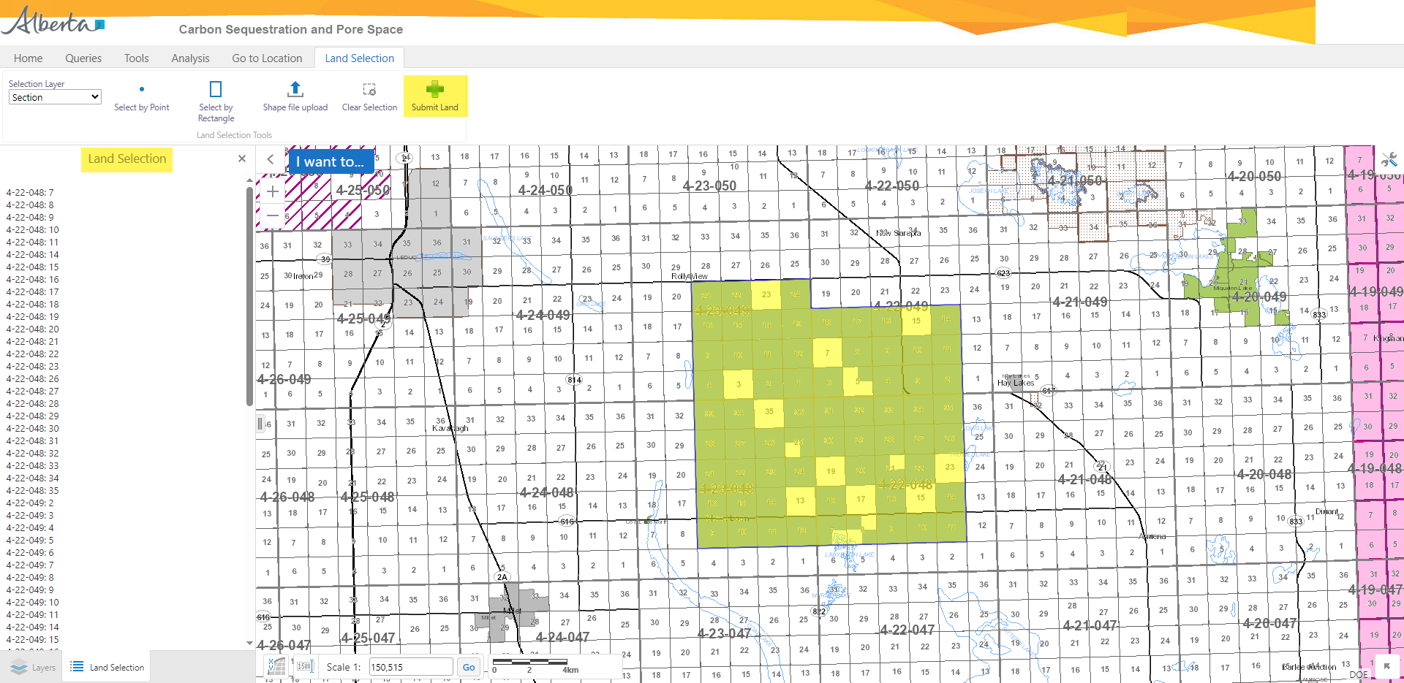
Carbon Sequestration Agreement Application
Government of Alberta
LANDS TAB – OPTION 2B: IMPORT LAND FROM MAP – SHAPEFILE UPLOAD
6. Click Submit Land.
Note: only click this button once.
Do not click repeatedly as the lands will be listed more than once on the ETS request. If the area is large, you may have to wait for the map to load the lands in the ETS application.
Land Selection treenode list all landkeys uploaded via shapefile.
Landkeys uploaded via shapefile.
Once submitted, edit the lands added in ETS. Refer to Slide 26, ‘Edit Selected Lands’.

Slide 29
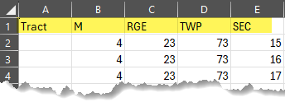
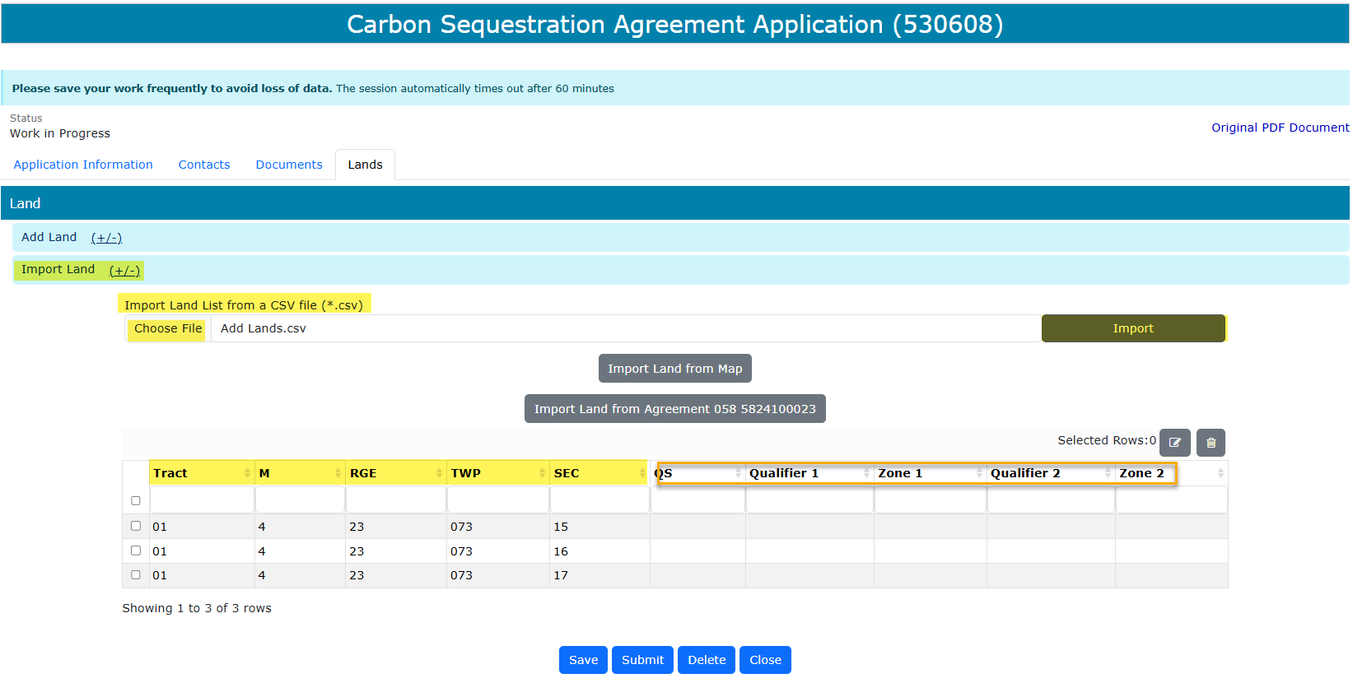
Carbon Sequestration Agreement Application
Government of Alberta
LANDS TAB – OPTION 3: IMPORT LAND LIST FROM A CSV FILE (*.csv)
Note: Land(s) must be from the Carbon Sequestration Evaluation Agreement (CSEA) entered in the Application Information.
Create a .csv file. The format must be as follows: Tract, M, RGE, TWP and SEC.
To import, navigate to the ETS request/ Lands tab.
Click Import Land (+/-).
Click Choose File to browse the .csv file on your personal computer.
Navigate to the File Explorer and select the .csv file and click Open. The file is now chosen.
Click Import to add the lands into the grid.
1.
2.
3.
4.
6.
5.
6.
7. Edit the added lands. Refer to Slide 24.

Slide 30
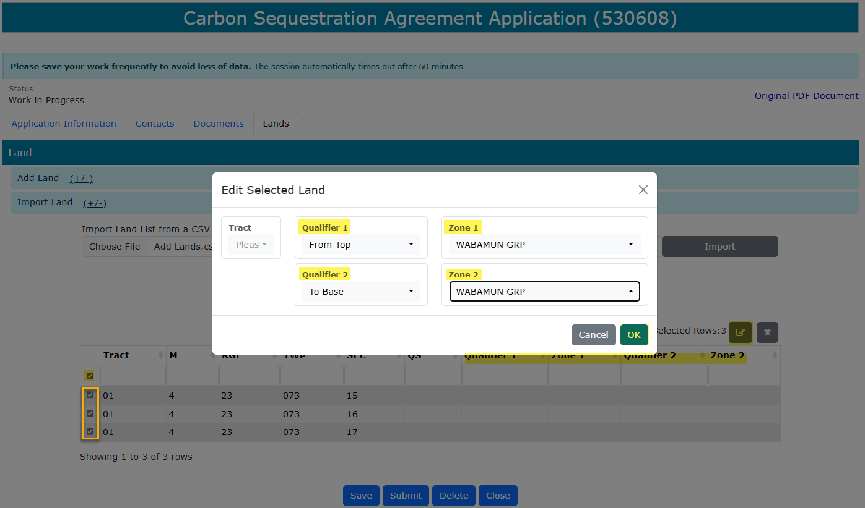
Carbon Sequestration Agreement Application
Government of Alberta
LANDS TAB – OPTION 3: IMPORT LAND LIST FROM A CSV FILE (*.csv – EDIT LANDS
Lands are now added into the grid. Qualifiers are required.
Select all landkeys. Checkmark all.
Click the modify landkey icon. Edit Selected Land box appears.
“Edit Selected Land’ box appears. Add the Qualifiers and Zones.
Click OK.
Click Save.
4.
5.
3.
2.
1.

Slide 31
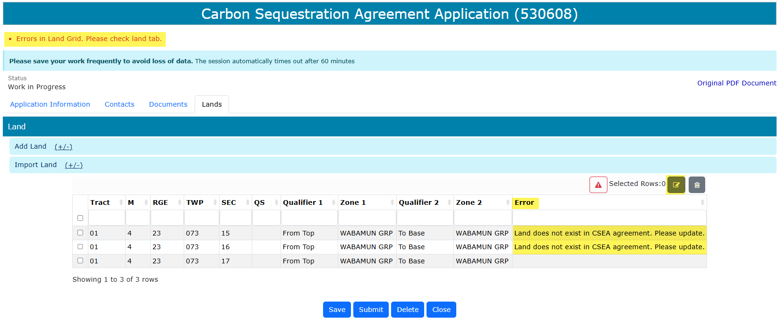
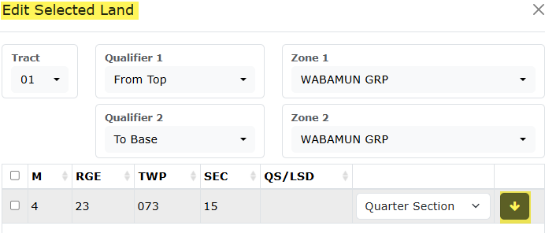
Carbon Sequestration Agreement Application
Government of Alberta
LANDS TAB – OPTION 3: IMPORT LAND LIST FROM A CSV FILE (*.csv) – EDIT LANDS
Lands must be the exact lands from the Carbon Sequestration Evaluation Agreement. If lands added are not from the CSEA, a validation error will appear and must be corrected prior to moving to the next step.
In the example below, section 15 and 16 are not exact match of the CSEA lands. It should be section 15N, SE and section 16NW, SE
3. Click the down arrow to breakdown the section.
2. Click the modify landkey icon.
1. Error appears to the corresponding landkey and at the top of the form in red font.

Slide 32
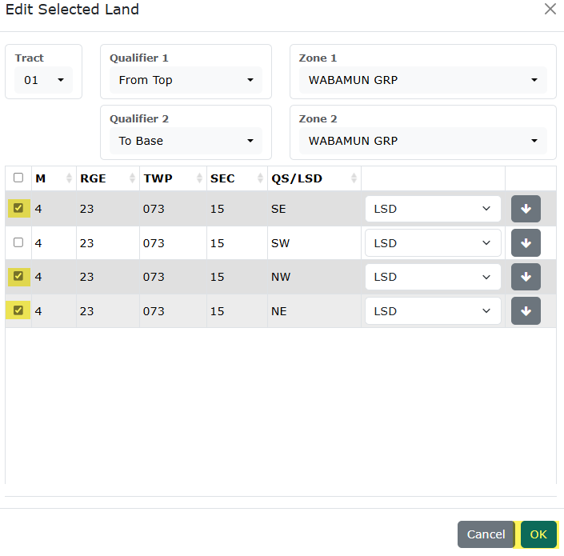
Carbon Sequestration Agreement Application
Government of Alberta
LANDS TAB – OPTION 3: IMPORT LAND LIST FROM A CSV FILE (*.csv) – EDIT LANDS
The land is now broken down into quarter section.
Checkmark the landkeys to be added.
Click OK to add to the grid.
1.
2.

Slide 33
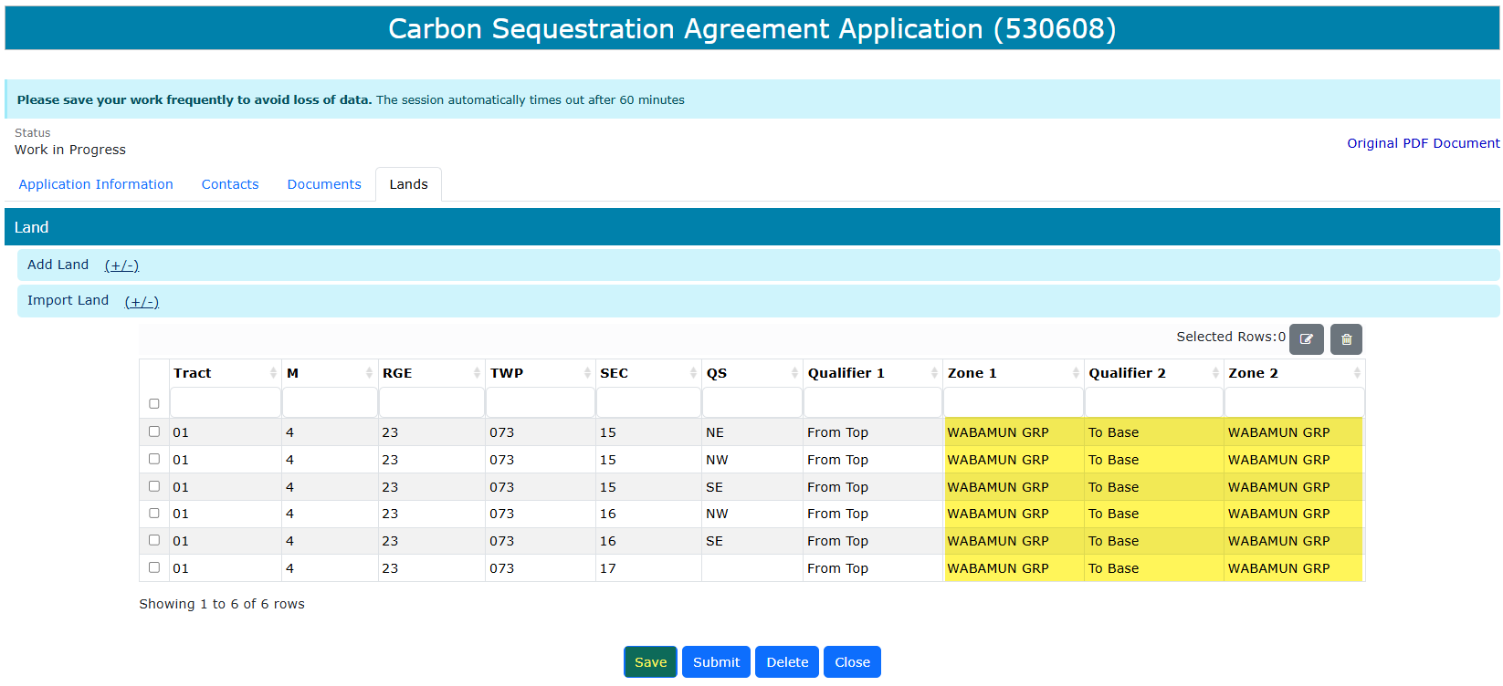
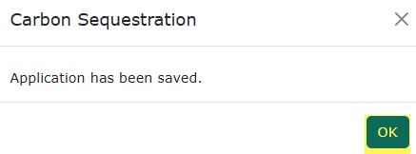
Carbon Sequestration Agreement Application
Government of Alberta
LANDS TAB – OPTION 3: IMPORT LAND LIST FROM A CSV FILE (*.csv) – SAVE LANDS
Lands are now modified.
Click Save to save the changes.
Click OK on the save prompt box.
3.
1.
2.

Slide 34
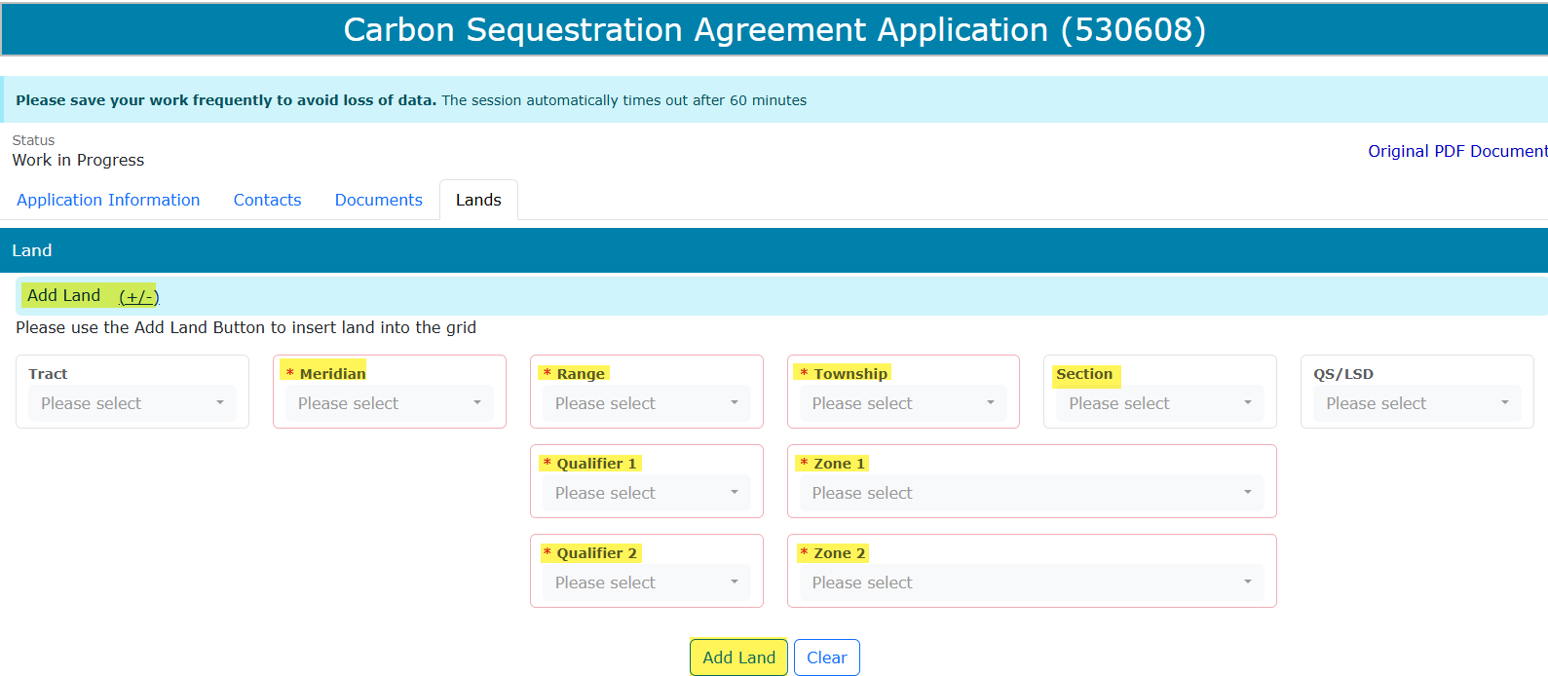
Carbon Sequestration Agreement Application
Government of Alberta
LANDS TAB – OPTION 4: ADD LAND (+/-)
Use this option if prefer to enter lands one landkey at a time.
Note: Land(s) must be from the Carbon Sequestration Evaluation Agreement (CSEA) entered in the Application Information.
Click Add Land (+/-). The screen below appears.
Input the required information (flagged with asterisk and outlined in red)
Click Add Land to add the land into the grid.
1.
2.
3.

Slide 35
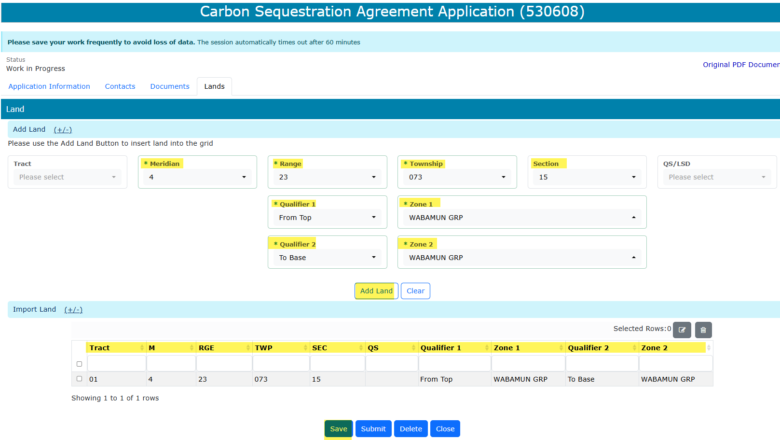
Carbon Sequestration Agreement Application
Government of Alberta
LANDS TAB – OPTION 4: ADD LAND (+/-) …continued
Required information inputted and added into the land grid. Repeat previous steps to add remaining lands.
Click Save.

Slide 36
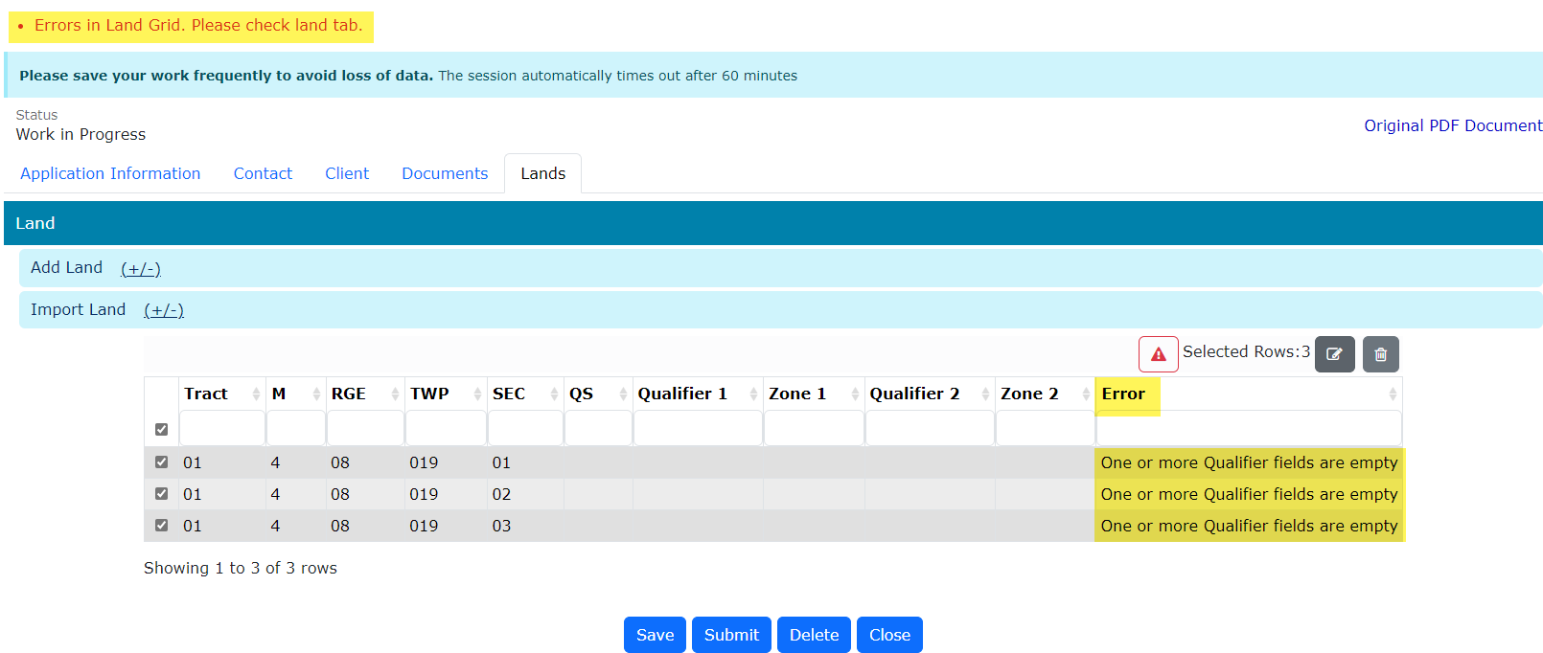
Carbon Sequestration Agreement Application
Government of Alberta
VALIDATION ERRORS – ERRORS IN LAND GRID
Any validation errors are displayed at the top of the application in red. These require attention before proceeding to the next step of the application.
Validation error: One or more Qualifier fields are empty
Refer to Slide 31 ‘Edit Selected Lands’.

Slide 37
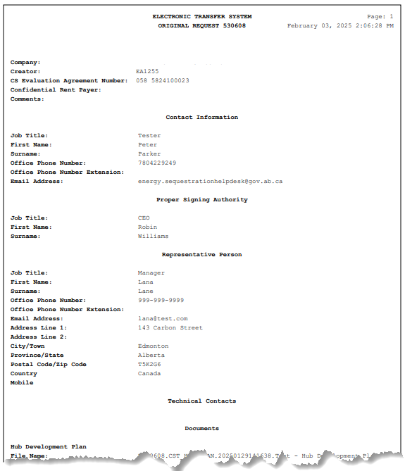
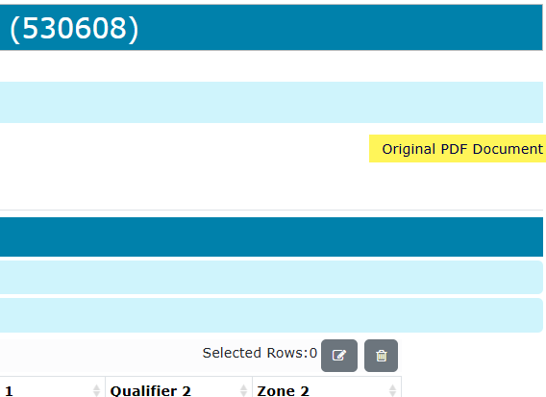

Carbon Sequestration Agreement Application
Government of Alberta
APPLICATION SUMMARY REPORT
The Original PDF Document link is the application summary report. It contains all data entered on the application.
This tool is useful to review the entire application before submitting the application.
Click Original PDF Document to generate the report.

Slide 38



Carbon Sequestration Agreement Application
Government of Alberta
SUBMIT APPLICATION
Once all pertinent information has been entered, submit the Carbon Sequestration Agreement Applicaiton.
The system performs validation check to ensure all mandatory data has been provided.
Upon successful submission, the status is updated to Submitted.
3. Click OK
2. Click Submit
1. Click Submit
Delete (deletes entire application) is available when the request Status is at Work in Progress.
Close (closes application).

Slide 39

Carbon Sequestration Agreement Application
Government of Alberta
WITHDRAW APPLICATION
The Withdraw button is only available when the Status is at Submitted.
The creator or submitter has the option to withdraw the application during the duration of the status of Submitted.
When the request status is changed from Submitted to Processing, the Withdraw button is no longer available.

Slide 40

Carbon Sequestration Agreement Application
Government of Alberta
WORK IN PROGRESS
The Work in Progress screen contains all different status depending on the state of each ETS Request.
To search all ETS requests, select the Find icon on the Work in Progress screen.
User can also narrow the search by the following search parameters: Status, Request Number, Start Date and End Date.
Click the Request link to view the application.

Slide 41
Carbon Sequestration Agreement Application
Government of Alberta
WORK IN PROGRESS – continued…
Work in Progress
The creator can modify and save the form.
Submitted
The creator or submitter has Submitted the form.
Processing
The request has been submitted to Alberta Energy and Minerals. Only the contact information can be modified at this point. The rest of the application is read-only.
Completed
Application has been completed and agreements documents have been issued.
Client Withdrawn
Client has withdrawn the ETS application. This notifies Alberta Energy and Minerals they no longer want to proceed with the application.
Department Rejected
Alberta Energy and Minerals has rejected the client’s requested application.

Slide 42


Carbon Sequestration Agreement Application
Government of Alberta
WORK IN PROGRESS – View Documents
User has the option to view all documents for the corresponding ETS request. The Application Documents box list all attached documents from the application.
2. Click View/Download
1. Click View

Slide 43


Carbon Sequestration Agreement Application
Government of Alberta
ACCEPT OFFER AND FUNDS CONFIRMATION
Before the application can be approved, client is required to accept the offer and funds confirmation. An email notification is sent to the client similar to below.
1. Navigate to Carbon Sequestration Tenure/ Work In Progress subnode.
2. Enter the request number quoted from the email notification.
3. Click Find.
3. Click the hyperlinked request number to view the request.

Slide 44


Carbon Sequestration Agreement Application
Government of Alberta
ACCEPT OFFER AND FUNDS CONFIRMATION continued…
Navigate to Offers and Funds Confirmation tab.
2. Input the response by clicking the arrow.
4. Click Save.
3. Select a response.

Slide 45


Carbon Sequestration Agreement Application
Government of Alberta
ACCEPT OFFER AND FUNDS CONFIRMATION continued…
1. Click OK.
2. Input the response by clicking the arrow.
2. Click OK.

Slide 46
Carbon Sequestration Agreement Application
Government of Alberta
EXECUTION OF AGREEMENT DOCUMENT
Agreement document requires signature from the proponent. This agreement document can be retrieved in ETS/Request Status. ETS email notification is sent to the proponent.
Once agreement document is signed, proponent is required to upload this signed agreement document via ETS/Upload Documents. Refer to Information Request – Upload Documents online module.

Slide 47

Carbon Sequestration Agreement Application
Government of Alberta
Congratulations!
You have completed the
Carbon Sequestration Agreement Application
Online Training Course
If you have any comments or questions on this training course,
please forward them to:
energy.sequestrationhelpdesk@gov.ab.ca

