Slide 1

Welcome
PNG Continuation – Expiry Reinstatement:
This is the process to complete and submit an Online Expiry Reinstatement request via ETS for a PNG Agreement. The process begins with the creation of a new request through to submission. The request progresses through various stages (statuses) until completion.
To the ETS – PNG Continuation:
Expiry Reinstatement
Online Training Course

Slide 2
Revisions
Revisions Table
Date | Revisions Type | Page Number
March 10, 2017 | Initial Creation | All
June 2020 | Update Banner and Resource Page | All
September 2020 | Updated | Various
August 2025 | Updated | All

Slide 3
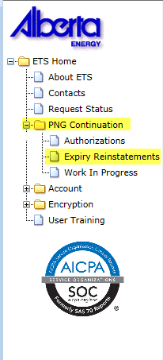

Expiry Reinstatement - Introduction
In this module, you will learn how to:
Create and submit an Online Expiry Reinstatement request
Cancel or withdraw an Online Expiry Reinstatement request
View response document(s)
Course Pre-requisites:
Training System Overview
ETS Account Setup and Preferences (For Site Administrators)
You must have the Creator role to create or withdraw a request and the Submitter role to submit a request.

Slide 4
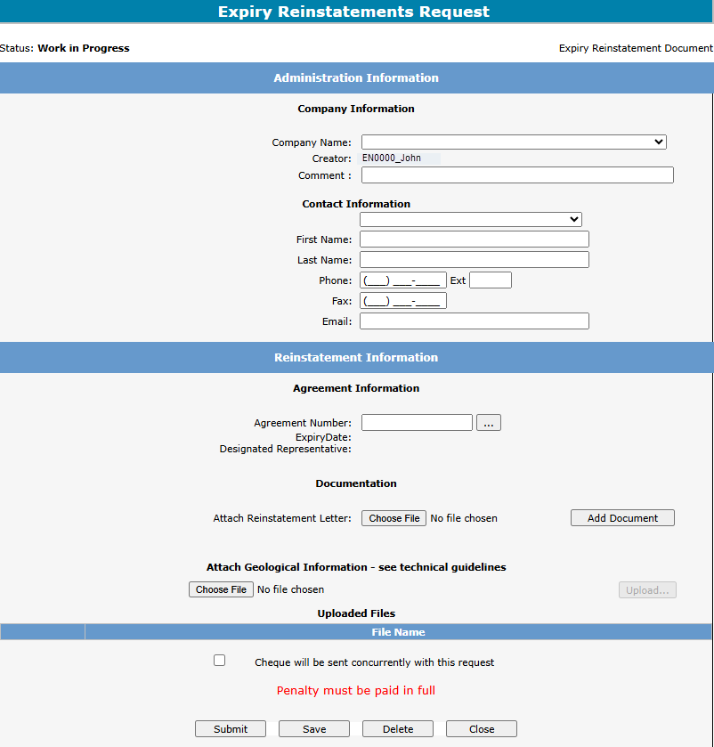
Create – Expiry Reinstatement
Select the Expiry Reinstatements node under PNG Continuation. Complete the Company Information, then under the Agreement Information select the dotted box to enter your agreement number.
1. Complete Company and Contact Information
2. Select for Agreement Number

Slide 5
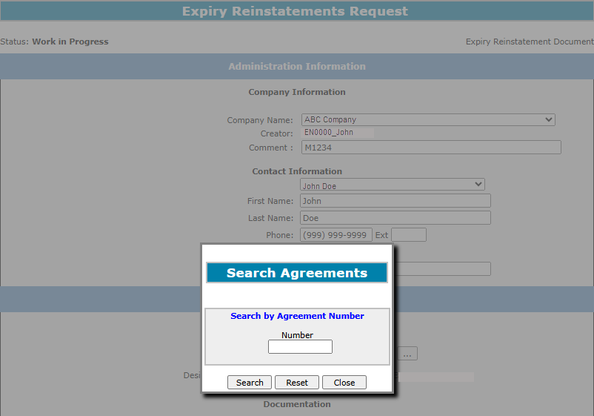
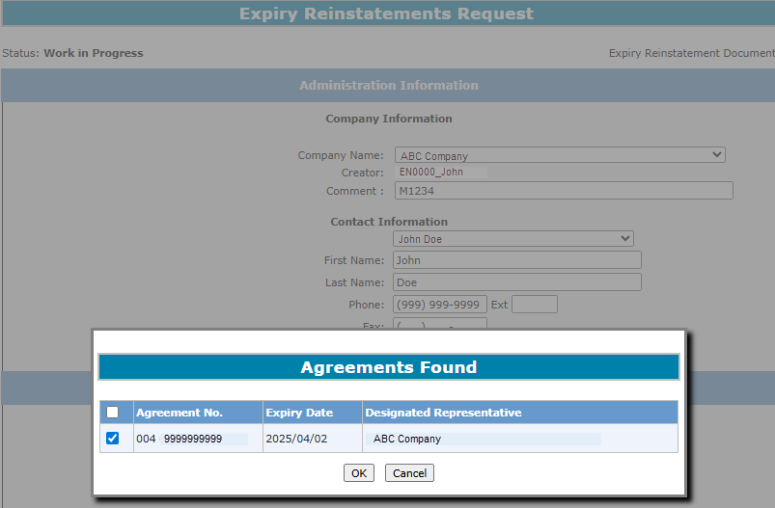
Type in the PNG Agreement Number in the Search Agreements screen, select Search. The Agreements Found screen will populate the Agreement Number. Select the Agreements Found number Check Box, then select OK.
2. Check Box
1. Enter Agreement Number
3. Select OK

Slide 6
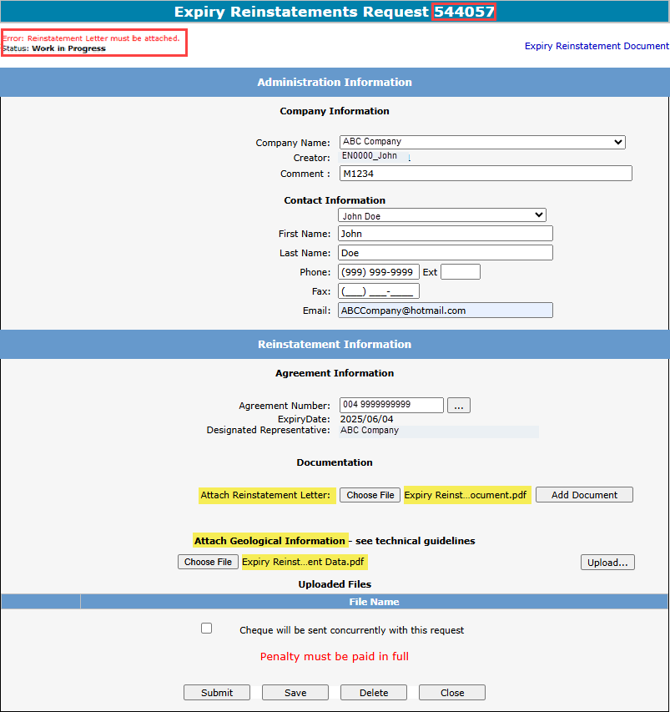

After selecting Ok you will be taken back to the Expiry Reinstatement - Administration Information screen. The screen status will be updated to Work in Progress with a ETS Reference Number. Select the Choose File button to attach your Reinstatement Letter, which outlines your rational for requesting a reinstatement. Then select Add Document, to upload your document. If you have geological data to support your Reinstatement Letter, you may attach it using the Choose File button under the Attach Geological Information section and selecting Upload.
1. Select Choose File
2. Select Add Document
3. Select Choose File
4. Select Upload
Ensure you select Add Document, or you will receive the Error above: “Reinstatement Letter must be attached”.

Slide 7
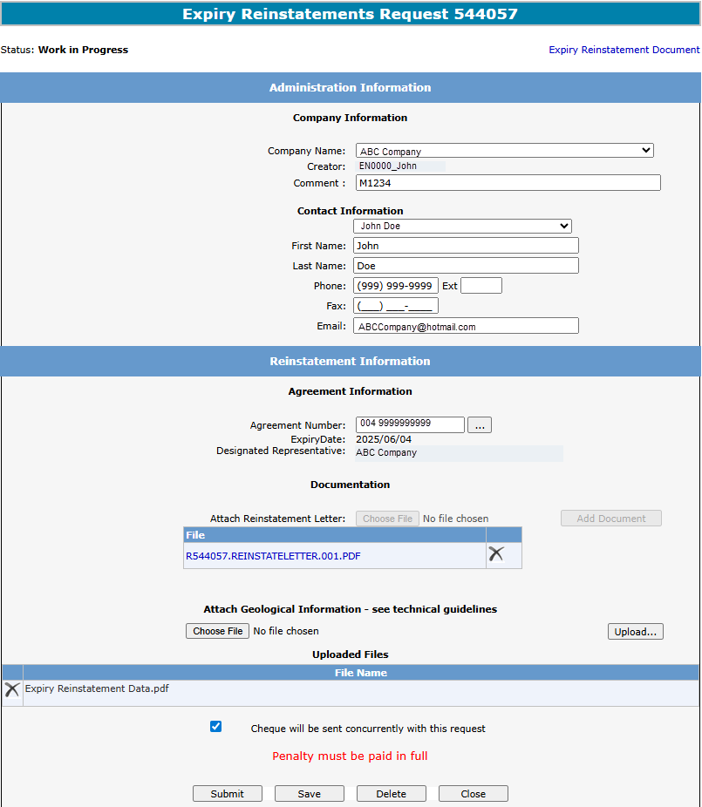
You must check off Cheque will be sent concurrently with this request. If this is not checked, you will not be able to submit your request. Select Save and then Submit.
1. Select Cheque will be sent concurrently with request
2. Select Save
3. Select Submit

Slide 8
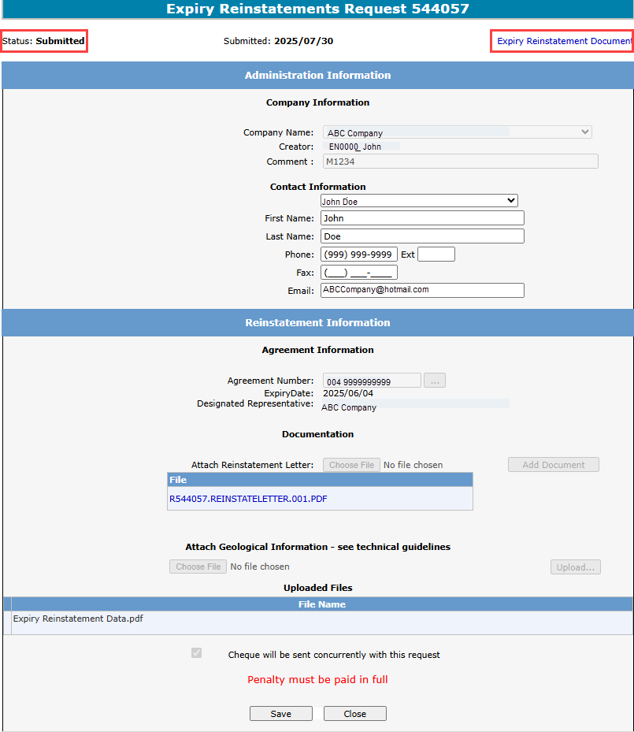

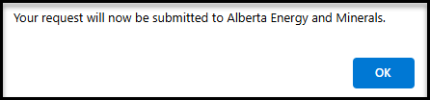
A Message Box will populate stating are you sure you want to Submit Request. Select Ok. Another Message Box will appear stating Your request will now be submitted to Alberta Energy and Minerals. Select Ok. Your Expiry Reinstatement Request status will now be Submitted.
1. Select OK
2. Select OK
Please note: If you wish to print out or save an electronic copy of your request, please select the “Expiry Reinstatement Document” on the top right hand of the screen.

Slide 9
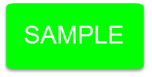
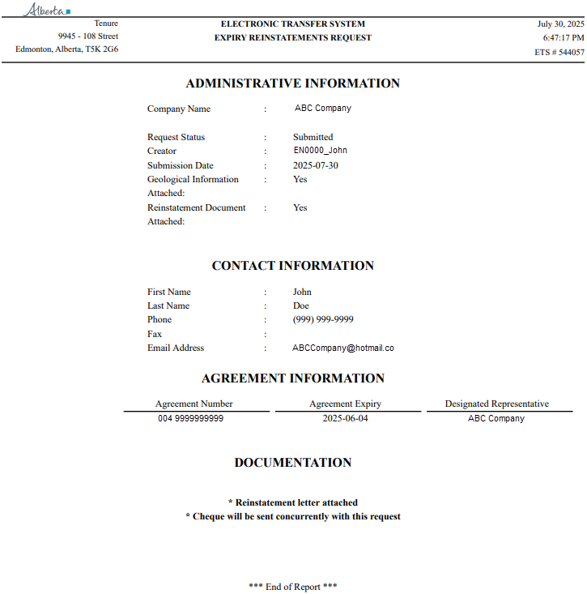
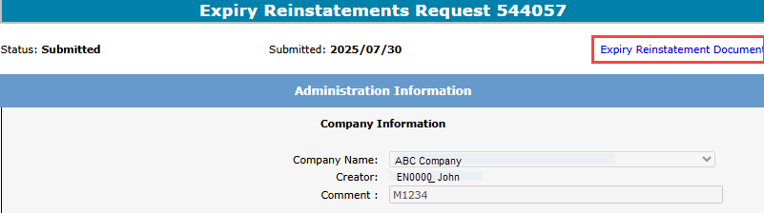
By selecting Expiry Reinstatement Document on the Administration Information screen, the following PDF document will populate for your records.

Slide 10
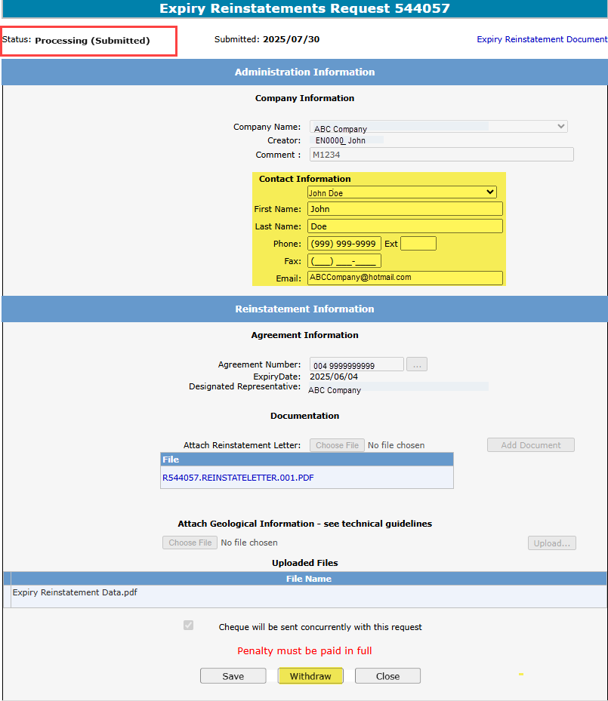
Once ETS verifies your request, the Status will change to Processing (Submitted). At this point you can only edit the contact information or withdraw the request
1. The Contact Information can be edited.
2. To withdraw the request, click on the Withdraw button.

Slide 11
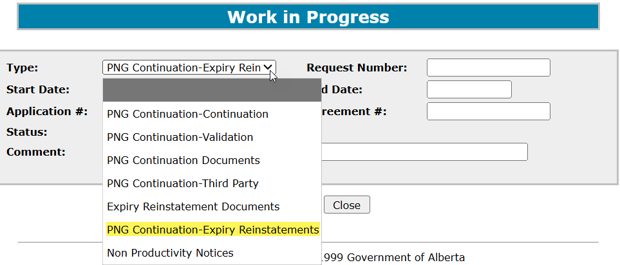
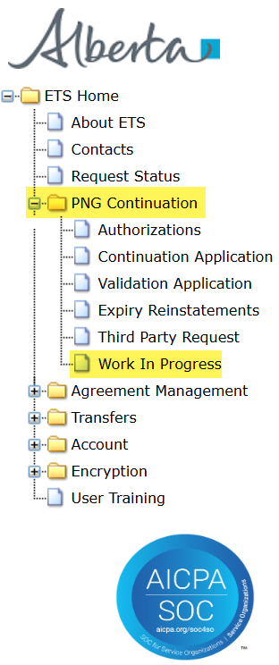
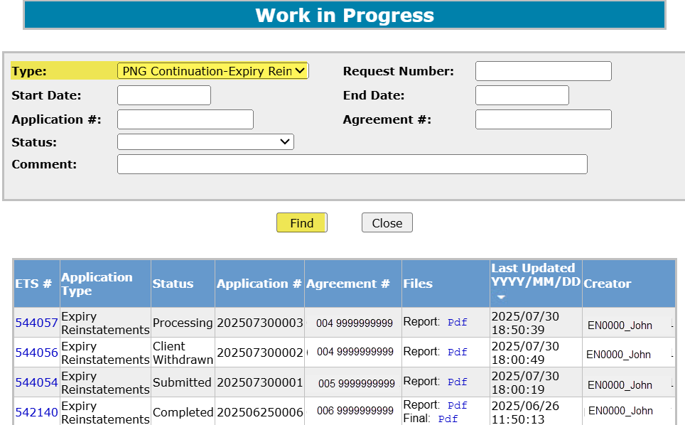
Work in Progress
Click on the Work in Progress page and new screen will populate. Using the dropdown list, enter the application Type, PNG Continuation-Expiry Reinstatements, and then select Find. The reinstatements currently in ETS will generate. By changing the parameters on the Work in Progress screen, varying results will populate. You can also search by the Request Number.
2. Application Type
1. Work In Progress page
3. Select Find

Slide 12
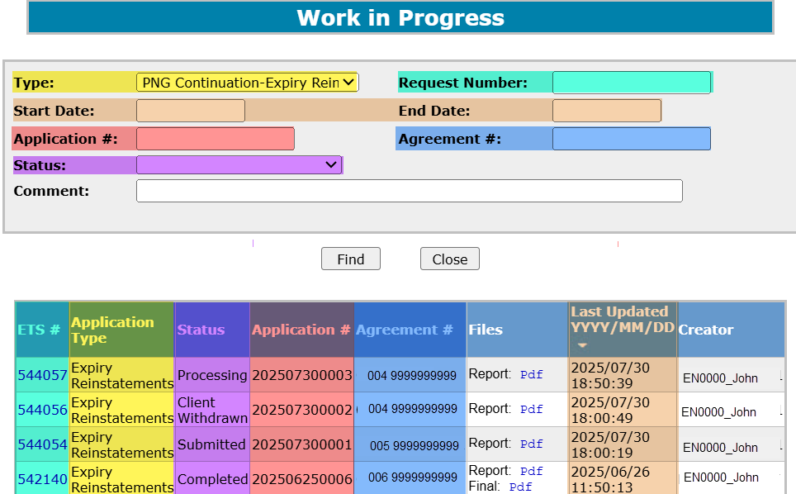
Request Status – Search Parameters and Result
Parameter Field | Result Column
Type | Application Type
Request Number | ETS #
Start/End Date | Last Updated
Application | Application #
Agreement # | Agreement#
Status | Status
Comment | (not shown as a result column)
You can utilize the search parameter fields to filter search results.
The table on the right shows the correlation between the parameter fields and each corresponding result column.
Below is a color-highlighted illustration of the Work in Progress search screen to further demonstrate the relationship between the data.

Slide 13
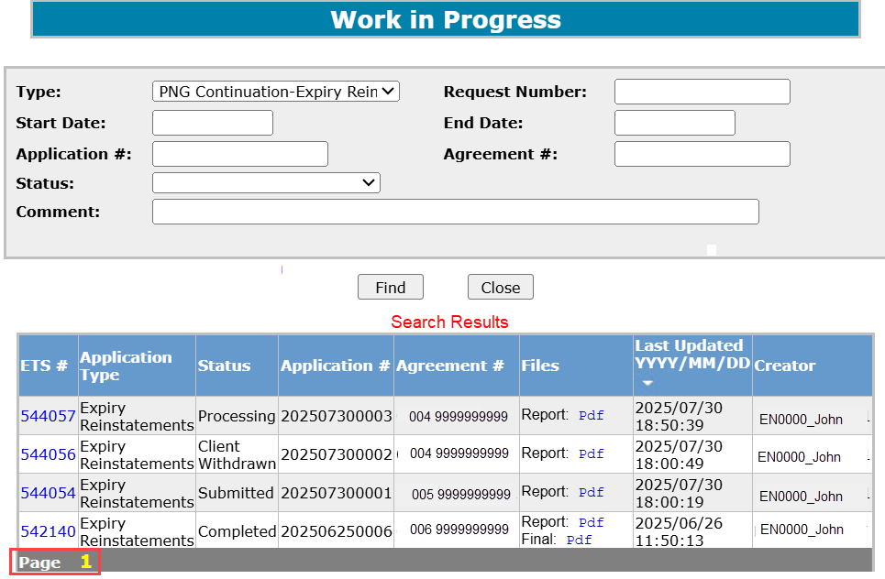
Request Status – Search Result
To load a request, click on the ETS Request number link.
To open a document click on the report Pdf link.
Navigate with this page number, if there are multiple pages of search results.

Slide 14
Reinstatement Completed
If a decision is received by ETS, the request status becomes Completed.
An email may be sent from ETS informing your company’s contact that an offer is available for review and response. These email notifications are considered a courtesy and should not be relied on to track PNG Continuation requests in ETS.
When submitting a request through ETS, it is your responsibility to continually check your Work in Progress to determine if any decisions have been sent.

Slide 15
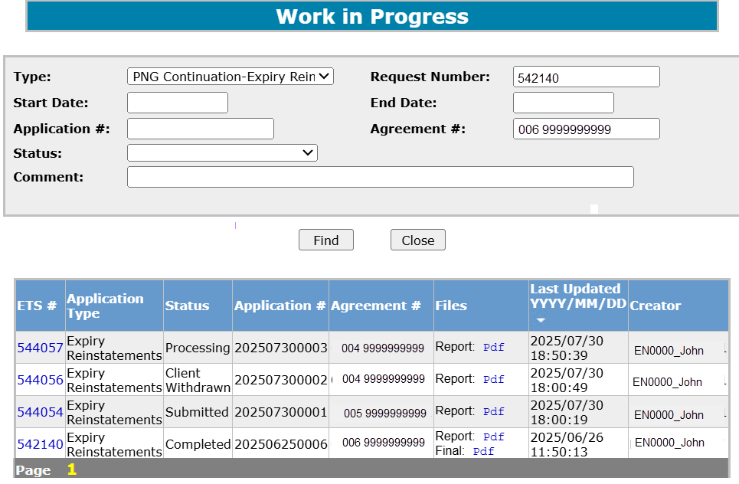
Click on the Work in Progress page under the PNG Continuation node. The Work In Progress screen will populate. Remove the Start and End Dates and select Find; all your Reinstatements currently in ETS will generate. You may also search your request using the Status field, Agreement Number or the Request Number provided with your original submission.
1. Select Find

Slide 16
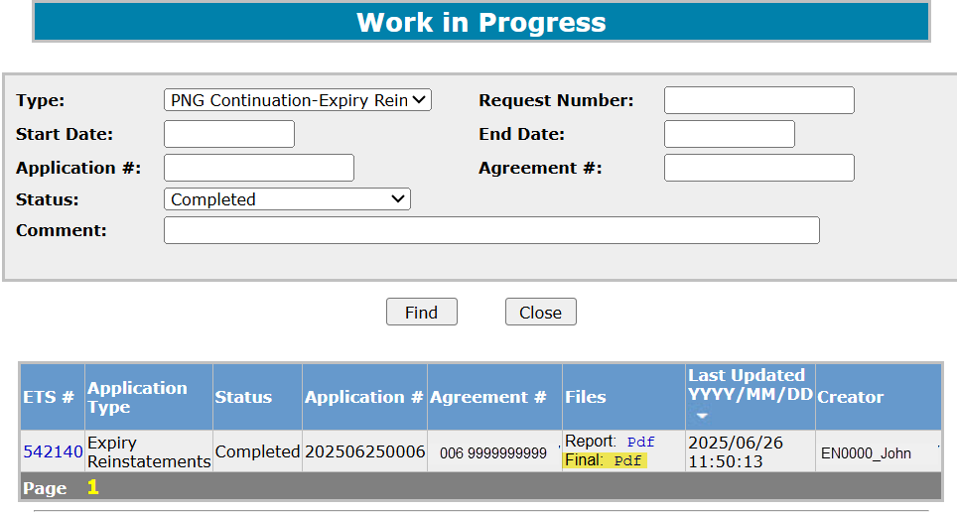
Rental Reinstatement Letter
Once you find your request, select the Final Pdf and the Reinstatement Letter will populate.
1. Select PFD

Slide 17
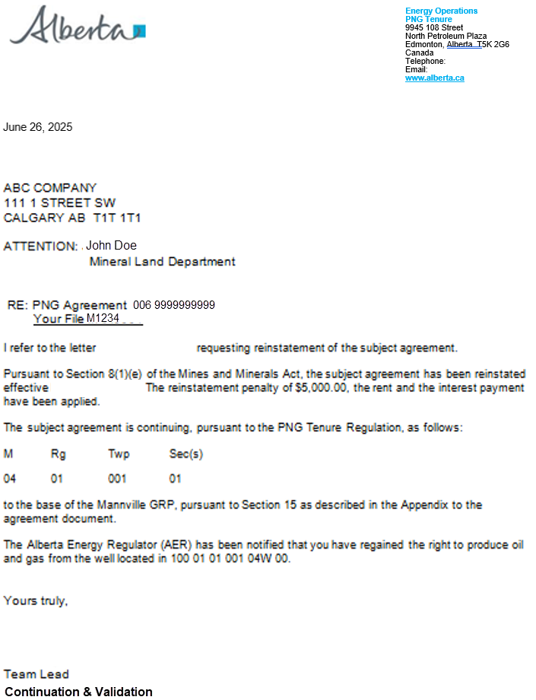
Expiry Reinstatement Letter

Slide 18
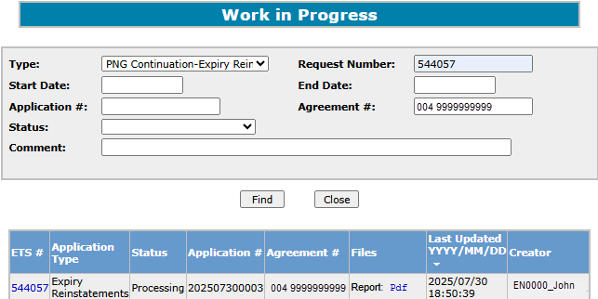
Expiry Reinstatement - Withdraw
To Withdraw your Expiry Reinstatement request, you will access the Work in Progress screen, select the PNG Continuation Expiry Reinstatement Type, enter in the Agreement Number or Request Number and click Find. The Status of the request will need to be Processing (Submitted) to withdraw your Expiry Reinstatement Request.
1. Select the Request Number

Slide 19
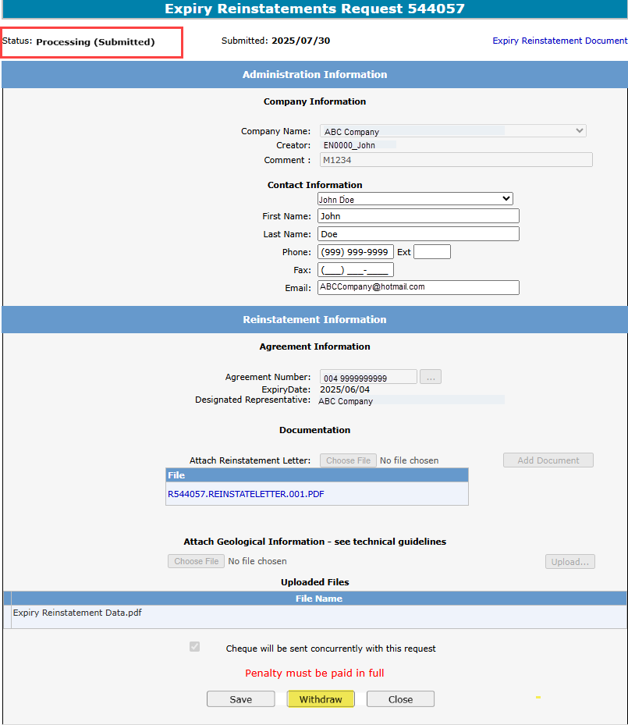
Expiry Reinstatement – Withdraw (continued)
The Administration Information screen will populate displaying the Company Information and the Agreement Information to reinstate. Click on the Withdraw button at the bottom of the screen.
2. Click Withdraw

Slide 20
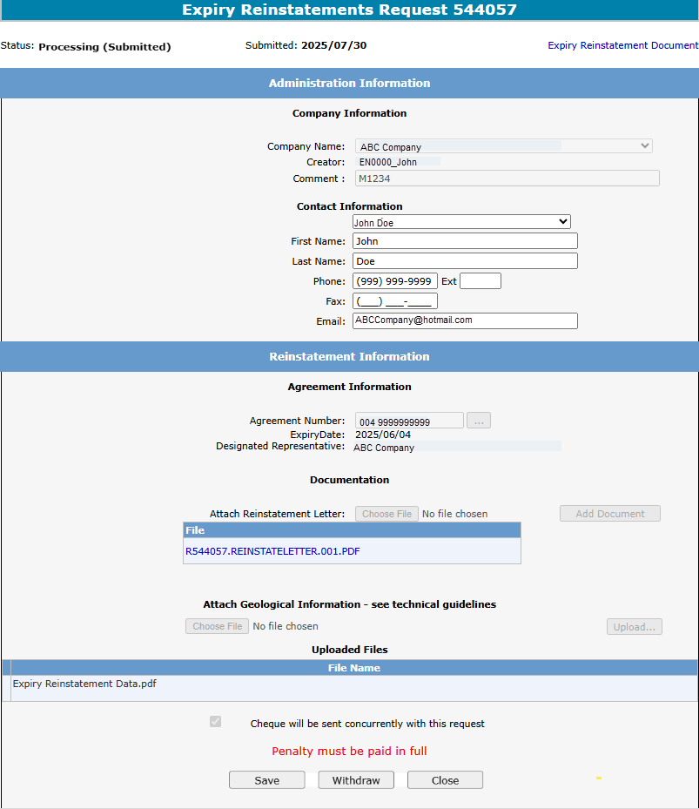
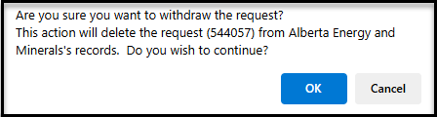
Expiry Reinstatement – Withdraw (continued)
A Message box will populate confirming the Withdrawal of your Expiry Reinstatement application. To proceed click the Ok button.
3. Click OK

Slide 21
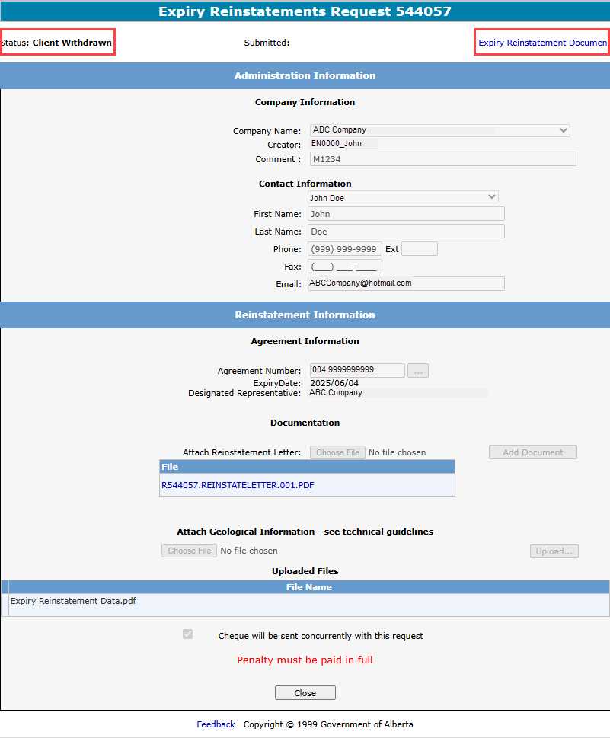

Expiry Reinstatement – Withdraw (continued)
Once you select Ok, the Administration Information screen will populate with the Status of Client Withdrawn. All information has been deleted from Alberta Energy & Mineral's records. Select Close, you will be taken back to Work In Progress.
Please note: By selecting the Reinstatement Document a PDF electronic version of your form will populate.
4. Select Close

Slide 22
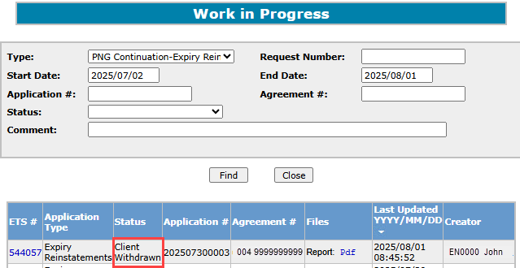
Expiry Reinstatement – Withdraw (continued)
The Work in Progress screen will confirm the Expiry Reinstatement has been Client Withdrawn.

Slide 23
Resources
ETS Support and Online Learning provides access to relevant guides, courses and other information.
If you have questions, please contact PNGContinuations.Energy@gov.ab.ca
or the PNG Tenure Help Line at (780) 644-2300.

Slide 24

Congratulations!
Congratulations!
You have completed the ETS – PNG Continuation: Expiry Reinstatement
Online Training Course
To access Courses, Guides and Forms for all your ETS Business please see ETS Support and Online Learning.
If you have any comments or questions on this training course,
please contact:
Crown Agreement Management
Helpdesk: (780) 644-2300
Email inquires: PNGContinuations.Energy@gov.ab.ca

