Slide 1
Crown Mineral Activity
Government of Alberta
Welcome!
to the
Crown Mineral Activity (CMA)
Work in Progress
Online Training Course
The Work In Progress functionality of CMA enables you to retrieve a request and view the request status.

Slide 2
Crown Mineral Activity
Government of Alberta
Revision Page
Revisions Table
Date | Revisions Type | Page Number
Sept 20, 2013 | Initial Creation | All
September 1, 2020 | Updated headers and contents | All
July 11, 2023 | Updated contents | 4,9,10

Slide 3
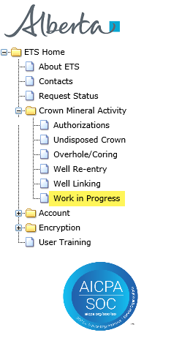
Crown Mineral Activity
Government of Alberta
INTRODUCTION
In this module, you will learn how to:
retrieve and view CMA requests
delete a request that is in Work in Progress status
Page 3 of 10

Slide 4
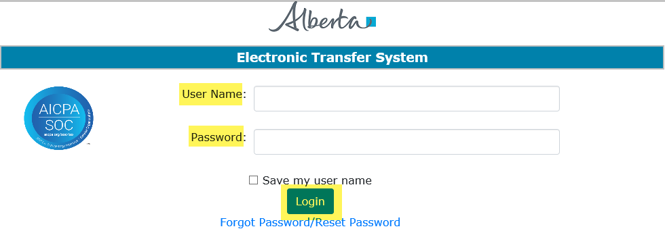

Crown Mineral Activity
Government of Alberta
LOGIN TO ETS
1. Login to ETS with your user name and password
The Work in Progress screen allows you to monitor the status and the updates made by Alberta Energy and Minerals (the department) to your requests.
When a CMA application is submitted, the status of the request changes from Work in Progress to Submitted.
When the department has started the processing of your request, the status changes to Processing until the request is Completed, Cancelled or Rejected.
All requests that are in Work in Progress will remain according to the user’s account preferences or for a maximum of 90 days. It is important to retrieve your document within those days; otherwise, the request is archived.
2. Expand Crown Mineral Activity
3. Select Work in Progress
Page 4 of 10

Slide 5
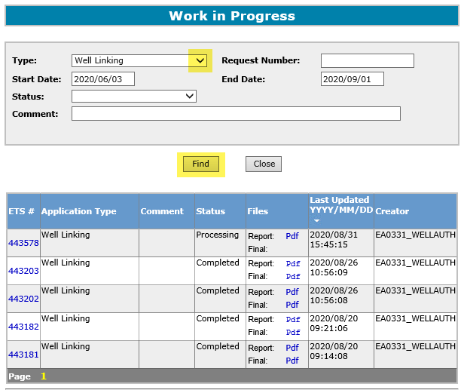

Crown Mineral Activity
Government of Alberta
WORK IN PROGRESS – RETRIEVE REQUESTS
1. Choose the request Type.
Click the drop down arrow. Enter other request parameters to narrow your search, if needed.
2. Click Find
Search results.
All parameters are searchable. The Start and End dates default depending on the range of days chosen in your Account Preferences. To see all available requests remove the Start Date.
Page 5 of 10

Slide 6
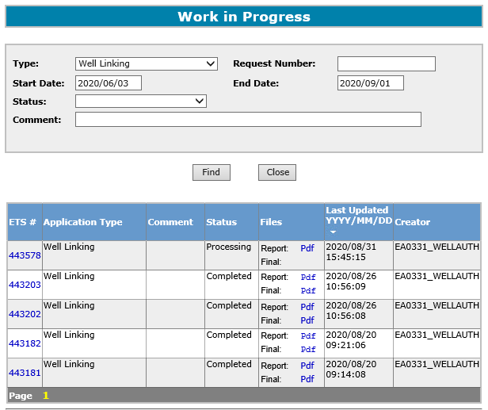
Crown Mineral Activity
Government of Alberta
WORK IN PROGRESS – VIEW REQUESTS
Select the Pdf link to see the details of your submitted request.
Search results.
You can print or save your request to your own system as it will be archived from the work in progress folder 90 days after the last update date.
Page 6 of 10

Slide 7
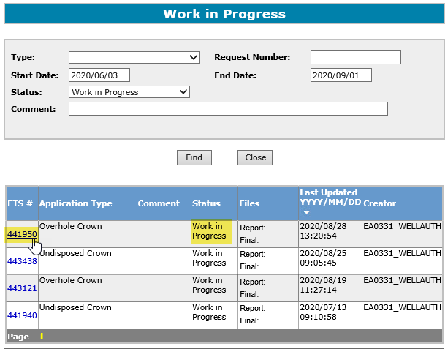
Crown Mineral Activity
Government of Alberta
WORK IN PROGRESS – DELETE REQUESTS
Click ETS #. Once you hover your mouse, the request number changes to hyperlink.
A request that is in Work in Progress status and no longer required or was entered in error, can be deleted.
After a successful search, select the ETS Request Number to delete.
Page 7 of 10

Slide 8
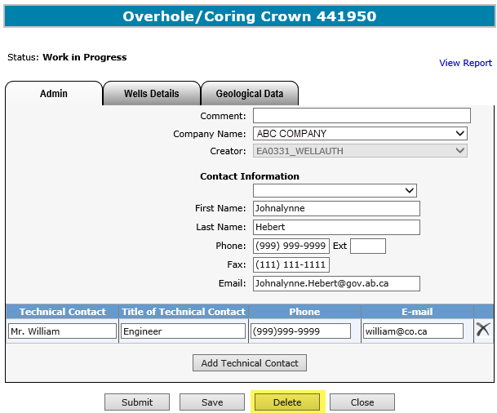
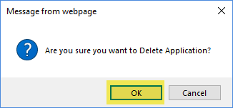

Crown Mineral Activity
Government of Alberta
WORK IN PROGRESS – DELETE REQUESTS Continued
2. Click OK.
1. Click Delete.
Selecting Delete will change the status of the request to Client Cancelled and no other action can be performed on this request.
Page 8 of 10

Slide 9
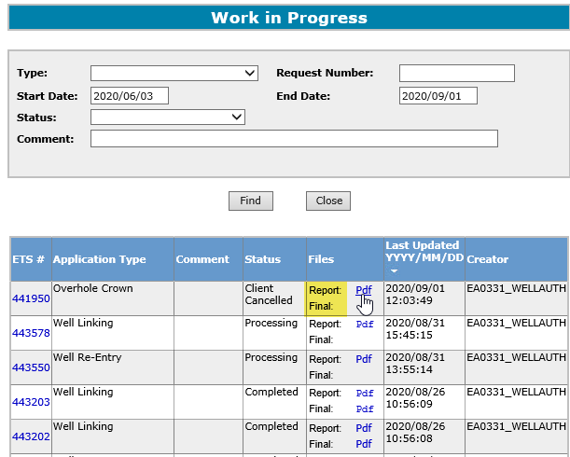
Crown Mineral Activity
Government of Alberta
WORK IN PROGRESS – SEARCH RESULTS
The information on the screen can be re-sorted by clicking on the column headers. If the cursor changes to a hand when you move over a column heading you can re-sort the column.
For each request, there will be two PDF documents available in the Files column:
Report and Final.
Report Pdf is the application request you are submitting to the department.
Final Pdf – is the Final letter in .PDF format uploaded from the department.
The request will remain at Processing until the Final Letter has been received from the department. Then, the Status changes to Complete.
Page 9 of 10

Slide 10

Crown Mineral Activity
Government of Alberta
CONCLUSION
Congratulations!
You have completed the Crown Mineral Activity
Work in Progress
Online Training Course
Please proceed to the subsequent modules detailing other functionality of the CMA.
If you have any comments or questions on this training course,
please forward them to the following email address:
Energy.CrownAuthorizations@gov.ab.ca
Page 10 of 10

