Slide 1
Crown Mineral Activity
Government of Alberta
Welcome!
to the
Crown Mineral Activity (CMA)
Well Re-Entry
Online Training Course
This module describes the process for initiating a CMA application for Well Re-Entry.
An Authorization Request may be required, if the applicant is not the designated representative of the Crown agreement or the well licensee.

Slide 2
Crown Mineral Activity
Government of Alberta
Revision Page
Revisions Table
Date | Revisions Type | Page Number
Sept 20, 2013 | Initial Creation | All
August 31, 2020 | Updated headers and contents | All
July 11, 2023 | Updated email | 12

Slide 3
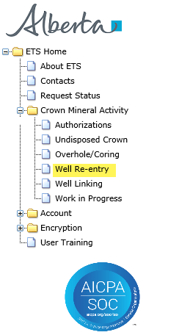
Crown Mineral Activity
Government of Alberta
INTRODUCTION
In this module, you will learn how to:
complete the Admin tab
complete the Wells Details tab
submit the Well Re-entry application form
Page 3 of 12

Slide 4
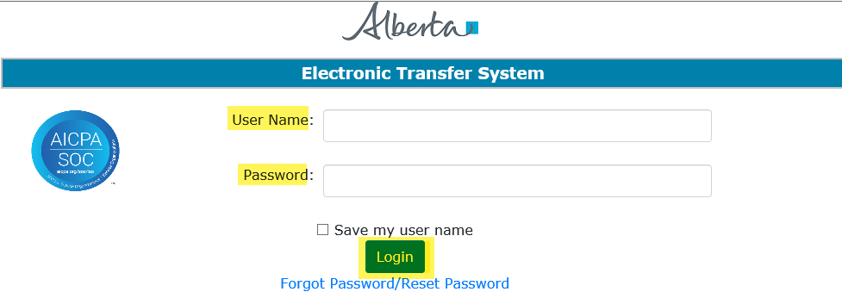
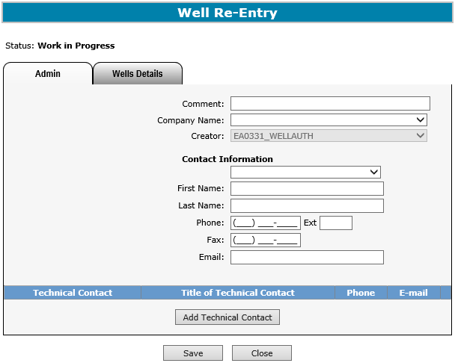
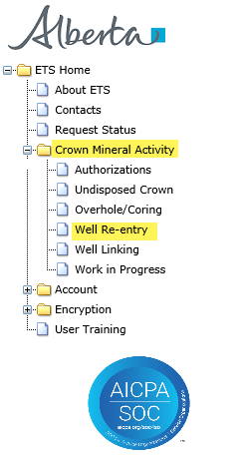
Crown Mineral Activity
Government of Alberta
LOGIN TO ETS
1. Login to ETS with your user name and password
2. Expand Crown Mineral Activity
3. Select Well Re-entry
Page 4 of 12

Slide 5
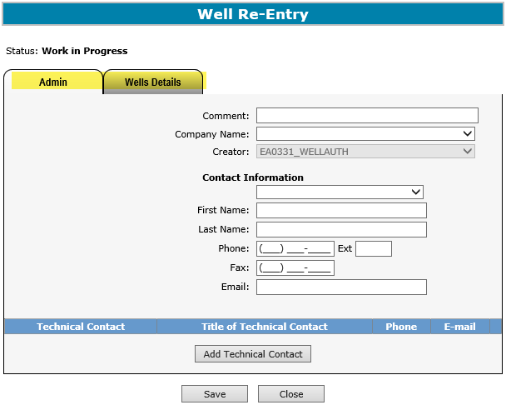
Crown Mineral Activity
Government of Alberta
WELL RE-ENTRY – SCREEN TABS
Admin – this tab contains Contact Information and Technical Contact, if needed.
Well Details – this tab displays the Well ID, Agreement, Formations, Terminating Location, and other Well Information for this CMA Type.
Page 5 of 12

Slide 6
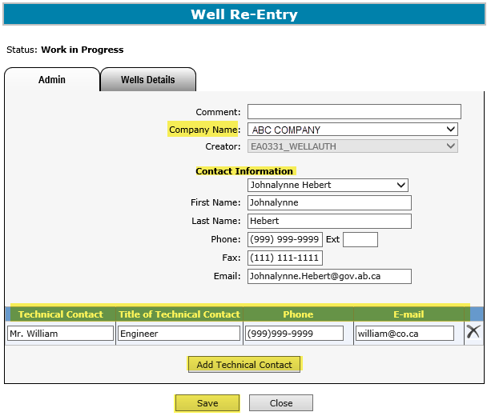
Crown Mineral Activity
Government of Alberta
WELL RE-ENTRY – ADMIN TAB
1. Select Company Name
2. Enter Contact Information
3. Enter Technical Contact Information if available
4. If adding more than one contact, click Add Technical Contact
5. Click Save
Page 6 of 12

Slide 7
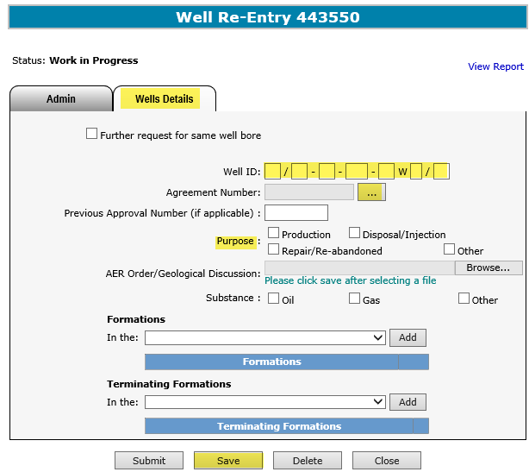
Crown Mineral Activity
Government of Alberta
WELL RE-ENTRY - WELLS DETAILS TAB (WELL ID, AGREEMENT NUMBER, PURPOSE)
1. Click on check box, if required
2. Enter Well ID
3. Click on the find button ( ) to search for a Crown agreement
4. At least one Purpose must be selected
3. Click Save
Page 7 of 12

Slide 8
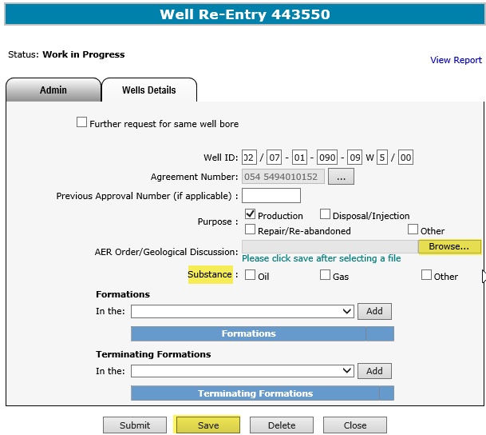

Crown Mineral Activity
Government of Alberta
WELL RE-ENTRY – WELLS DETAILS TAB (ATTACH .PDF FILE)
1. Enter Previous Approval Number, if applicable
2. Browse and select a PDF File.
4. At least one Substance must be selected
3. Click Save
An AER Order is mandatory, if the purpose of Repair/Re-abandoned is selected.
A Letter of Explanation is required when an existing approval is due to expire or has expired.
Browse and select from your directory to attach a .PDF file under AER Order/Geological Discussion.
Please click Save after attaching a .PDF file.
Page 8 of 12

Slide 9
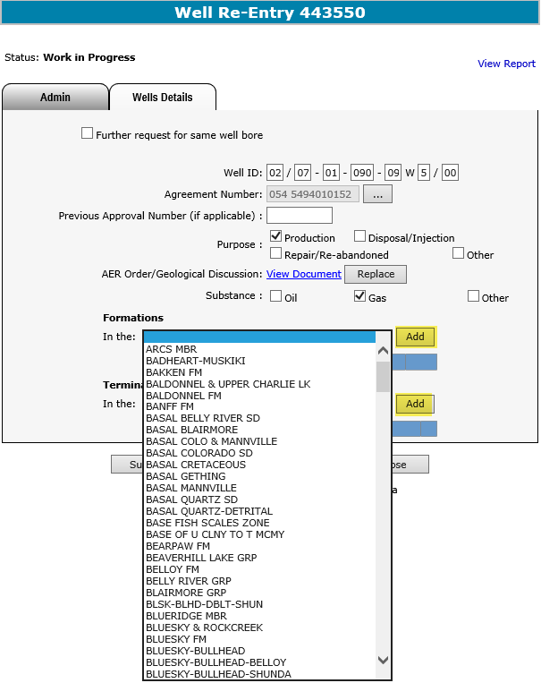

Crown Mineral Activity
Government of Alberta
WELL RE-ENTRY – WELLS DETAILS TAB (FORMATIONS)
1. Click on the Formation dropdown to select an option
2. Click Add
3. Select and Add a Terminating Formation from the dropdown
4. Click Save
The Terminating Formation must be selected, if different from the
(or In that) Formation.
Page 9 of 12

Slide 10
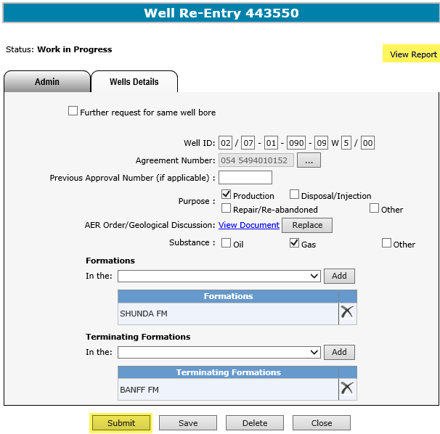
Crown Mineral Activity
Government of Alberta
WELL RE-ENTRY – SUBMIT
Click Submit
Click on the View Report link to review the details of this application.
Page 10 of 12

Slide 11
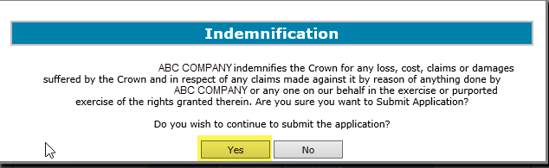
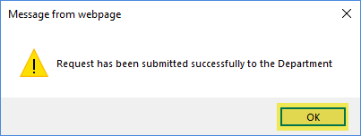
Crown Mineral Activity
Government of Alberta
WELL RE-ENTRY – SUBMIT
Click Yes
Click OK
Refer to the Work In Progress module for more information on the status of a submitted application request.
Page 11 of 12

Slide 12

Crown Mineral Activity
Government of Alberta
CONCLUSION
Congratulations!
You have completed the Crown Mineral Activity
Well Re-Entry
Online Training Course
Please proceed to the subsequent modules detailing other functionality of the CMA.
If you have any comments or questions on this training course,
please forward them to the following email address:
Energy.CrownAuthorizations@gov.ab.ca
Page 12 of 12

