Slide 1
Crown Mineral Activity
Government of Alberta
Welcome!
to the
Crown Mineral Activity (CMA)
Well Linking
Online Training Course
This module describes the process for initiating a CMA request for a Well Linking.
An Authorization Request may be required, if the applicant is not the designated representative of the Crown agreement or the well licensee.

Slide 2
Crown Mineral Activity
Government of Alberta
Revision Page
Revisions Table
Date | Revisions Type | Page Number
Sept 20, 2013 | Initial Creation | All
August 31, 2020 | Updated headers and contents | All
July 11, 2023 | Updated email | 9

Slide 3
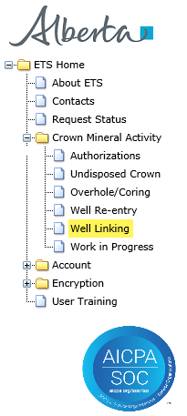
Crown Mineral Activity
Government of Alberta
INTRODUCTION
In this module, you will learn how to:
complete the Admin tab
complete the Wells Details tab
submit the Well Linking application form
Page 3 of 9

Slide 4
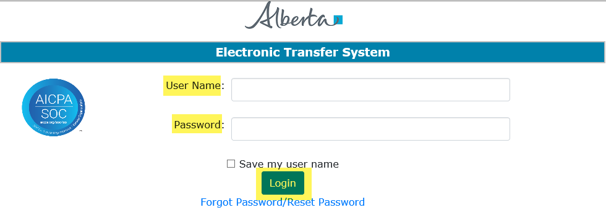
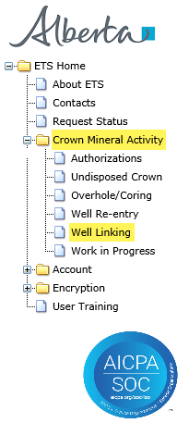
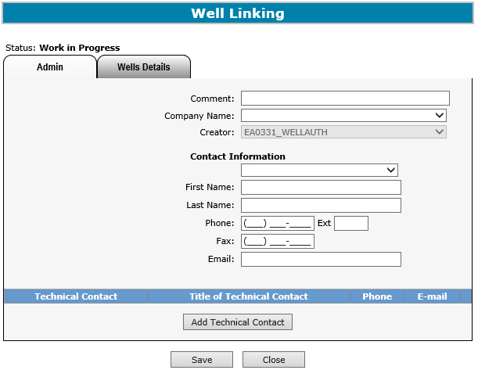
Crown Mineral Activity
Government of Alberta
LOGIN TO ETS
1. Login to ETS with your user name and password
2. Expand Crown Mineral Activity
3. Select Well Linking
Page 4 of 9

Slide 5
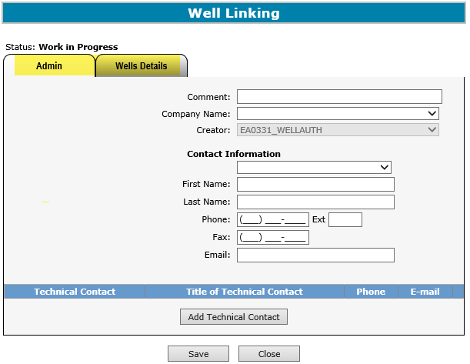
Crown Mineral Activity
Government of Alberta
WELL LINKING – SCREEN TABS
Admin – this tab contains Contact Information and Technical Contact, if needed.
Well Details – this tab displays the Well ID, Agreement, Formations, Terminating Location, and other Well Information for this CMA Type.
Page 5 of 9

Slide 6
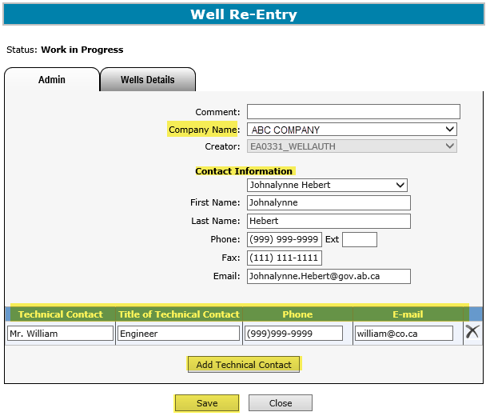
Crown Mineral Activity
Government of Alberta
WELL LINKING – ADMIN TAB
1. Select Company Name
2. Enter Contact Information
3. Enter Technical Contact, if available
4. If adding more than one contact, click Add Technical Contact
5. Click Save
Page 6 of 9

Slide 7
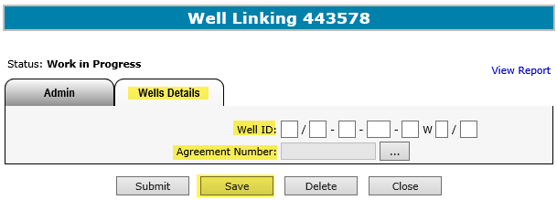
Crown Mineral Activity
Government of Alberta
WELL LINKING – WELLS DETAILS TAB
1. Enter Well ID
1. Click on the find button ( ) to search for a Crown agreement
Click Save, then Submit
Page 7 of 9

Slide 8
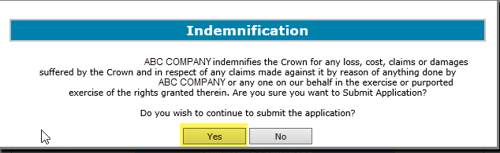
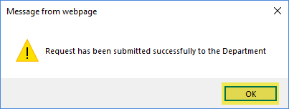

Crown Mineral Activity
Government of Alberta
WELL LINKING – SUBMIT
Click Yes
Click OK
Refer to the Work In Progress module for more information on the status of a submitted application request.
Page 8 of 9

Slide 9

Crown Mineral Activity
Government of Alberta
CONCLUSION
Congratulations!
You have completed the Crown Mineral Activity
Well Linking
Online Training Course
Please proceed to the subsequent modules detailing other functionality of the CMA.
If you have any comments or questions on this training course,
please forward them to the following email address:
Energy.CrownAuthorizations@gov.ab.ca
Page 9 of 9

