Slide 1
Crown Mineral Activity
Government of Alberta
Welcome!
to the
Crown Mineral Activity (CMA)
Overhole/Coring
Online Training Course
This module describes the process for initiating a CMA application for Overhole/Coring.

Slide 2
Crown Mineral Activity
Government of Alberta
Revision Page
Revisions Table
Date | Revisions Type | Page Number
Sept 20, 2013 | Initial Creation | All
December 17, 2018 | Updated | 10 and 11
August 28, 2020 | Updated headers and contents | All
July 11, 2023 | Updated email | 13
July 4, 2025 | Updated content | All

Slide 3
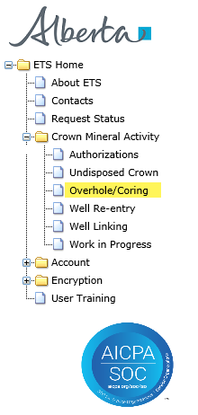
Crown Mineral Activity
Government of Alberta
INTRODUCTION
In this module, you will learn how to:
complete the Admin tab
complete the Wells Details tab
complete the Geological Data tab
submit the Well Overhole/Coring application form
Page 3 of 13

Slide 4
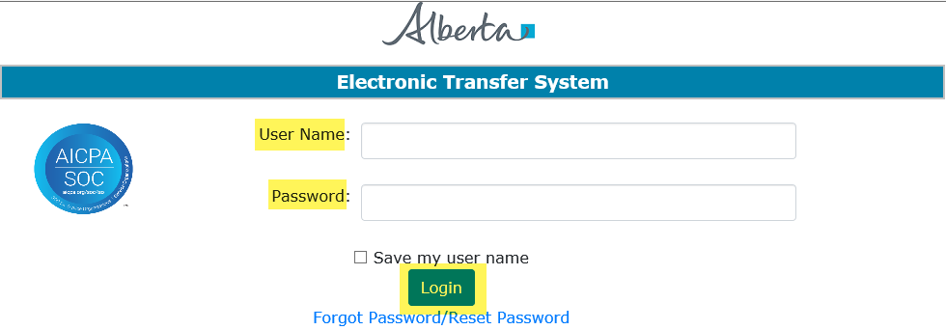
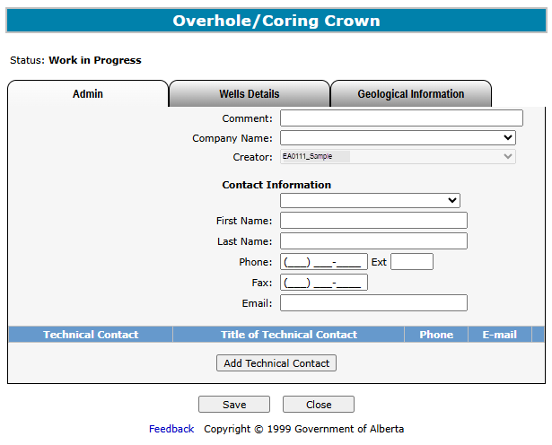
Crown Mineral Activity
Government of Alberta
LOGIN TO ETS
1. Login to ETS with your user name and password
2. Expand Crown Mineral Activity
3. Select Overhole/Coring
Page 4 of 13

Slide 5
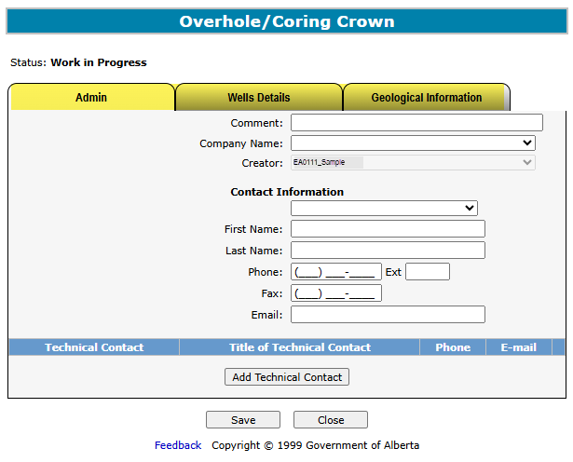
Crown Mineral Activity
Government of Alberta
OVERHOLE/CORING – SCREEN TABS
Admin – this tab contains Contact Information and Technical Contact, if needed.
Well Details – this tab displays the Well Type, Rights, Substance, Meterage, AER order, and Well Information for this CMA type.
Geological Information – this tab allows you to submit geological information for this form.
Page 5 of 13

Slide 6
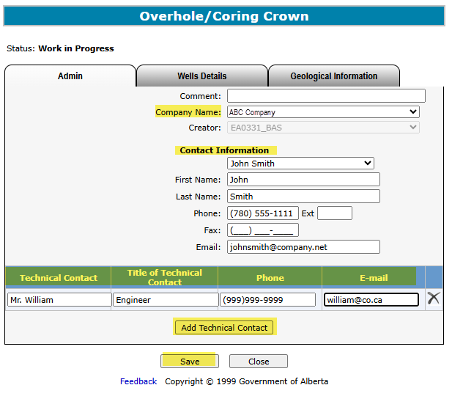
Crown Mineral Activity
Government of Alberta
OVERHOLE/CORING – ADMIN TAB
1. Select Company Name
2. Enter Contact Information
3. Enter Technical Contact Information, if available
4. If adding more than one contact, click Add Technical Contact
5. Click Save
Page 6 of 13

Slide 7
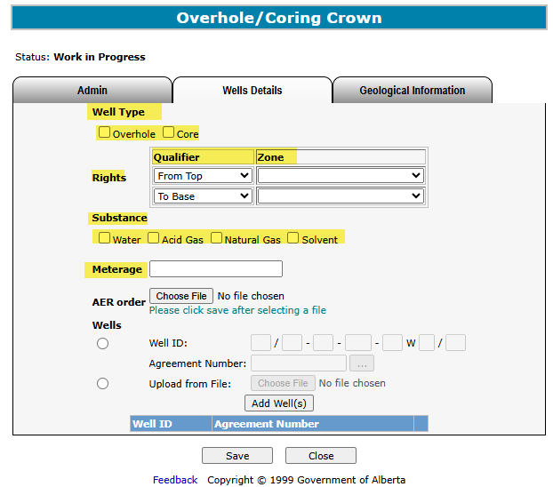

Crown Mineral Activity
Government of Alberta
OVERHOLE/CORING - WELLS DETAILS TAB (WELL TYPE, RIGHTS, SUBSTANCE, AND METERAGE)
1. Check the appropriate Well Type
2. Click on Qualifier and Zone dropdown to choose an option
3. Check the appropriate Substance
4. Enter the Meterage
Meterage is required if greater than 15 meters.
Page 7 of 13

Slide 8
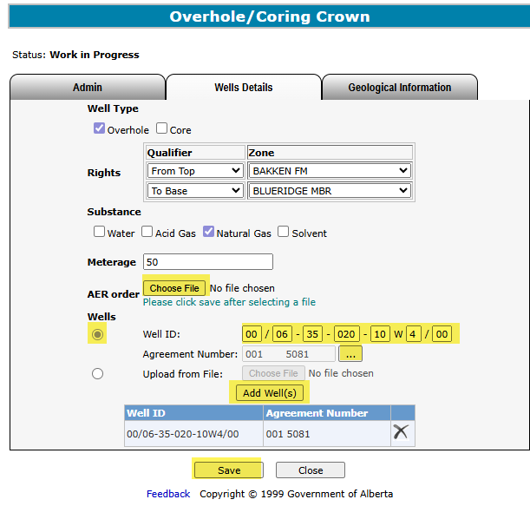
Crown Mineral Activity
Government of Alberta
OVERHOLE/CORING - WELLS DETAILS TAB (AER ORDER AND WELLS)
1. Choose File
An AER order is required. Browse and select from your directory to attach this document. Click Save.
2. Enter Unique Well Identifier
4. Click Add Well(s)
3. Click on the find button ( ) to search for a Crown agreement
5. Click Save
Page 8 of 13

Slide 9
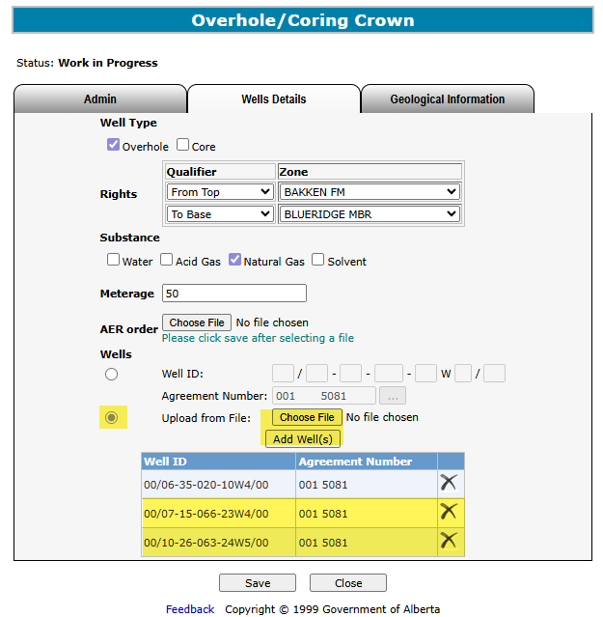

Crown Mineral Activity
Government of Alberta
OVERHOLE/CORING - WELLS DETAILS TAB (WELL ID – FILE UPLOAD FORMAT)
Alternatively, you can browse and upload a file in .CSV (Comma Separated Values) file format containing multiple well IDs and
Agreement numbers.
The CSV file must follow this format:
The file contains 2 columns and must be Save As and uploaded in a .CSV file extension.
First column is Well ID containing 20 characters including the “/” and “-”:
Well ID format is 00/00-00-000-00X0/00
Second column is Agreement Number containing maximum 10 characters: Well ID format is 0000000000
Sample file to upload:
1. Click Upload from File button
2. Click choose File to attach the .CSV file
Wells from the .CSV file are now added.
3. Click Add Well(s)
4. Click Save.
Page 9 of 13

Slide 10
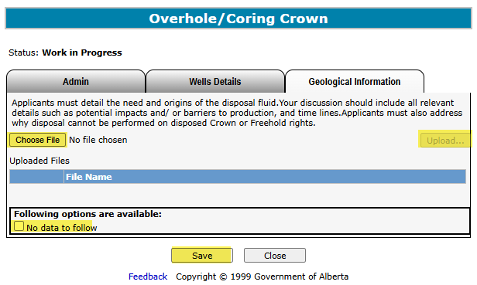
Crown Mineral Activity
Government of Alberta
OVERHOLE/CORING - GEOLOGICAL DATA TAB
1. Browse and upload document
2. Check
box
3. Click Save
A Geological Discussion document is required.
Browse and select from your directory to attach the document and save.
Please refer to Information Bulletin 2019-01 for application requirements.
Page 10 of 13

Slide 11
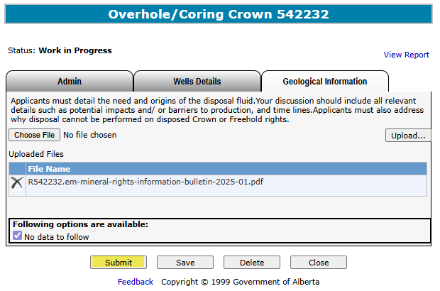

Crown Mineral Activity
Government of Alberta
OVERHOLE/CORING - SUBMIT
Click Submit
You may click on the View Report link to review the details of this CMA Application.
Page 11 of 13

Slide 12
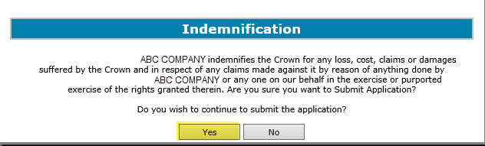
Crown Mineral Activity
Government of Alberta
OVERHOLE/CORING - INDEMNIFICATION
Click Yes
Refer to the Work In Progress module for more information on the status of a submitted application request.
Page 12 of 13

Slide 13

Crown Mineral Activity
Government of Alberta
CONCLUSION
Congratulations!
You have completed the
Crown Mineral Activity Overhole/Coring
Online Training Course
Please proceed to the subsequent modules detailing other functionality of the CMA.
If you have any comments or questions on this training course,
please forward them to the following email address:
Energy.CrownAuthorizations@gov.ab.ca
Page 13 of 13

