Slide 1
Crown Mineral Activity
Government of Alberta
Welcome!
to the
Crown Mineral Activity (CMA)
Authorization
Online Training Course
This process involves authorizing a company to act on behalf of the designated representative (Crown lessee or licensee) on a matter for a Crown petroleum and natural gas lease or licence (PNG agreement) or authorizing another company to use your company’s well for a tenure-related purpose relating to a PNG agreement.

Slide 2
Crown Mineral Activity
Government of Alberta
Revision Page
Revisions Table
Date | Revisions Type | Page Number
September 20, 2013 | Initial Creation | All
August 28, 2020 | Updated Header and Contents | All
July 11, 2023 | Updated email | 21

Slide 3
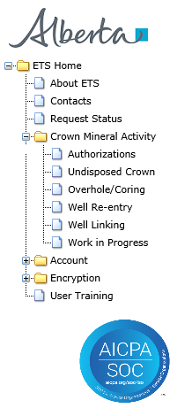
Crown Mineral Activity
Government of Alberta
INTRODUCTION
In this module, you will learn how to:
As the company submitting the request for Authorization:
Complete Well Re-entry or Well Linking Authorization Request
Check the status of your request
As the company authorizing the request:
concur
reject
revoke
Page 3 of 21

Slide 4
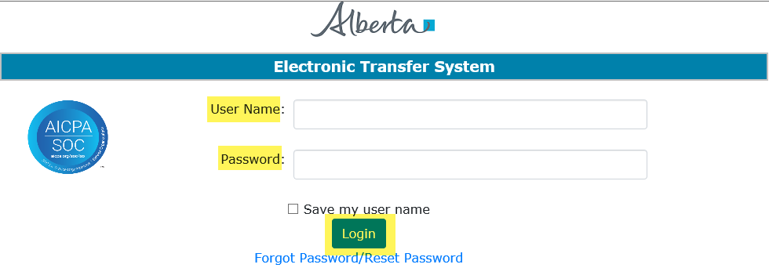
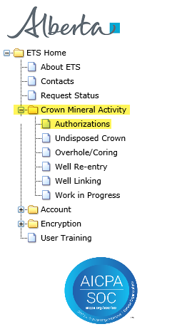
Crown Mineral Activity
Government of Alberta
LOGIN TO ETS
2. Expand Crown Mineral Activity
1. Login to ETS with your user name and password
3. Select Authorizations
Page 4 of 21

Slide 5
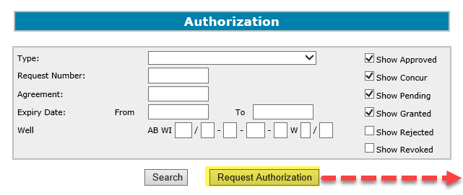
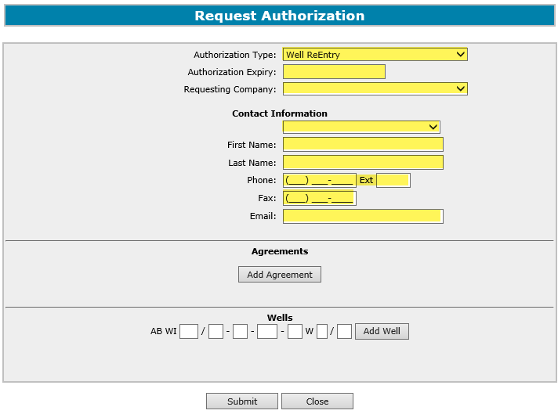

Crown Mineral Activity
Government of Alberta
REQUEST AUTHORIZATION
2. Select Authorization Type, Authorization Expiry and Requesting Company
1. Click Request Authorization
3. Enter Contact information. You may use the dropdown list for quick fill of the contact info, provided that the contact is in the dropdown list.
The Request Authorization processes for Well Re-Entry and Well Linking are the same.
Page 5 of 21

Slide 6
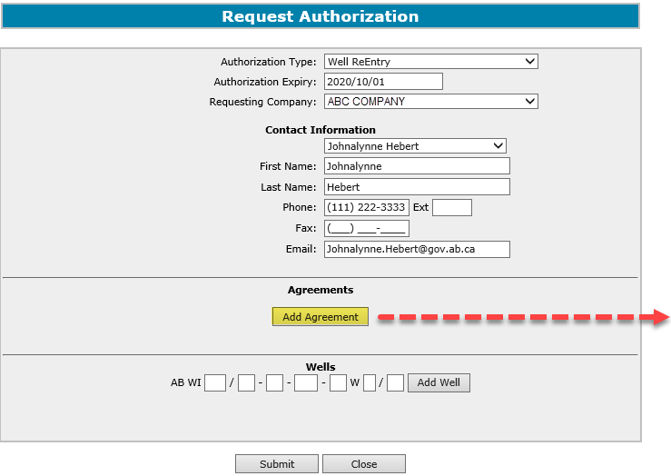
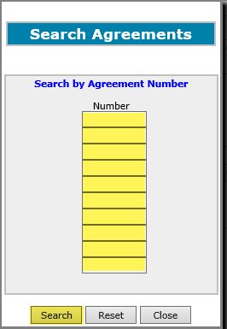
Crown Mineral Activity
Government of Alberta
REQUEST AUTHORIZATION – ADD AGREEMENT
1. Click Add Agreement, to add a Crown agreement
2. Enter Crown agreement number(s)
3. Click Search
Page 6 of 21

Slide 7
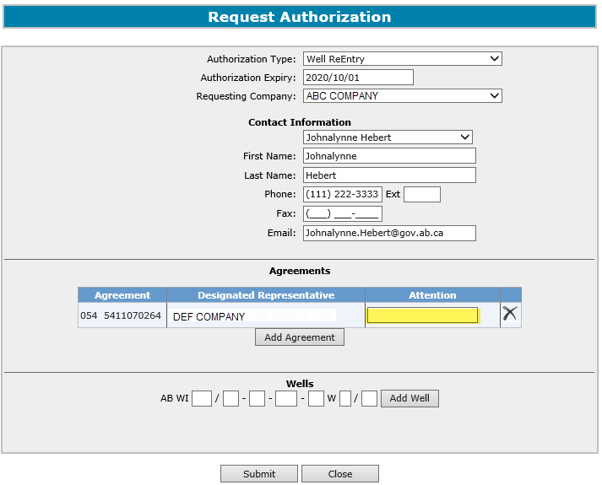
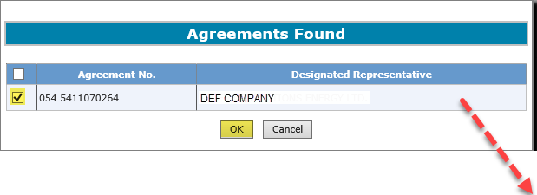
Crown Mineral Activity
Government of Alberta
REQUEST AUTHORIZATION – ADD AGREEMENT - Continued
1. Click check box
2. Click OK
3. Enter Attention Name for this Agreement, if available
Page 7 of 21

Slide 8
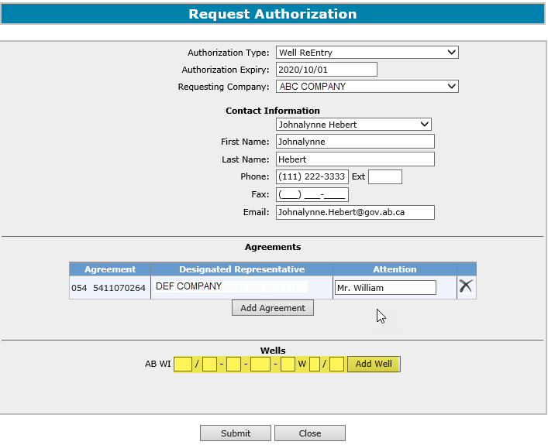
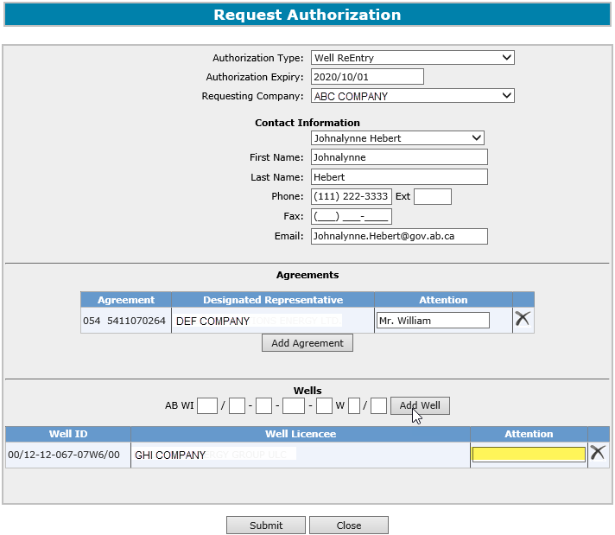
Crown Mineral Activity
Government of Alberta
REQUEST AUTHORIZATION – ADD WELL
1. Enter Well Information, then click Add Well
2. Enter Attention Name for the Well Licensee
Page 8 of 21

Slide 9
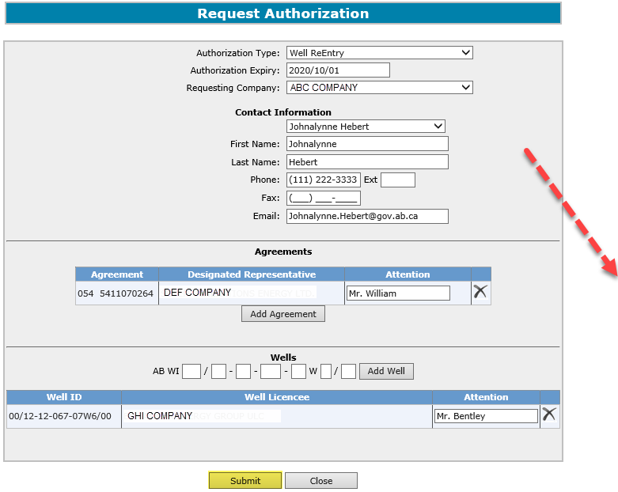
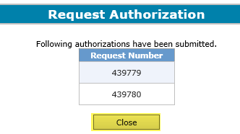
Crown Mineral Activity
Government of Alberta
REQUEST AUTHORIZATION - SUBMIT
If the Designated Representative and the Well Licensee are different, two separate requests will be submitted.
1. Click Submit
2. Click Close
Page 9 of 21

Slide 10
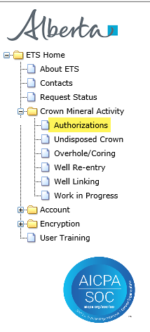
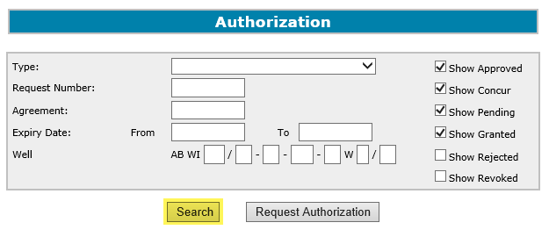
Crown Mineral Activity
Government of Alberta
REQUEST AUTHORIZATION – CHECK STATUS
1. Select Authorizations
2. Choose your search parameters
3. Click Search
Page 10 of 21

Slide 11
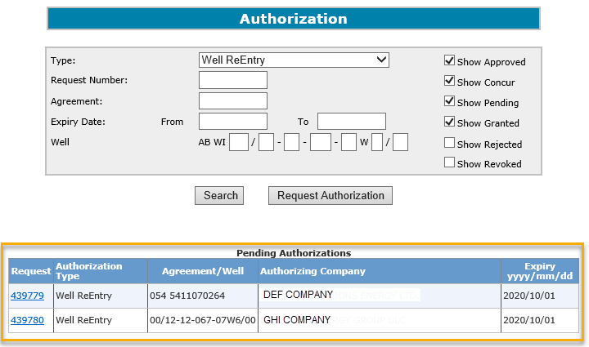
Crown Mineral Activity
Government of Alberta
REQUEST AUTHORIZATION - SEARCH RESULTS
Page 11 of 21

Slide 12
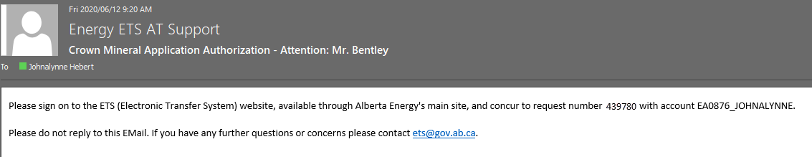
Crown Mineral Activity
Government of Alberta
REQUEST AUTHORIZATION – EMAIL NOTIFICATION SAMPLE
ETS sends an email notification advising the company that there is an authorization request(s) that is available for concurrence.
Page 12 of 21

Slide 13
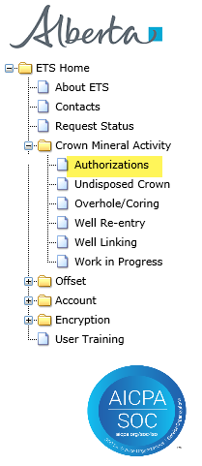
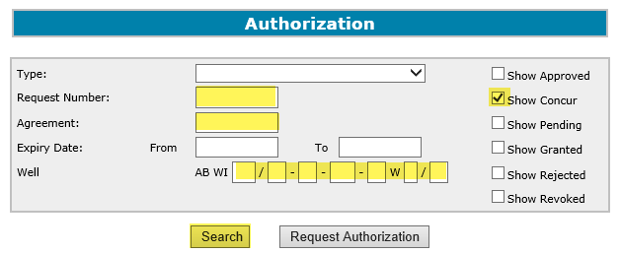

Crown Mineral Activity
Government of Alberta
REQUEST AUTHORIZATION - CONCUR
2. Select
Show Concur
1. Select Authorizations
3. Click Search
4. Click Concur
If the Request Number, Agreement or Well is known, input these data for a more specific search.
Page 13 of 21

Slide 14
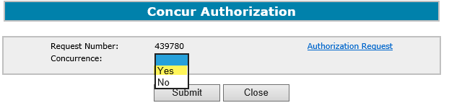
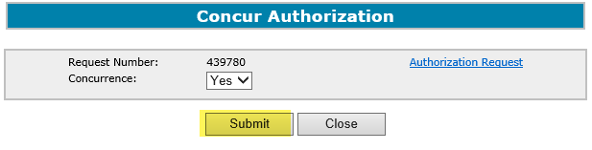
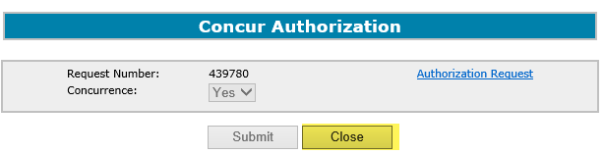
Crown Mineral Activity
Government of Alberta
REQUEST AUTHORIZATION – SUBMIT CONCURRENCE
1. Click the dropdown and select Yes
2. Click Submit
Upon submission of the acceptance, ETS will send an email advising that the concurrence has been completed.
3. Click Close
Page 14 of 21

Slide 15
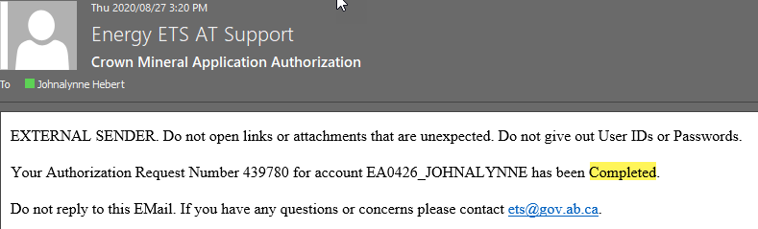
Crown Mineral Activity
Government of Alberta
REQUEST AUTHORIZATION – EMAIL NOTIFICATION SAMPLE FOR COMPLETED
Page 15 of 21

Slide 16
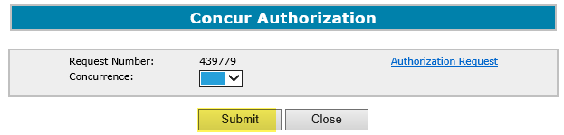
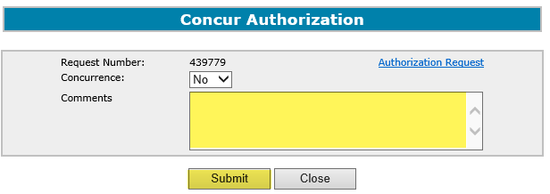
Crown Mineral Activity
Government of Alberta
REQUEST AUTHORIZATION - REJECT
Follow the same process as to Concur; however, select No in the Concurrence dropdown.
1. Click the dropdown and select No
2. Enter Comments for rejecting the authorization request
3. Click Submit
Upon submission of the rejection, ETS will send an email advising that the concurrence has been rejected.
Page 16 of 21

Slide 17
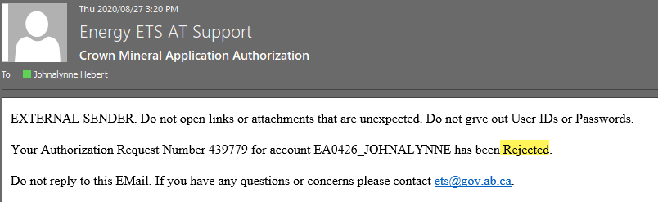
Crown Mineral Activity
Government of Alberta
REQUEST AUTHORIZATION – EMAIL NOTIFICATION SAMPLE FOR REJECTED
Page 17 of 21

Slide 18
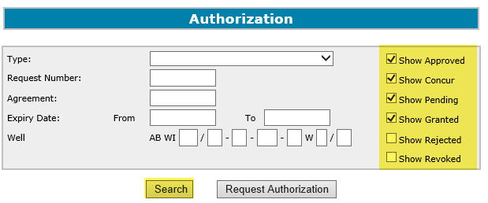
Crown Mineral Activity
Government of Alberta
REQUEST AUTHORIZATION – REVOKE PREVIOUSLY GRANTED AUTHORIZATION
2. Select your parameters. The following may be checked.
1. Select Authorizations
3. Click Search
Page 18 of 21

Slide 19

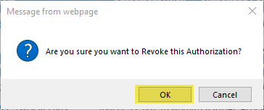
Crown Mineral Activity
Government of Alberta
REQUEST AUTHORIZATION – REVOKE CONTINUED
Search Result
1. Click Revoke
2. Click OK to Revoke.
Upon clicking on revoke, ETS will send an email advising of the authorization that has been revoked.
Page 19 of 21

Slide 20
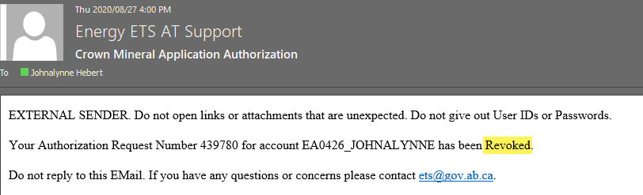
Crown Mineral Activity
Government of Alberta
REQUEST AUTHORIZATION – EMAIL NOTIFICATION SAMPLE FOR REVOKE
Page 20 of 21

Slide 21

Crown Mineral Activity
Government of Alberta
CONCLUSION
Congratulations!
You have completed the
Crown Mineral Activity
Authorizations
Online Training Course
Please proceed to the subsequent modules detailing other functionality of the CMA.
If you have any comments or questions on this training course,
please forward them to the following email address:
Energy.CrownAuthorizations@gov.ab.ca
Page 21 of 21

