Slide 1
Unit Agreement Exhibit A
Government of Alberta
Welcome!
to the
ETS – Unit Agreement Exhibit A
Change of Unit Operatorship
Online Training Course
The purpose of this course is to provide guidance and information to ETS clients who require a
Change of Unit Operatorship.

Slide 2
Unit Agreement Exhibit A
Government of Alberta
Revision Page
Revisions Table
Date | Revisions Type | Page Number
March 7, 2016 | Initial Creation | All
October 13, 2020 | Update headers and contents | All
July 10, 2023 | Update content | 8

Slide 3
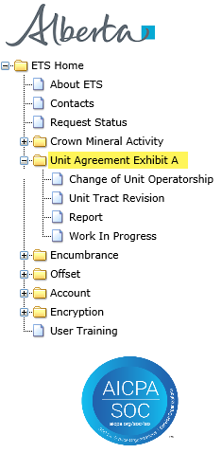
Unit Agreement Exhibit A
Government of Alberta
INTRODUCTION
In this module, you will learn how to:
create and submit a request
review and concur to a request
search on the status of a request
Prerequisite Learning Module
Before proceeding, we recommend that you view the Unit Agreement Exhibit A Roles module located in the Online Learning portal.
Page 3 of 27

Slide 4
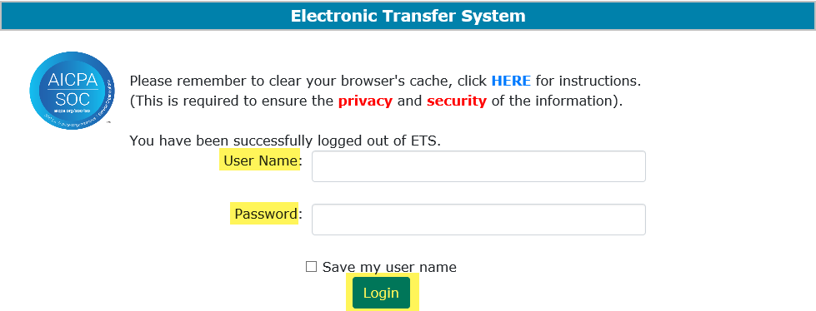
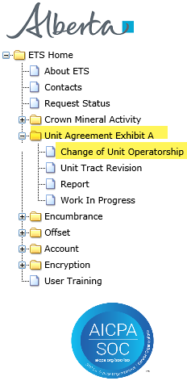
Unit Agreement Exhibit A
Government of Alberta
UNIT AGREEMENT EXHIBIT A – LOGIN – CHANGE OF UNIT OPERATORSHIP
2. Expand Unit Agreement Exhibit A
1. Login to ETS with your User Name and Password
3. Select Change of Unit Operatorship
Page 4 of 27

Slide 5
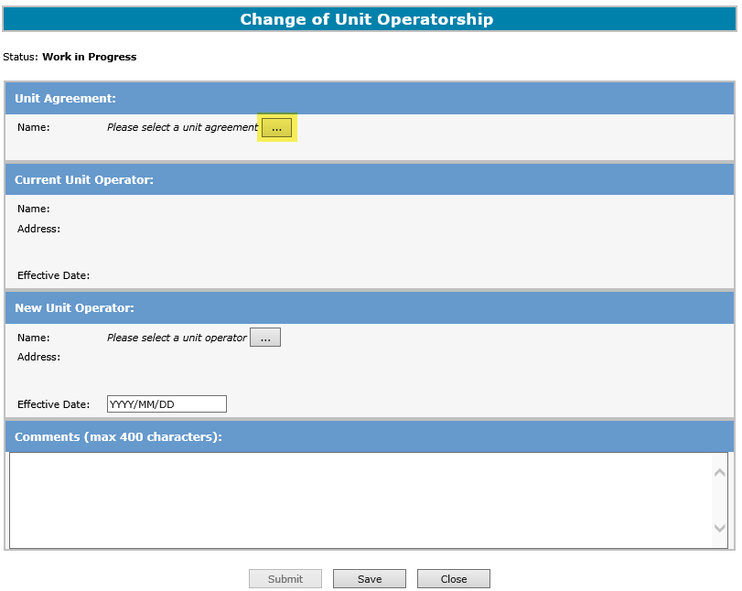
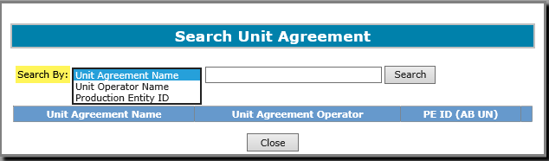

Unit Agreement Exhibit A
Government of Alberta
CHANGE OF UNIT OPERATORSHIP – CURRENT UNIT OPERATOR INFORMATION
1. Select Search button to search for Unit Agreement
2. Select “Search By:” dropdown list and choose.
Either the Current or the New Operator can create a request for a Change of Unit Operatorship.
If mandatory input is not entered, the field displays with a red asterisk (*) or if validation fails, a red error message will appear at the top of the page. Input must be corrected in order to save and submit a Change of Unit Operatorship.
Page 5 of 27

Slide 6
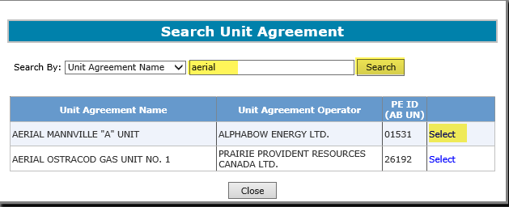
Unit Agreement Exhibit A
Government of Alberta
CHANGE OF UNIT OPERATORSHIP – SEARCH FOR UNIT AGREEMENT
1. Enter Unit Agreement Name and click on the Search button
3. Click Select
2. Search result of all Unit Agreements containing the word ‘aerial’.
Page 6 of 27

Slide 7
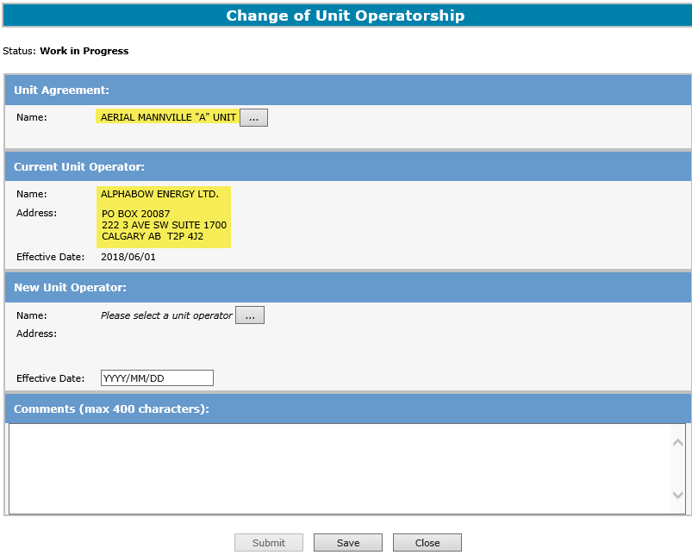
Unit Agreement Exhibit A
Government of Alberta
CHANGE OF UNIT OPERATORSHIP – CONFIRM CURRENT UNIT OPERATOR INFORMATION
Confirm Unit Agreement Name and Current Unit Operator
While working in the Change of Unit Operatorship screen, saving periodically is required to avoid the session from timing out. If there is no activity in 15 minutes, the screen timeouts.
Page 7 of 27

Slide 8
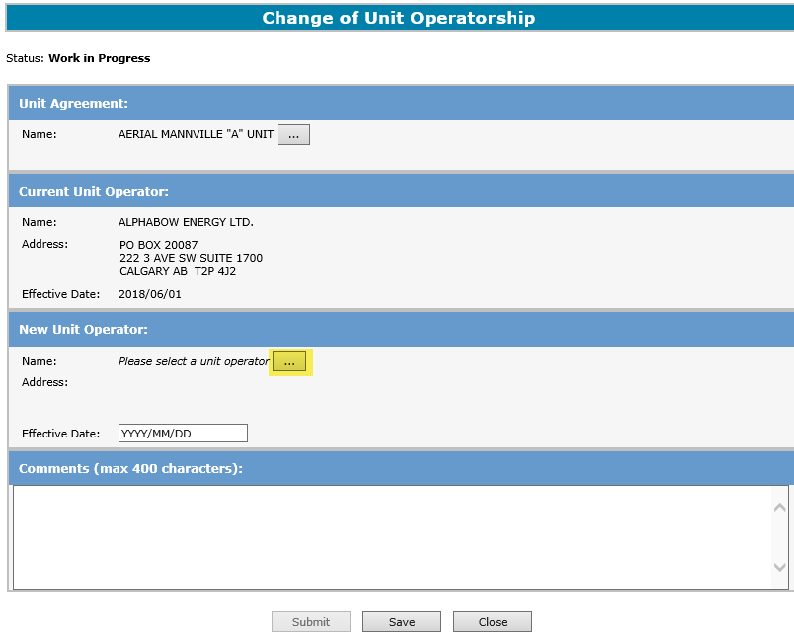
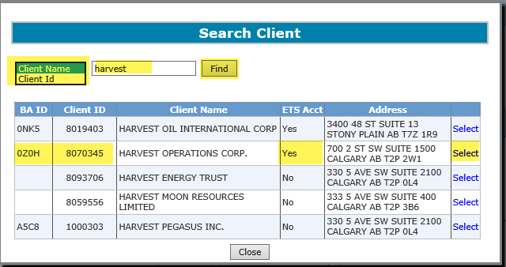

Unit Agreement Exhibit A
Government of Alberta
CHANGE OF UNIT OPERATORSHIP – SEARCH NEW UNIT OPERATOR
2. Search by Client Name or Client, then click Find
1. Click t to search New Unit Operator
3. Search result. Click Select to select the required client.
New Unit Operator must have a Business Associate (BA) ID, Client ID and ETS Acct prior to being selected.
If the New Unit Operator does not have a BA ID, Client ID and/or an ETS Account, please contact:
Alberta Energy and Minerals – Crown Land Data: email crownlanddatasupport@gov.ab.ca or
call (780) 644-2300
Page 8 of 27

Slide 9
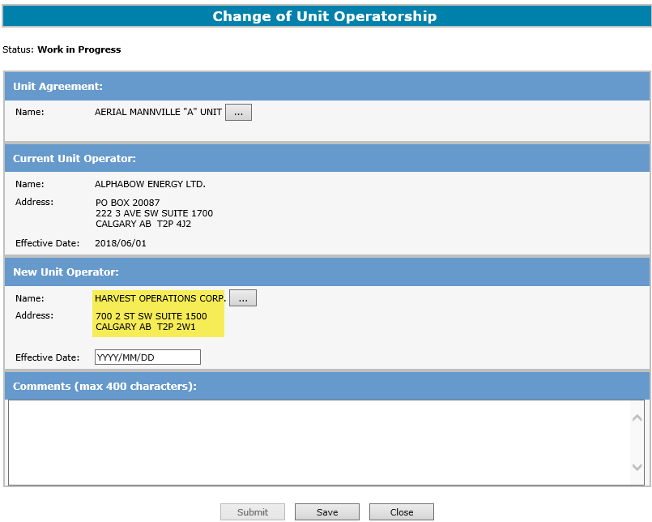
Unit Agreement Exhibit A
Government of Alberta
CHANGE OF UNIT OPERATORSHIP – CONFIRM NEW UNIT OPERATOR INFORMATION
Confirm New Unit Operator
New Unit Operator must be different from the Current Unit Operator.
Page 9 of 27

Slide 10
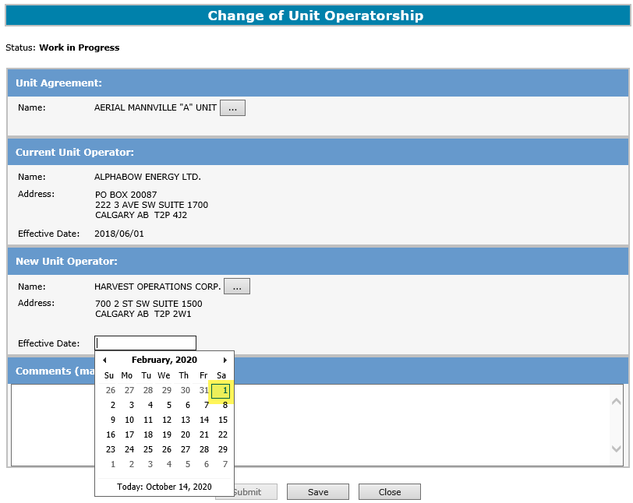
Unit Agreement Exhibit A
Government of Alberta
CHANGE OF UNIT OPERATORSHIP – NEW UNIT OPERATOR EFFECTIVE DATE
To bring up the calendar, click the Effective Date blank field and select the New Unit Operator Effective Date
The Effective Date of the New Unit Operator must be the first day of the month and cannot be less than the Effective Date of the Current Unit Operator.
Note: Effective Date can be future dated one month from the submission date.
Page 10 of 27

Slide 11
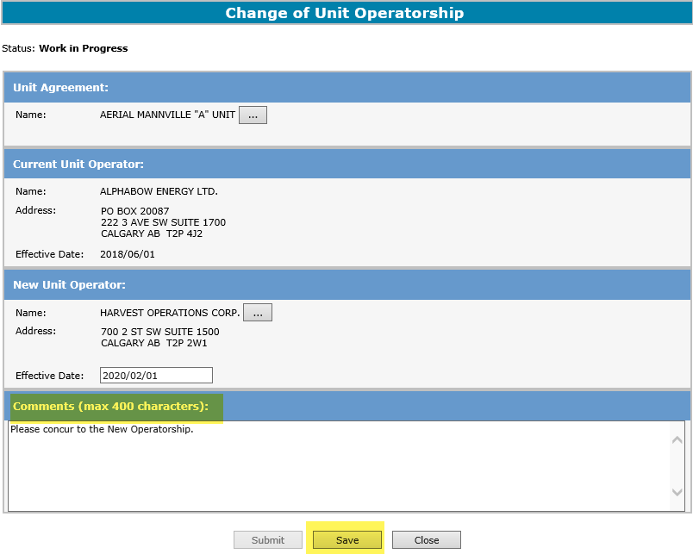
Unit Agreement Exhibit A
Government of Alberta
CHANGE OF UNIT OPERATORSHIP – COMMENTS FOR NEW UNIT OPERATOR
1. Enter comments here (max. 400 characters)
2. Click Save button to enable Submit button.
Creator’s comments and contact info is viewable to the concurrer.
Page 11 of 27

Slide 12
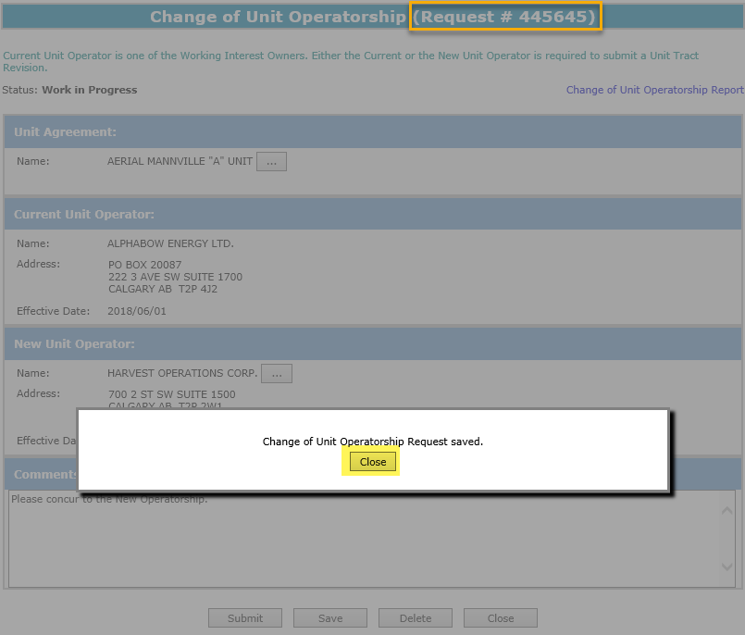
Unit Agreement Exhibit A
Government of Alberta
CHANGE OF UNIT OPERATORSHIP – SAVE – ETS REQUEST NUMBER INITIATED
The request is now saved. Click Closed.
The request is now saved. Click Close.
Once the request is saved, the ETS Request Number (e.g. Request #: 445645) is assigned and displayed in the header of the screen.
Page 12 of 27

Slide 13
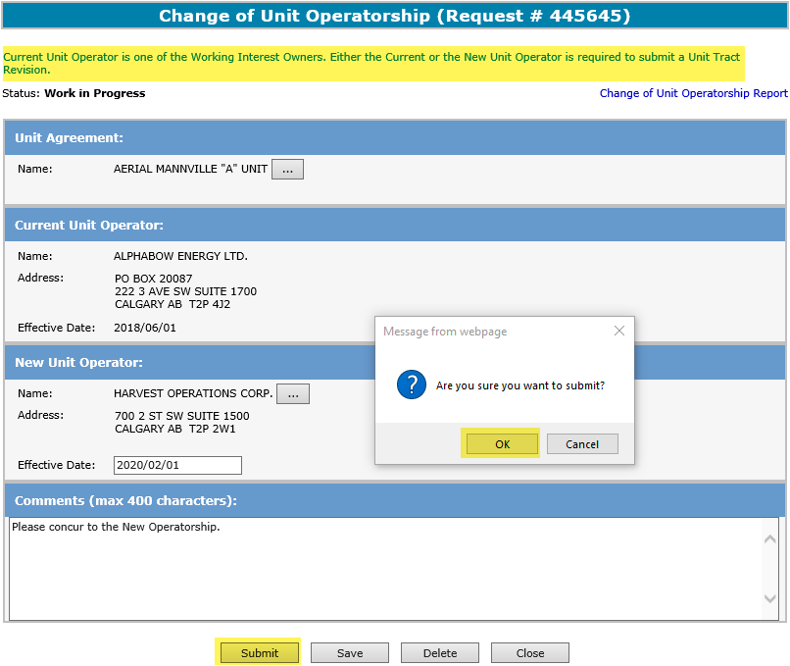
Unit Agreement Exhibit A
Government of Alberta
CHANGE OF UNIT OPERATORSHIP – SUBMIT
1. Click Submit
2. Click OK
Note: Before hitting the Submit button, take note of the reminder above in green, “Current Unit Operator is one of the Working Interest Owners. Either the Current or the New Unit Operator is required to submit a Unit Tract Revision.”
If the creator is the Current Unit Operator, once this request is submitted, the Current Unit Operator will no longer be able to submit a Unit Tract Revision, instead, the New Unit Operator is required to submit a Unit Tract Revision.
Page 13 of 27

Slide 14
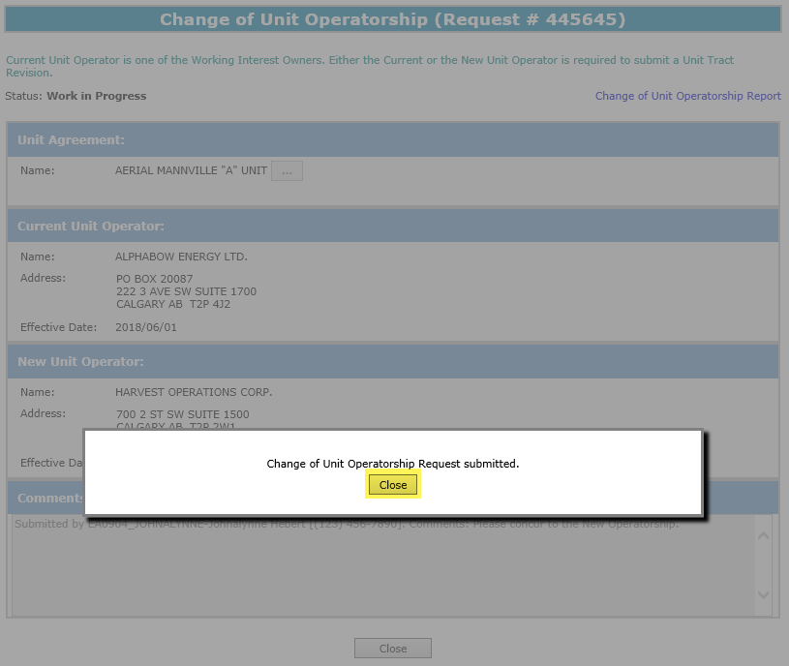
Unit Agreement Exhibit A
Government of Alberta
CHANGE OF UNIT OPERATORSHIP – REQUEST SUBMITTED
1. Click Close
Page 14 of 27

Slide 15
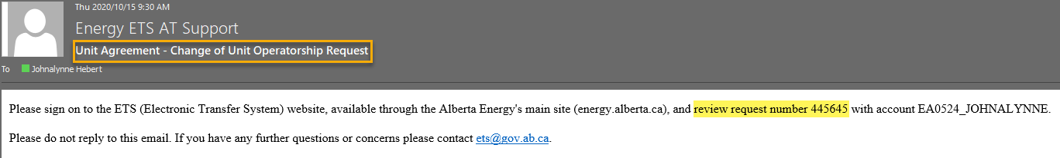
Unit Agreement Exhibit A
Government of Alberta
CHANGE OF UNIT OPERATORSHIP – EMAIL NOTIFICATION FOR CONCURRENCE
Once the request is submitted successfully, an email notification is sent to the Concurrer to concur the Change of Unit Operatorship. The email notification contains the ETS Request Number and the account number.
Page 15 of 27

Slide 16
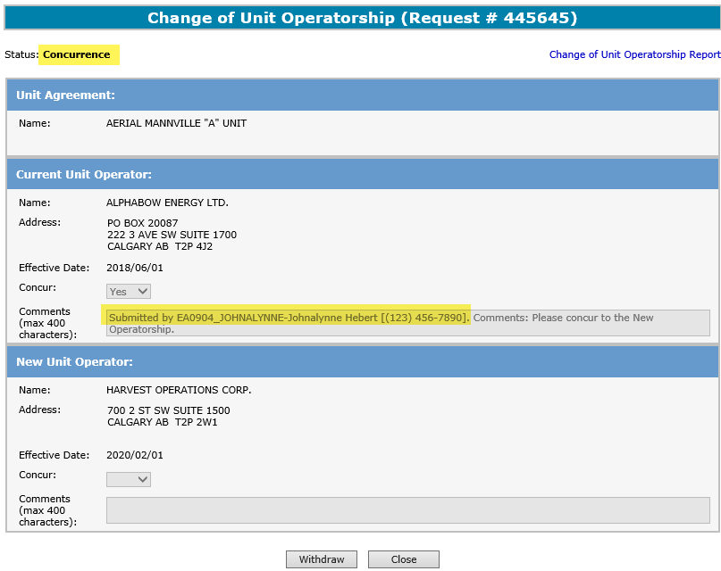
Unit Agreement Exhibit A
Government of Alberta
CHANGE OF UNIT OPERATORSHIP – REQUEST AT CONCURRENCE STAGE
The status changes to Concurrence when the request is successfully submitted.
Once, the request is submitted, the creator’s contact info is automatically added in the Comments field.
Page 16 of 27

Slide 17
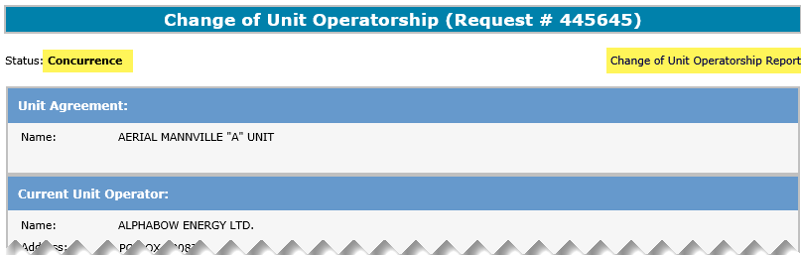
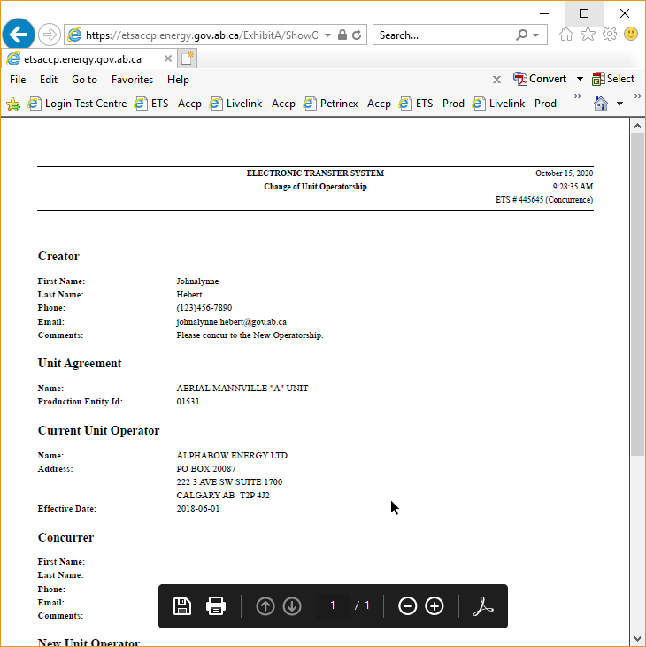
Unit Agreement Exhibit A
Government of Alberta
CHANGE OF UNIT OPERATORSHIP – REPORT
Click on this link to view a .pdf report
The Change of Unit Operatorship Report, is an overview of screen data, which helps in verifying the data entered. This report can be produced at any time during the request’s lifecycle.
Page 17 of 27

Slide 18
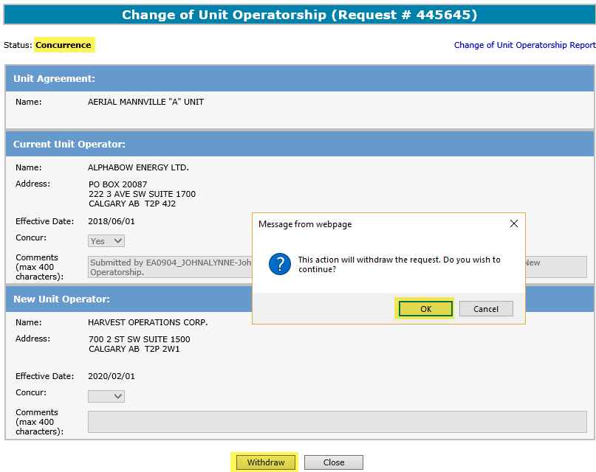
Unit Agreement Exhibit A
Government of Alberta
CHANGE OF UNIT OPERATORSHIP – WITHDRAW REQUEST OPTION
1. Click Withdraw
2. Click OK
Once the request has been submitted for concurrence and the concurrer has not concurred yet, the creator can Withdraw the request. Note: The Withdraw button is disabled once the request has been concurred.
If the creator wishes to withdraw the request and the withdraw button is no longer available, please contact EnergyUnitsHelpdesk@gov.ab.ca. The Units team will change the status of the request to Client Withdraw.
Page 18 of 27

Slide 19
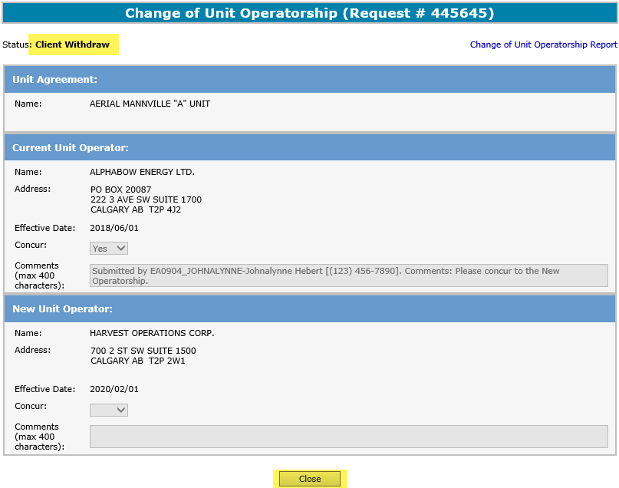
Unit Agreement Exhibit A
Government of Alberta
CHANGE OF UNIT OPERATORSHIP – WITHDRAW REQUEST STATUS
1. Status is now changed to Client Withdraw
2. Click Close to close the screen
Notice that only the Close button is available. No further action required.
Page 19 of 27

Slide 20
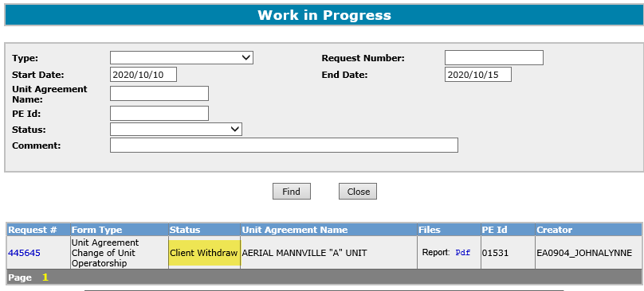
Unit Agreement Exhibit A
Government of Alberta
CHANGE OF UNIT OPERATORSHIP – WITHDRAW REQUEST WORK IN PROGRESS
Request remains in Work in Progress with a status of Client Withdrawn for 90 days and then it is archived.
Page 20 of 27

Slide 21
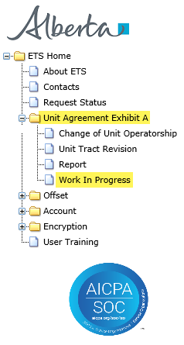
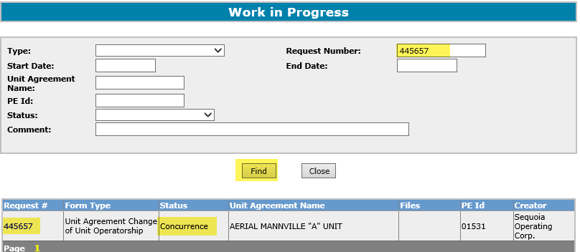
Unit Agreement Exhibit A
Government of Alberta
CHANGE OF UNIT OPERATORSHIP – CONCUR WORK IN PROGRESS
1. After receiving the email notification, sign is as the concurrer to concur the request. Expand Unit Agreement Exhibit A
4. Click Find
3. From the email notification, enter the request number here
2. Click Work In Progress node
5. Search result. Click the hyperlinked Request #
If you do not have the Request Number handy, click Find. The search result returns all Request numbers associated with the login account.
Page 21 of 27

Slide 22
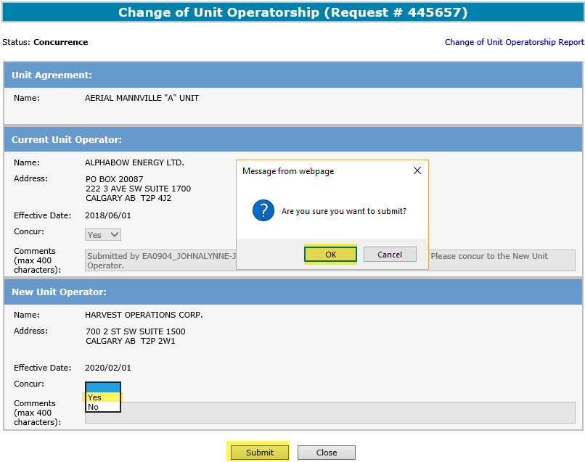
Unit Agreement Exhibit A
Government of Alberta
CHANGE OF UNIT OPERATORSHIP – CONCUR YES OR NO
1. Click Concur dropdown and select either Yes or No
2. Click OK
2. Click Submit
If the concurrer selects No, the Comments field is enabled. This field is mandatory to add the reason of the rejection. Otherwise, if Yes is selected, the Comments field remains disabled. No reason is required.
Page 22 of 27

Slide 23
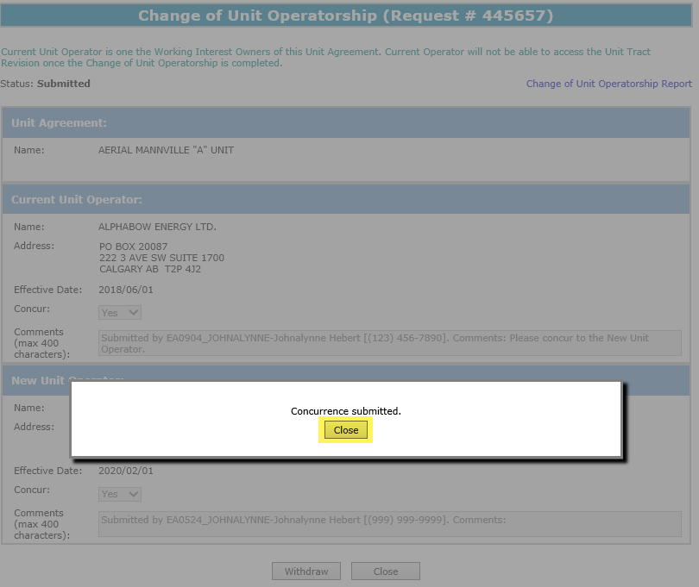
Unit Agreement Exhibit A
Government of Alberta
CHANGE OF UNIT OPERATORSHIP – CONCURRENCE SUBMITTED
1. Click Close
Page 23 of 27

Slide 24
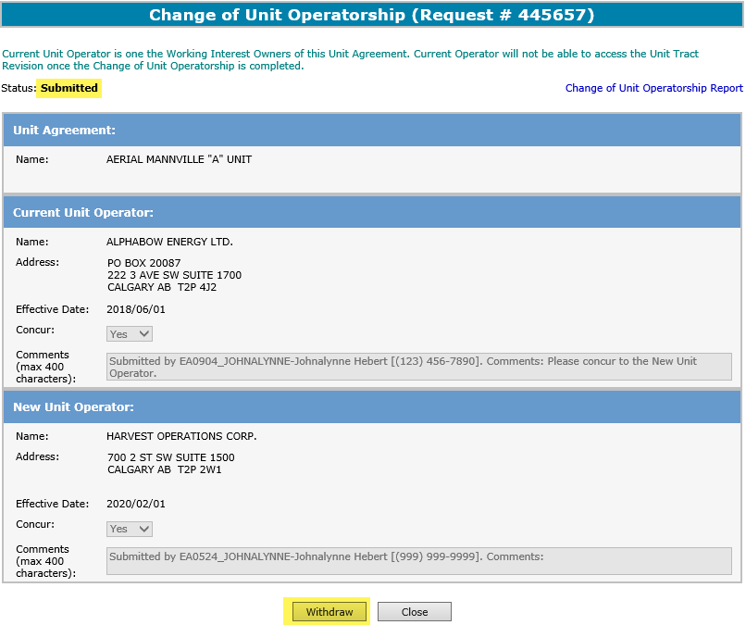
Unit Agreement Exhibit A
Government of Alberta
CHANGE OF UNIT OPERATORSHIP – CONCURRENCE WITHDRAW OPTION
Once the concurrence has been submitted, the concurrer can Withdraw the request. Note: The Withdraw button is disabled once the status of the request has changed to Processing.
If the concurrer wishes to withdraw the concurrence and the withdraw button is no longer available, please contact EnergyUnitsHelpdesk@gov.ab.ca. The Units team will change the status of the concurrence to Client Withdraw.
Page 24 of 27

Slide 25
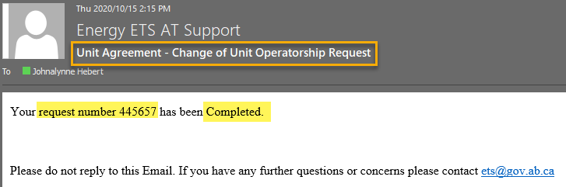
Unit Agreement Exhibit A
Government of Alberta
CHANGE OF UNIT OPERATORSHIP – EMAIL NOTIFICATION FOR REQUEST COMPLETION
Once the request is processed successfully, an email notification is sent to the creator indicating that the request is now Completed.
Page 25 of 27

Slide 26
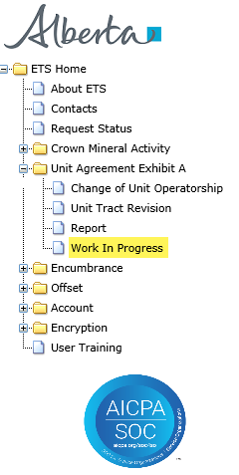
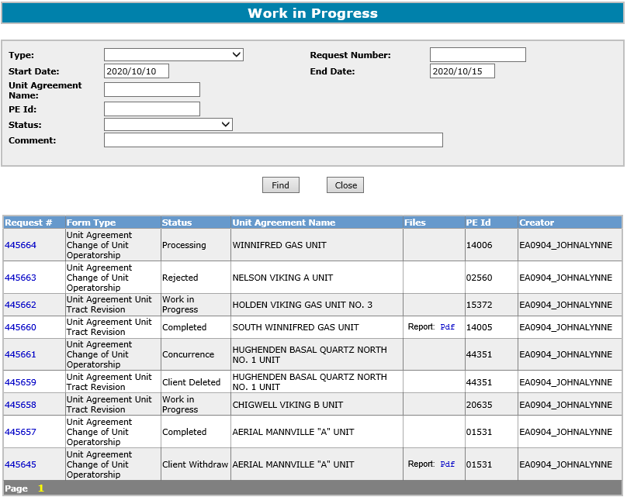
Unit Agreement Exhibit A
Government of Alberta
CHANGE OF UNIT OPERATORSHIP
The Status of a Request can be searched and viewed in the Work in Progress screen. Requests that have been created will remain available in the Work in Progress for 90 days after which they are archived and then deleted.
Page 26 of 27

Slide 27

Unit Agreement Exhibit A
Government of Alberta
CONCLUSION
Congratulations!
You have completed the
Unit Agreement Exhibit A
Change of Unit Operatorship
Online Training Course
If you have any comments or questions on this training course,
please forward them to the following email address:
EnergyUnitsHelpdesk@gov.ab.ca
Page 27 of 27

