Slide 1
Welcome!
To the ETS – Encumbrance
Certified Copy of Encumbrance
Online Training Course
This is the process of submitting and retrieving a certified copy of an encumbrance.

Slide 2
Revision Page
Revisions Table
Date | Revisions Type | Page Number
May 3, 2018 | Initial Creation | All
April 2020 | Heading updates | All
June 2021 | Update | Slide 7
January 2022 | Updates | Various

Slide 3
Introduction
In this module, you will learn how to:
Request Certified Copy of Encumbrance
Retrieve Requested Document(s)
Click on any of the above links to be directed to the corresponding instructions in the module.

Slide 4
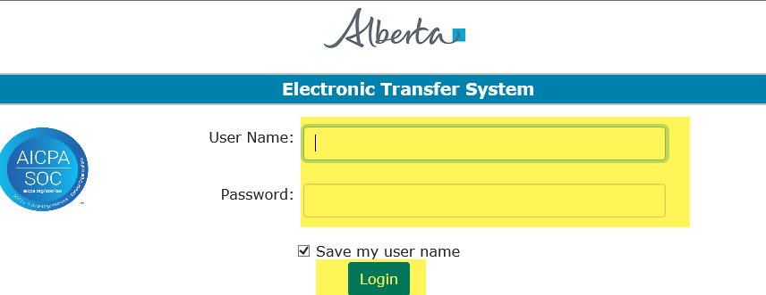
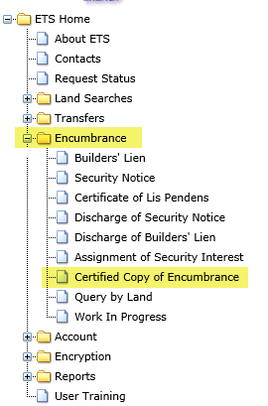
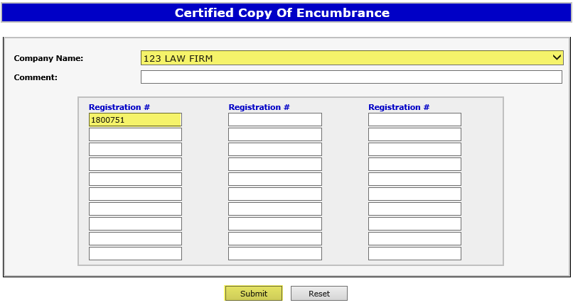

Certified Copy Of Encumbrance
1. Log into ETS.
4. Select the applicable company name that will be requesting the Certified Copy of Encumbrance.
2. Click on Encumbrances.
5. Enter your Registration # and click Submit.
3. Click on Certified Copy of Encumbrance.
Encumbrances are public information and can be requested by anyone wanting to review the registration document.
4

Slide 5
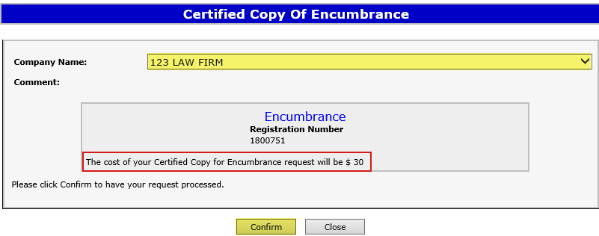
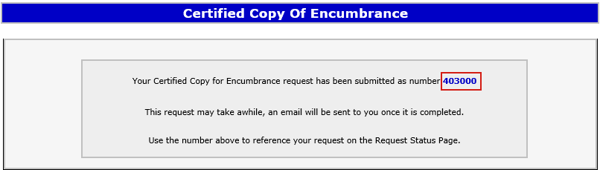
Confirming Request
Confirm the Registration number, and amount. If anything is missing click on Close to add any additional agreements.
Click Confirm.
An ETS request number will be displayed after selecting confirm.
The ETS request Number will be used to track your request in the Request Status Screen.
The fees for certified copies are $30.00 per encumbrance document. Charges will be applied to the requestors Internet Land Searches (ILS) billing account and invoices will be mailed out monthly to the submitter of the request.

Slide 6
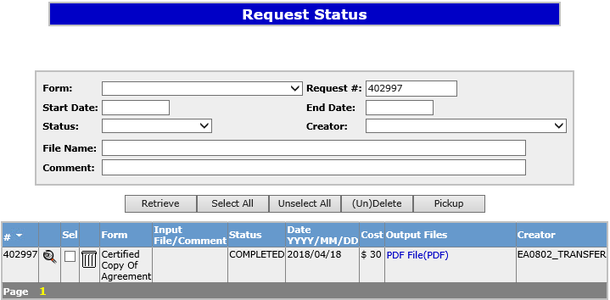
Certified Copy Status
The status of a certified copy request is available when searching the ETS request number on the Request Status screen. There are 3 types of Statuses:
Processing – request was submitted and being processed by Alberta Energy.
Completed – request has been completed and documents are available to be viewed/printed.
Rejected – request has been rejected by Alberta Energy.
The Request Status screen will show the ETS Request Number, Form type, Input File/Comment, Status, files, when the request was last updated and the Creator.
6

Slide 7
Email Notification
Sample
EXTERNAL SENDER. Do not open links or attachments that are unexpected. Do not give out User IDs or Passwords.
Your Certified Copy of Encumbrance request number XXXXXX for account ENXXXX has been Completed. This request can be found under Request Status.
To review your request sign on to the Electronic Transfer System (ETS) website, available through Alberta.ca.
Do not reply to this EMail. If you have questions or concerns please contact Transfers.Energy@gov.ab.ca
A request for a certified copy may take up to one business day to process. An email notification will be sent to notify users that the certified copy request has either been completed or department rejected.
The user will be able to access the certified copy of the document by signing into the ETS website.

Slide 8
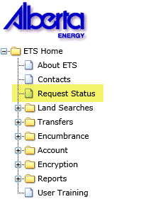
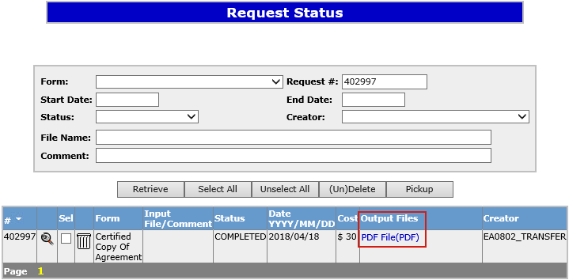

Retrieving Final Documents
Remove the Start Date and End Date if you request does not appear.
2. Enter in ETS Request Number and click Retrieve.
1. Select
Request Status.
3. Click on PDF File to open document.
4. Documents will be stamped “Certified Copy by Alberta Energy”.
If Alberta Energy could not supply all or any of the requested documents the cost will be altered to reflect the new charge. Charges will be applied to the client’s Internet Land Searches (ILS) account and an invoice will be mailed out monthly to the submitter of the request.
NOTE: Please ensure you either print or save a copy of the documents for your records as they will be removed after your specified archiving schedule lapses. You may extend the archiving schedule of your ETS account to a maximum of 90 days in the Account node under Preferences.

Slide 9

Encumbrances
Government of Alberta
Resources
ETS Support and Online Learning provides access to relevant guides, course and other information
If you have questions, please contact Transfers.Energy@gov.ab.ca or the Transfer Helpdesk line at 780 644-2300 and by selecting option #5.
Page 9 of 10

Slide 10

Encumbrance
Government of Alberta
Congratulations!
You have completed the ETS – Encumbrance
Certified Copy of Encumbrance
Online Training Course
If you have any comments or questions on this training course,
please forward them to the following email address:
Transfers.Energy@gov.ab.ca
10
10

