Slide 1
Welcome
Welcome!
In 2009, Alberta Energy required Oil Sands Royalty (OSR) Project operators to provide additional information that will enable the department to improve reporting of Oil Sands activities to Albertans. This training material will discuss what you need to know to submit the CARE Reports using Alberta Energy's Electronic Transfer System (ETS).
To the Cost Analysis Reporting Enhancement (CARE)
Online Training Course

Slide 2
Revisions
Date | Revisions Type | Page Number
November 2011 | Updated Content | All
September 2012 | Conversion | All
June 2015 | Updated Content | All

Slide 3

Introduction
In this module, you will learn:
CARE Information Background
CARE Key Reasons for Reporting
CARE Reporting Requirements
Amendments to CARE Reporting
Report Submissions
Statement of Approval
Reporting Templates
File Naming Conventions
Filing Deadlines
ETS Submission
CARE Resources
Course Pre-requisite:
ETS Correspondence

Slide 4

Background
Alberta Energy introduced the Cost Analysis and Reporting Enhancements (CARE) Forms in 2009 which were updated in 2011 to Reporting Workbooks. The workbooks have been revised in 2015 and are now referred to as CARE Reports. Please refer to Oil Sands Information Bulletin 2015-03 CARE reporting is mandatory under the Oil Sands Royalty Regulation 2009. Under this legislation, Alberta Energy will apply reporting enforcement provisions to any operator not providing these reports to the Minister as specified.

Slide 5

Key Reasons for CARE Reporting
Project Assessment and Tracking
Provides Alberta Energy with more detailed reporting of Project costs and revenues.
Tracks the evolution of approved OSR Projects to ensure their implementation is progressing according to the original Project Approval.
Royalty Collection and Verification
Supports the verification of the cost and revenue information that are reported for royalty calculation.
Policy Development and Forecasting
Assists Alberta Energy in assessing effectiveness of the Royalty Regime.
Supports policy development, strategic planning and forecasting processes.

Slide 6

CARE REVENUE Reporting Requirements
The OSR Operator or individual owners must provide the following to Alberta Energy in the CARE Revenue Report:
General Information in Cover Page
Bitumen/Bitumen Blend Revenue
Bitumen Blend Netback Calculation
Transportation Costs
Diluent Supplied to a Stream
Other Oil Sands Product Revenue
Additionally, operators that have Western Canadian Select sales are required to file the Western Canadian Select (WCS) Sales Report.

Slide 7

CARE COST Reporting Requirements
The OSR Operator must provide to Alberta Energy the Cost Data and Volumetric Data which are incurred by or on behalf of the lessee or the operator of the approved OSR Project. Cost and Volumetric Data are reported in the CARE Cost Report effective Period 2015. (Reporting requirements differ for Periods prior to 2015. Please refer to Alberta Oil Sands Royalty Guidelines Appendix C dated January 31, 2015 for details.)
The CARE Cost Report is an annual report effective Period 2015. The report includes:
Capital Costs incurred for approved In-Situ and Mining Projects. The costs are segregated into the following life cycle stages:
Initial PNCB
Strategic
Sustaining
Reclamation/Abandonment
Operating Costs and Volumetric Data incurred for approved In-Situ and Mining Projects. All volumetric data measurements are standardized as reported to the Alberta Energy Regulator (AER) and are identified in AER Directive 017 – Measurement Requirements for Oil and Gas Operations.

Slide 8
CARE COST Reporting Requirements…
Additionally, Deposit Data, Reservoir Data and Reserves Data for the approved OSR Project are also required to be reported to Alberta Energy. The information is reported in the CARE Subsurface Report effective Period 2015. (For Periods prior to 2015, the information is reported in the CARE Project Workbook. Please refer to Alberta Oil Sands Royalty Guidelines Appendix C dated January 31, 2015 for details.)
Deposit Data is reported for approved Mining Projects.
Reservoir Data is reported for approved In-Situ Projects.
Reserves Data includes the initial and remaining Project area’s proven and probable reserves. The calculation of reserves is based on gross reserves prior to royalty determination and is prepared in accordance to recognized reserve evaluation methods, i.e. Canadian Oil & Gas Evaluation Handbook. Information should not be confused or compared to reporting for securities purposes.

Slide 9

Amendments to CARE Reporting
Since there are different CARE reporting templates for different Periods (see Reporting Templates slide), CARE Report amendments must be completed on the reporting template that is in effect for the amending Period.
CARE Revenue and WCS Sales Reports As these reports are filed on a cumulative year to date basis, amendments within a Period for previously submitted information must be incorporated in the current Period’s quarter reporting. If an amendment is necessary after the Period has ended, then an amendment to the 4th quarter report will be required. CARE Cost and Subsurface Reports As these reports are filed on an annual basis, amendments within a Period for previously submitted information will require a full report replacement for that Period.
The CARE Cost Report for a Period must reconcile to the costs that are reported in the Project’s End of Period Statement (EOPS). Operators must make the corresponding report amendments when cost changes are identified.

Slide 10

Report Submissions
All CARE Reports must be submitted electronically in Excel using Alberta Energy’s Electronic Transfer System (ETS) by the filing deadlines. Refer to the Resources slide at the end of this module for the CARE Reports and filing deadlines. The ETS is a secure web application portal. The Correspondence in ETS allows Oil Sands Royalty clients to send and receive data through a secure connection. NOTE: The CARE reporting templates should not be altered by the submitter. Doing so may result in a rejection of the submission. Penalty charges may also apply.

Slide 11

Statement of Approval
A Statement of Approval must accompany the submission of the CARE Reports for each reporting period. The approval of the reports must be signed by the operator’s Chief Financial Officer or another senior officer on behalf of the operator.
Note: See Oil Sands Royalty Regulation, 2009, Section 38.1(3) and 38.1(4) for the Statement of Approval and authorization requirements. A Statement of Approval:
Is a separate document, such as a letter, accompanying the CARE submission, providing that such a letter clearly references the report to which it relates.
Clearly indicates the name of the individual approving the report.
Includes a scanned signature page with the electronic submission.

Slide 12
Reporting Templates
All CARE reporting templates are available on Alberta Energy's Oil Sands Forms website
http://www.energy.alberta.ca/OilSands/582.asp Note: Scroll down the page to the Cost Analysis and Reporting Enhancement (CARE) section for the reporting templates that pertain to each reporting period. See also Appendix C – Cost Analysis and Reporting Enhancement (CARE) Forms, and Appendix D – CARE Glossary of the Alberta Oil Sands Royalty Guidelines Appendix (dated January 31, 2015) for a summary listing of the CARE Reports and a glossary of terms that are specific to CARE reporting. See Oil Sands Information Bulletin 2015-03 for the CARE Reports that are effective from Period 2015. These reports are not reflected in the January 31, 2015 version of the Alberta Oil Sands Royalty Guidelines and will be incorporated in the next guideline release.

Slide 13

File Naming Convention
As CARE Reports are still submitted through ETS Correspondence (rather than through ETS Oil Sands), the report submissions must adhere to the specific file naming conventions required by the system.
The file naming conventions are listed in
Appendix H - Electronic Transfer System (ETS) - File Naming Conventions of the Alberta Oil Sands Royalty Guidelines Appendix (dated January 31, 2015). See Oil Sands Information Bulletin 2015-03 for the file naming conventions of the CARE Reports that are effective from Period 2015.

Slide 14
Filing Deadlines
Refer to Appendix E – CARE Timeline and Timetable of the Alberta Oil Sands Royalty Guidelines Appendix (dated January 31, 2015) for the filing deadline of each CARE Report. See Oil Sands Information Bulletin 2015-03 for the filing deadlines of the CARE Reports that are effective from Period 2015.

Slide 15
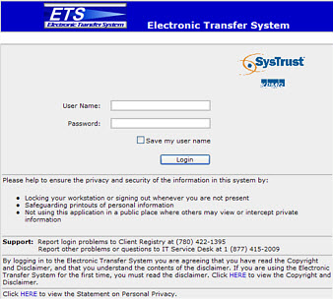
Electronic Transfer System (ETS)
Alberta Energy’s Electronic Transfer System (ETS) is a secure web application that is used to transfer information to the department. It is not only used for the submission of CARE Reports. The ETS website is located at: https://ets.energy.gov.ab.ca.
CARE Reports are submitted through the Correspondence Folder in ETS. To request access to ETS Correspondence, complete the ETS Account Setup/Change Form under Apply for Access at http://www.energy.alberta.ca/OurBusiness/1076.asp ETS training modules are available in the Alberta Energy Online Learning Portal at http://training.energy.gov.ab.ca/
In addition to this training module (CARE Reporting), the following supplemental modules should also viewed:
Energy Online Learning – Correspondence
Energy Online Learning - ETS Accounts (ETS Account Setup and Preferences)

Slide 16
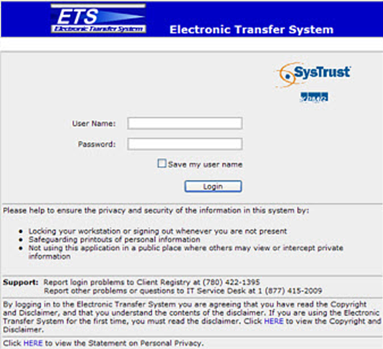
Login to ETS
More Information (Pages 16 to 29)
Upon the approval of the ETS Account Setup, a User Id and Password will be assigned to the Company ETS Site Administrator by Alberta Energy’s Client Registry Team. The Company ETS Site Administrator can further assign ETS Client Account Ids and Passwords to other individuals in the company.
Use the assigned User Id/Password to login to ETS.
(Read about the ETS Account Setup process here http://www.energy.alberta.ca/OurBusiness/1076.asp)
Course Link - ETS Correspondence

Slide 17
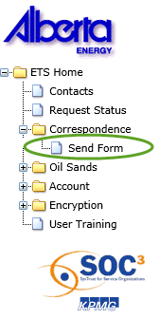
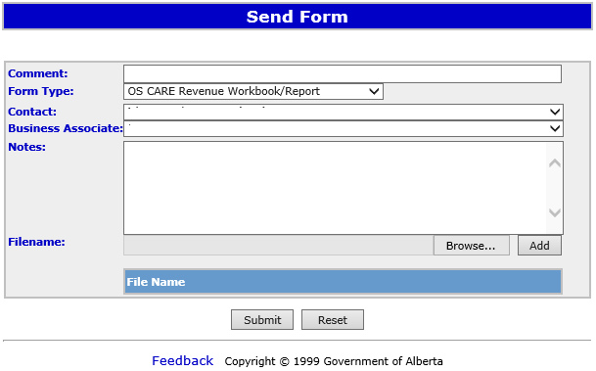
Submit Forms
Use the Send Form screen located in the Correspondence node in ETS to send CARE Report Forms. Select the appropriate Form Type for submission. Form Types are different for different reporting periods.
Refer to Appendix H – ETS File Naming Conventions of the Alberta Oil Sands Royalty Guidelines Appendix (dated January 31, 2015) for the Form Types applicable to each reporting period’s CARE Reports. See Oil Sands Information Bulletin 2015-03 for the file naming conventions of the CARE Reports that are effective from Period 2015.
View the Correspondence training module for the features in Correspondence:
Energy Online Learning - Correspondence
View the ETS Submission Process for Supplemental Reporting document in
http://www.energy.alberta.ca/OilSands/814.asp for the submission process related to the CARE Reports and Operator’s Forecast.

Slide 18
Resources
Oil Sands Royalty Guidelines http://www.energy.alberta.ca/OilSands/pdfs/Royalty-Guidelines-2015.pdf
Oil Sands Royalty Guidelines – Appendices
http://www.energy.alberta.ca/OilSands/pdfs/Royalty-Guidelines-Glossary-And-Appendix-2015.pdf
Oil Sands Information Bulletins http://www.energy.alberta.ca/OilSands/806.asp
Subscription to Information Bulletins http://www.energy.alberta.ca/OurBusiness/1070.asp. (scroll down to Oil Sands Royalty Information Bulletins.)
CARE Reporting Templates http://www.energy.alberta.ca/OilSands/582.asp. (scroll down to Cost Analysis and Reporting Enhancement.)
CARE Frequently Asked Questions http://www.energy.alberta.ca/OilSands/1740.asp
CARE Training Presentation (dated April 1, 2015) http://www.energy.alberta.ca/OilSands/pdfs/CAREPresentation.pdf
Oil Sands Contacts http://www.energy.alberta.ca/OilSands/575.asp

Slide 19
Content Review
In this module you have learned about:
CARE Information Background
CARE Key Reasons for Reporting
CARE Reporting Requirements
Amendments
Report Submissions
Statement of Approval
Reporting Templates
File Naming Conventions
Filing Deadlines
ETS Submission
CARE Resources

Slide 20

Conclusion
Congratulations!
You have completed the Care
Online Training Course
If you have any comments or questions on this training course,
please forward them to OSReport@gov.ab.ca and indicate Online Training Feedback in the Subject Line.

