Slide 1
Location Amendment Application
Government of Alberta
Welcome!
To the
Location Amendment Application
Online Training Course
In this module you will learn how to:
Enter a Location Amendment application into ETS.
Add lands to an existing agreement.
Modify zones on existing lands and/or remove lands from existing agreement.
Add lands, modify zones on existing lands and/or remove lands from an agreement.
Retrieve and view agreement documents.

Slide 2
Location Amendment Application
Government of Alberta
Revisions Table
Date | Revisions Type | Page Number
October 28, 2024 | Initial Creation | All
October 14, 2025 | Correction | Page 5, 10

Slide 3
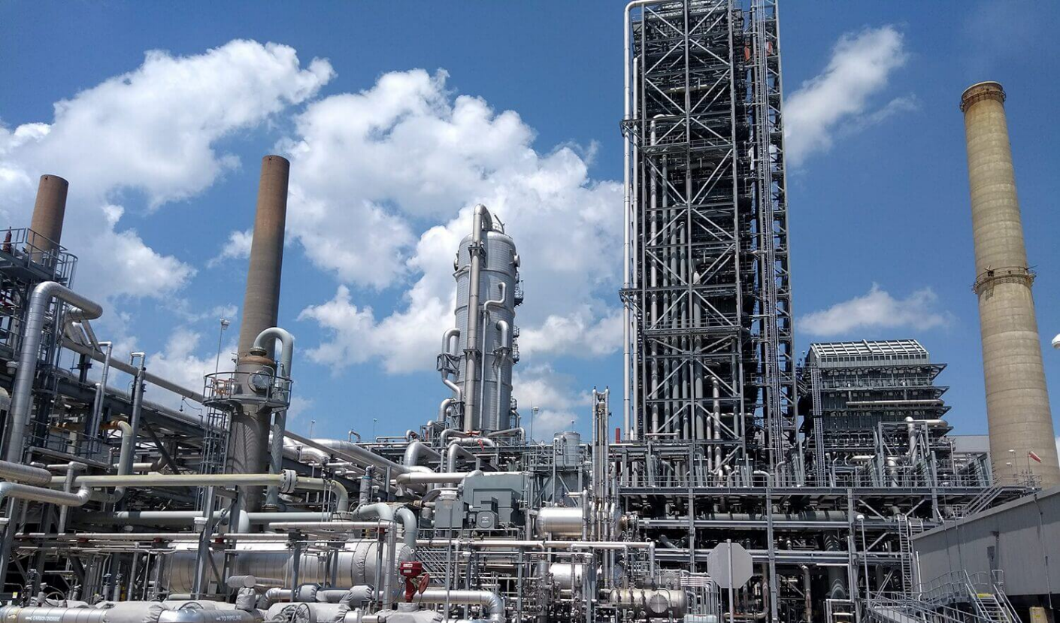
Location Amendment Application
Government of Alberta
INTRODUCTION
Location Amendment ETS form allows industry to initiate an application to amend the location for Carbon Sequestration Evaluation Agreement, Carbon Sequestration Agreement and Pore Space Lease.

Slide 4
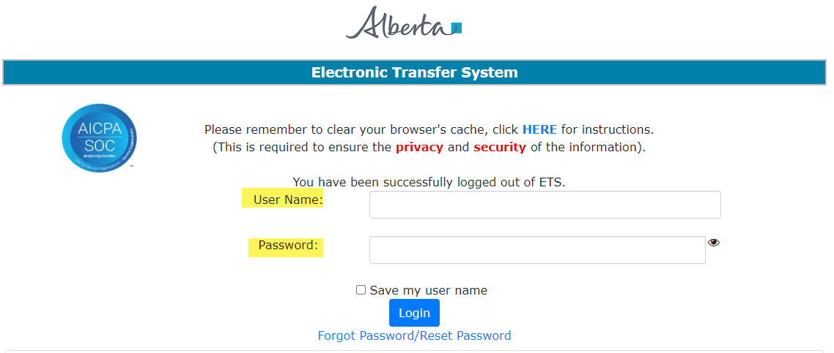
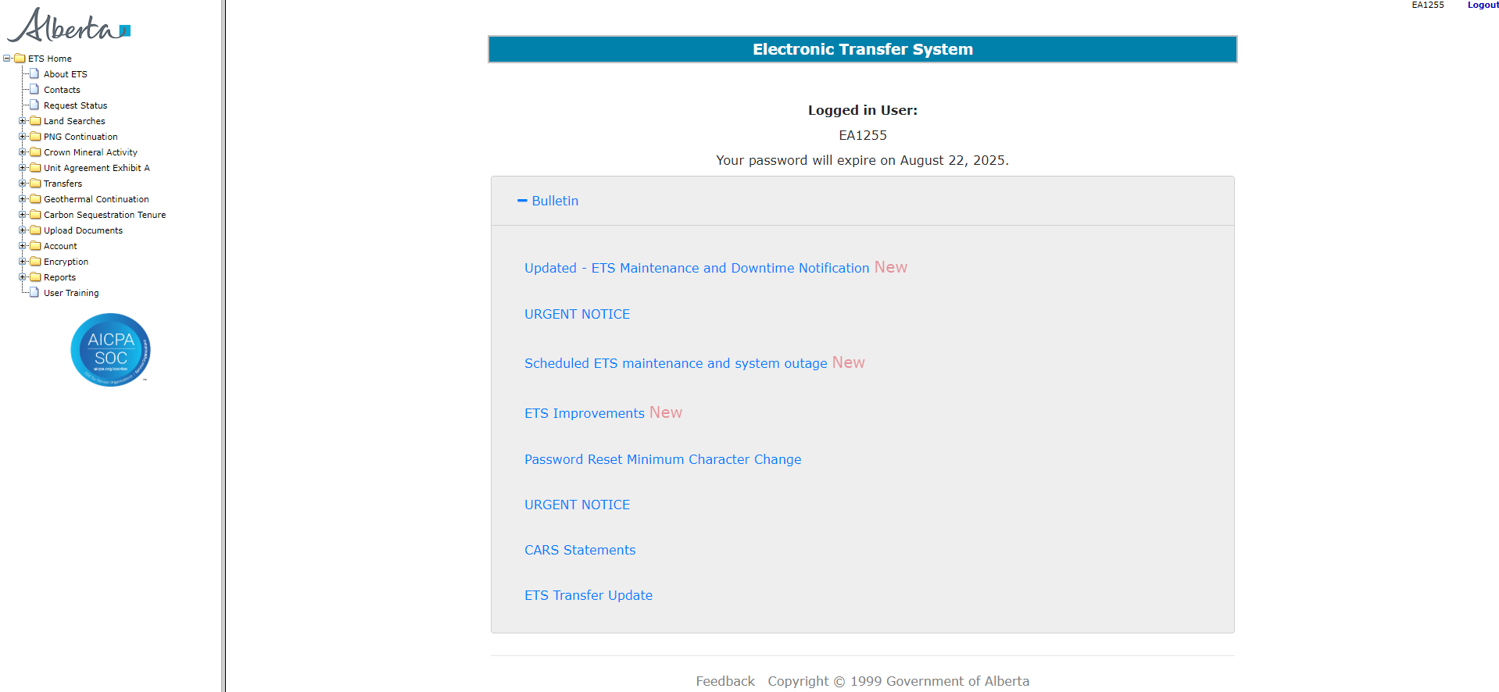
Location Amendment Application
Government of Alberta
LOGIN TO ETS
Go to ETS (https://ets.energy.gov.ab.ca/logon.aspx)
Enter your login credentials: User Name (EN account) and Password.
Once logged in, the screen below is displayed.

Slide 5
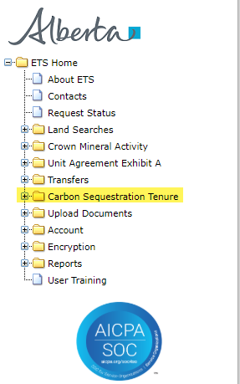
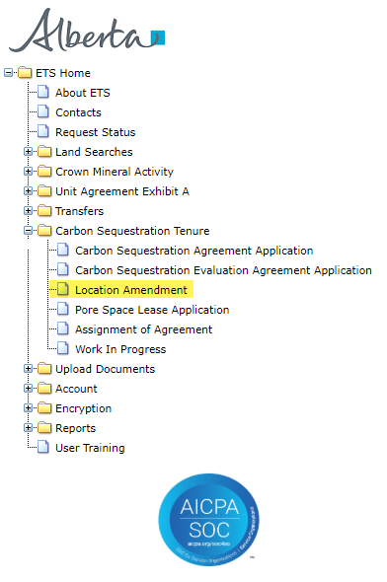
Location Amendment Application
Government of Alberta
NAVIGATION TO LOCATION AMENDMENT APPLICATION FORM
In the treenode (left-hand side of the screen), navigate to Carbon Sequestration Tenure node.
Expand Carbon Sequestration Tenure node to display its subnodes.
Click Location Amendment subnode.
2.
1.
3.

Slide 6
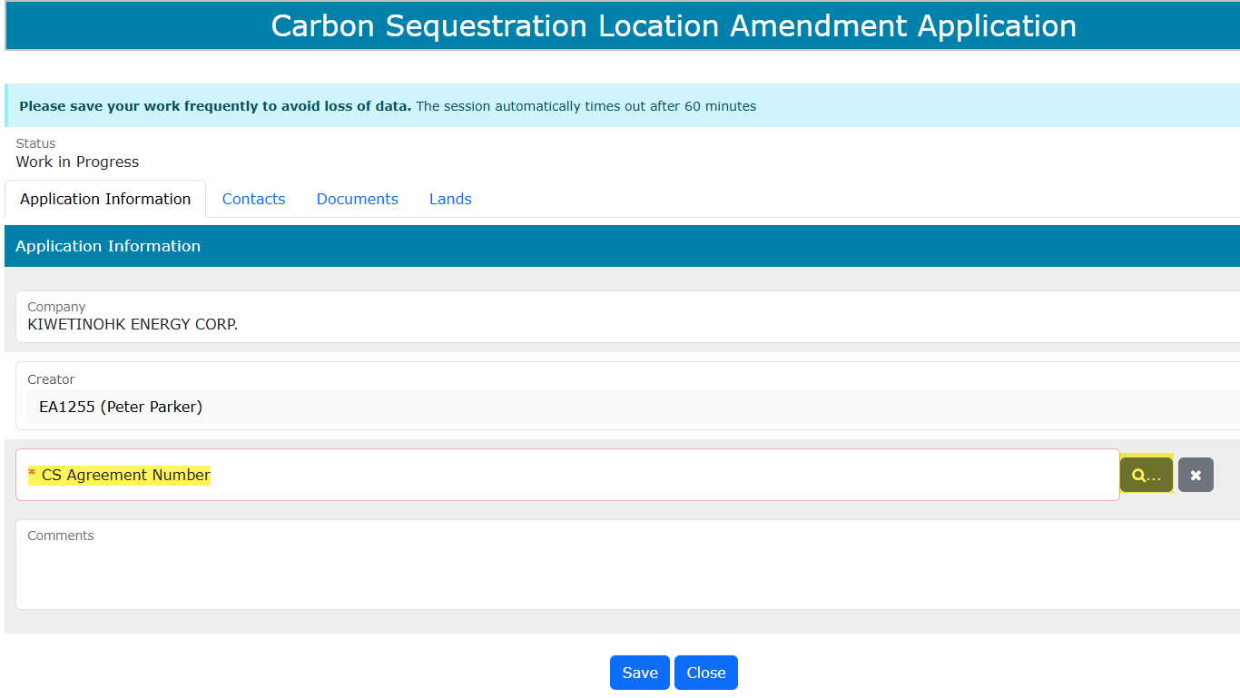
Location Amendment Application
Government of Alberta
APPLICATION INFORMATION TAB
On the main screen, a blank application form is displayed. ETS auto populates the Company and Creator fields. These information are generated from the login account information.
At the creation stage, the status of the request is set to Work in Progress.
CS Agreement Number field is the existing CS agreement number on which industry would like to add or modify the lands. This field is required on this tab.
1. Click the magnifying glass to search the agreement

Slide 7
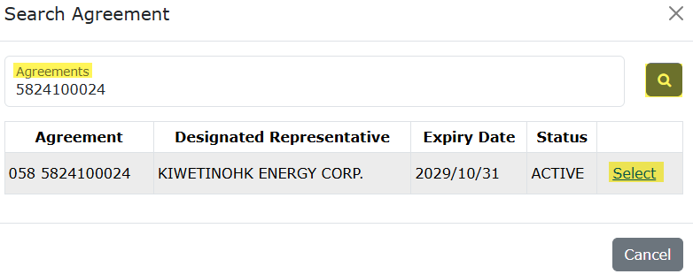
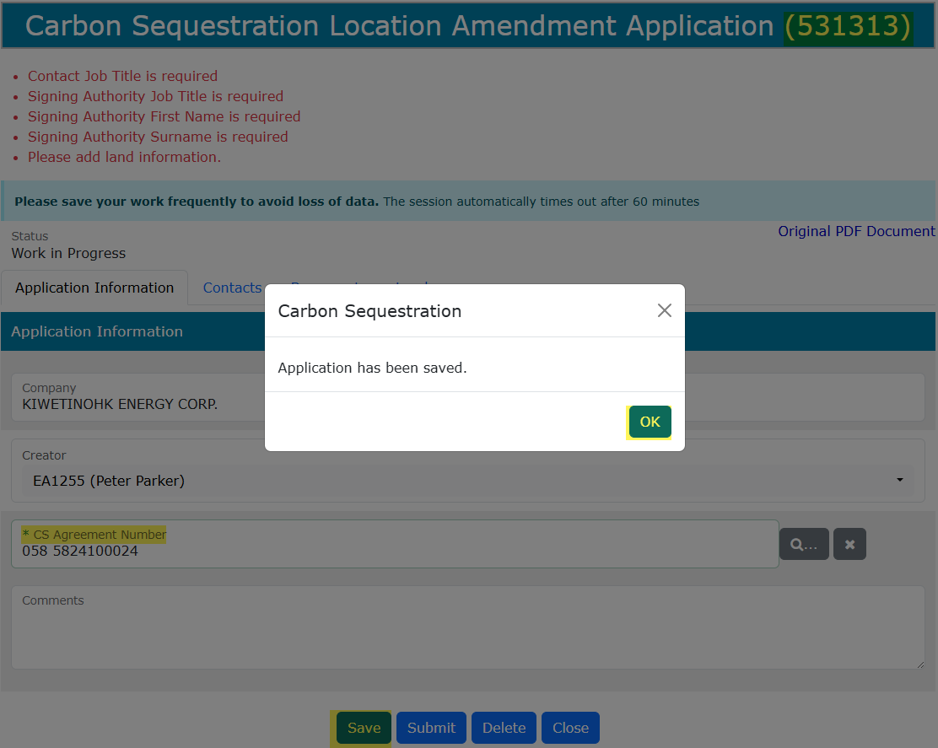
Location Amendment Application
Government of Alberta
APPLICATION INFORMATION TAB – SEARCH AND ADD CS AGREEMENT
In the Search Agreement box,
Click the Agreements field and type in the CS Agreement Number.
Select the magnifying glass to search the agreement.
Search result appears and displays the Agreement, Designated Representative, Expiry Date and Status. Click Select, if the information is correct.
Click Cancel if you need to restart the search.
2.
1.
3.
Back to the main screen, the selected CS Agreement Number is now added.
Click Save. The ETS request is generated at the header.
Click OK.
4.
5.

Slide 8
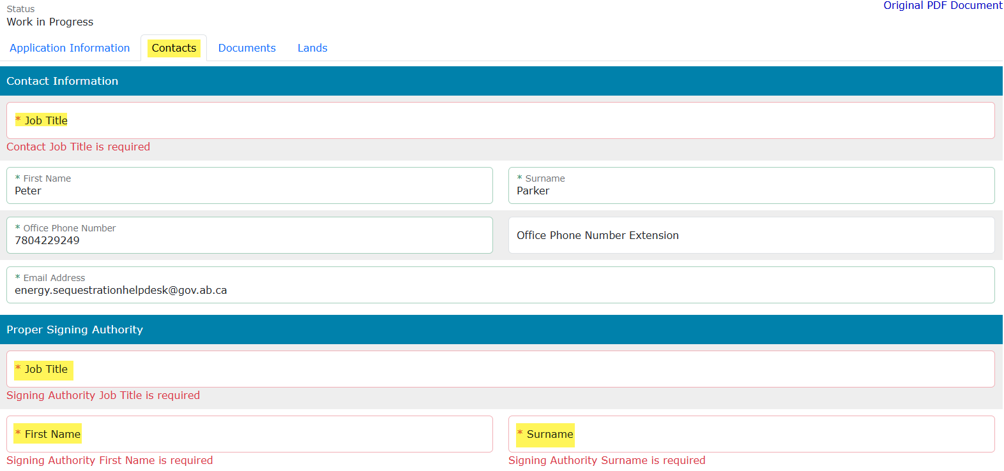
Location Amendment Application
Government of Alberta
CONTACTS TAB – CONTACT INFORMATION AND PROPER SIGNING AUTHORITY
Note: Enter the required information indicated with asterisk (or outlined in red). Once information is entered, the outline turns in green)
Contact Information section – ETS auto populates the Name and Contact information. These information are generated from the login account information. Update the Job Title.
Proper Signing Authority – Enter the required information indicated with asterisk. The Signing Authority is a person who has the authority to sign documents on behalf of the company.

Slide 9
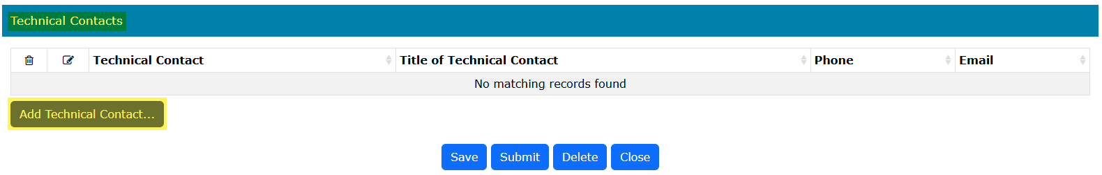
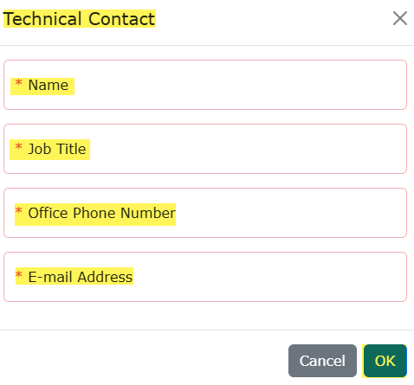
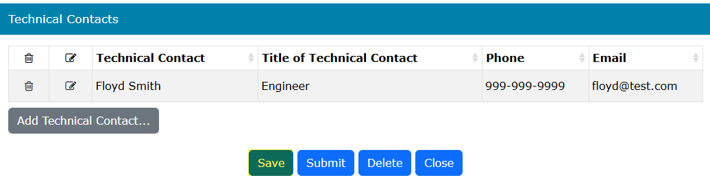
Location Amendment Application
Government of Alberta
CONTACTS TAB – TECHNICAL CONTACTS
1.
2.
Click Add Technical Contact... A new window appears.
Enter the required information indicated with asterisk (or outlined in red). Once information is entered, the outline turns in green)
Click OK to add the Technical Contact in the main grid.
Back to the application form, scroll down and click Save to save all added information.
3.
4.

Slide 10
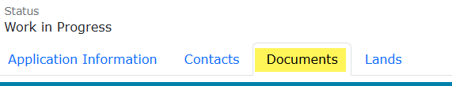
Location Amendment Application
Government of Alberta
DOCUMENT TAB
The Document tab consists of 4 different types of attachment documents:
Hub Development Plan (optional)
This is required only if the CS Agreement Number supplied is a 059 Carbon Sequestration Agreement.
One PDF file of up to 100MB in size may be uploaded.
Proposal
This is required only if the CS Agreement Number supplied is a 058 Carbon Sequestration Evaluation Agreement.
One PDF file of up to 100MB in size may be uploaded.
Pore Space Unit Agreement Document (required)
This is required only if the CS Agreement Number supplied is a 061 Pore Space Lease.
One PDF file of up to 100MB in size may be uploaded.
Supplementary Documents Uploads (required)
This is required for all 058, 059 and 061 CS Agreement types.
Maximum 5 documents with maximum size limit up to 100MB of each file.
File formats include PDF, Excel and ZIP files.

Slide 11
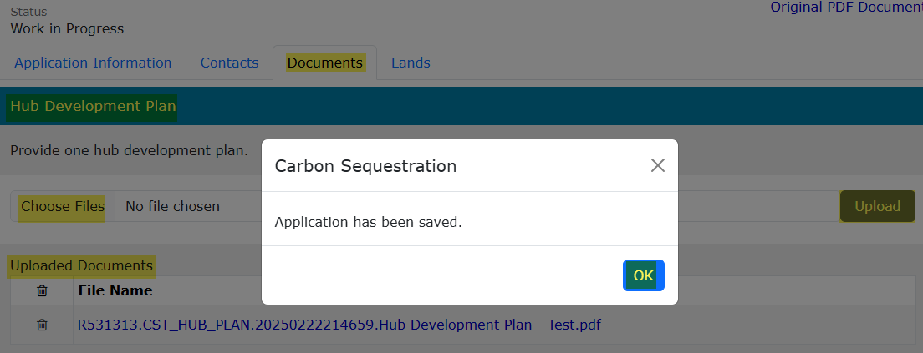
Location Amendment Application
Government of Alberta
DOCUMENT TAB – HUB DEVELOPMENT PLAN (059 CSA)
Under Hub Development Plan section, click Choose Files. File Explorer folders opens. Locate the file to upload.
Back to the ETS request application, the name of the file is added on the ‘No file chosen’ field.
Click Upload.
Save prompt appears, click OK. The document is added in the Uploaded Documents grid.
To delete an uploaded document, simply click the corresponding trash bin icon.
To add, follow the steps above.
1.
3.
2.
4.

Slide 12
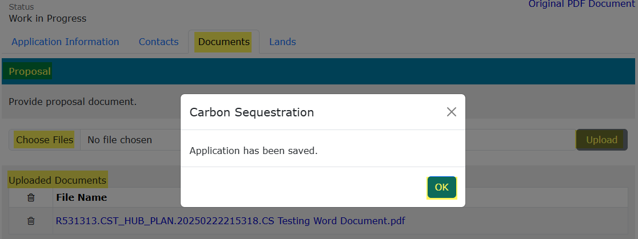
Location Amendment Application
Government of Alberta
DOCUMENT TAB – PROPOSAL (058 CSEA)
Under Proposal section, click Choose Files. File Explorer folders opens. Locate the file to upload.
Back to the ETS request application, the name of the file is added on the ‘No file chosen’ field.
Click Upload.
Save prompt appears, click OK. The document is added in the Uploaded Documents grid.
To delete an uploaded document, simply click the corresponding trash bin icon.
To add, follow the steps above.
1.
2.
3.
4.

Slide 13
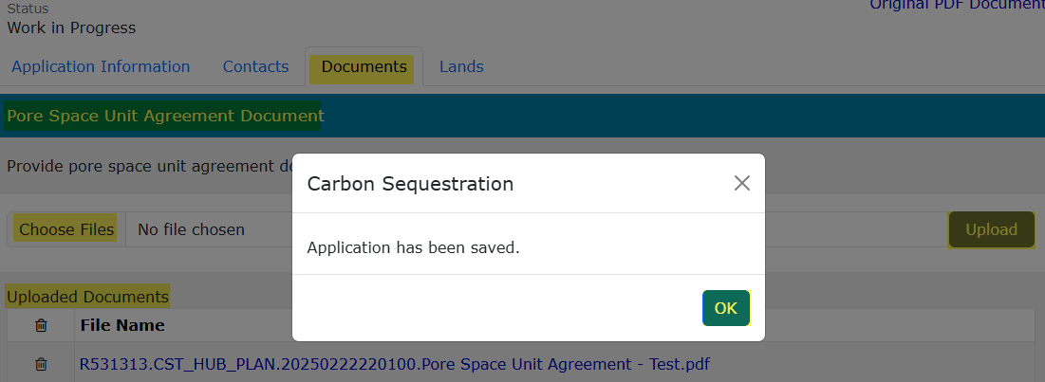
Location Amendment Application
Government of Alberta
DOCUMENT TAB – PORE SPACE UNIT AGREEMENT DOCUMENT (061 PSL)
Under Pore Space Unit Agreement section, click Choose Files. File Explorer folders opens. Locate the file to upload.
Back to the ETS request application, the name of the file is added on the ‘No file chosen’ field.
Click Upload.
Save prompt appears, click OK. The document is added in the Uploaded Documents grid.
To delete an uploaded document, simply click the corresponding trash bin icon.
To add, follow the steps above.
1.
3.
2.
4.

Slide 14
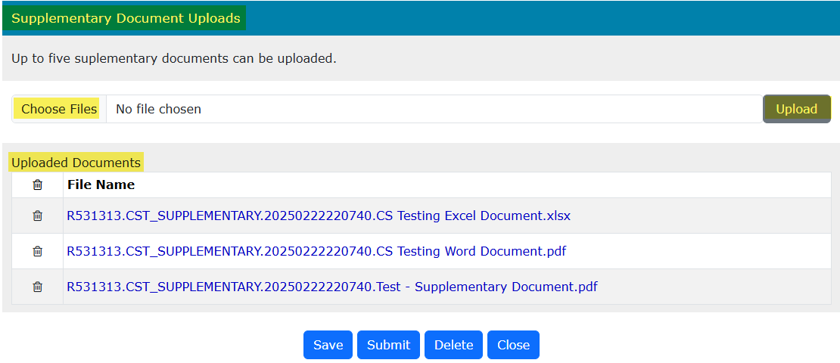
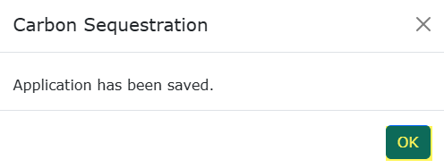
Location Amendment Application
Government of Alberta
DOCUMENT TAB – UPLOAD SUPPLEMENTARY DOCUMENT
Under Supplementary Document Uploads section, click Choose Files. File Explorer folders opens. Locate the file to upload. Note: up for 5 supplementary documents can be uploaded.
Back to the ETS request application, the number of uploaded files is added on the ‘No file chosen’ field.
Click Upload.
Save prompt appears, click OK. The document is added in the Uploaded Documents grid.
To delete an uploaded document, simply click the corresponding trash bin icon.
To add, follow the steps above.
1.
3.
2.
4.

Slide 15

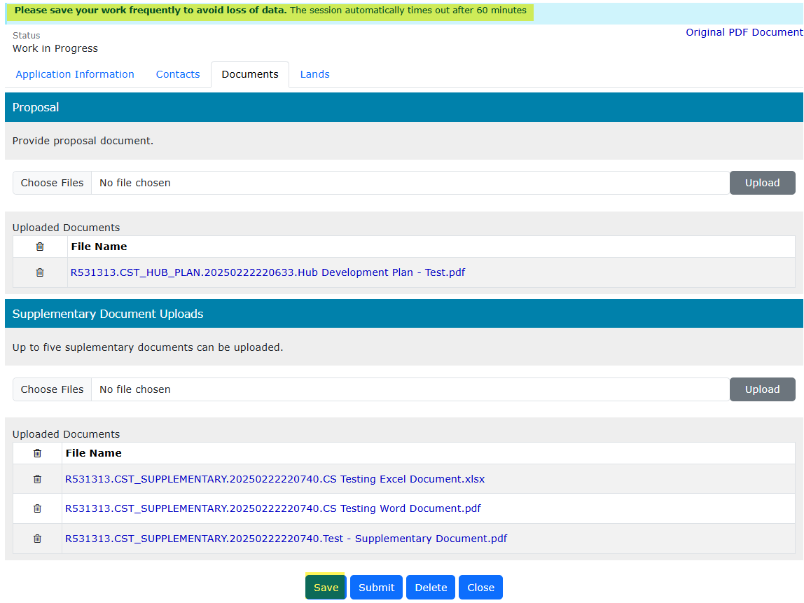
Location Amendment Application
Government of Alberta
DOCUMENTS TAB – SAVE
Once your documents have been uploaded and are displaying under the Uploaded Documents grid, click Save.
Save your work frequently to avoid the loss of data. The session will automatically time out after 60 minutes.

Slide 16
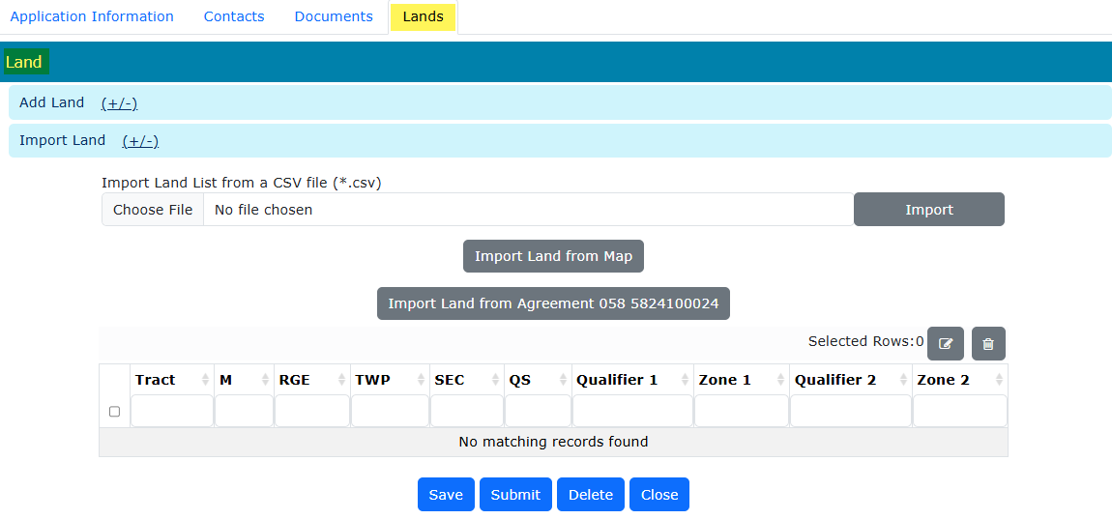
Location Amendment Application
Government of Alberta
LANDS TAB
The Lands tab allows industry to specify lands for location amendment on the supplied CS Agreement.
Creator must import existing lands from the supplied CS Agreement.
Location Amendment request can be one of the following or a combination of the following:
Delete existing lands that will be removed from the agreement.
Update the zone information, i.e. Qualifier 1, Zone 1, Qualifier 2, Zone 2, on existing lands.
Add new lands and specify zones on those new lands to the agreement.

Slide 17
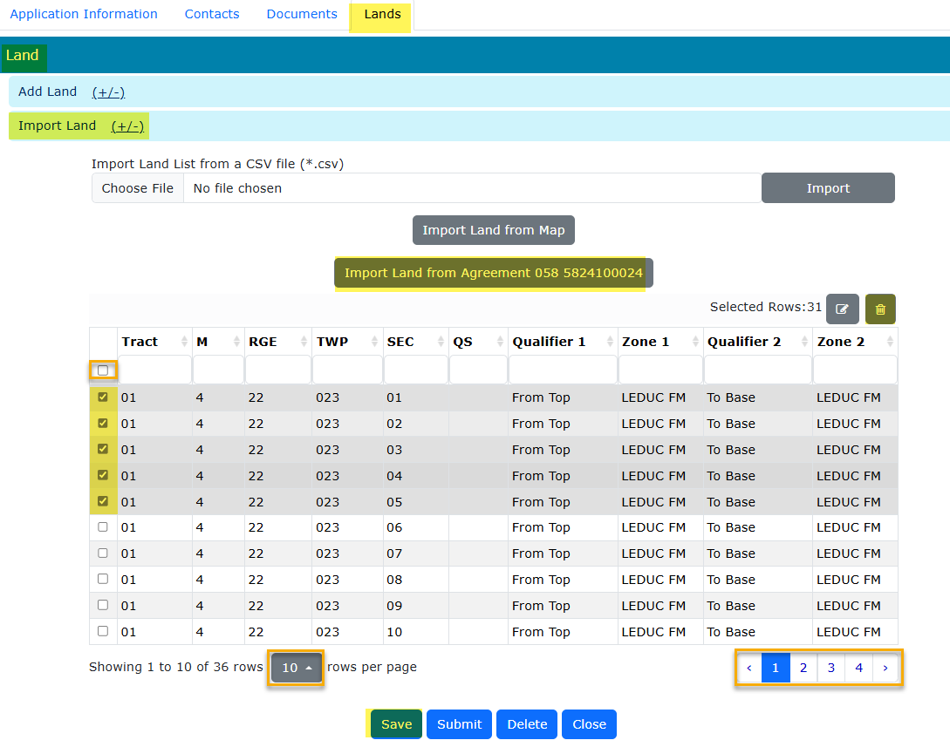
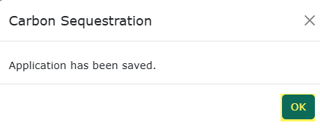
Location Amendment Application
Government of Alberta
LANDS TAB – DELETE EXISTING LANDS
Delete existing lands that will be removed from the agreement.
Creator must import existing lands from the supplied CS Agreement.
4. Click the trash bin icon to delete the selected lands. The selected lands are removed from the grid.
2. Click Import Land from Agreement ##supplied CS Agreement##.
1. Click Import Land (+/-)
This checkbox selects all landkeys.
5. Click OK.
3. Checkmark the lands to be deleted.
User can show up to 50 rows per page.
User can navigate each page here.
4. Click Save.

Slide 18
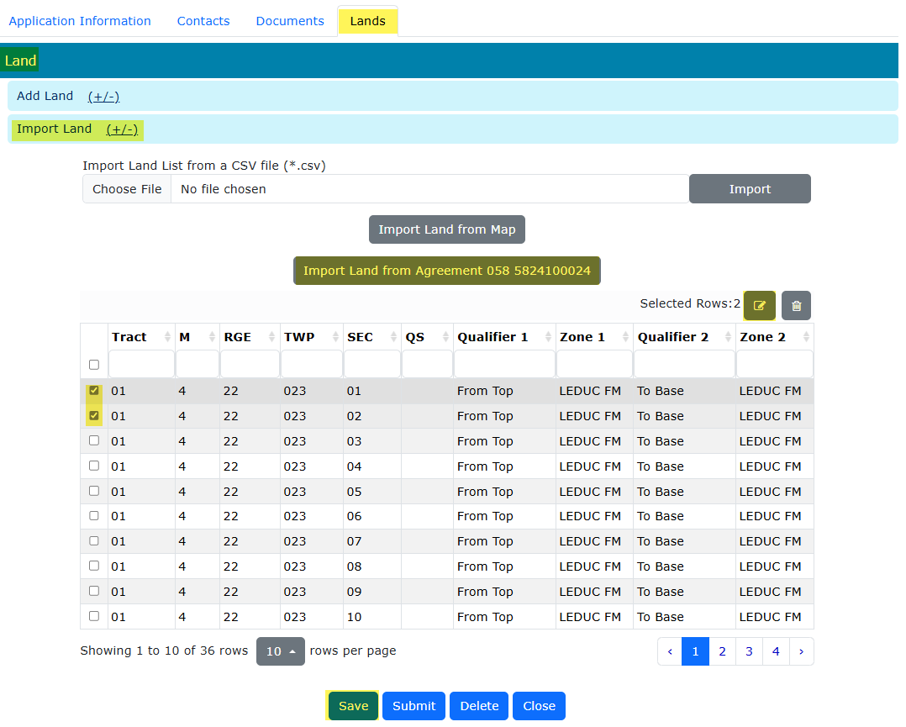
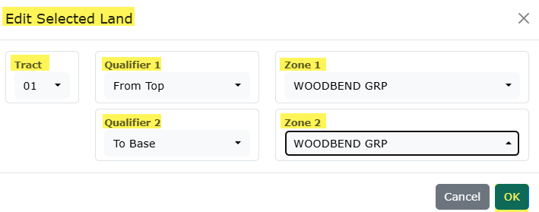
Location Amendment Application
Government of Alberta
LANDS TAB – UPDATE ZONE INFORMATION
Update the zone information on existing lands, i.e. Qualifier 1, Zone 1, Qualifier 2, Zone 2, on existing lands.
Creator must import existing lands from the supplied CS Agreement.
2. Click Import Land from Agreement ##supplied CS Agreement##
1. Click Import Land (+/-)
4. Click the modify icon to update the selected lands.
3. Checkmark the lands to be updated.
5. Edit Selected Land. Input the amended zone
6. Click OK.
7. Click Save.

Slide 19
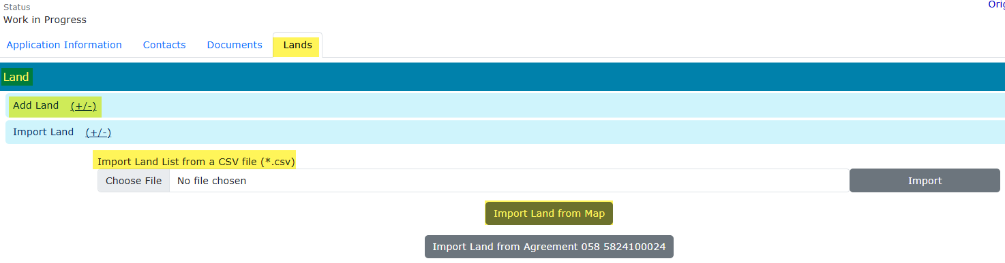
Location Amendment Application
Government of Alberta
LANDS TAB – ADD NEW LANDS
Add new lands and specify zones on those new lands to the agreement.
Adding lands have 3 options:
1. Add Land (+/-)
Import Land (+/-)
2. Import Land List from a CSV file (*.csv)
3. Import Land from Map (shapefile)
1.
2.
3.

Slide 20
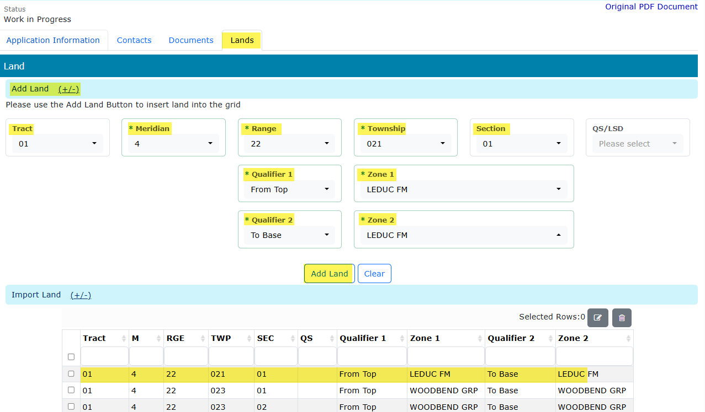

Location Amendment Application
Government of Alberta
LANDS TAB – ADD NEW LANDS
OPTION 1: ADD LAND (+/-)
Use this option if prefer to enter lands one landkey at a time.
Click Add Land (+/-). The screen below appears.
Input the required information (flagged with asterisk and outlined in red)
Click Add Land to add the land into the grid. Required information inputted and added into the land grid.
Repeat previous steps to add remaining lands.
Click Save.
1.
2.
3.

Slide 21
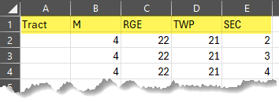
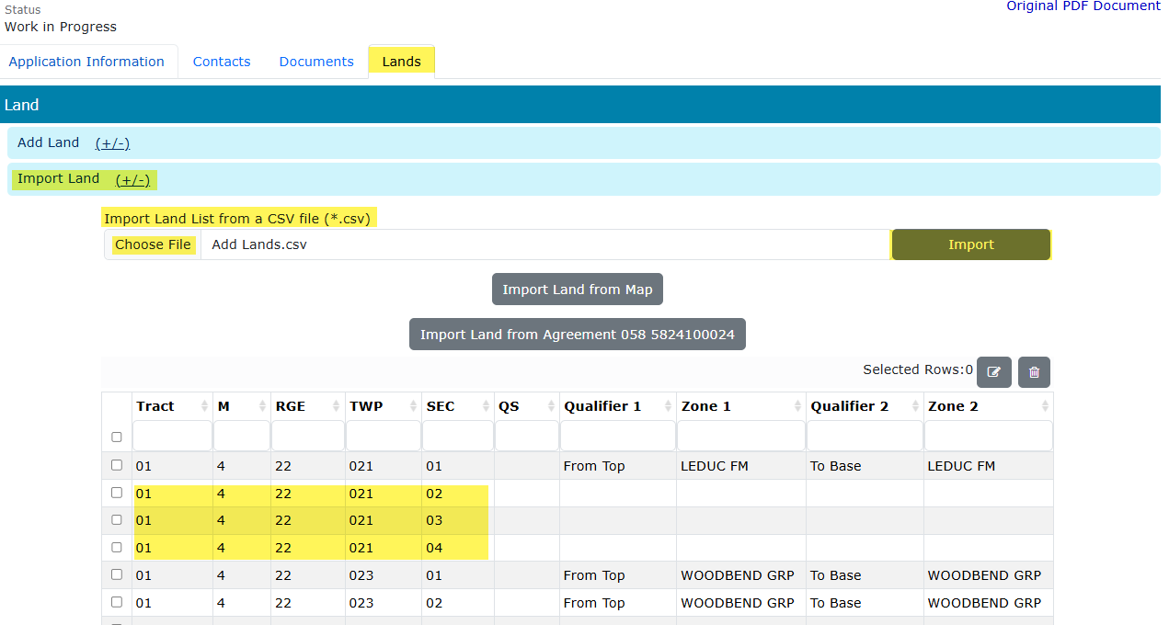
Location Amendment Application
Government of Alberta
LANDS TAB – ADD NEW LANDS
OPTION 2: IMPORT LAND LIST FROM A CSV FILE (*.csv)
Create a .csv file. The format must be as follows:
Tract, M, RGE, TWP and SEC.
To import, navigate to the ETS request/ Lands tab.
Click Import Land (+/-).
Click Choose File to browse the .csv file on your personal computer.
Navigate to the File Explorer and select the .csv file and click Open. The file is now chosen.
Click Import to add the lands into the grid.
Click Save.
1.
2.
3.
4.
6.
5.
6.
7.

Slide 22
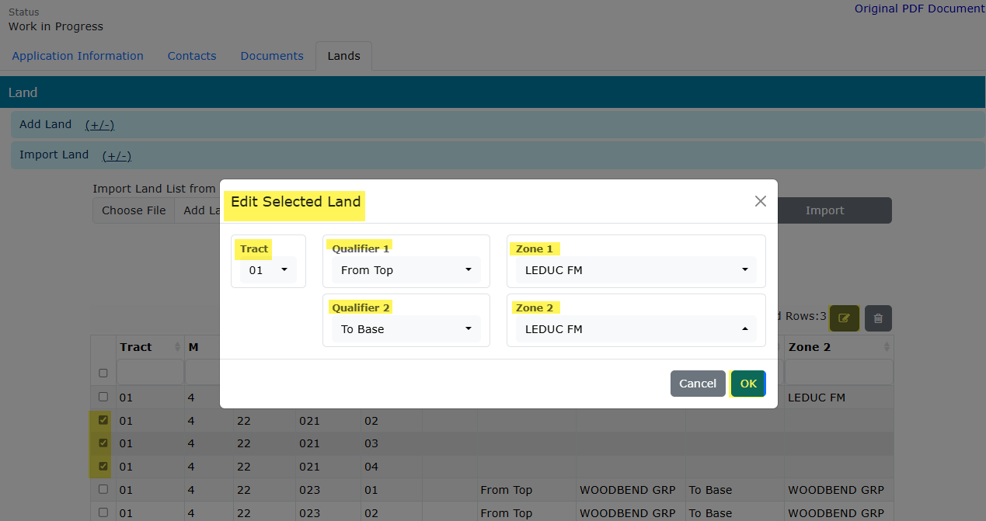
Location Amendment Application
Government of Alberta
LANDS TAB – ADD NEW LANDS
OPTION 2: IMPORT LAND LIST FROM A CSV FILE (*.csv) – EDIT LANDS
Lands are now added into the grid. Qualifiers and Zones are required.
Select all landkeys. Checkmark the new added lands.
Click the modify landkey icon. Edit Selected Land box appears.
“Edit Selected Land’ box appears. Add the Qualifiers and Zones.
Click OK.
Click Save.
4.
3.
5.
2.
1.
6.

Slide 23
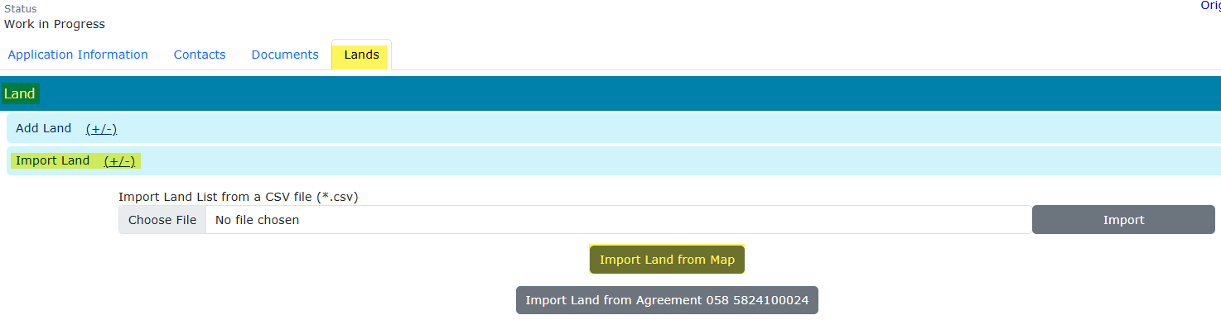
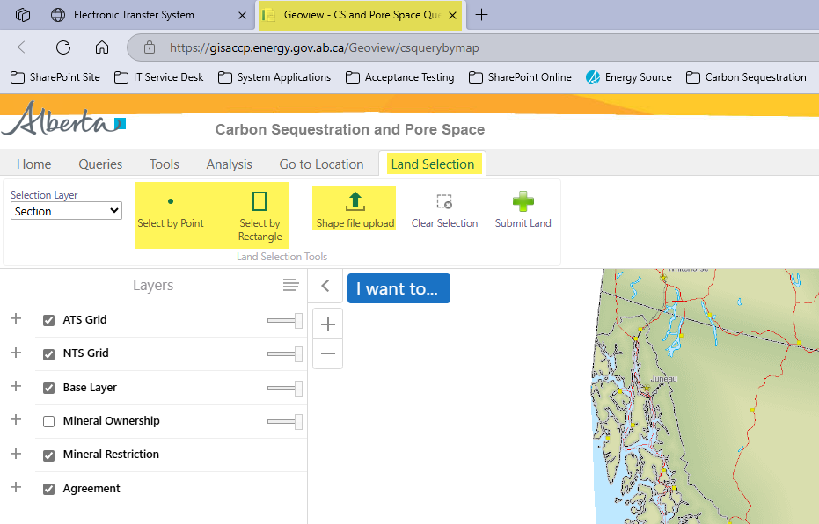
Location Amendment Application
Government of Alberta
LANDS TAB – ADD NEW LANDS
OPTION 3: IMPORT LAND FROM MAP
Click Import Land (+/-)/ Import Land from Map
Geoview – Carbon Sequestration and Pore Space Query map is opened on a new browser page.
Under Land Selection tab, there are 2 option to import land from Map: selecting the lands directly from the map (Select by Point or Select by Rectangle) or shape file upload.
1.
2.
3.

Slide 24
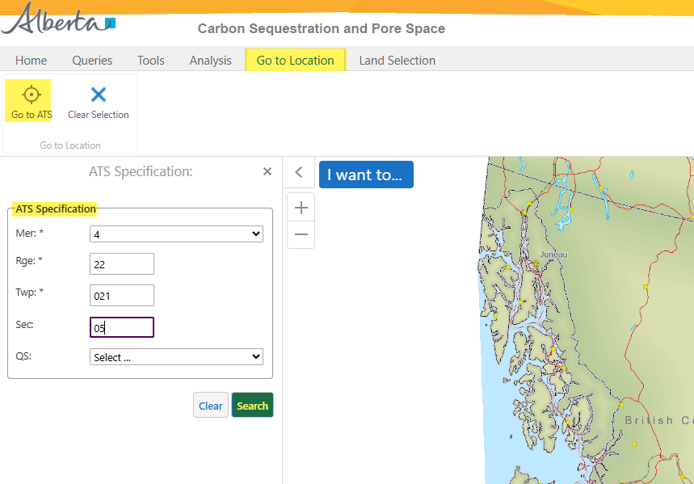
Location Amendment Application
Government of Alberta
LANDS TAB – ADD NEW LANDS
OPTION 3: IMPORT LAND FROM MAP – NAVIGATE TO THE TARGET LOCATION
2. Click Go to ATS.
1. Navigate to Go to Location tab.
3. Input the landkey.
4. Click Search.

Slide 25
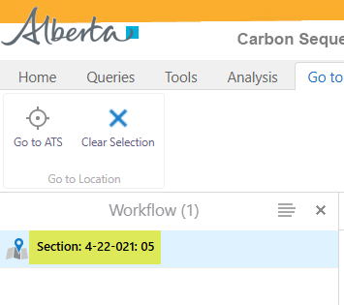
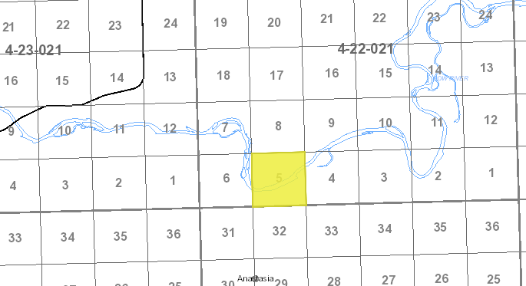
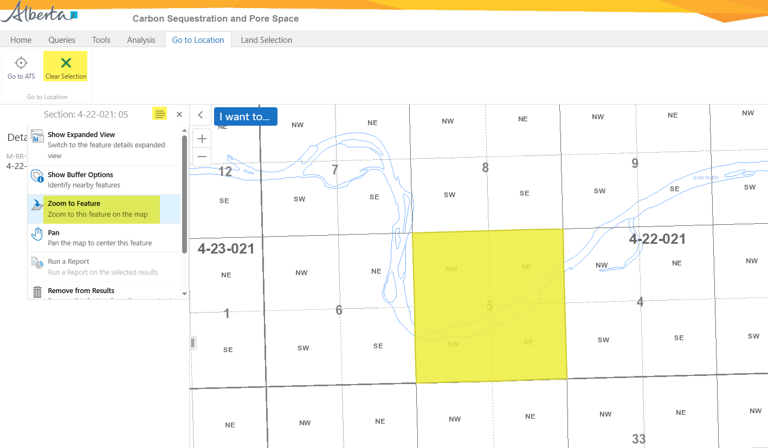
Location Amendment Application
Government of Alberta
LANDS TAB – ADD NEW LANDS
OPTION 3: IMPORT LAND FROM MAP – NAVIGATE TO THE TARGET LOCATION
5. Click Clear Selection.
1. Select the land result.
2. Click the hamburger icon.
4. Zoom in or Zoom out on the target location.
3. Click Zoom to Feature.

Slide 26
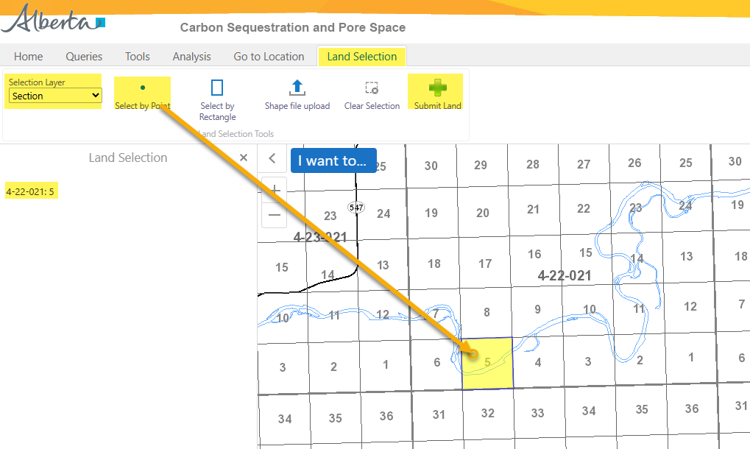
Location Amendment Application
Government of Alberta
LANDS TAB – ADD NEW LANDS
OPTION 3A: IMPORT LAND FROM MAP – ADD LAND - SELECT BY POINT
Once a target location is searched, add the land. There are 2 options:
Select by Point (use this option if selecting lands not adjacent to each other.)
Select by Rectangle
1. Navigate to Land Selection tab.
3. Click Select by Point.
6. Click Submit Land.
Note: only click this button once. Do not click repeatedly as the lands will be listed more than once on the ETS request.
2. Change Selection Layer, if required before selecting land(s).
5. As land is selected, the land node displays the selected landkeys here.
Repeat steps 1-4 to add remaining lands.
4. Point and click the section to add.

Slide 27
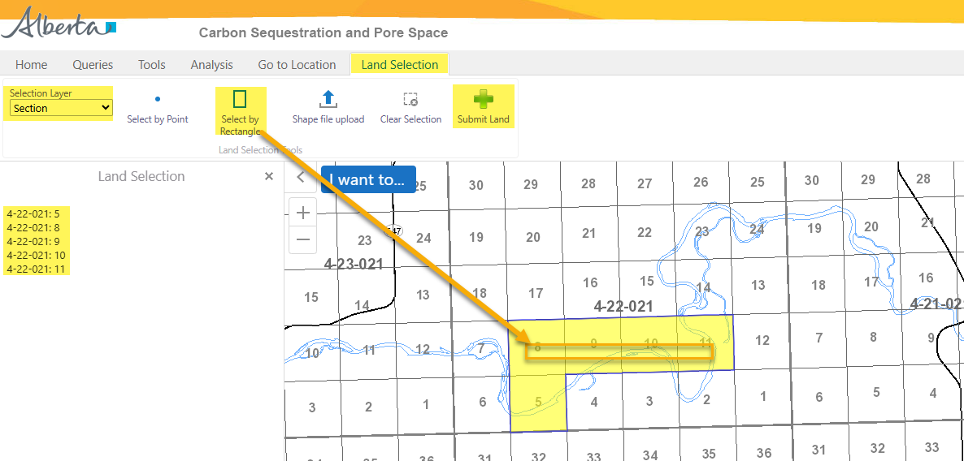
Location Amendment Application
Government of Alberta
LANDS TAB – ADD NEW LANDS
OPTION 3A: IMPORT LAND FROM MAP – ADD LAND - SELECT BY RECTANGLE
Once a target location is searched, add the land. There are 2 options:
Select by Point
Select by Rectangle (use this if selecting adjacent lands.)
2. Change Selection Layer, if required before selecting land(s).
1. Navigate to Land Selection tab.
3. Click Select by Rectangle
6. Click Submit Land.
Note: only click this button once. Do not click repeatedly as the lands will be listed more than once on the ETS request.
4. Draw a rectangle on multiple lands required to select.
5. As land is selected, the land node displays the selected landkeys here.
Repeat steps 1-4 to add remaining lands.
Once lands added are submitted from the Geoview map, the lands are loaded back into the ETS request land grid.
Added new lands must edit the zones/qualifiers. Refer to Slide 22 Edit Rights.

Slide 28
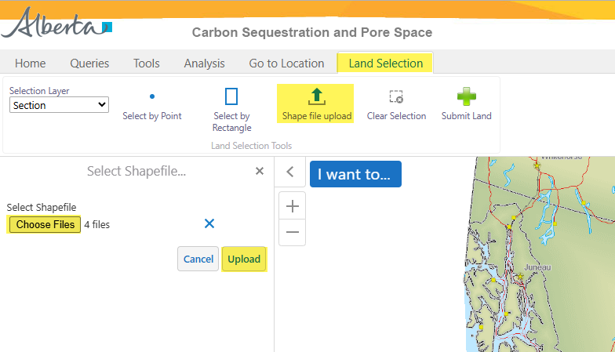
Location Amendment Application
Government of Alberta
LANDS TAB – ADD NEW LANDS
OPTION 3B: IMPORT LAND FROM MAP – SHAPE FILE UPLOAD
1. Navigate to Land Selection tab.
3. Click Choose Files. File Explorer opens. Browse to the location of the shape file to upload.
2. Click Shape file upload.
4. Number of files to upload are indicated in this field.
5. Click Upload.

Slide 29
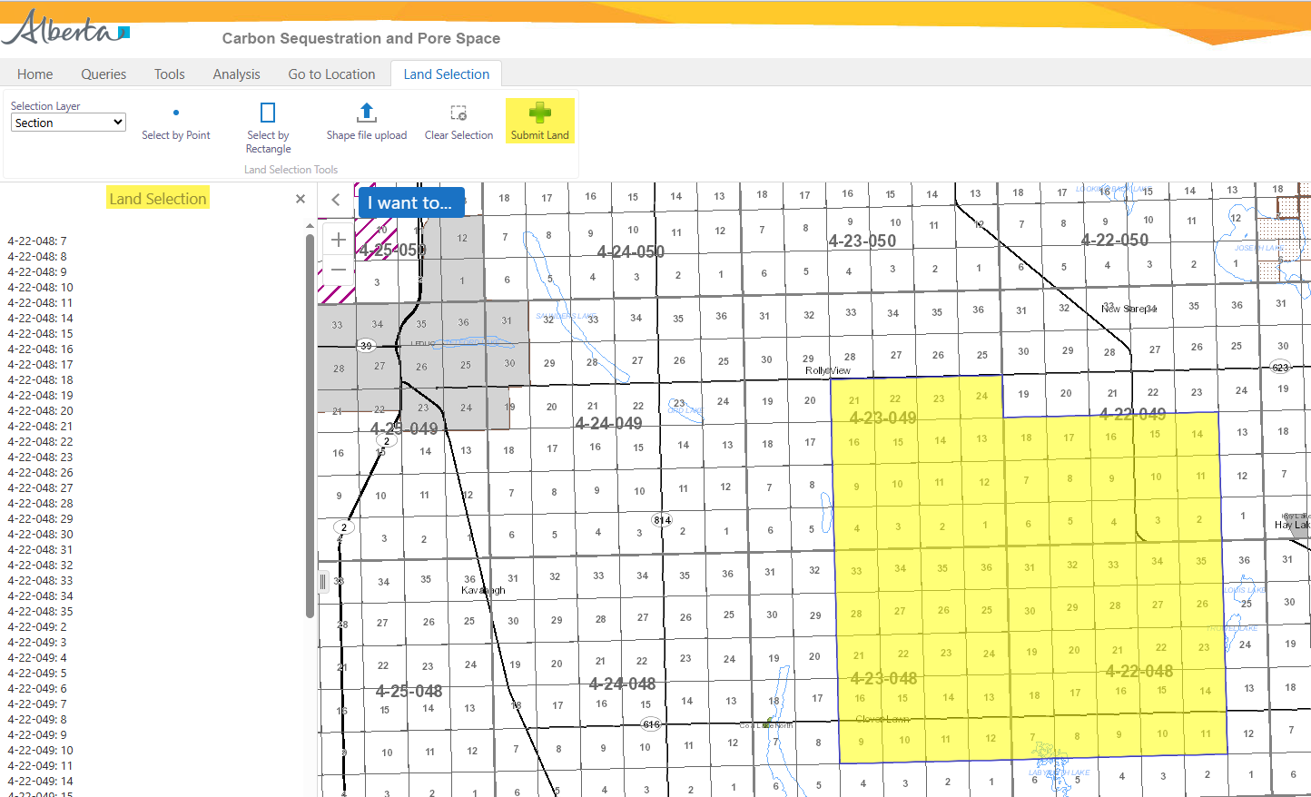
Location Amendment Application
Government of Alberta
LANDS TAB – ADD NEW LANDS
OPTION 3B: IMPORT LAND FROM MAP – SHAPE FILE UPLOAD
1. Click Submit Land
Landkeys uploaded via shape file.
Land Selection treenode list all landkeys uploaded via shape file.
Once lands added are submitted from the Geoview map, the lands are loaded back into the ETS request land grid.
Added new lands must edit the zones/qualifiers. Refer to Slide 22 Edit Rights.

Slide 30
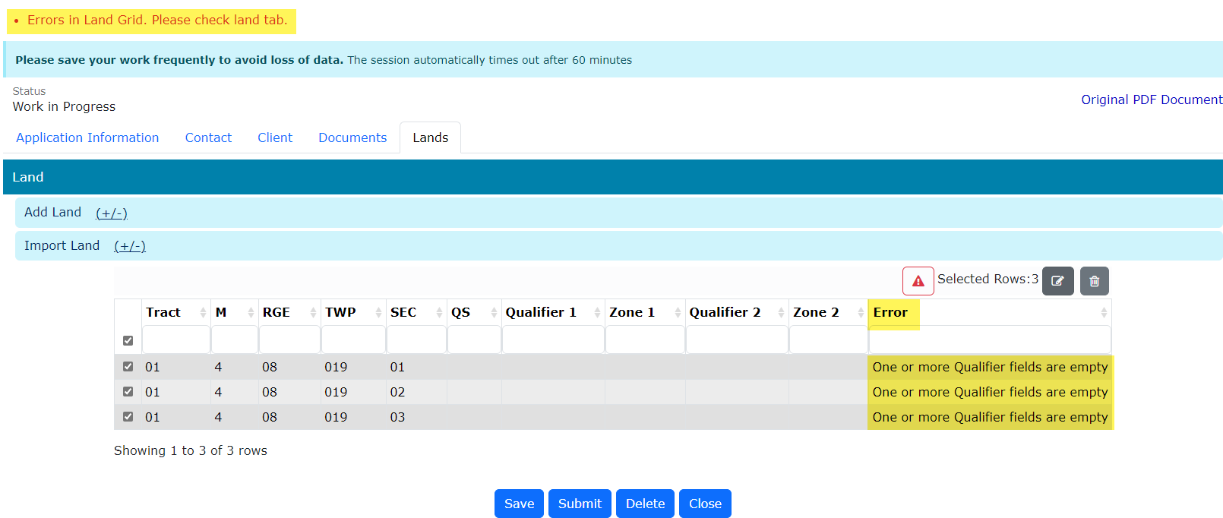
Location Amendment Application
Government of Alberta
VALIDATION ERRORS – ERRORS IN LAND GRID
Any validation errors are displayed at the top of the application in red. These require attention before proceeding to the next step of the application.
Validation error: One or more Qualifier fields are empty
Refer to Slide 22 ‘Edit Selected Lands’.

Slide 31
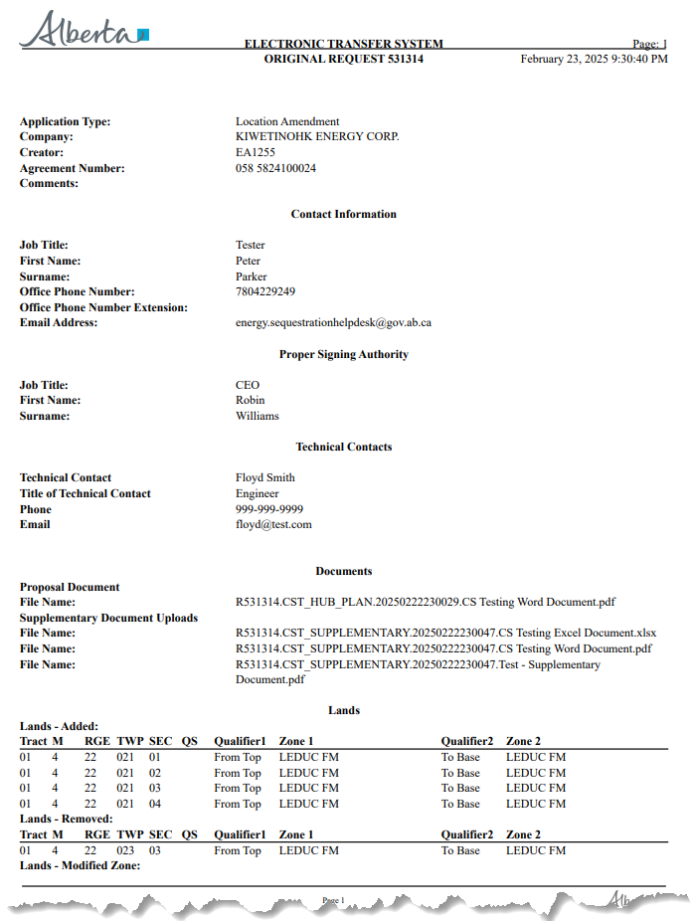
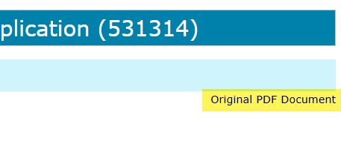
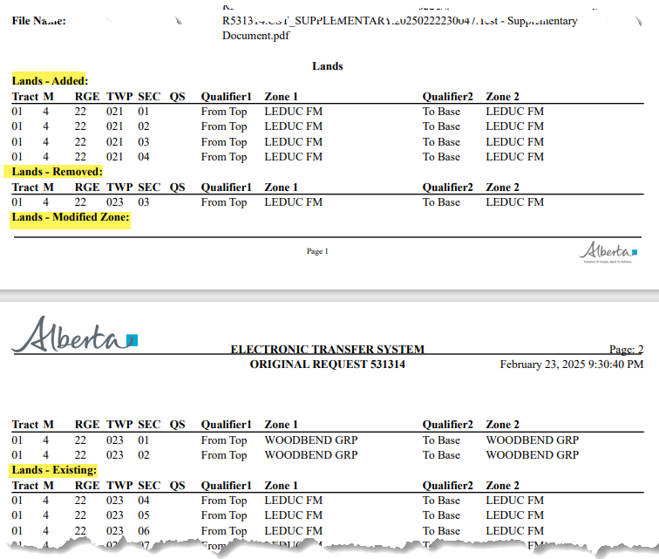
Location Amendment Application
Government of Alberta
APPLICATION SUMMARY REPORT
The Original PDF Document link is the application summary report. It contains all data entered on the application.
This tool is useful to review the entire application before submitting the application.
Click Original PDF Document link (top right of the form) to generate the report.
The report also contains Land information pertaining to the location amendment.

Slide 32
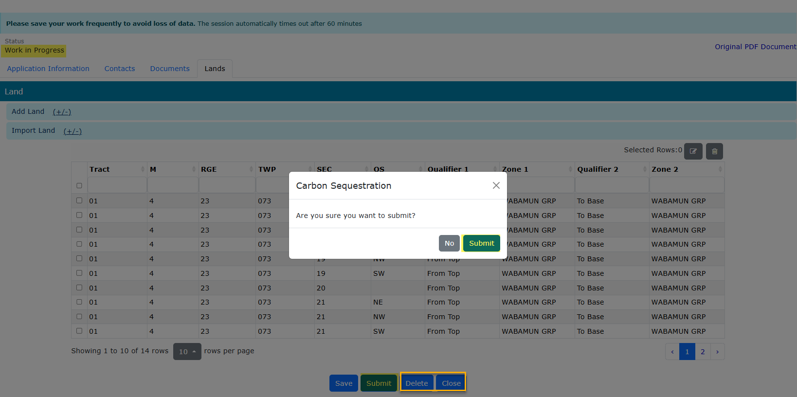
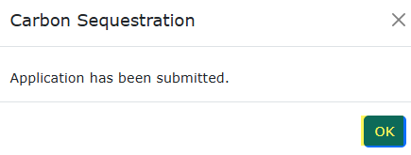
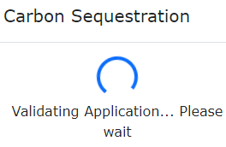
Location Amendment Application
Government of Alberta
SUBMIT APPLICATION
3. Click OK
2. Click Submit
1. Click Submit
Delete (deletes entire application) is available when the request Status is at Work in Progress.
Close (closes application).

Slide 33
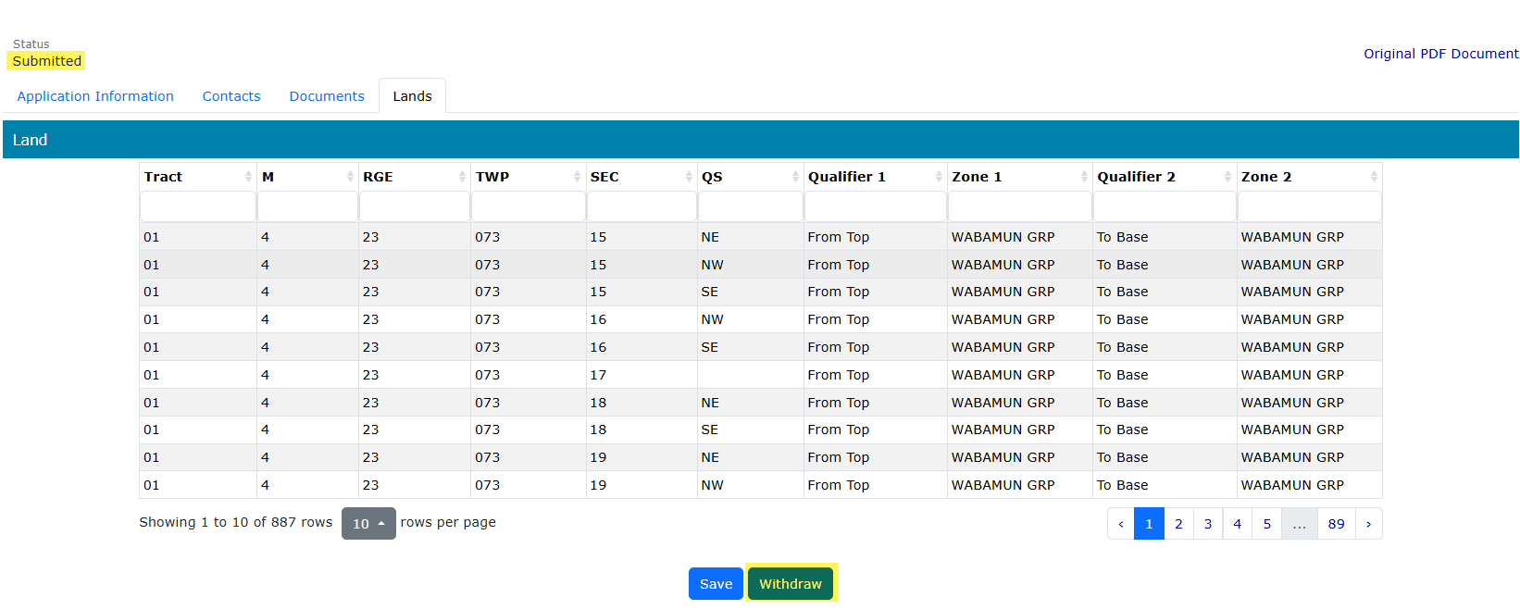
Location Amendment Application
Government of Alberta
WITHDRAW APPLICATION
The Withdraw button is only available when the Status is at Submitted.
The creator or submitter has the option to withdraw the application during the duration of the status of Submitted.
When the request status is changed from Submitted to Processing, the Withdraw button is no longer available.

Slide 34
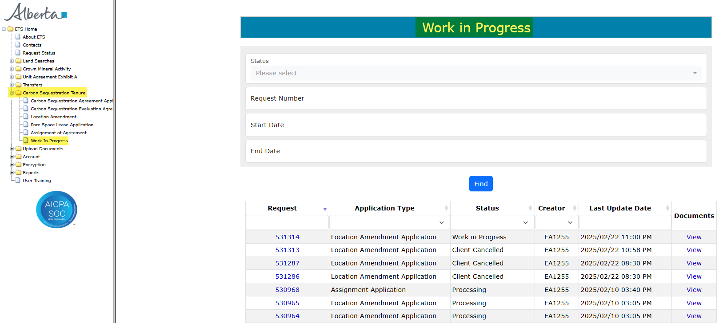
Location Amendment Application
Government of Alberta
WORK IN PROGRESS
The Work in Progress screen contains all different status depending on the state of each ETS Request.
To search all ETS requests, select the Find icon on the Work in Progress screen.
User can also narrow the search by the following search parameters: Status, Request Number, Start Date and End Date.
Click the Request link to view the application.

Slide 35
Location Amendment Application
Government of Alberta
WORK IN PROGRESS – continued…
Work in Progress
The creator can modify and save the form.
Submitted
The creator or submitter has Submitted the form.
Processing
The request has been submitted to Alberta Energy and Minerals. Only the contact information can be modified at this point. The rest of the application is read-only.
Completed
Application has been completed and agreements documents have been issued.
Client Withdrawn
Client has withdrawn the ETS application. This notifies Alberta Energy and Minerals they no longer want to proceed with the application.
Department Rejected
Alberta Energy and Minerals has rejected the client’s requested application.

Slide 36
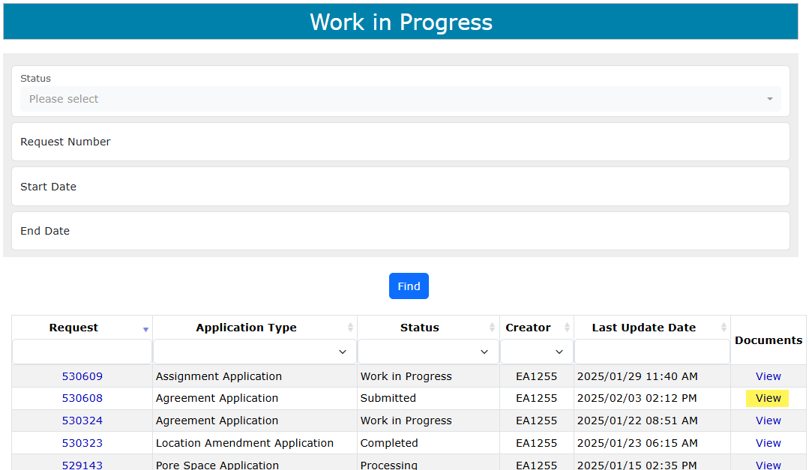
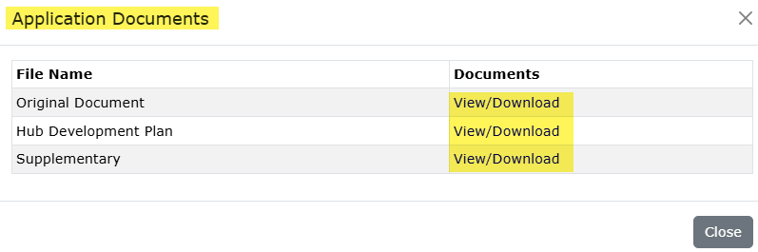
Location Amendment Application
Government of Alberta
WORK IN PROGRESS – View Documents
User has the option to view all documents for the corresponding ETS request. The Application Documents box list all attached documents from the application.
2. Click View/Download
1. Click View

Slide 37

Location Amendment Application
Government of Alberta
Congratulations!
You have completed the
Location Amendment
Online Training Course
If you have any comments or questions on this training course,
please forward them to:
energy.sequestrationhelpdesk@gov.ab.ca

