Slide 1
Information Request – Upload Documents
Government of Alberta
Welcome!
To the
Information Request –
Upload Documents
Online Training Course
In this module you will learn how to:
Upload documents
Retrieve and view documents

Slide 2
Information Request – Upload Documents
Government of Alberta
Revisions Table
Date | Revisions Type | Page Number
February 3, 2025 | Initial Creation | All

Slide 3
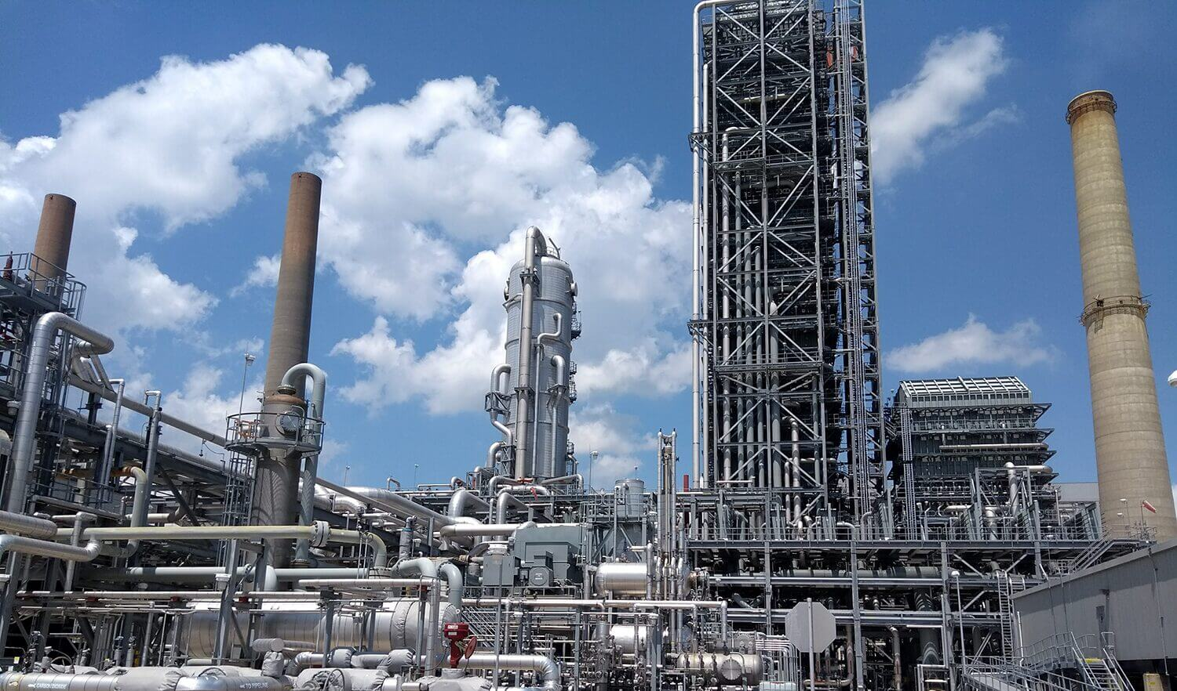
Information Request – Upload Documents
Government of Alberta
INTRODUCTION
This Upload Documents is only used until after an agreement has been issued and active. The purpose is to upload annual report, requested information response, notice of change in ownership or control and other document types.

Slide 4
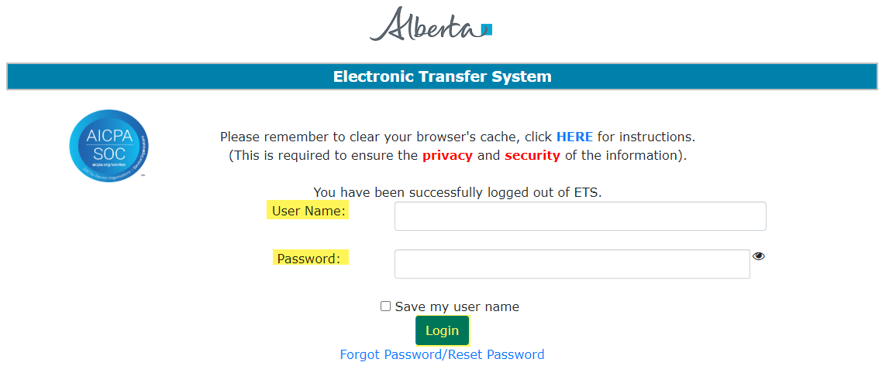
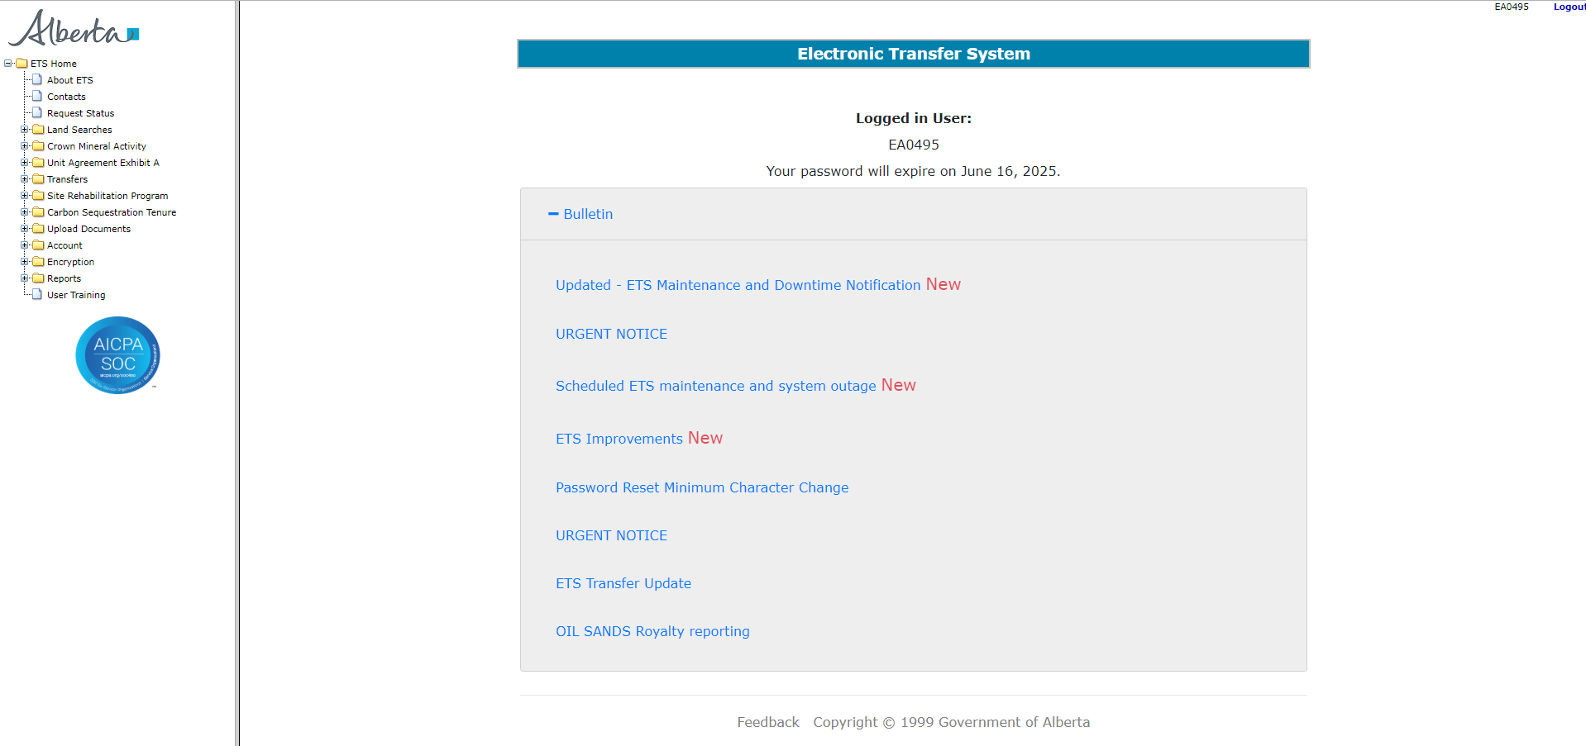
Information Request – Upload Documents
Government of Alberta
LOGIN TO ETS
Go to ETS (https://ets.energy.gov.ab.ca/logon.aspx)
Enter your login credentials: User Name (EN account) and Password.
Once logged in, the screen below is displayed.

Slide 5
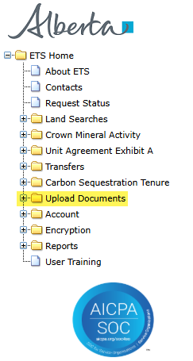
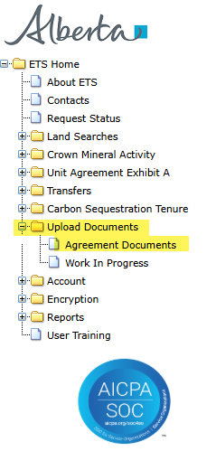
Information Request – Upload Documents
Government of Alberta
NAVIGATION TO UPLOAD DOCUMENTS
In the treenode (left-hand side of the screen), navigate to Upload Documents node.
Expand Upload Documents to display its subnodes.
Click Agreement Documentssubnode.
2.
1.
3.

Slide 6
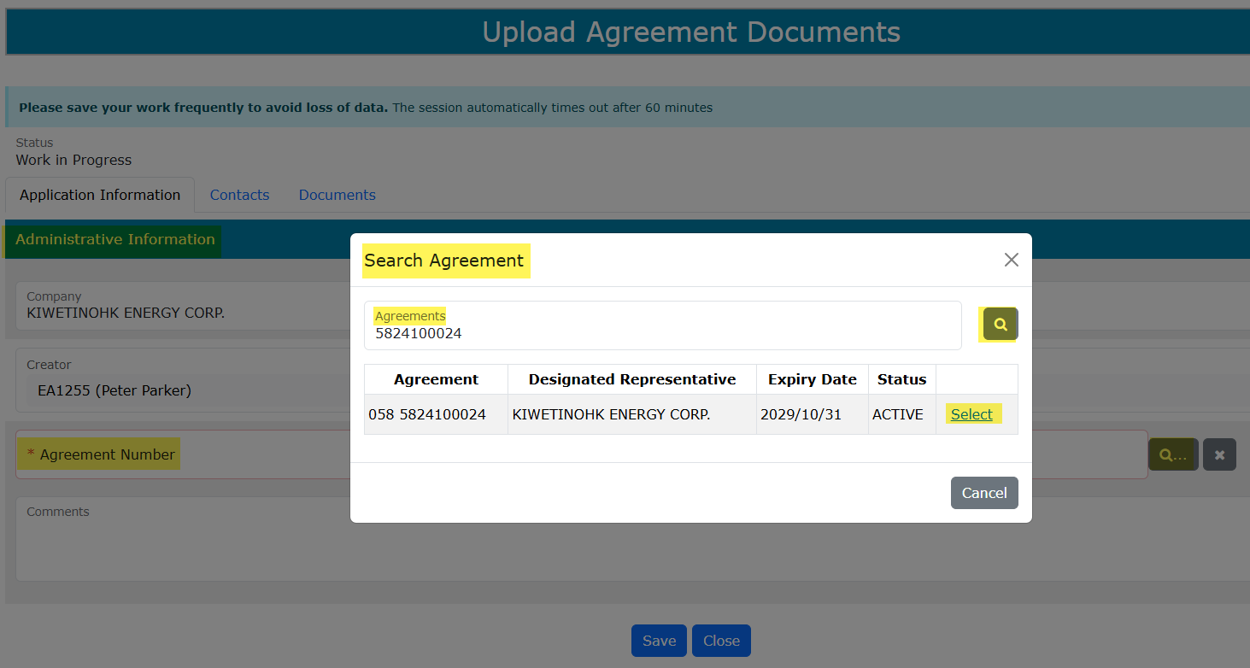
Information Request – Upload Documents
Government of Alberta
APPLICATION INFORMATION TAB
On the main screen, a blank application form is displayed. ETS auto populates the Company and Creator fields. These information are generated from the login account information.
Mandatory fields are outlined in red and flagged with asterisk (*).
2. Enter the CS Agreement number
3. Click the magnifying glass to search agreement.
4. Click Select.
1. Click the magnifying glass to search agreement.
Note: Only the CS Agreement Designated Representative have permission to upload documents.

Slide 7
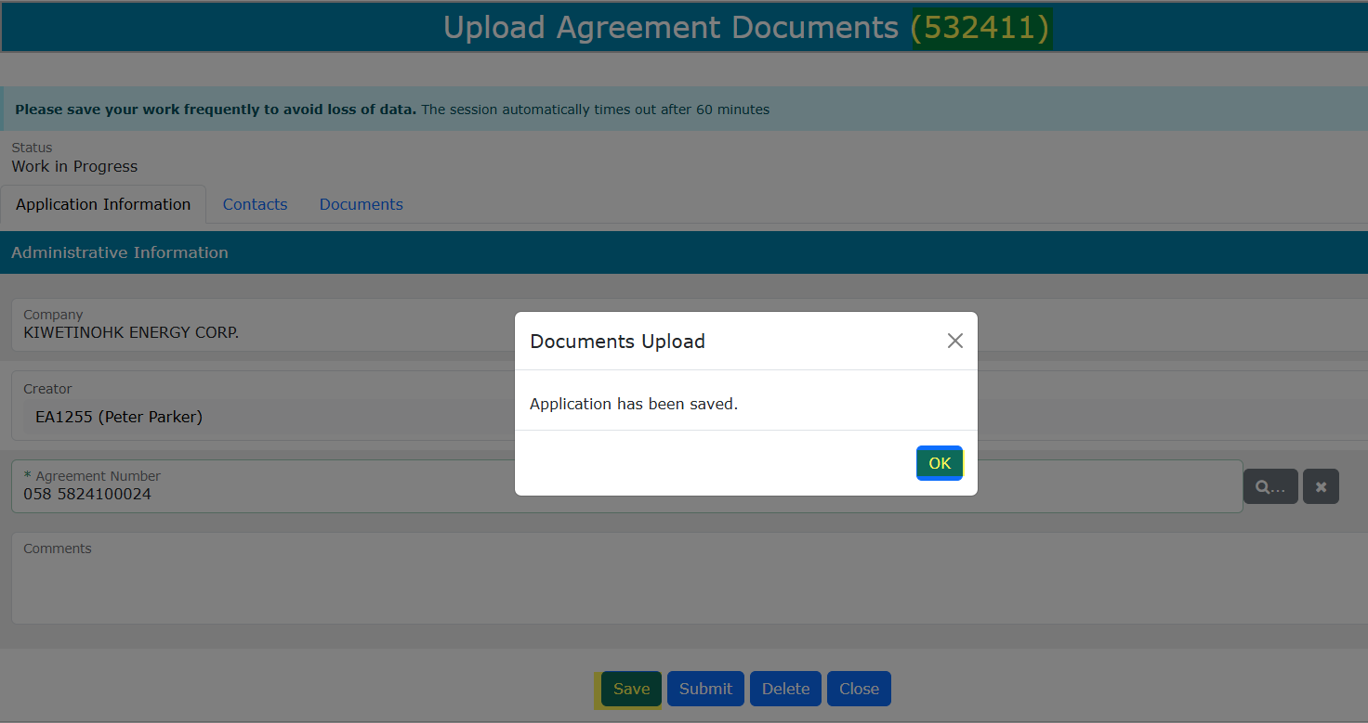
Information Request – Upload Documents
Government of Alberta
APPLICATION INFORMATION TAB
First click of Save, ETS request number is generated at the header.
2. Click OK
1. Click Save

Slide 8
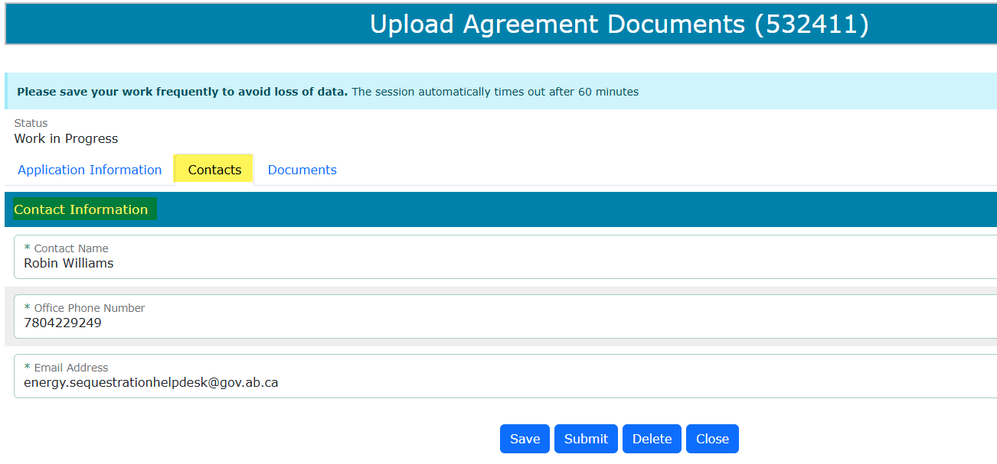
Information Request – Upload Documents
Government of Alberta
CONTACTS TAB
Contact Information is autopopulated based on the login information.
If required, the fields are editable. Then, click Save to save changes.

Slide 9
Information Request – Upload Documents
Government of Alberta
DOCUMENTS TAB – DOCUMENT TYPE
Depending on the CS Agreement number entered in the Application Information tab, the Document type dropdown selection varies.
Document Type | 058 (CSEA) | 059 (CSA) | 061 (PSL)
Annual Report | ✓
Notice of change in ownership or control | ✓ | ✓
Requested Information response | ✓ | ✓ | ✓
Insurance information |  | ✓
Revised Hub Development Plan |  | ✓
Other | ✓ | ✓ | ✓
Carbon Sequestration Evaluation Agreement (CSEA)
Carbon Sequestration Agreement (CSA)
Pore Space Lease (PSL)

Slide 10
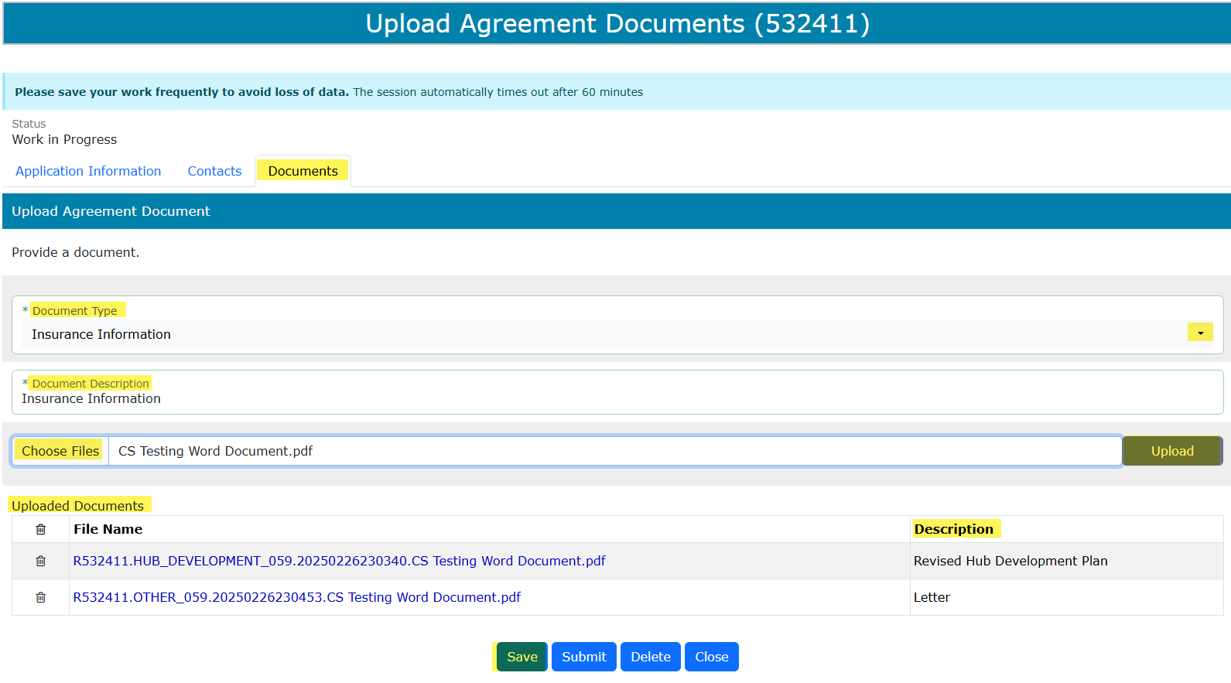
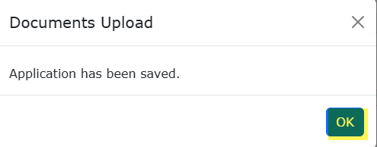
Information Request – Upload Documents
Government of Alberta
DOCUMENTS TAB – UPLOAD DOCUMENTS
Document Type. Click the Document Type dropdown list and select document type.
Document Description. Type in the description of the document to upload.
Upload Files. Click Choose Files. Browser to your folder opens. Select the document. Filename is added on the field
Click Upload. The Uploaded Documents are added on the grid. Click OK.
Click Save. The corresponding Description of the uploaded document is added on the grid.
1.
2.
4.
3.
5.

Slide 11
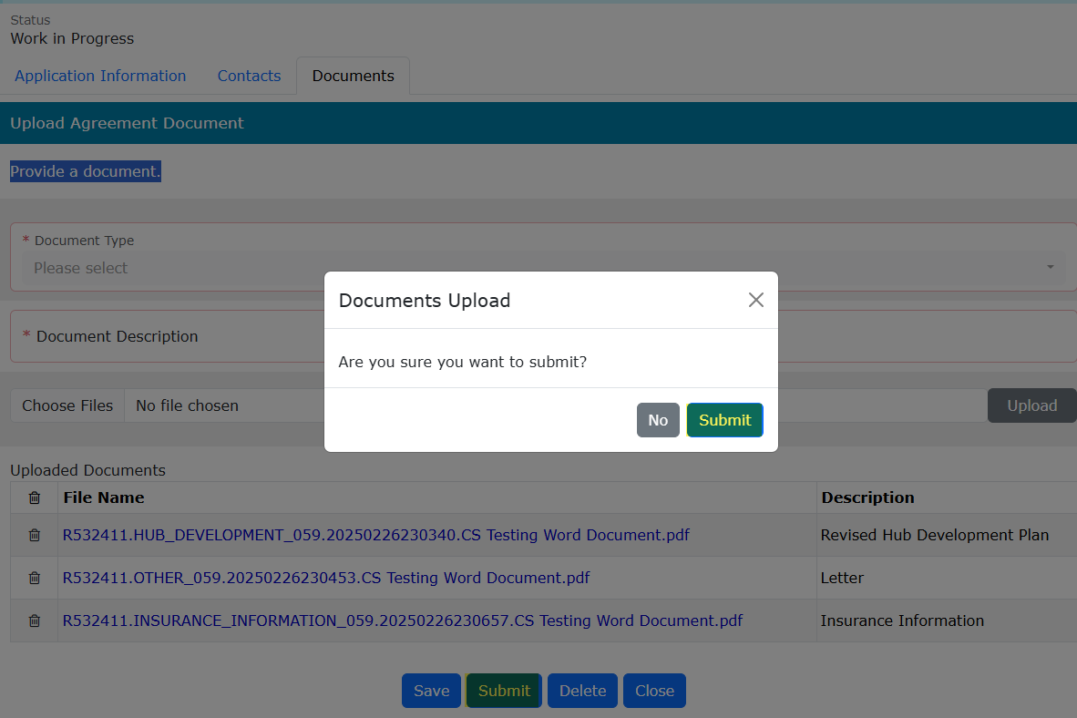
Information Request – Upload Documents
Government of Alberta
SUBMIT UPLOADED DOCUMENTS
Once all pertinent information has been entered, submit the uploaded documents.
The system performs validation check to ensure all mandatory data has been provided.
2. Click Submit
1. Click Submit
Delete (deletes entire application) is available when the request Status is at Work in Progress.
Close (closes application).

Slide 12
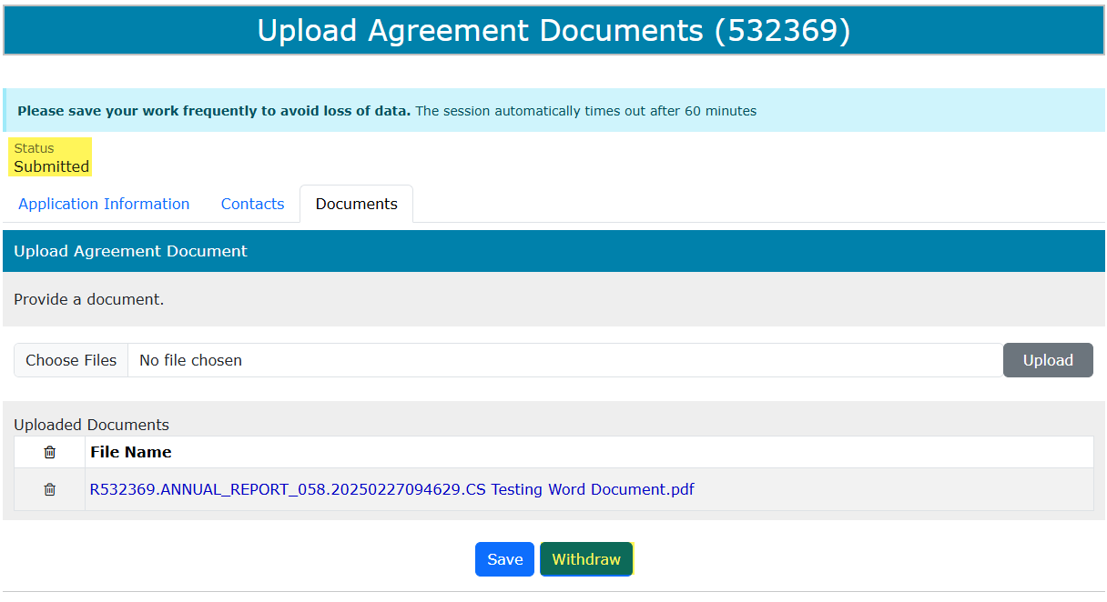
Information Request – Upload Documents
Government of Alberta
WITHDRAW APPLICATION
The Withdraw button is only available when the Status is Submitted.
The creator has the option to withdraw the application during the duration of the status Submitted.
When the request status is changed from Submitted to Processing, the Withdraw option is no longer available.

Slide 13
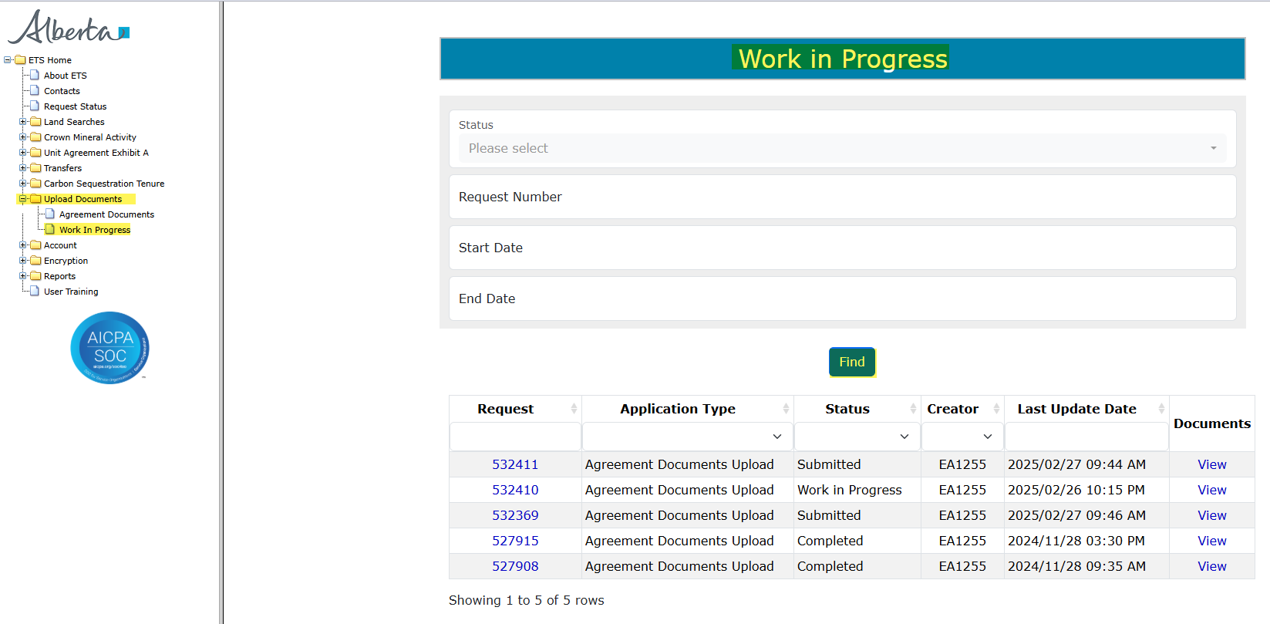
Information Request – Upload Documents
Government of Alberta
WORK IN PROGRESS
The Work in Progress screen contains all different status depending on the state of each ETS Request.
To search all ETS requests, select the Find icon on the Work in Progress screen.
User can also narrow the search by the following search parameters: Status, Request Number, Start Date and End Date.
Click the Request link to view the application.

Slide 14
Information Request – Upload Documents
Government of Alberta
WORK IN PROGRESS – continued…
Work in Progress
The creator can modify and save the form.
Submitted
The creator or submitter has Submitted the form.
Processing
The request has been submitted to Alberta Energy and Minerals. Only the contact information can be modified at this point. The rest of the application is read-only.
Completed
Application has been completed and agreements documents have been issued.
Client Withdrawn
Client has withdrawn the ETS application. This notifies Alberta Energy and Minerals they no longer want to proceed with the application.
Department Rejected
Alberta Energy and Minerals has rejected the client’s requested application.

Slide 15
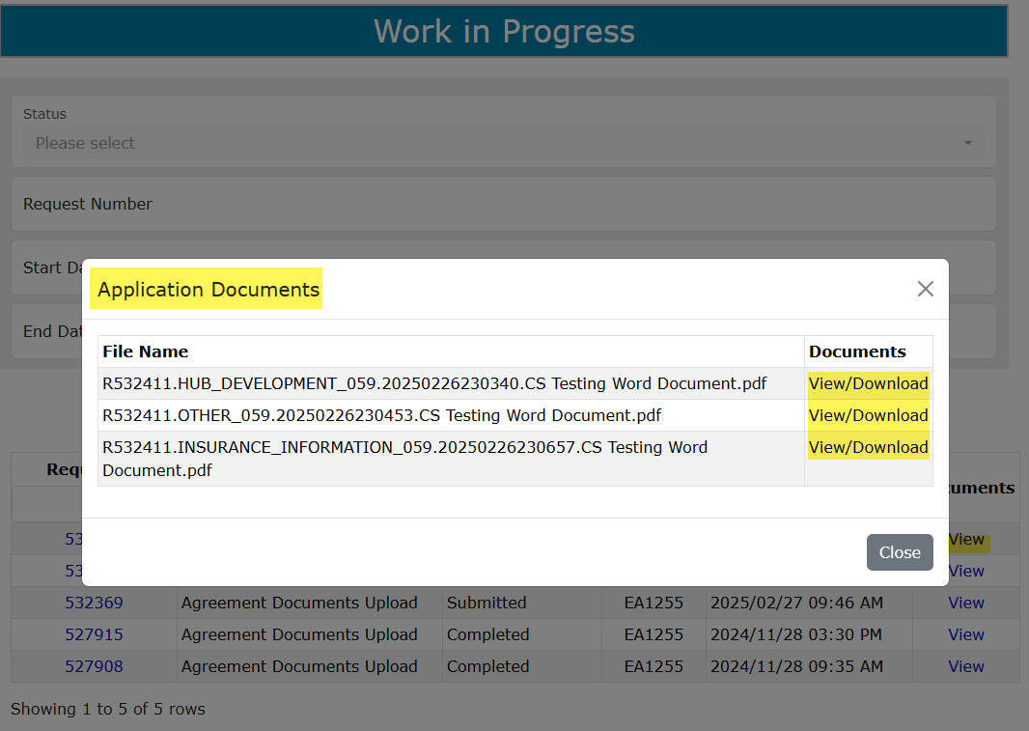
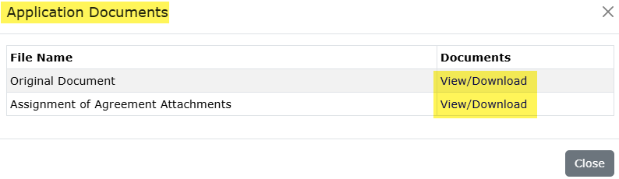
Information Request – Upload Documents
Government of Alberta
WORK IN PROGRESS – View Documents
User has the option to view all documents for the corresponding ETS request. The Application Documents box list all attached documents from the application.
2. Click View/Download
1. Click View

Slide 16

Information Request – Upload Documents
Government of Alberta
Congratulations!
You have completed the
Information Request –
Upload Documents
Online Training Course
If you have any comments or questions on this training course,
please forward them to:
energy.sequestrationhelpdesk@gov.ab.ca

